Slide 1
Zero Trust in CRQ?
Or CRQ in Zero Trust?

Slide 2
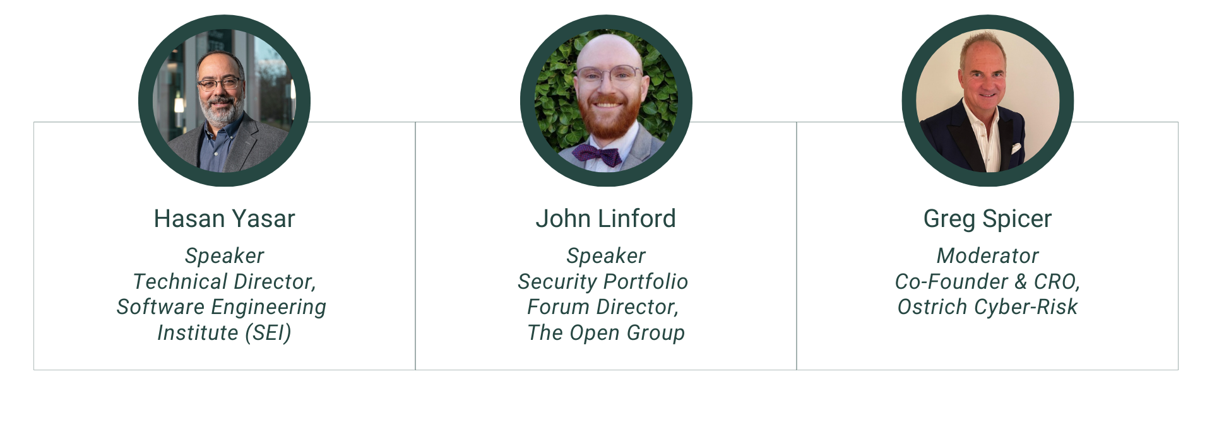
Meet Your Speakers

Slide 3
Agenda
Defining Zero Trust
Zero Trust and CRQ at a High Level
Implementing Zero Trust with CRQ
  Changing Culture
  Changing Processes
  Changing Technology
Putting It All Together

Slide 4
What is Zero Trust?
What is Cyber Risk Quantification?
Zero Trust
An asset-centric information security approach for modern, digital enterprises
Embraces an asset- and data-centric approach to security
Requires a mindset shift to function in a state of assumed breach
Cyber Risk Quantification
The application of risk quantification techniques to an organization’s cybersecurity risk
Embraces consistent terminology and framework for describing and discussing risk as loss
Requires data and SME inputs to make informed decisions about effectively managing risk

Slide 6

Zero Trust Commandments
Standardized Rules for Zero Trust Security
Assume Success
Assume Failure
Practice Deliberate Security Establishes pragmatic view of ‘trust’ in today’s world of continuous threats + how to prioritize applying that in a world of complex and continuously changing requirements
Secure Assets by Risk
Validate Trust Explicitly
Support Business Objectives Aligns security explicitly to business priorities and assets (vs. networks) and considers long term implications
Enable the Organization’s Mission
Implement Asset-Centric Controls
Enable Sustainable Security
Develop a Security-Centric Culture Guides the application of security across all teams
Practice Accountability
Enable Pervasive Security
Utilize Least Privilege
Deploy Simple (User-Friendly) Security
Deploy Agile and Adaptive Security Ensures security can keep up with continuous change
Make Informed Decisions
Improve and Evolve Security Controls
Utilize Defense in Depth
Enable Resiliency
pubs.opengroup.org/security/zero-trust-commandments/

Slide 7











Zero Trust Reference Model
Clarity, Automation, and Metrics-Driven Approach
Governance
Visibility and Policy
Access Control
Identity and Network - Multi-factor Authentication
Asset Protection
Classification, Protection, Tokenization
Digital Ecosystems
Centralized Security Policy Decisions
Data/Information
Distributed Policy Enforcement Points (PEPs)
Innovation
Security
Securing
new asset
development
Apps & Systems
</> APIs
Threat
Intelligence
Security Zones
Asset-Centric Security Operations
Rapid Threat Detection, Response, and Recovery

Slide 8
Implementation Model (3 pillars)
Strategic
Set the Direction
Operational
Integrate into Organization
Operating Model
Monitor and Adjust
Mission, Vision, Goals, and Capabilities
Align strategic models to market
Build & update agile roadmaps
Provide products (goods) and services
Set up organizational structure
Set up functions to enable capabilities
Governance (translate goals to principles and policies & monitor)
Organizational culture

Slide 9
Implementing Zero Trust with CRQ: Cultural Changes
Zero Trust
CRQ
Assumptions behind Zero Trust
Assume failure
Assume success
Advocate for simplicity
Active role of security team communication
Need for security champions
Zero Trust as a continuous journey
Extension of current security
Adoption of new tools and techniques
Security as a “team sport”
Assumptions behind CRQ
Prevalence of data
Consistency in descriptions
Advocate for objective view
Avoid subjective value measures
Need for security champions
CRQ as a mindset shift
“Risk” as a singular definition
Broad organizational support
Security as a “team sport”

Slide 10
Implementing Zero Trust with CRQ: Process Changes
Zero Trust
CRQ
Shift security left
Security included in design, build phases
Personnel educated on responsibilities
Connect security with business
Security strategy, metrics, & policies connect to organizational mission and business model
Integrate security throughout organization
Business & technical environments address security context
Human experience paramount
Define the concerns
Identify assets early
Identify risk owners
Business value connected to potential loss
Utilize quantitative measures
Balance value and loss
Improved telemetry
Use of automated data collection and reporting
Prioritization based on data
Results based on evidence

Slide 11
Implementing Zero Trust with CRQ: Tech Changes
Zero Trust
CRQ
Adjust access
Evolving and changing access control
Least privilege and just-in-time access
Full lifecycle considerations
Monitoring and testing constantly
Inventories and ownership
Asset-centric controls
Extend infrastructure-level controls
Reduced reliance on network
Asset-centric SOC
Improved tooling needs
Connecting data generation to threat modeling, inventories, registers
Risk analysis support
Reporting and compliance
Reports on implementation and processes
Audit on demand
Integrated risk management
Holistic view of cyber risk and enterprise risk
Supply chain visibility

Slide 12
Zero Trust in CRQ? No: CRQ in Zero Trust
Zero Trust implementation requires changes throughout the organization
Rapid prioritization
Consistency and coherence for security decisions
Direct support of business objectives and decisions
CRQ implementation requires mindset shift and communication
Improvements to return on security investment
Connecting security value to business decisions
Business decision-maker risk ownership

Slide 13
John Linford
j.linford@opengroup.org
https://www.linkedin.com/in/johndouglaslinford/
Hasan Yasar
hyasar@sei.cmu.edu
https://www.linkedin.com/in/hasanyasar/
Questions?
Greg Spicer
greg.spicer@ostrichcyber-risk.com
https://www.linkedin.com/in/gregjspicer/

