Slide 1
Understanding CRQ: A Buyer’s Guide Review
Jack Jones
Chairman FAIR Institute
Co-founder RiskLens
Notes:
Welcome
Guide you through industry standard called FAIR
Industry standard – FAIR
Main subject: enabling risk economics – helping organizations measure information and operational risk and the cost effectiveness of risk mitigation activities

Slide 2
Why is a CRQ buyer’s guide necessary?
Can you trust, and defend, a solution’s results?

Slide 3
What is CRQ?
Cyber Risk Quantification (CRQ) measures risk in economic terms
The probability of loss events occurring in a given timeframe
The probable magnitude of loss if/when loss events occur

Slide 4
What isn’t CRQ?
If there isn’t a unit of measurement, it’s not quantitative.
CVSS scores
Credit-like scores
Numeric ordinal measurements
Volume
Time
$
Distance
%
Frequency

Slide 5
Ordinal numbers are not quantitative values
(
x
) /
= ?
Green
Yellow
Red
Very Low
Low
Medium
High
Very High
“5”
3
5
“3”
“4”
“1”
4
1
“2”
2
“-8”
“4”
“28”
“53”
“2961”

Slide 6
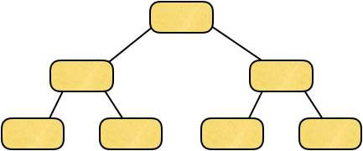
Another source of confusion
Control Frameworks
Cybersecurity Maturity Models
CMMC
CSF
2700x
800-53
Risk Measurement Models
Only these provide risk measurement
800-30
FAIR
RAM
Notes:
This is our taxonomy... don’t worry it goes deeper, but rarely do we go there.
Discussion opportunity!
Notice that risk is made up of what?
Where is vulnerability?

Slide 7
CRQ value propositions — i.e., why it matters
Risk Reduction
Prioritization
Cost-Benefit Analysis
Aggregation
?
$
$
Executive Communication
Accounting for Uncertainty

Slide 8
Common concerns about CRQ
Accuracy/Reliability
Level of Effort
Scope clarity
Model quality
Data quality
Comprehensiveness
Data quality

Slide 9
Important Questions to Ask Solution Providers
Red Flags to Look Out For

Slide 10
Three fundamental elements of any risk measurement
Scope — i.e., what’s being measured
Model
Data

Slide 11
Scope
(What’s being measured?)

Slide 12
How are “risks” defined?
Threat community
Insiders
Reputation
Phishing
Ransomware
Weak passwords
Poor cyber hygiene
Asset
Method
Method
Control deficiency
Cause of deficient controls

Slide 13
The classic formula for risk
Risk = Probability x Impact
Probability and Impact of what?
Loss Event Scenarios

Slide 14
These aren’t loss events
Insiders
Reputation
Phishing
Ransomware
Weak passwords
Poor cyber hygiene
You can only measure probability and impact for loss event scenarios.

Slide 15
How are “risks” defined?
Do they describe loss event scenarios (risks) in a way that can be reliably measured?
“New service by external provider.”
“Internal malicious acts and vandalism.”
“Attackers exploit weak default configurations of systems that are more geared to ease of use than security.”

Slide 16
Example of a clearly scoped risk (a loss event scenario)
Outage of key business systems due to cybercriminals performing a ransomware attack via a phishing e-mail.
Asset
Threat
Effect
Vector
Method

Slide 17
If you get scope wrong, it doesn’t matter how good your model and data are.

Slide 18
Data

Slide 19
Three categories of data…
Loss magnitude data
Threat event data
Controls data

Slide 20
What data are they using for loss magnitude?
Ponemon?
Insurance claims?
Advisen?
SME estimates?
What about non-breach events?
Quality?
What about losses not covered by insurance?
Forms of loss not captured?
SME qualifications, calibration?

Slide 21
What data are they using for threat event frequency?
Their own threat intelligence?
SME estimates?
Quality?
SME qualifications, calibration?

Slide 22
What controls data are they using?
Vulnerability scan results?
Scores from framework assessments (e.g., NIST CSF)?
Policy exceptions?
Audit findings?
Attack and penetration results?
…

Slide 23
Vulnerability scan results
Not all vulnerability scoring models are created equal…
Most vulnerability results are ordinal values
Not quantitative
Need to be interpreted, which requires modeling assumptions
Only covers technology-related weaknesses

Slide 24
Control framework scores as data
Fundamental challenges
Control definition ambiguity
Scoring model ambiguity
Control relationships and dependencies
Control functionality
Context sensitivity

Slide 25
Control definition ambiguity
PR.AT-1: All users are informed and trained
On what?
PR.PT-4: Communication control networks are protected
What actual controls are they assuming are relevant to this?

Slide 26
Scoring model ambiguity
What are the scoring criteria?
E.g., What does a “2” mean?
Is a scoring model even explicitly defined?

Slide 27
Ordinal values
How do they translate discrete ordinal values into quantitative values?
1 = 0% to 24%
2 = 25 to 49%
3 = 50% to 74%
4 = 75% to 99%

Slide 28
Control relationships and dependencies
Imagine that you’re trying to determine your Detection efficacy…
Logging is scored as a “3”
Log monitoring is scored as a “1”
What’s the overall score?
What about the relationship between policies and training?

Slide 29
Control functionality
How does the control affect risk?
Does it affect the probability of an event?
Does it affect the magnitude of an event?
Both?
For example:
Logging
Policies

Slide 30
Context sensitivity
Which loss event (risk) scenarios is a control relevant to?
Logging
WAF
Authentication

Slide 31
Data - particularly control data - is very easy to screw up.

Slide 32
Models

Slide 33
Do they use weighted values?
Largely subjective — rarely supported by actual data
Highly context sensitive
You need to ask how they’re applying weighted values.
Where do the values come from
How they’re accounting for context
Which of these should be weighted higher?
Authentication
Logging

Slide 34
How is measurement uncertainty accounted for?
Are they using discrete values as inputs?
For example, are ordinal input values being translated into ranges or distributions?
PR.AT-1: All users are informed and trained
2
1 = 0% to 24%
2 = 25% to 49%
3 = 50% to 74%
4 = 75% to 99%

Slide 35
How is measurement uncertainty accounted for?
Are they using discrete values for results?
For example, are they generating exact values for loss exposure?
Probability: 100%
Impact: $300M

Slide 36
Is their model proprietary, or open?
Risk analysis always involves modeling assumptions.
Open models surface and expose the modeling assumptions so they can be challenged, validated, and evolved.
This is fundamentally no different than proprietary vs. open encryption algorithms.

Slide 37
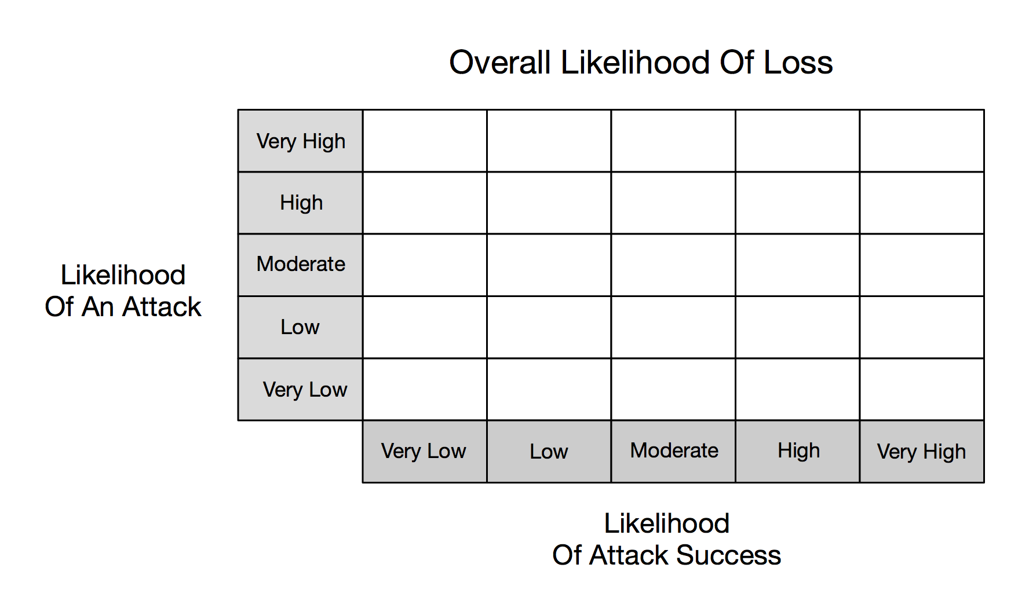
An inaccurate cybersecurity risk model
Low
Moderate
High
Very High
Very High
Low
Moderate
Moderate
High
Very High
?
50%
Low
Low
Moderate
Moderate
?
50%
High
Very Low
Low
Low
Moderate
Moderate
Very Low
Very Low
Low
Low
Low
100%
Table G-5 NIST 800-30

Slide 38
Has their model been independently validated?
Has the model/method been independently vetted?
Historical performance
Backtesting
Scenario testing
Methodological review
NOTE: Patents have absolutely nothing to do with validity!
Understand the testing scope, parameters, and methods!
https://www.investopedia.com/terms/b/backtesting.asp

Slide 39
Are they using AI?
If so…
What kind of AI are they using?
For what part of their model or data?
How was it trained?
How are they avoiding bias?

Slide 40
If the model is screwed up it doesn’t matter how well your risks are defined or how good your data are.

Slide 42
Summary
CRQ is now recognized as crucial in effective risk management.
Prioritizing effectively to focus on the things that matter most
Cost-effective use of resources
Risk aggregation
Communication with executives
Three fundamental dimensions for reliable and defensible risk measurements:
Need to be measuring clearly defined risks (loss event scenarios)
Models are based on assumptions. We need to know what those assumptions are, and be comfortable with them.
We should approach any CRQ solution provider with healthy skepticism.
We need to be able to trust the information our CRQ solutions provide.

Slide 44
https://mitsloan.mit.edu/ideas-made-to-matter/machine-learning-explained

