Slide 1
The Future of AI Risk Management: A Deep Dive with the FAIR Institute AI Workgroup
April 25th 2024
Jacqueline Lebo, Risk Advisory Manager (Safe Security)
Arun Pamulapati, Sr. Staff Security Field Engineer (Databricks)
Brandon Sloane, Security Risk Management Lead
Notes:
Luke to kick off and introduce us.
everyone introduce themselves.

Slide 2
Agenda
1
2
3
Intro: FAIR Institute AI Workgroup
Our Members
2024/2025 Initiatives
4
5
6
Recent AI Events and our POV
Materiality of Model Development Risks
QA Session
Notes:
Today we will be covering a few topics: an introduction to the workgroup, our members, and initiatives. Then we will move into Recent AI events and out POV, Material Model Development Risk and then we will have time at the end for questions. However feel free to add them to the chat during the session.

Slide 3
FAIR Institute’s AI Workgroup
Vision: To accelerate the adoption of GenAI by businesses and individuals with confidence built by risk-informed decision making and help harness the enormous power of AI technologies.
Objectives of the Research Working Group:
To enable risk-informed decision making in GenAI with the right standards, frameworks, tools and expertise.
To collaborate with industry bodies like NIST, MITRE and EU - to complement their work with risk driven thinking
To educate and support the FAIR community on this topic
Notes:
Arun to talk through vision and Jackie to read through objectives.

Slide 4
Our Members:
Jacqueline Lebo
Risk Advisory Manager, (Safe)
Pankaj Goyal, Director of Standards and Research (FAIR Institute)
Arun Pamulapati, Sr. Staff Security Field Engineer (Databricks)
Omar Khawaja, Field CISO (Databricks)
Brandon Sloane, Security Risk Management Lead
You?
Notes:
memberservices@fairinstitute.org

Slide 5
2024 Planned and Tentative Initiatives
April 2024:
Introduction Webinar
Why is AI Different? Blogpost
Future Topics:
How to think about risk and controls in AI (e.g. Databricks Framework)
What is the proper AI risk strategy
How material is AI risk
Why should CISO’s care from a personal liability perspective
FAIRCON 24’
Notes:
We will want to use this slide to talk about what has been done in April and what we will doing going forward. However we need to hear from the community on what is important to them!
Future topics - Brandon
Faircon - Jackie
Arun - Databricks Security Framework for AI

Slide 6
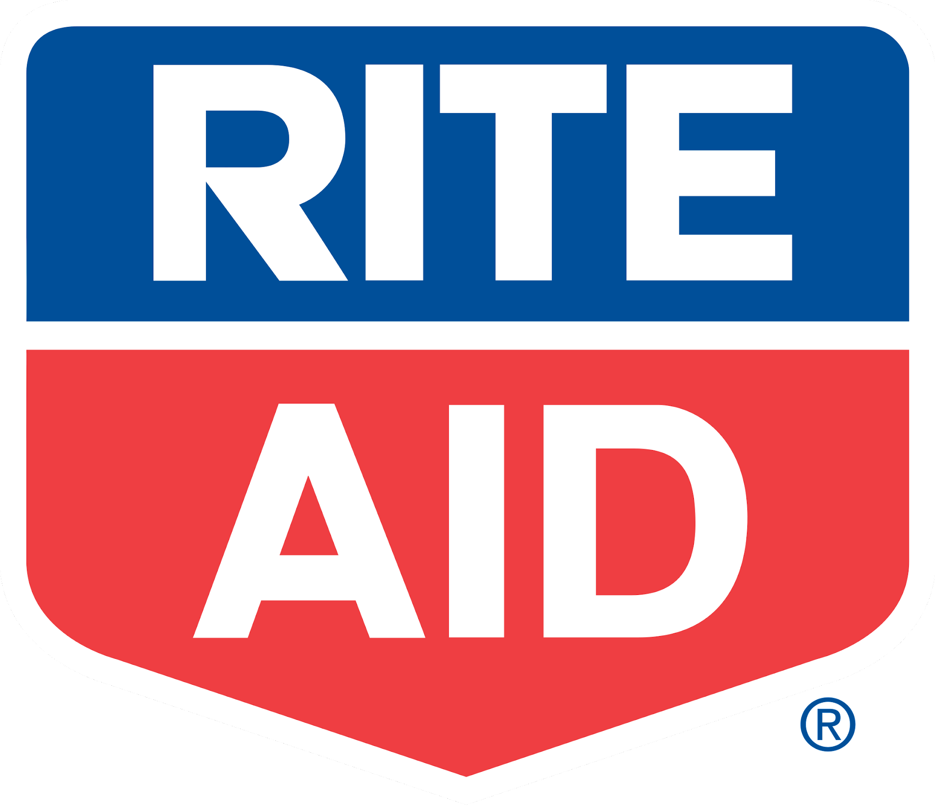
Use Case: Rite AID Case; nH Predict/claims algorithm class action litigation
Facts:
Rite Aid deployed biometric technology to find shoplifters
FTC found they did not do the due diligence and monitoring required to deploy such AI technology
FTC also found that the algorithm was biased particularly against people of color
Rite Aid has been banned from AI use for surveillance for 5 years
Potential Losses might include: reputation damage, legal fees, compliance fees, and losses associated with the AI technology
Notes:
the up front cost of deploying this technology responsibly would likely be significantly less than the losses caused by :
-reputation damage, legal fees, and compliance fees (for audits and having to deploy the requirements) also losses from use of the deployed technology that was paid for that could have cost millions if not tens of millions to deploy in stores.

Slide 7
Use Case: Using AI Robocalls
Facts: Many organizations have taken to using AI to generate Robocalls and marketing content as a first use case. The FTC has banned this practice.
Are your AI Marketing tactics cold calls? Are you taking a risk based approach to evaluate your internal use of AI in Marketing?
Notes:
https://www.nytimes.com/2024/02/08/technology/fcc-ban-ai-robocalls.html
https://docs.fcc.gov/public/attachments/DOC-400393A1.pdf
** use case around diabetes related treatment but if its a cold call unrelated to treatment or selling a service it might fall into the FCC no robocall rule.

Slide 8
EU Act (Not your mother’s acceptable use policy)
Requires all AI Systems to be trustworthy and transparent with someone accountable for them. The Act classifies AI systems based on risk (high-risk being most strictly regulated) and sets requirements for developers and users. This aims to minimize risks from AI while fostering innovation in Europe.
Notes:
The important of this from a risk perspective is to be aware of the trends in emerging laws.
requiring people to take a risk based approach
banning types of AI use (for instance AI facial recognition databases are banned for surveillance and in other cases considered high risk)
Using FAIR you can evaluate the risk of such technologies being deployed within your orgnaization in order to explain why certain technologies are within your organizations risk tolerance
Arun will talk about an example of this from Article 15 by talking about the security side of this.
High-risk AI systems cybersecurity solution in place. 1) Accuracy, robustness and cybersecurity 2) benchmarks and measurement methodologies . 3) Technical redundancies and monitoring 4) Avoid ‘feedback loops’ 5) “The technical solutions to address AI specific vulnerabilities shall include, where
appropriate, measures to prevent, detect, respond to, resolve and control for attacks trying
to manipulate the training data set (‘data poisoning’), or pre-trained components used in
training (‘model poisoning’), inputs designed to cause the AI model to make a mistake
(‘adversarial examples’ or ‘model evasion’), confidentiality attacks or model flaws.”

Slide 9
Materiality of Model Development Risks
Examples of AI Risks:
Data Poisoning
Bias Amplification
Attribution Challenges
Increased Attack Surface
Privacy Violations
Deep Fakes and Misinformation
Weaponization of Content (i.e. phishing attacks)
DDOS Attacks powered by AI
Fraudulent Activity (ie LinkedIn accounts)
To whom is it Material?
Company building the model
Companies hosting the model
Users interacting with the model
Society at large
What sorts of Risks could be Material?
Social / Societal - does the model exacerbate societal problems?
Privacy - does the model expose data it shouldn’t?
Security - does the model enable adversarial activities?
Notes:
Quantifying AI Risks is a way of answering the Materiality question
The New SEC rule does not redefine materiality but more emphasizes its importance when it comes to determining what is a reportable breach. You will want to focus on a reasonable investor standard for determining materiality of a scenario you're considering. Meaning would a reasonable investor determine the identified losses (This means potential financial impact, business disruption, and reputational damage) would rise the the level of material?
You must also disclose material incidents via the 8k within 4 days with information on the nature and scope of the incident, the organizations response, and potential impact.
Finally, the requirement that companies have risk management and governance. Its important when looking at AI that you have a process to identify, assess, and mitigate risks.
for instance if we go back to the rite aid case, that is clearly a material incident. The fact that their AI software is potentially bias once discovered internally likely would have required an 8k disclosure. However, if the company would have had the proper Risk management and governance process from the beginning they would likely not have been banned from its use for 5 years.
Deepfakes and Misinformation: Malicious actors can use generative AI to create deepfakes – fabricated videos or audio recordings that appear genuine. This can be used to spread misinformation, damage reputations, or manipulate public opinion.
Bias Amplification: Generative AI models are trained on massive datasets, which can reflect and amplify societal biases. This can lead to discriminatory outputs, perpetuating stereotypes in areas like hiring or loan approvals.
Weaponization of Content: AI-generated content could be used for cyberattacks like phishing scams or social engineering. These scams could become more believable and harder to detect.
Attribution Challenges: When AI creates content, it can be difficult to pinpoint who is responsible. This creates challenges in holding bad actors accountable for malicious content generation.
Increased Attack Surface: AI systems themselves can be a target for attackers. By compromising an AI system, attackers could gain access to sensitive data, manipulate its outputs, or even weaponize it for further attacks. The cost of such an attack can be quantified based on the value of the data accessed or the potential damage caused by manipulation.
Data Poisoning: Malicious actors might try to manipulate the training data used to develop AI models. This "poisoning" can lead to biased or inaccurate outputs. The potential financial impact can be estimated by considering the cost of retraining the model and any downstream consequences of bad decisions based on the poisoned model.
Privacy Violations: AI systems often require access to vast amounts of data to function effectively. This data can contain personally identifiable information (PII). Quantifiable risks here include potential fines for regulatory non-compliance and reputational damage if privacy breaches occur.
Denial-of-Service (DoS) Attacks: AI-powered bots can be used to launch large-scale DoS attacks, overwhelming a system with requests and making it unavailable to legitimate users. The cost of such attacks can be measured in lost revenue or productivity.
Fraudulent Activity: AI can be used to automate fraudulent activities such as generating fake accounts or creating synthetic identities for financial crimes. Quantifying this risk involves estimating the potential financial losses from such fraudulent activities

Slide 10
Questions…

Slide 11
Resources
https://www.fairinstitute.org/blog/fair-artificial-intelligence-ai-cyber-risk-playbook
https://www.databricks.com/blog/introducing-databricks-ai-security-framework-dasf
https://berryvilleiml.com/
https://www.databricks.com/product/machine-learning

Slide 12
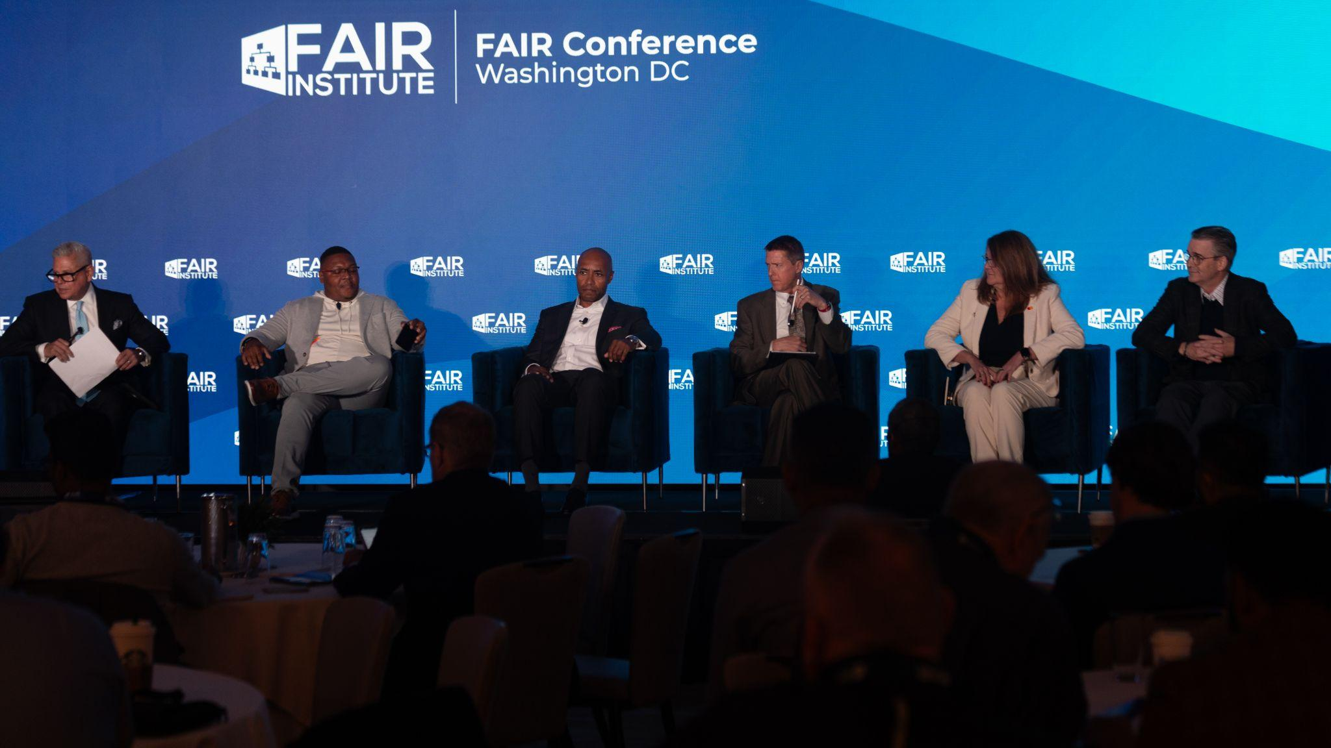
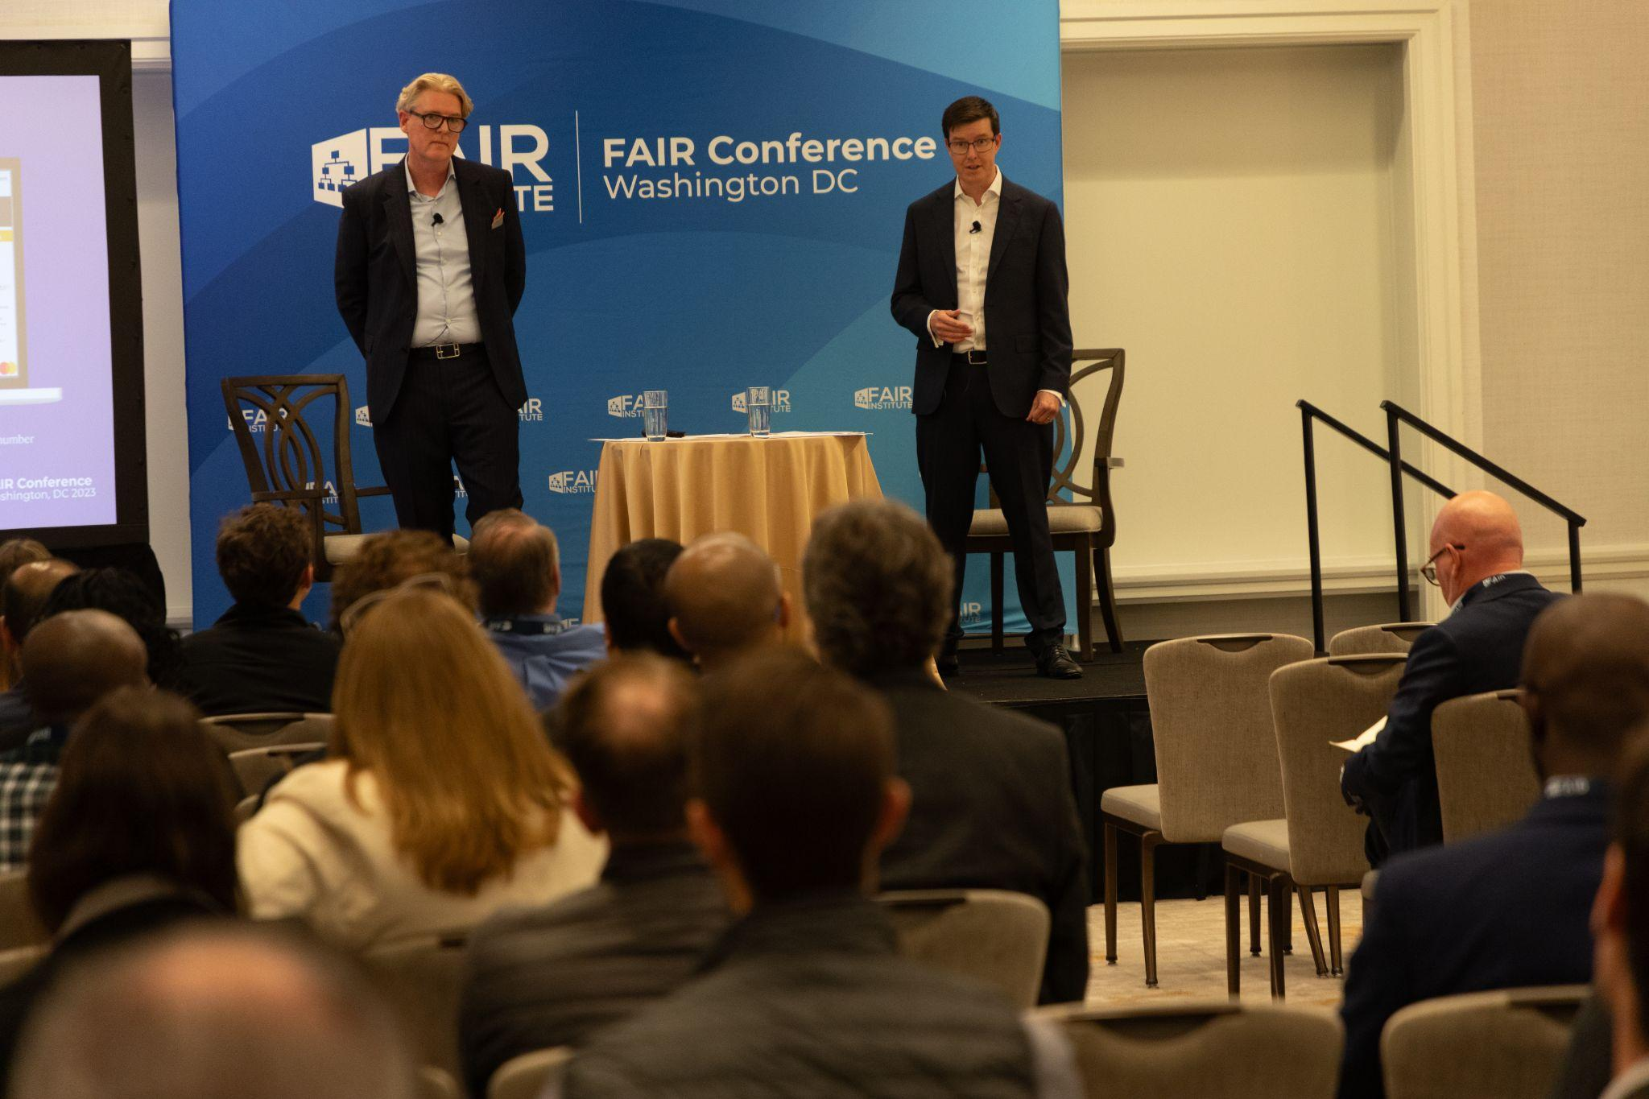
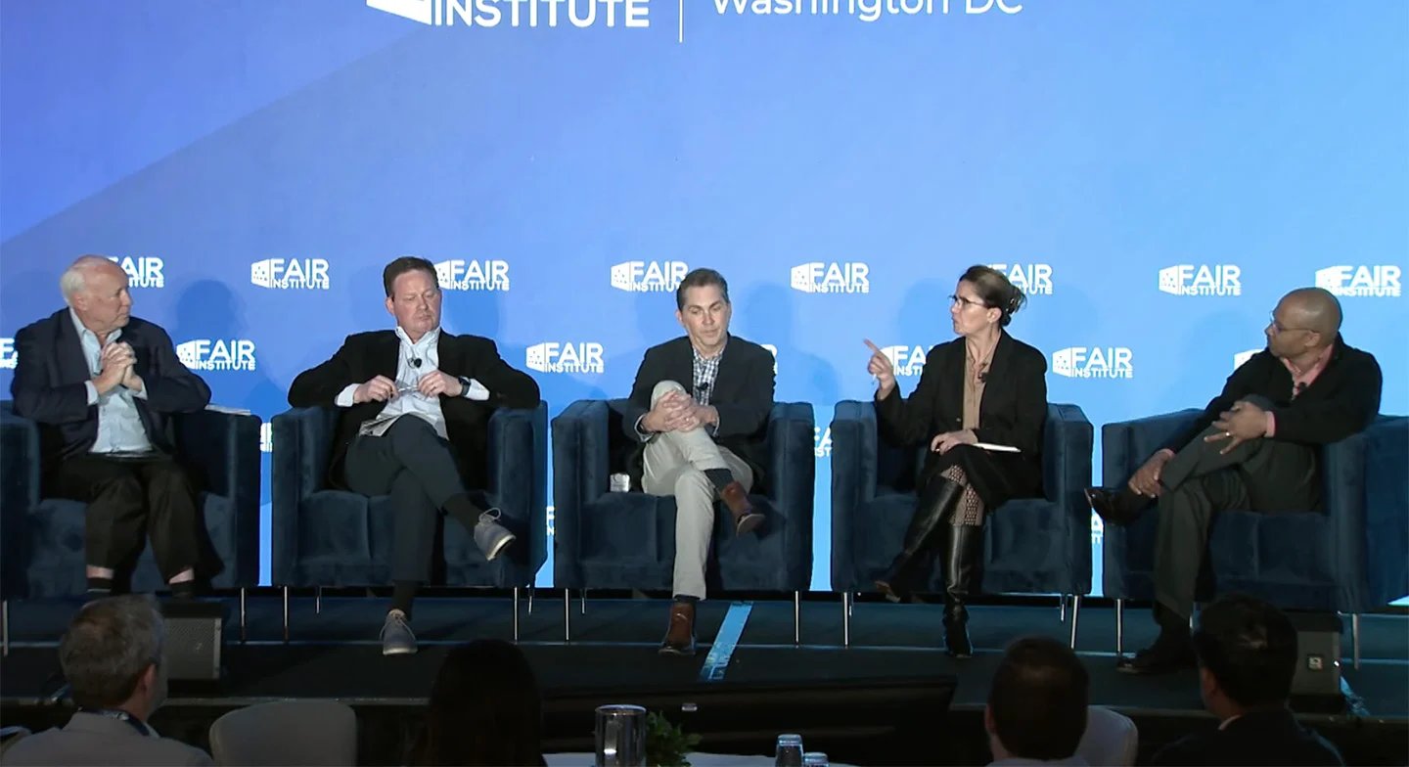
Learn more at the 2024 FAIR Conference
When
Oct. 1-2, 2024
Where
Fairmont Hotel, Washington DC, Georgetown
Theme
Managing Risk at the Speed of the Business
www.fairconference.org

