Slide 1
A LUXURY WATCHMAKING USE CASE
Pierre Olodo – Cyber Risk Specialist
June 2023
Notes:
Hello everyone, my name is Pierre Olodo. I work as a cyber risk specialist in Richemont Group.
I am French (no one is perfect), I am focusing on risk quantification aspects, organizing the different assessment requests received by the Cyber Risk & Advisory team, making sure they are adequately integrated in our risk quantification roadmap.

Slide 2
Presentation - Disclaimer
For confidentiality purpose, data have been anonymized in this presentation
Figures and Loss Exceedance Curves are for illustration only
Notes:
Of course, all data that I will display today here are fictitious, as well as the loss exceedance curves.

Slide 3
Today’s Agenda
04 Context
06 Challenge
09 Manufacturing use case
19 Sales use case
Notes:
So together, we will first go through some context, which is really important when it comes to quantification, briefly discussing about the challenges we face in our organization, and we will finally go through the core of this discussion: 2 risk quantification use cases extracted from the value chain of a luxury watch.

Slide 4
Richemont Group – Who are we?
26 Maisons and Businesses
4 Business Areas (Jewelry, Watchmaking, Online Distribution and Fashion & Accessories)
2 297 Monobrand Boutiques
35 000+ Colleagues across more than 130 countries
Notes:
Context. Richemont Group is about 26 Maisons, each Maison has its own DNA, which makes it unique.
4 different business areas exist: Jewelry (Van Cleef & Arpels, Cartier, Buccellati), Watchmaking (IWC, JLC, Vacheron Constantin), Fashion & Accessories (Dunhill, Chloé, Purdey), and Onlind Distributors (Watchfinder&Co, YNAP). We have more than 2’000 boutiques, and around 37’000 colleagues.
Having said that, you can have a guess of how complex our environment is, driving the need to have a structured and repeatable way to perform risk assessments across the Group.

Slide 5
Richemont Group – Our organization
Operating behind the scenes, linking all central and regional support to our Maisons.
Provide tools, support teams and development initiatives to our Maisons.
In charge of creation, manufacturing and customer services.
Notes:
Another layer of complexity is described here. The organization. We are basically working with 25+ Maisons CEO, but also some Regional functions. And in both cases we cannot have different ways to assess the risk because of the specificity of this and this stakeholder. We need to remain consistent.

Slide 6
Watchmaking – From R&I to Sales
Research & Innovation
Sales
Raw Material Sourcing
Manufacturing
Logistics
Marketing
Distribution Center
How much risk is associated with the entire lifecycle of this product?
Notes:
When we started our risk quantification journey some years ago, initial objectives were indeed to make informed decisions about investments (identifying the right controls, helping prioritize solution implementation, etc. ), increase awareness in the Maisons, but also, and primarily to build a proper risk register that we would maintain over the time (portfolio manager in IB parallel) to be able to report the financial exposure.
We then faced another important challenge: how to put together the different assessments already done and make it easy to digest for our business and our top management?
One possible answer was to map those assessment to something they know very well: our value chain and pose the problem in that way: how much risk is associated with the lifecycle of a product (give examples).

Slide 7
Watchmaking – From R&I to Sales
Research & Innovation
Sales
Raw Material Sourcing
Manufacturing
Logistics
Marketing
Distribution Center
How much risk is associated with the entire lifecycle of this product?
Notes:
In today’s session, I propose you to go through 2 key steps of the lifecycle of such a product (which is, by the way, a beautiful Jeager-Lecoultre Memovox):
Manufacuring
Sales

Slide 8
Watchmaking – From R&I to Sales
Research & Innovation
Sales
Raw Material Sourcing
Manufacturing
Logistics
Marketing
Distribution Center
How much risk is associated with the entire lifecycle of this product?
Notes:
Those 2 steps are very different by nature, but applying quantification allows to compare the risk associated with each of them in a consistent way.

Slide 9
Manuf. use case – Scenario scoping
Shop floor scenarios
Partial/ Full loss of availability of the manufacturing lines
Loss of availability of Intellectual Property systems
Office scenarios
Loss of confidentiality of Intellectual Property
Loss of confidentiality of employee personal data
Loss of integrity of financial data
Notes:
So let's have a look at the manufacturing use case, in details.
As for every assessment, we need to scope the scenarios appropriately, otherwise we would miss some exposure somewhere.
Well in a manufacture, we have generally speaking two possibilities. Either and event will affect the shop floor (pure manufacturing and craftmanship part), or the offices (Technical Office processing intellectual property, Human Resources, Finance, etc.).
The data at risk does not generally includes customer data (it might be when engraving cases for example with the first and last names of a customer), but it will be more about Intellectual Property and Financial data if we are talking about loss of confidentiality.
Go through the 5 possibilities.

Slide 10
Manuf. use case – Scenario scoping
Shop floor scenarios
Partial/ Full loss of availability of the manufacturing lines
Loss of availability of Intellectual Property systems
Office scenarios
Loss of confidentiality of Intellectual Property
Loss of confidentiality of employee personal data
Loss of integrity of financial data
Risk
Scenario
Loss of availability of the manufacturing lines caused by external threat (via phishing)
Notes:
In the context of this use case, we have selected one scenario to focus on: the loss of availability of the manufacturing lines caused by an external threat (via phishing).
The interest and complexity of this one is in the model the productivity loss as we will discuss afterwards.

Slide 11
Manuf. use case – LEF
RISK
LEF
LM
Threat Event Frequency
Vulnerability
Number of clicked malware (annually) | 1
Minimum | 13 clicks
Most Likely | 22 clicks
Maximum | 40 clicks
Effectiveness of control environment | 1
Segmentation | Effective
IPS / IDS | Ineffective
IAM Controls | Partially effective
Patch management | Ineffective
MFA | Ineffective
Transport security | Effective
Minimum once every 38 years
Most Likely once every 15 years
Maximum once every 6.25 years
Minimum is 40%
Most Likely is 60%
Maximum is 80%
Risk
Scenario
Loss of availability of the manufacturing lines caused by external threat (via phishing)
Notes:
So let’s go down the road to see how we can quantify this. In this case, the attack vector is a phishing which is one of the most common ones.
What can we do obtain a defendable threat event frequency? Well, it depends on the information we have. In this case, it happens that the CSIRT is able to provide us with regularly updated information about the number of phishing emails landing in our mailboxes. And we can weight this figures with the specific click rate communicated by the team in charge of the phishing campaigns. The elements of the ontology we have just defined here are the contact frequency (number of emails tied to the number of users in scope of the scenario) and the probability of action (click rate).
We then use industry standard metrics to derive a number of clicked malware displayed here.
And then for the vulnerability part of the ontology, we assess the control set corresponding to the attack vector to determine what appropriate values are.
In this case the lack of effectiveness in key areas like patch management and IAM controls led to a high vulnerability of the asset once the attacker is inside the network.

Slide 12
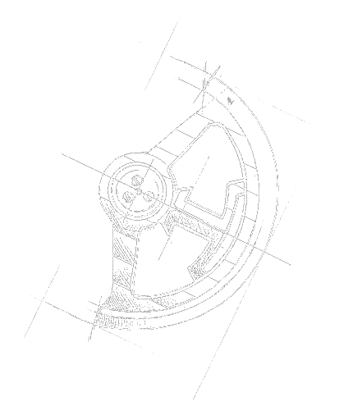
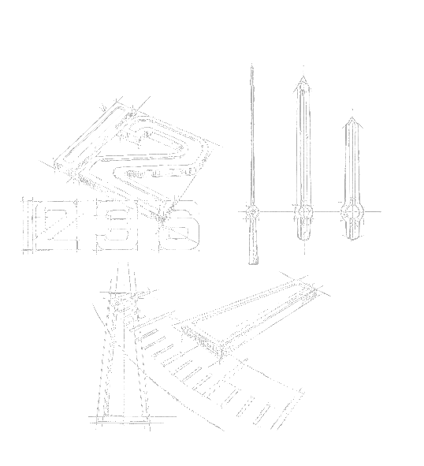
Manuf. use case – Understand the process
Manufacturing of individual pieces
Caliber assembly
Chronometry
Encasement
Risk
Scenario
Loss of availability of the manufacturing lines caused by external threat (via phishing)
Notes:
And then comes the most difficult part from my perspective. Model the productivity losses. First let’s have a look at the process.
There are roughly four steps in the manufacturing of a watch:
1. Making the little pieces, case, needles, etc.
2. Put together the pieces to make the caliber (heart of the watch)
3. Test the quality of the caliber
4. Put the caliber into the case.

Slide 13
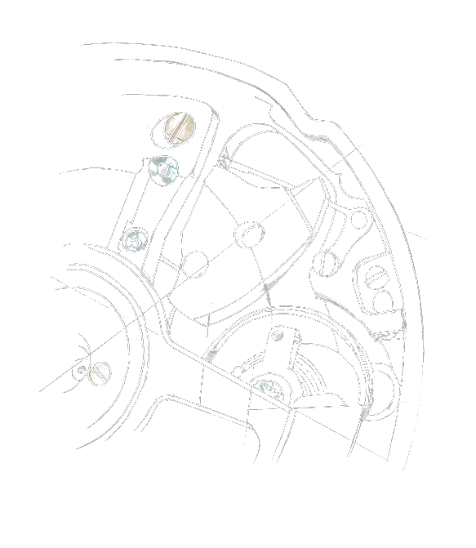
Manuf. use case – Understand the process
Manufacturing of individual pieces
Caliber assembly
Chronometry
Encasement
Risk
Scenario
Loss of availability of the manufacturing lines caused by external threat (via phishing)
Notes:
For instance, if the group of machines allowing to manufacture the individual pieces like the spring or the case are not available, the whole downstream part of the value chain will be highly affected.
In fact, it is likely that the employees working in the assembly atelier can finish the current caliber they were working on, and then cannot work anymore.

Slide 14
Manuf. use case – Understand the process
Manufacturing of individual pieces
Caliber assembly
Chronometry
Encasement
Risk
Scenario
Loss of availability of the manufacturing lines caused by external threat (via phishing)
Notes:
Now, let say the application used to guide the artisans working in the assembly lines is not available. A workaround exist as all caliber plans are also available in paper, but it would result in a 40% loss in their productivity.

Slide 15
Manuf. use case – Understand the process
Manufacturing of individual pieces
Caliber assembly
Chronometry
Encasement
Risk
Scenario
Loss of availability of the manufacturing lines caused by external threat (via phishing)
Notes:
If the machines use to test the precision of the calibers are not available, then it means that not a single watch can go out of the manufacture because as you may know, in Switzerland we do not joke about the precision of our watches. The funny part of that being that in some cases, if a caliber fails to meet the precision requirement, the whole mecanism is de-assembled, cleaned, and re-assembled again.

Slide 16
Manuf. use case – Understand the process
Manufacturing of individual pieces
Caliber assembly
Chronometry
Encasement
Risk
Scenario
Loss of availability of the manufacturing lines caused by external threat (via phishing)
Notes:
If the machines use to test the precision of the calibers are not available, then it means that not a single watch can go out of the manufacture because as you may know, in Switzerland we do not joke about the precision of our watches. The funny part of that being that in some cases, if a caliber fails to meet the precision requirement, the whole mecanism is de-assembled, cleaned, and re-assembled again.

Slide 17
Manuf. use case – Loss Magnitude
RISK
LEF
LM
Response costs
Productivity losses
Number of hours spent by CSIRT | 1
Minimum | 4 hours
Most Likely | 6 hours
Maximum | 8 hours
Loss of productivity | 1
Minimum | $ 80’000
Most Likely | $ 130’000
Maximum | $ 440’000
Average employee wage | 1
Minimum | $ 40
Most Likely | $ 52
Maximum | $ 118
Those amounts were calculated using the average employee wage in the four steps of the manufacturing line, multiplied by the foreseen unavailability of the supporting assets (e.g., CNC machine, PLM software, etc.) in hours.
The response cost was estimated based on historical events and professional judgment of CSIRT SMEs.
The response cost is split into two variables:
Number of hours spent by CSIRT
Average employee wage
Risk
Scenario
Loss of availability of the manufacturing lines caused by external threat (via phishing)
Notes:
What does that mean for the productivity loss calculation? This is where it is becoming interesting. In fact there are 2 ways to do it, you can either create one risk sub-scenario for each and every step of the manufacturing process, or you can make a more holistic assumption an come with one range covering all steps of the process, which we have done here because:
1. The servers supporting the assets in scope are located on the same VLAN;
2. The effectiveness of the control environment around those assets is equivalent from one to another;
3. The average wage per employee is comparable within the manufacturing lines.
This leads us to something which is still accurate and much more maintainable.
With regards to response costs, it was estimated based on the historical events and professional judgment of CSIRT SMEs.
Finally, the response cost is split into two variables:
Number of hours spent by CSIRT in such a scenario (based on historical events and PJ of the SMEs)
Average employee wage

Slide 18
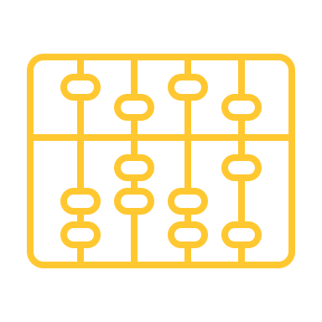
Manufacturing use case – Report
Loss Exceedance Probabilities
Average Annualized Loss Exposure
The loss exceedance curve is the output of the 50’000 iterations of the Monte Carlo simulations. It helps to visualize the probability of the loss exceeding a certain amount.
Based on all probable loss of asset availabilities across the manufacturing lines, it is estimated that from an average annualized perspective, a loss amount of $ 115’000* is foreseen.
Depending on the location of the unavailable asset in the manufacturing line, this amount may reach up to $ 380’000*
*Fictitious values
Risk
Scenario
Loss of availability of the manufacturing lines caused by external threat (via phishing)
Notes:
And finally, this is how it looks like when reporting about the scenario. We always communicate the LEC, ALE, which is something that is hopefully well understood by the management.
And in this case given the complexity of the process we have also indicated what would be loss in case the asset impacted is at the very beginning of the chain.
Merging the scenarios this way really allow for a better maintenance of the risk register, but also a more "to the point" communication.

Slide 19
Use case – Focus on Sales
Research & Innovation
Sales
Raw Material Sourcing
Manufacturing
Logistics
Marketing
Distribution Center
Notes:
Now, let’s focus on sales.

Slide 20
Use case – Focus on Sales
Research & Innovation
Sales
Raw Material Sourcing
Manufacturing
Logistics
Marketing
Distribution Center
Notes:
When it comes to sales, there are usually 2 ways of doing it in our context. The first requires physical presence of the customer, in a boutique.

Slide 21
Use case – Focus on Sales
Research & Innovation
Sales
Raw Material Sourcing
Manufacturing
Logistics
Marketing
Distribution Center
Notes:
And the second is via eCommerce (or distant sales).

Slide 22
Sales use case – Scenario scoping
Boutique scenarios
Loss of availability of Point of Sale systems
Loss of availability of the boutique’s infrastructure
Loss of confidentiality of customer data
eCommerce scenarios
Loss of availability of eCommerce website
Loss of availability of Order Management System
Loss of confidentiality of customer data
Loss of confidentiality of credit card data
Notes:
Which means that when scoping the scenarios, we will need to make sure that both sales channels are covered.
Go through the scenarios.

Slide 23
Sales use case – Scenario scoping
Boutique scenarios
Loss of availability of Point of Sale systems
Loss of availability of the boutique’s infrastructure
Loss of confidentiality of customer data
eCommerce scenarios
Loss of availability of eCommerce website
Loss of availability of Order Management System
Loss of confidentiality of customer data
Loss of confidentiality of credit card data
Risk
Scenario
Loss of confidentiality of customer data caused by external threat (via phishing)
Notes:
What is interesting here is that we can tackle at once similar scenarios covering different sales channels (the threat actor is missing but we will talk about it later) at once.
So the scenario here will be a loss of confidentiality of the manufacturing lines caused by external threat (via phishing).

Slide 24
Sales use case – LEF
RISK
LEF
LM
Threat Event Frequency
Vulnerability
Number of clicked malware (annually) | 1
Minimum | 26 clicks
Most Likely | 44 clicks
Maximum | 80 clicks
Effectiveness of control environment | 1
Segmentation | Effective
IPS / IDS | Ineffective
IAM Controls | Partially effective
Patch management | Effective
MFA | Effective
Transport security | Effective
Minimum once every 19 years
Most Likely once every 7 years
Maximum once every 3 years
Minimum is 2%
Most Likely is 8%
Maximum is 20%
Risk
Scenario
Loss of confidentiality of customer data caused by external threat (via phishing)
Notes:
So let’s go down the road again to see how we can quantify this. The LEF would be calculated in the same way than in the first use case.
Probably the number of users of assets like sales application is likely to be higher than the number of users of manufacturing assets, but maybe the vulnerability % will be lower because those assets can be better protected than CNC machines and OT technologies.
So it is all about the number of phishing emails landing in our mailboxes., weighted by the specific click rate communicated by the team in charge of the phishing campaigns. We then use industry standard metrics to derive a number of clicked malware displayed here.
And then for the vulnerability part of the ontology, we assess again the control set corresponding to the attack vector to determine what appropriate values are. In this case the application seems to be better protected than in the first use case as the vulnerability is lower, leading to less chance for the attacker to pivot from a workstation, to the application.
ACTION: CHANGE CLICK RATE

Slide 25
Sales use case – Loss Magnitude
Notes:
Let's know talk about loss magnitude. Because here we are involving customer data, will we have the fines & judgement type of loss triggered. But what about loss of revenues generated by such an event? How do we model this? What could be right the path to start from a data leak and end with a loss exposure?
We need find the right SME here.
And the department in the company that knows more about customers is of course marketing. They perfectly know the habits of the customers, what they are willing to tolerate in such a situation. But what next? What information could help us to determine appropriate ranges for loss magnitudes?

Slide 26
Sales use case – Loss Magnitude
Notes:
Well, in this case and according to the SMEs, there is no direct link between the customer data leakage and the certain amount of money that would be exposed. The link is indirect, and is going through determining the portion of customers for which such an event would have an effect.

Slide 27
Sales use case - Client segmentation
Loyal customers : more than 3 watches over the past 5 years
Active customers : between 1 and 3 watches
over the past 5 years
New customers : 1 watch
over the past 5 years
Prospects
Notes:
And according to the SMEs again, the best way to do this is via the analysis of client segmentation.
Go through client segmentation.

Slide 28
Sales use case - Client segmentation
Loyal customers : more than 3 watches over the past 5 years
Active customers : between 1 and 3 watches
over the past 5 years
New customers : 1 watch
over the past 5 years
Prospects
Notes:
Up to 40% of prospects would be affected (ML 15%).
Up to 20% of new customers would be affected(ML 5%)
No effect on other segment is expected.

Slide 29
Sales use case - Client segmentation
Loyal customers : more than 3 watches over the past 5 years
Active customers : between 1 and 3 watches
over the past 5 years
New customers : 1 watch
over the past 5 years
Prospects
Notes:
And according to the SMEs again, the best way to do this is via the analysis of client segmentation.
Go through client segmentation.

Slide 30
Sales use case – Loss Magnitude
RISK
LEF
LM
Loss of revenues
Fines & Judgment
Portion of the revenue impacted | 1
Minimum | $ 1’200’000
Most Likely | $ 2’000’000
Maximum | $ 2’800’000
Amounts arising from fines | 1
Minimum | $ 3’000
Most Likely | $ 910’000
Maximum | $ 2’400’000
These amounts were determined using the model explained before, by identifying the number of customers impacted by such an event, and calculating the corresponding portion of revenues that might be lost.
Those amounts were calculated based on the number of customer records involved in the incident.
The correlation between the number of records and the amounts of the fines is done by a specific data helper in Risk Lens.
Risk
Scenario
Loss of confidentiality of customer data caused by external threat (via phishing)
Notes:
So loss of revenue then. Here, we have applied the model discussed with marketing, by identifying the portion of revenues generated by the segments of customers impacted.

Slide 31
Sales use case – Loss Magnitude
RISK
LEF
LM
Response costs
Number of hours spent by CSIRT | 1
Minimum | 250 hours
Most Likely | 550 hours
Maximum | 1400 hours
Average employee wage | 1
Minimum | $ 40
Most Likely | $ 52
Maximum | $ 180
The response cost was estimated based on historical events and professional judgment of CSIRT SMEs.
The response cost is split into two variables:
Number of hours spent by CSIRT
Average employee wage
Risk
Scenario
Loss of confidentiality of customer data caused by external threat (via phishing)
Notes:
Go through secondary loss.

Slide 32
Sales use case – Report
Loss Exceedance Probabilities
Average Annualized Loss Exposure
The loss exceedance curve is the output of the 50’000 iterations of the Monte Carlo simulations. It helps to visualize the probability of the loss exceeding a certain amount.
Foreseen annualized amount of risk associated with the customer data leakage within Sales process is $ 1.65M*.
Given the nature of the risk (low frequency and high impact), it was strongly advised to consider that there is a 10% annual probability to suffer a $ 4.5M* or greater loss.
*Fictitious values
Risk
Scenario
Loss of confidentiality of customer data caused by external threat (via phishing)
Notes:
Go through the report.

Slide 33
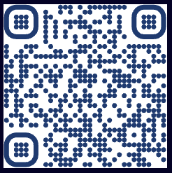
Thank you
Scan this QR code if you want to connect with me via LinkedIn
pierre.olodo@richemont.com

