Slide 1
How much risk does Ransomware pose to your organization?
Professional due care?
Any liability for downstream losses?
How does being “critical infrastructure” affect liability?
A 7-10 day recovery to normal operations within tolerance?
Cyber Insurance contributing?
What organizations suffered financial losses?

Slide 2
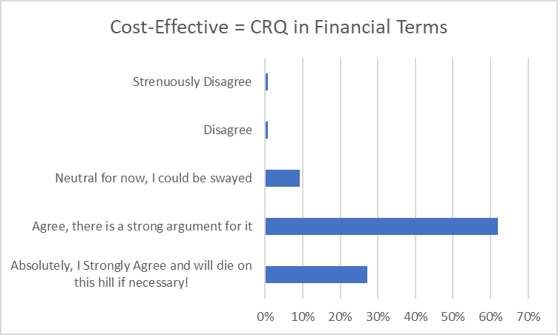
Which best describes your agreement with the following statement: “In order to achieve cost-effective cyber risk management, you must be quantifying cyber risk in financial terms.”
May 2020
Notes:
Jack, do you have any idea where this quote came from? Let’s talk about the merits of this statement.
We have to do better quantitative measurement. Even if you are doing qualitative, the best you can do is put things into buckets. Severe limitations to qualitative measurements. You can make improvements.
But you are limited with how far you can get with qualitative.
Q3 - Jack, are you ready to die on the hill defending cyber risk quantification to achieve cost-effective cyber risk management?

Slide 3
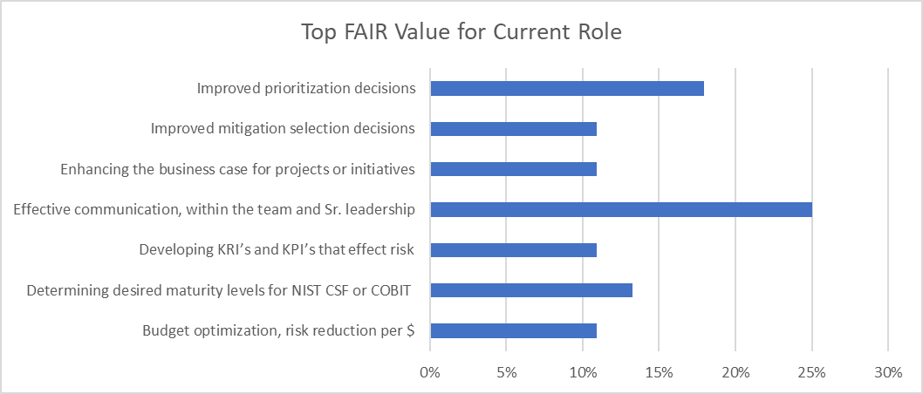
Select the top benefit of the FAIR value proposition that is most important to you in your current role.
May 2020
Notes:
FAIR CRQ is like a swiss army knife, and these are all challenging areas that are not addressed well with other methods or frameworks.
Q2 - Jack, as you consider the value proposition to an organization for investing in the capability to employ FAIR based cyber risk quantification, do you see any trends in who is driving the adoption decision and what is most important to them?

Slide 4
Ohio Chapter
13 MAY 2021
Joe Tanner, Co-Chair Mike Radigan, Co-Chair Aaron Schaub, Vice-Chair, Columbus Paul Frenken, Vice-Chair, Columbus
Apps Garcia, Vice-Chair, Cincinnati

Slide 5
Agenda
Pre-Event Chatter
Colonial Pipeline and Professional Due Care
Welcome and Chapter Business (10 mins)
Presentation by Jack Whitsitt (30 mins)
Q&A with Jack (10 mins)
Peer networking breakouts (20 mins)
FAIR war stories (15 mins)
Wrap-up (5 mins)

Slide 6
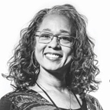
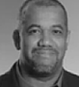
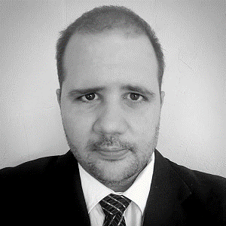
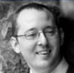
About the FAIR Institute
The FAIR Institute is a non-profit expert organization dedicated to enabling business-aligned and cost-effective risk management
Universities offering
FAIR courses
23 Local Chapters
Workgroups
30
16
5
Based on the Open FAIR Standard
Leadership & Board Members
Education | Collaboration | Best Practices
Jack Jones
Chairman, FAIR Institute Chief Risk Scientist, RiskLens
Sounil Yu Author Cyber Defense Matrix
James Lam
Board Member
eTrade
Chris Porter
CISO Fannie Mae
La’Treall Maddox
Strategy Risk Manager Cisco
Kim Jones
Director, Security Operations
Intuit
10,400+
Members
Donna Gallaher
CEO New Ocean Enterprises
Omar Khawaja
CISO Highmark Health
Wade Baker
Founder Cyentia Institute Prof. Integrated Security, VA Tech
Jack Whitsitt
SVP & FAIR Team Lead Bank of America
Nicola (Nick) Sanna
President FAIR Institute CEO RiskLens
Evan Wheeler
VP of Risk Management
NVDR, Inc
6
Notes:
We are at 10,700 members and the open fair foundation certification is at 987

Slide 7
Greater Ohio Chapter Opportunities
Become a member of the FAIR Institute (free) and “Join” the Chapter https://www.fairinstitute.org/
Membership
Partnership
Local Volunteer Roles
(un-official)
Vice-Chair (6)
(Cols, Cincy, Cleve)
Program Committee (3)
Meeting Logistics (1)

Slide 8
Ohio Chapter Meeting Format
Quarterly on Thurs Aug 19, Nov 11
Local In-Person: TBD
Agenda / Content Each Meeting (1.5 Class A CPE – self-reported )
Chapter business
Presentation
Networking
Advanced Track - Topic or Panel
Special Interest Groups
Open FAIR Foundation Certification Study Group
Notes:
The

Slide 9
"What They Didn't Teach You in FAIR School“ Jack Whitsitt fair institute board advisor sira board member cybersecurity psychologist all around good guy

Slide 10
Post Event Response Survey General Discussion Q&A
Mike Radigan
Co-Chair, Ohio Chapter
mradigan@businessofsecurity.com
Joe Tanner
Co-Chair, Ohio Chapter
joseph.tanner99@gmail.com
Luke Bader
Director, Membership and Programs
lbader@fairinstitute.org
16

