Slide 1
Supporting Your Company’s Digital Transformation with
Quantitative Risk Management
Harold Marcenaro
Head of Non-Financial Risk - BCP

Slide 2
Agenda
BCP’s Transformation Journey
Risk Management’s Transformation Journey
Our Cybersecurity Program
Quantitative Risk Management

Slide 3
About BCP
Largest bank in Peru, approx. 30% market share
131 years old
US $45 Billion in Assets
US $1.1 Billion in Net Profit in 2019
Part of Credicorp (NYSE: BAP), Market Cap US $11 Billion

Slide 4
BCP’s ”Burning Platform”
Transformation Program started in 2014
Pace picked up with 4th place in customer satisfaction in mass market in 2017

Slide 5
BCP’s North Star for 2021
1. Our Purpose
Transform plans into reality
2. Our Values:
4. Key Objectives
#LearnByDoing
#1
#CustomerCentricity
Best efficiency ratio in LatAm
#Risk-Conscious&Righteous
In customer experience
#Collaboration
#GiveYourBest
5. Results
3. Our desires are to offer a WOW Experience
Achieving WOW Management
#BoostYourSkills
Cost/ Income ratio in mid-thirties
Duplicate cross-sell for all customers
Pre approve
of EAP
50%
#1
70%
+++ profit growth
Not disclosed
in employee experience
of sales served digitally
With a WOW Team

Slide 6
BCP’s Transformation Program
Digital labs
Remote Banking for Affluent segment
Digital Marketing
Digital Journies
Customer
Experience
Customer journies
Customer experience in physical channels
Data & Analytics
Data architecture
Advanced Analytics
Big Data labs
Next-gen architecture
IT infrastructure optimisation
Cloud, APIs and Ecosystems
Efficiency
IT
Culture & Leadership
Digitalisation and automation of operating processes
Change Management
Talent strategy
Communication
Digital Ops
Digital Risk capabilities
Cybersecurity program
Digital Risk
Capex and Opex governance
Governance
Distribution model transformation
Distribution Model
Agile organisation
6
Copyright 2020 FAIR Institute, Inc.
Agile @ Scale

Slide 7
Why transform risk management?
Transform plans into reality
for more people
and many generations to come
7
Copyright 2020 FAIR Institute, Inc.

Slide 8
We started managing our Cybersecurity Program Program with FFIEC's Cybersecurity Assessment Tool (CAT)
2021
2020
2019
The Federal Financial Institutions Examination Council (FFIEC) is a formal U.S. government interagency body composed of five banking regulators that is "empowered to prescribe uniform principles, standards, and report forms to promote uniformity in the supervision of financial institutions".
FFIEC developed the Cybersecurity Assessment Tool (Assessment) to help institutions identify their risks and determine their cybersecurity preparedness.
8
Copyright 2020 FAIR Institute, Inc.

Slide 9
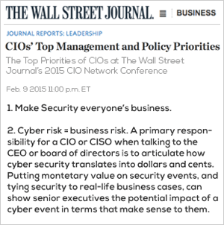
However, cybersecurity frameworks aren't enough. We aspire to manage cybersecurity as a risk with decisions made based on cost-effectiveness.
Projected enterprise risk reduction
2018 – 2019
2019 – 2020
Impact
2020 – 2021
Very high
7
7
7
7
1
1
1
1
High
2
2
2
2
Medium
8
8
8
Low
Very low
Very low
Very low
Low
Medium
Low
Very high
Likelihood
High
Enterprise risks
1
Unauthorized transactions and monetary loss
7
Insufficient technical disaster recovery
2
Data leakage
8
Disruption of services/ DDoS
9
Copyright 2020 FAIR Institute, Inc.

Slide 10
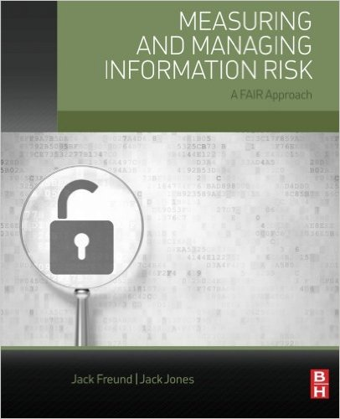
Why FAIR?
Our first approximation to FAIR was reading “Measuring and Managing Information Risk”
Quantification as a means to thinking things through, not as complicated mathematical models that on the contrary hinder intuition
Quantification enables us to aggregate, compare, prioritize and decide
FAIR has more chance to become a standard vs proprietary solutions. An open, active FAIR “community” facilitates further adoption and development.
Initially we tried on our own but were taking too long to move forward. Collaboration with RiskLens to speed adoption and facilitate escalation.

Slide 11
Quantitative Cybersecurity Risk Management
During 2020 we are implementing with RiskLens a systematic method for identifying cybersecurity risks, quantifying them, aggregating them, communicating them, and prioritizing mitigating actions in order to focus our cybersecurity program on the most cost-effective initiatives.
In particular by the end of 2020 we want to…
Aggregate the bank's total exposure to cybersecurity risk, and how does that split between threats, vulnerabilities, assets, process, and products. Ex: The bank's total exposure to cybersecurity risks is of US$XXXMM, of which X% is concentrated in asset A, B, and C, and the top vulnerability is D because it represents Y% of total exposure.
Define and build a risk appetite metric and limits with the total exposure to cybersecurity risk.
Quantify specific risks and prioritize initiatives between possible mitigating strategies. Exs: To protect asset X from threat Y is it most effective to invest in preventive controls or detective controls? Is the exposure to threat Z higher in asset A or asset B?
Understand how an enterprise-wide initiative impacts several treats, vulnerabilities, and/or assets. Ex: Investing US$XMM in upgrading our firewalls would decrease our cybersecurity risk exposure in $YMM.
Introduce these tools into our decision-making processes.

Slide 12
Our Plan
 |  | Use for Decision Making
Q1 | Squad. On boarding. Train team.
Q2 | Quantify 10 scenarios lead by RL. | Use in 1-2 investment or risk acceptance decisions
Q3 | Quantify 10 scenarios lead by us | Use tactically
Q4 | Quantify 100 scenarios. | Start using regularly. Figure out use in investments across risks. Create aggregated visión of risks. ¿Risk appettite?

Slide 13
El mundo está cambiando
V
U
C
A
Volatility
The nature and dynamics of change, and the nature and speed of change forces and change catalysts.
Uncertainty
The lack of predictability, the prospects for surprise, and the sense of awareness and understanding of issues and events.
Complexity
The multiplex of forces, the confounding of issues, no cause-and-effect chain and confusion that surrounds organization.
Ambiguity
The haziness of reality, the potential for misreads, and the mixed meanings of conditions; cause-and-effect confusion
13
Copyright 2020 FAIR Institute, Inc.
(As introduced by the U.S. Army War College to describe the multilateral world perceived as resulting from the end of the Cold War.)
Notes:
VUCA is an acronym—first used in 1987—to describe or to reflect on the volatility, uncertainty, complexity and ambiguity of general conditions and situations;^{[1]} drawing on the leadership theories of Warren Bennis and Burt Nanus.^{[2]} The U.S. Army War College introduced the concept of VUCA to describe the more volatile, uncertain, complex and ambiguous multilateral world perceived as resulting from the end of the Cold War.

Slide 14
Agility is business´ response
Leadership shows direction and enables action
”Boxes and lines” less important, focus on action
Top-down hierarchy
Bureaucracy
Detailed
instruction
Quick changes, flexible resources
Teams built around e2e accountability
Silos
From…
To…
Organizations as “machines” with hard coded instructions and a rigid blueprint; people fill their assigned roles as “cogs” in the system
Organizations as organic systems, in which people collaborate quickly and effectively around tasks and projects, across boundaries
Leaders as masterminds who delegate tasks and instructions in a top-down manner
Leaders as catalysts who show direction and set up the system for people to do their jobs effectively
Protecting most people in the organizations from stressors and complexity, and treating information as a scarce resource
Exposing all employees to a certain amount of uncertainty and stressors to help them grow and stay flexible, and making information by default available
Optimizing for set outcomes and plans
Optimizing exposure to unexpected events (positive and negative)
SOURCE: McKinsey

Slide 15
With inspiration from software development and digital natives
AGILE
Scaling Agile
MANIFIESTO
Wih Tribes, Squads, Chapters & Guilds
INDIVIDUALS
&INTERACIONS
Over processes and tools
WORKING
SOFTWARE
Over full documentation
CUSTOMER
COLABORATION
Over contract negotiation
RESPONDING
TO CHANGE
Over following a plan
Henrik Kniberg & Anders Ivarsson
Oct 2012
15
Copyright 2020 FAIR Institute, Inc.

Slide 16
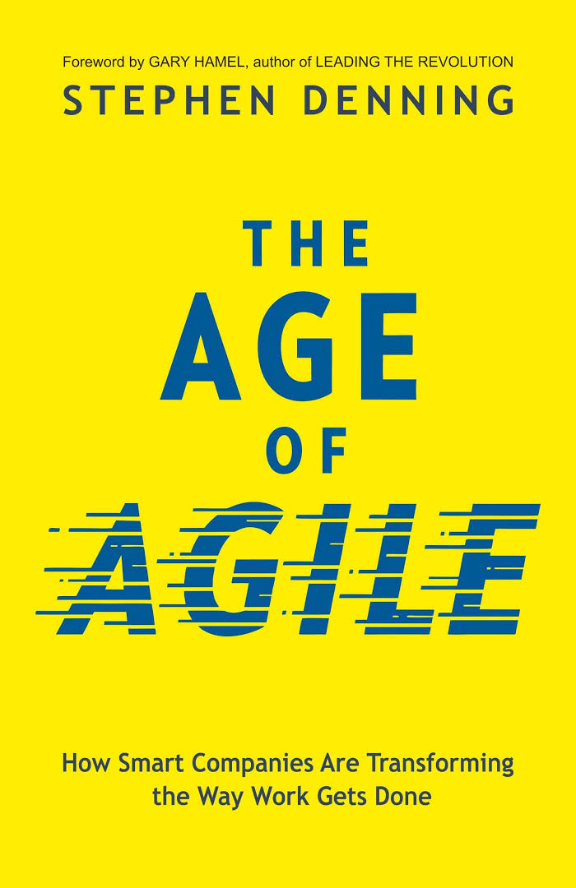
What is agility?
The law of the small team
Big and difficult problems should be disaggregated into small batches and performed by small cross-functional autonomous teams working iteratively in short cycles in a state of flow, with vast feedback from customers and end-users.
The law of the customer
“There is only one valid definition of business purpose: to create a customer.” (Peter Drucker, 1954)
The law of the network
Create a team of teams. Each team needs to look beyond its own goals and concerns and see its work as part of a larger mission of the collectivity.
16
Copyright 2020 FAIR Institute, Inc.

Slide 17
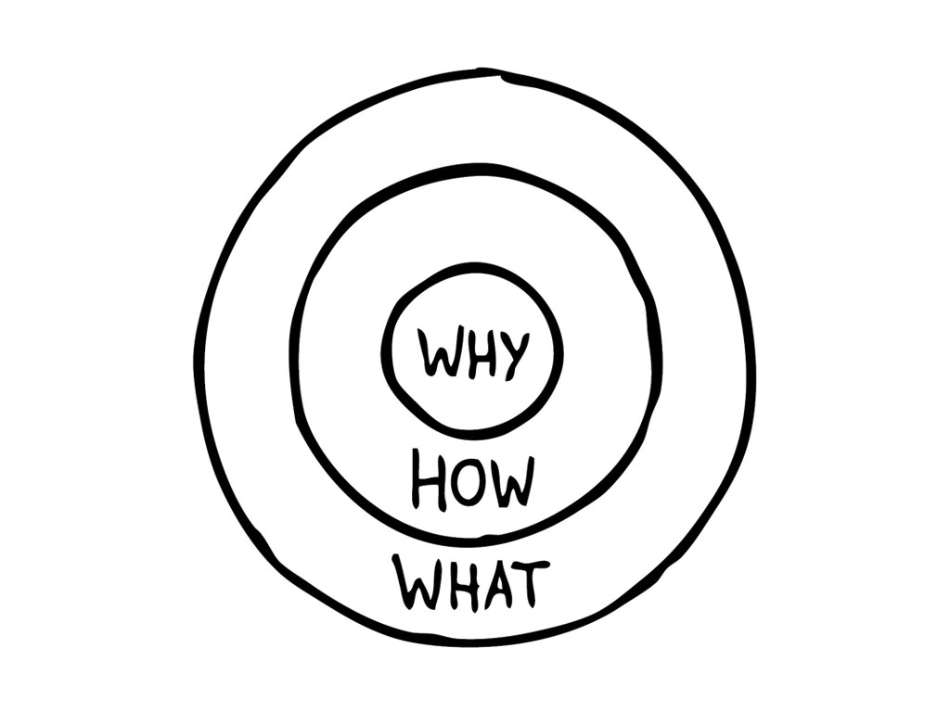
Risk Transformation plan Responds to Three Questions…
The purpose: ¿WHY do we need to transform the risk funtion?
The result: ¿WHAT do we need to transform?
The process: ¿HOW do we go about transforming Risk?
17
Copyright 2020 FAIR Institute, Inc.

