Slide 1
HITRUST and FAIR Integration Leveraging two methodologies’ strengths to improve your risk management program
Marshall Lambert and Greg Rothauser
Notes:
Good Day, everyone. First thing we want to say up front is that we are going to be discussing what we have done at Highmark Health to integrate the FAIR methodology and the HITRUST Approach in order to operationalize our Risk Quantification program. We recognize that not everything we did will necessarily work at your organizations, but this is what worked well for us. OK, with that in mind, let’s briefly discuss where we were coming from. I don’t want to spend too much time on this, but it’s helpful to quickly discuss why we went down this path. I am guessing We are all pretty familiar with this “classic approach” to InfoSec. Some examples of Security or Risk department statements as to purpose:
“Protect our patients’ data and critical clinical systems.”
“Safeguard customer data entrusted to our organization”
So how do orgs go about reporting on the successes and ongoing challenges of that endeavor?

Slide 2
The “Classic” Approach to Information Risk
Often, a qualitative “Top Risk” view is the result:
This often leads to difficult questions…
Notes:
This leads to leadership reporting models with limited usefulness that we continue to see across the risk community. Probably nothing new to us - we're at this conference because we know the limitations of this approach.
It is easy to imagine (or for some of us, recall) questions that arise from this kind of reporting: · “What does it mean that ‘Cloud’ is ‘likely’?” · “Of the four ‘High’ risks, which one is the biggest risk to the organization?” · “Does this mean we do not need to deal with 3rd party risk right now?”
Sometimes, organizations address this by providing semi-quantified controls reporting.

Slide 3
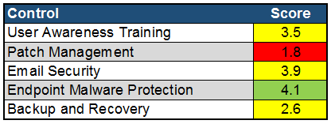
The “Classic” Approach to Information Risk
Sometimes, a controls-focused report is provided:
And again, hard questions arise…
Notes:
Similarly, if we report out specific control status to leadership, it can look like this. Most of us have probably either produced something like this or consumed it. While it has some usefulness, for risk decision making it is also flawed and is bound to raise more questions we are all probably used to hearing:
· “Does this mean we are in good shape or bad shape?” · “Why is patch management so bad and what does that mean to the organization?” · “Why are both ‘Backup and Recovery’ and ‘Email Security’ yellow with such a difference in score?”
Occasionally, organizations combine these approaches. but even together there are clear limitations:

Slide 4
The “Classic” Approach to Information Risk
For both solutions, there are clear limitations:
Well-informed decisions – How?
Boiling the ocean
Failure to focus = Failure to succeed
Do any of us have unlimited budgets, resources, and time to throw at our programs?
Notes:
· It is very difficult to make well-informed decisions around monetary and effort investment. (Controls are not connected well to risk outcomes) · It is unrealistic and in many cases unwise to attempt to mature all controls. · These approaches often lead to multiple, simultaneous efforts that each are resource starved and struggle to realize their goals.
So, to change the results, we first have to look at our purpose as an Information Risk function.

Slide 5
A Better Approach
“Cost effectively achieve business objectives while maintaining an acceptable level of risk from probable threats to our confidential data and critical systems.”
This requires an understanding of threats to your organization, the controls for those threats, and the resulting risk exposure.
(FAIR & HITRUST together)
Notes:
This is how we look at our function and purpose in the risk quantification group at Highmark.
- Identifies that we have resource limitations
- Recognizes that there are business constraints to account for. - Acknowledges that no organization is ever 100% secure and free of risk.
This is what we were working to achieve and FAIR alone gets us pretty far along this road. But FAIR alone has some challenges that I have encountered at multiple organizations. A key challenge that we are going to focus on here is how to connect control activity - deficiencies, improvements, or other changes - to the risk scenarios and resulting exposure effects.
“Highmark found that an integrated approach between HITRUST CSF and FAIR addresses this challenge”

Slide 6
A Better Approach
Leveraging this integration provides more valuable results:
Notes:
It allows us to produce results like this:
Walk through columns.
Armed with this result, organizations can prioritize how they expend their resources to best address risk and a means by which to monitor and measure success. So to discuss some of the specifics on how we look at the integration between FAIR and HITRUST< I will turn it over to my colleague, Marshall.

Slide 7
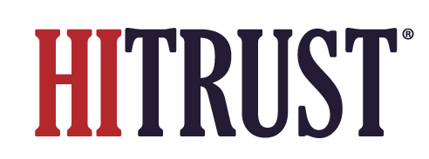
What is HITRUST?
Responsible for the development of HITRUST CSF
Comprehensive, prescriptive, certifiable
International, federal, and state regulations
HIPAA, GDPR, ISO 27000, etc
“Assess once, attest many” approach
Hundreds of thousands of organizations
8 of 10 top cloud service providers
75% of Fortune 20 companies
Notes:
Thank you Greg
As this is a FAIR conference, many of you might have found out “What is FAIR” at this point, but it is important to give you a bit of background around the other approach we’ll be discussing- HITRUST.
- HITRUST is an organization that has created a controls framework called the HITRUST CSF
The CSF encompasses a multitude of regulations and industry standards, including HIPAA, GDPR, ISO
It’s used by a majority of Fortune 20 companies and hundreds of thousands of organizations
If I were to run some FAIR-based estimation my head, I’d guess some of you in the audience probably already have familiarity with HITRUST
What HITRUST brings to the table for your org is rather simple… It keeps things simple. Highmark has found value in the “assess once, attest many” approach, saving time and resources for compliance-focused activities.
What you may not realize is that HITRUST also brings value to your FAIR program, and that’s what we’re going to touch on today.

Slide 8
Marrying the Methodologies
FAIR
Uniform risk scenario structure (asset, threat, effect)
Discrete risk scenario components, e.g. security control metrics
Common language for security decision-making
HITRUST
HITRUST Threat Catalogue maps cyber threat events to controls
Necessary control governance for security control metrics
Structures useful security decision-making
Notes:
So how do these differing methodologies begin to connect?
We’re going to offer you a high-level look at how there are some overlapping components, but we’re just skimming the surface in this presentation.
For a deeper view, you’ll need to be on the lookout for the integration whitepaper Greg and I have drafted with FAIR and HITRUST. We’ll have more details on that at the end of the presentation.
What does our “better” risk management approach entail? Understanding of our organizations’ threats, controls, and resulting risk exposure.
Threats
Powerful element of FAIR is uniform risk scenario structure, one of the components of which is a threat acting on an asset
HITRUST has a threat catalogue that ties controls to threat events. This sets up for tying your understanding of controls to the threats and risk scenario they control against.
Control Metrics
Another element of FAIR is breaking down risk scenarios into discrete components. Many of you who are practitioners will be aware that more often than not, a cyber risk scenario will be influenced by security control-related metrics or measurements.
When you go to collect those metrics, is it always readily apparent which team is responsible for them or which individual on that team is the best point of contact? Is it always readily apparent if the metrics themselves are accurate, appropriately scoped, or appropriately collected? The answers to these questions aren’t always “yes” without effective control governance, something HITRUST introduces.
Security Decision-Making
HITRUST creates decision-making constructs for your risk management program and leadership in the form of determining existent security control gaps.
FAIR enhances the decision-making within that construct by providing common language for all stakeholders in the form of financial loss.

Slide 9
Roles In Effective Risk Reporting
FAIR + HITRUST
FAIR
HITRUST
FAIR + HITRUST
Notes:
- That common language and reporting around control gap investment prioritization and corresponding decision-making may begin to look something like this.
Rather than presenting purely on control gaps, we can present on loss scenarios that they impact as defined by using FAIR.
Additionally, corresponding risk exposure for such loss scenarios can be presented
At Highmark, we have found that risk exposure can be calculated more precisely, while still maintaining accuracy, if the calculation inputs, particularly security control metrics, have appropriate governance around them.
With HITRUST, we can define specific control improvement opportunity with defined scope, as well as the individuals responsible for managing those controls.
Prioritization of those control improvement opportunities can be determined by the calculated ROI for a particular control investment, which takes into account both forecast risk reduction and the control cost.
Forecasting risk reduction is dependent upon the change in a security control’s operational metrics, something that is really hard to determine without appropriate governance.
The reporting here results in clear options for decision-makers around which security controls they can fund to improve and the risk reduction or value forecasted from those decisions.

Slide 10
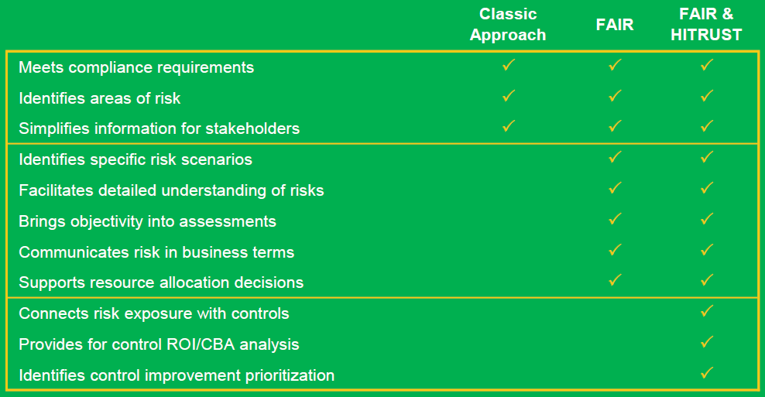
Integration Approach Value
Notes:
As is detailed here, while FAIR provides unquestionable value beyond the benefits your program may realize by simply pursuing the classic cyber risk management approach, leveraging an integration between FAIR and HITRUST even furthers that value.
FAIR introduces things like:
Enhanced communication to non-cyber employees or leadership
Both in the form of financial language and translating security “concerns” into comprehendible loss scenarios, effectively answering the question of “so what?”
Brings objectivity into assessments and reduces the rampant FUD (Fear, Uncertainty, and Doubt) that all too often plays into risk assessment
Sets up for defensible analysis to support resource allocation decisions
HITRUST and FAIR together can enhance what FAIR alone offers by:
Connecting risk exposure with controls and ensuring risk scenario inputs that are related to controls are effectively-governed
Providing for security-control based return on investment analysis
Such an integration allows you and your decision-makers to understand in even greater detail your threats, connecting controls, and resulting risk exposure, allowing for more informed risk-based decision making and ultimately, more effective cyber risk management.

Slide 11
But Wait… There’s More!
Jointly-authored whitepaper
FAIR
HITRUST
Highmark Health
Further detail on integration use cases and upcoming initiatives
Available on FAIR Institute LINK’s blog and member resource library
Notes:
If this is of interest to you, please be on the look out for an integration whitepaper that will be published on the FAIR Institute LINK website
This whitepaper is the outcome of a partnership between FAIR, HITRUST, and Highmark Health
This whitepaper is merely the beginning, though, as this partnership is ongoing
The whitepaper will detail integration to a deeper degree, but it also sets the stage for upcoming integration opportunity
Ideally our goal, is to define actionable guidance for integration between the two methodologies to result in more effective cyber risk management across the industry
With that, we’re going to invite in two of our other contributing authors, Bryan Cline from HITRUST and Tyler Britton from the FAIR Institute to have a bit of a Q&A session around the intent of this initiative.

Slide 12
Author Q&A
Bryan Cline, HITRUST
Tyler Britton, FAIR Institute
Greg Rothauser, Highmark Health
Marshall Lambert, Highmark Health
Notes:
Greg- Posed to each of you individually – “For your particular organization, what value do you expect to realize from an integrated approach between FAIR and HITRUST?”
Marshall- Posed to Bryan – “Can you provide a little more information on the HITRUST Threat Catalog and how it can help organizations understand the threat landscape they face and the controls for those threats?”
Marshall- Posed to Tyler – “Would you discuss any challenges that you have seen at organizations you have worked with that you feel HITRUST is well-suited to answer?” (I think we are kind of looking for an anecdote here to illustrate that this would work for not just Highmark)
Greg- Posed to Bryan (time allowing) – “We mentioned in our presentation about the ‘Assess once, Attest many’ aspect of HITRUST CSF. Can you discuss a bit about how that works, and how it sets the HITRUST CSF apart from other control frameworks?”
Greg- Posed to Tyler (time allowing) – “What are you most excited to work on or address as we continue to produce detailed integrated processes between FAIR and HITRUST?”

