Slide 1
Improving Cyber Visibility and Decision-Making at Maersk
Pooya Alai – Senior Cyber Security Risk Manager
Rebekka Kurland – Cyber Security Risk Manager

Slide 2
Disclaimer
The following presentation is based on the presenters’ own opinions and may not necessarily reflect those of Maersk or The FAIR Institute or any other body
Neither the presenters nor Maersk nor The FAIR Institute make any attestation as to the accuracy of the content presented
Neither the presenters nor Maersk nor The FAIR Institute accept any liability for any decisions made or not made based on the content presented

Slide 3
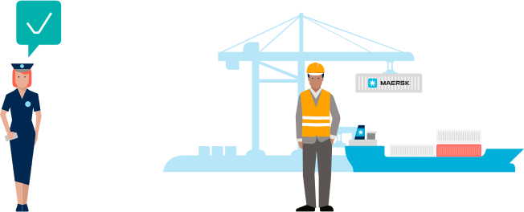
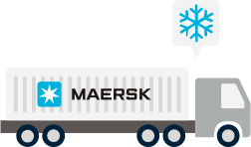
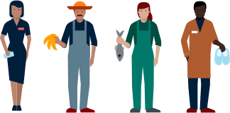
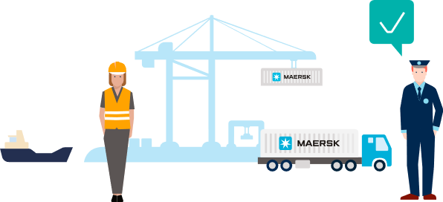
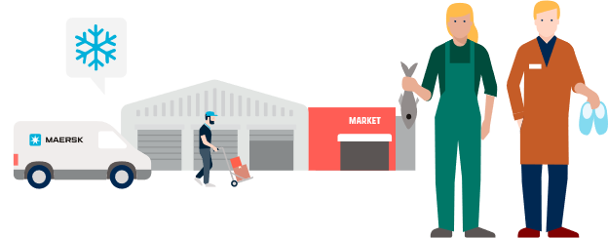
START
Meet the customer
Collect the goods
Store the goods
Clear the goods
Rail Freight
Connecting and simplifying global supply chains
Transport the goods
ALL THE WAY
Connecting and simplifying
our customers’ supply chains
A.P. Moller - Maersk enables its customers to trade and grow by transporting goods anywhere.
Maersk works to provide customers with a simple end-to-end offering of products and services, seamless customer engagement and a superior end-to-end delivery network, taking the complexity out of global supply chains.
Clear the goods at arrival
Store the goods
END
Deliver the goods

Slide 4
Every day, we help our customers move almost
of the world’s food, materials and goods – items we all depend on to live, work and thrive.

Slide 5
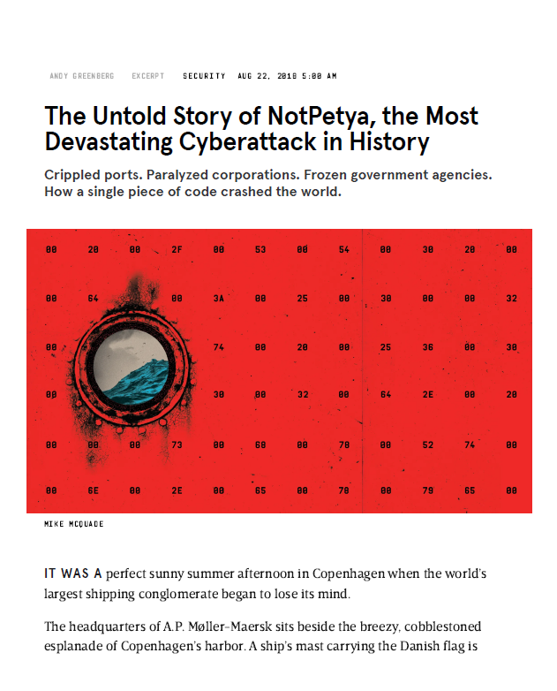
Cyber attack in 2017

Slide 6
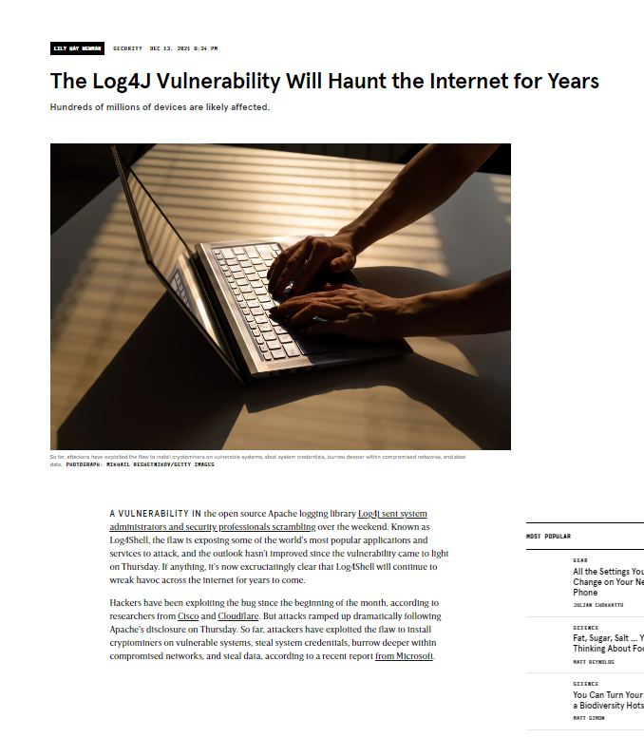
“ What’s the risk from Log4j? “
From a big list of risks (issues) needing to be fixed ..

Slide 7
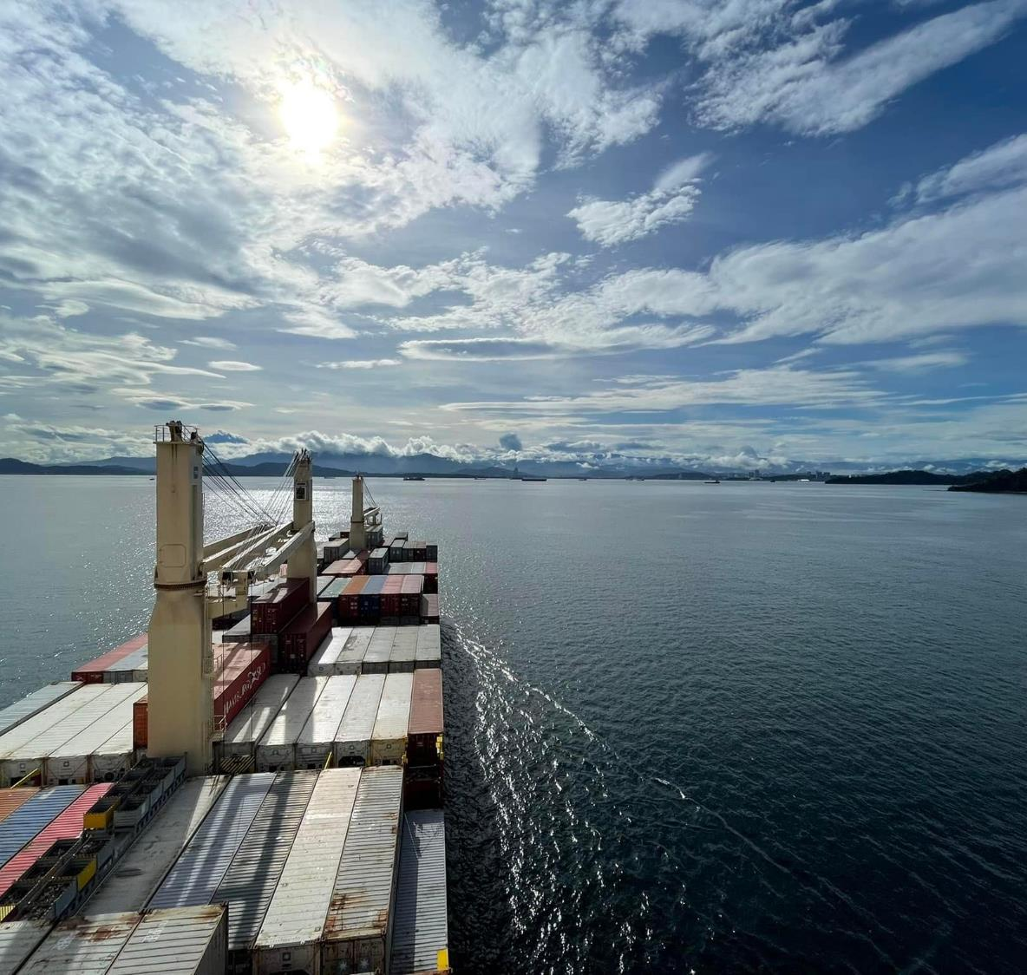
... to a forward-looking risk register

Slide 8
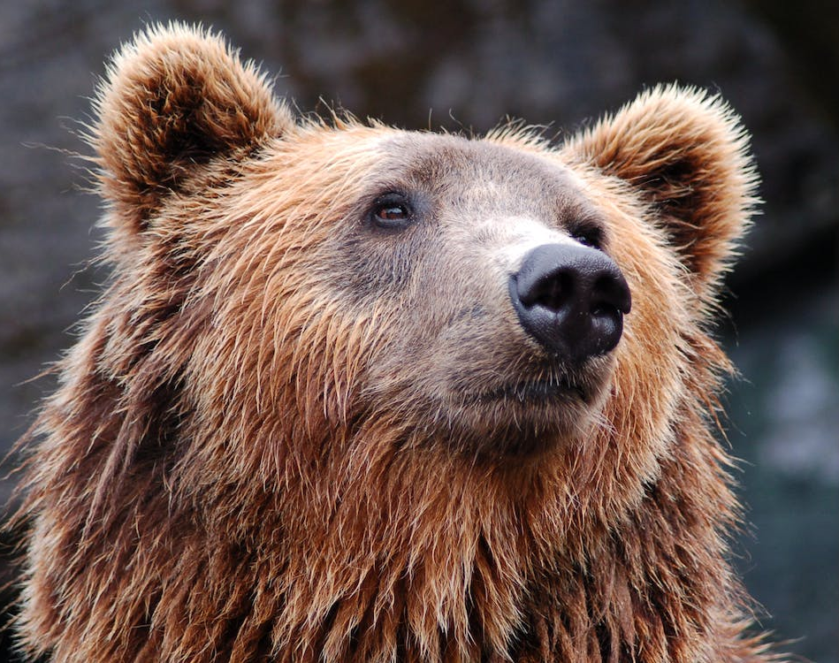
A bear means different things to different people

Slide 9
Multiple Cyber Risk Lenses…
Foresight: Radar
Possible
Bears could attack Maersk employees
Probable
Bears have attacked office workers in some European countries

Slide 10
Multiple Cyber Risk Lenses…
Foresight: Radar
Enterprise Risks
Risk to Employee Safety
Possible
Bears could attack Maersk employees
Business Risks
Risk to Maersk from bears attacking employees
“Forward looking”
FAIR
Probable
Bears have attacked office workers in some European countries

Slide 11
Multiple Cyber Risk Lenses…
Foresight: Radar
Enterprise Risks
Risk to Employee Safety
Possible
Bears could attack Maersk employees
Business Risks
Risk to Maersk from bears attacking employees
“Forward looking”
FAIR
Probable
Bears have attacked office workers in some European countries
Risk Scenarios
Employees attacked by bears whilst commuting to/from office
Employees attacked by bears whilst taking breaks/getting lunch
FAIR

Slide 12
Multiple Cyber Risk Lenses…
Foresight: Radar
Enterprise Risks
Risk to Employee Safety
Possible
Bears could attack Maersk employees
Business Risks
Risk to Maersk from bears attacking employees
“Forward looking”
FAIR
What needs building soon to protect us in the future
Probable
Bears have attacked office workers in some European countries
Risk Scenarios
Employees attacked by bears whilst commuting to/from office
Employees attacked by bears whilst taking breaks/getting lunch
FAIR
Enterprise Cyber Issues mgmt. (ECIM)
Gates to the office car park are broken
Operational Risk(s)
Bears could attack employees as the car park gates are broken, resulting in injury
“Known Vulnerability Focused”
“Known Vulnerability Focused”
What needs to be fixed right now!

Slide 13
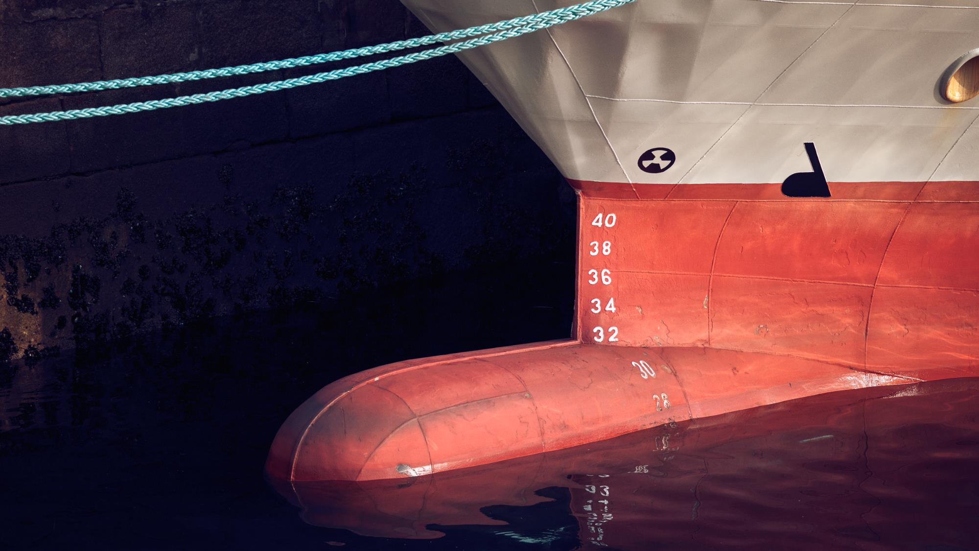
Case Study

Slide 14
Risk Governance
Decision
Risk
Risk
Decision
Risk?
Risk?
✗
✓

Slide 15
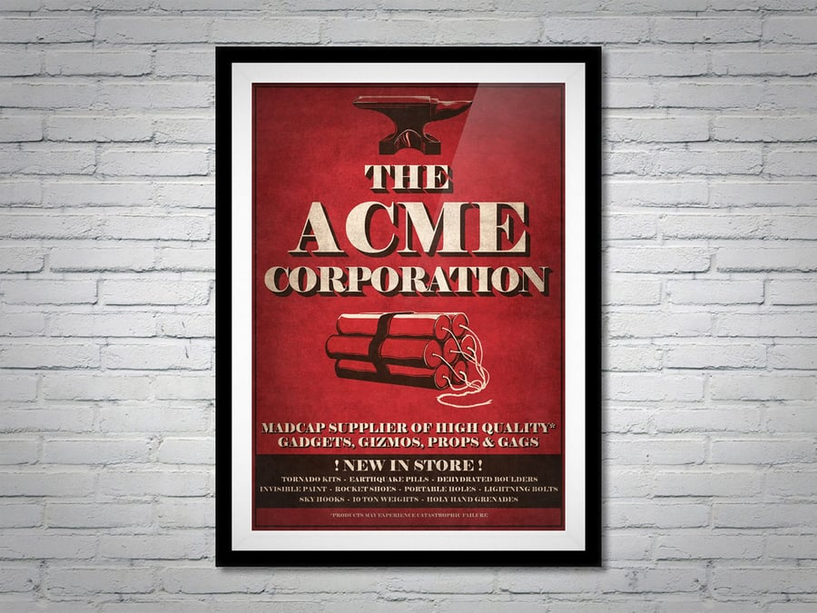
Acquisition of ACME Inc.

Slide 16
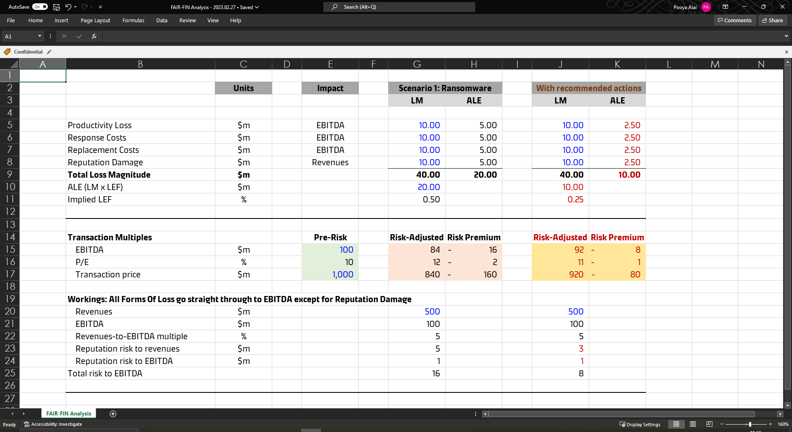
A narrative tailored to the audience

Slide 17
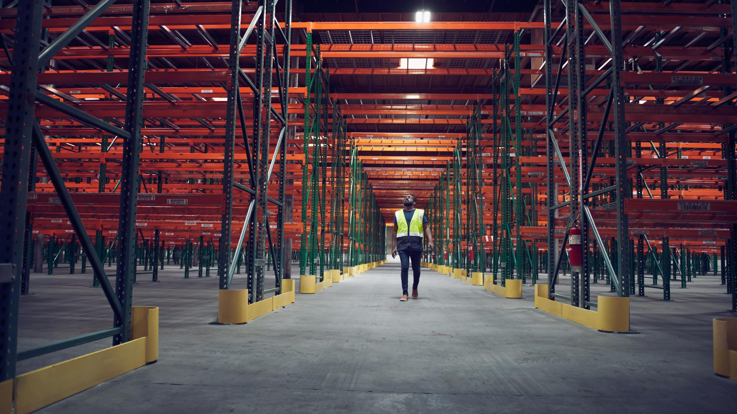
Summary
Risk Analysis: We use FAIR to provide quick answers to difficult questions e.g. “what’s the risk from … [this Threat] / [that Vulnerability]?”
Risk Governance: ShiftLeft doesn’t just apply to developers, risk should be taken into account before all major decisions.
Risk Communication: The best way to talk about risk is not to talk about risk, but about the variance around the metrics that matter (Forecasts, Returns, Multiples)

Slide 18
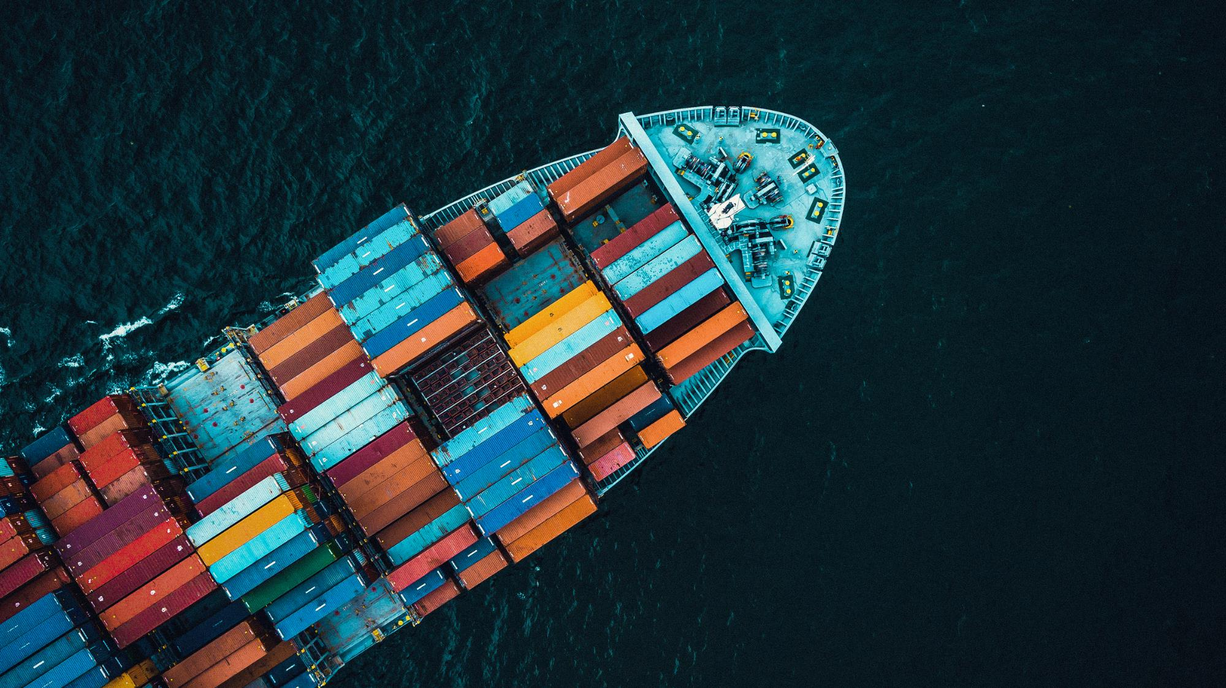
Q&A

