Slide 1
The Future of Cybersecurity
Risk Measurement
Jack Jones

Slide 2
Can you relate to one or more of these?
“Religious battles” over risk ratings.
Too much to do — everything’s important.
How many mediums equal a high?
Difficulty cost-justifying expensive cybersecurity improvements.
Uncertainty regarding thresholds for KRIs and KPIs?
Executives that are too quick to accept risk.
These are the result of risk measurement deficiencies.

Slide 3
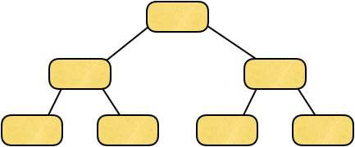
Differentiating cyber-related measurements…
Control Frameworks
Cybersecurity Maturity Models
CSF
2700x
CMMC
800-53
Risk Measurement Models
Only these actually provide risk measurement
FAIR
800-30
Notes:
This is our taxonomy... don’t worry it goes deeper, but rarely do we go there.
Discussion opportunity!
Notice that risk is made up of what?
Where is vulnerability?

Slide 4
Getting on the same page…
Risk measurement requires the analysis and quantification of loss event frequency (or probability) and impact.

Slide 5
How do you like your risk measurement?
Fast, cheap, or good.
Pick two.

Slide 6
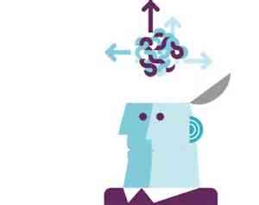
What is the most commonly used cyber risk measurement model?
Mental models
What scope?
What formula?
What data?

Slide 7
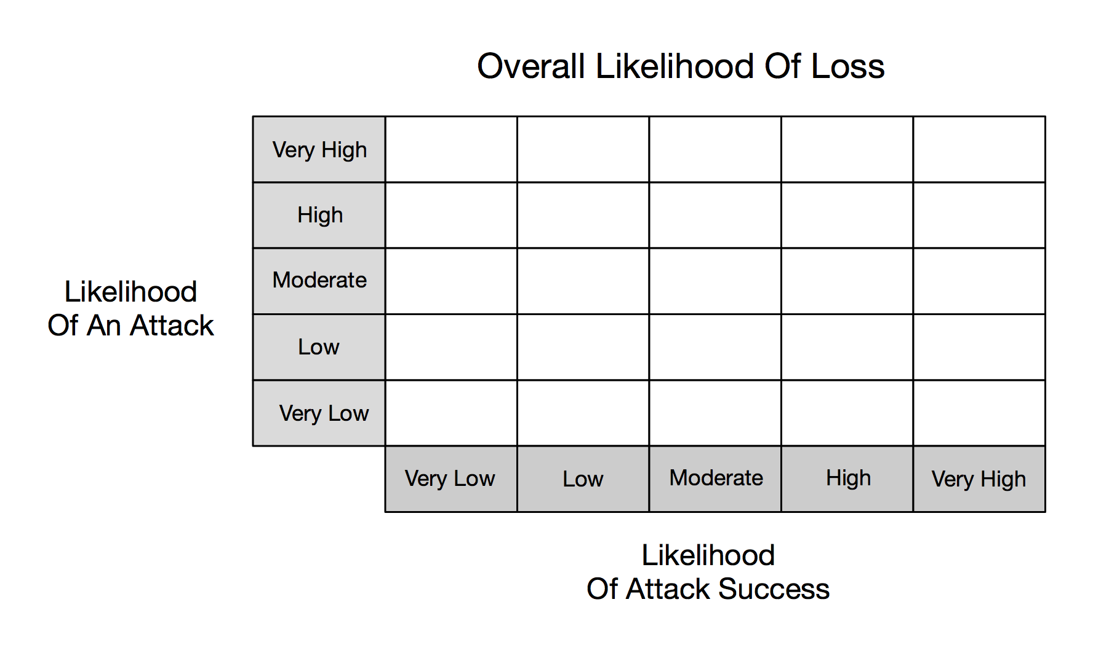
Broken cybersecurity risk models
Low
Moderate
High
Very High
Very High
Low
Moderate
Moderate
High
Very High
?
50%
Low
Low
Moderate
Moderate
?
50%
High
Very Low
Low
Low
Moderate
Moderate
Very Low
Very Low
Low
Low
Low
100%
Table G-5 NIST 800-30

Slide 8
Math on ordinal values
(
x
) /
= ?
Red
Green
Yellow
Very Low
Low
Medium
High
Very High
No unit of measurement
“1”
“2”
“3”
“4”
“5”
“—8”
“4”
“28”
“53”
“2961”

Slide 9
But have these methods been “good enough?”
Over 70% of “high risk” findings aren’t, in fact, high risk.
No organization I’ve encountered in the past 5 years had accurately identified their top 10 cyber-related risks.

Slide 10
Remember these…?
“Religious battles” over risk ratings.
Too much to do — everything’s important.
How many mediums equals a high?
Difficulty cost-justifying expensive cybersecurity improvements.
What should the thresholds be for KRIs and KPIs?
Executives that are too quick to accept risk.

Slide 11
There is no evidence that existing risk measurement methods are effective.

Slide 12
CRQ to the rescue?
CRQ

Slide 13
CRQ Past and Present
Mid-to-late1980’s - early attempts to quantify information security risk in economic terms failed, creating a perception that it couldn’t be done.
Late1990’s - Interest in cyber risk quantification (CRQ) resurfaced, but approaches were complicated and deemed impractical. This reinforced the perception that qualitative measurement was the only choice.
Early-to-mid 2000’s - FAIR developed and published. Was seen as relatively easy to understand and use. Adoption was slow due to established perception that CRQ can’t be done.
Early 2010’s - FAIR adopted by The Open Group as an international standard.
Mid 2010’s - FAIR Institute established. Now with over 14,000 members.
Late 2010’s - the question regarding CRQ began to change from “Can it be done?” to “Should it be done?”
Today - the question regarding CRQ has changed from “Should it be done?” to “How do we do it — easily and at scale?”
We are here

Slide 14
The Future of Cybersecurity Risk Measurement
?
?
?
?
We are here

Slide 15
Remember “Fast”, “Cheap”, or “Good”?
A “good” risk measurement method does not have significant intrinsic flaws in scoping, modeling, or the use of data.
You have to be able to defend your results.
This should be table-stakes.

Slide 16
What about “good enough?”

Slide 17
Remember “Fast”, “Cheap”, or “Good”?
The cyber risk landscape is highly dynamic.
We need to be able to quickly recognize and act on problematic changes.

Slide 18
Automation and AI

Slide 19
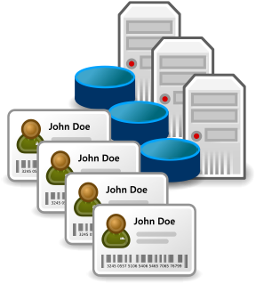
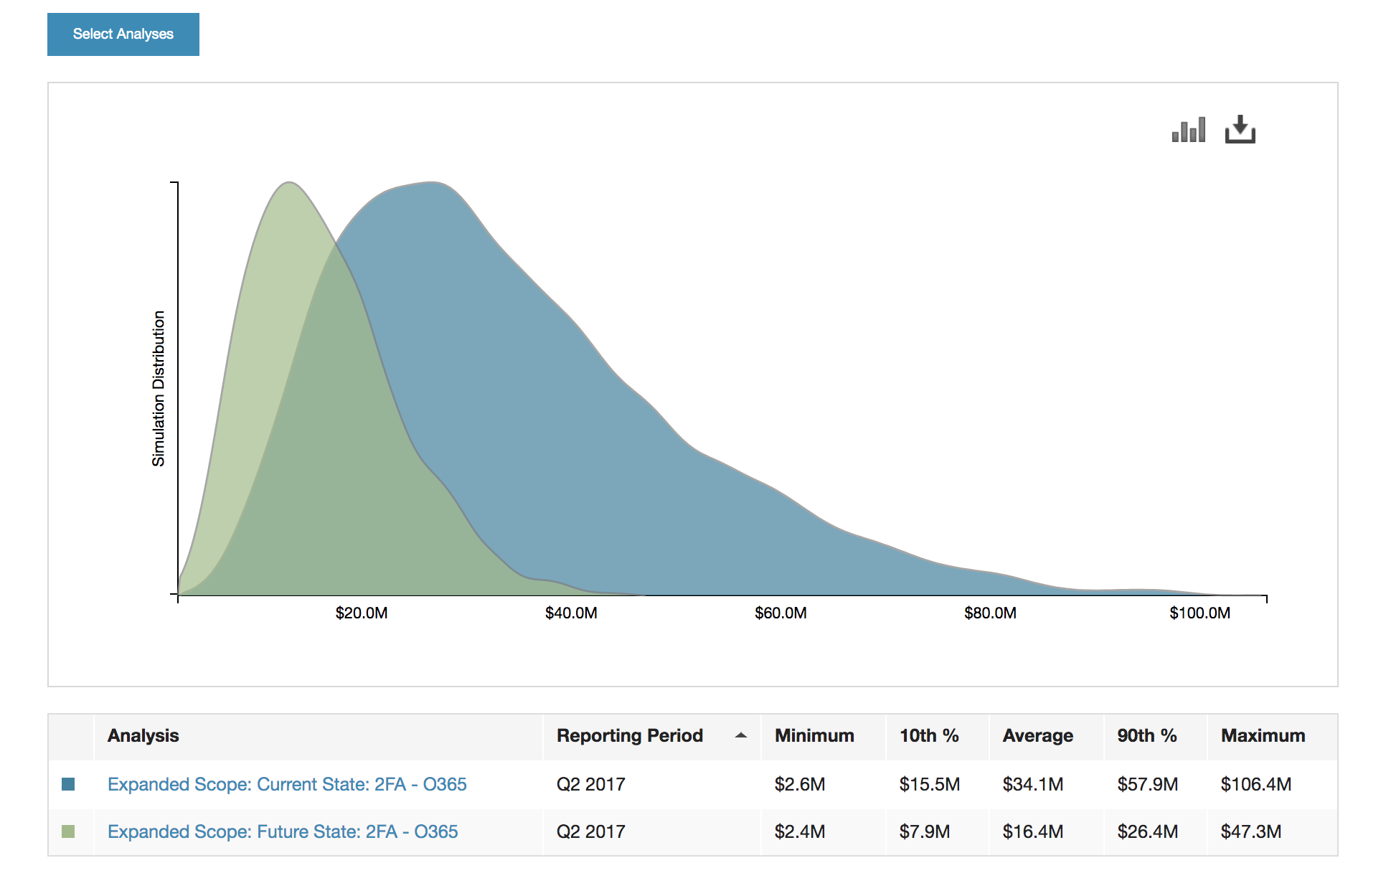
Automated risk measurement…
Threat data
Threat intelligence services
An organization’s own logs
Control data
Security telemetry
Security framework ratings
Loss data
Verizon DBIR
Advisen
Insurance providers
Proprietary research

Slide 20
How does a control affect risk?
Does logging affect likelihood or magnitude?

Slide 21
Which of these is more important?
Is it twice as important? Three times…?
Control relevance is context sensitive!

Slide 22
Control dependencies…
?
1
Loss Event Detection
Visibility
Monitoring
Recognition
3
1
2
VISIBILITY: There has to be data that contains evidence of a breach (e.g., logs)
MONITORING: Someone or something has to review the data (e.g., manual reviews, SIEM, etc.)
RECOGNITION: Exploit signatures, malware signatures, baselines of normal activity, etc.

Slide 23
Key take-aways…
Control relevance is highly context sensitive.
Controls often have key dependencies with other controls.
If automation fails to account for these (and other nuances), analysis results will be inaccurate.

Slide 24
Artificial Intelligence
What’s the difference between automation and AI?
In AI, the analytic model is learned rather than designed, which means it’s only as good as its training.

Slide 25
Training AI — it’s all about the data
A risk measurement AI is supposed to estimate the likelihood and magnitude of loss from the scenario data it’s presented with.
?
Its simulated neurons and synapses get reinforced when its estimate is correct.

Slide 26
Simplified training example
Inputs:
Asset: Sensitive customer information
Threat agent: Disgruntled insider
Event type: Data leakage
Method: Data exfiltration
Vector: E-mail
Controls in place: Authentication, access privileges, anti-malware, logging, etc.
AI output:
Likelihood: 10%-15%
Impact: $5M-$20M
What is the AI’s estimate going to be checked against?
Either empirical loss data has to exist for that scenario, or someone has to have done the analysis beforehand.

Slide 27
The problem of training bias
Bias exists when an AI draws inappropriate conclusions due to poor training data
It is one of the most prevalent and difficult to manage dimensions of AI
https://www.technologyreview.com/2019/02/04/137602/this-is-how-ai-bias-really-happensand-why-its-so-hard-to-fix/

Slide 28
The problem of opaqueness
The ability to audit and analyze how an AI arrived at a particular result is non-trivial.
Unless the AI is auditable, it should be considered just as prone to failure as proprietary models.

Slide 29
Key take-aways…
The quality of AI is dependent upon the quality of training
Bias and opaqueness are serious challenges that need to be addressed before AI can be trusted
There is great potential for automation and AI in cyber risk measurement, but there is also significant danger if they are done poorly.

Slide 30
Where FAIR-CAM fits into things
(The FAIR Controls Analytics Model)

Slide 31
“Half of your marketing dollars are wasted. You just don’t know which half.”
An old marketing proverb

Slide 32
“In the 19th century we had a relatively advanced understanding of anatomy, but we had a terrible understanding of physiology.
We knew what was happening, but we didn’t understand why it was happening.”
A Retired Surgeon

Slide 33
FAIR-CAM defines controls physiology — i.e., how the controls landscape works as a complex system of interdependent parts.

Slide 34
Tactical application of FAIR-CAM
Understanding and measuring how much risk we have today.
Identifying tactical control improvements to reduce risk.
Cost-benefit analysis for tactical control improvements.

Slide 35
Strategic application of FAIR-CAM
Understanding why an organization has the risk it does, as well as what factors affect risk over time.
Forecasting an organization’s future risk exposure.
Identifying strategic and systemic control improvements to achieve and maintain a desired level of risk.

Slide 36
Direct vs. indirect effects on risk
Directly affect the frequency or magnitude of loss
Indirectly affect risk
Enable well-informed decisions
Asset management
Threat intelligence
Awareness training
Risk analysis
Etc.
Decision Support Controls
Authentication
Access privileges
Logging
Data recovery processes
Etc…
Assets
Loss Event Controls
Controls
Risk
Scanning
Patching
Auditing
Change management
Etc…
Variance Mgmt. Controls
Threats
Affect the reliability of other controls

Slide 37
Direct vs. Indirect example…
Directly affect the frequency or magnitude of loss
Indirectly affect risk
Asset management
Threat intelligence
Anti-phishing training
Risk analysis
Incentives
Etc.
Decision Support Controls
Trained personnel
Anti-malware
Access privileges
Data recovery processes
Etc…
Assets
Loss exposure from a ransomware event
Controls
Risk
Loss Event Controls
Variance Mgmt. Controls
Patching
Auditing
Etc…
Threats

Slide 38
Key take-aways…
The controls landscape is the most complex and least understood dimension of cybersecurity.
FAIR-CAM resolves a huge gap in our ability to understand, measure, and manage control efficacy and risk.
It also provides the means to responsibly automate and apply AI to risk analysis.

Slide 39
Wrapping up

Slide 40
Summary
In order to evolve and mature as a profession, we have to recognize and correct what isn’t working.
“Good” risk measurement is defensible and should be table-stakes
The future of risk measurement will:
Leverage automation and AI
Account for controls physiology
In order for automation and AI to generate results we can trust, they can’t rely on the commonly used methods of the past and present

Slide 41
Questions?

