Slide 1
How Risk Economics
Can Help Us Win the Battle to Secure Cyberspace
Nicola (Nick) Sanna
President FAIR Institute
CEO RiskLens
ISA Board Member
Notes:
Good morning, everybody. I can’t tell you how pleased I am to be here in London for this first European FAIR Summit.
I would like to thank again our sponsors for supporting this inaugural event.
The opportunity of coming together to discuss about how risk economics can help us win the battle in cyberspace is of particular importance.

Slide 2
The 3 Elements of the Cybersecurity Equation
Technology
Economics
Government
Notes:
We have to come together and work in the same direction. The goal of my presentation is to make the case for integrating advanced technology with economics and public policy to create a sustained system of cybersecurity.
The key term in this picture is economics. We need to understand that
Technology is about HOW the attacks occur
To solve the problem on a sustainable basis, we need to understand WHY the attacks occur
The economics – and in some case the geopolitics – need to be understood and considered to tackle the problem at the source
And government has a key role to play by enforcing best practices
So in sum,
Not only we need to find better ways to Protect organizations and our government institutions
But we need to make it sustainable on an economic basis
And have the government facilitate this dynamic by helping enforce best practices

Slide 3
FAIR Institute Mission
Non-profit expert organization made up of forward-thinking risk officers, cybersecurity leaders and business executives that operates with a central mission:
  Establish and promote risk management best practices that empower risk professionals to collaborate with their business partners on achieving the right balance between protecting the organization and running the business.
Factor Analysis of Information Risk (FAIRTM) is the model and the driver behind our mission.
Notes:
What is the FAIR Institute’s mission?
….
Note the emphasis on achieving the right balance between protection and the operations of the business.
This balance can only be achieved if we understand the economical underpinnings of cybersecurity.
Which is what the FAIR risk model helps assess.
My colleague Jack Jones will be telling you more about that model in the next session.

Slide 4
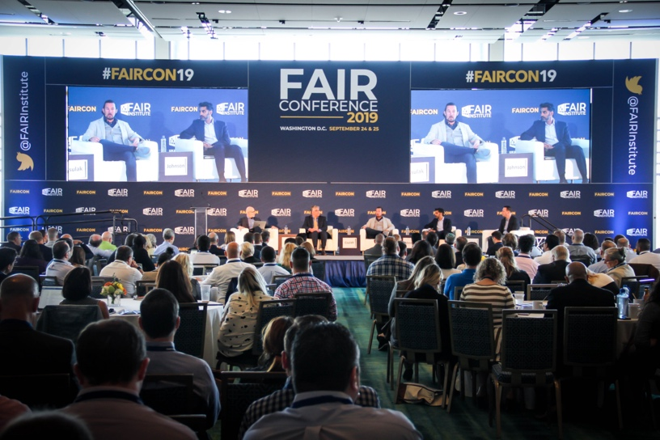
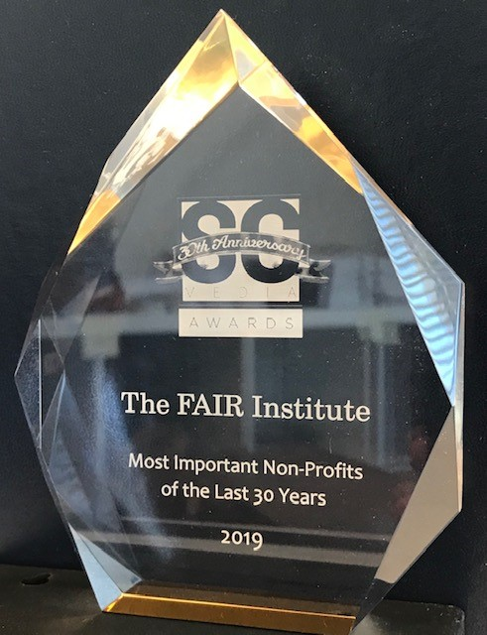


THE FAIR INSTITUTE
14,000+
Members Worldwide
“One of Three Most Important
Industry Organizations of the Last 30 Years”
SC Magazine
49%
Fortune 1000
23
Local Chapters
20
Universities
Teaching FAIR
10,000+
FAIR Trained
1000+
FAIR Certified
FAIR accredited as an
Industry Standard by
Complementary to
Risk Frameworks
FAIR Book Inducted in
the Cybersecurity Canon

Slide 5
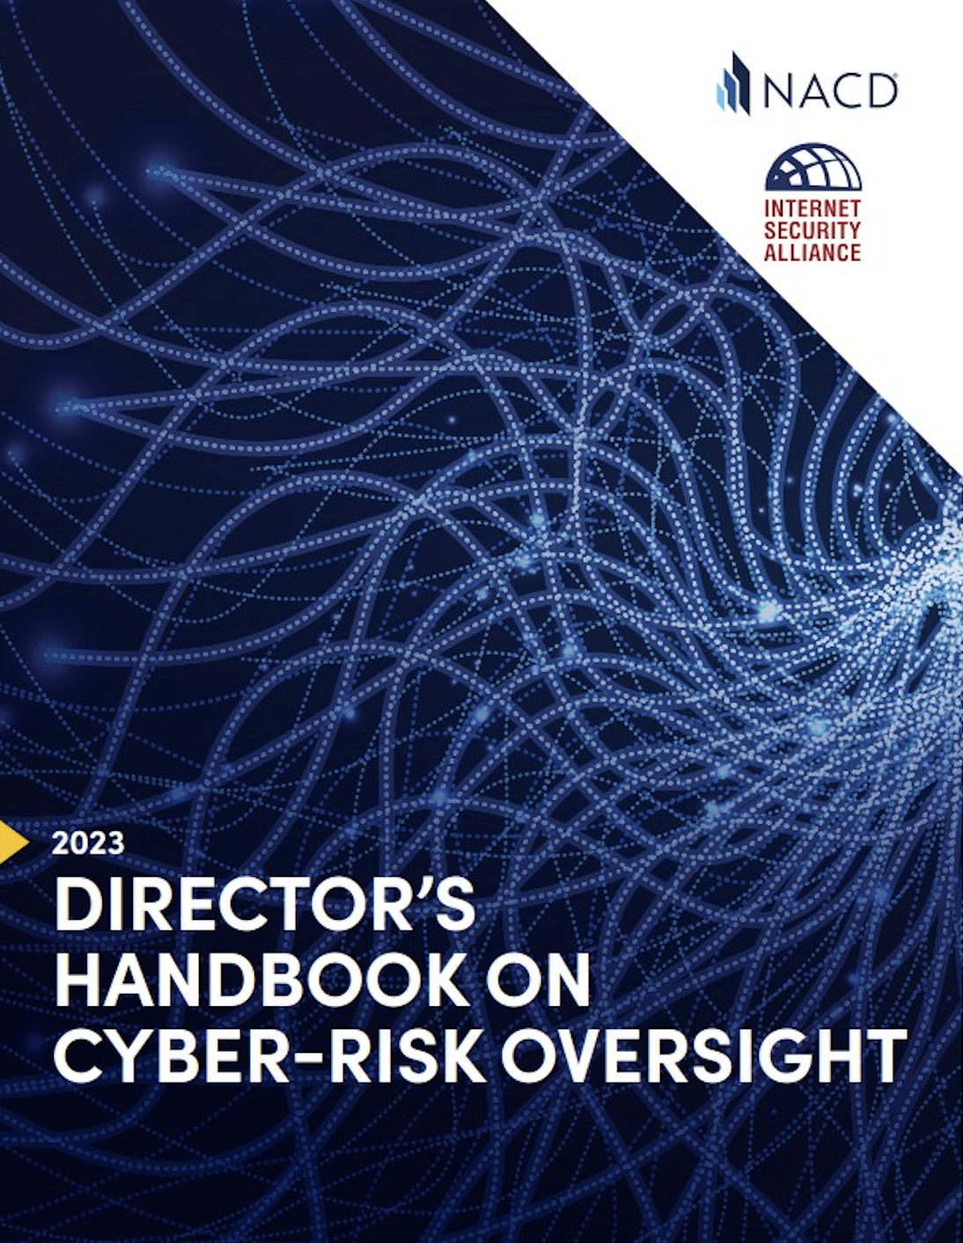
Cyber Risk Oversight – 6 Core Principles
Cyber is a strategic, enterprise-wide issue, not an IT issue
Boards need to understand their unique legal obligations
Boards need to access adequate cyber security expertise
Management needs to provide a cyber security framework (technical and management)
Management must assess and report risk
Boards should encourage systemic resilience and collaboration
Notes:
One of the resources that we will speak about today is the Cyber risk oversight handbook that is published by the NACD and ISA, of which I am on the board of.
The intent of the handbook is to help boards of directors and government oversight agencies fulfil their risk oversight and governance obligations
We need to stop pretending that directors and government officials become technical cybersecurity experts
Corporate boards don’t do cybersecurity management. Management does. Boards do oversight. We want to talk about that handshake that needs to happen between directors and management
Instead of asking them to speak our technical language, let’s learn their language.
What do corporate and government board want to talk about
They want to talk about innovation, revenue and earnings, resilience, M&A,…
We need to explain how cyber risk affects their issues, so they understand the implications of investing or not in cybersecurity, in terms they can understand…. Typically financial/economical terms…
This Handbook is significant as it documents 6 core principles that will help organizations manage cybersecurity risk, from the business and policy perspective, and not just from a technical one.
Number one, cybersecurity is not a technical issue, it is an enterprise-wide risk management issue, a strategic business issue, which is much larger, and need to be treated as such
This might be obvious for many on our FAIR circles, but outside of it, this is not an established principle: too many orgs are still seeing cyber risk as merely an IT issue
In some US agencies they may have hundreds of cybersecurity specialists and only 1 economist looking at the possible impact of these issues… we need to clearly rebalance this
What FAIR does at the organizational level, we need to do at the policy level
2nd
3rd
4th and 5th principles I want to focus on, that I helped author

Slide 6
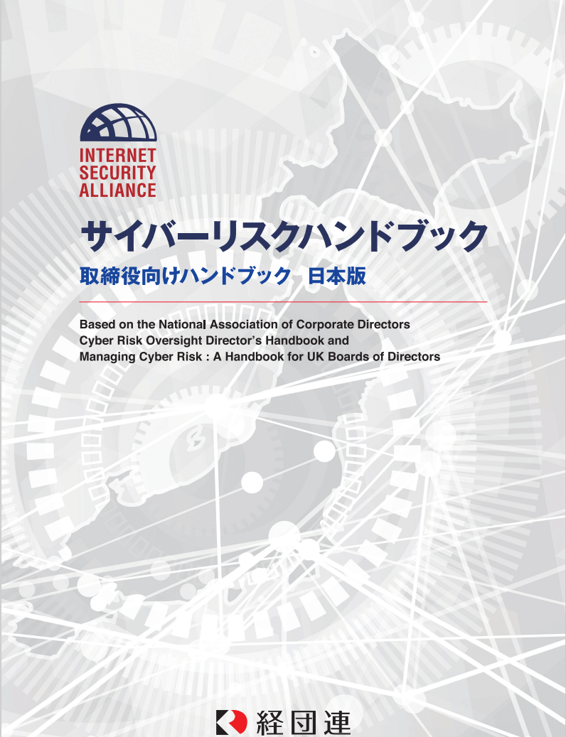
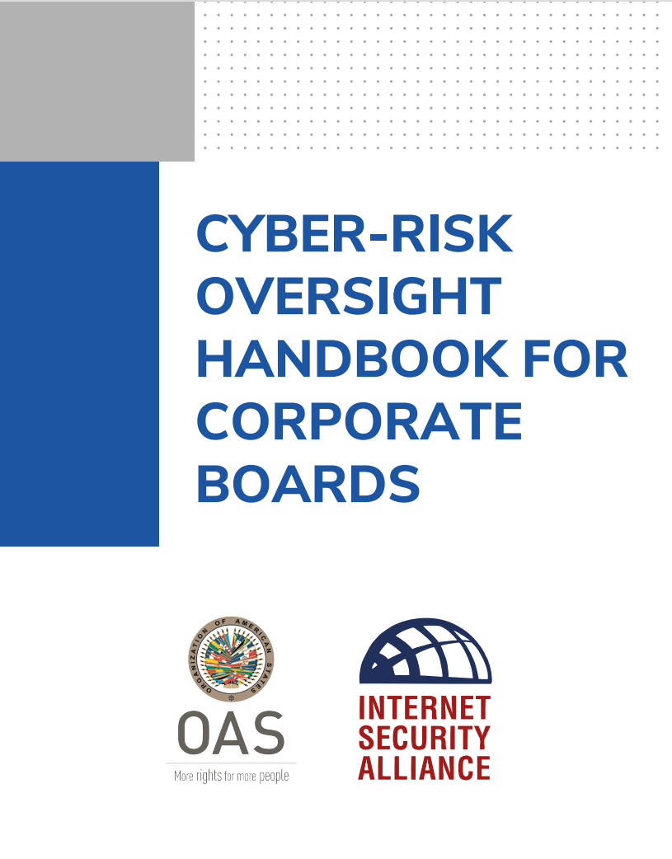
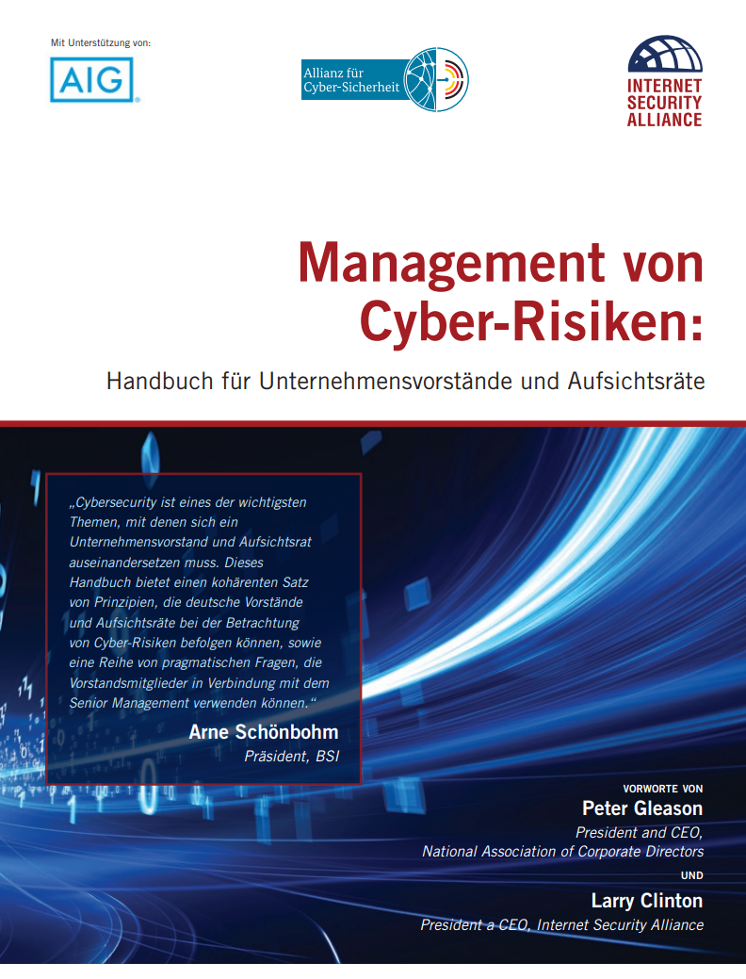
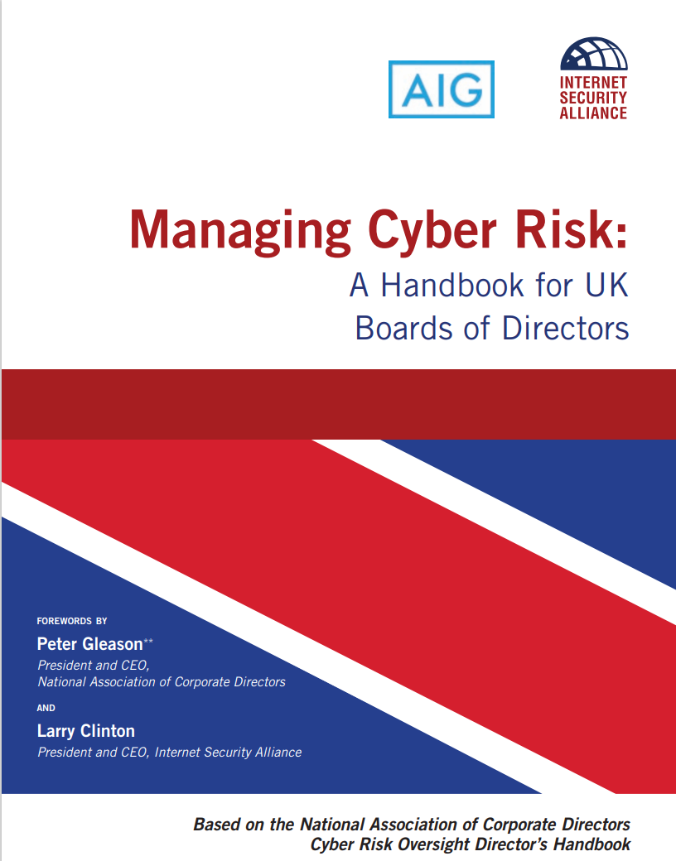
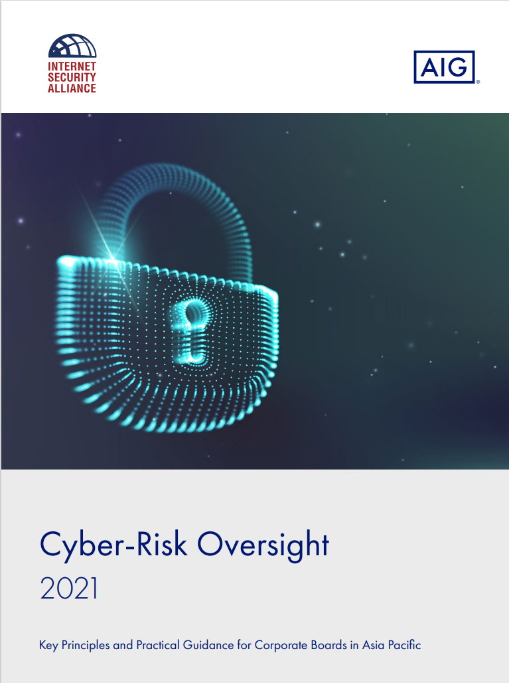
International Versions

Slide 7
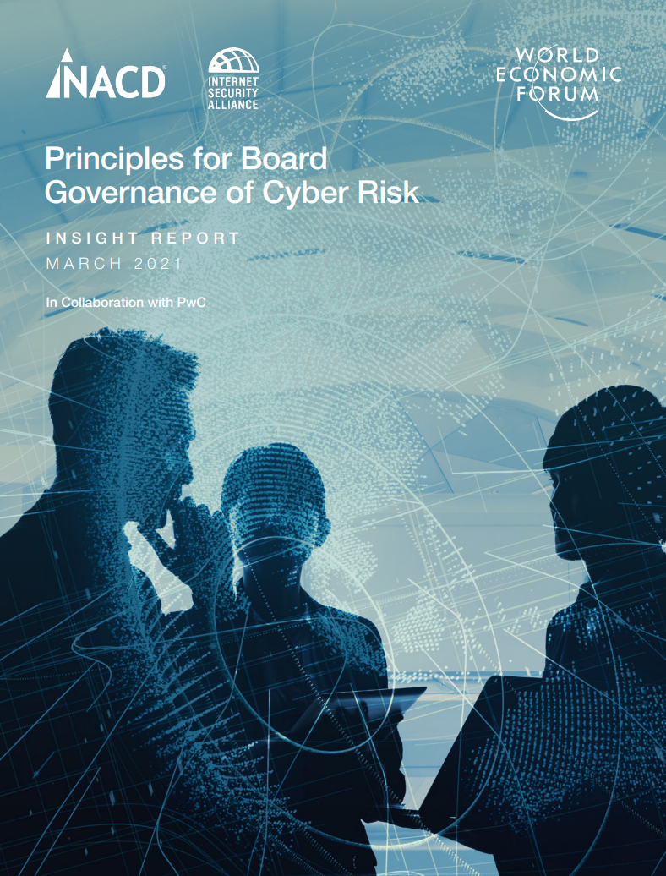
Industry & Gov Support for the Handbooks
National Association of Corporate Directors
Internet Security Alliance
Center for Audit Quality
European Conference of Directors Associations
Cyber Security Council of Germany
Japanese Federation of Businesses
Association of Indian Telecommunications and Infrastructure
US Department of Homeland Security
US Department of Justice
German Federal Office of Information Security (BSI)
Organization of American States
Notes:
WEF!

Slide 8
PwC on Handbook Effectiveness
"Boards appear to be listening to this guidance. This year we saw a double-digit uptick in Board participation in most aspects of information security.”
“As more Boards participate in cyber security budget discussions, we saw a 24% boost in security spending.”
“Other notable outcomes include identification of key risks, fostering an organizational culture of security and better alignment of cybersecurity with overall risk management and business goals “
“More than anything, board participation has opened the lines of communication between executives and directors treating cyber security as an economic issue.”
Notes:
Here is what PwC, an independent audit form found out in their 2022 survey board survey on cyber risk.
(…)
These Handbooks are now the #1 publication at NACD and surpassed director compensation
So, now, we are making some inroads with FAIR at the organizational level and with NACD at the board level.
What is left to do?

Slide 9
The Fifth Domain, R. Clarke & R. Knake, Penguin Press 2019
Little Change in Cybersecurity Strategy
“(In the last 30 years) our cybersecurity strategy has changed very little…companies that own and operate the internet will be responsible for protecting themselves. Government’s role will be limited to support the private victims of cyber-attacks with law enforcement, information sharing, diplomacy and in the rare cases military force.
Government also help industry help itself through nudges to encourage investment and cooperation in cybersecurity through research training convening and ultimately through regulation.”
Notes:
We have a massive cybersecurity problem at national levels.
In an excellent book by Richard Clark, cybersecurity advisor to president bush and Clinton, and Knake for Obama,,…hey said:
(...)
You would think this is a good strategy, isn’t it

Slide 10
How Bad is it?
Cyber Crime costs $ 2.2 Trillion a year, rising to $ 10.5 T by 2025
Director of US National Intelligence reports Cyber attacks are a larger threat to the USA than international terrorism
Nation States regularly and successfully attack each other
Notes:
This is where this strategy has gotten us…
(…)
Maybe it’s time to come up with a new strategy, since this one doesn’t seem to be working and work with government to do so

Slide 11



Cybercrime vs. Nation-State Revenues
$6 T
$4.45 T
$3.42 T
Notes:
A lot of people do not know that the cyber crime nation is growing 10% a year
If it were to be seen as a nation, it would be par tof the G8
So, we want to ask ourselves: “what is the essence of the problem?”
“Are we asking the right questions?”

Slide 12
We Are Not Asking the Right Questions
86% of cyber attacks are economically motivated
(Verizon DBIR)
Overwhelming focus of cyber policy has been on the technology – the HOW of cyber attacks
To solve the problem, we need to address Economics – the WHY of cyber attacks
Notes:
The overwhelming amount of cyber attacks are not based on the technology, they are based on the economics (even when they are politically motivated).
According to the Verizon study 86% of attacks are economically motivated
When the Russians were trying to influence the outcome of the US election it was for geopolitical profit…
We need to get governments to understand cyber risk as part of an economic calculation.
If we can get them to understand this, similarly to how many private organizations have done already with FAIR, we can get to a more enlightened government policy.
Analyzing technology without considering economics is as misguided as analyzing economics without considering technology
Here are some examples

Slide 13
Is Our Infrastructure Vulnerable? YES!
Is that the Essence of the Problem? NO.
The Internet was built vulnerable – it’s an open system
The system is getting technically more vulnerable all the time
New business practices create new vulnerabilities (excited about AI?)
But Cyber is not alone – water/food/transport are also vulnerable
Avg # of malicious code Microsoft discovers every month:
77,000
Notes:
The Internet was built vulnerable – it’s an open system
The system is getting technically more vulnerable all the time - technology VOIP/Cloud/mobile devices
The business practices create new vulnerabilities – BOYD/long international supply chains/web-based marketing and remote employees
But Cyber is not alone – water/food/transport also vulnerable
Why don’t we hear about the attack on these guys? Because there is no money in it.
The attacks go where the money is

Slide 14
Mis-Aligned Incentives
“Security failure is caused as least as often by bad economic incentives as by bad technological design. Economists have long known that liability should be assigned to the entity that can manage risk.
Yet everywhere we look we see online risk allocated poorly… People who connect their machines to risky places do not bear full consequences of their actions. And developers are not compensated for costly efforts to strengthen their code.”
Anderson and Moore’s Economics of Information Security
Notes:
Anderson and Moore… say…
(..)
In the private sector, there is not always a market for secure apps… we prefer cheap, fast, etc…
Again, The incentives are mis-aligned

Slide 15
Cost of Entry for Cyber Crime is Low
Go on the Dark Web and …
You can “buy”(outsource) a DOS attack for apx $500
You can “buy” access to corp. mailboxes for apx $200
You can “buy” fake Instagram/Twitter addresses for apx $100
Tutorial on how to conduct email attacks -- $25
Purchase a Template to conduct the attack -- $3
Creating a “dummy” retail website -- $24.43 – creating a dummy banking website -- $67.91
Notes:
Another thing we need to realize is that the economics of cybersecurity favor the bad guys
The entry level for cyber crime is incredibly low
(…)

Slide 16

Cyber Criminals Invest in the business
Cybercriminals at the high-end are as technologically sophisticated as the most advanced IT companies and like them have moved quickly to adopt cloud computing, artificial intelligence, and encryption.
Notes:
Cybercriminals are highly organized and act as sophisticated enterprises…
(…)
Then there are nations-state that are putting vast amount of resources in play

Slide 17
Bottom Line on Cyber Crime
“Cyber crime is relentless, undiminished and unlikely to stop. Its just too easy rewarding and chances of getting caught are far to low.
It’s a low-risk crime with high profits. A smart cybercriminal can easily make millions without fear of being caught.”
McAfee Cyber Crime Report
Notes:
“Cyber crime is relentless, undiminished and unlikely to stop. Its just too easy rewarding and chances of getting caught are far to low.
Cybercrime also leads on a risk to payoff rate. It’s a low-risk crime with high profits. A smart cybercriminal can easily make millions without fear of being caught.”

Slide 18
WE Need to Understand cyber from an Economics Point of View – like FAIR/NACD
Cyber is NOT just a technical issue
We need to understand our legal obligations
We need to access adequate cyber expertise
We need to do sophisticated cybersecurity risk assessments – empirical and economics based
Need a clear strategy
We need to work together – beyond our boundaries
Notes:
We need to understand cyber crime and cyber attacks from an economic point of view at the policy level
(…)
We need governments to adopt the same principles that the FAIR Institute, NACD, and the WEF have adopted
Here are some example of possible policy focus areas

Slide 19
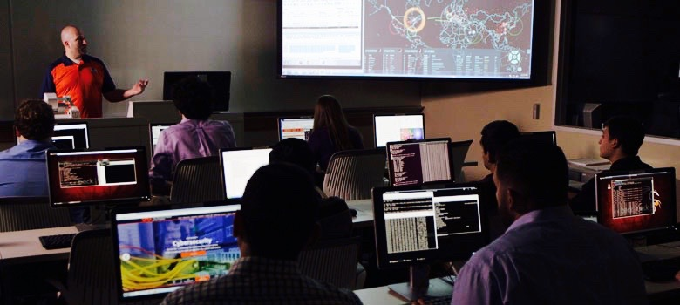
Example 1 – Workforce Development
Establish National Cyber Training Academies
  Teaching both the technical & management frameworks for cyber risk
Notes:
Huge shortage in cyber risk professionals: in US, from 1M shortage to 3M
Government cannot hire sufficient cyber experts
This is a supply and demand problem
To solve this we need to inject an economic stimulus
This is a unique area of warfare (see Ukraine) and we do not have enoughh people mobilized
Governments need to create cybersecurity training academies
This is a unique area of warfare, like air fights in WWII
Create the incentives for student to adopt this, with free tuition or scholarships funded by the government… this is like military mobilization
This will help solve the recruitment problem of both gov and private sectors
Again, we need to look at this from the economical point of view, not just technical

Slide 20

Example 2 – Protecting Critical Infrastructure
The essence of the issue
Private entities financing security at a commercial level
Governments assessing risk on a different basis
We need a new system of economic incentives that closes the gap
Notes:
Yes, digitalization is making the cybersecurity problem bigger in critical infrastructure
But, The problem we have with securing the infrastructure is an economic issue
Companies are required to provide for their own security, at a commercial level
In physical security, everybody knows that 10% of inventory goes out every month in theft… why don’t they hire more guards… because it would cost them more than that 10%
So we have critical infrastructure secured on.a commercial basis
The government has a much higher level of security requirements – based on national security policy on a non-economic level– that is based on privacy, national security, critical infrastructure protection,
So, we have a gap between what we are funding for our critical infrastructure at a commercial level and what we need to, because in the cyber world we use the same systems, and these systems are under nation-state attack
We need to close the gap between commercial level security and national level security and we need to do it on a sustainable basis
Some in gov say let’s just off-load this to shareholders… The consequence is that those higher costs will lead to shareholders leaving
We need to find a fundamentally different way to go about this. We need to find a set of economic incentives that can get our economy going and protect our critical infrastructure
Again, we cannot just look at protecting critical infrastructure from a technical perspective but we need to look at it from an economic perspective

Slide 21
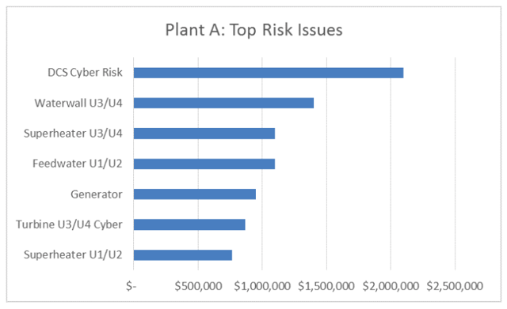
Example 3 – Regulatory Reform
Current model is focused on technical compliance
Mandate cyber risk assessments to factor in economical considerations
Notes:
The essence of the problem: we have cyber attacks that are constantly morphing, technologies constantly changing, the attack vectors changing, the threat actors are constantly changing
The traditional regulatory model is a bad fit for this
The traditional regulatory model is backward looking, check the box model, that is insufficiently dynamic and doesn’t work. We did it because that was all we had
Our regulatory reform proposal: let’s take sophisticated cyber risk assessment methods, like FAIR and mandate that
We need to make sure that every organizations makes a sophisticated, economically driven, cyber risk assessment that blends into their business plan
That is what we need to expect from organizations, because they have to run the business
That will give us a clear idea on the severity of cyber risks that we face and can assess the adequacy of our responses and cybersecurity spend: what is necessary to run the business at a successful level?
If that level of security is not adequate for national security purposes, then we need to provide incentive to fill the gap

Slide 22
Winning the Battle in Cyberspace
It will take all of us working together and align
technology, economics and government policy
Notes:
FAIR is changing the discussion on how risk is measured and managed at an organizational level
But to affect change at a national level, and to get a chance to win the battle in cyberspace, it will take all of us working together:
tech companies, academia and government.
I challenge you to work with us and all other key players in the space to align, tech, economics and government policy
Thank you very much

