Slide 1
From Legacy to Leading Edge: Harmonizing Risk Assessment Approaches
Adam Lamantia, Director @ Ostrich Cyber-Risk
John Feezell, Director, Risk Advisory Services @ Kyndryl
Penny Longman, Director, Security Assurance Services @ Kyndryl
Notes:
From Legacy to Leading-Edge: Harmonizing Risk Assessments - Transition from legacy risk assessment techniques to leading-edge practices while maintaining harmony and consistency.

Slide 2
Meet Your Speakers

Slide 3
Tell us a little bit about your cybersecurity and cyber risk quantification journey.
Notes:
Before we dive in, I’d like to get to know you a little better...tell us a little bit about your cybersecurity and cyber risk quantification journey

Slide 4
Why is it so important to combine qualitative and quantitative risk approaches?
Notes:
Why is it so important to combine qualitative and quantitative information?

Slide 5
Biggest roadblocks?
Notes:
Biggest roadblocks to doing that work?

Slide 6
What are the external data sources you think are the most impactful?
Notes:
Two part question - First, with risk work, what are the external data sources you think are the most impactful?

Slide 7
How about internal data sources?
Notes:
How about internal data sources?

Slide 8
How granular of a look should you take towards your control posture?
Notes:
How granular of a look should you take towards your control posture?

Slide 9
What are the pros and cons of doing control assessment work yourself vs pulling in consultants?
Notes:
Pros and Cons of doing that control assessment work yourself vs pulling in an outside consultancy, like Kyndryl?

Slide 10
Tooling?
Notes:
Lets talk about tooling...my bias is obviously X...how do you feel about bringing in tooling?

Slide 11
How do the assessment outputs drive actionable results?
Notes:
I have a strong bias towards actionable information and not doing something 'just to check the box'...what kinds of outputs are going to resonate best with this risk assessment process?

Slide 12
Who are the typical consumers of assessment results and how should this inform changes to the narrative?
Notes:
Who are the typical consumers of assessment results and how should this inform changes to the narrative?

Slide 13
How often should these scenarios and assessments be revisited?
Notes:
How often should these scenarios and assessments be revisited, recognizing the need to balance time and value from the work?

Slide 14
Key Takeaways From Today’s Session
Notes:
Consider adjusting your risk approach to be more inclusive of both qualitative and quantitative consumers in the organization.
Depending on where you're at in your journey: request a free 30-minute consultation to discuss your business
-Request Demo of risk management tooling like Ostrich to help inform your planning

Slide 15
Q&A
Notes:
Who are the typical consumers of assessment results and how should this inform changes to the narrative?

Slide 16
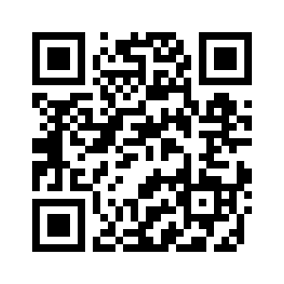
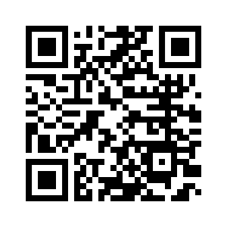
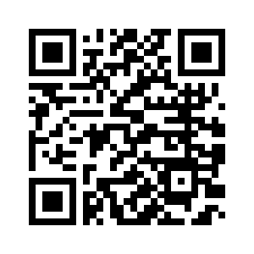
Connect With Us On LinkedIn

Slide 17
Learn more about Birdseye™

