Slide 1





Approach and Lessons Learned From Building a Cyber Risk Quantification Program
David Steng – Director Cyber Risk & Economics, Fresenius Group
Ferhat Yazgili – Sr. Cyber Risk Manager, Fresenius Kabi

Slide 2







The Fresenius Group is a global healthcare group advancing patient care.
Operating Companies
Investment Companies
Fresenius Kabi supplies healthcare products for critically and chronically ill patients.
‘22 Sales: 7,850 €m
Fresenius Medical Care offers dialysis products and services
‘22 Sales: 19,398 €m
Fresenius Helios is Europe’s leading private hospital operator
‘22 Sales: 11,716 €m
Fresenius Vamed specializes on project business and management of healthcare facilities
‘22 Sales: 2,359 €m
Global Healthcare Group | > 300,000 employees | > €40 billion annual sales
see: https://www.fresenius.com/group-overview

Slide 3




Protecting the entire digital ecosystem across the patient health journey is key to secure products and services and enable business performance.
Home
Dialysis
Internet of Medical
Things (IoMT)
Telehealth
Care
Our Vision
We are always
ahead of cyber threats.
Process
Automation
Prevention
Diagnostics
Therapeutics
Recovery
Wellness
We provide secure products and services to our patients and customers.
MedTech
Digital
Rehabilitation
We secure our digital ecosystem to enable business performance.
Artificial
Intelligence
Our Dual-Mission
Electronic
Patient File

Slide 4

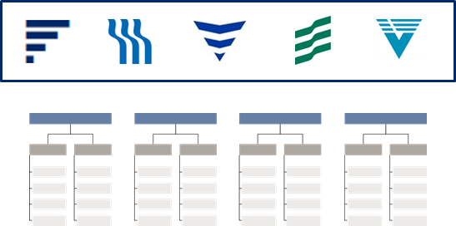
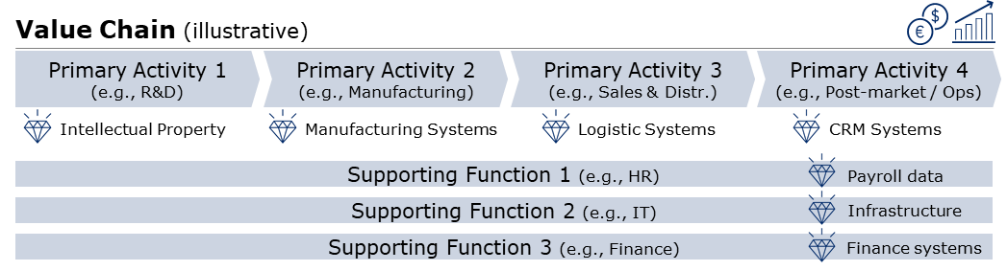
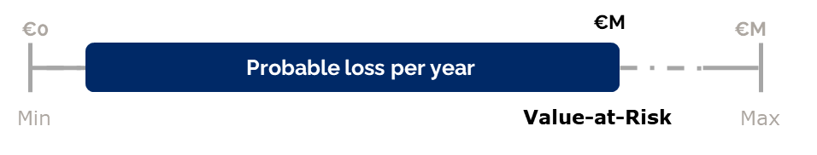
Paving the way for risk-based decision making – the evolution at Fresenius
Selective Efforts
Establishing the Fundamentals
Risk-based Decision Making
Individual risk management approaches across segments, regions and divisions
Varying skills, maturities and technologies
No proper reporting of Cyber risks, if at all
Cyber risk considered as IT risk
Group-wide Cyber Risk Management Framework (principles, roles & resp., taxonomy, process, etc.)
Business-focused cyber risk categories and cyber risk scenarios (threat actor > threat > asset > consequence)
Integration of cyber risk management into enterprise risk management
Cyber risk considered as business risk
Quantitative risk assessments along the value chain by prioritizing key cyber threats against most critical assets
Enabling decisions on risk buy-down and resilience to support organizational objectives
Advising the business as a “trusted advisor” to improve overall risk exposure
Mandatory (cyber) risk quantification with “EBIT @ Risk” reporting into risk committee

Slide 5
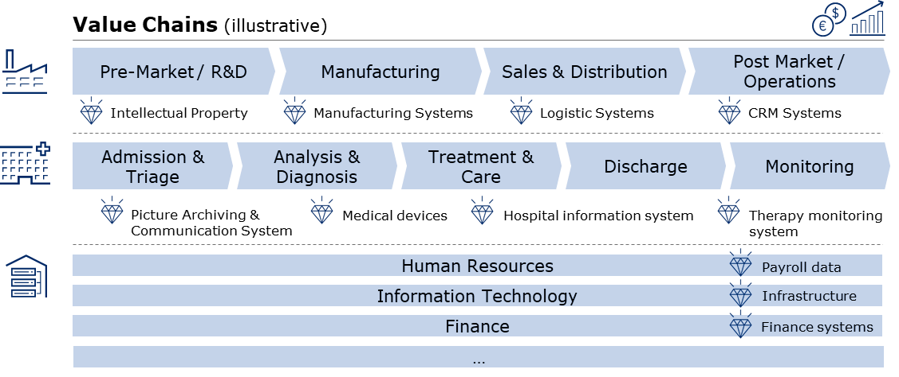

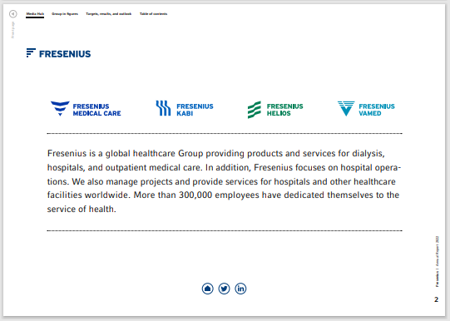
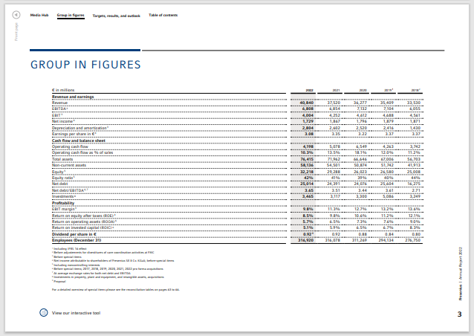
Step 1: Understand the business and how it generates value
Annual Report
Talk to business executives and about “nightmare scenarios”
Critical process / asset candidates

Slide 6
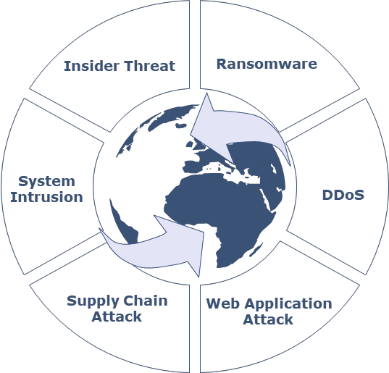










Step 2: Define meaningful cyber risk scenarios: threat + asset + consequence
Understand the Threat Landscape
Map threats to critical & commodity assets
Articulate the consequences
Illustrative assessment scope
Disruption of:
manufacturing operations
logistics or supply chain processes
health facility operations
IT operations
Value Chains
Patient systems
IT systems
R&D systems
Disclosure/theft, manipulation or inaccessibility of:
IP or sensitive business information
personal or patient data
Endpoints
Bi-annual cyber threat intelligence analysis describing top threat, common attack vectors & TTPs
Mapping of key controls against threats across “cyber kill chain”
Clear guidance for prioritized control assessment against baseline
Leverage identified critical assets candidate across value chains
Conduct business impact analyses to determine actual asset criticality and primary security objective(s)
Map threats to assets
Example
Cyber criminal performs ransomware attack against endpoints causing disruption of health facility operations

Slide 7
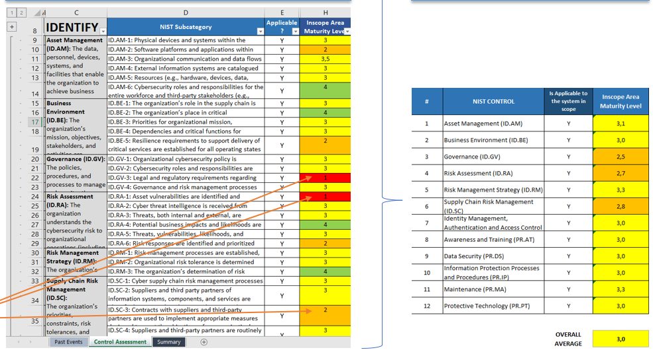
Step 3: Estimate the loss event frequency
NIST CSF Assessment
Resistance Strength
Historic incidents
Control assessments
Threat intelligence analysis (int., ext.)
Cybersecurity issues
Control Framework (e.g., NIST 53 rev. 5)

Slide 8
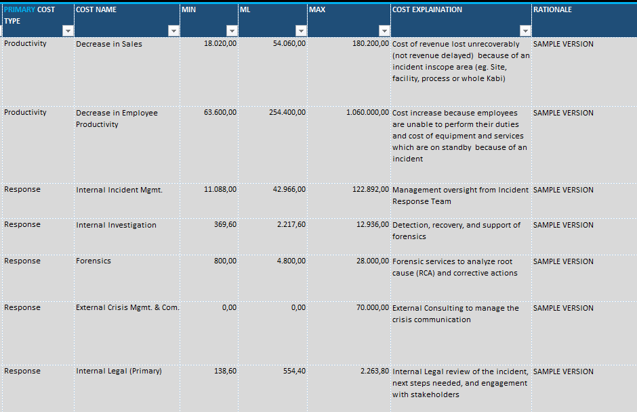
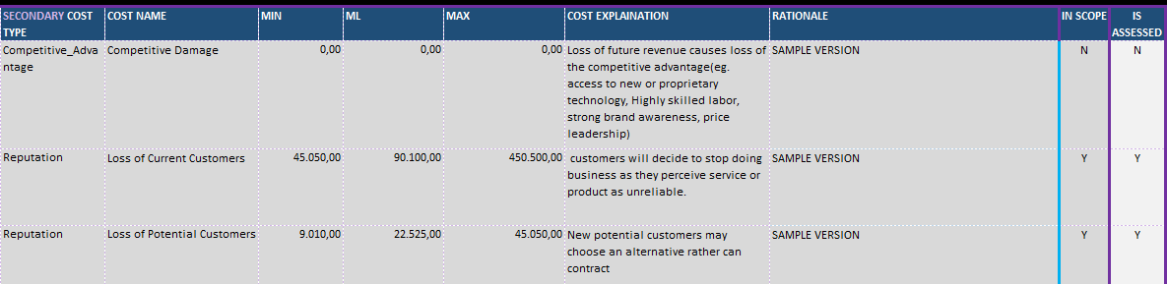
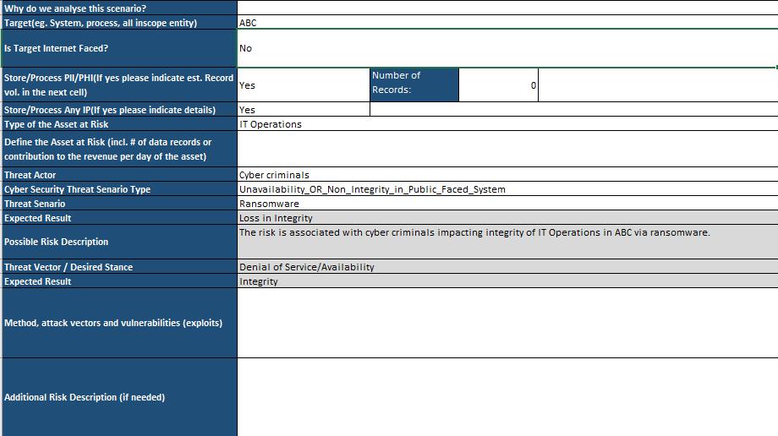
Step 4: Estimate loss magnitude
Post-incident business impact analyses
(“loss event database”)
Determine key cost drivers (e.g., loss of productivity)
External studies and reports on business impacts

Slide 9
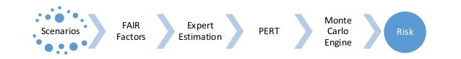
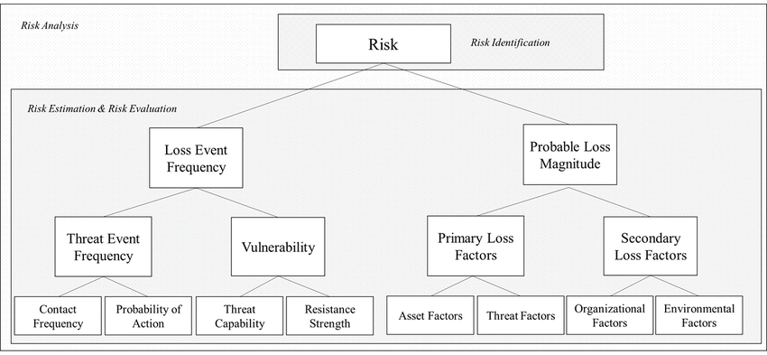


Putting it all together: Our quantitative risk estimation
Threat Intelligence
(internal, external)
Loss event database (historic impacts)
Control strength
Key cost drivers
Loss event database (historic incidents)
External studies & reports
Cybersecurity issues

Slide 10
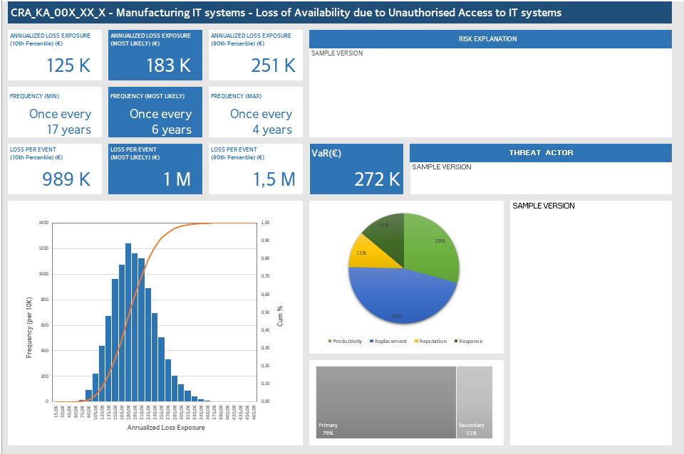
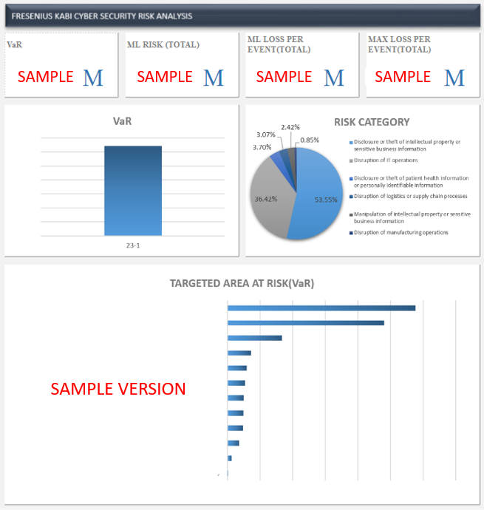
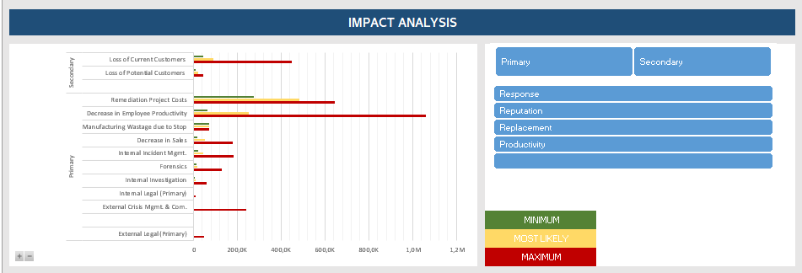
Exemplary risk quantification outputs – Single risks and consolidated risk report.

Slide 11
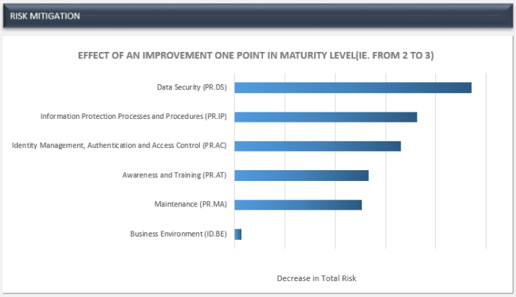
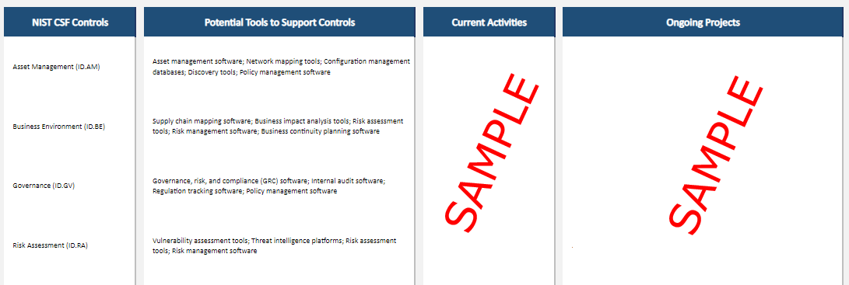
Cyber risk quantification enables meaningful measurements, effective comparison and ultimately supports decision making.
In-depth understanding and articulation of the cyber risk exposure (i.e., business risk)
Meaningful measurement and effective comparison
Improved discussions about the prioritization and effectiveness of investments
Enhanced risk accountability and more focused risk buy-down

Slide 12
Challenges of adopting cyber risk quantification
Initiation
Planning
Execution
Monitoring
Closing
Initiation
Lack of executive sponsorship
Unclear objectives
Organizational complexity
Planning
Understanding and quantifying the organization’s risk appetite
Defining fundamental for an effective risk management
Consider CRQ as a product, not a project
Execution
Training and calibration of cyber risk managers and subject matter experts
Resistance to change
Complexity of risk factors
Difficulty in assessing non-financial impact
Coordination with other teams
Integration into existing processes (e.g., ERM)

Slide 13
Lessons learned
Understand your business model, its value generation and strategic objective – Speaking the same language as executives will allow you to be considered as “trusted advisor”
Closely align cyber risk management with your enterprise risk management - Cyber risk is a business risk and requires visibility (pull-effect towards quantification)
Build meaningful risk scenarios (threat + asset + consequence) that attempt to solve clearly defined use cases – There no value in quantifying anything and everything
“There’s not enough data” – Actually there is. Build a loss event database, involve your finance organization and gather useful insights from external studies.
Consistency is key – Clearly document rationales of estimates to ensure traceability, consistency and comparability over time, while building trust and educating stakeholders.
Organizational change requires time - Pitch CRQ at every useful occasion to show its value

Slide 14





Thank you for your attendance!
We’re happy to answer any questions and would be glad to connect!
David Steng
Ferhat Yazgili

