Slide 1
Closing Remarks
Cybersecurity – A Tier One Risk
Tony Morbin
Executive Editor EU
Information Security Media Group (ISMG)

Slide 2
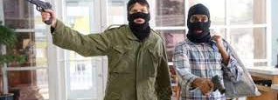
Because that’s where the money is
Except today, everything, from money, to data, information and critical infrastructure is online

Slide 3
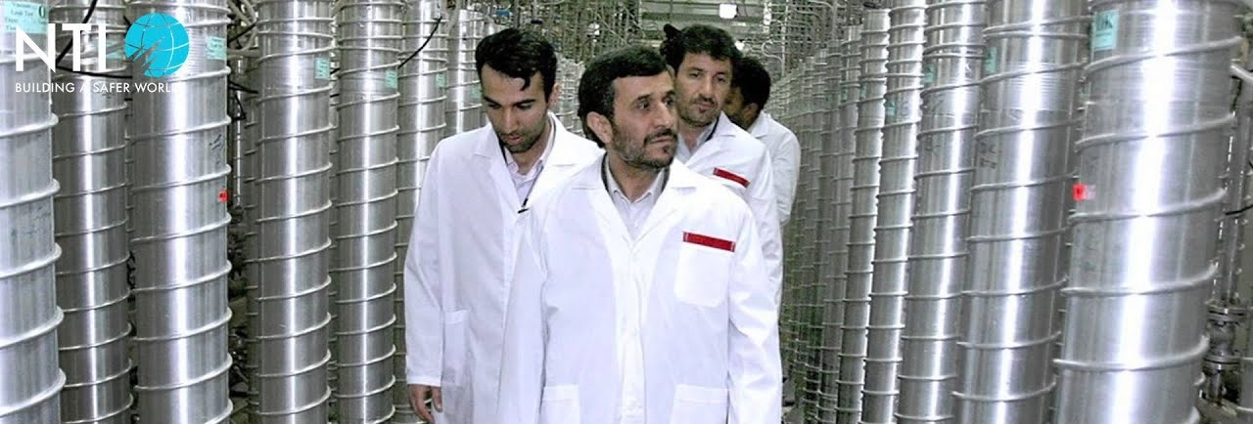
Iran’s Nantanz nuclear power station – hit by stuxnet
Connected critical infrastructure is under threat

Slide 4
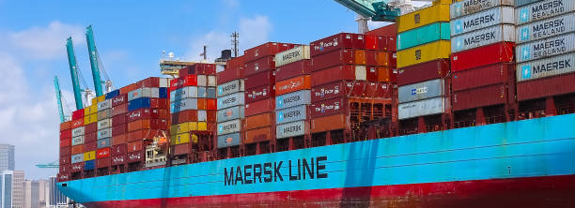
Wannacry caused collateral damage Globally
Even if you are not a target you can still be hit

Slide 5

Potential GDPR fines incentivize investment in cybersecurity
Regulatory compliance sets minimum standards but does not ensure security

Slide 6
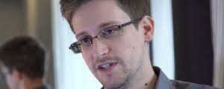
Even the NSA can get privileged access wrong
Which of the Snowden era errors are we still living with?
https://www.youtube.com/watch?v=QlSAiI3xMh4

Slide 7
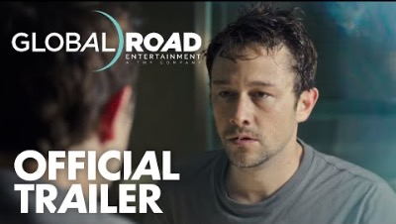

Slide 8
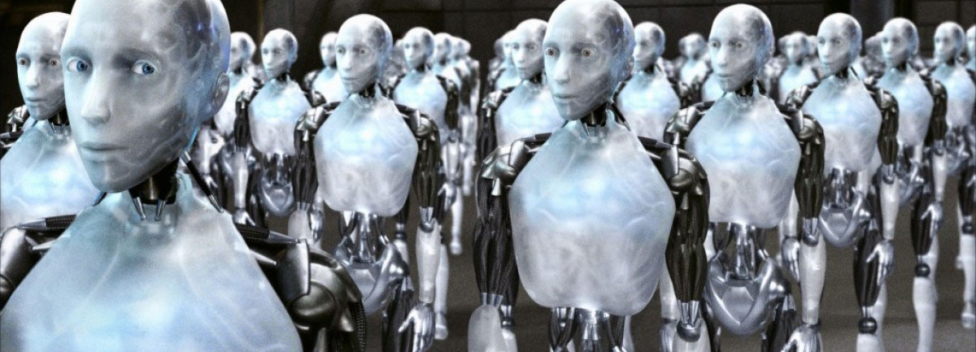
AI attacks have already become A reality
Can we regulate security into superintelligent AI to prevent it being a threat?

