Slide 1
Winning over the doubters
Cutting through complexity to exceed stakeholder expectations

Slide 2
Agenda
Fear factor: it’s too complex!
RISK EXPOSURE
Loss Event Frequency
Loss Magnitude
Managing inflated expectations
Threat Event Frequency
Susceptibility
Primary Loss
Secondary Loss
Secondary Loss Event Frequency
Secondary Loss
CRQ takes too long
Notes:
This presentation is all about communication. Not just to senior management, but across a range of stakeholders.
MC has integrated CRQ into their ERM framework – this is a transformational change, and the successful adoption has been facilitated by top down sponsorship communication, training and awareness. Another core principle of successful change is addressing objections. Today we will share the top 3 stakeholder concerns we have encountered (and how to manage them)
Fear Factor – complexity. Perception CRQ is too complex and the output is not correct . Some people assume the model is too complex and therefore must ‘be snake oil’.
Managing inflated expectations – Assumption it is precise model which predicts the future rather than a risk analysis which is future looking forecast.
CRQ is too much Effort – takes long, too much effort due to insufficient data

Slide 3
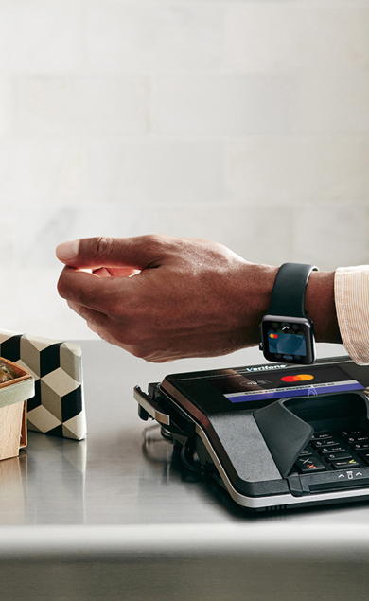
About Mastercard
5
82
130+
26,000+
Continents
Countries
Office locations
Employees
We power transactions in more than
$90.1 Billion
$6.5 trillion
One of the world’s largest data sets
150 currencies and 210 countries
Transactions switched
Gross dollar volume
Notes:
If that excites you, come join the global powerhouse that is Mastercard.
Did you know we are the 12th most recognized brand in the world!!
Our organization brings colleagues from different functions together to work toward accomplishing our mission.
​
As you can see:​
​
We’re a quickly growing organization of more than 26,000 employees​
And we’re making a local impact on five continents that each hosts a regional HQ​
Our colleagues work in more than 130 office locations to support the growth of our business in over 210 countries and territories​
And..
We power transactions in more than 150 currencies in 210 countries
Nearly 3,000 transactions are switched per second​
And Mastercard has one of the worlds largest datasets.
​

Slide 4
FAIR at Mastercard
Risk oversight: Board and committees
Global team of FAIR certified risk professionals
Integrated process with Mastercard's ERM Framework (right)
C-Level reporting that informs Mastercard Board
Supports regulatory obligations
Strategy
Risk governance structure (3 lines of defense)
Risk Identification/ Risk Assessment
Risk Taxonomy
Risk Appetite
Policies and Procedures
Strategic Operational Legal/Regulatory Financial
Risk Appetite Statement
Approach to identify, measure, respond, monitor and report risks
(Principles by each key area of risk company faces)
Corporate Policies/ Procedures
Risk Appetite Metrics and Limits
(Establish risk management principles and controls to manage our risks)
(Quantitative articulation of level of risk the company is willing to take by category)
Risk Exposure
Loss Event Frequency
Loss Magnitude
Threat Event Frequency
Susceptibility
Primary Loss
Secondary Loss
Secondary Loss Event Frequency
Secondary Loss
Notes:
Mastercard journey began in 2018-19 with an excel based FAIR model developed to quantify some of the organisations biggest risks
Starting with just two people, the approach over the next 4 years developed into a global risk assessment and analysis practice with 11 team members, 40 people trained on the approach, procured tooling and a partnership with C-RisK
Global team -> FAIR training, standard loss models aligned to business, presentation templates, use case (services) definition, continuous training. Integration of operational technology risk in addition to cyber.
ERM -> MC level of awareness and focus on tech risk is industry leading. ERM model incorporates FAIR for cyber and tech and integrates it into the boarder ERM model.. We have applied CRQ principles into the boarder model.. with increased clarity on risk definitions and consistency

Slide 5
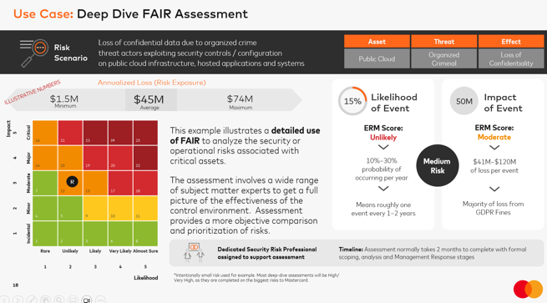
Overcoming the fear factor
“Risk quantification is complex and scary, how can I explain this approach to executives?“
Adapt the presentation to the audience and use case
Use visuals to bring assessment to life — it does not have to be complex
Tie back to standard industry heat maps while demonstrating that FAIR helps avoid their pitfalls
Align KRI’s to FAIR and show opportunities to manage
Notes:
CRQ is not just about the output such as ALE or distribution.
It is a solid scoping taxonomy, a standard model reflecting how controls impact risk, the concept of ranges reflecting uncertainty, the ability to apply valid stats and maths on each variable in the model. (no fake maths on ordinal scales)
What happens when we present a CRQ Risk assessment to an audience used to a qualitative approach (HML): Stakeholders latch onto or focus on one number.. this leads to.. Challenge of that single number. Some examples. how did you derive a 15% Most likely LEF? When wide ranges exist rather than accept this is a reflection of uncertainly it can be considered a weakness in the model.
How do we address these concerns? Adapt output to the audience and use case. Keep it as simple as possible... it is not how the sausage is made that counts but how it tastes Have some industry examples to hand to defend numbers We present results using a combination of a heatmap AND ranges of LEF/LM. We also map the CRQ output back to the ERM standard definition. ALE is used sparingly and always in conjunction with other metrics..
Include drivers of risk and opportunities to reduce risk.. this is what matters most to stakeholders… LEF/LM then inform decisions about these..Now we will address a different reaction where stakeholders believe we can predict the future…

Slide 6
Managing expectations
“The model is not precise...”
“It’s the wrong distribution...”
“It's too high level/too detailed…”
Report numbers as no different than a financial forecast
Avoid “death by statistics” — no need to explain distribution types or number of monte carlo simulations

Slide 7
CRQ just takes too long
“We don’t have the data.”
Standardised Risk Assessment Services
Risk Intelligence model aligned to business
Continuous Improvement via Training
Don’t let perfection be the enemy of good enough; build wide scenarios
“FAIR takes too long to support decision-making in a timely manner.”

Slide 8
Takeaways
1
2
3
Communication, sponsorship and continuous learning is key
Integration with an Enterprise ERM framework is achievable
CRQ can be performed as quickly as qualitative methods
Accurate Model
(FAIR)
Meaningful Measurements
Effective Comparisons
Well-Informed Decisions
Effective Risk Management

