Slide 1
USING THE FAIR MODEL FOR RISK-BASED ACCOUNTABILITY
Luis Enríquez
Professor at Université de Lille,
and Universidad Andina Simón Bolívar

Slide 2
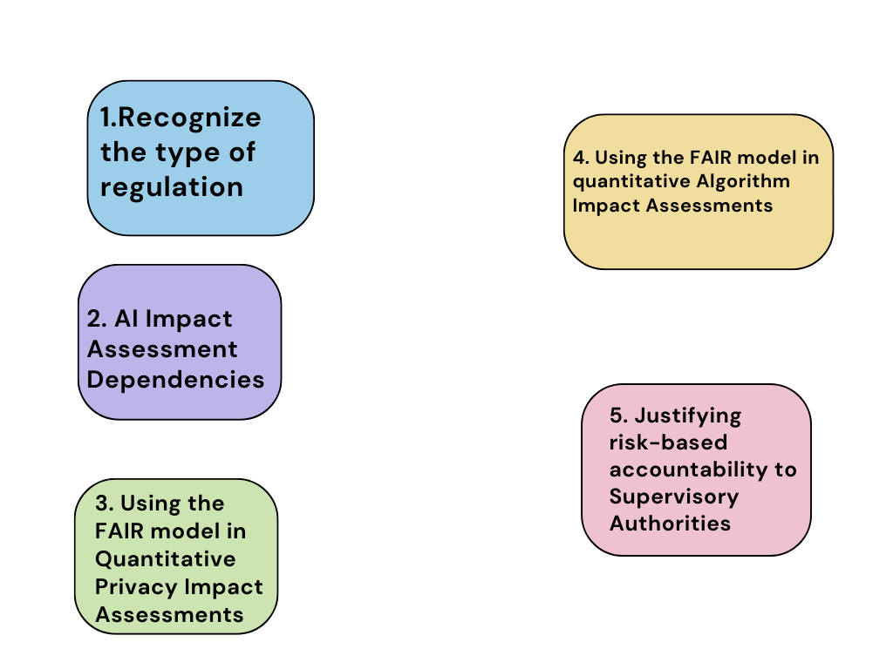
Summary

Slide 3
1.Recognize the type of Regulation

Slide 4
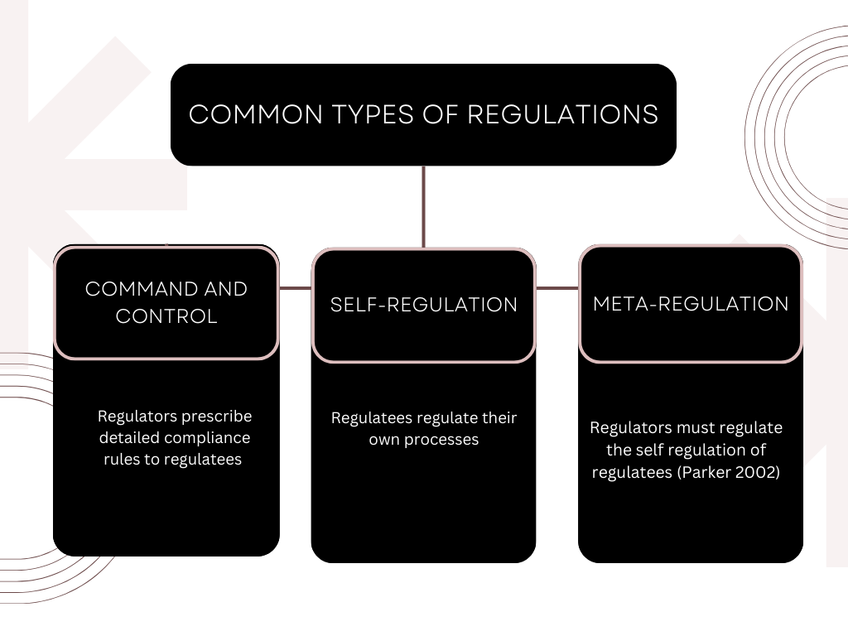

Slide 5
META-REGULATION
Risk-Based Accountability
Risk-Based Regulation

Slide 6
For instance, the Upcoming (EU) AI Act:
Has Meta-regulatory instances => Conformity Assessment (Art. 43)
Is a Risk-based Regulation = > (Art. 9)

Slide 7
Considerations
Purpose
The proposal lays down a solid risk methodology to define “high-risk” AI systems that pose significant risks to the health and safety or fundamental rights of persons.
Scope (art. 2)
(1) Providers placing on the market or putting into service AI systems in the
Union [...] ;
(2) Users of AI systems located within the Union;
(3) Providers and users of AI systems that are located in a third country, where the output produced by the system is used in the Union;

Slide 8
HIGH-RISK AI SYSTEMS
Biometric identification and categorization of natural persons.
Management and operation of critical infrastructure.
Education and vocational training.
Employment, workers management and access to self-employment.
Access to and enjoyment of essential private services and public services.
Law enforcement.
Migration, asylum and border control management.
Administration of justice and democratic processes.

Slide 9
2. Artificial Intelligence Impact Assessment Dependencies

Slide 10
Some AI risk management methodologies are:
  ISO / IEC 23894:2023
  NIST AI 100-1 (2023)
  capAI (Oxford University - 2022)
  AI Procurement in a box (WEF - 2020)

Slide 11
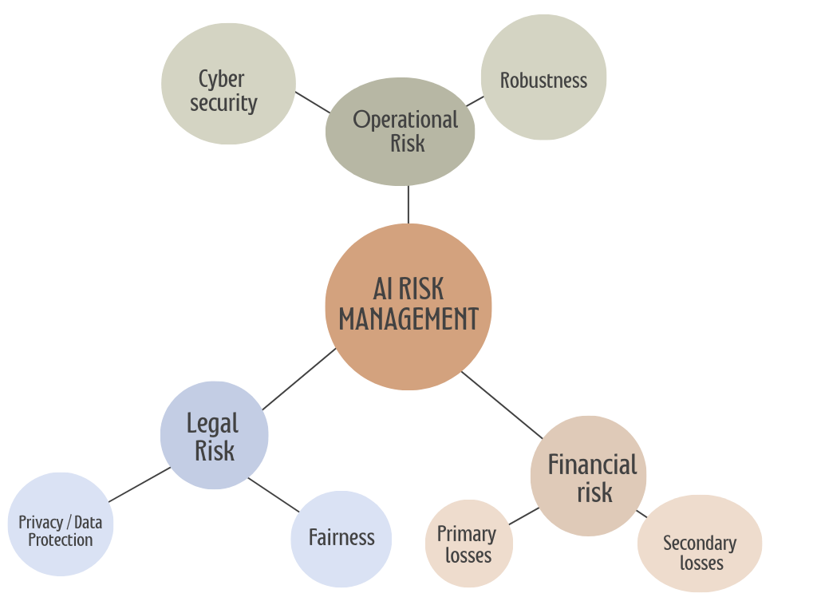
Basic AI Risk Dimensions
Don’t forget that the purpose of AI risk management shall be the protection of the rights and freedoms of physical persons.

Slide 12
TIPS for an Integrated AI Compliance Strategy:
1. Identifying obligations of risk-based compliance linked to an AI product (e.g. robotics, smart cars, and so on).
2. Assessing Data protection/Privacy risk-based compliance in a Data Protection Impact Assessment / Privacy Impact Assessment (e.g. GDPR compliance).
3. Assessing Algorithm Performance risk-based compliance in an Algorithm Impact Assessment (e.g. AI Act Compliance).
4. Cyber security risk management is still immature. (Jones - 2022).

Slide 13
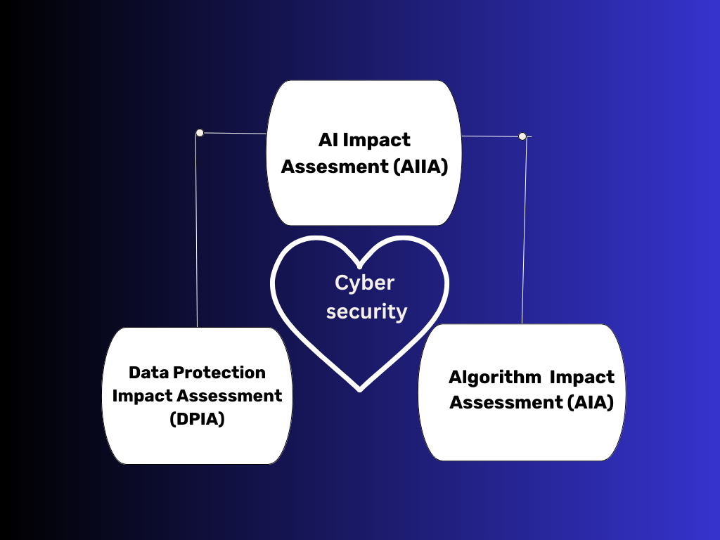

Slide 14
3. Using the FAIR model in quantitative
DPIAs / PIAs

Slide 15
Problems
  They tend to emphasize description over analysis, and risks are construed narrowly They shall be updated (Shapiro 2021).
  The state of the art of PIA methodologies is qualitative and superficial (e.g. ISO/IEC 29134, Data Protection Authority’s guidelines).
  Many authors believe that is not possible to measure the impact on the rights and freedoms of physical persons.
  The state of the art of information security risk management is immature (Jones 2022).

Slide 16
Solutions
A quantitative risk analysis approach for DPIAs / PIAs.
Everything is measurable (Hubbard - 2010).
Fixing current DPIA/PIA methods with quantitative privacy risk analysis. (Cronk & Shapiro - 2021).
Applying jurimetrics and legal analytics in order to understand the sanctioning psychology of regulators ( Loevinger - 1949, Lawlor - 1963).

Slide 17
E.g. Personal Data Value at Risk (Pd-VaR)
The Pd-VaR of an X French company with a turnover of €150 millions in 2022 that has committed a GDPR consent violation (category 1) can be expressed as :
Frequency input taken from 2022: E[x] = 19 / 19 + 326 = 0.055 (5,5 %).
Magnitude input: Turnover of the undertaking & Category of the infringement & Seriousness of the infringement (EDPB-2022).
Credible interval: Get a range by following confidence procedures ( Morey & Hoekstra - 2016).
« The probability of receiving an administrative fine in 2023 (if controlled) has a percentage range of 2,3 % and 8,7 % in the next year, while there is a 90 % chance that the loss will be between €300 000 and €400 000, at a 90th credible interval ».

Slide 18
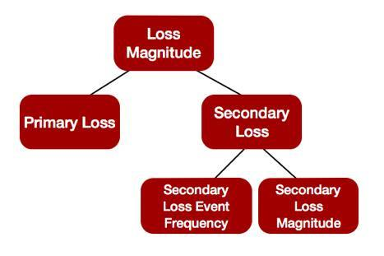
Scenario 1: Merging information security risks and GDPR compliance risks. GDPR article 5 § 1(f), using FAIR
  We could Calculate SLEF with legal analytics, and separate it from other secondary losses.
  However, we must combine such prior information with the current situation of the data controller (TEF + Vulnerablity).
  We could calculate the loss due a GDPR potential administrative fine by using legal analytics, and add it to the FAIR ontology.

Slide 19
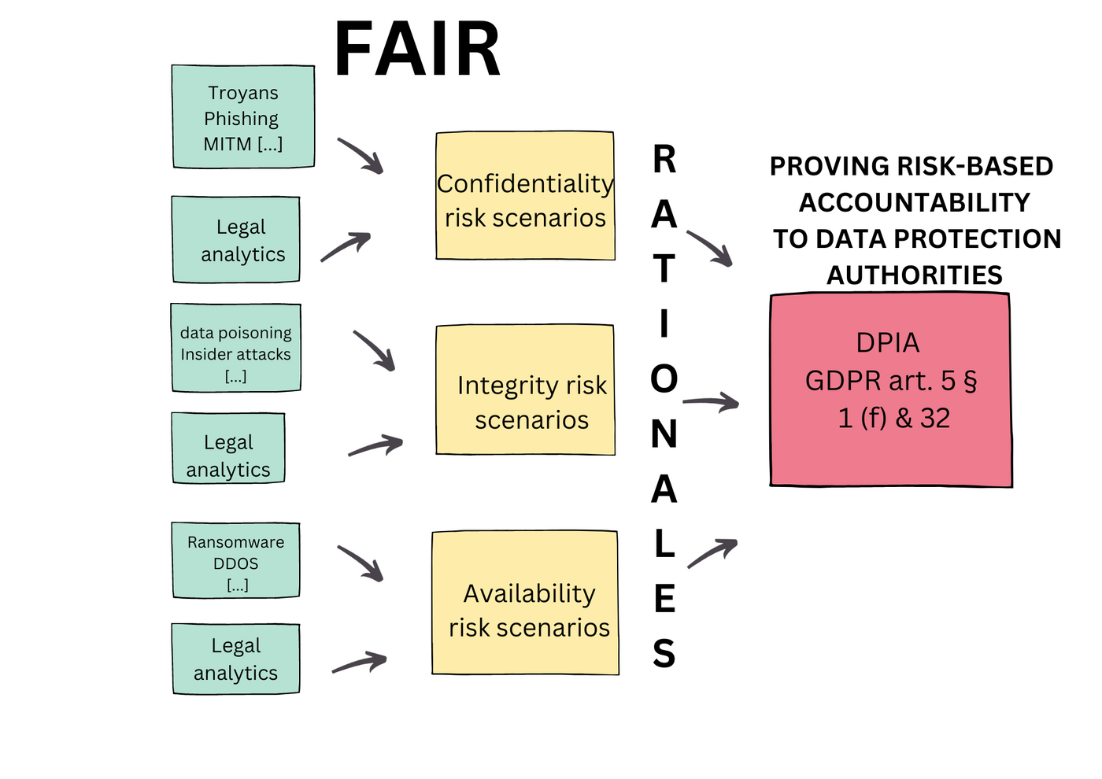
Integrated GDPR risk-based compliance strategy

Slide 20
Scenario 2: Use the FAIR model for only legal risk scenarios
  The FAIR ontology remains intact. Only the branch definitions are customized.
  The GDPR’s administrative fine becomes the primary loss.
  Other type of losses may become secondary losses.

Slide 21
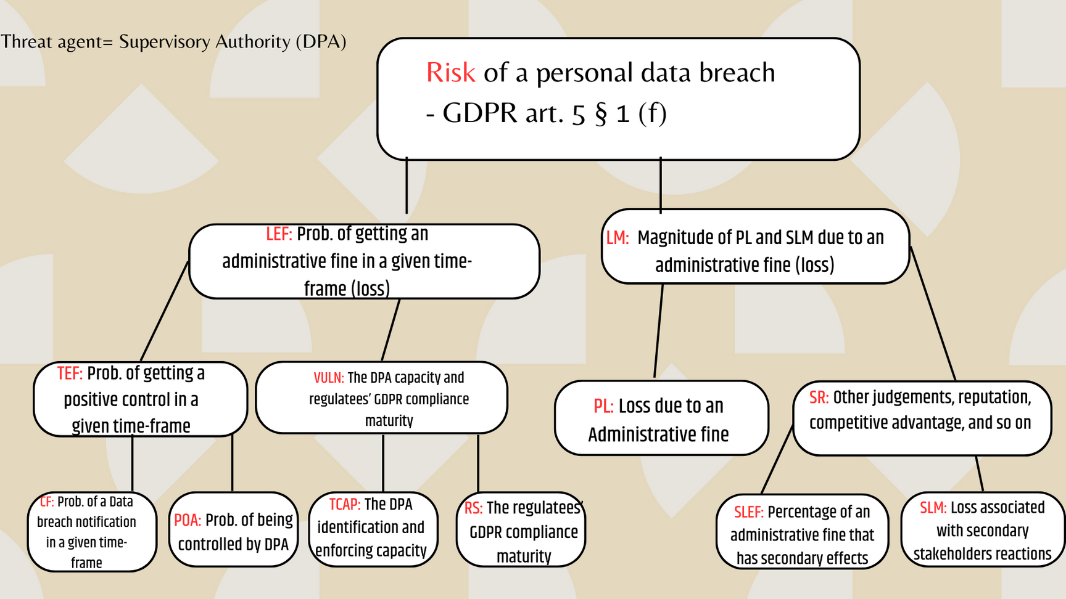
For instance, GDPR’s article 5 § 1(f)

Slide 22
4. Using the FAIR model in quantitative Algorithm Impact Assessments

Slide 23
Considerations
  Machine learning / deep learning models use quantitative performance metrics, such as accuracy, recall, MSE, RMSE, sentiment polarity, and so on.
  Algorithms can be classified into deterministic, and non-deterministic (Yanofsky - 2006)
  Measuring algorithms have two dimensional challenges: measuring robustness, and measuring fairness (capAI - 2022).

Slide 24
Considerations
  Robustness can be understood as an operational risk (just like cyber security). Fairness can be linked to the legal and ethical domain (just like privacy), with a widest “fundamental rights” scope.
  The term has been already proposed, with the aim of complying with the GDPR’s article 22 (Kaminski & Malgieri - 2021).

Slide 25
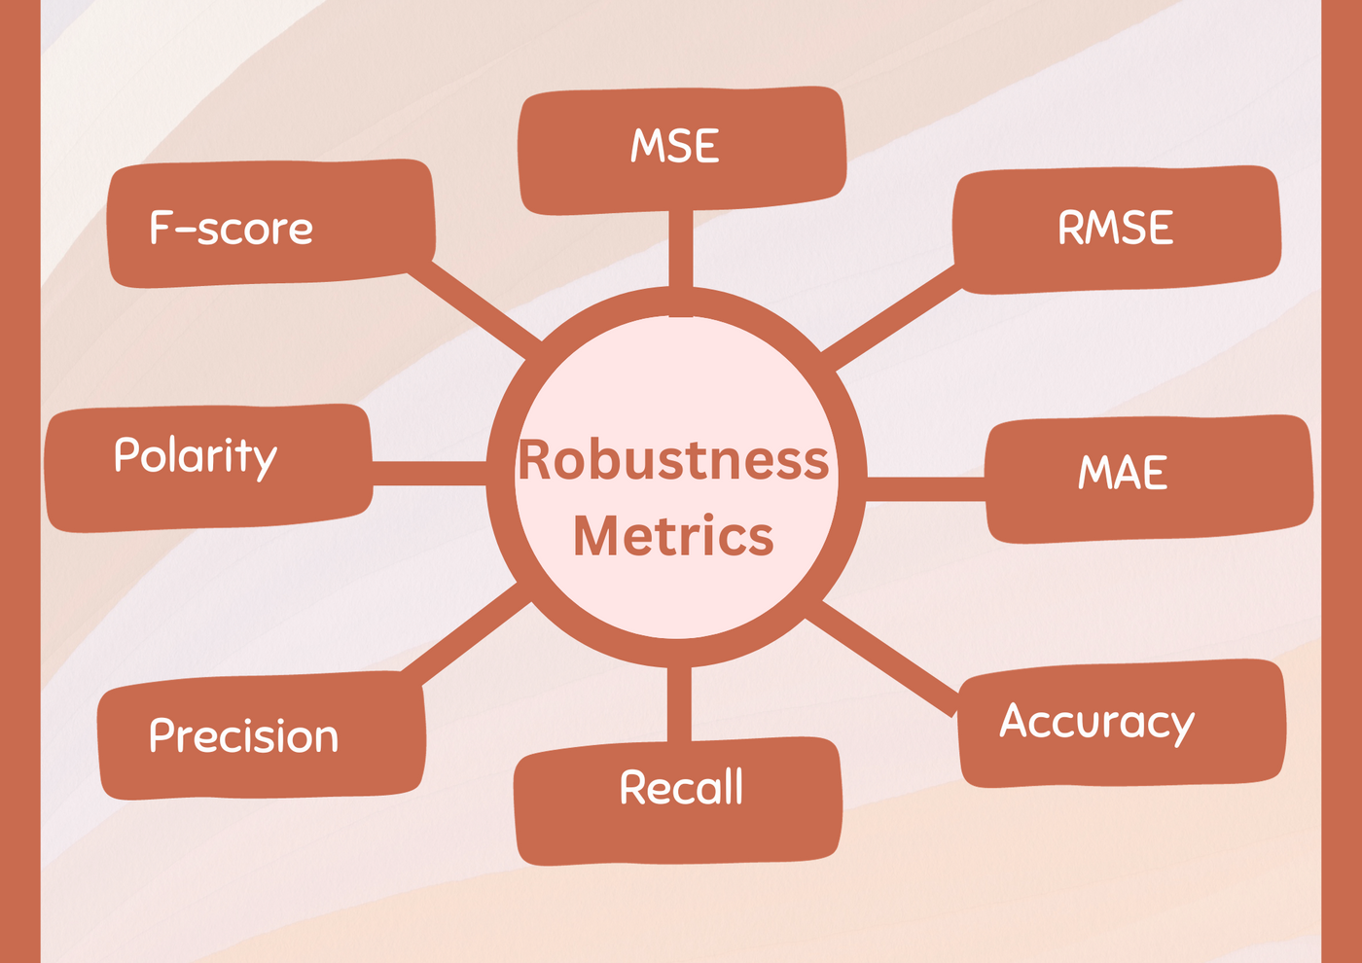
Robustness metrics => FAIR
The Robustness of an AI system may be considered as a risk control measure for increasing its Resistance Strength, and therefore, reducing the probability of getting primary and secondary losses. Yet, the FAIR ontology can be also useful for only-robustness risk scenarios, but it would have to be integrated in cyber security risk scenarios sooner or later.

Slide 26
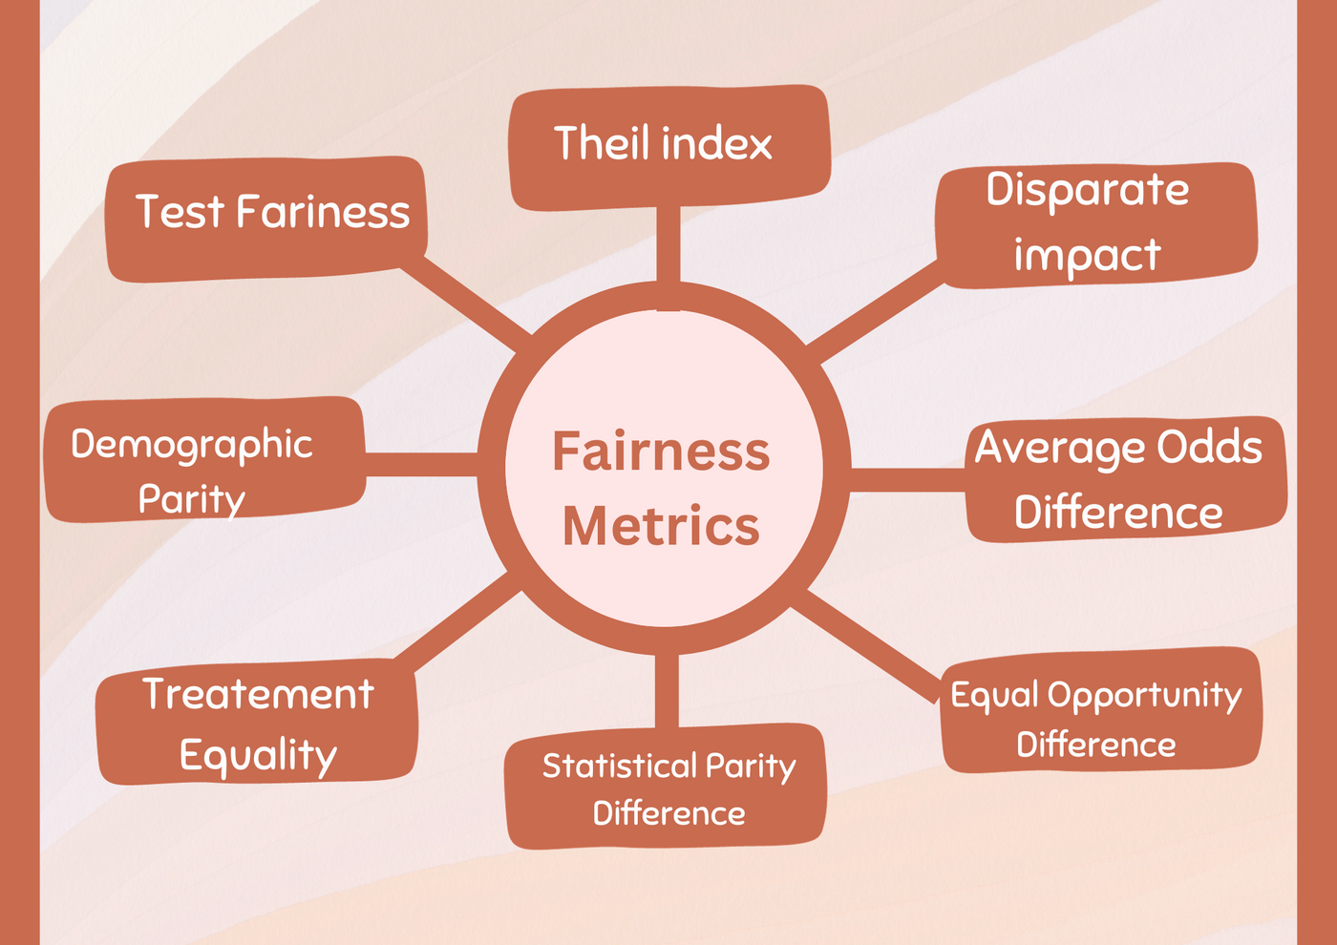
Fairness Metrics => FAIR
For practical reasons, fairness shall be understood as a legal issue, since Interpreting fairness is the task of supervisory authorities. Thus, these metrics will be better calibrated in the light of jurimetrics and legal analytics, through case-based legal reasoning (Ashley - 2017). It would mainly fit as a secondary risk, since the lack of fairness may violate fundamental rights. The FAIR model can be useful for purely fairness risk scenarios.

Slide 27
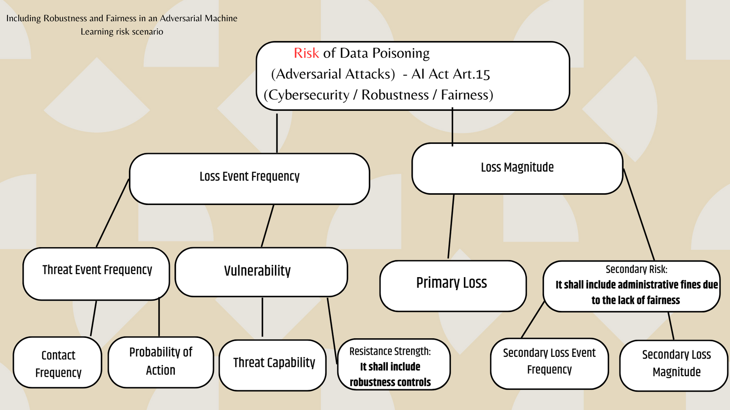


First scenario: FAIR integration proposal
FAIRNESS
ROBUSTNESS

Slide 28
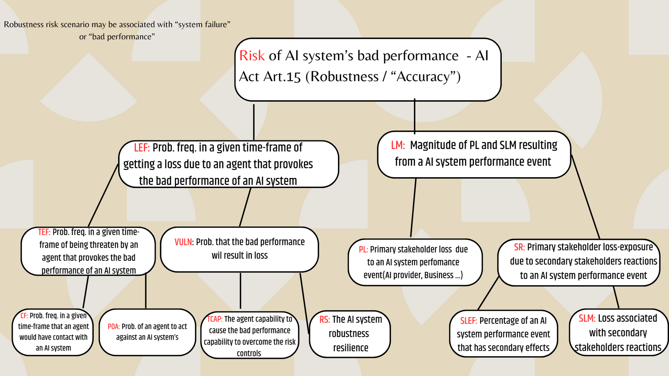
Second scenario: Robustness without cyber security

Slide 29
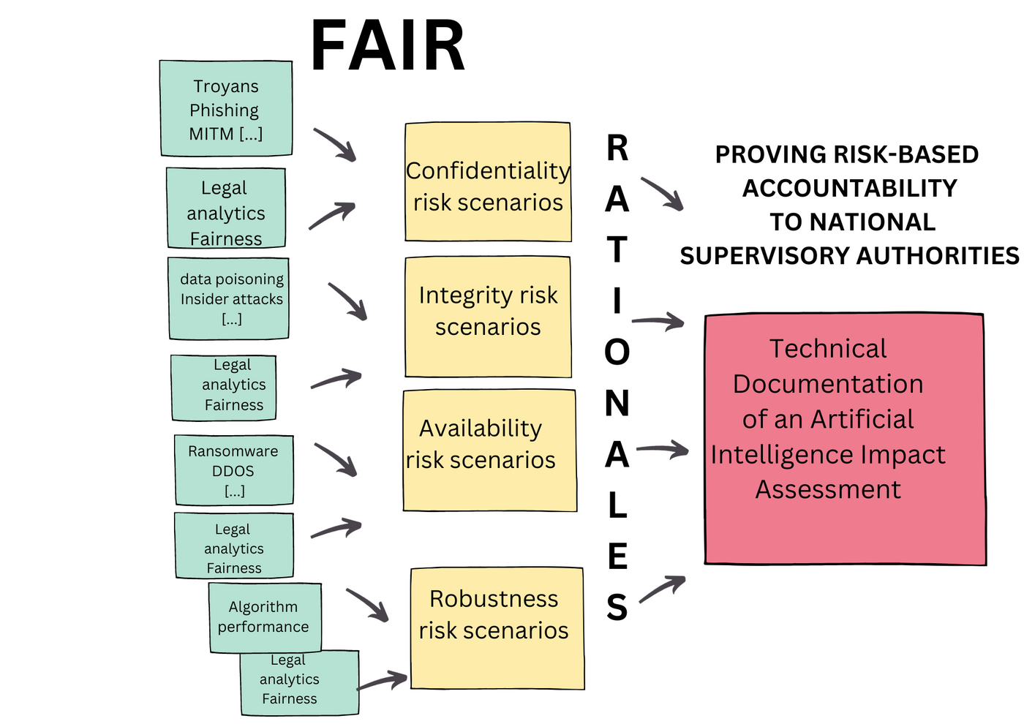
Integrated AI Act risk-based compliance strategy

Slide 30
5. Justifying risk-based accountability to Supervisory Authorities

Slide 31
Concerns
  What is the regulatory practice of supervisory authorities with regard to risk assessment? (Sparrow - 2000).
  Is the risk-based approach clearly defined by regulatory law?
  Have the supervisory authority started a risk transformation process in their proactive and reactive strategies?
  What type of documentation are they actually requiring?

Slide 32
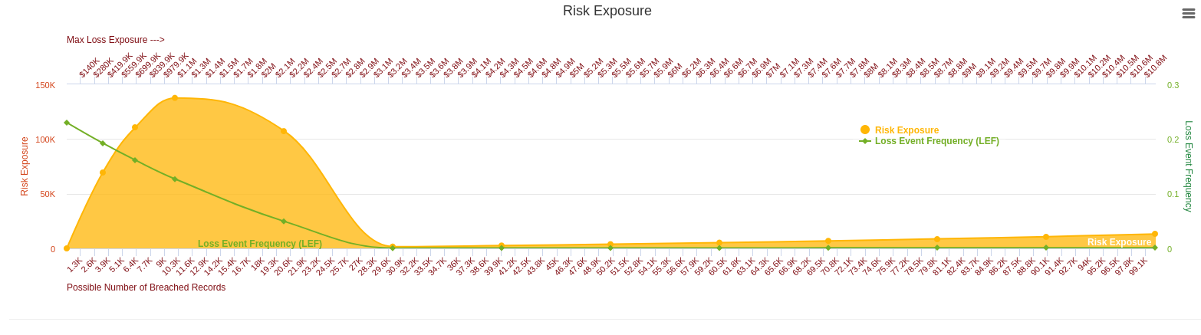
Would they accept Probability Distributions and Loss Exceedance Curves?
Yes, but don’t forget to explain them in a simple natural language. Furthermore, “the levels of accuracy and the relevant accuracy metrics of high-risk AI systems shall be declared in the accompanying instructions of use”. (AI Act art. 15 § 2)

Slide 33
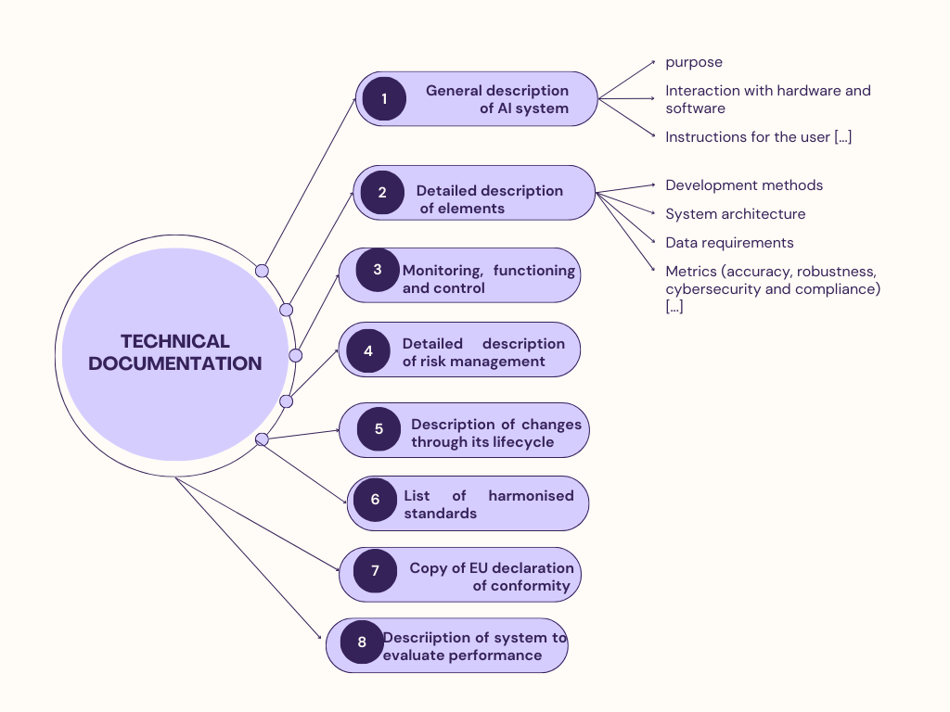
AI Act - Technical Documentation
Risk models, metrics, and quantitative risk assessments representations may be included

Slide 34
Benefits
Metrics, probability distributions, and loss exceedance curves can be included.
Quantitative risk analysis is allowed (and necessary).
The technical documentation may become a good risk-based compliance mechanism.
AI risk management may contribute to the directional shift of operational risk management, towards a scientific and rational risk-based approach.

Slide 35
Drawbacks
The risk analysis outcomes shall be explained and justified in a natural written language.
There are not standardized methods for integrating the dimensions of AI risk.
AI risk management is not an autonomous risk discipline.
Human oversight may shall be deeply analyzed in specific risk scenarios (art. 14).
Are regulators aware of the need to transform towards a quantitative risk culture?

Slide 36
Thank you!!
luis.enriquez@univ-lille.fr
luis.enriquez@uasb.edu.ec

