Slide 1
Using Cyber Risk Intelligence to Scale FAIR Assessments
John Feezell & Bob Maley

Slide 2
John Feezell, CISSP®, PMP®, Open FAIR 2® Global Security Consultant, Cyber Risk Quantification - Kyndryl
John Feezell, a recognized leader in the field of Cyber Risk Quantification, is the global CRQ lead for the Kyndryl Security and Resiliency Practice. John comes to Kyndryl with 20 years of security and systems expertise, tempered in the fires of IBM Services, as well as 4 years in the Insurance Industry with Blue Cross Blue Shield and Unum.
John is a frequent contributor to the Open Group Security Forum, most recently working to craft and test exam questions for the new Open FAIR 2 certification. Additional Open Group collaborations include whitepapers and lectures harmonizing FAIR utilization with both the Open Trusted Technology Forum (OTTF) and Zero Trust. (in process)
As a passionate evangelist of the FAIR standard, John is leading the charge to launch Kyndryl service offerings related to CRQ and Third-Party Risk Management, as well as coaching many to achieve FAIR certification through mentoring and boot camps.
John is published and holds 5 patents in the information security domain as well as the CISSP®, PMP®, Open FAIR®, and Open FAIR2® certifications.

Slide 3
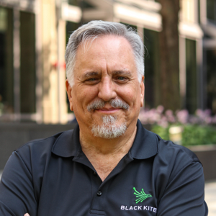
Bob Maley, CTPRP, CRISC, CCSK, Open FAIR™ Chief Security Officer - Black Kite
Bob has been involved in security for most of his career, initially in physical security as a law enforcement officer. In those years Bob acquired a broad range of expertise and experience in all areas of security, including third-party security, risk assessment, architecture, design, policy development, deployment, incident response and investigation and enterprise solution deployments in areas including intrusion detection, data protection, compliance, and incident reporting and response.
Most recently, he was the Head of PayPal’s Global Third-Party Security & Inspections team, developing the program from the ground up into a state-of-the-art risk management program.
In a previous role as Chief Information Security Officer for the Commonwealth of Pennsylvania, he led the Pennsylvania Information Security Architecture program to win the 2007 award for outstanding achievement in information technology by the National Association of State Chief Information Officers (NASCIO).
Bob has been named a CSO of the Year finalist for the SC Magazine Awards and was nominated as the Information Security Executive of the Year, North America. Additionally, his team was a finalist in the SC Magazine Awards for Best Security Team.
Bob’s certifications include CRISC, CTPRP and OpenFAIR

Slide 4
Discussion

Slide 5
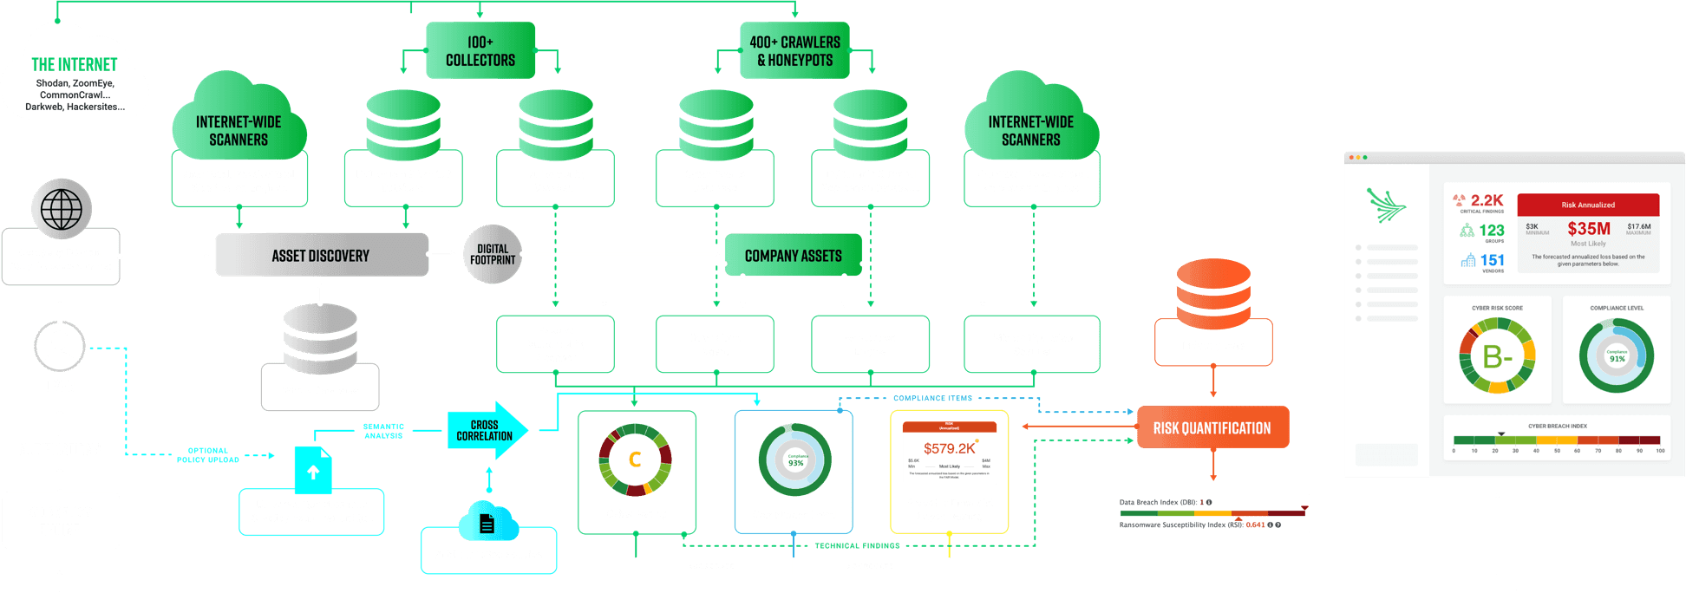
Collect & Calibrate

Slide 6
Discussion

Slide 7
Thank You!
Follow John:
Follow Bob:

