Slide 1
The CRQM Program Development Blueprint
Zach Cossairt – Equinix IRM Senior Manager
Jon Oppenhuis – Safe Security Director, Risk Strategy and Success

Slide 2
The aspects of things that are most
important to us are hidden by their
simplicity and familiarity.
Ludwig Wittgenstein

Slide 3
Agenda
CRQM Practices Today
Ten Guiding Principles of CRQM Program Development
CRQM Program Development Blueprint
Case Study: A Programmatic Approach to Information Risk Quantification at Equinix
Call to Action and References

Slide 4
EXECUTIVE SPONSORSHIP
RISK WORKFLOW
LONG-TERM PLANNING
BUSINESS OUTCOMES
SHORT-TERM PLANNING
GOVERNANCE MODEL
CRQM
Practices Today
BUDGETING
CROSS-
ORGANIZATIONAL ENGAGEMENT
SUSTAINABILITY
METRICS
USE CASES
RISK QUANTIFICATION
MODEL
PLATFORM SELECTION
RISK TREATMENT
RISK REPORTING
RESOURCING

Slide 5
Value Propositions of Cyber Risk Quantification
Considering cyber risk new business initiatives
Making financial decisions to cover cyber risk exposure
Selecting and pricing cyber insurance
Treating risk with cost benefit analysis
Providing executives with measurements in familiar terms
Making comparisons between risks from different risk domains
Aggregating risk
Meeting evolving regulatory expectations
Enabling decision-makers to adjust decisions
Improving defense of decisions
Ranking risk-related concerns of risk
Jones, Jack. 2023.
Understanding Cyber Risk Quantification: A Buyer’s Guide. FAIR Institute.

Slide 6
Value Propositions of CRQM Program Development
Strengthens the business case to secure investment
Increases executive and BoD support
Improves planning activities
Elevates cross-org initiatives and communication
Creates proactive and accountable approach
Enhances program resilience
Enhances the credibility of CRQ function
Builds recruitment strategy and provides enhanced professional development
Integrates initiatives within company strategy
Enables ERM integration
Assists budgeting exercises
Strengthens cooperation among Lines of Defense

Slide 7
TEN GUIDING PRINCIPLES OF CRQM PROGRAM DEVELOPMENT
PRINCIPLE #1
Obtain executive sponsorship and program champions and maintain throughout program journey
PRINCIPLE #2
Plan short-term objectives and multi-year goals
PRINCIPLE #3
Consider advantages of top-down versus bottom-up approach
PRINCIPLE #4
Differentiate between a project-based approach versus a programmatic approach
PRINCIPLE #5
Align program activity to organizational strategy and achievement of business outcomes
PRINCIPLE #6
Implement practical oversight (program charter, program success plan, executive business meetings)
PRINCIPLE #7
Ensure program is sustainable and examine resourcing strategically
PRINCIPLE #8
Communicate program achievements and evaluate program success
PRINCIPLE #9
Adopt relevant metrics and apply to technical and business outcomes
PRINCIPLE #10
View CRQM program development comprehensively, strategically, and incrementally

Slide 8
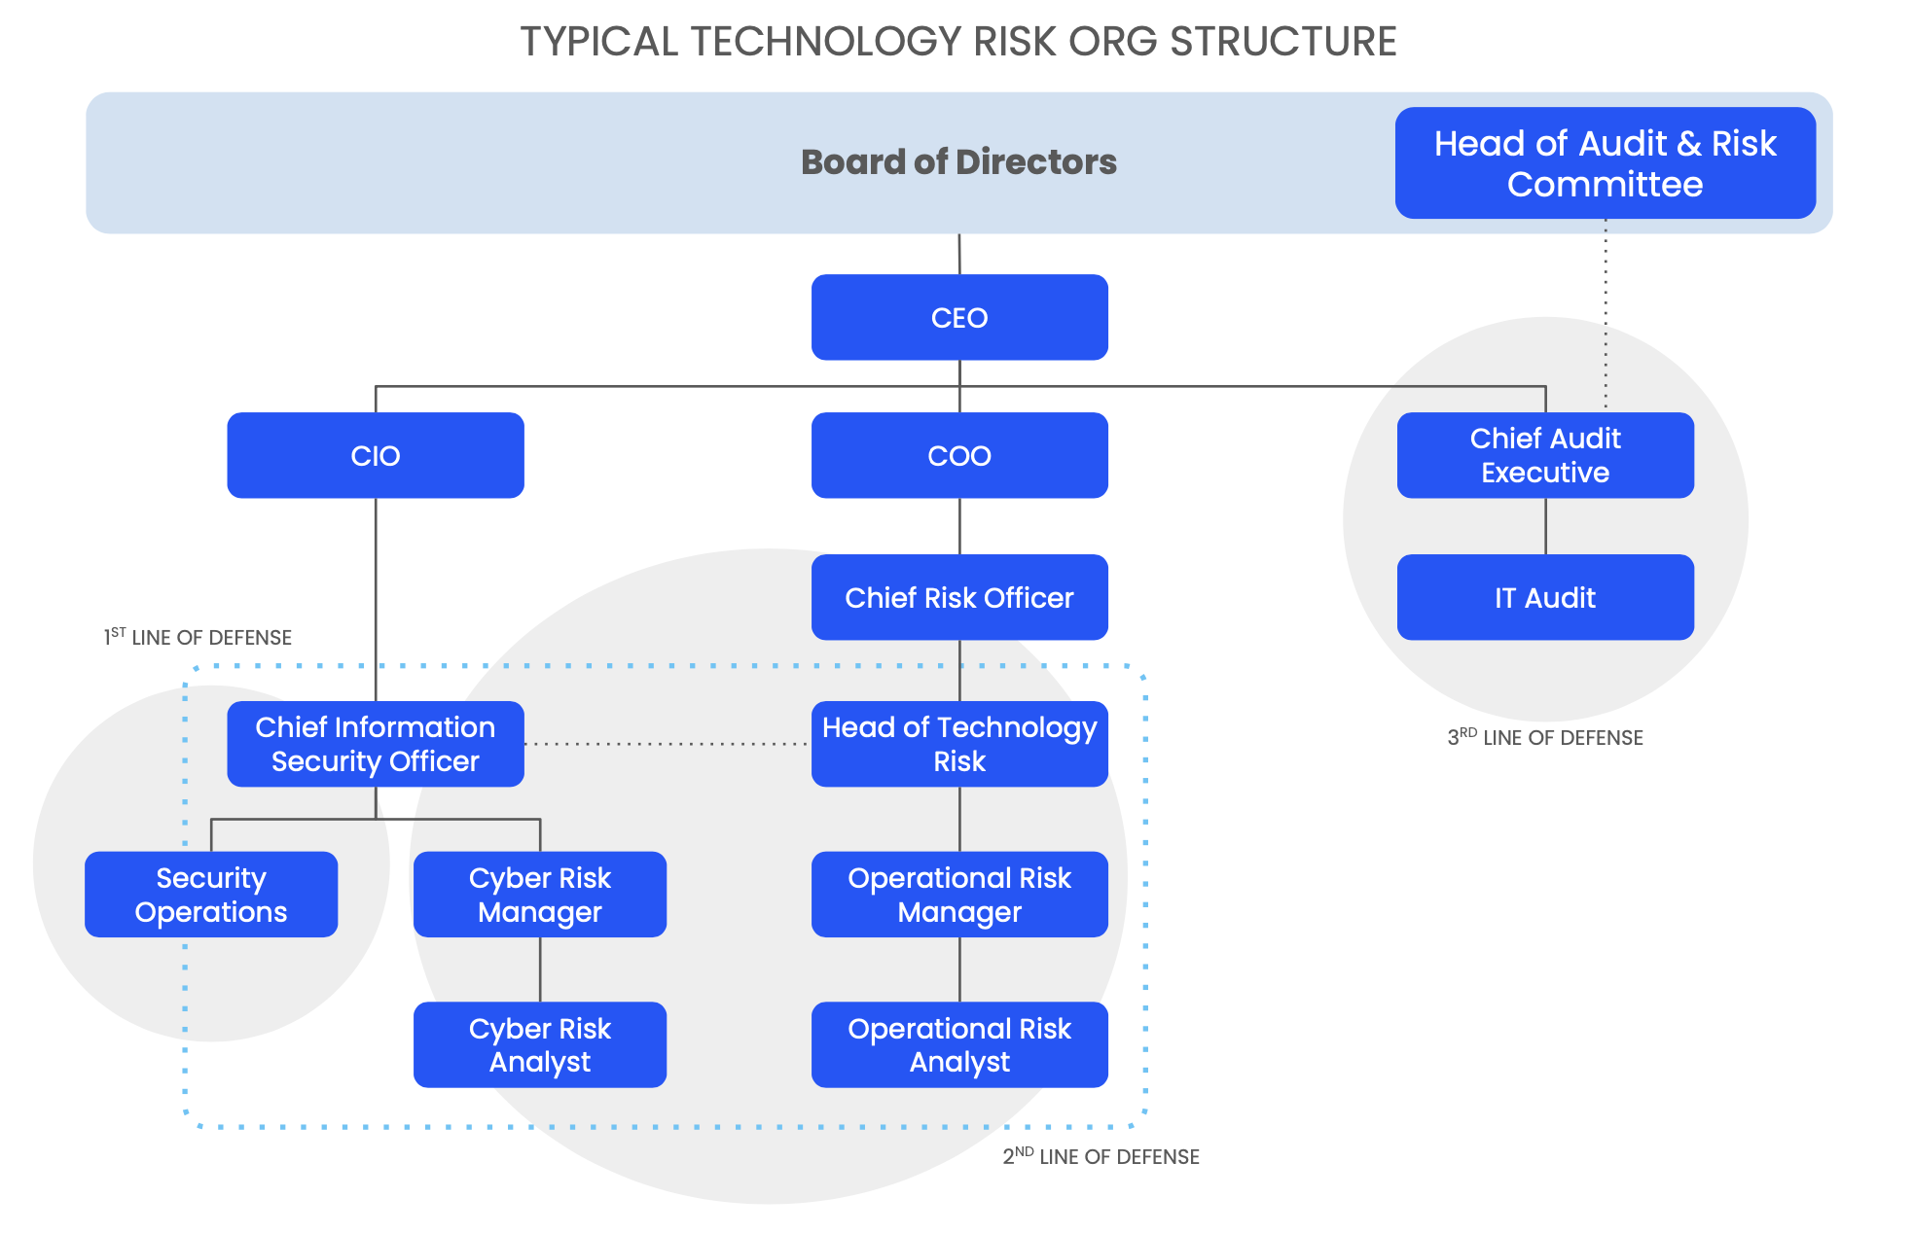
EXECUTIVE SPONSORSHIP AND PROGRAM CHAMPIONS

Slide 9
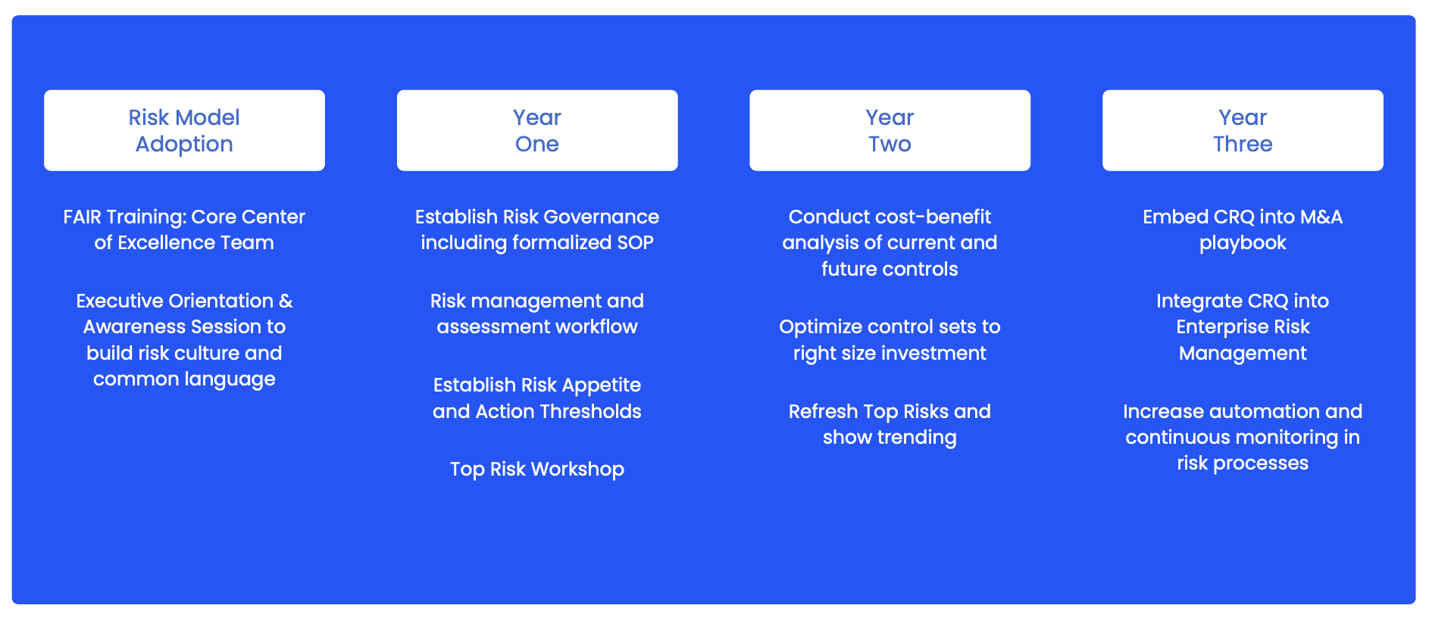
PLAN SHORT-TERM OBJECTIVES AND MULTI-YEAR GOALS

Slide 10
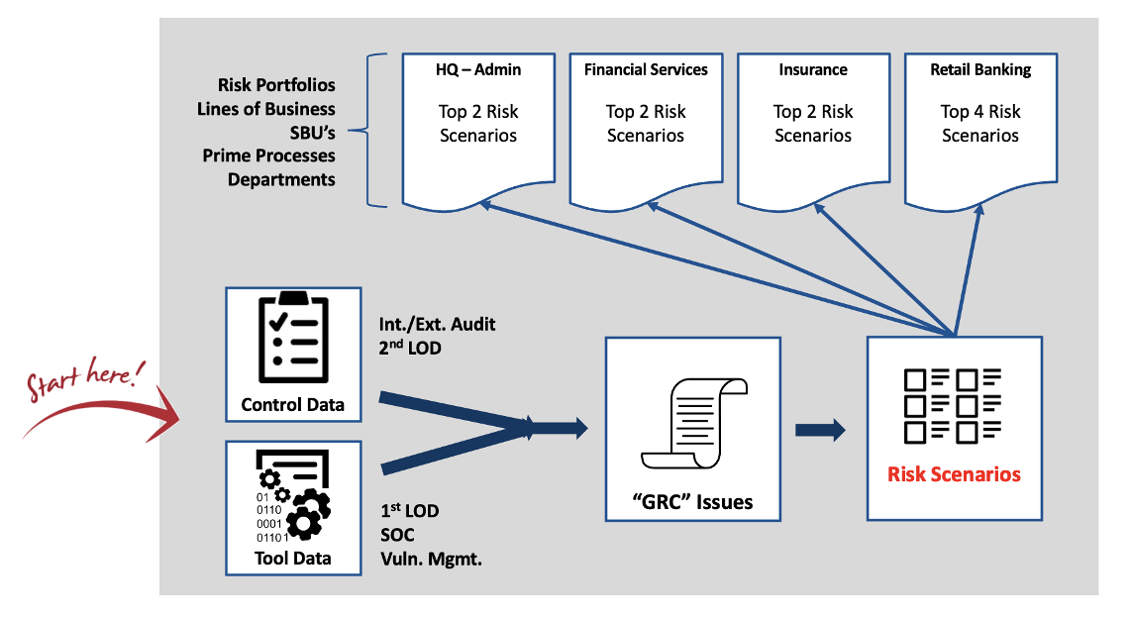
A BOTTOM-UP APPROACH

Slide 11
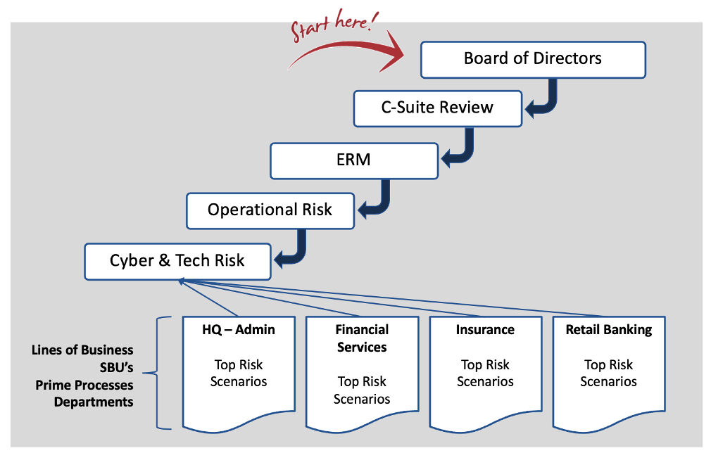
A TOP-DOWN APPROACH

Slide 12
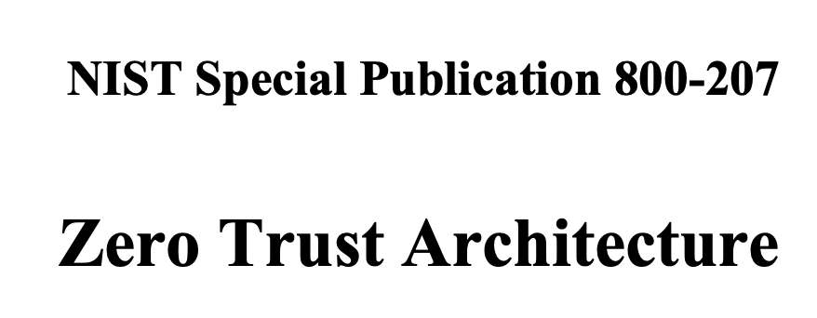
ALIGN PROGRAM ACTIVITY TO ORGANIZATIONAL STRATEGY
ZTNA Initiative
Goldman Sachs 2022 Annual Report
David Solomon, Chairman and CEO
Tools Rationalization

Slide 13
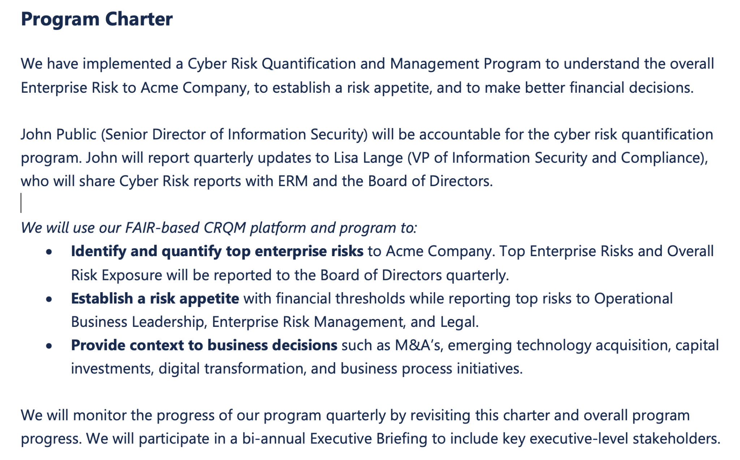
CREATING AND MAINTAINING A PROGRAM CHARTER
Why?
Who?
What?
&
How?
When?

Slide 14
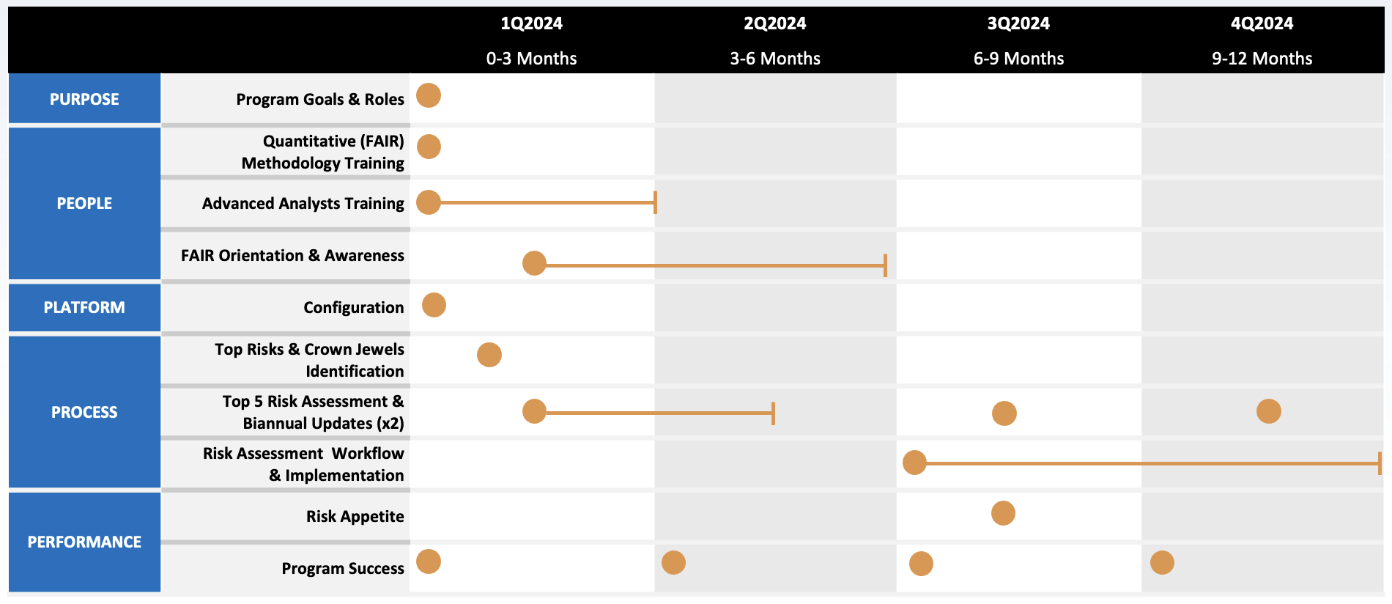
PROGRAM CHARTER AUTHORIZES ACTIVITY TIMELINE

Slide 15
Process and Playbook
Safe Security and the CRQM team will work together to document a playbook and tabletop the playbook through a specified risk assessment.
Data Clean up
The CRQM team will work with stakeholders to review and update assets, risk assessment, data helpers, and scenarios within the Safe Security tool.
Q1
Quarterly Roadmap
Q2
Top Risk Workshop
Safe Security will lead the CRQM team through a workshop to identify critical assets, threats, effects and then scope 10-20 scenarios to report the organizations top risks to leadership.
M&A Integration + CBA Tabletop
Safe Security will work with the CRQM team to document a playbook and to perform a tabletop through a Cost Benefit Analysis.
Integration with ERM
The CRMQ team will work with Enterprise Risk Management to integrate cyber risk assessments into existing processes.

Slide 16
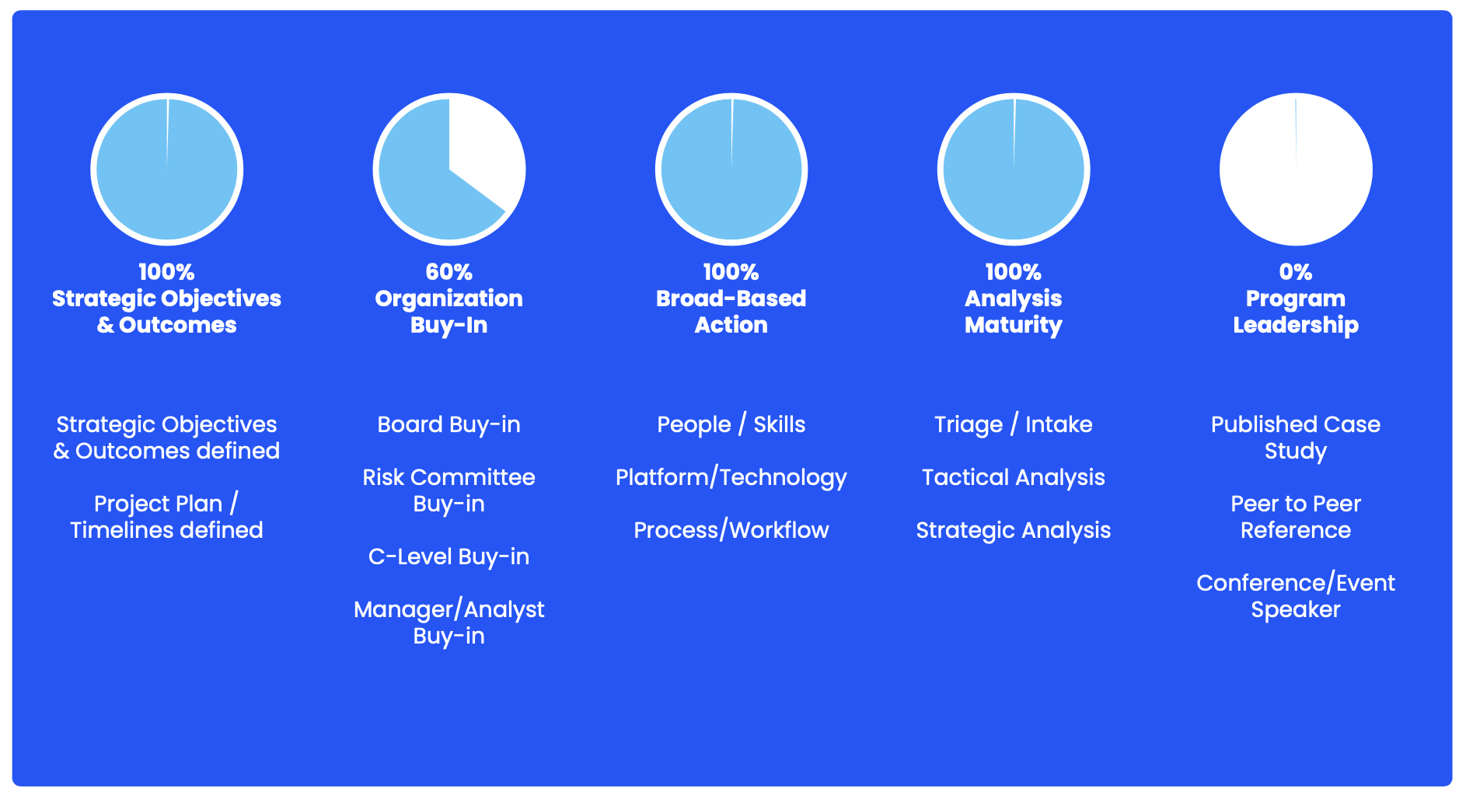
THE MEASUREMENT OF TECHNICAL AND BUSINESS OUTCOMES

Slide 17
TEN GUIDING PRINCIPLES OF CRQM PROGRAM DEVELOPMENT
PRINCIPLE #1
Obtain executive sponsorship and program champions and maintain throughout program journey
PRINCIPLE #2
Plan short-term objectives and multi-year goals
PRINCIPLE #3
Consider advantages of top-down versus bottom-up approach
PRINCIPLE #4
Differentiate between a project-based approach versus a programmatic approach
PRINCIPLE #5
Align program activity to organizational strategy and achievement of business outcomes
PRINCIPLE #6
Implement practical oversight (program charter, program success plan, executive business meetings)
PRINCIPLE #7
Ensure program is sustainable and examine resourcing strategically
PRINCIPLE #8
Communicate program achievements and evaluate program success
PRINCIPLE #9
Adopt relevant metrics and apply to technical and business outcomes
PRINCIPLE #10
View CRQM program development comprehensively, strategically, and incrementally

Slide 18
BLUEPRINT FOR CRQM PROGRAM DEVELOPMENT
1
2
3
4
5
DOCUMENT STRATEGY, SUPPORT & ALIGNMENT
DEVELOP MULTI-YEAR ACTION PLAN
BUILD & OPERATE THE PROGRAM
MATURE & SCALE THE PROGRAM
MONITOR & OPTIMIZE THE PROGRAM

Slide 19
Case Study
A Programmatic Approach to Information
Risk Quantification at Equinix

Slide 20
Equinix Case Study
Make it more than an academic exercise”
BACKGROUND
As the world’s digital infrastructure company™, Equinix necessitates security at the speed of business. This entails the ability to take quick, decisive, and risk-informed action to allow the company to deliver on their value proposition, providing customers with the digital resources needed to enable acceleration of their advantage.
Michael Montoya, CISO
OBJECTIVES
Teach don’t preach
Robust core relationships
Resiliency mindset
Human-centric design

Slide 21
Pillars of Our Approach
1
2
3
ESTABLISH AND MAINTAIN THE BRAND STRATEGY
PLAN, BUILD, OPERATE, SCALE, REPEAT
APPRECIATE THE HUMAN ELEMENT
Realize the value
Program Charter
Heuristics and Biases
Establish the North Star
Know the audience and what drives their decisions
Fuel and Friction
“Improve the pace and quality of decision making across the organization”
Inertia
Establish credibility
Effort
Top-down, bottom-up, hybrid
Emotion
Repeatable workflow, process, and reporting
Reactance
Market, sell, and promote adoption
Design for humans
Operationalized use cases
Science-based scaling
Notes:
Realize the value
What goals are we helping our consumers address? What rewards are they seeking?
How does our program allow them to address those permanent hard-wired goals?
How can we get it to them quicker and above expectation? (dopamine)
Establish the North Star
The marker signifying that you’re on the right path
Anything you’re doing that doesn’t point toward this marker probably isn’t a priority
Revisit periodically to ensure

Slide 22
A Cyclic Approach to Program Development
Plan
-Business objective(s) and dilemmas
-Normalize the stack
-Decision making structure
-Acceptable level of risk
Applied risk program development at Equinix materializes as a living, breathing, continuous process with practicality, innovation, and disruption built into its DNA
Scale
-Objectives 🡪 Outcomes
-Check for false positives
-Prepare for variability
-Validate the recipe
-Increased influence on decision making
Build
-Standardize the taxonomy
-Established form of intake
-Decision support use cases
-Discover and alleviate friction
Operate
-Decision support time to value
-Automate where appropriate
-Optimize risk response
-Discover and alleviate friction
Notes:
Plan:
Risk management is fundamentally about making decisions
Decisions about which risk issues are most critical (prioritization)
Which risk issues are not worth worrying about (acceptance)
And how much to spend on the risk issues that need to be dealt with (budgeting)

Slide 23
Challenges of a Programmatic Approach
Upholding Human-Centric Design Principles
Establishing and Maintaining Governance
Minimizing the Effect of Voltage Drops
Evaluate the various action-oriented decision points within the risk landscape
Program Charter defining objectives that align with business strategy
Be aware of false positives
Consider variability across consumers
Reduce friction to facilitate action by those interacting within the landscape
Business case delivering on pre-determined success criteria
Know the recipe for success
Monitor for spillovers
Enhance choice environments to improve decisions
Clearly defined outcomes
Economies of scale
Distinction between strategic and tactical program activities (decision support)
Notes:
Program Charter
How does the program help the organization execute on their business strategy?
Know the recipe for success
Does your definition of risk, or how you measure or manage it affect another org’s compliance status or goals?

Slide 24
CALL TO ACTION AND REFERENCES
Read “The Safe Security Blueprint for CRQM Program Development”
Evaluate your CRQM program using “Ten Guiding Principles for CRQM Program Development”
Create CRQM program improvement plan based on evaluation findings
Make program changes over the next three (3) months
Monitor results and communicate achievements to appropriate program stakeholders
References
Oppenhuis, Jon. 2023. The Safe Security Blueprint for CRQM Program Development. jon.o@safe.security
Jones, Jack. 2023. Understanding Cyber Risk Quantification: A Buyer’s Guide. FAIR Institute.
Scott, Cody and Valente, Alla. 2022. The Cyber Risk Quantification Landscape, Q4 2022. Forrester.
Brotby, Krag and Hinson, Gary. 2013. PRAGMATIC Security Metrics: Applying Metametrics to Information Security. CRC Press.

