Slide 1
2024 Cybersecurity Risk Report
The Data behind the Data & EY Insights
Sponsored by SAFE Security, EY
Ben Gowan, Data Scientist, Safe Security
Carolyn Schreiber, Principal, Advisory | Risk | Cybersecurity

Slide 2
Purposeful Benchmarks
Answers the questions
What’s my risk of key cyber events in the next 12 months?
How much will it cost me if it does?
How do I compare to my industry in general?
Using data from
Real scans, Real Events, Real Losses
Respected industry sources and vendors (DBIR/VCDB, Advisen)
Almost 10 Billion iterations!
Value provided
Instantly, without onerous research and/or training
Consistently and coherently at scale

Slide 3
Data Drawn from Giants
Probability
Theme
Loss
Historical security scan and event data
General Annual Event Probability
Bayesian Logistic Regression
DBIR Incident Classification patterns
VCDB scoped prevalence
Beta regression
Advisen data loss modeling
Four FAIR forms of loss, independent, with secondary loss probabilities
Econometric, log-log, penalized regressions

Slide 4
Show Me The Data

Slide 5
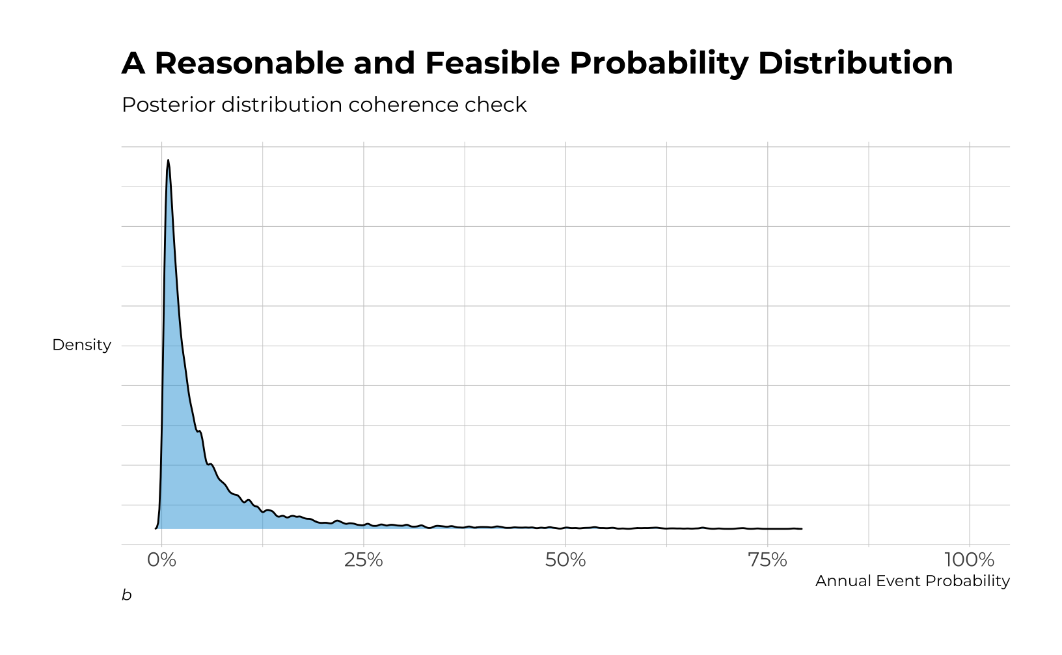
Probability Key Drivers

Slide 6
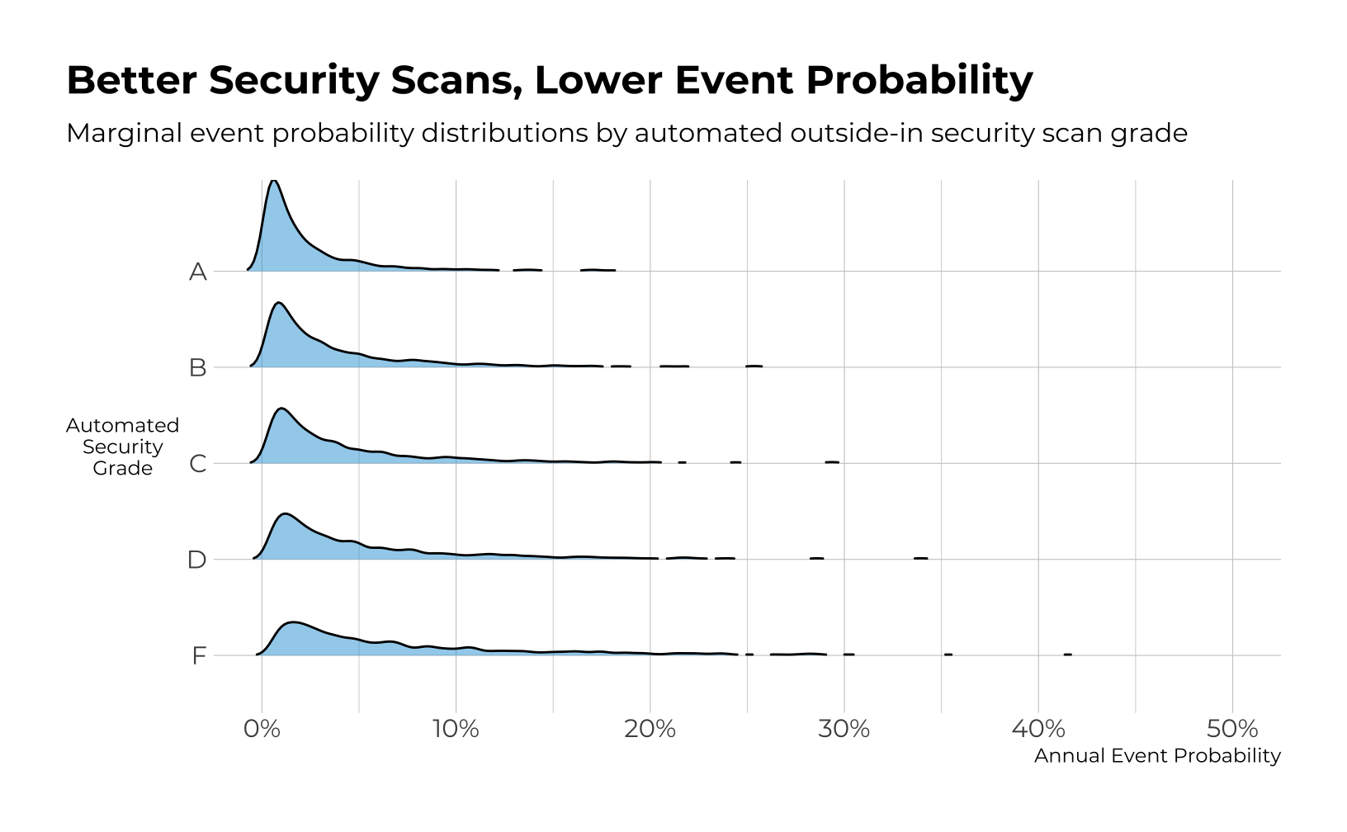
Probability Key Drivers

Slide 7
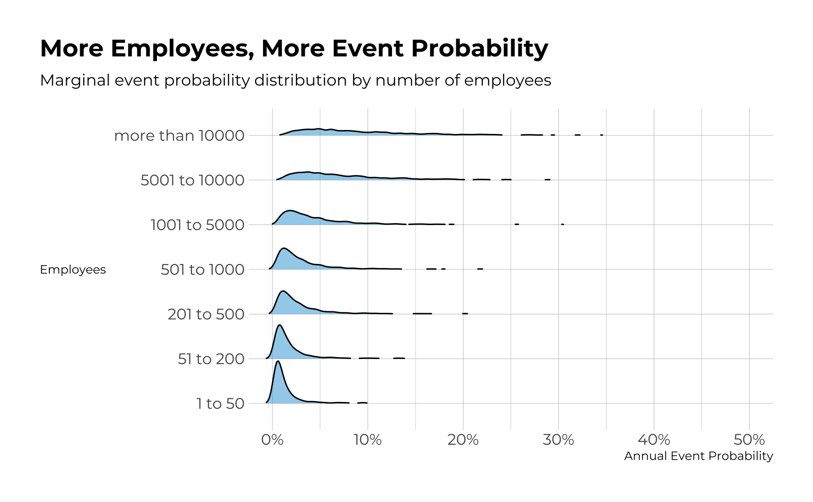
Probability Key Drivers

Slide 8
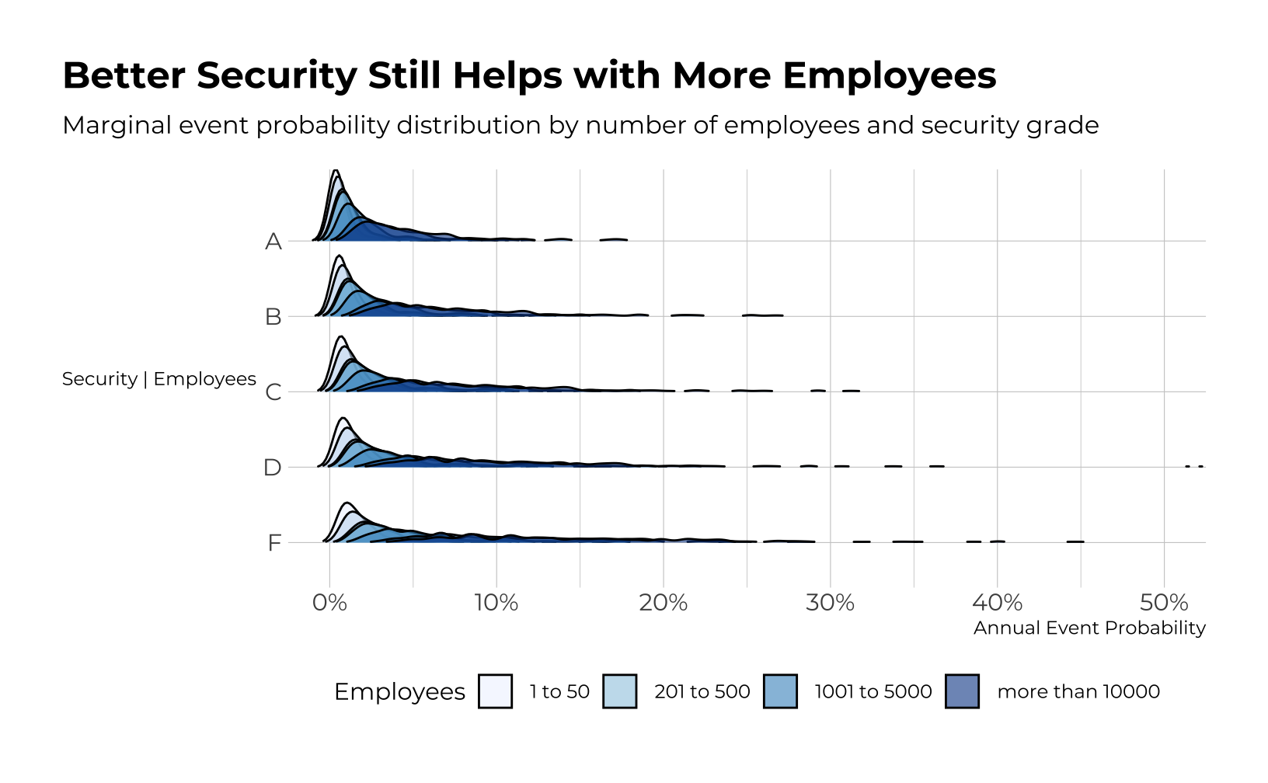
Probability Key Drivers

Slide 9
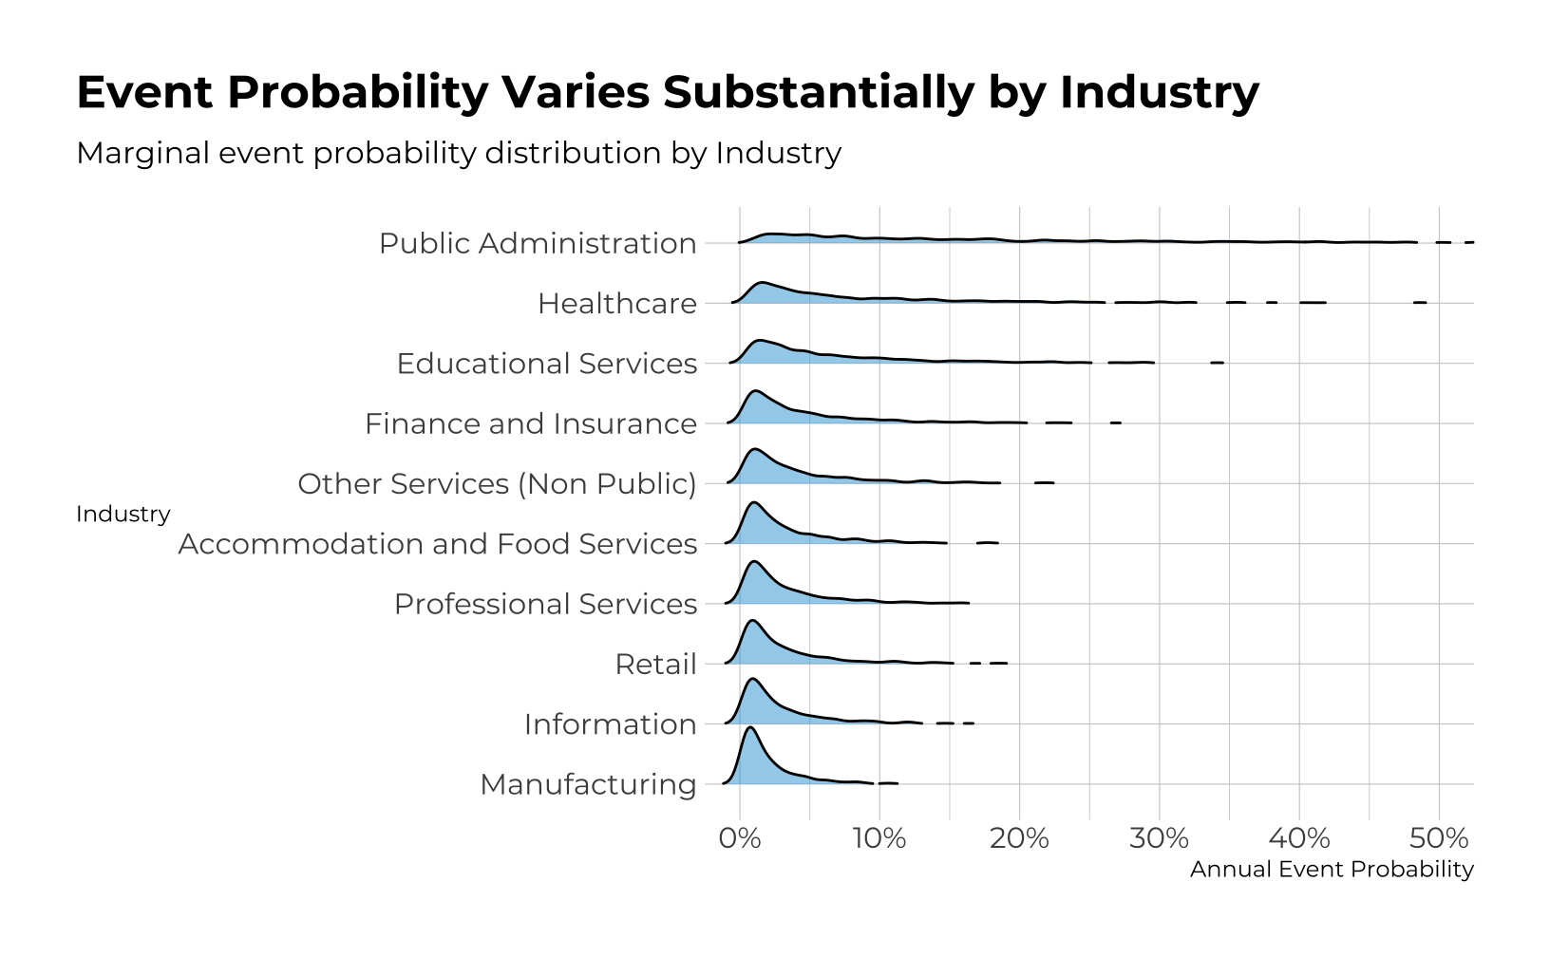
Probability Key Drivers

Slide 10
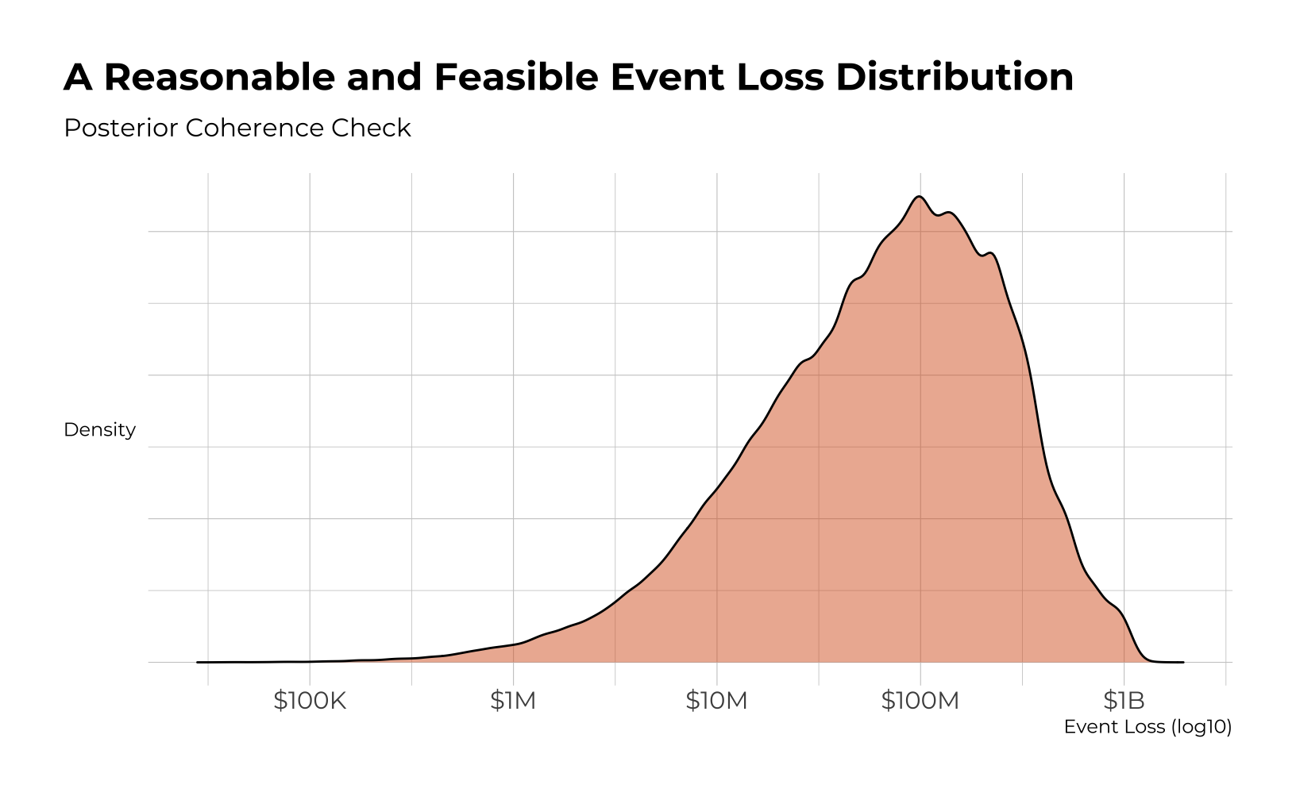
Loss Key Drivers

Slide 11
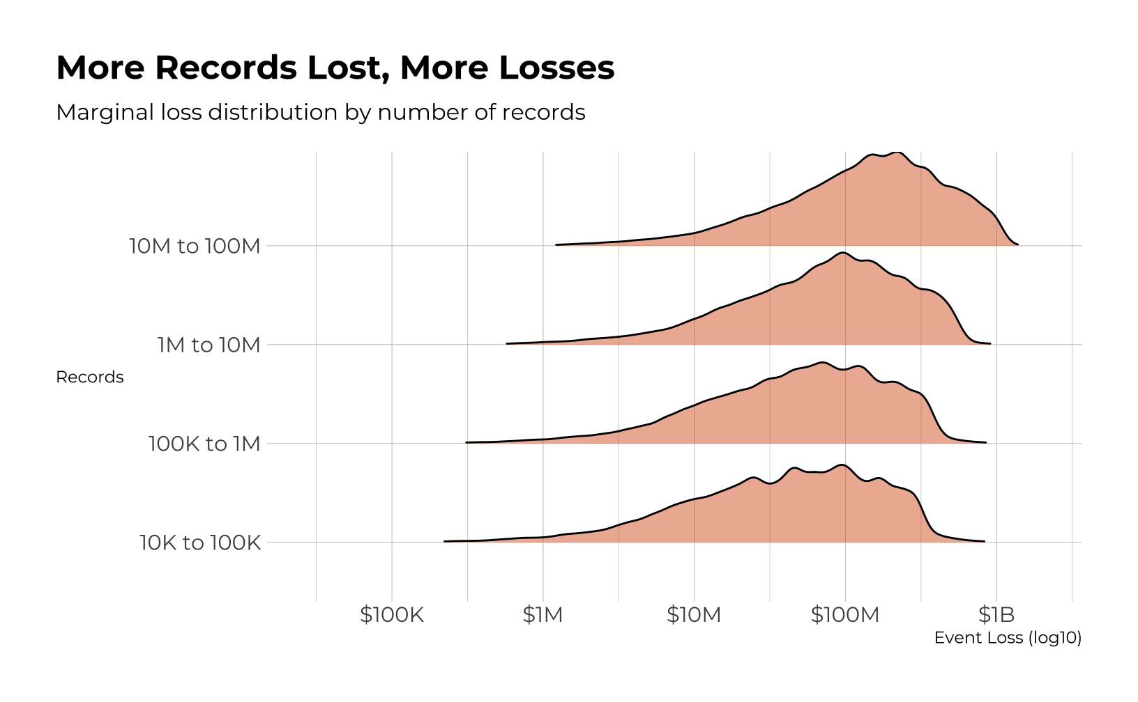
Loss Key Drivers

Slide 12
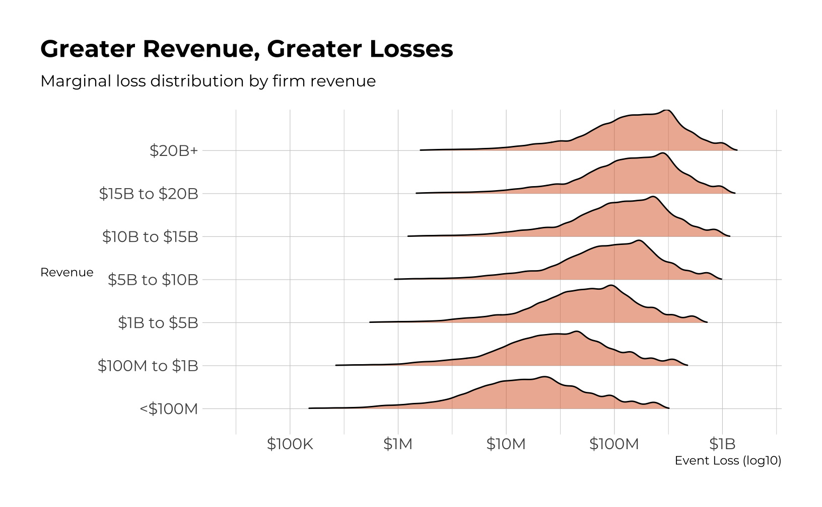
Loss Key Drivers

Slide 13
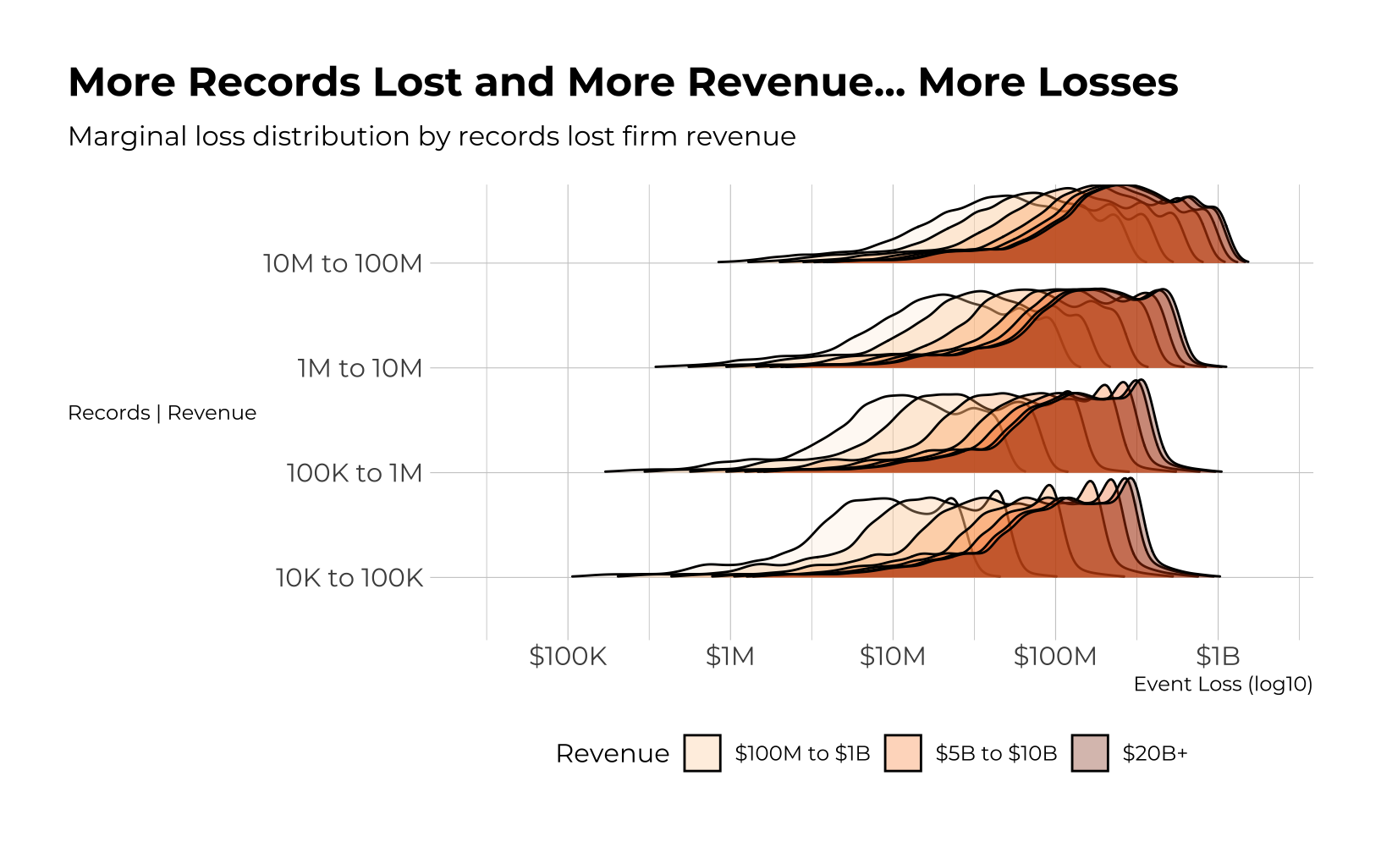
Loss Key Drivers

Slide 14
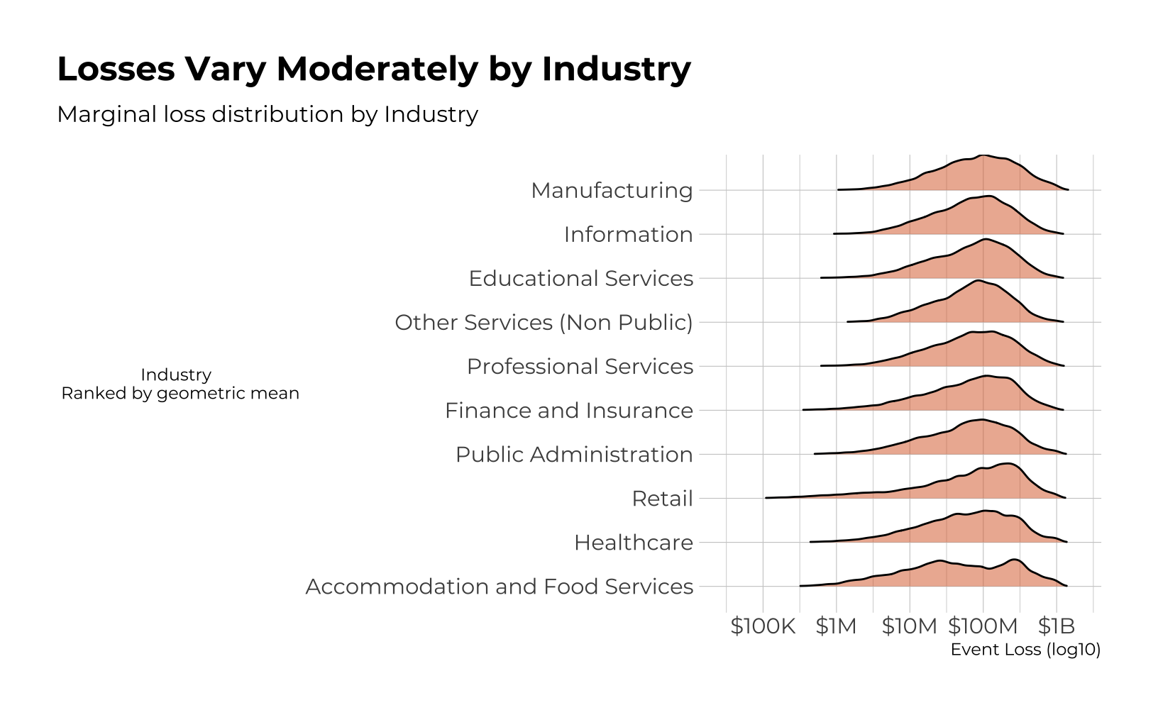
Loss Key Drivers

Slide 15
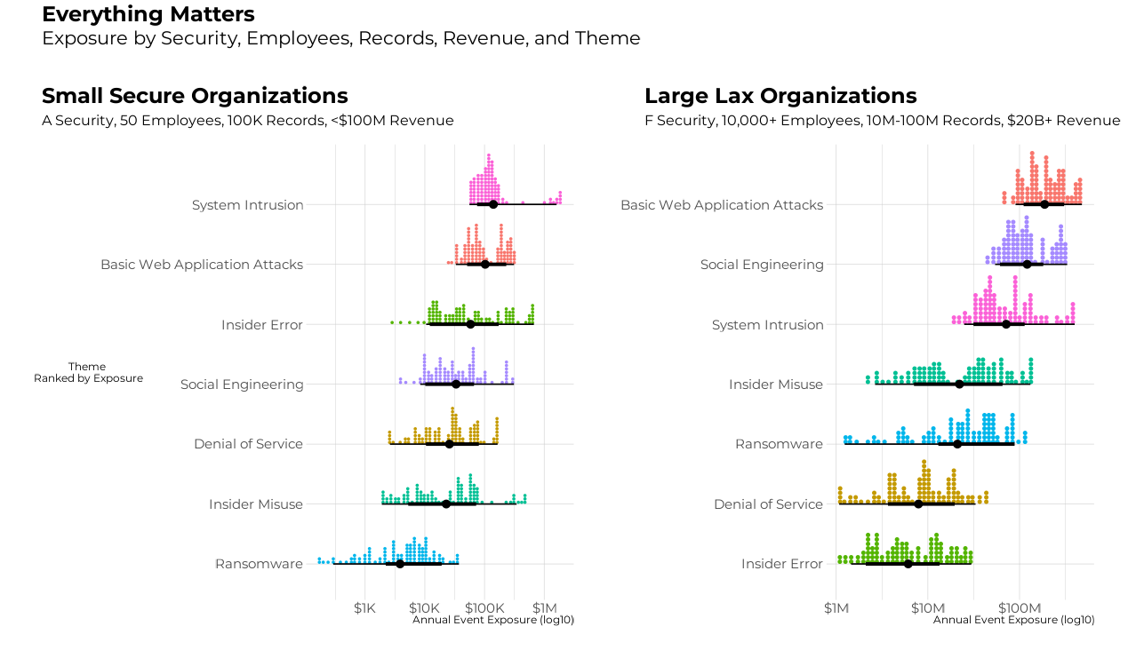
All Drivers

Slide 16
Insights

Slide 17
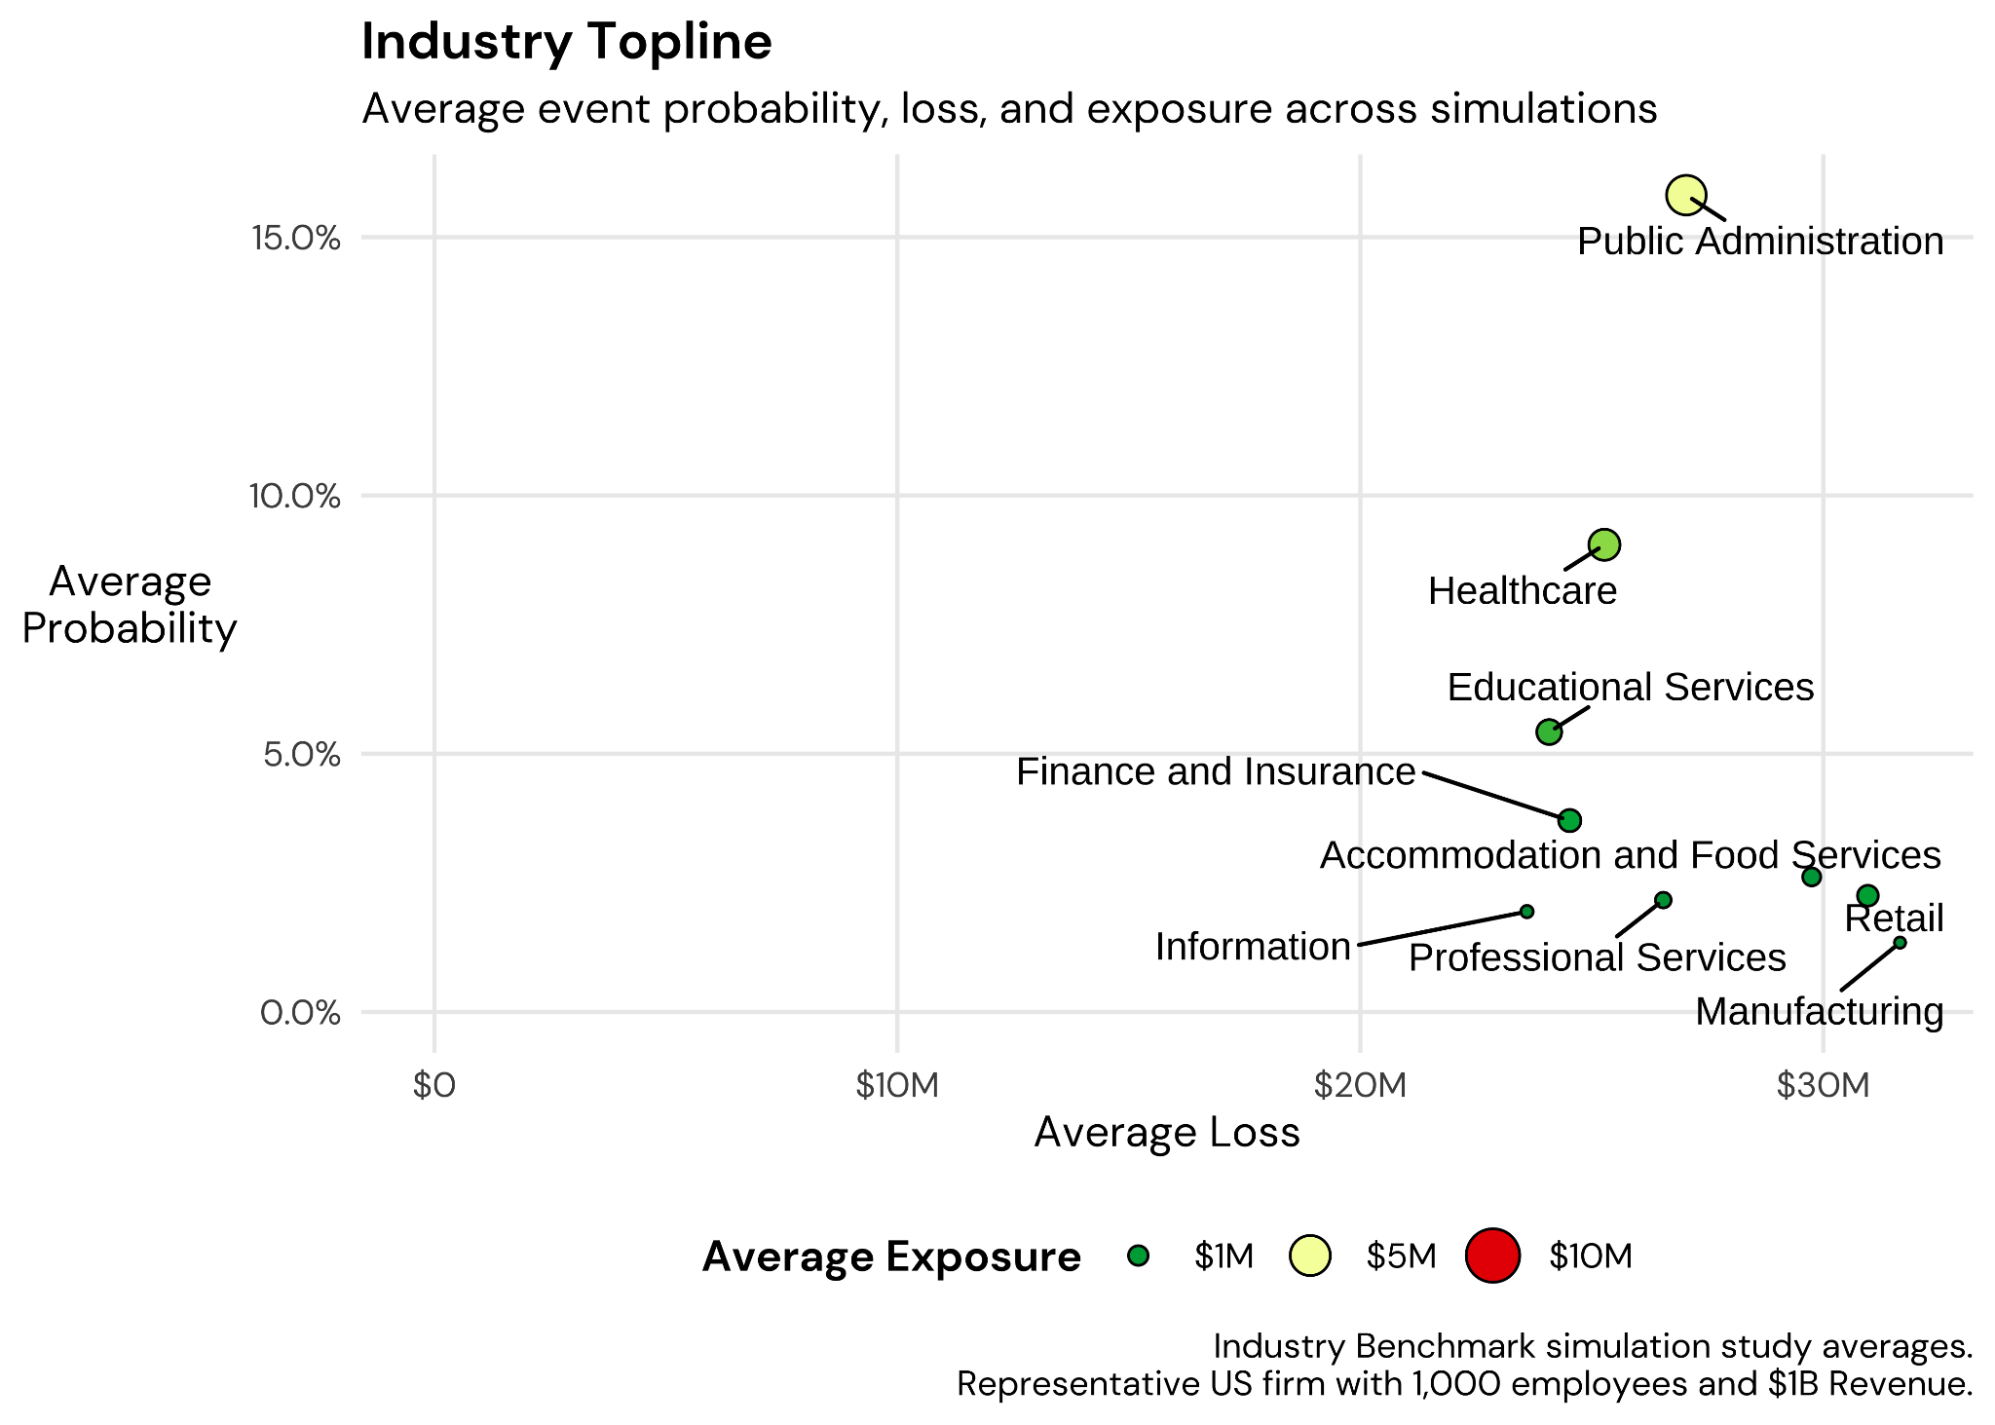
Top Industries By Loss Exposure

Slide 18
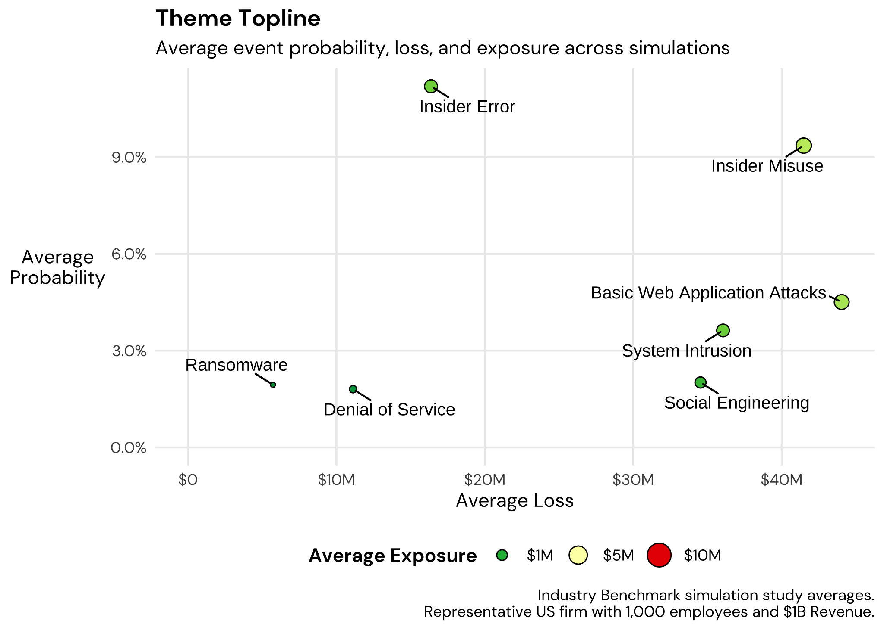
Top Risk Themes By Loss Exposure

Slide 19
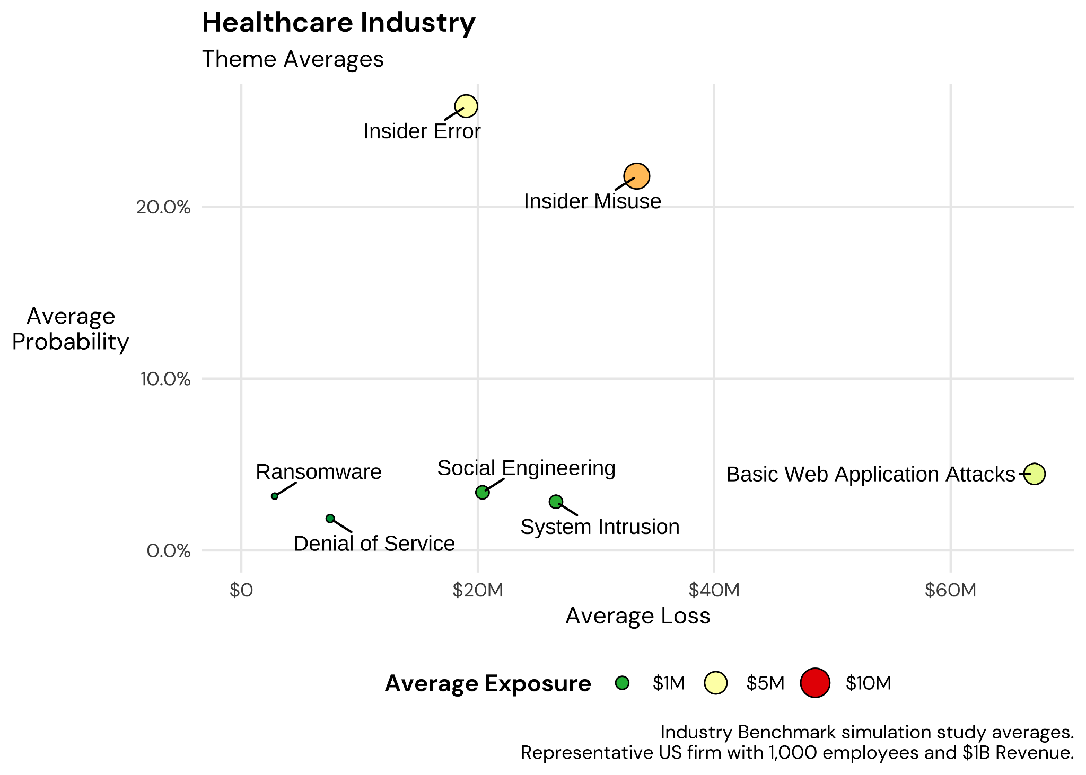
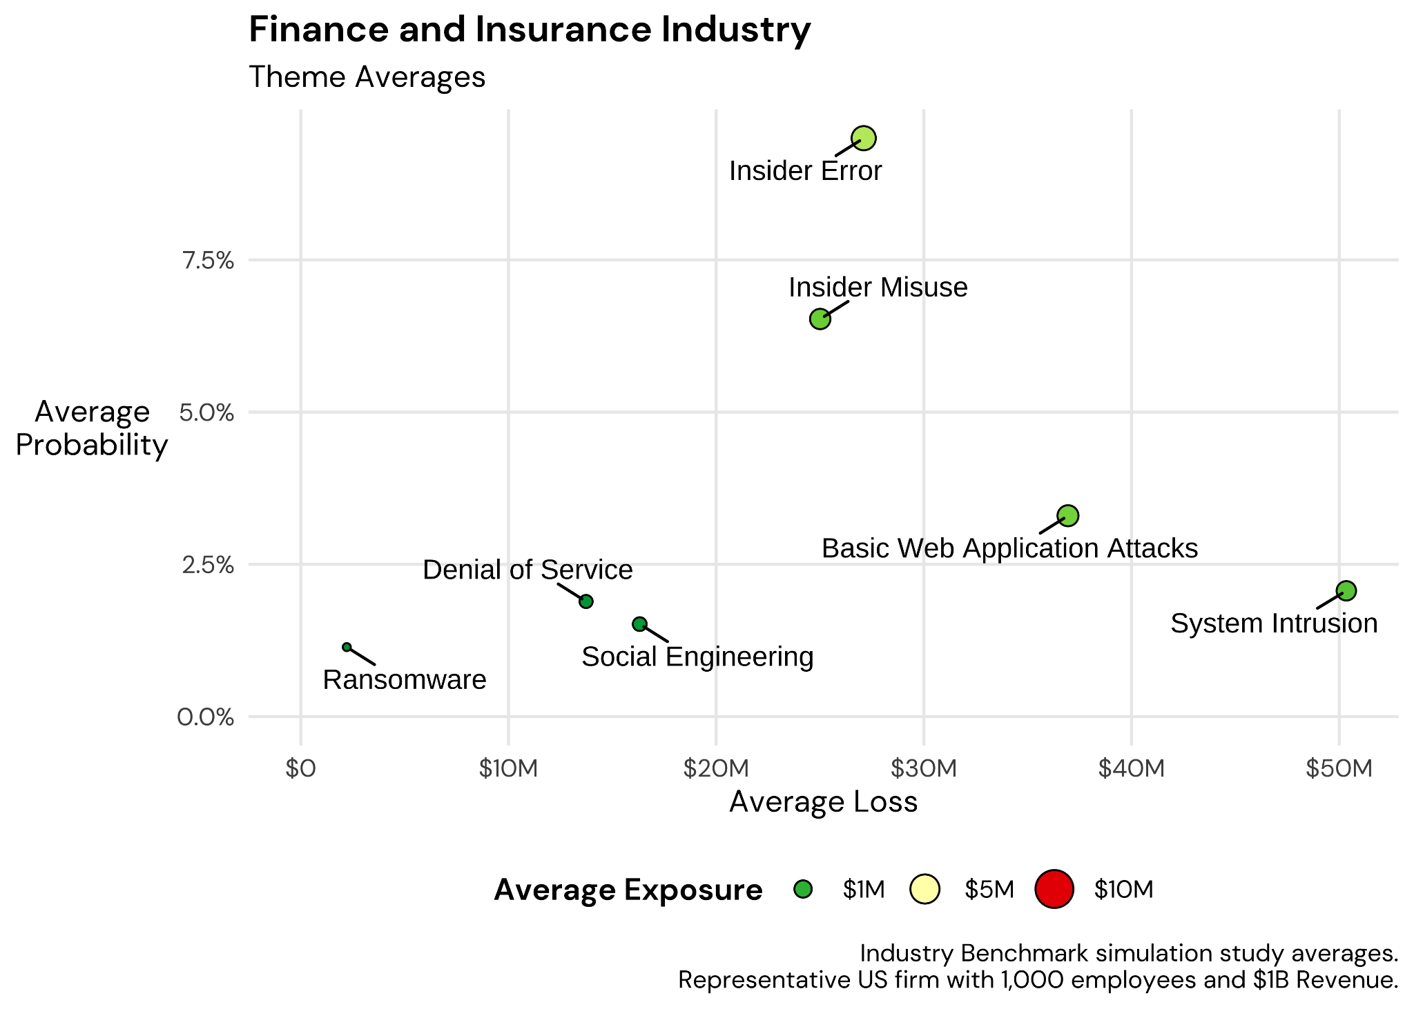
Healthcare
Financial Services

Slide 20
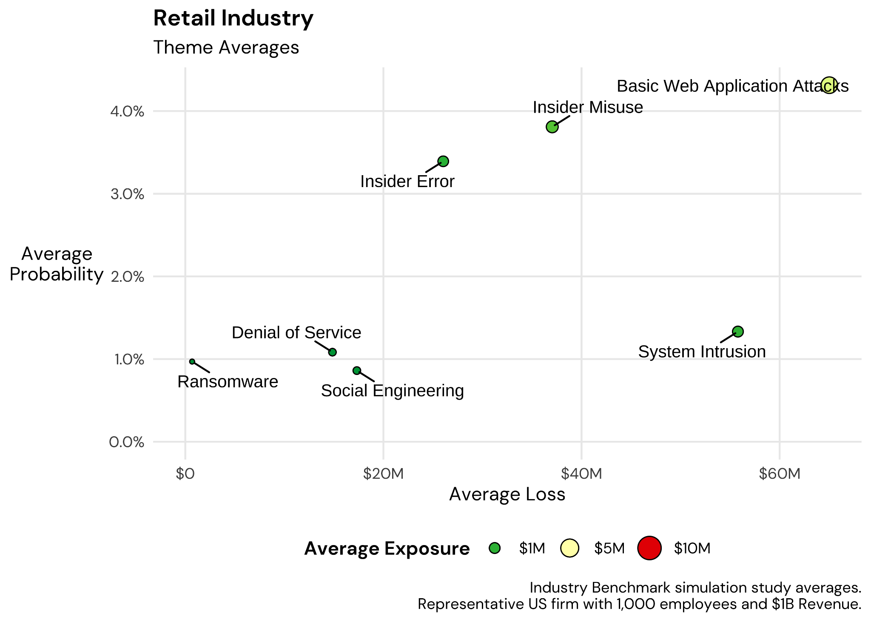
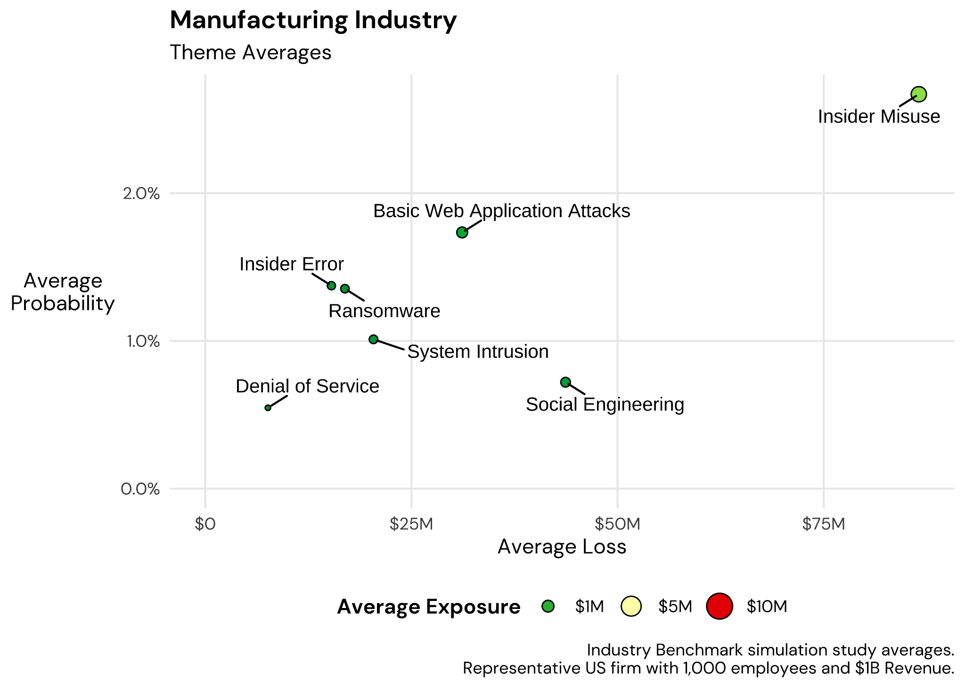
Retail
Manufacturing

Slide 21
Bigness Matters
A Healthcare organization with over 10,000 employees and over $20 billion in revenue has a 54.3% probability of an Insider Error costing $30.4 million, with an annualized exposure of $13.9 million.
The probability for a mid-size org of an impactful Insider Error is 26%.

Slide 22
Bonus - Top Risk Scenarios by Industry
Healthcare Providers
Ransomware leading to PII/PHI data loss (Electronic Medical Records)
Cyber criminals exfiltrating patient data via Third Party APIs
Insider Error leads to data exposure
Insider Error leads to outage of critical system(s)
Ransomware causes systems outage

Slide 23
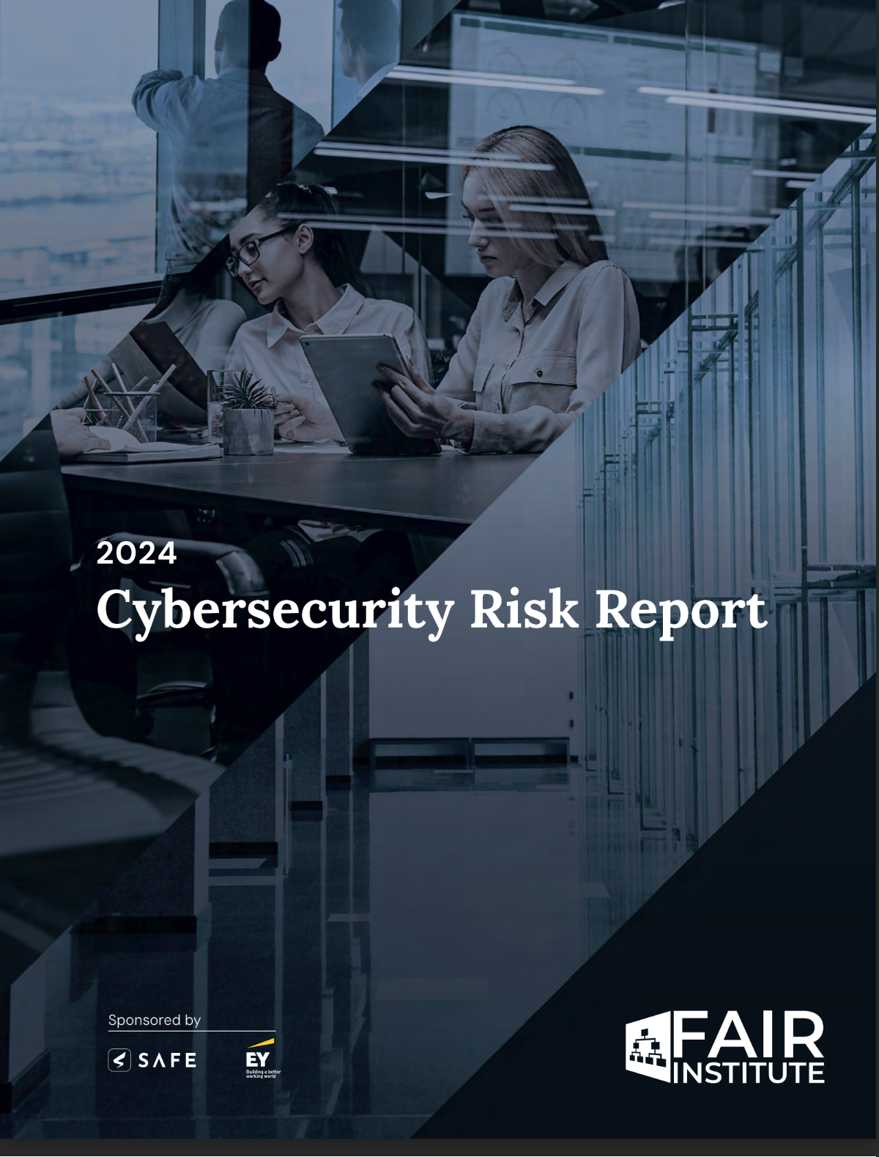
Download the Full Report
Under ‘Resources’ fairinstitute.org

Slide 25
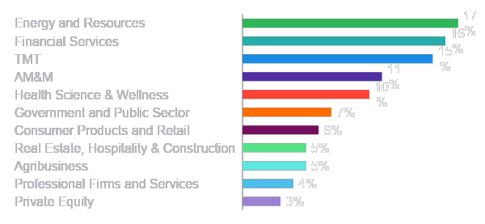
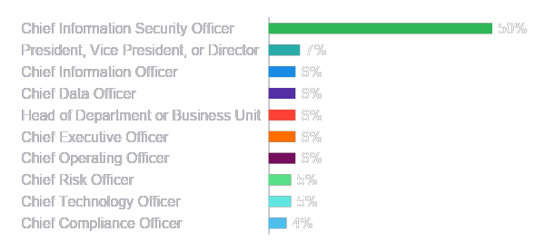
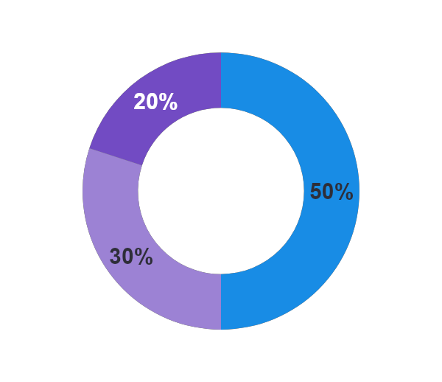
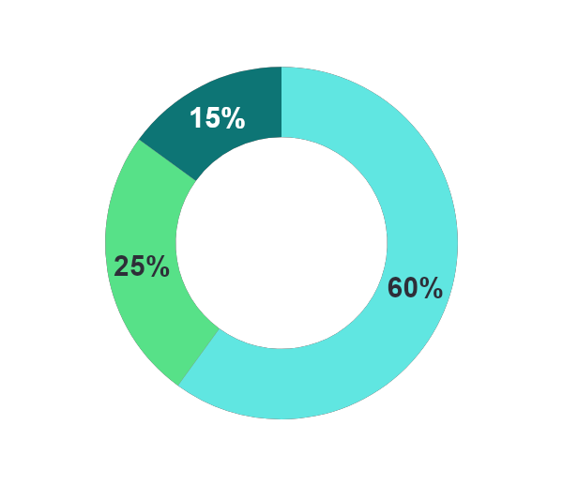
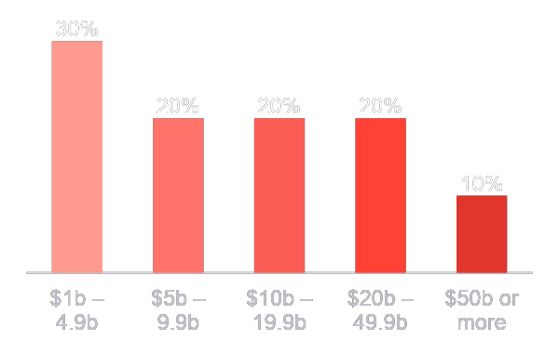
About the survey
Demographics
n=500
The EY 2023 Global Cybersecurity Leadership Insights Study was developed to better understand how companies are approaching their organization’s cybersecurity to prepare for the cybersecurity threats of today and tomorrow.
The study draws on insights from a global survey of 500 cybersecurity leaders – including 250 Chief Information Security Officers (CISOs) – across eight groups of industries and 25 countries covering the Americas, Asia-Pacific, and EMEIA (Europe, the Middle East, India and Africa). Respondents represented organizations with over US$1b in annual revenue.
Research background
Primary industry
Primary role
Regions
Ownership structure
Revenue
Publicly owned
Americas
Privately owned
EMEIA
Asia-Pacific
Government agency or department

Slide 26
How cybersecurity leaders are mastering complexity
Organizations face evolving challenges in managing the cyber threats of today and tomorrow. Among CISOs and the C-suite, only one in five consider their cybersecurity effective today and well positioned for tomorrow.
Organizations are under constant attack and their response is not up to par:
~75%
increase in known cyber attacks in the last five years*
44
Average number of cyber incidents in 2022
76%
take six months or longer to detect and respond to an incident
We identified organizations who achieve better cybersecurity outcomes, called Secure Creators
To identify companies with better cybersecurity outcomes, leaders evaluated their organization against a range of objective and subjective cybersecurity metrics. Through statistical modeling, we identified two segments:
Secure Creators
Prone Enterprises
5 months
Average time to detect and respond to a cyber incident
11 months
Secure Creators
The most effective cybersecurity (42% of organizations)
32
Average number of cyber incidents in 2022
52
51%
% satisfied with overall cybersecurity approach
36%
Prone Enterprises
Their lower performing counterparts (58% of organizations)
53%
% agree org is positioned well for tomorrow’s threats
41%
*University of Maryland CISSM Cyber Attacks Database

Slide 27
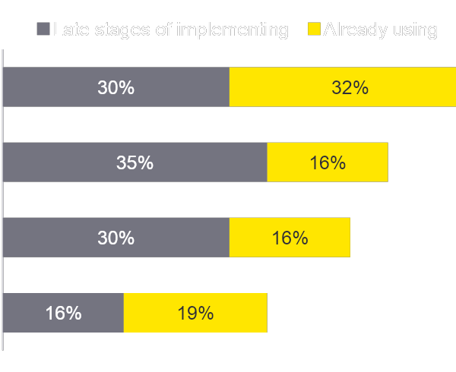
Secure Creators focus significantly more on adopting new technology into cybersecurity
Most Secure Creators (70%) consider themselves early adopters of emerging technology rather than waiting until technology is tried and tested.
Secure Creators are utilizing advanced solutions to simplify their environment by adopting technology focused on automation and simplification, such as AI or ML, SOAR, DevSecOps, and cloud orchestration and automation.
Early adopters of emerging technology
Emerging technologies focused on automation and simplification
70%
Artificial intelligence or machine learning
Security Orchestration, Automation, and Response (SOAR)
Secure Creators
Cloud orchestration and automation
DevSecOps
60%
Key takeaway
Organizations should accelerate their adoption of automation including AI or ML and SOAR.
Prone Enterprises

Slide 28
Download the Full Report
https://www.ey.com/en_gl/consulting/is-your-greatest-risk-the-complexity-of-your-cyber-strategy

Slide 29
Appendix

Slide 30
A wave of new cybersecurity technology adoption is imminent, bringing along new risks
Secure Creators’ approach also positively impacts their adaptability as threats change.
With 84% of organization in the early stages of adopting two or more cybersecurity technologies, adaptability will be an ongoing necessity as this wave of new technology implementation poses two key risks:
01 | The scale and complexity of the growing cybersecurity tech stack may inadvertently create new vulnerabilities.
02 | The same technology has the potential to empower hackers.
Companies need a cybersecurity technology strategy which provides security through simplification. Cyber leaders should:
Key takeaway
Simply bolting on new technologies may inadvertently create new vulnerabilities. Companies need a strategy which provides security through simplification.
Review legacy systems that are duplicative or poorly integrated
Consider automation-led approaches including DevSecOps and SOAR
Seek to adopt a platform-based approach to cybersecurity technology - removing point solutions wherever possible
Pursue co-sourcing and a managed services approach that simplifies infrastructure, increases visibility, and provides cost efficiencies

Slide 31
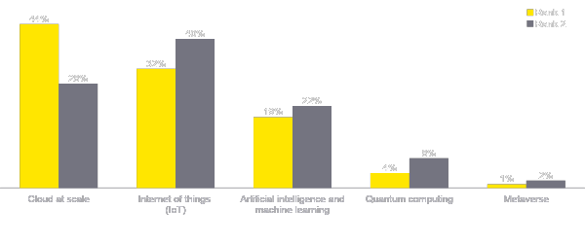
New technologies are creating new attack surfaces
Gaining coverage of a sprawling attack surface
Too many potential attack surfaces is the #1 internal challenge for an organization’s cybersecurity approach today (52%).
Budget, historically cited as a top challenge, only ranked 6 out of 8 overall (36%).
Compounding this is the risk that cloud at scale and IoT pose – over 7 in 10 rank these as the top two technology risks in the next five years.
Organizations need to harness automation — 50% of Secure Creator CISOs are already using or about to implement cloud orchestration and automation in their approach to cybersecurity.
Technologies that pose the biggest cybersecurity risks
Key takeaway
Organizations cannot assume cyber risk is being handled by their service providers. They need to take a shared responsibility approach and hold these providers to the same security standards across the organization.

Slide 32
How we identified Secure Creators
Methodology
To identify organizations with better outcomes, we defined the key outcomes, which include both objective and subjective metrics:
Mean time to detect (MTTD)
Mean time to respond (MTTR)
Number of incidents
Integration of cybersecurity within the organization
Cybersecurity’s impact on innovation and value creation
Using latent class analysis, we identified two segments:
Secure Creators: Higher performing organizations (n=209)
Prone Enterprises: Lower performing organizations (n=291)
The biggest behavioral drivers of better outcomes in high-performing organizations include:
Higher budget allocation to detection and prevention
Already using AI/ML, cloud orchestration and automation, and DevSecOps
Late stages of implementing passwordless authentication and SOAR
Early adopters of technology
Compliance driven

