Slide 1
State of the CRQ Market
Cody Scott
Forrester Research

Slide 2
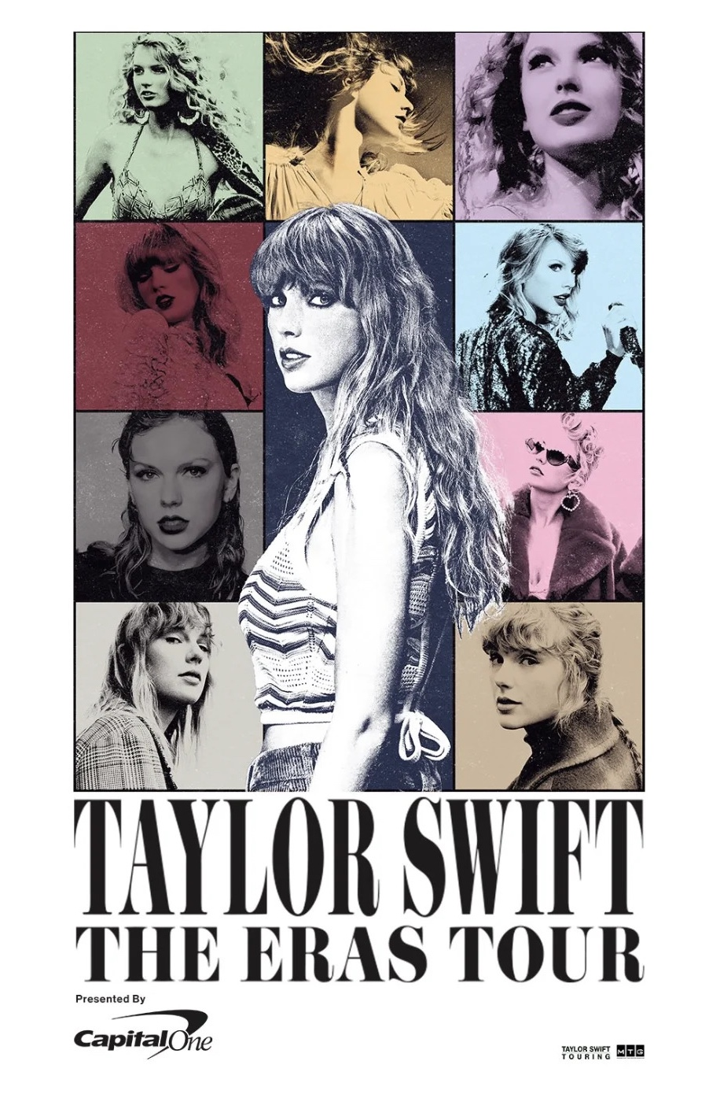
The CRQ market’s unofficial champion
Image credit: Suzy Byrne, yahoo.com

Slide 3
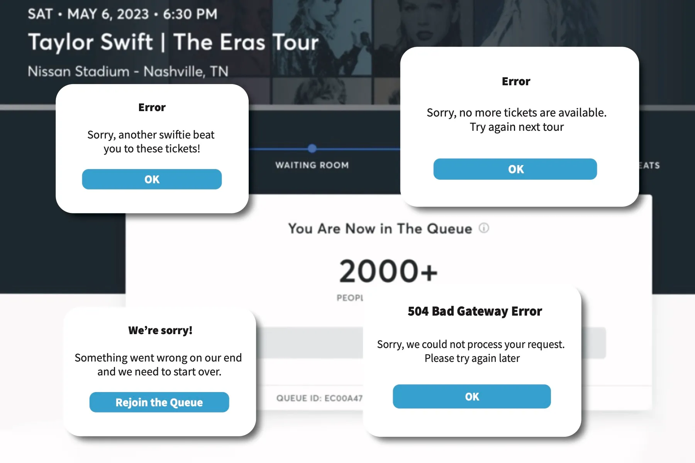
If only we could’ve forecasted this…
Image credit: Erin Shi, Rebecca Smith via The Michigan Daily
Notes:
DOWNSIDE RISK
Staggering number of bot attacks, as well as fans without invite codes, drove unprecedented traffic
Resulting in 3.5 billion total system requests – 4x our previous peak
Ticketmaster only anticipated traffic for 3.5M verified accounts. (Despite a long record of big-name artists experiencing higher demand than verified buyers on their platform, in addition to historical problems with bot attacks).

Slide 4
…or this…
Image credit: Brian Fung, CNN
Notes:
“"We knew bots would attack that onsale, and planned accordingly," according to Berchtold's prepared remarks.
"We were then hit with three times the amount of bot traffic than we had ever experienced, and for the first time in 400 Verified Fan onsales they came after our Verified Fan access code servers.
While the bots failed to penetrate our systems or acquire any tickets, the attack required us to slow down and even pause our sales. This is what led to a terrible consumer experience that we deeply regret."

Slide 5
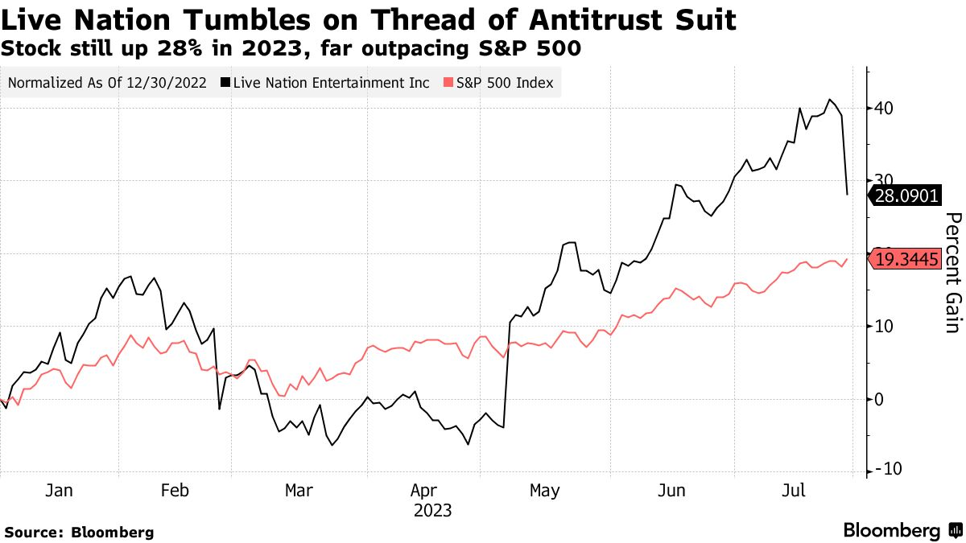
…or this…

Slide 6
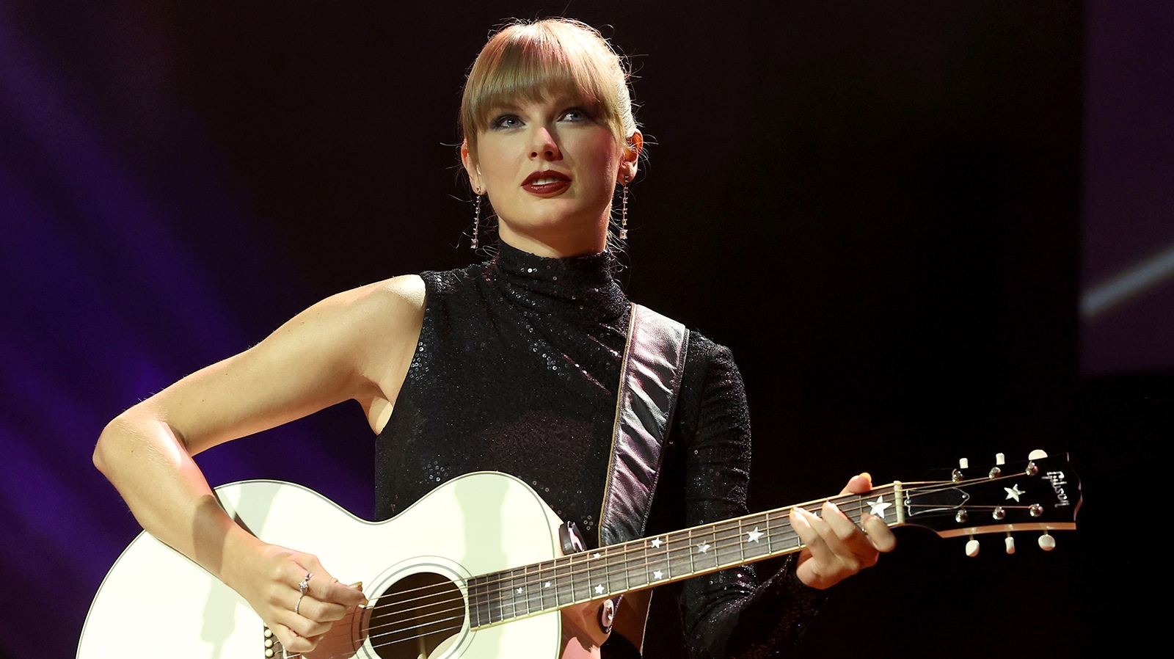
Rare loss event?
Or everyday problem at scale?
Image credit: Frank Pallotta, CNN
Notes:
[Threat actor] – economically motivated attackers, targeting…
[Asset] – crown jewels – Verified Fan access code server, via…
[Method] – bot attacks

Slide 7
Risk is increasing globally
Image credit: TheDigitalArtist on Pixabay

Slide 8
44%
Enterprise risk decision-makers reporting that the level of risk has increased in the past 12 months
Base: 1285 Business and technology professionals who indicated that reducing enterprise risk is a priority for their organization Source: Forrester’s Priorities Survey, 2023
Notes:
Risk is increasing globally.
North America, 52% report that risk has increased in past 12 months.
What’s

Slide 9
What’s driving increased risk globally?
35% Increased reliance on 3rd parties
34% Financial instability
29% Increased regulatory requirements
27%
Increased reliance on technology
Source: Forrester’s Priorities Survey, 2023

Slide 10
Why CRQ? And why now?
Notes:
3 key drivers…

Slide 11
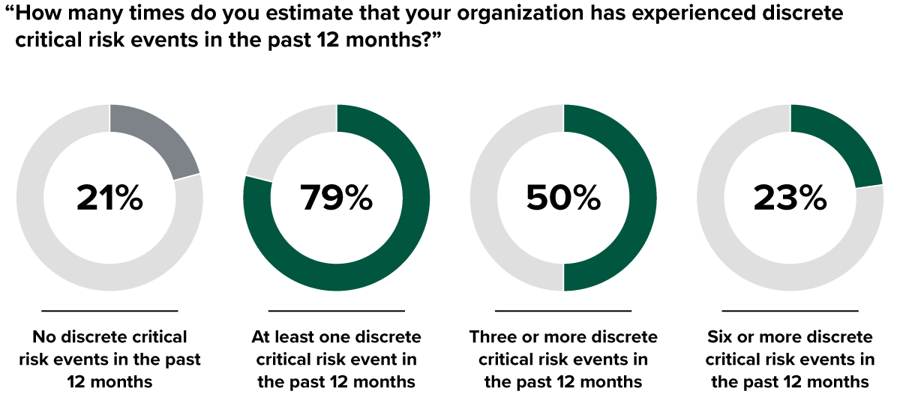
1. Critical risk events are increasing…
Base: 882 enterprise risk management decision-makers at enterprises
Source: Forrester’s Priorities Survey, 2023
Notes:
Companies are facing more discrete critical risk events than before
Discrete critical risk event: ”events causing significant business, financial, or reputational impacts or disruptions”
79% — up from 72% in 2021
Even more pronounced — 23% experienced 6 or more — up from 19% in 2021
Averages to a crisis at least every other month
Now, organizations are doing something about it…. [NEXT SLIDE]

Slide 12
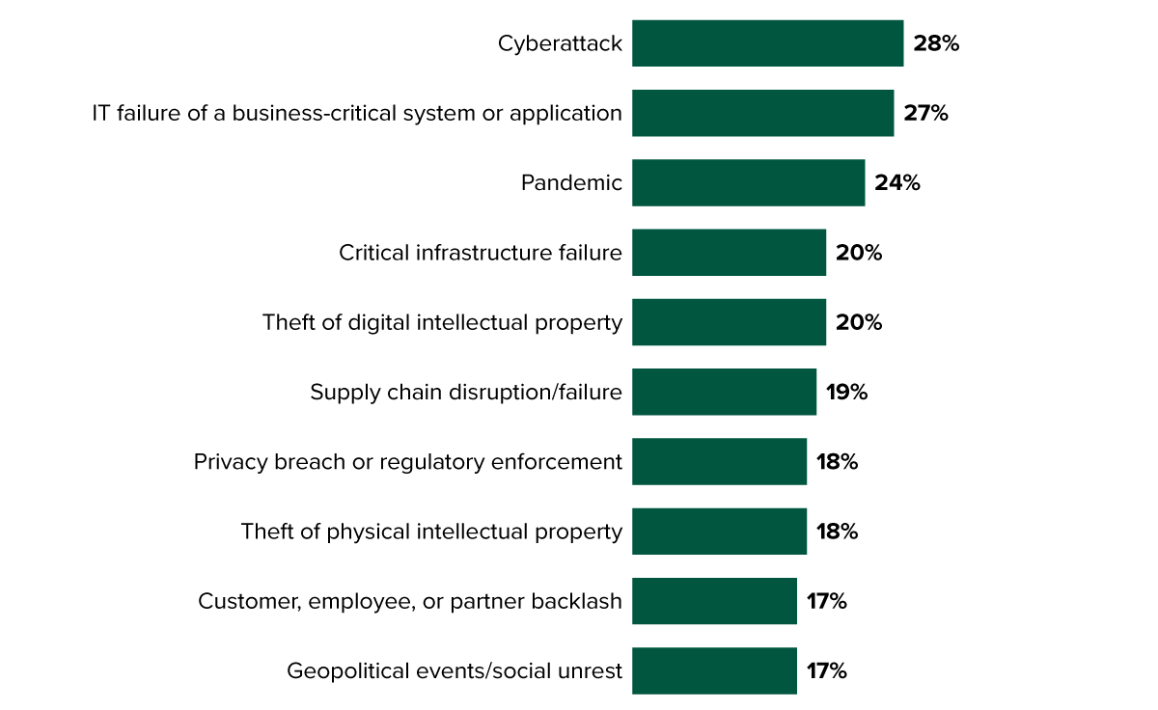
Cyber and IT-related risk events are prolific
Base: 700 global enterprise risk management decision-makers whose enterprise experienced at least one critical risk event in the past 112 months
Source: Forrester’s Business Risk Survey, 2022
Notes:
Survey question: “Which of the following types of discrete risk events did your organization experience in the past 12 months”
Cyber and IT-related risk events are MOST COMMON

Slide 13
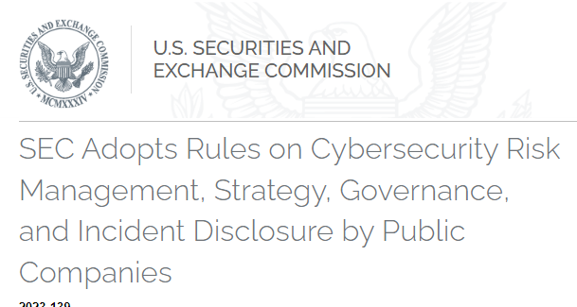
2. Cyber regulatory pressure is increasing…

Slide 14
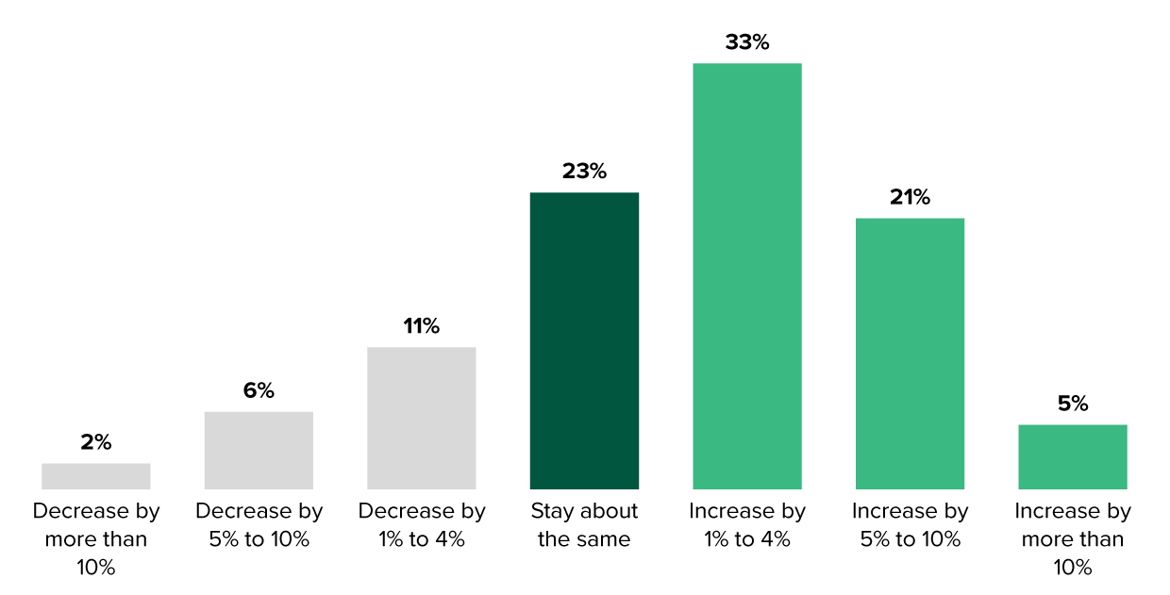
3. Risk management budgets are increasing…
59% plan to increase their ERM budget in the next 12 months
Base: 887 global enterprise risk management decision-makers at enterprises
Source: Forrester’s Priorities Survey, 2023
Notes:
Survey question: “Considering the next 12 months, which best describes any expected change in your org’s overall budget for ERM?”
59% will increase their budget

Slide 15
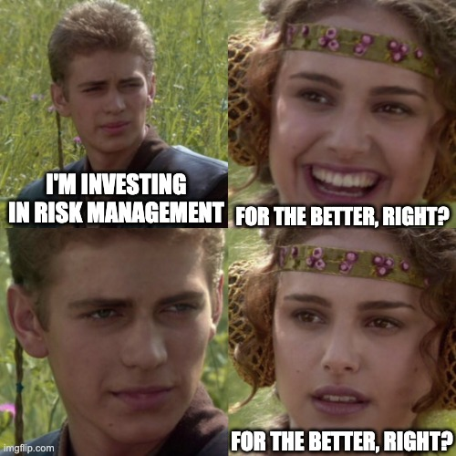
Investment is good, but what are the priorities?
Notes:
Now we need to talk about a competing issue: the Maturity Problem
The meme could be misconstrued as orgs not investing meaningfully… and that’s not my intention; rather, risk management is still reactive.
End user understanding of CRQ still has a maturity problem.

Slide 16
21%
Business/tech pros planning to invest in cyber risk quantification to reduce enterprise risk
Base: 1285 Business and technology professionals who indicated that reducing enterprise risk is a priority for their organization Source: Forrester’s Priorities Survey, 2023
Notes:
How are business and technology leaders responding? It’s complicated. CRQ seems like an obvious answer to improve the way organizations manage risk…
PRO: Orgs are no longer just thinking about it --- they’re putting money behind it signaling a step forward
CON: It’s only 21 percent.
Teams that manage CRQ are often 2-3 FTEs.
Enterprises that can afford it and are actively piloting CRQ face significant organizational silos and internal barriers
FORTUNATELY: We’re starting to see interest in risk quant outside of just the security team.
HOWEVER, organizations have a maturity problem… and many of them are only just now discovering it, which influences their priorities

Slide 17
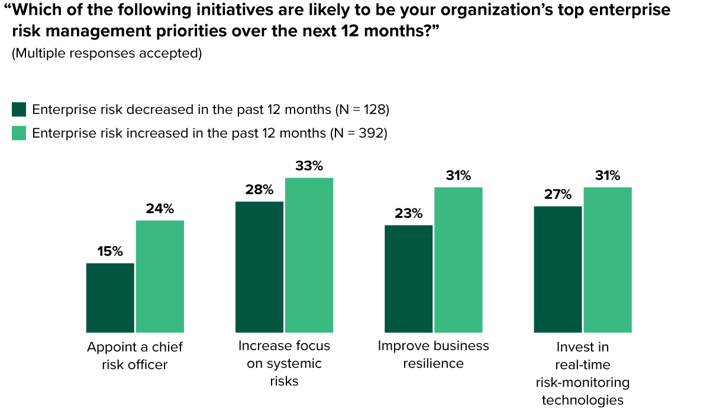
Risk management priorities are (still) reactive…
Base: 128 and 392 global enterprise risk management decision-makers at enterprises
Source: Forrester’s Business Risk Survey, 2022
Notes:
Reflect back on the 44% of orgs saying that their overall enterprise risk has increased in the last 12 months…
We asked them what their priorities will be in the next 12 months.

Slide 18
Navigating the CRQ Market

Slide 19
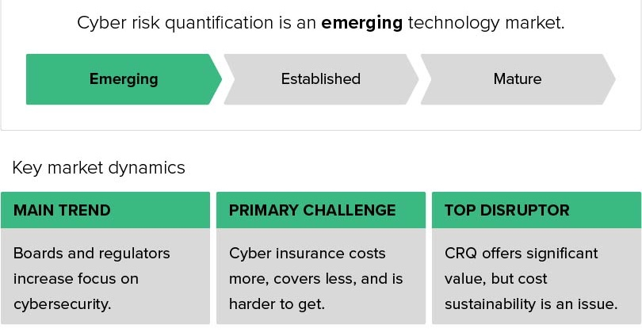
CRQ market dynamics
Source: Forrester, The Cyber Risk Quantification Landscape, Q4 2022

Slide 20
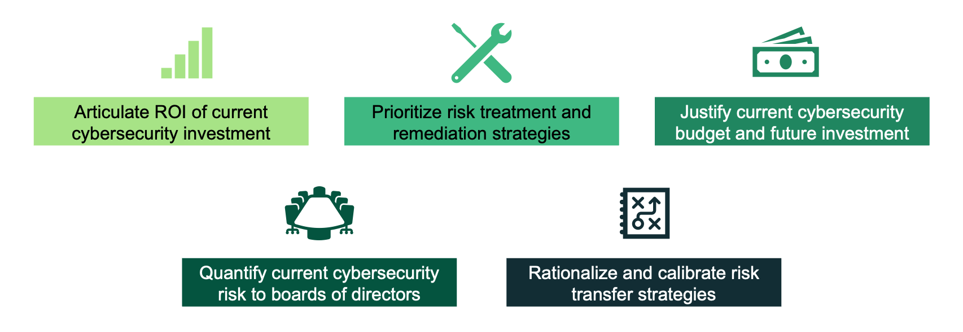
Top CRQ use cases
Source: Forrester, The Cyber Risk Quantification Landscape, Q4 2022
Notes:
These use cases are fairly well known… but, importantly, they are driving innovation in the technology offerings on the market today.
Evolving from a point solution for risk modeling to a platform tool that functions similarly to IT GRC tools

Slide 21
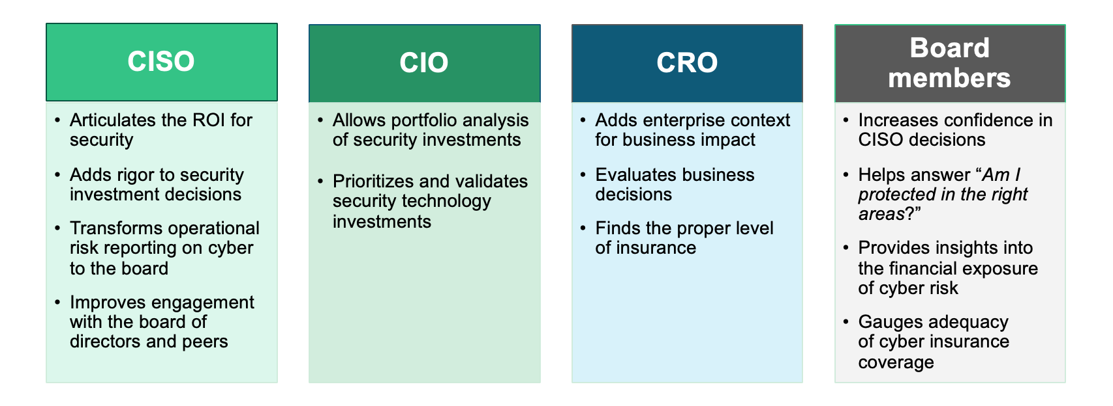
CRQ value by audience
Source: Forrester, The Cyber Risk Quantification Landscape, Q4 2022
Notes:
Organizations are starting to look beyond the obvious CISO/CIO and Board connection and focusing on the CRO as well.
Boards are becoming more active – from recipient to partner – driven primarily by regulatory environment

Slide 22
Software versus services
Software-centric
Services-led
Dedicated software product deployed to end user
Scoped consulting engagements with services firms
Guided implementation support
Some customization to meet user needs
Full customization to user requirements
Customer success and solution support
Primary support on software implementation, limited consulting support
Offers more “hands-on” implementation approach
Moderate price but harder to consume
Expensive and harder to scale implementation

Slide 24
Evaluation criteria
Product Offering
Methodology
Data
Analytics
Reporting
User experience
Integrations
Workflow
End-user program development

Slide 25
Evaluation criteria
Company Strategy
Vision
Innovation
Roadmap
Partner ecosystem
Adoption
Pricing flexibility

Slide 26
Customers should look for vendors that…
Offer flexible risk modeling AND drill-down functionality
Easily integrate with existing security tech stacks
Align with industry standards/frameworks
Adhere to a cyber value-at-risk model

Slide 27
Where does industry research need to go?
Image credit: BBC News

Slide 28
1. Exploration
Level: Beginner
Key principles
Reinforcing basics
(Most common type today)
Image by WikiImages from Pixabay

Slide 29
2. Implementation
Level: Beginner/intermediate
Case studies
CRQ pilots*
How To guides*
Lifecycle approaches
Image by geralt from Pixabay

Slide 30
3. Benchmarking
Level: Intermediate/advanced
Data focused
Addressing uncertainty
Supplementing internal sources
Image by Mohamed Hassan from Pixabay

Slide 31
4. Retroactive
Level: Advanced
Case studies measuring how CRQ could have measurably improved real-world events
Ticketmaster!
Image credit: motorsportlab.com

Slide 32
What kinds of research would you find most interesting?
Notes:
3 key drivers…

Slide 33
Thank you!

