Slide 1
Quantifying Multi-Product Security and Privacy AI Risk with FAIR and NIST AI RMF
Presented By:
Tyler Britton | Security Engineer, Risk Nerd
Taylor Maze | Risk & Governance Manager, Wine Enthusiast

Slide 2
Agenda
Assessment Scope & Background
Assessment Process
Methodology
NIST AI RMF
FAIR
Key Takeaways
Practical Application: AI Risk Quantification Guide

Slide 3
Assessment Scope: the Ask
How does the usage and development of AI products impact our overall risk posture?
…and how can we best manage that new risk?

Slide 4
The Challenge
How do we quantify AI-related risks?
Key lack of industry information and regulatory guidance about AI risks, as the emergence of AI is new.

Slide 5
Assessment Process
AI risk assessment process remains largely unchanged:
Initial scope ideation (using NIST AI RMF)
Review & refine scope into risk scenarios with SMEs
Data gathering / quantification
Reporting

Slide 6
Step 1: AI-Risk Recon to Establish Scope

Slide 7
NIST AI Risk Management Framework
Goal: to think outside the [cyber and privacy] risk box to encompass risk related to AI trustworthiness
Source: Characteristics of trustworthy AI Systems, NIST AI RMF (https://nvlpubs.nist.gov/nistpubs/ai/NIST.AI.100-1.pdf)

Slide 8
AI Risk Recon Topics
Hallucinations
Membership Inference
Model Inversion
AI Risk topics gathered from a variety of sources, including SMEs and online
Model Theft
Model Poisoning
Biased Data/Outputs
Prompt Injection
Model Deterioration
Harmful/Unlawful Outputs

Slide 9
Step 2: Sanity Check & FAIRitization

Slide 10
FAIR-itization example: Hallucination
Concern to risk scenario translation process
Define the loss (i.e. risk scenario statement)
Identify the attack chain
Identify the point at which the loss event and secondary loss event happens
Identify the loss impacts

Slide 11
FAIR-itization example: Hallucination
Concern Identification / Risk Therapy
What is a hallucination?
How do hallucinations happen?
Why do we care if it happens?
What’s the impact?

Slide 12
FAIR-itization example: Hallucination
Loss Event Defined: Quantifiable Risk Statement
The risk associated with an impact to the quality of the product as a result of the foundational model hallucinating and producing inaccurate, misleading, or false outputs.

Slide 13
Multi-Product Application
How we assessed 60+ scenarios in <2 weeks
Map each identified risk scenario to the in-scope products
Remove those that do not apply (this will become obvious during data gathering)

Slide 14
AI Risk Recon Topics
Hallucinations
Product A immature model causes hallucination
Product A bad data leads to hallucination
Product B bad data leads to hallucination
Product A model theft by insider
Product A model theft by external actor
Product B model theft by insider
Attacker performs P.I. on Product A
Attacker performs P.I. on Product B
Model Theft
Prompt Injection

Slide 15
Step 3: Data gathering & quantification

Slide 16
AI Data Gathering: Hallucinations Loss Frequency
Loss Chain
How many AI-generated outputs does the product produce, per year? [Contact Frequency]
What is the hallucination rate of the product, i.e., what percentage of outputs may result in a hallucination? [Probability of Action]
What portion of hallucinations will users (1) be aware of and (2) adversely impacted by? [Susceptibility]
Users use the product
Output is a hallucination
User notices hallucination
User is “adversely impacted” by the hallucination

Slide 17
AI Data Gathering: Hallucinations Loss Frequency
Loss Chain
How many AI-generated outputs does the product produce, per year? [Contact Frequency]
What is the hallucination rate of the product, i.e., what percentage of outputs may result in a hallucination? [Probability of Action]
What portion of hallucinations will users (1) be aware of and (2) adversely impacted by? [Susceptibility]
Users use the product
1M
Output is a hallucination
2%
User notices hallucination
50%
User is “adversely impacted” by the hallucination
1%
100 Loss Events per Year
Notes:
Tyler to give a foloow up example of how these numbers might look very different, such as in the case of AI moderating healtchare equipment

Slide 18
AI Data Gathering: Hallucinations
Frequency - What factors impact the likelihood of customer adverse reactions?
Estimation Considerations
What service is the product providing?
What does a hallucination look like for the given product?
Does the output inform a material outcome?
Customer awareness - how likely are they to notice?
Customer impact - how harmful is the hallucination?
Customer sensitivity - how much is too much?

Slide 19
AI Data Gathering: Hallucinations
Frequency - What factors impact the hallucination rate?
Temperature (model creativity)
Other Controls:
Few shot
Chain of reasoning
Delimiting
Constraints on model response
Estimation Considerations
What is the control’s intended efficacy?
What is the degree of variance from the intended efficacy?

Slide 20
AI Data Gathering: Hallucinations
Magnitude
Costs to consider:
Incident response effort - customer complaints, investigation
Legal impact - Torts, Privacy laws, litigation
Customer churn
Estimation Considerations
Level of effort to respond to customer complaint
Limitations of liability, required effort to pursue damages
Normal customer churn, degree of harm

Slide 21
Step 4: Reporting

Slide 22
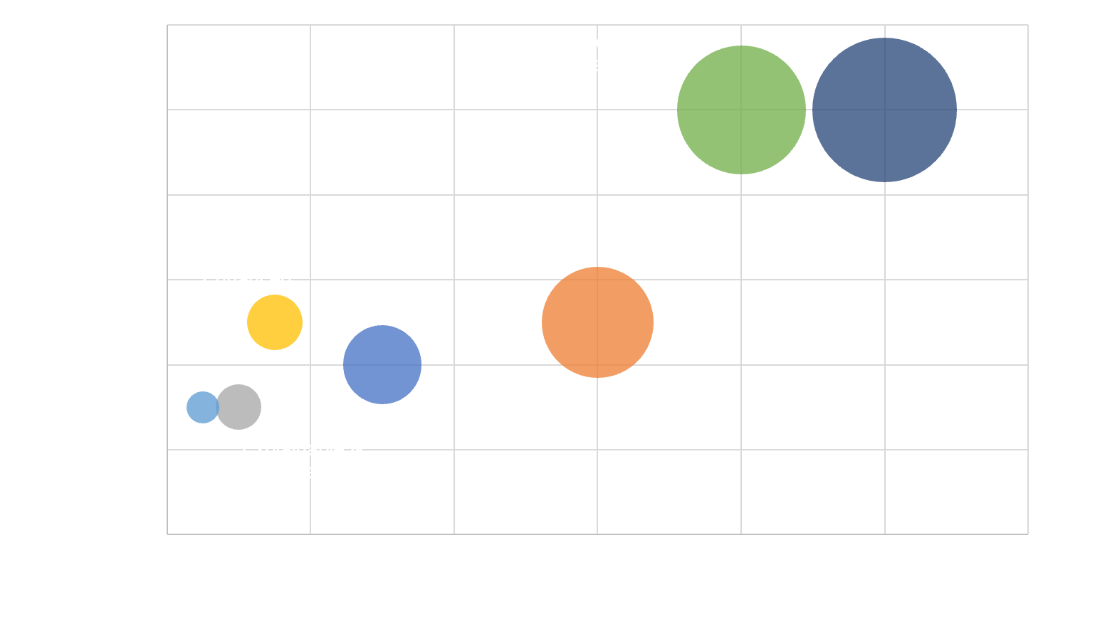
Example Reporting:
NIST AI RMF Mapping

Slide 23
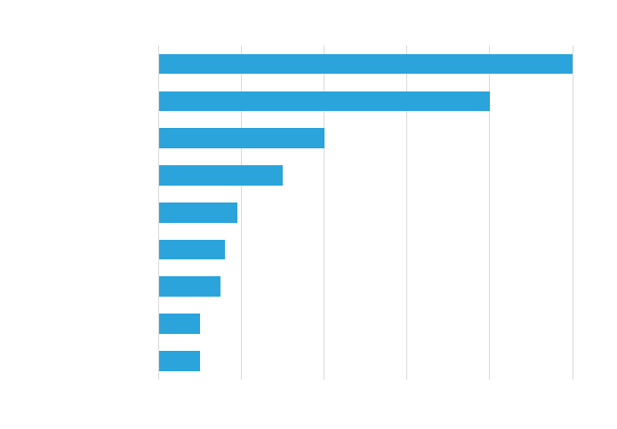
Example Reporting:
Scenario Themes

Slide 24
Lessons Learned & Key Takeaways

Slide 25
Key Takeaways
The use of AI is not inherently high-risk
There’s nothing special about AI-risk, it’s just a new attack surface
How you develop/deploy AI, and what you use it for determines it’s risk
Different types of AI risks will be wildly different in different companies
Considerations
How are we building AI products?
How are we deploying AI products?
How are we using AI 3rd Party Services?
Notes:
Give an example for each of these. For example - for bullet point 4, model theft for a social media company is likely not valuable. But model theft for a bank is likely a huge deal.

Slide 26
Thank you!
Inquire for Quant Risk AI Assessment Framework
Questions?
Taylor Maze | tmaze@dropbox.com
Tyler Britton | tbritton@dropbox.com

