Slide 1
Patch Prioritization A FAIR-CAM use case
Denny Wan, FAIR-CAM Workgroup Chair, FAIR Institute
John Linford, Forum Director, The Open Group
Sasha Romanosky, Senior Policy Researcher, RAND

Slide 2
Protect What Mattered Most
Evolution in Patching

Slide 3
Agenda
Patch Prioritization business case
EPSS overview
Patching threshold dilemma
Open FAIR & EPSS
FAIR-CAM informing Asset-Centric threshold
Fireside chat

Slide 4
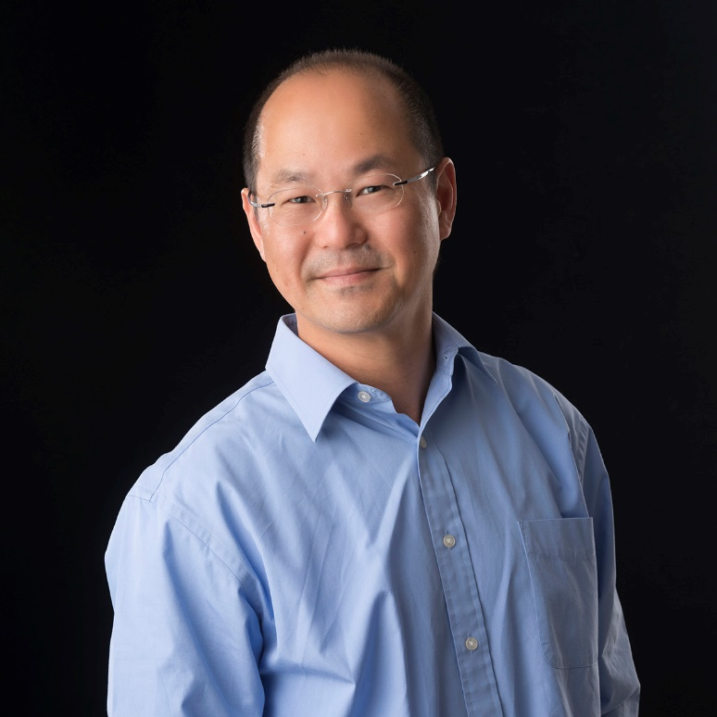
Denny Wan
ISO 27001 LA, PCI QSA
Chair, FAIR-CAM Workgroup
Founder, Sydney Chapter of FAIR Institute
Founder, Reasonable Security Institute
Email: dwan@reasonablesecurity.org.au
LinkedIn: https://www.linkedin.com/in/wandenny/

Slide 5
John Linford
Forum Director, The Open Group
Primary author of Open FAIR™ Risk Analysis Process Guide
Frequent speaker at conferences/events
Open FAIR & Open FAIR 2 Certified

Slide 6
Sasha Romanosky, PhD
Senior Policy Researcher, RAND
Studying topics related to economics
of cyber crime, risk and insurance
Former DoD Cyber Policy Advisor
Original co-author of CVSS
Co-developer of EPSS

Slide 7
Patch Prioritization business case
About 5% of known vulnerabilities are exploited-in-the-wild
All Published vulnerabilities
Exploited Vulnerabilities
Current remediation strategies are inefficient

Slide 8
Current prioritization strategies are inefficient
CVSS 9+
Exploited Vulnerabilities
We need a better way to prioritize vulnerability remediation

Slide 9
Exploit Prediction Scoring System
We are a volunteer group organized under FIRST
Composed of 300+ researchers, practitioners, and govt members from around the world
SIG is open to anyone
EPSS is a data-driven model for estimating the probability that a vulnerability will be exploited in the wild in the next 30 days
Leverages evidence of actual exploitation
Produces probability scores between 0-1 (or 0-100%)
EPSS scores are freely available for all 220k+ vulns
See http://www.first.org/epss

Slide 10
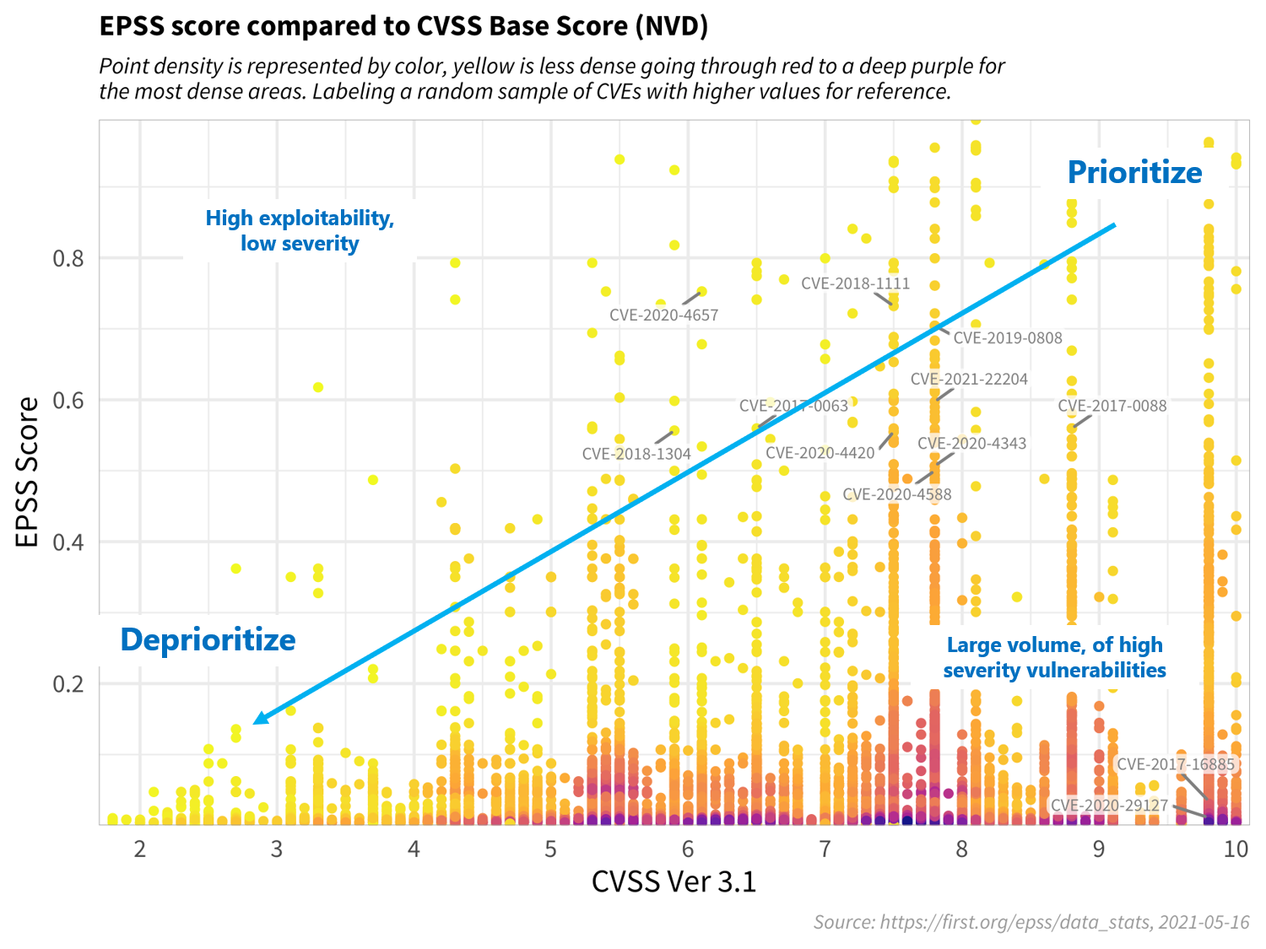
Patching threshold dilemma
EPSS exists among a collection of other prioritization standards and tools
What is the best way to prioritize among all of these?

Slide 11
Open FAIR and EPSS
CRQ is gaining popularity and respect in industry and is crucial for making defensible, consistent decisions
Zero Trust approaches rely upon securing assets by value/risk, implying the need for CRQ to bridge the gap in conversation and improve ROSI
Open FAIR requires data to complete analyses
Many analysts start with a “blank sheet of paper” and face substantial work to “fill it in”
EPSS provides a consistent, deliberate approach to estimate the probability of exploitation for given vulnerabilities
These may or may not be related to assets of concern/value or even relevant to an organization

Slide 12
Open FAIR and EPSS
The exact relationship between Open FAIR and EPSS scores needs to be better understood
EPSS scores can act as a starting point for conversations and critical thinking, allowing better prioritization
The Open Group Security Forum and the FIRST EPSS SIG are interested in collaborating to understand this relationship and to document the value of combining processes

Slide 13
Open FAIR and EPSS
Probability of Action
Vulnerability
Pr(TCap>RS)
Loss Event Frequency
Loss
Event
Contact Event
Threat Event Frequency
Vulnerability
Threat Event
Contact Frequency
Probability of Action
Threat Capability
Resistance Strength
Loss Event Frequency
Contact Frequency
Threat Event Frequency
EPSS scores likely useful

Slide 14
FAIR-CAM informing Asset-Centric thresholds
Asset-Centric IT risks thresholds (RTO/RPO)
Patch Prioritization Policy as a proxy for cyber maturity
Stakeholder-Specific Vulnerability Categorization (SSVC)
Variance Management Control
Decision Support Control

Slide 15
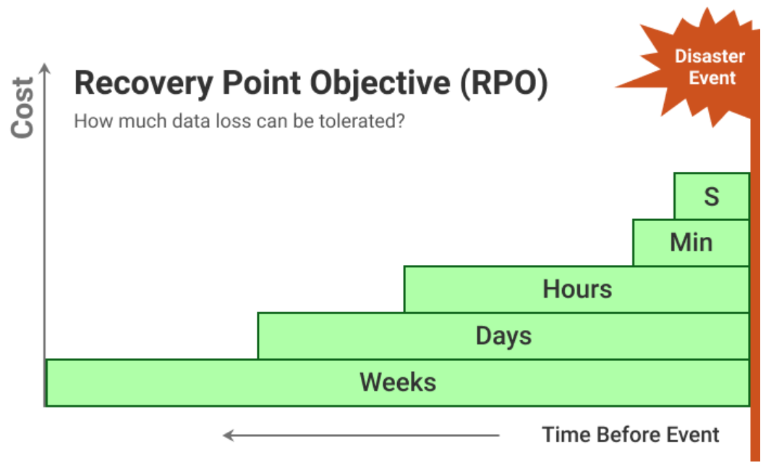
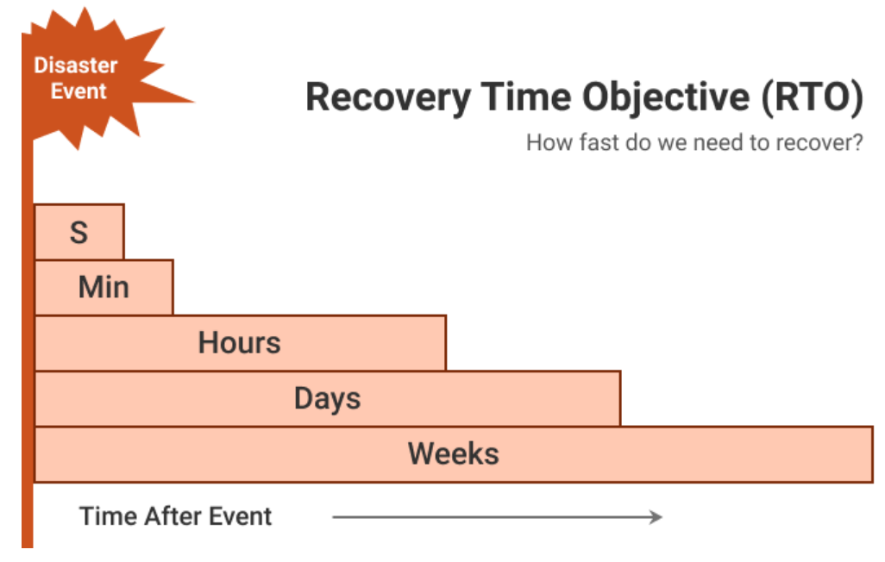
Asset-Centric IT risks thresholds (RTO/RPO)
https://www.msp360.com/resources/blog/rto-vs-rpo-difference/

Slide 16
Patch Prioritization Policy as a proxy for cyber maturity

Slide 17
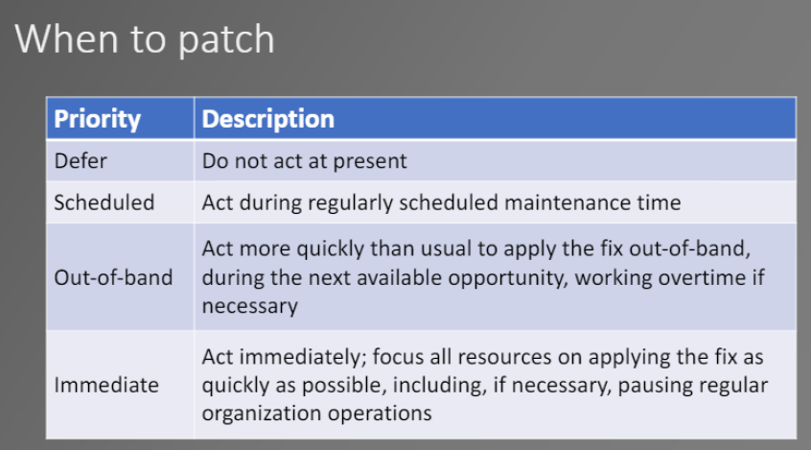
Stakeholder-Specific Vulnerability Categorization (SSVC)
Art Manion, FIRST PSIRT TC 2020
https://docplayer.net/185957081-Ssvc-stakeholder-specific-vulnerability-categorization.html

Slide 18
Variance Management Control

Slide 19
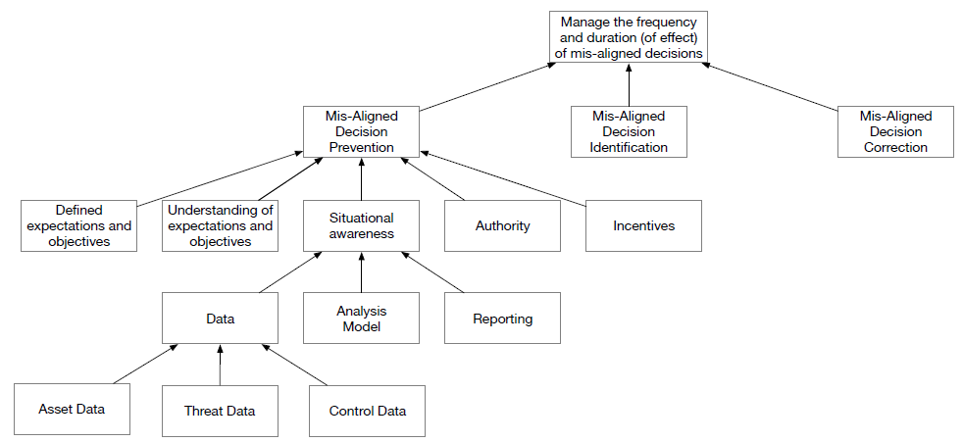
Decision Support Control

