Slide 1
Measuring Real Life Cyber Attacks on Enterprise Networks
FAIR Kill Chains
Christian Ellerhold, Lead Principal Engineer, Cyber Risk Management, Infineon Technologies

Slide 2
Douglas Hubbards’ five levels of risk management
Level | Type | Description
1 | Best | In this level, quantitative models are used, simulations are run, empirical measurements are used, and efforts are made to identify all possible risks.
2 | Better | This is the first level in which quantitative models are built.
3 | Baseline | Intuition (explicitly, not hiding behind unproven models that often dilute the intuitive assessment or otherwise decrease its accuracy) is used, and no formal risk management is attempted.
4 | Worse | Worse, aka “the merely useless.” In this level, detailed (though not quantitative) scoring methods are used, but management does not rely on the results, so the main negative consequence is the waste of time and money
5 | Worst | “Worse than useless.” In this level, ineffective methods are used that result in increased error, higher confidence, and poor decision-making that is no improvement over using pure intuition.

Slide 3
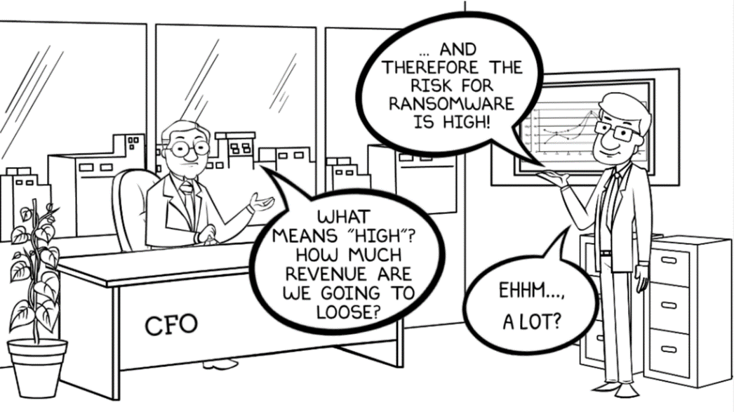
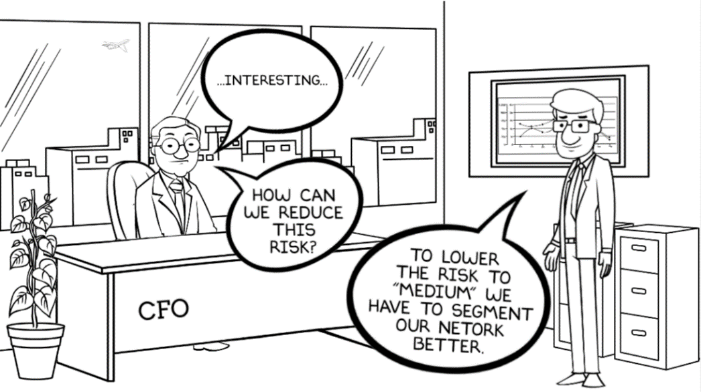
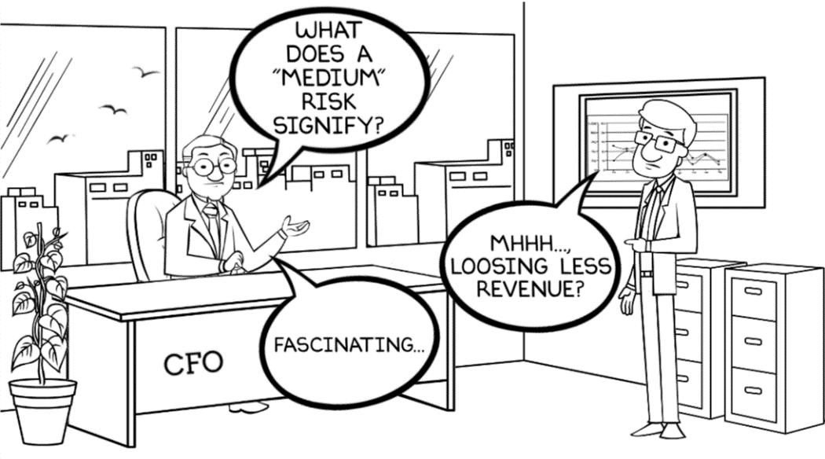
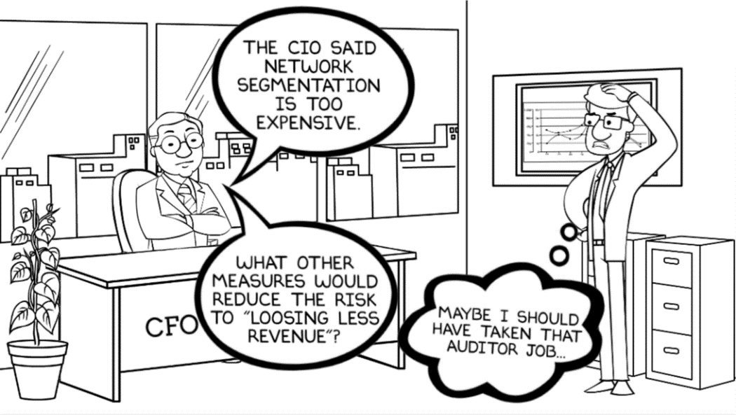
© Christian Ellerhold

Slide 4
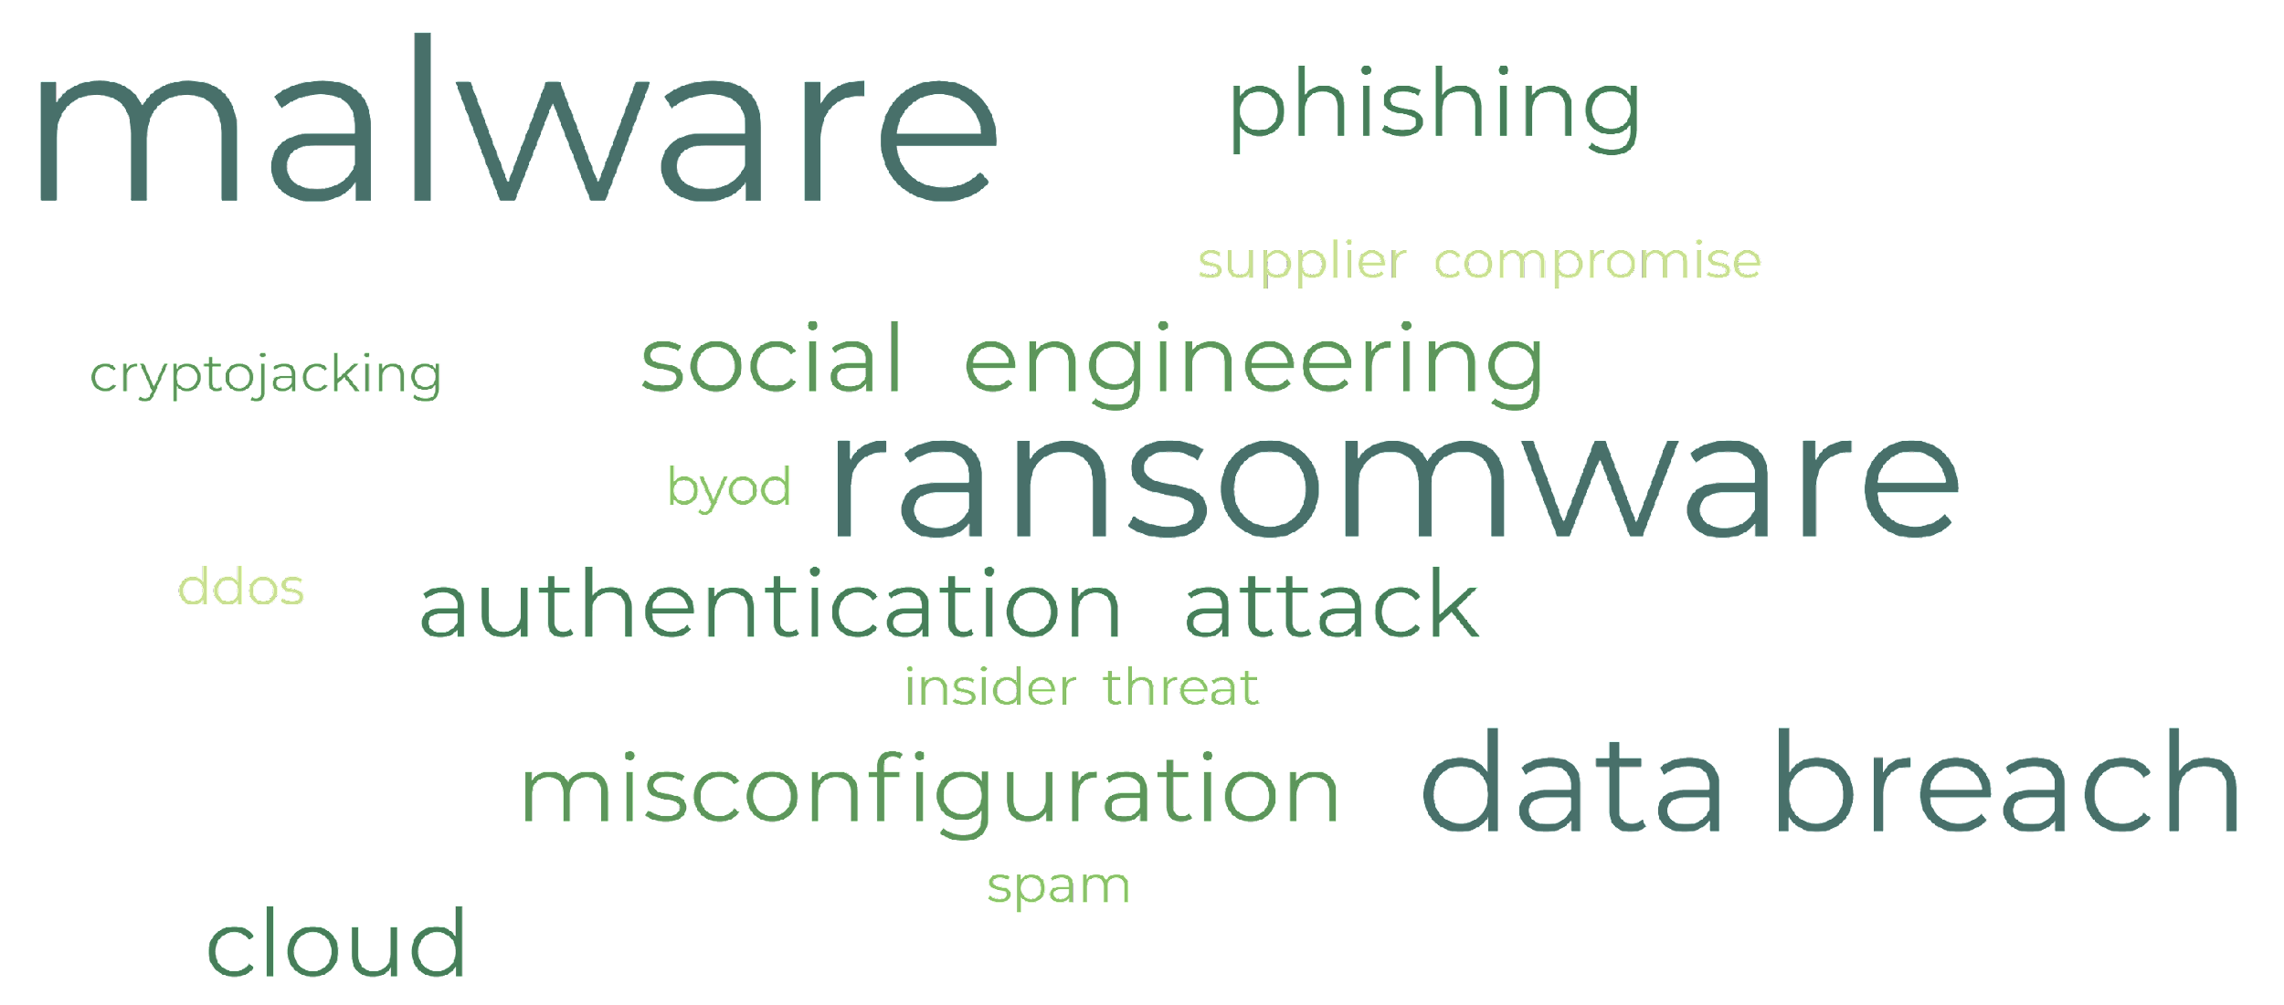
Threat Catalogs do not reflect real attacks

Slide 5
Data Loss Scenario
More friendly user help
User Execution
Exploit vulnerability in legacy database
Spearphishing w/ attachment
Internal Spearphishing
CnC
Credential access fails
Credential Access
Remote access w/ valid accounts
Exfiltration from DB via Jumphost
CnC
Compromise Supplier
Malicious signed software update
SMB tool transfer
Load second stage
Kerberoasting
Juicy DB Admin credentials

Slide 6
Alternate Data Loss Scenario
Unprotected S3 bucket

Slide 7
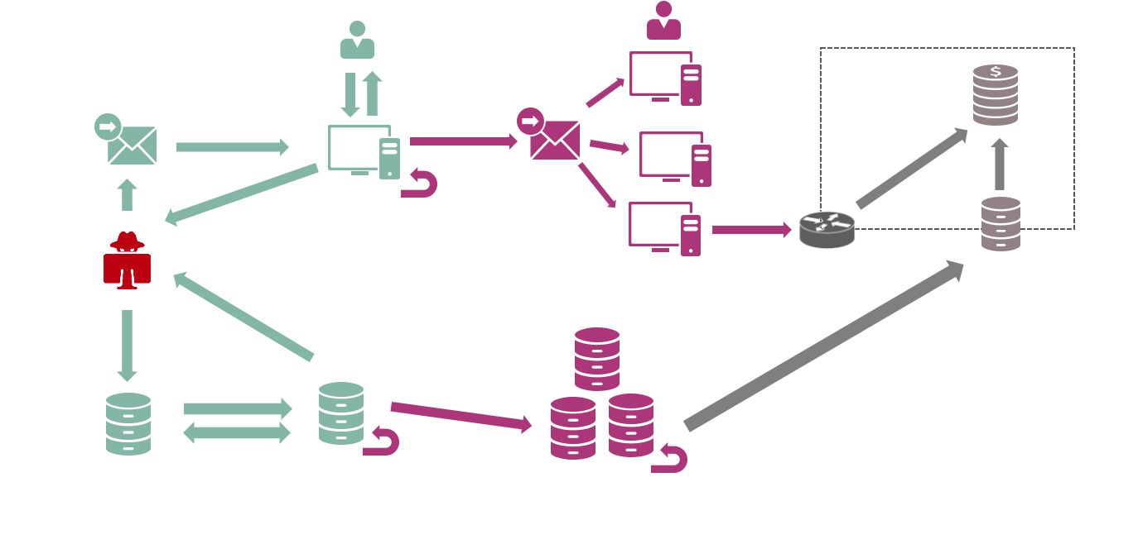
How could we apply FAIR?

Slide 8
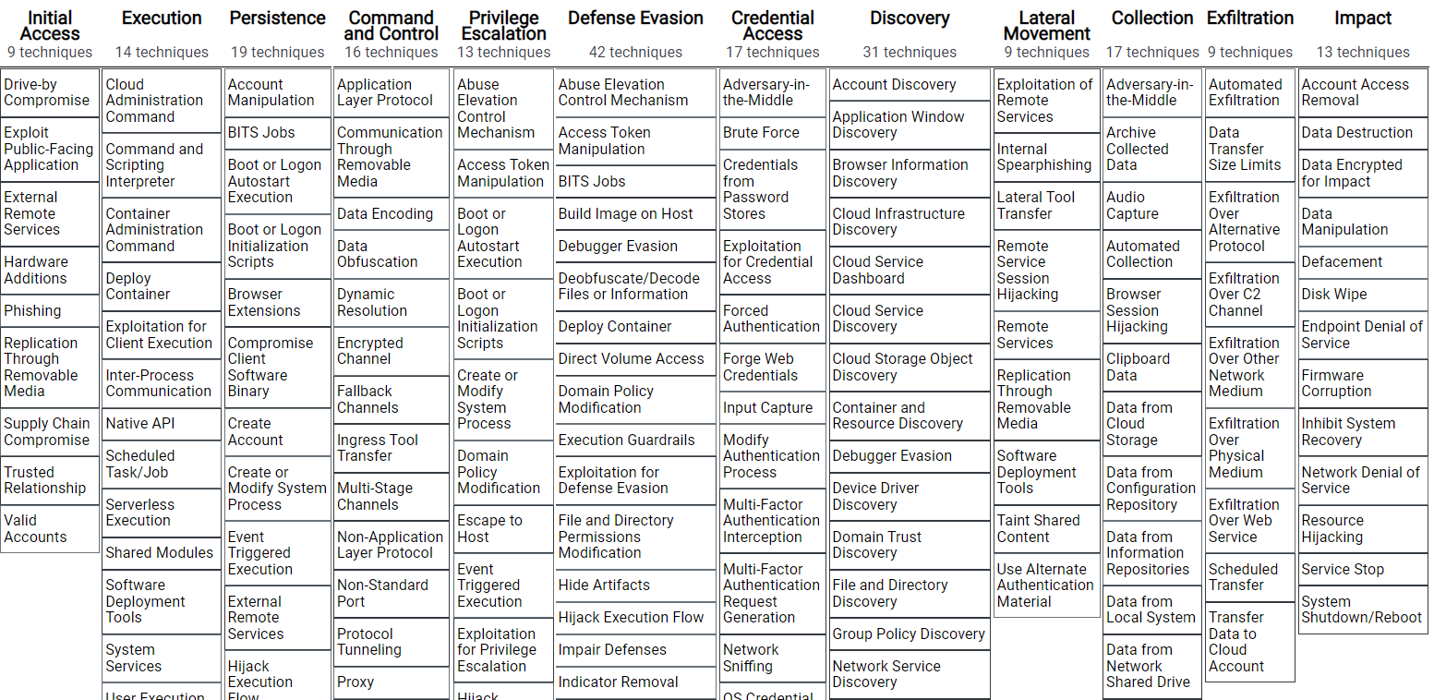
Thinking in Attack Phases
Initial Foothold
Network Propagation
Action on Objectives
Step 1: Initial Foothold
Step 2: Network Propagation
Step 3: Action on Objectives
Phishing

Slide 9
Example: Apply FAIR to Phishing
Loss Event Scenario
Initial Foothold
on
via
Client
IPS
Spear-Phishing
Malware Defense
User Awareness
e.g. CTI data
e.g. SOC data
URL Blocklist
Resistance Strength
e.g.
Threat Actor Capabilities
Threat Event Frequency

Slide 10
Initial Foothold: Attack Tree
Spear-Phishing
IPS
Malware Defense
User Awareness
URL Blocklist
Client
Removable Media
Drive-by compromise
Secure Development
Exploit public facing App
FW
Secure Configuration
Server (DMZ)
Vulnerability Management
Supply Chain Compromise
Network (DMZ)
Ext. remote services
MFA
Supply Chain Compromise

Slide 11
Network Propagation: Attack Tree
Internal Spearphishing
Client
Taint Shared Content
Repeat n times
Privilege Escalation
Remote Services
Exploitation of remote Services
If prevented: Attack continues with different technique and/or system
Local
Discovery
Remote Discovery
Server
Credential Access
Software Deployment Tools
Patient Zero
Network
Remote Services
If detected: Attack is over
Exploitation of remote Services
Lateral Movement
Defense Evasion

Slide 12
Action on Objectives
Rinse and Repeat
Select relevant Impact or Exfiltration techniques for target risk
Map techniques to controls
Note: Insider attacks mostly start in this attack phase.

Slide 13
Cost-benefit calculations
Loss Event Scenario
Initial Foothold
on
via
Client
IPS
Spear-Phishing
Application Control
Malware Defense
User Awareness
e.g. CTI data
e.g. SOC data
URL Blocklist
Resistance Strength
e.g.
Threat Actor Capabilities
Threat Event Frequency

Slide 14
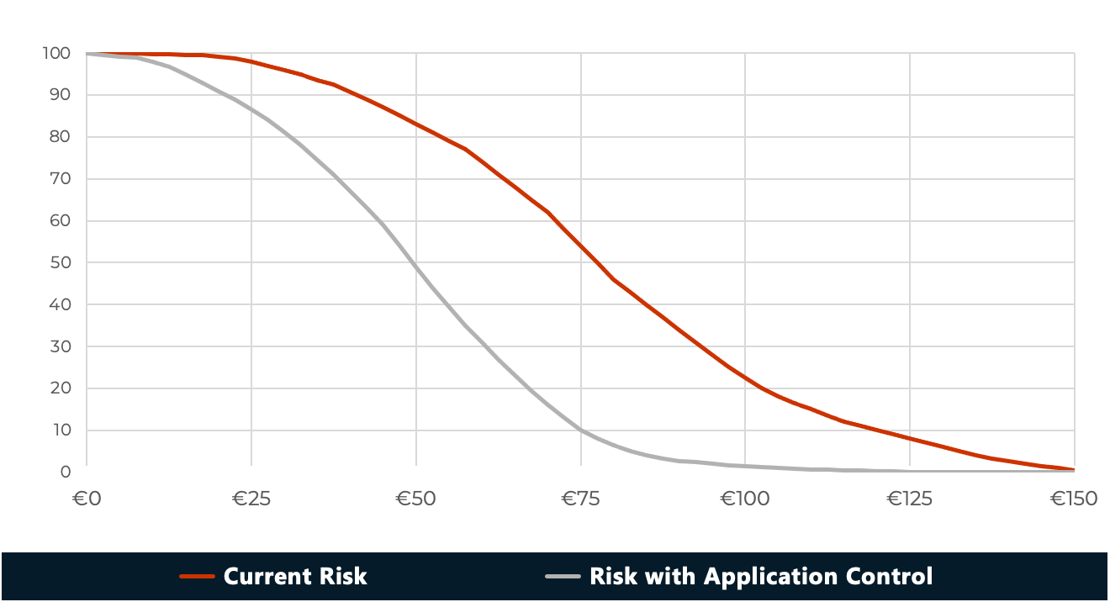
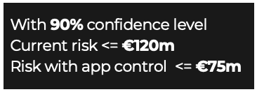
Cost-benefit reporting

Slide 15
Loss Event Frequency input parameters
SOC Incident Data
Partner Incident Data
Infrastructure Assessments
Application Assessments
Threat Intelligence
SME
Threat Intelligence
SME
Threat Intelligence
Vulnerability Scans
Penetration Tests
Adversarial Simulations
Resistance Strength
(coverage and efficacy of security controls)
Threat Actor Capabilities
(attacker’s skills and resources)
Threat Event Frequency (frequency of attack types)
Vulnerability
(probability of success for an attack)
Loss Event Frequency

Slide 16
Threat Event Frequency from SOC
mock data

Slide 17
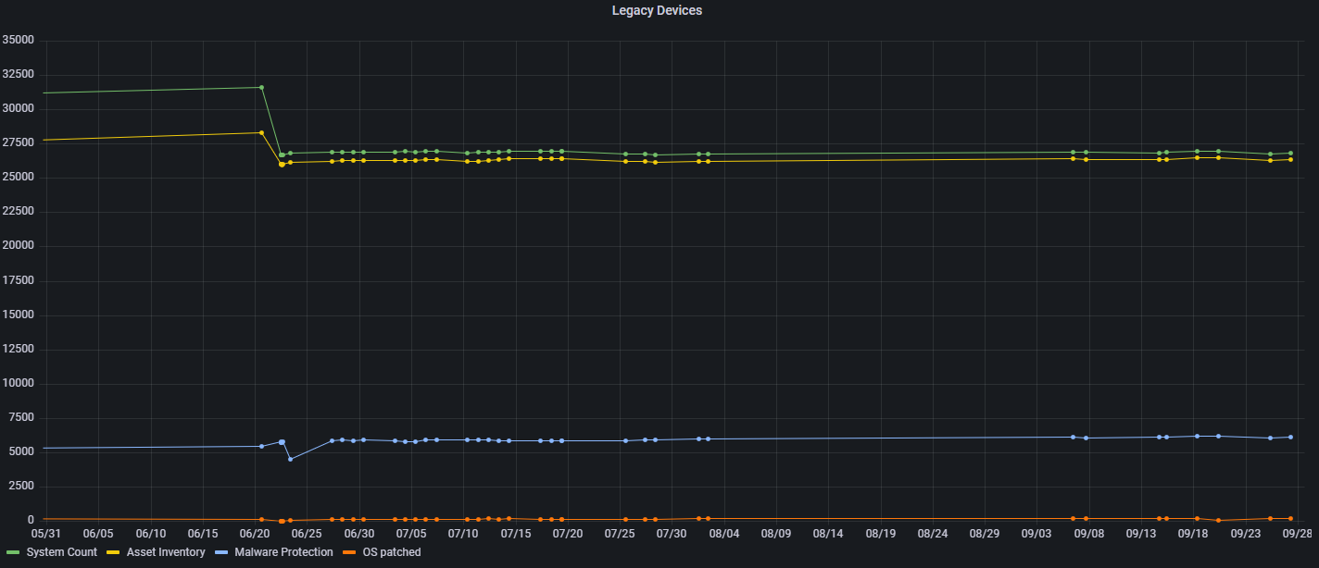
Infrastructure Assessment (CIS Controls)
mock data

Slide 18
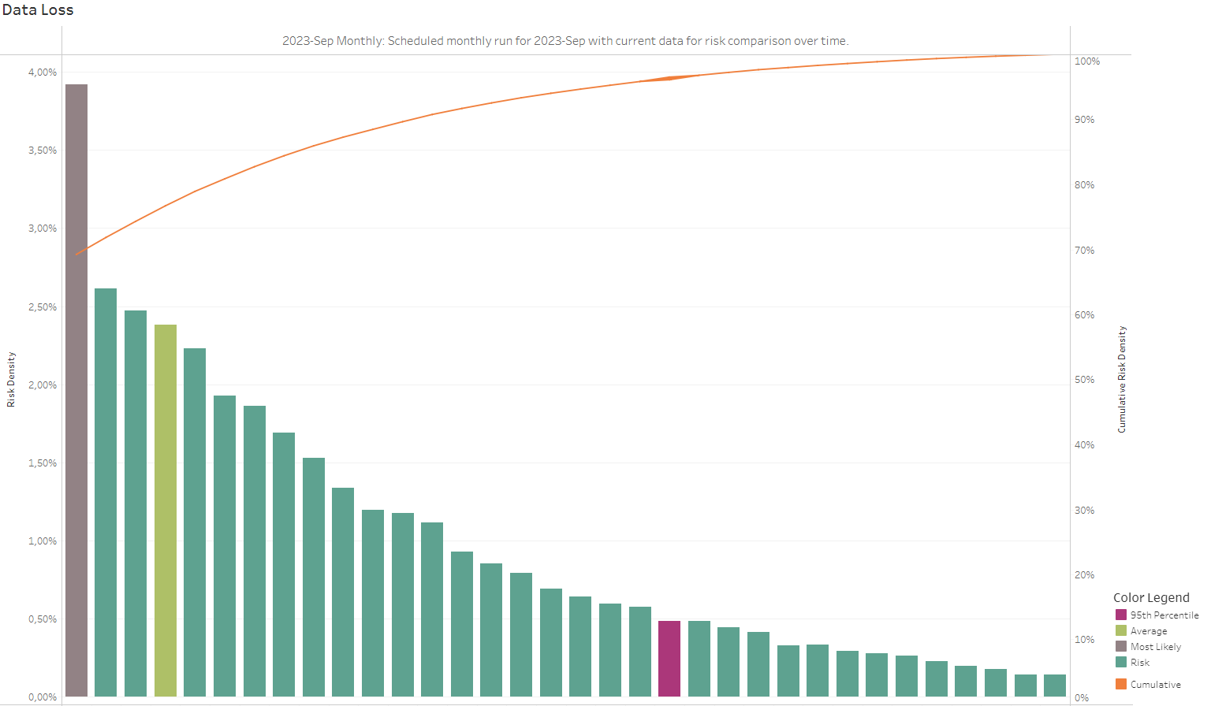
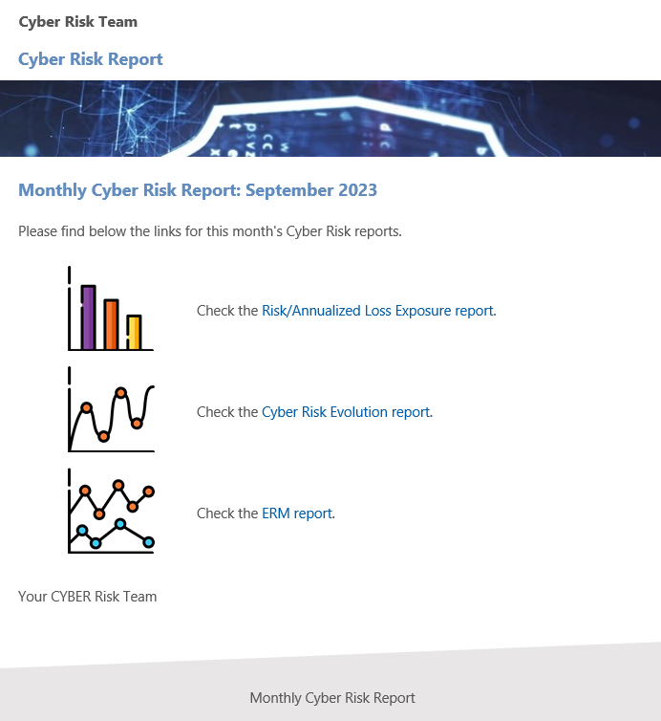
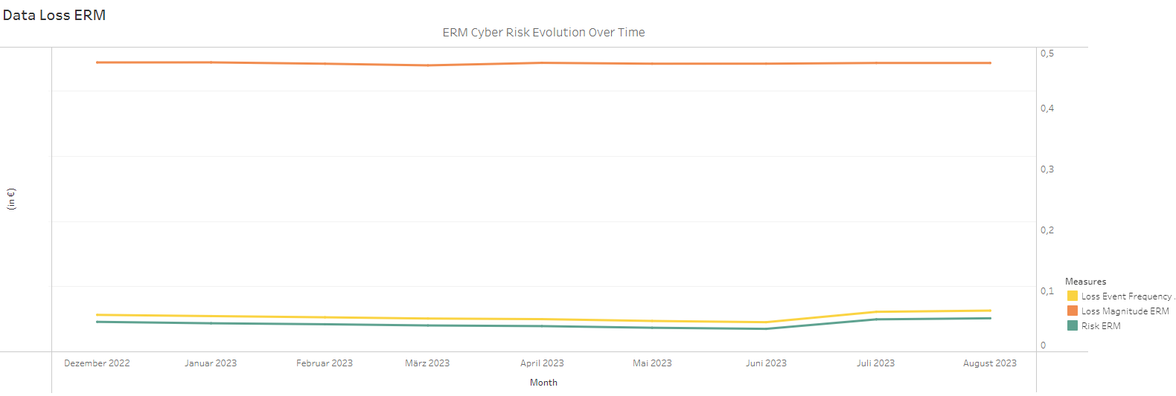
Reporting
mock data

Slide 19
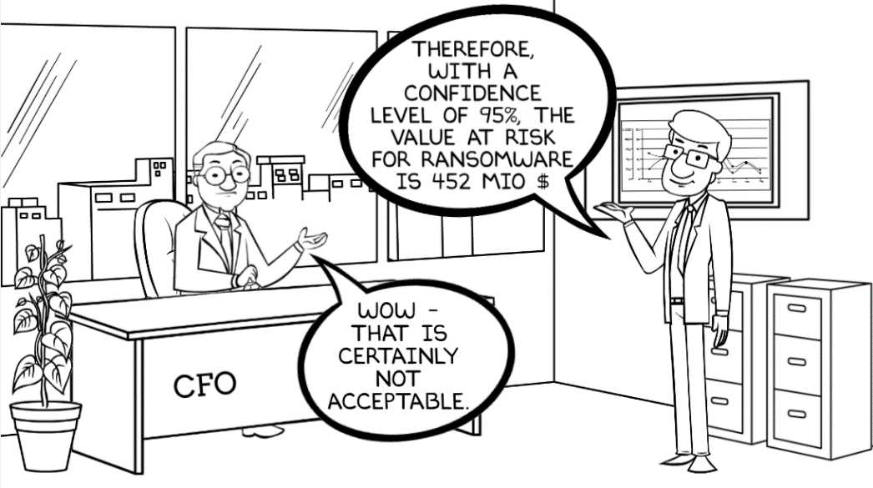
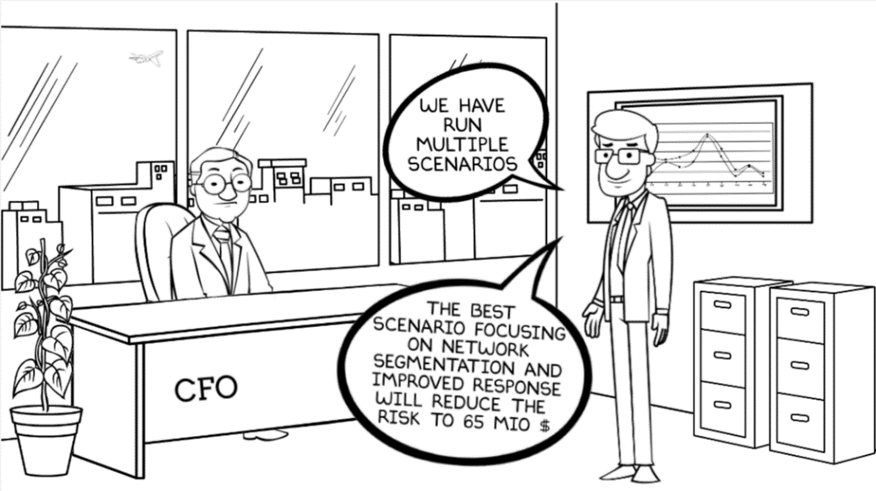
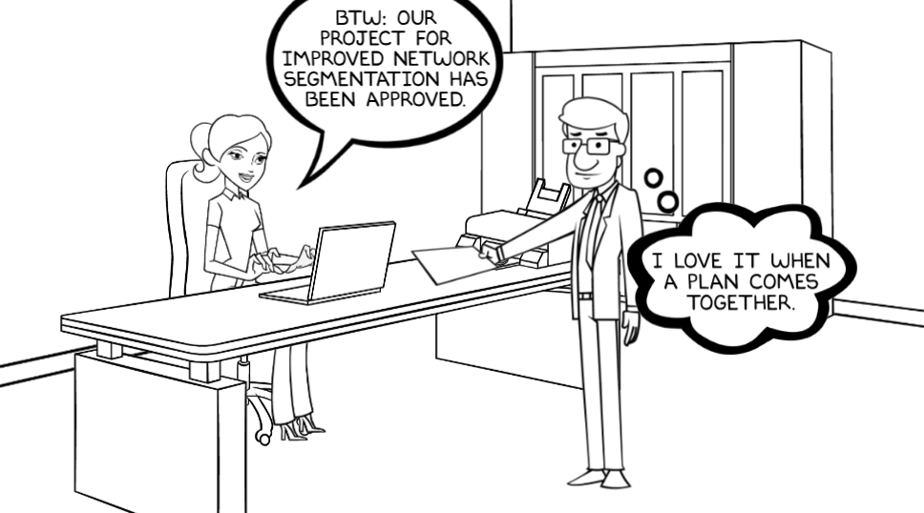
CISO

Slide 20
Do you want to know more?
Paper
Available from December 2023 (free)
ACM digital library: Enterprise Cyber Threat Modeling and Simulation of Loss Events for Cyber Risk Quantification
Ask me after this session
in person
LinkedIn
christian.ellerhold@infineon.com

