Slide 1
Measuring Control Effectiveness and Risk with FAIR-CAMTM
Tyler Britton, DropBox
Bryan Smith, Safe Security

Slide 2
Tyler Britton
Dropbox
Bryan Smith
Safe Security

Slide 3
Measuring Control Effectiveness and Risk with FAIR-CAMTM
Defining the Control
Finding Control Data
Measuring Control Effectiveness

Slide 4
Define the Controls
Notes:
Review FAIR-CAM Control Types
Controls being measured for scenarios almost always Loss Event Controls
Using LEC, understand how the control impacts risk
Using VM, you can often measure a LEC
Using DS, you can often do a RCA on why a control is failing

Slide 5
Example – Traditional View
A cyber criminal, using a misconfiguration to gain access, against a serverless cloud web app, resulting in data exfiltration.
Cyber Criminal
Serverless Web App
Data Exfiltration
Notes:
First need to understand the scenario scope & it’s high-level attack chain
FAIR 101
What am I protecting
Who is attacking me
What am I worried will happen

Slide 6
Example – View with FAIR-CAM
A cyber criminal, using a misconfiguration to gain access, against a serverless cloud web app, resulting in data exfiltration.
Cyber Criminal
Serverless Web App
Data Exfiltration
Primary Loss
Secondary Loss
Notes:
Now where do controls reside?

Slide 7
What you’re measuring
Intended Control Efficacy
Operating Efficacy
Variance
(Frequency & Duration)
Consider that some controls measured as an efficacy range (ex. EDR), others as effective or not (ex. IAM)

Slide 8
Finding Control Data

Slide 9
Finding Control Data
What kinds of data should you be looking at?
​Loss Event Controls (Intended Efficacy):
-SMEs​
​
-Independent studies​
​
-Historical analysis, incidents, engagement, audits, etc.​
​Variance Mgmt Controls:
-SMEs​
​
-Maturity analysis
​
-Historical incident frequency
​
-Historical incident response and reaction analysis
-Root cause analysis
-Audit findings
​Decision Support Controls:
-Compliance documentation
​
-Registers
​
-Root cause analysis

Slide 10
Finding Control Data
Less data
More data

Slide 11
Finding Control Data
Less data
More data
Calibrated SME estimates
Internal empirical data
Calibrated SME estimates, some data
External empirical data

Slide 12
Finding Control Data
Estimates calibrated from SMEs
Control owners, red teams, and blue teams are best source of this
Data in this case is purely experience
"Based on my experience, multi-factor authentication is very effective at stopping attackers, best case it stops them (100%) and worst case 50/50 (50%)."
Calibrated SME estimates
Internal empirical data
Calibrated SME estimates, some data
External empirical data

Slide 13
Finding Control Data
Estimates calibrated from SMEs, backed by empirical data
Control owners, red/blue teams, and historical data are best source of this
Data in this case is experience that is justified by limited data
"In red team exercises, they were only able to defeat out MFA authentication in 1 out of 5 times. A real threat actor could be a bit more or less skilled than our red team. (60%-100%)"
Calibrated SME estimates
Internal empirical data
Calibrated SME estimates, some data
External empirical data

Slide 14
Finding Control Data
Estimates using external empirical data and calibrated by SMEs
Independent studies, control owners, red/blue teams, and historical data are best source of this
Data in this external data calibrated by SME experience
"A study by Google indicated that TOTP MFA is 60% - 90% effective. Given that we use TOTP with only pre-approved devices, we expect slightly better performance (70%-95%)."
Calibrated SME estimates
Internal empirical data
Calibrated SME estimates, some data
External empirical data

Slide 15
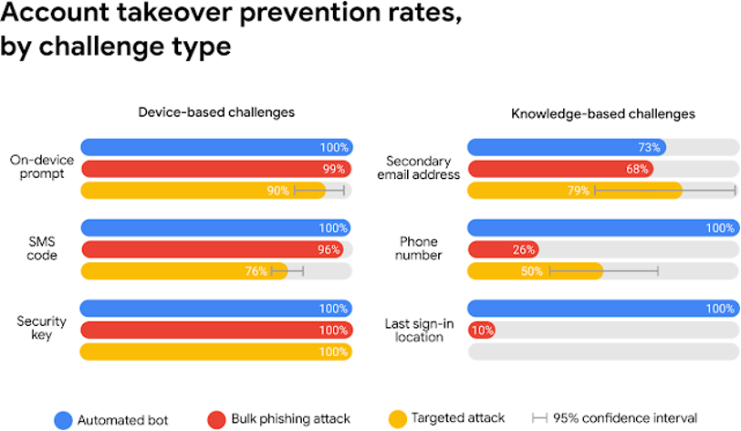
Finding Control Data
Calibrated SME estimates
Internal empirical data
Calibrated SME estimates, some data
External empirical data

Slide 16
Finding Control Data
Estimates using external empirical data and calibrated by SMEs
Independent studies, control owners, red/blue teams, and historical data are best source of this
Data in this case is significant internal evidence to justify SME estimates
"Red team engagements, external penetration tests have only been able to defeat MFA authentication 2 times in the past 3 years, over 12 engagements. Given this, SMEs estimate only very strong threat actors will be able to defeat MFA (80%-95%)"
Calibrated SME estimates
Internal empirical data
Calibrated SME estimates, some data
External empirical data

Slide 17
Measuring Control Effectiveness

Slide 18
Measuring Control Efficacy
You likely don't have much data...

Slide 19
Measuring Control Efficacy
...and that's okay
Time to get "scientific"

Slide 20
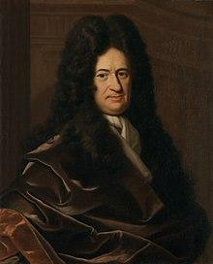
Measuring Control Efficacy
Each control evaluation is a hypothesis

Slide 21
Measuring Control Efficacy
Step 1 – Who's your threat actor?
Cyber Criminal

Slide 22
Measuring Control Efficacy
Step 1 – Who's your threat actor?

Slide 23
Measuring Control Efficacy
Step 2 – What's the intended efficacy of the control?

Slide 24
Measuring Control Efficacy
Step 2 – What's the intended efficacy of the control?
MFA

Slide 25
Measuring Control Efficacy
Step 2 – What's the intended efficacy of the control?
MFA
Best
Worst
Unsophisticated threat actor
Control performs better than expected and/or historical data indicated
Sophisticated threat actor
Control performs worst than expected and/or historical data indicated

Slide 26
Measuring Control Efficacy
Step 3 – What's the intended efficacy of the VMC for the LEC?
MFA Configuration -> MFA

Slide 27
Measuring Control Efficacy
Step 3 – What's the intended efficacy of the VMC for the LEC?
MFA Configuration -> MFA
Best
Worst
The number of days (i.e. % of time) the VMC is effective is on the higher end of what data/experience indicate
Your identification and remediation of variance is extremely effective (requiring days/weeks to fix)
The number of days (i.e. % of time) the VMC is effective is on the lower end of data/experience
Your identification and remediation of variance is ineffective, requiring weeks/months to identify/fix

Slide 28
Measuring Control Efficacy
Step 4 – Calculate the Operational Efficacy of your control set
LEC * VMC = Operational Efficacy

Slide 29
Measuring Control Efficacy
Step 4 – Calculate the Operational Efficacy of your control set
LEC * VMC = Operational Efficacy
Many tools to multiply this together (try to avoid doing min*min and max*max)

Slide 30
Measuring Control Efficacy
Each control evaluation is a hypothesis

Slide 31
Measuring Control Efficacy
More data, more assurance
Tighter ranges
Less data, less assurance
Wider ranges

Slide 32
Closing Remarks/QA

