Slide 1
Accelerating your GenAI adoption through AI Risk Posture Management
October 18, 2023

Slide 2
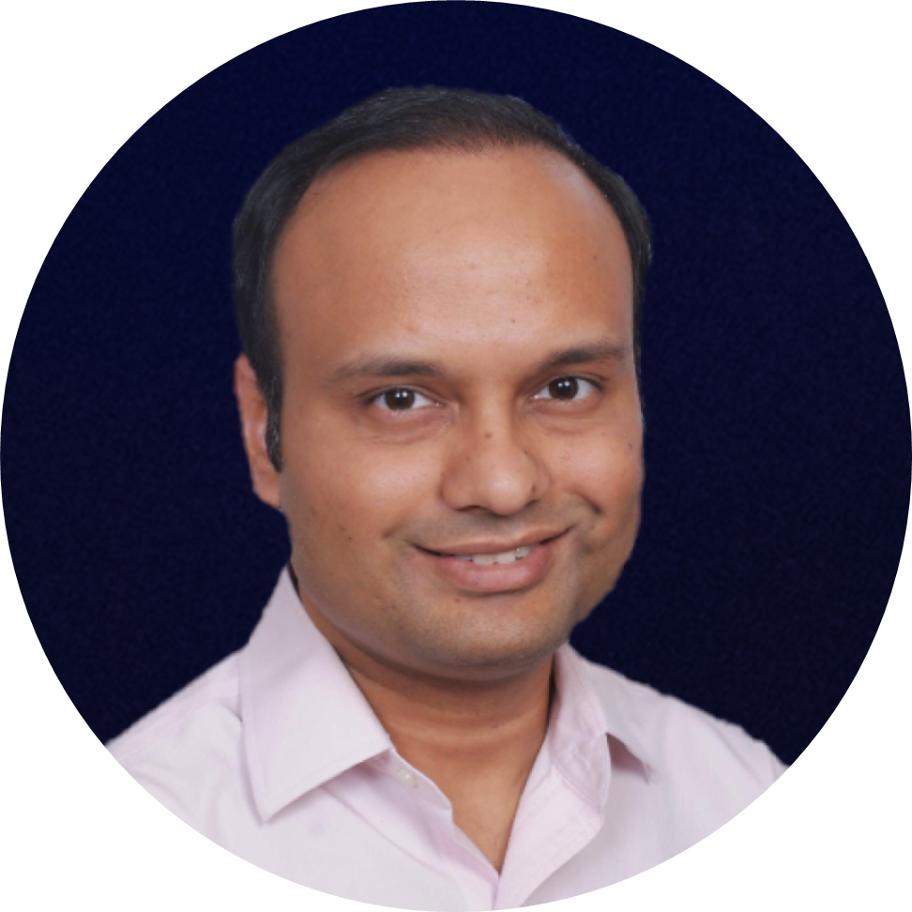
Speakers
SPEAKER
MODERATOR
Brandon Sloane
Pankaj Goyal
Information Security Risk Management Lead, AI GRC Meta
Director, Standards & Research, FAIR Institute

Slide 3
How many of you have used LLMs like ChatGPT personally?

Slide 4
How many have been involved in an internal GenAI Project?

Slide 5
Have you been asked about GenAI Risks?

Slide 6
Are you actively evaluating GenAI Risks?

Slide 7
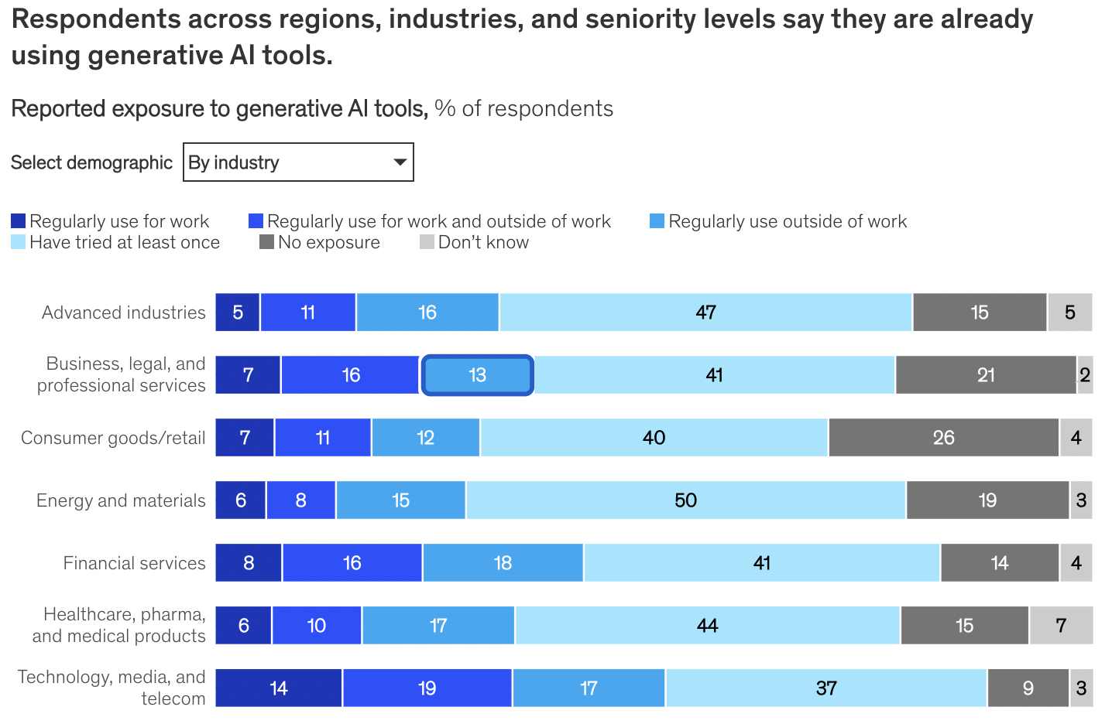
15-25% employees are already actively using GenAI for work
Another 40-50% already exposed to GenAI tools at least once
Source: McKinsey & Company

Slide 8
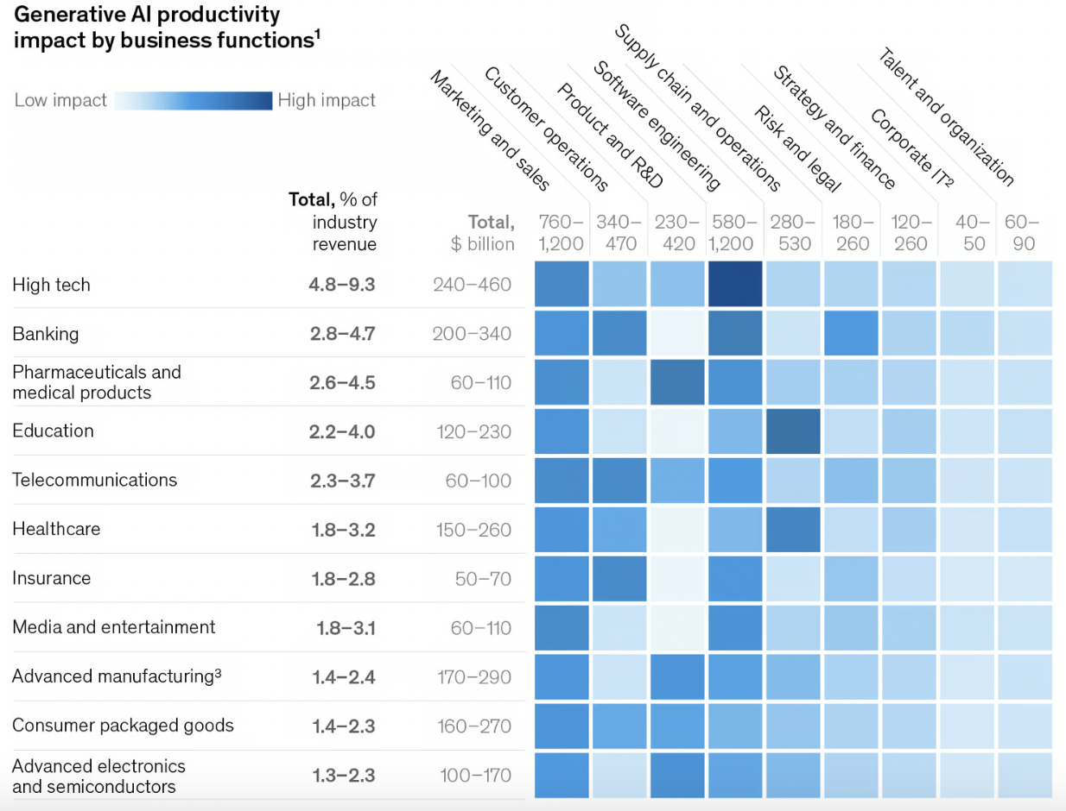
Technology, Banking, Pharma/Healthcare & Telecommunications will likely be the biggest beneficiaries
Source: McKinsey & Company

Slide 9
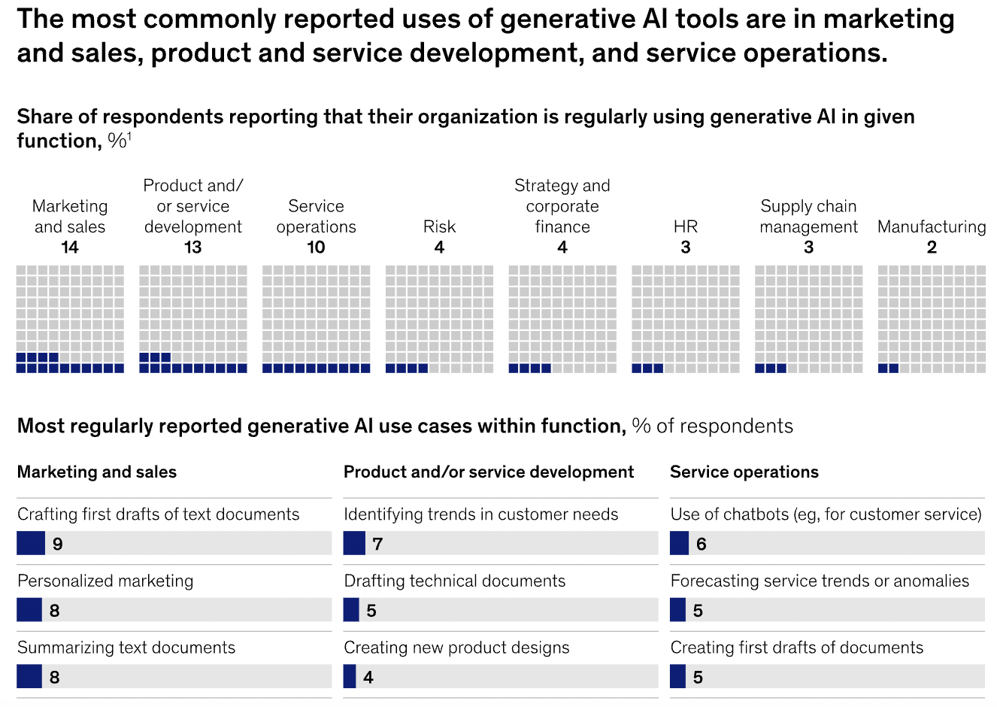
Functionally, Marketing, Software development and service operations teams are leading the adoption
Source: McKinsey & Company

Slide 10
GenAI adoption is exposing you to new risks

Slide 11
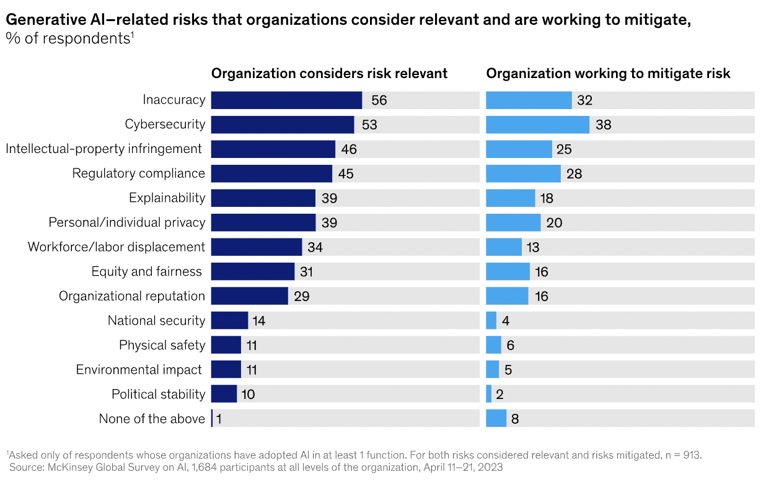
Inaccuracy, Cybersecurity, and IP infringement are the top GenAI-related risk vectors
Source: McKinsey & Company

Slide 12
Questions we will aim to answer today
How should we think about different GenAI risk scenarios?
How can we quantify GenAI risks using FAIR?
How should risk professionals help companies to make risk-informed decisions on GenAI?

Slide 13
The ‘Five Vectors’ of GenAI Risk
You are using GenAI - just you don’t know it - ‘Shadow GenAI’
You are building foundational LLMs
You are hosting an LLM to build your use cases
You are using managed third-party LLMs to build your use cases
Your adversaries are using LLMs to attack

Slide 14
One big question today
My business units want to leverage GenAI in their Product / Process
Should we use a third-party managed LLM?
Should we host an LLM internally?
OR

Slide 15
What are some risk scenarios that are applicable to this decision?
Risk Scenario | Host the LLM | Use managed LLM
Misinformed decisions / actions resulting from inaccurate content generation | Fully Own | Fully Own
Business disruption or loss due to model availability issues | Fully Own | Partial Transfer
Disclosure of private, confidential, or sensitive information (customer information, organization information, intellectual property, etc.) | Fully Own | Partial Transfer
Regulatory or User harms due to the generation of undesirable content (legally restricted, sensitive or policy-violating, harmful, etc.) | Fully Own | Partial Transfer
(non-exhaustive)

Slide 16
What are some risk scenarios that are applicable to this decision?
Risk Scenario | Host the LLM | Use managed LLM
Misinformed decisions / actions resulting from inaccurate content generation | Fully Own | Fully Own
Business disruption or loss due to model availability issues | Fully Own | Partial Transfer
Disclosure of private, confidential, or sensitive information (customer information, organization information, intellectual property, etc.) | Fully Own | Partial Transfer
Regulatory or User harms due to the generation of undesirable content (legally restricted, sensitive or policy-violating, harmful, etc.) | Fully Own | Partial Transfer
Let’s explore two of these in more detail

Slide 17
Using FAIR framework to quantify these risks
Fill an ‘AI Control Libraries’
(Based on MITRE ATLAS and FAIR-CAM) for a risk scenario
Loss Event Frequency of the risk scenario using FAIR analysis
Financial Risk estimate
Prioritized list of actions to treat risk
‘What if’ scenario analysis
Fill an ‘AI Loss Questionnaire’
(Based on FAIR-MAM) for a risk scenario
Loss magnitude of the risk scenario using FAIR analysis

Slide 18
Risk Scenario 1: Disclosure of private, confidential, or sensitive information
Scenario description: Google, Microsoft, OpenAI and AWS have launched GenAI apps for enterprises. When an enterprise uses these apps, there is a potential loss event related to a company’s sensitive data.
A user might (by error) reveal sensitive information that could be stored by the LLM provider and then later either disclosed or leveraged as part of further model training.

Slide 19
We can use the FAIR Framework to quantify these risks
RISK
Loss Event Frequency
Loss
Magnitude
Threat Event Freq.
Suscept- ibility
Primary
Loss
Secondary Loss

Slide 20
Risk Scenario 1: Disclosure of private, confidential, or sensitive information
How do I estimate Susceptibility? What are the security controls to consider?
We reviewed multiple frameworks (NIST, FAIR-CAM, CIS) to create a list of potential security controls to use in evaluating your risk.

Slide 21
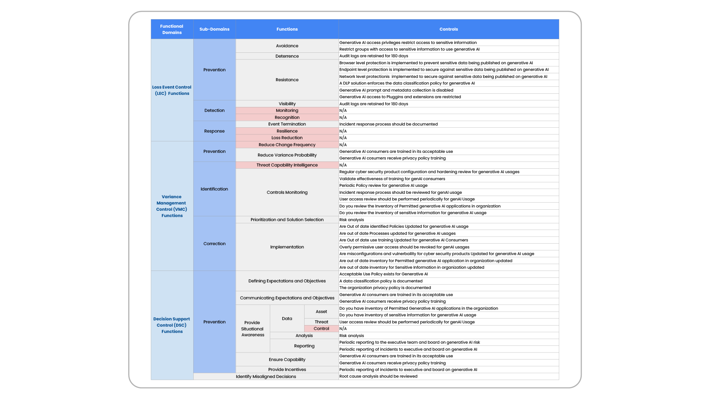
GenAI Control Library

Slide 22
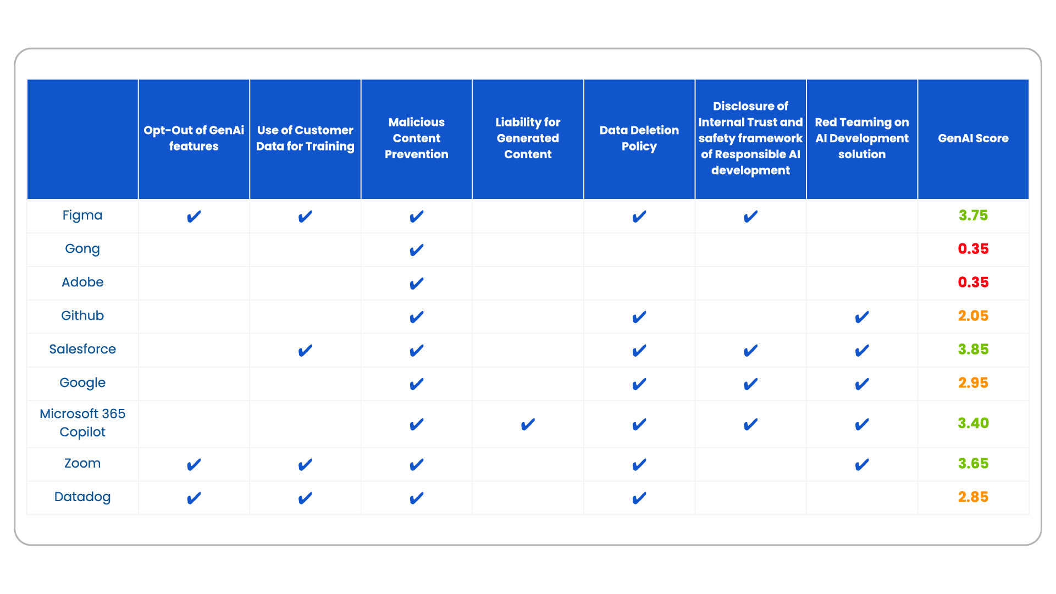
SaaS GenAI Index

Slide 23
Risk Scenario 2: Regulatory or User harms due to the generation of undesirable content
Scenario description: GenAI models will have trust and safety controls at various stages of content generation. These are not perfect though and undesirable content may still be generated.
A user might (either intentionally or unintentionally) use an LLM to generate content which is legally compromising or offensive. This could potentially lead to regulatory / financial impacts as well as impacts to the employees or customers who generated the content.

Slide 24
We can use the FAIR Framework to quantify these risks
RISK
Loss Event Frequency
Loss
Magnitude
Threat Event Freq.
Suscept- ibility
Primary
Loss
Secondary Loss

Slide 25
Risk Scenario 2: Regulatory or User harms due to the generation of undesirable content
HOW COULD WE CALCULATE LOSS EVENT FREQUENCY?
Let’s talk through what this means in the context of GenAI and what are some different data sources (signals) which we might be able to leverage to quantify this parameter.

Slide 26
Risk Scenario 2: Regulatory or User harms due to the generation of undesirable content
Ontology | Potential Description
Loss Event Frequency
Threat Event Frequency
Contact Frequency
Probability of Action

Slide 27
Risk Scenario 2: Regulatory or User harms due to the generation of undesirable content
Ontology | Potential Description
Loss Event Frequency | How many times (within a year) do we expect our model to generate undesirable content which resulted in user harm?
Threat Event Frequency | How many times (within a year) do we expect our Users to enter a prompt which has the potential to generate undesirable content?
Contact Frequency | How many times (within a year) do we expect our Users to interact with our GenAI model?
Probability of Action | How likely is it that our users will come up with a prompt which has the potential to generate undesirable content?

Slide 28
Risk Scenario 2: Regulatory or User harms due to the generation of undesirable content
Ontology | Potential Description | How might we quantify it?
Loss Event Frequency | How many times (within a year) do we expect our model to generate undesirable content which resulted in user harm?
Threat Event Frequency | How many times (within a year) do we expect our Users to enter a prompt which has the potential to generate undesirable content?
Contact Frequency | How many times (within a year) do we expect our Users to interact with our GenAI model?
Probability of Action | How likely is it that our users will come up with a prompt which has the potential to generate undesirable content?

Slide 29
Risk Scenario 2: Regulatory or User harms due to the generation of undesirable content
Ontology | Potential Description | How might we quantify it?
Loss Event Frequency | How many times (within a year) do we expect our model to generate undesirable content which resulted in user harm? | TEF x Vulnerability Model / System logs
Threat Event Frequency | How many times (within a year) do we expect our Users to enter a prompt which has the potential to generate undesirable content? | CF x PoA Prompt log history
Contact Frequency | How many times (within a year) do we expect our Users to interact with our GenAI model? | Model / System logs Network traffic API requests
Probability of Action | How likely is it that our users will come up with a prompt which has the potential to generate undesirable content? | Prompt log history User segmentation (categories of users)

Slide 30
GenAIRisk.ai

Slide 31
Operationalizing Risk Scenarios
Use Case: How can we use FAIR at various points in a GenAI project lifecycle?
Analyze
Design
Develop
Deploy
Define the requirements
Choose an architecture (model selection / build)
Fine-tune / evaluate / align model
Application integrations
We can use FAIR / Risk Quantification to help the business…
…identify requirements by thinking through potential Risk Scenarios
…make design decisions by quantifying Risk Scenarios associated with different architecture options
…evaluate the model by quantifying the Risk of model responses
…build LLM-powered applications by quantifying the Risk of various product / process integration use cases

Slide 32
QUESTIONS

