Slide 1
The Future of Risk Analysis in an AI and Automation World
Jack Jones
Chairman, FAIR Institute

Slide 2
Let’s talk medicine…

Slide 3
Medical “epochs”
We are here
Medicine 0.x
Medicine 1.0
Medicine 2.0
Medicine as Craft
Shamanism
Reliance on placebo effect
Bloodletting
Scientific but Reactive
(focus on diagnosis and treatment)
Introduction of scientific methods
Has given us advanced:
Diagnostics
Medicines
Surgeries
Roughly doubled our lifespan
Proactive Medicine
Focus on “Healthspan”
Living longer and healthier
Reduces medical costs
Understanding and treating root causes
Genetics
Environment
Lifestyle

Slide 4
AI in Medicine 1.0
Diagnostics
X-Ray and other radiological analysis
Biopsy analysis
Biomarker analysis
Treatment
Development of new medicines
AI-assisted robotic surgery
Pharmaceutical predictive modeling
Personalized treatments based on genetics

Slide 5
AI in Medicine 2.0
Prevention
Genomic analysis to identify risk factors for disease
Prophylactic surgery based on an individual’s genetics
Nutritional guidance based on genetics and medical history
Optimized exercise, diet, sleep plans based on an individual’s age, health records, and genetics
Analyze and adjust hospital workflows to prevent the spread of infections

Slide 6
Looking at risk analysis…

Slide 7
Where risk analysis fits (and why it matters)
Risk
Monitoring & Testing
Controls
Threats
Business Assets
Loss
Intended State of Risk
Actual State of Risk
Risk
Management
Execution
Awareness
Capabilities
Motivation
Policies
Strategies
Processes
Technologies
Initiatives
Communication
Resources
Enforcement
Analysis & Reporting
Decisions
Prioritization
Setting Objectives & Expectations

Slide 8
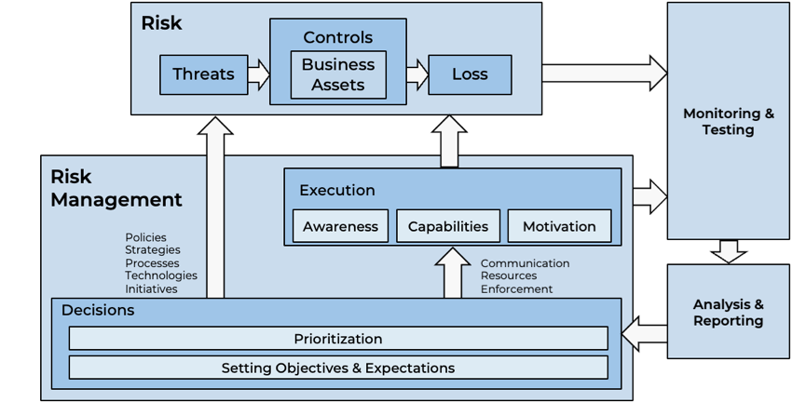
The challenges in a complex & dynamic world
Coverage
Data Accuracy
Timeliness
Analysis Accuracy
(Truthfulness)

Slide 9
Where is risk management maturity-wise?
We are here
Medicine 0.x
Medicine 1.0
Medicine 2.0
Risk 0.x
Risk 1.0
Risk 2.0
Do NOT confuse technical sophistication with maturity!
We are here

Slide 10
Commonly cited “top risks”…
Insiders
Reputation
Phishing
Ransomware
Weak passwords
Unpatched systems

Slide 11
Most commonly cited “top risks” aren’t risks…
Insiders
Reputation
Phishing
Ransomware
Weak passwords
Unpatched systems
Threat community
Asset
Method
Method
Control deficiency
Control deficiency

Slide 12
Math on colors
(
Green
x
Yellow
) /
Red
= ?
Green
Yellow
Red
Very Low
Low
Medium
High
Very High
“3”
“5”
“1”
“2”
“3”
“4”
“1”
“2”
“4”
“-8”
“4”
“28”
“53”
“2961”
“-8”
“4”
“28”
“53”

Slide 13
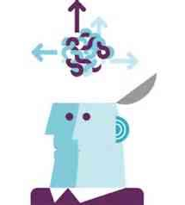
The most commonly used risk model in cybersecurity is…

Slide 14
“In the 19th century we had a relatively advanced understanding of anatomy, but we had a terrible understanding of physiology.
We knew what was happening, but we didn’t understand why it was happening.”
A Retired Surgeon

Slide 15
Ours is a VERY young profession!

Slide 16
Automation for risk analysis…

Slide 17
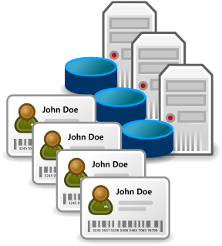
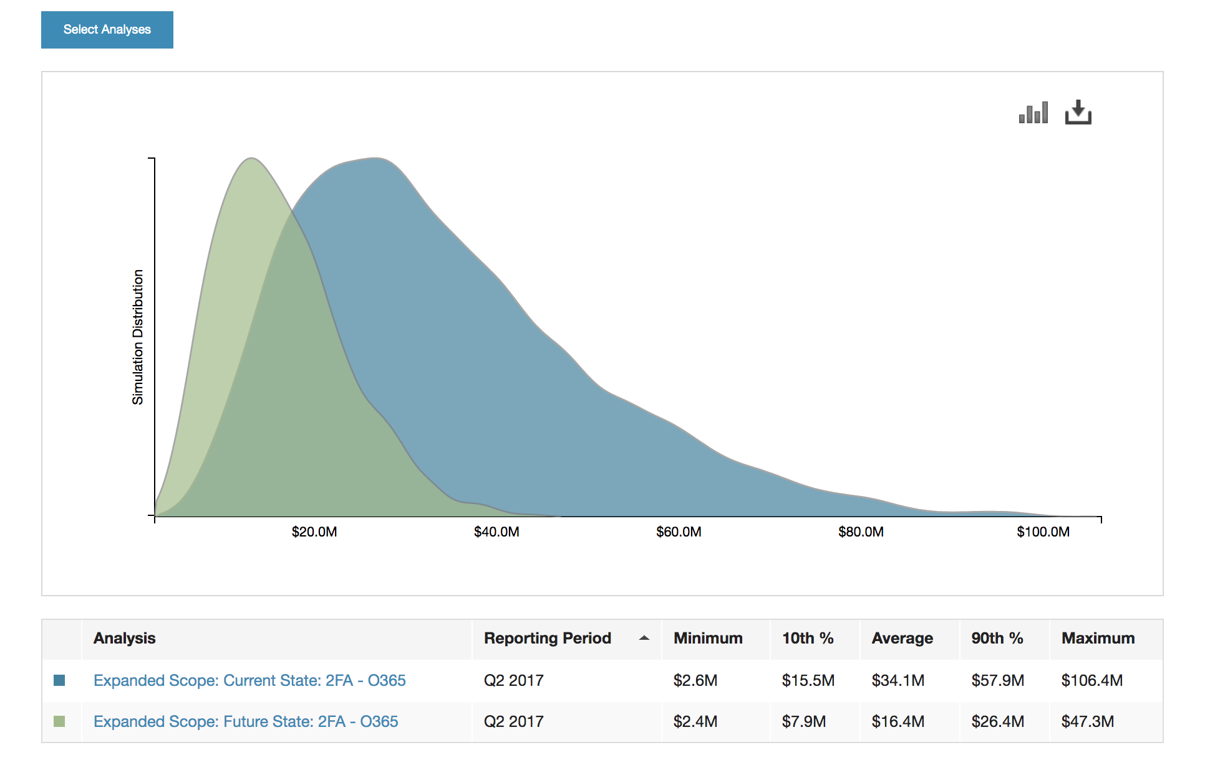
Automated risk measurement…
Threat data
Threat intelligence services
SIEM providers
An organization’s own logs
Models and math
Analysis results
Control data
Security telemetry
Security framework scores
Loss data
Verizon DBIR
Advisen
Insurance providers
Proprietary research

Slide 18
AI for cyber risk…

Slide 19
Artificial Intelligence
What’s the difference between automation and AI?
In AI, the analytic model is learned rather than designed, which means it’s only as good as its training.

Slide 20
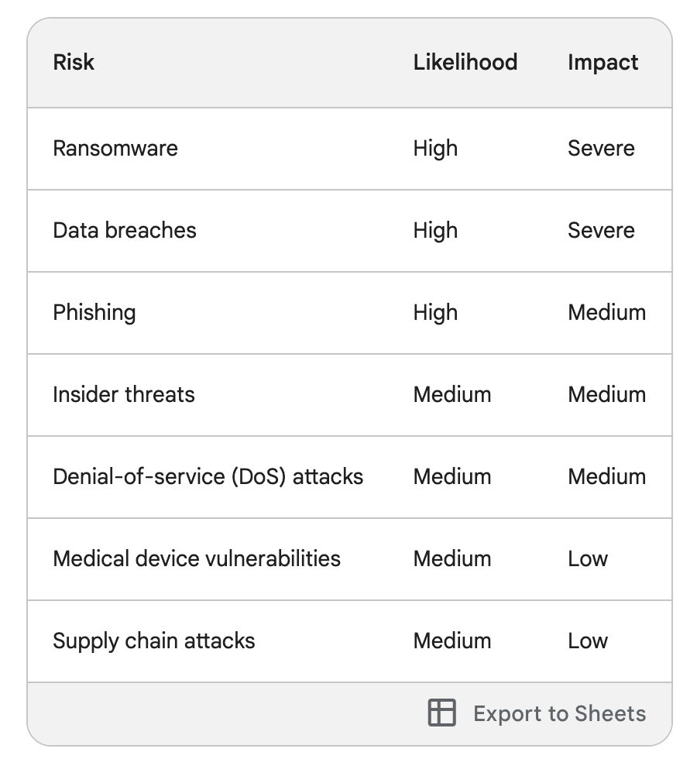
Example…
I posed this question to Bard:
Provide rough quantitative estimates of the likelihood and impact of the top cybersecurity risks a large hospital faces

Slide 21
How effectively could AI have been applied to medicine in the mid-to-late 1800’s…?

Slide 22
Strong risk management AI use-cases today
“Diagnosis”
Event detection
Malware detection
Behavioral analysis
Loss magnitude prediction
“Treatment”
?

Slide 23
The future…

Slide 24
Risk 0.x
Risk 1.0
Risk 2.0
Risk 1.0 (Reactive)
Diagnosis
Event detection
Malware recognition
Behavioral analysis
Loss magnitude forecasting
Risk 2.0 (Proactive)
Introduction of science (e.g., controls physiology)
Improving risk management “healthspan”
Prevention
Synthetic risk experimentation
AI-driven root cause analysis
Risk management “genetic engineering”
Treatment
Prioritized remediation
“Personalized” solution recommendations

Slide 25
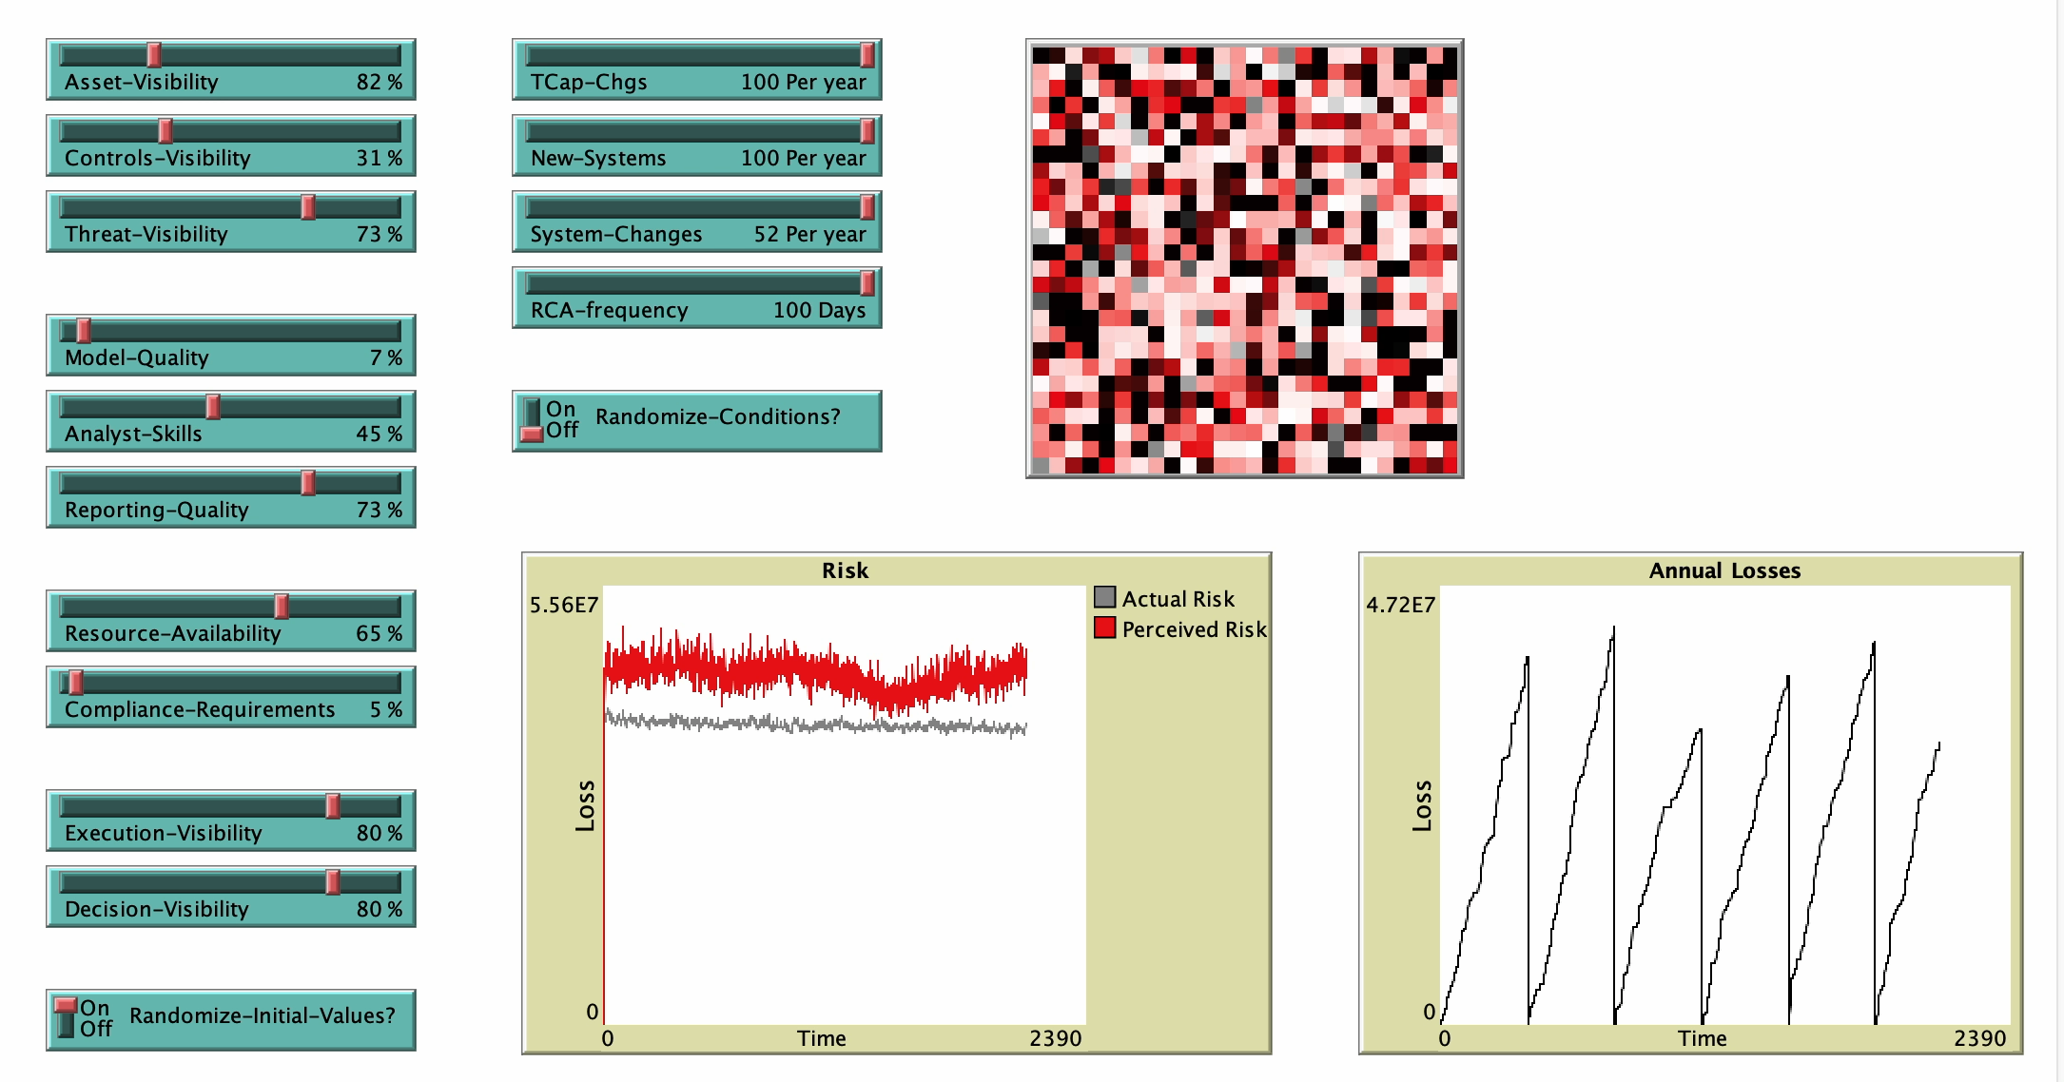
Synthetic experimentation

Slide 26
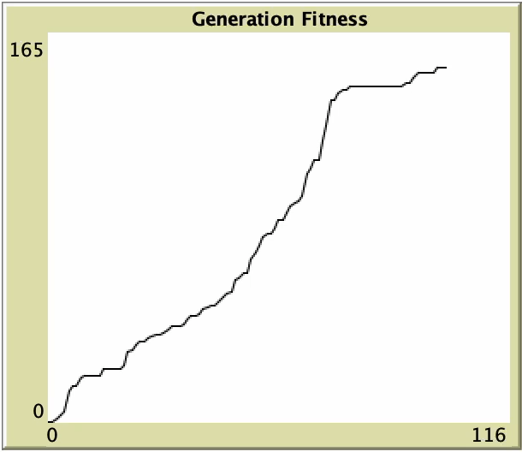
Exploring cybersecurity “genetics”…

Slide 27
Transforming risk management with Risk 2.0 and AI…
Less risk AND improved risk management “healthspan”
“Personalized” risk management strategies and programs
Dynamic adjustments in controls as business or the threat landscape changes
A lack of risk management “disability and disease”
Able to confidently pursue business goals
Risk management resource optimization
Absence of “risk management groundhog day”

Slide 28
Wrapping up…

Slide 29
The bottom line…
AI will transform risk management – eventually
There are strong use-cases even today, but…
Absent a deeper understanding of how our problem space actually works, we can’t fully leverage AI or realize the promise of Risk 2.0

Slide 30
Thank you!

