Slide 1
Is It Raining Risk?
What Data says about Cyber Risk in the Cloud
Dr. Wade Baker, Cyentia Institute

Slide 2
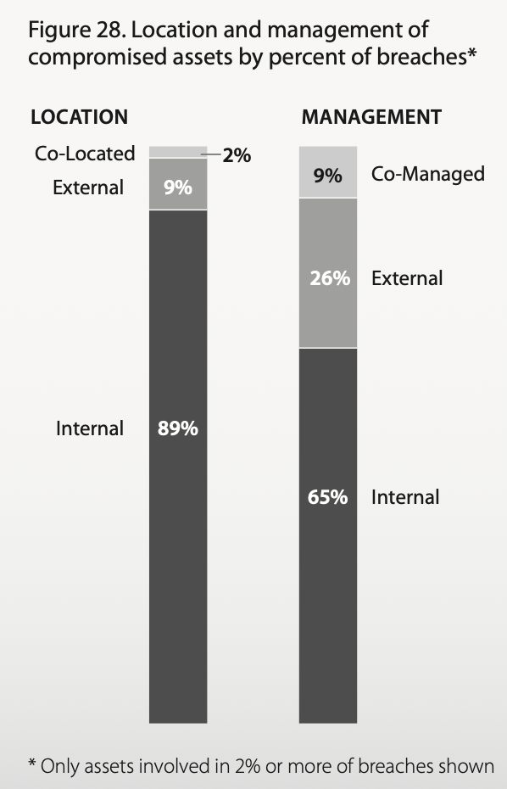
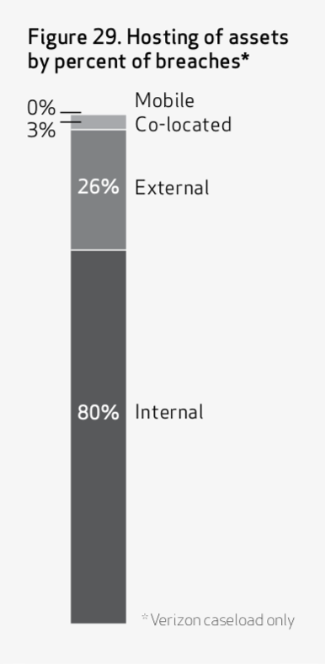
Wayback Machine: Cloud risk in the DBIR
2010 DBIR
2012 DBIR
Source: 2010 Data Breach Investigations Report (Verizon)
Notes:
No mention of “cloud” in 2008 – 2009 DBIRs. 2010 DBIR: “We continue to search for a link between data breaches and cloud-based or virtualized infrastructure but continue to find none.”
2012 DBIR: “The fact that these assets were in some form of fashion “in the cloud” was not a significant cause of the breach.”

Slide 3
Effect of Cloud on Risk Posture

Slide 4
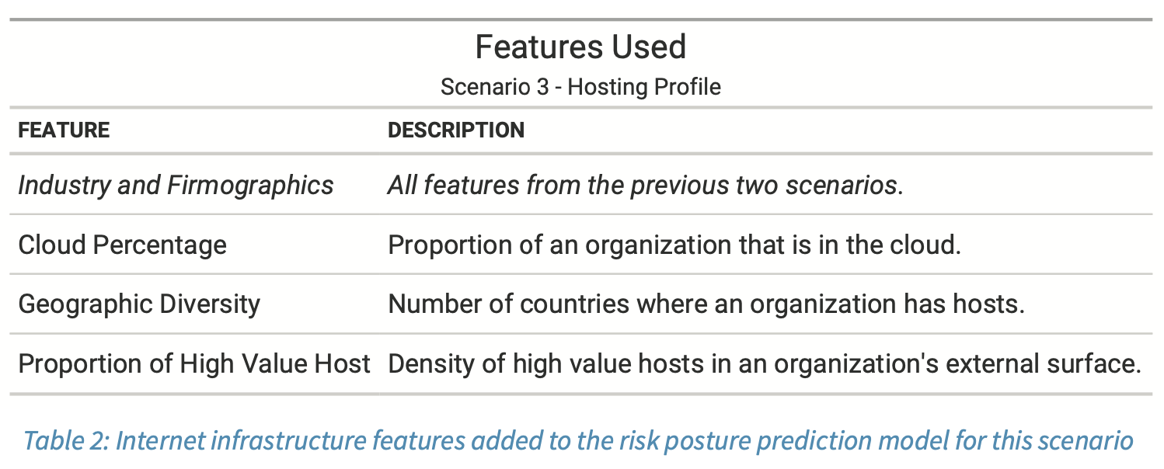
Effect of Cloud on Security Exposures
Source: From Uncertainty to Understanding (w/ Riskrecon)

Slide 5
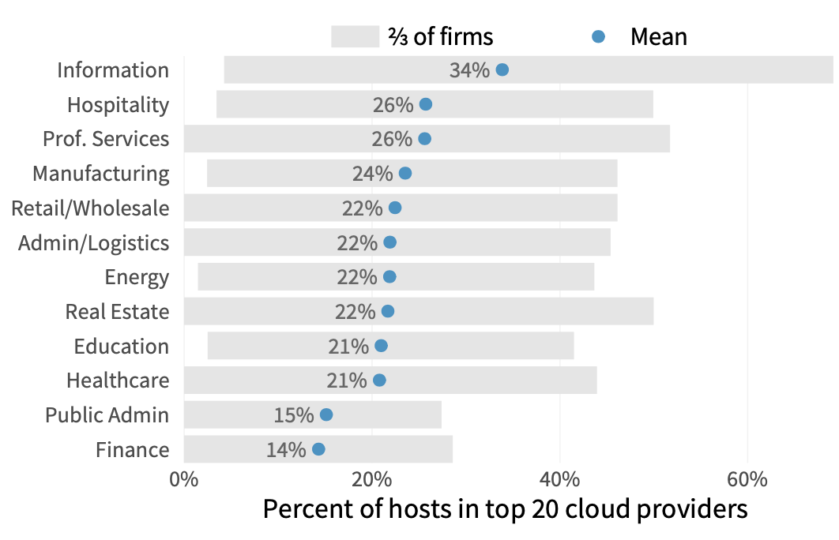
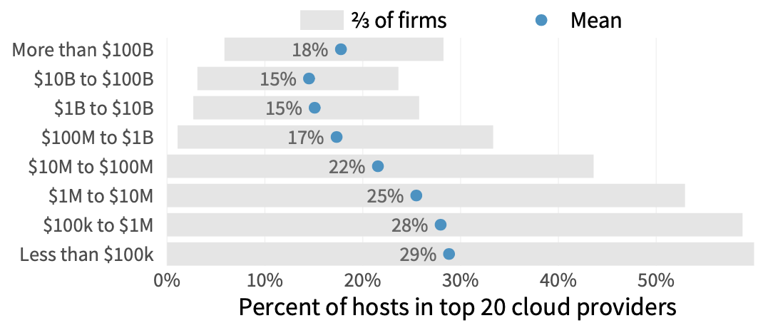
Effect of Cloud on Security Exposures
Cloud adoption differs by sector & size
Source: From Uncertainty to Understanding (w/ Riskrecon)

Slide 6
Effect of Cloud on Security Exposures
Source: From Uncertainty to Understanding (w/ Riskrecon)

Slide 7
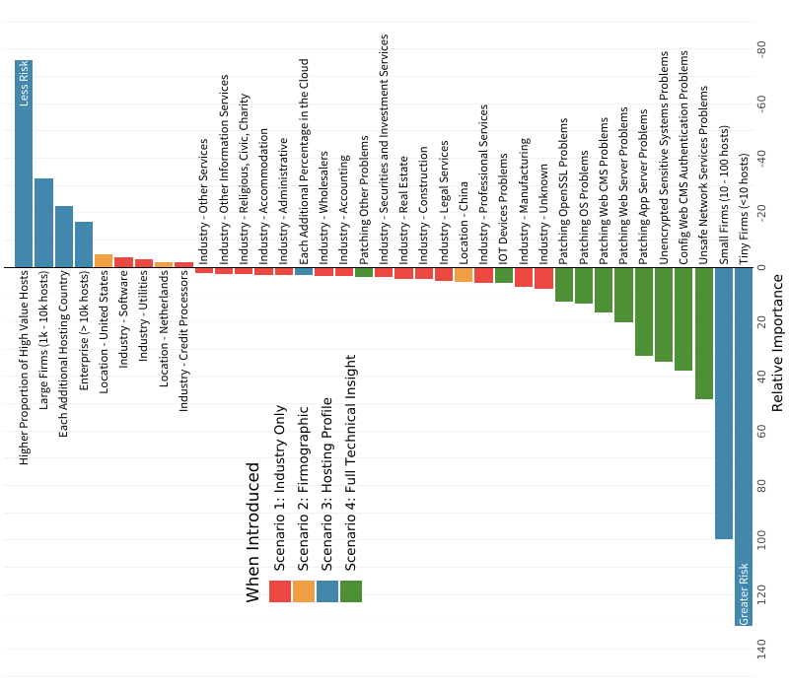
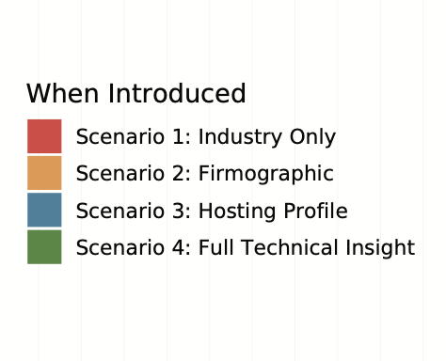
Effect of Cloud on Exposures
The bar lengths shown here correspond to the relative importance for each factor for predicting risk posture. We can say, for example, that the presence of security issues (in green) is much more important than knowing a firm’s industry.
Source: From Uncertainty to Understanding (w/ Riskrecon)

Slide 8
SUMMARY: Effect of Cloud on Exposures
Cloud usage is (in and of itself) a very weak predictor of risk posture.
But it’s possible that issues like unsafe services, misconfigurations, and firmographics – which are strong predictors – are more common in the cloud.
Let’s look at that hypothesis more closely…

Slide 9
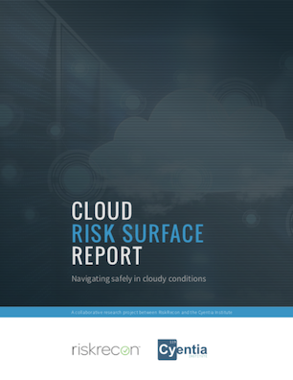
Are Clouds Less Secure?

Slide 10
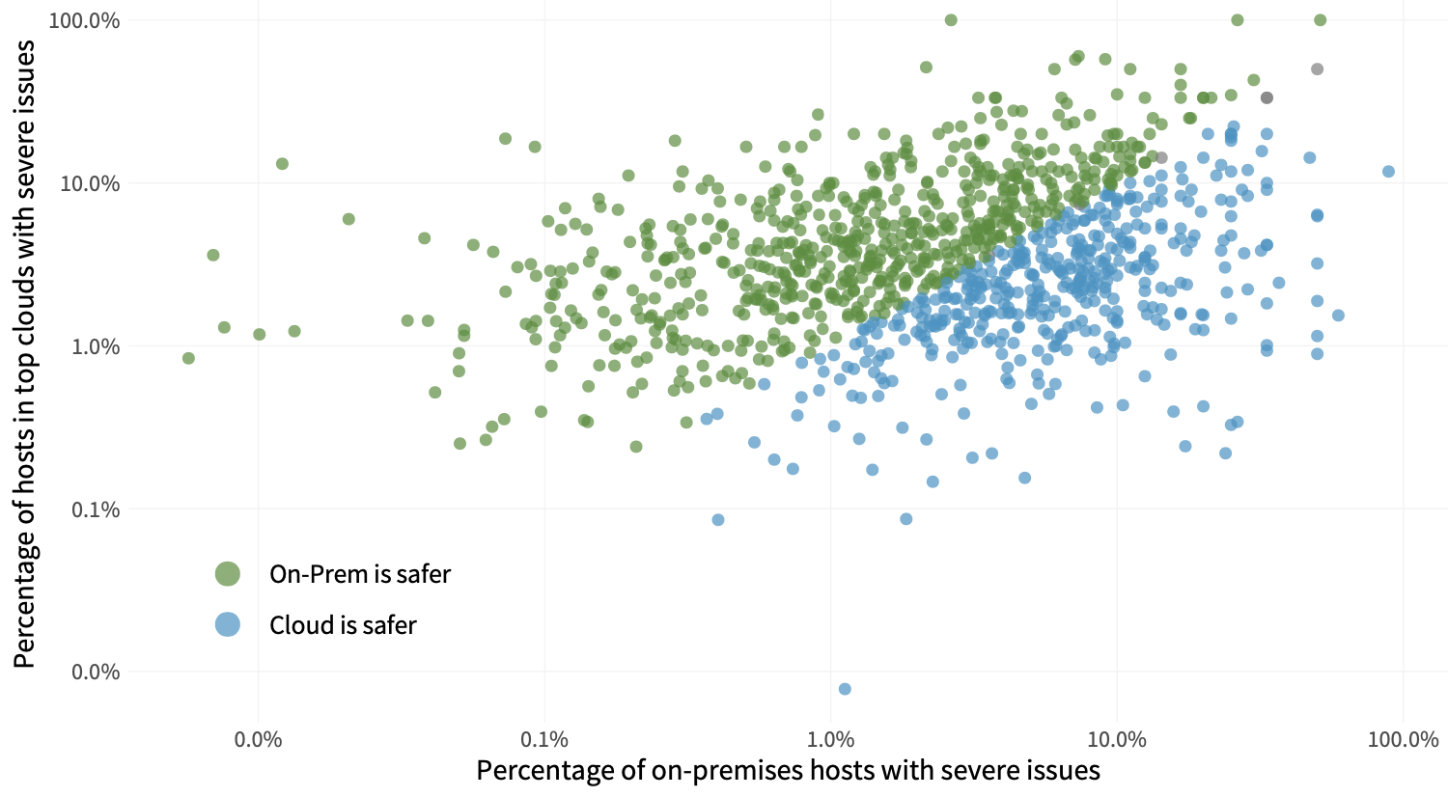
60%
40%
Source: Cloud Risk Surface Report (w/ Riskrecon)
Notes:
Each dot in Figure 1 represents an organizations in our dataset with hosts that have high or critical findings both in the cloud and on-premises. Their position on the grid portrays the percentage of internal (horizontal axis) and cloud-based (vertical axis) hosts that have high or critical security findings. Blue dots indicate firms that have comparatively fewer security issues in the cloud. Green dots, conversely, appear better off on-prem.
It shows a fairly similar split between organizations that operate more safely on-prem (60%) vs. in the cloud (40%).

Slide 11
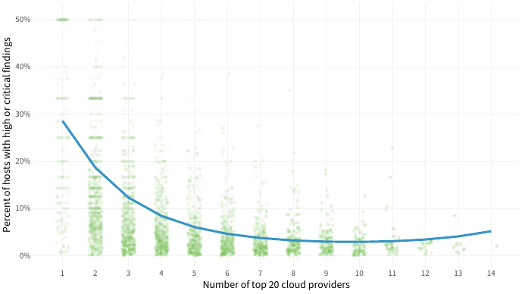
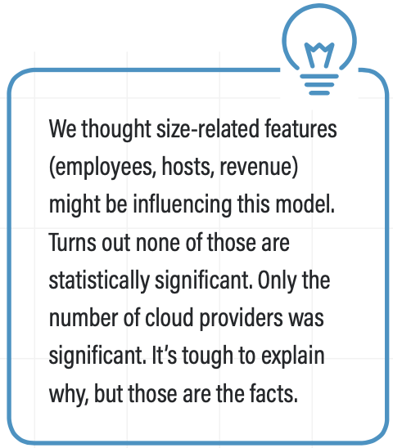
Are Clouds Less Secure?
The rate of severe findings is at its highest when cloud diversity is at its lowest.
As firms use more cloud providers, that rate drops steadily...to a certain point
Source: Cloud Risk Surface Report (w/ Riskrecon)

Slide 12
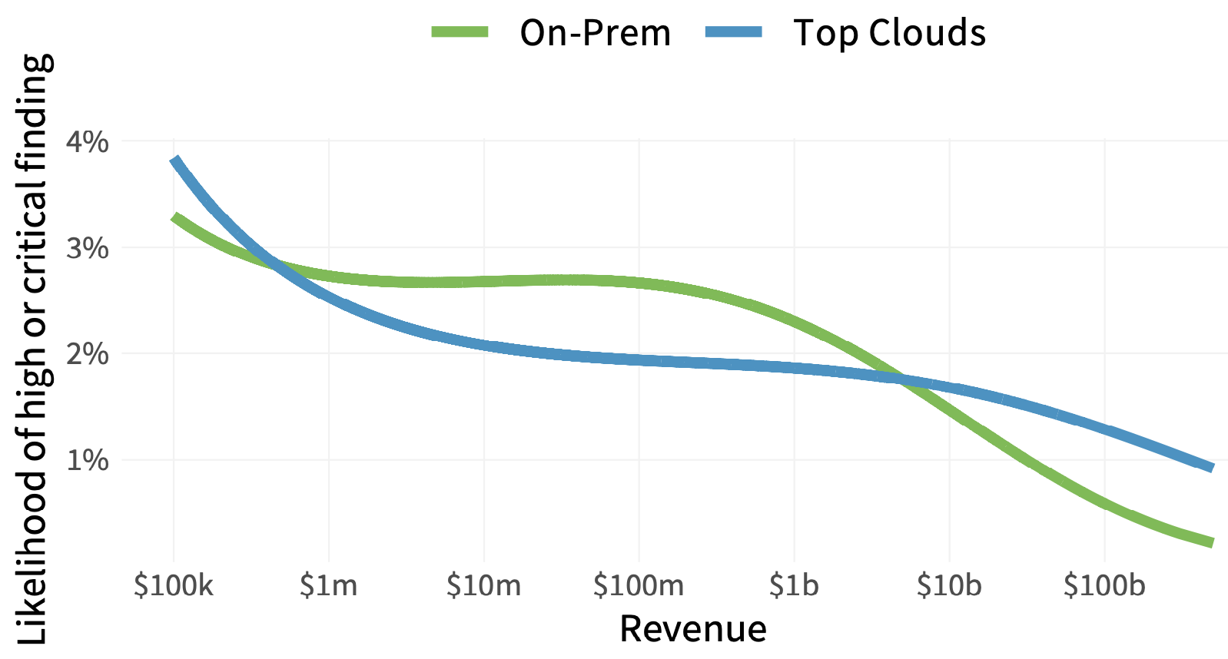
Are Clouds Less Secure?
Models comparing exposure rates on-prem vs. cloud by organization size (revenue) reveal mixed results.
Organizations between $1M and ~$5B operate a little more safely in the cloud.
Source: Cloud Risk Surface Report (w/ Riskrecon)

Slide 13
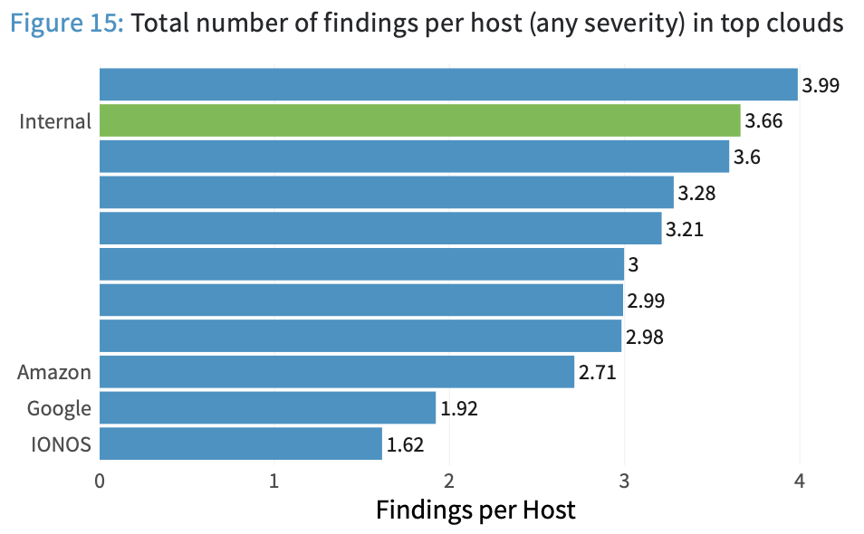
Are Clouds Less Secure?
All things being equal, many clouds offer equivalent or better “safety” than on-prem hosting.
Source: Cloud Risk Surface Report (w/ Riskrecon)

Slide 14
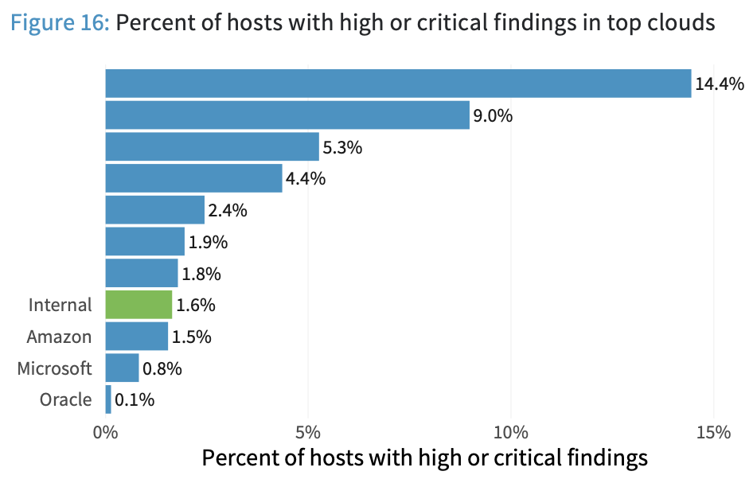
Are Clouds Less Secure?
From this perspective, 2/3 biggest cloud providers show a lower rate of severe exposures than internal (on-prem) environs.
There’s a 144X difference in that rate among cloud providers.
Source: Cloud Risk Surface Report (w/ Riskrecon)

Slide 15
SUMMARY: Are Clouds Less Secure?
A (slightly) greater share of organizations have a higher rate of security exposures in the cloud.
No evidence that cloud environments are inherently less secure than on-prem.
The differences likely boil down to organizational characteristics and risk management capabilities.
Choosing a cloud provider that suits your needs and capabilities an important cyber risk decision.

Slide 16
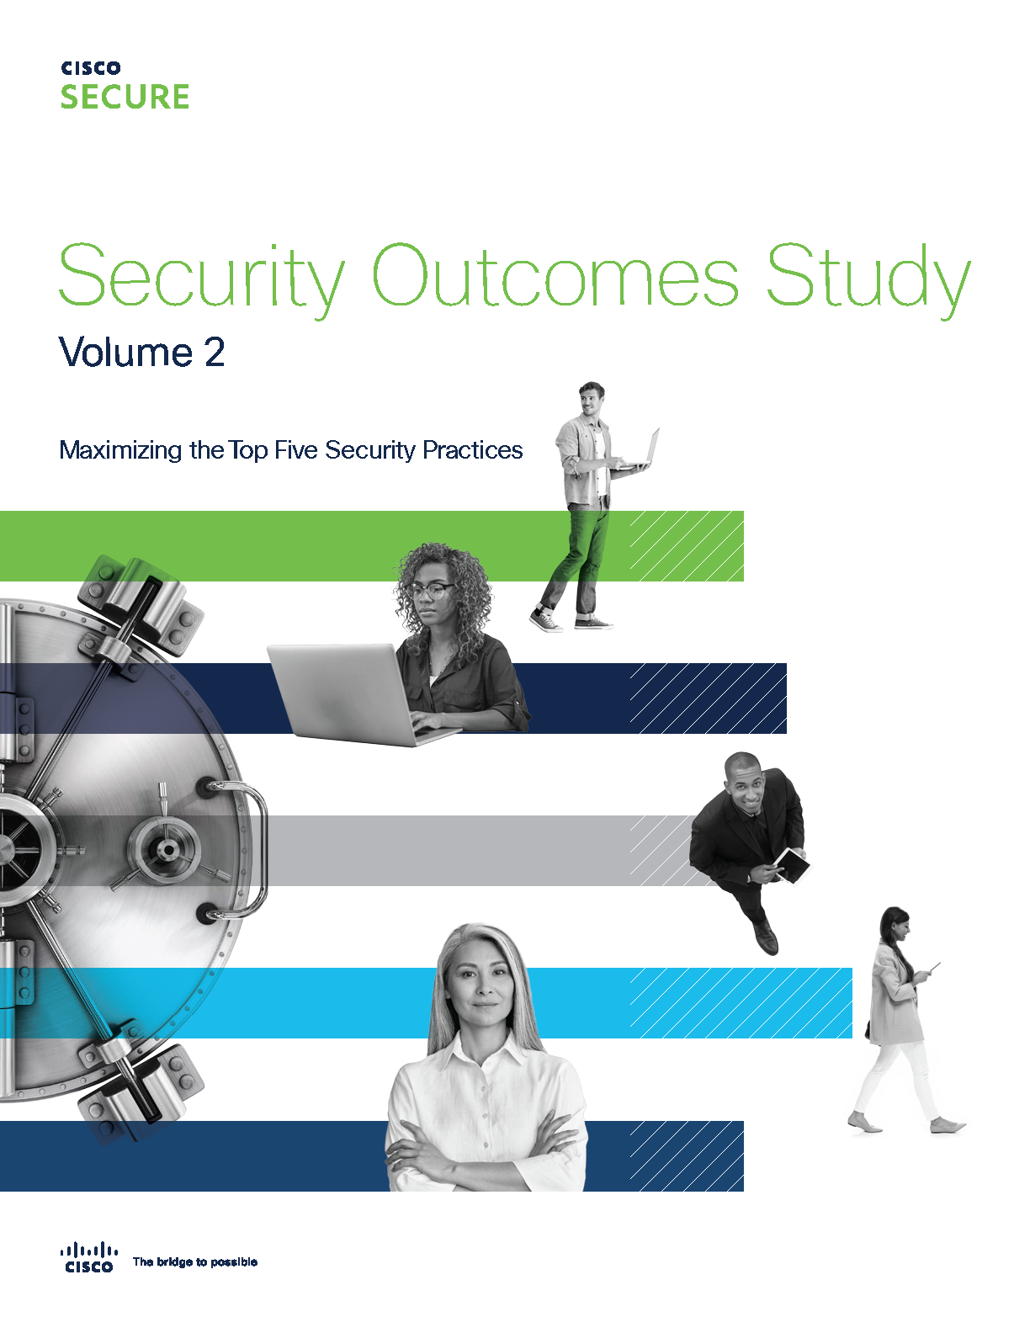
Are Clouds Less Resilient?

Slide 17
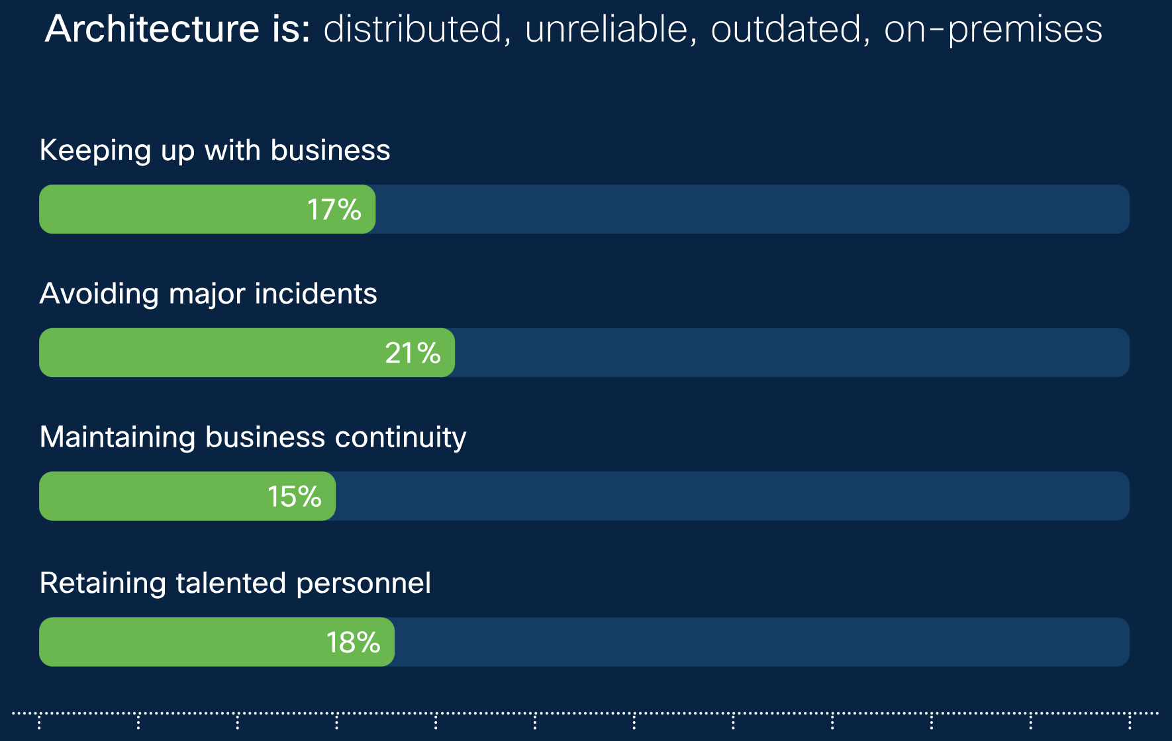
Are Clouds Less Resilient?
Orgs with these IT architecture traits don’t fare very well when it comes to security resilience outcomes.
Source: Security Outcomes Study (w/ Cisco)

Slide 18
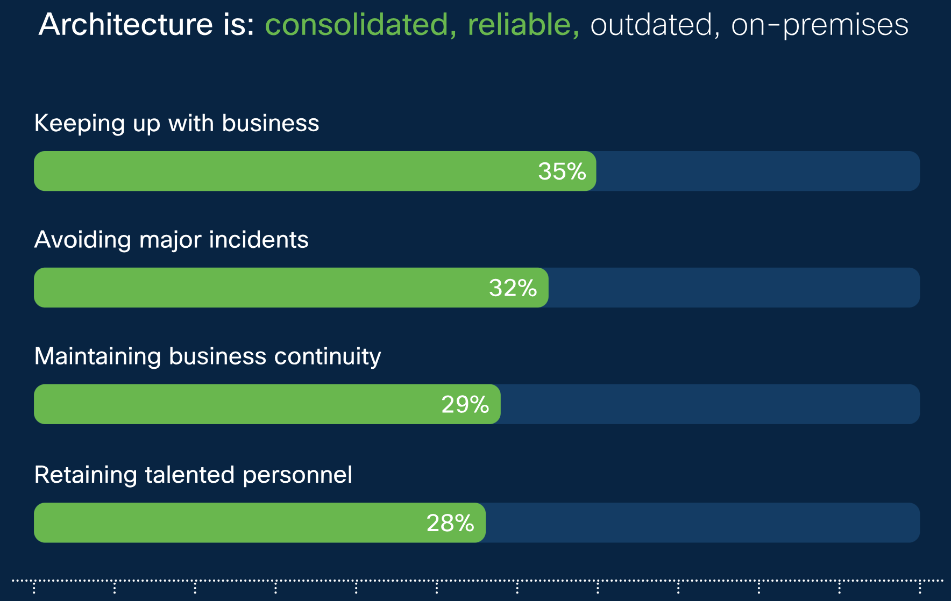
Are Clouds Less Resilient?
Making IT more consolidated and reliable boosts outcomes – esp. for enabling business and maintaining continuity.
Source: Security Outcomes Study (w/ Cisco)

Slide 19
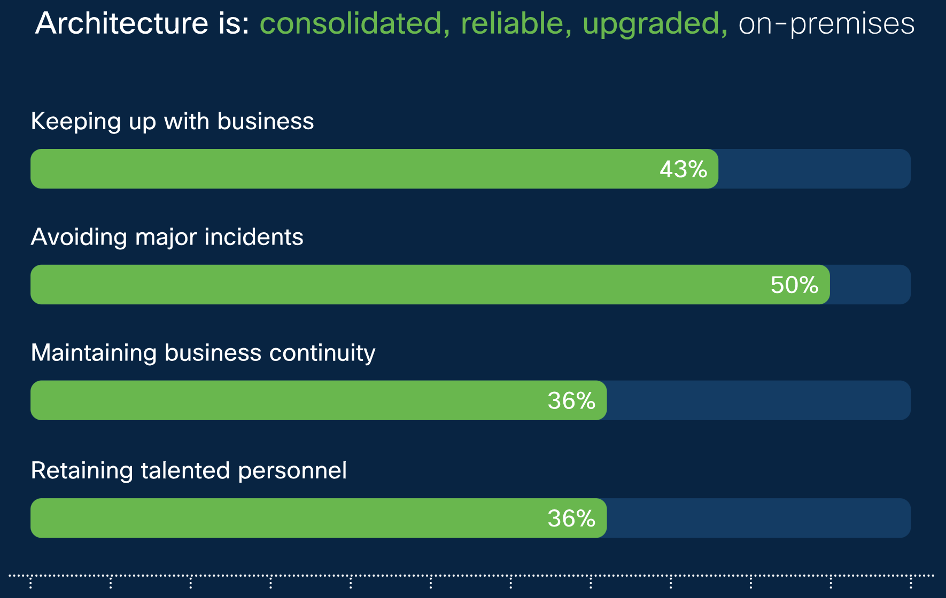
Are Clouds Less Resilient?
Even more gains come from upgrading IT – esp. in avoiding major incidents.
It’s hard to defend legacy infrastructure from modern attacks.
Source: Security Outcomes Study (w/ Cisco)

Slide 20
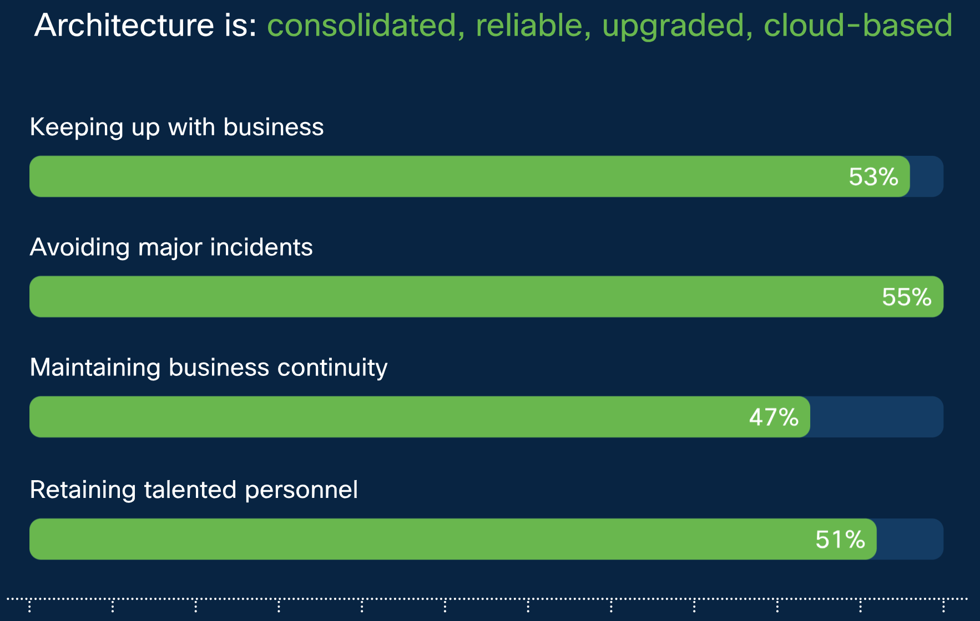
Are Clouds Less Resilient?
Maximum success across resilience outcomes was seen in orgs that embraced the cloud.
Source: Security Outcomes Study (w/ Cisco)

Slide 21
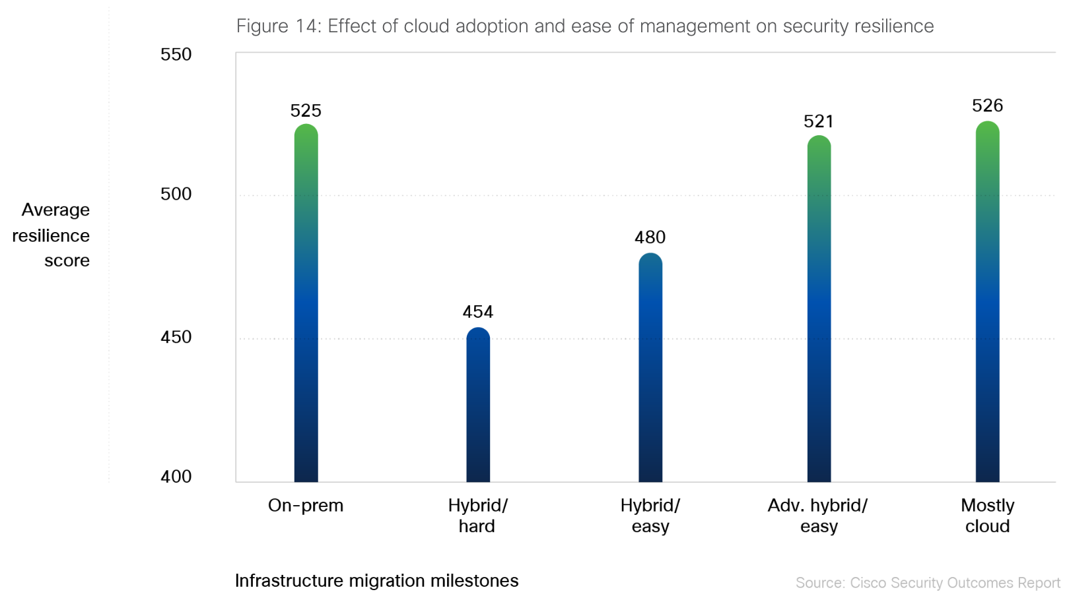
Are Clouds Less Resilient?
Source: Security Outcomes Study (w/ Cisco)

Slide 22
SUMMARY: Are Clouds Less Resilient?
Organizations with cloud-heavy architectures tend to report higher achievement of resilience outcomes.
But the evidence also suggests the early to mid stages of cloud migration may erode resilience.

Slide 23
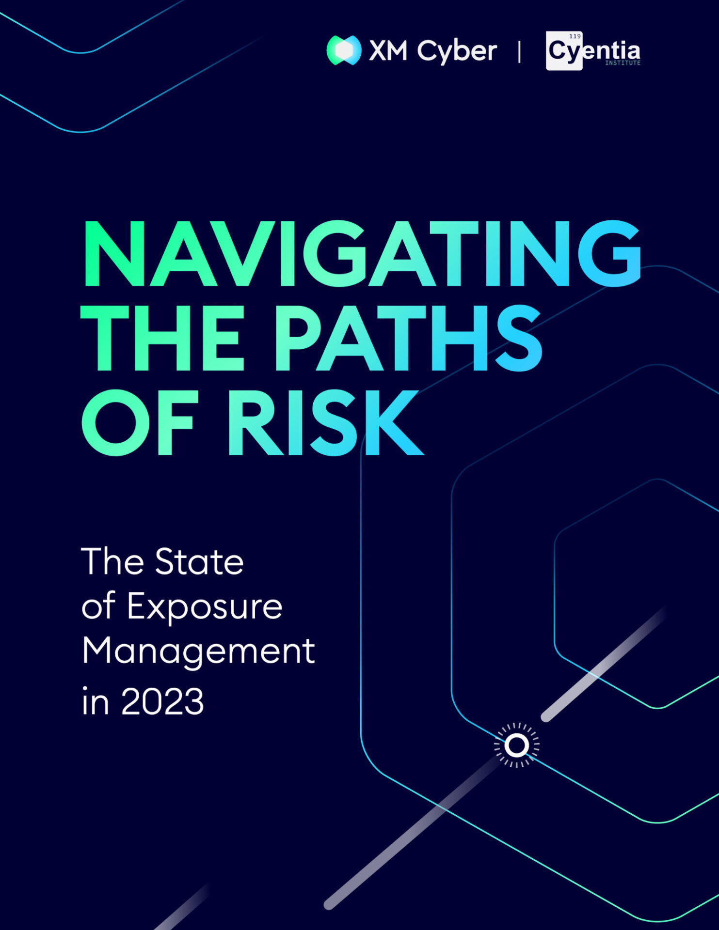
Attack Paths in the Cloud

Slide 24
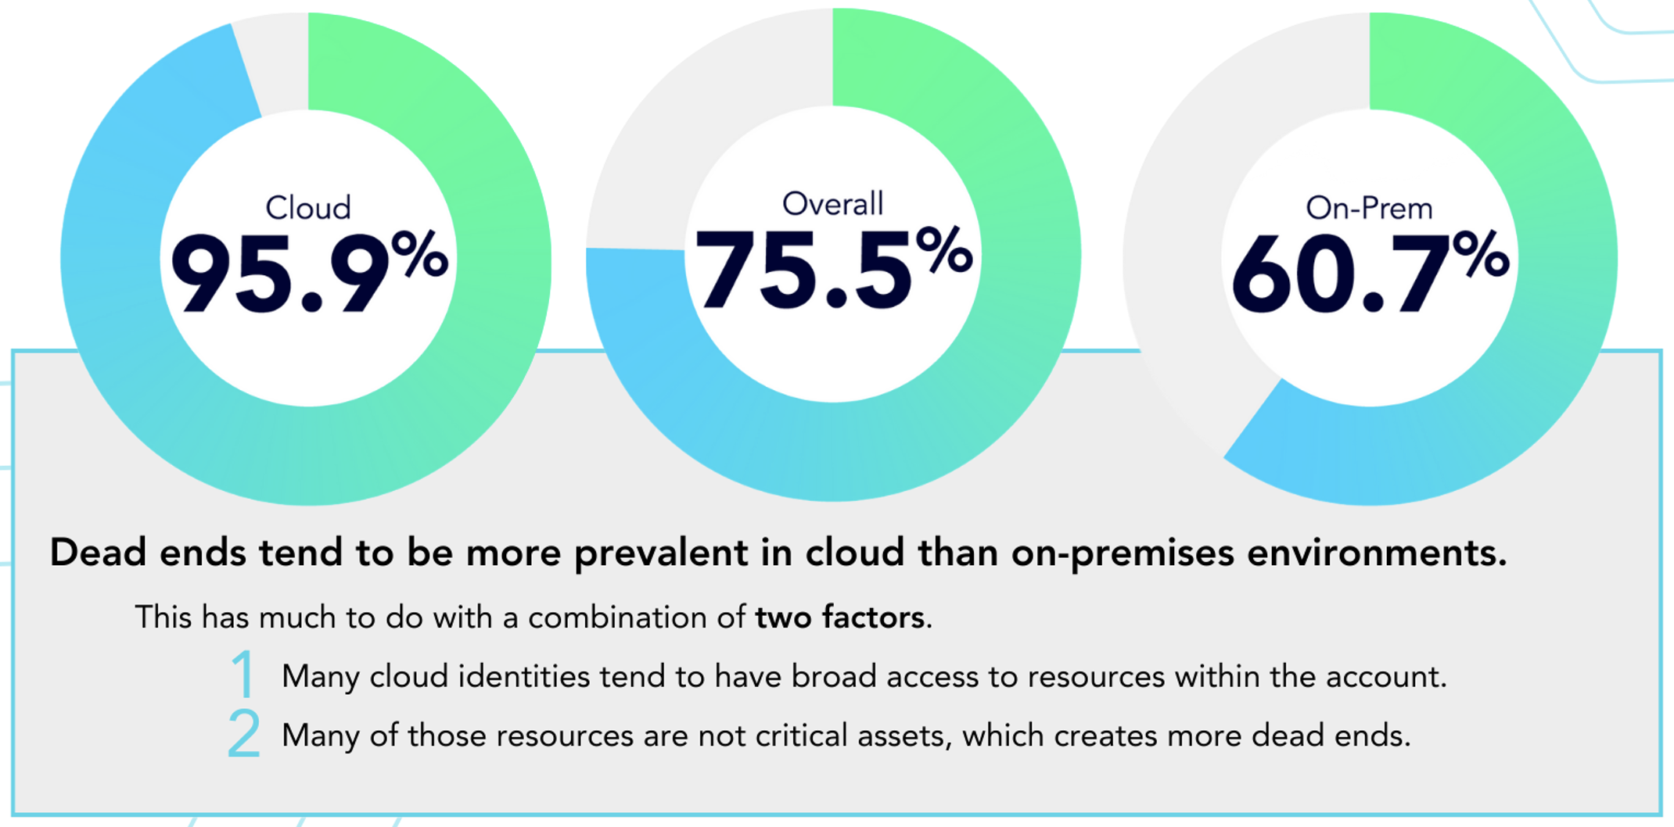
Attack Paths in the Cloud
Proportion of attack path vectors that lead to dead ends
Dead End: An isolated exposure that can’t be used by attackers to compromise critical assets.
Deprioritize these to focus on paths that lead to high risk scenarios.
Source: Navigating the Paths of Risk (w/ XM Cyber)

Slide 25
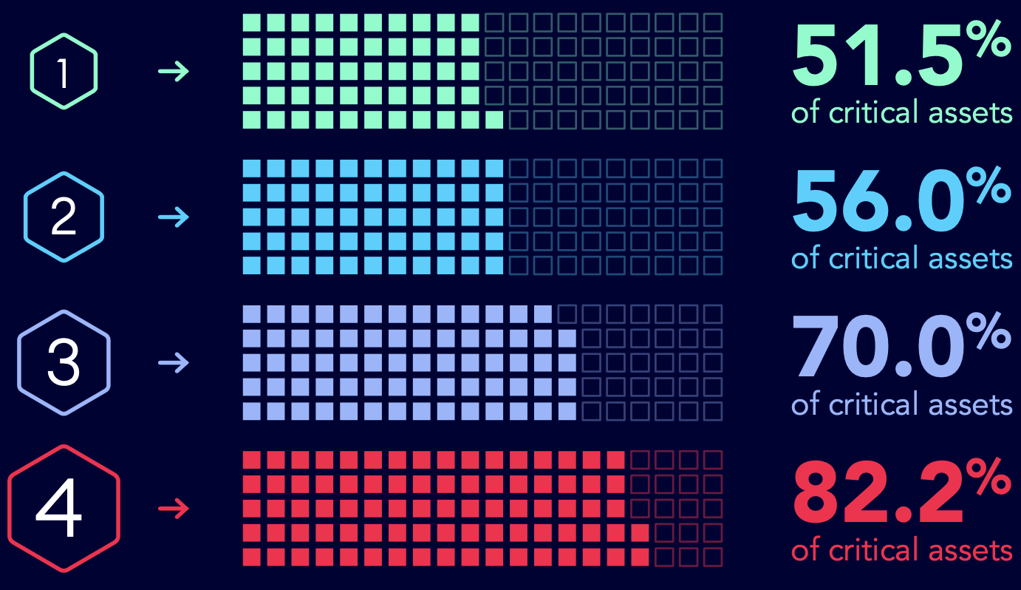
Attack Paths in the Cloud
Scope of critical assets at risk with each additional hop along on-prem attack paths
Hop: Steps taken by attackers from the point of initial foothold to compromising critical assets. Hops consist of various techniques used to exploit vulnerable resources, which become the staging ground for the next hop.
Source: Navigating the Paths of Risk (w/ XM Cyber)

Slide 26
Attack Paths in the Cloud
80% in Azure
71% of firms have exposures that enable pivoting from on-prem to cloud.
GCP
47% in AWS
Source: Navigating the Paths of Risk (w/ XM Cyber)

Slide 27
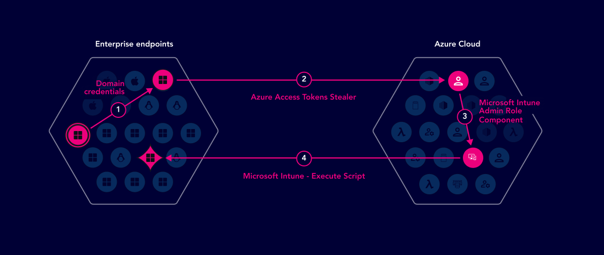
Attack Paths in the Cloud
Example attack vector consisting of multiple techniques
Source: Navigating the Paths of Risk (w/ XM Cyber)
Notes:
The example attack path below started from a random workstation machine in the on-prem environment. After exploiting some credentials issues in the enterprise environment, we were able to pivot into the cloud (Azure environment) by harvesting valid Azure access tokens (claimed with MFA). Once the Azure recon phase was complete, we were able to escalate our privileges and finally compromise an Intune (Azure MDM solution for managing devices) Administrator User. By abusing the permissions of that user, we could execute code back on the enterprise machines that he managed. Continued lateral movement would have led to the compromise of the entire enterprise environment.

Slide 28
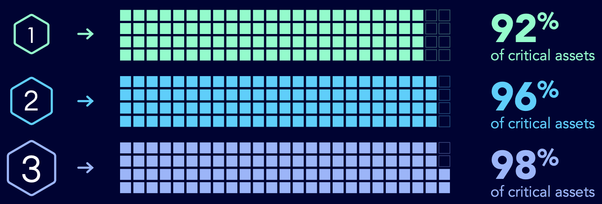
Attack Paths in the Cloud
Scope of critical assets at risk with each additional hop along cloud attack paths
After accessing cloud infra, 92% of critical assets lie just one hop away.
Source: Navigating the Paths of Risk (w/ XM Cyber)

Slide 29
Attack Paths in the Cloud
Attack techniques specific to cloud environments aren’t the most common or risky
Source: Navigating the Paths of Risk (w/ XM Cyber)
Notes:
As measured from the proportion of organizations affected, attack path techniques targeting network and IT services are the most common themes overall. Frequently observed techniques in these categories include proxy spoofing, DHCPv6 DNS poisoning, exploits against Windows Server Update Services, dumping and using private SSH keys, and hijacking SSH sessions. It’s noteworthy that these technique categories are decidedly less dominant when you measure the percentage of detected exposures they potentially exploit. In other words, they offer attackers broad but relatively shallow use.
Techniques that target AD and misappropriate user credentials are also very common (82% of organizations). What’s more, these techniques are able to exploit 72% of all identified security exposures! That’s important enough to warrant additional analysis, so we’ll leave it be for now and pick up this AD thread in a dedicated section to follow.
Exploits of prominent remote code execution (RCE) vulnerabilities in the CVE List were observed in 71% of firms but associated with just 0.7% of exposures. That points to a common misconception about exposure management—that it’s all about patching vulnerabilities. While patching is absolutely a core component of security operations, there’s a lot of risk exposure that falls outside that scope. We explore this further and provide more details about those CVEs in the next section.
And that brings us to the top techniques targeting each of the three major cloud platforms and Kubernetes. Their prevalence across organizations is, of course, largely dependent on which are more widely used. In terms of total exposures, Azure offers the largest attack surface for the same reasons we mentioned earlier (larger user population and deeper AD integration).

Slide 30
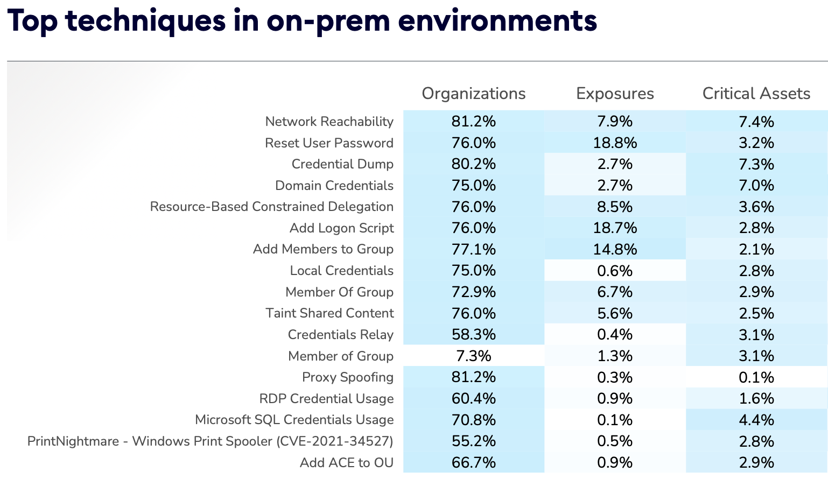
Attack Paths in the Cloud
Note the high proportion of organizations susceptible to techniques, yet relatively low % of exposures and crit assets.
Source: Navigating the Paths of Risk (w/ XM Cyber)

Slide 31
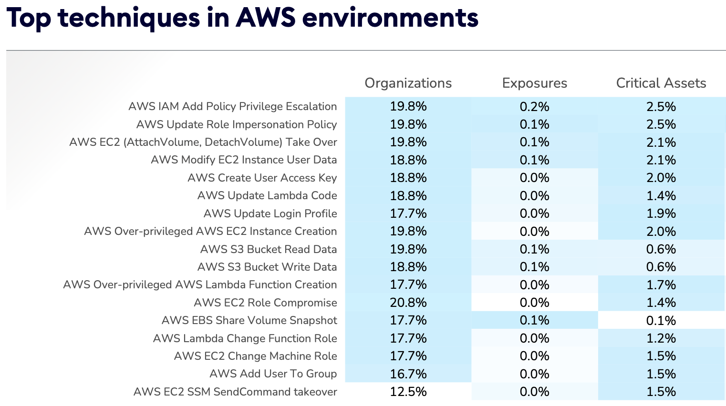
Attack Paths in the Cloud
Note the comparatively lower scope of exposure and critical assets at risk via these techniques in AWS.
Source: Navigating the Paths of Risk (w/ XM Cyber)

Slide 32
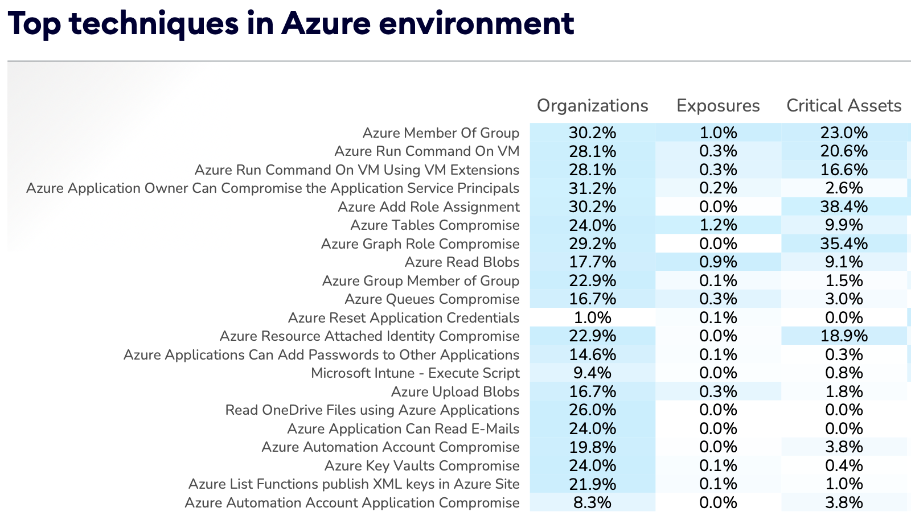
Attack Paths in the Cloud
Note comparatively higher scope of critical assets at risk via these techniques in Azure.
Source: Navigating the Paths of Risk (w/ XM Cyber)

Slide 33
SUMMARY: Attack Paths in the Cloud
The majority of firms have exposures allowing attackers to pivot between on-prem and cloud environments.
Attack paths to compromise critical assets in clouds tend to be shorter with fewer choke/control points.
Common attack techniques differ between cloud and on-prem as well as between cloud environments.

Slide 34
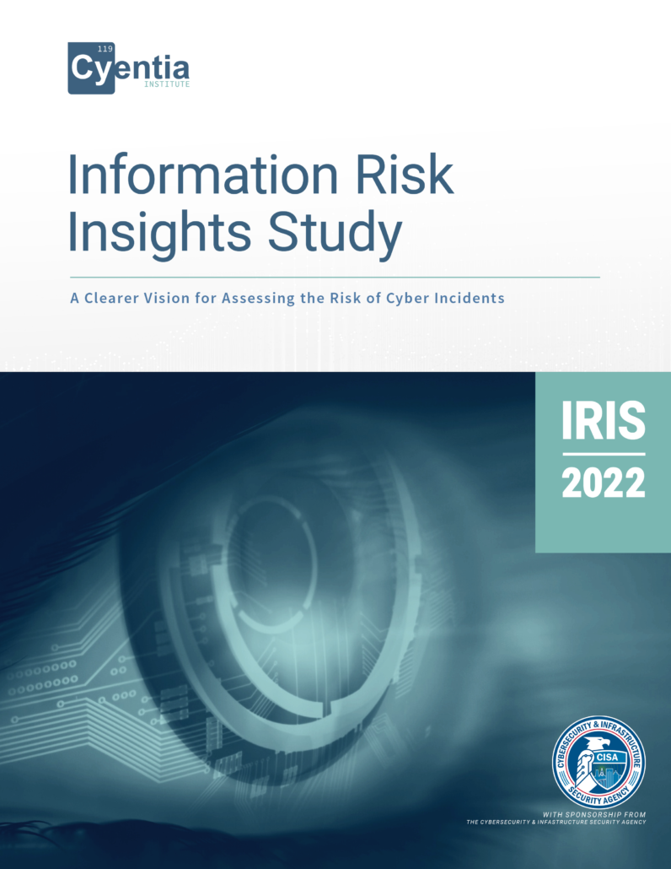
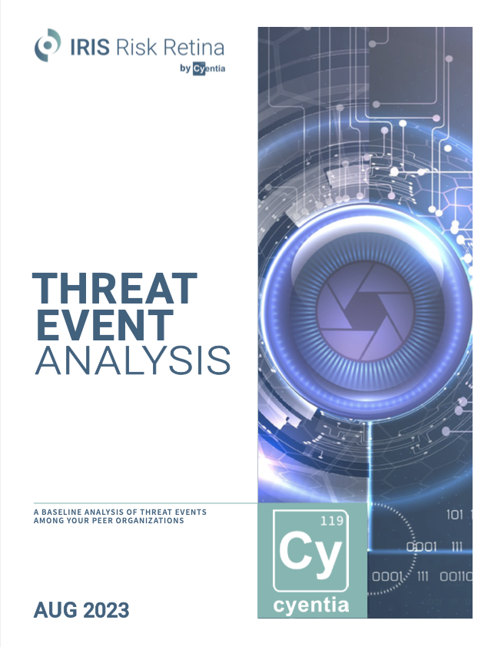
IRIS & Risk Retina CRQ Research
Source: www.cyentia.com/iris

Slide 35
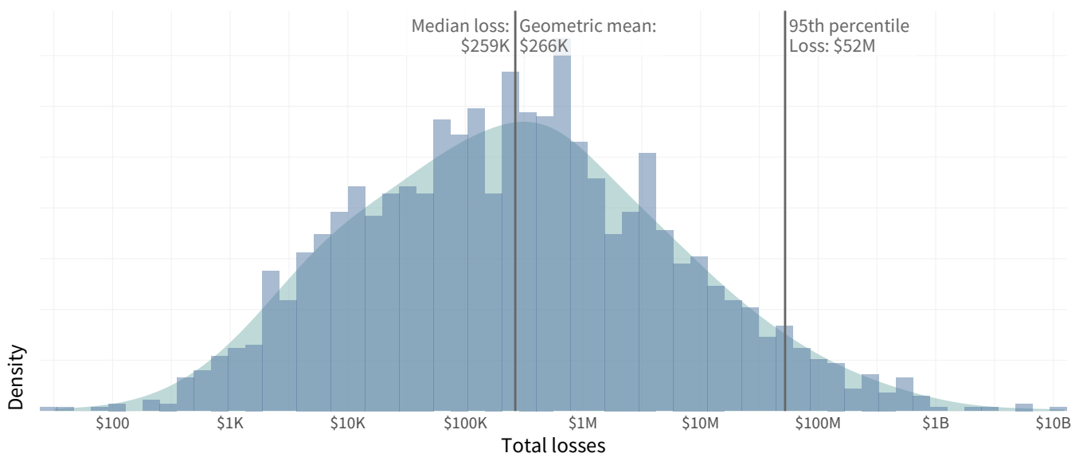
IRIS & Risk Retina: Loss Magnitude
The median loss magnitude for our sample of cloud security events is ~3X higher than that of all cyber loss events and extreme losses (95th percentile) are 3.5X higher.
 | IRIS 2022 | Cloud Events | IRIS Xtreme
Median | $259,000 | $668,000 | $47,000,000
Extreme | $52,000,000 | $185,000,000 | $1,000,000,000
Source: www.cyentia.com/iris

Slide 36
IRIS & Risk Retina: Event Categories
Cloud Events
IRIS Xtreme
Source: www.cyentia.com/iris
Notes:
IRIS-X
Tsunami?

Slide 37
IRIS & Risk Retina: Incident Patterns
Source: www.cyentia.com/iris
Notes:
IRIS 22

Slide 38
IRIS & Risk Retina: Threat Actors
Source: www.cyentia.com/iris
Notes:
Retina TEA

Slide 39
Thank You!
Next Generation Cloud Storage
For letting me share what the data says about cyber risk in the cloud
Get all you saw today:
www.cyentia.com/research
www.cyentia.com/iris

