Slide 1
Introducing FAIR-MAM ™
A Comprehensive Approach to Loss Modeling in FAIR ™
Tom Macphee
Cyber Risk Senior Manager, Cigna
Filippo Curti
Financial Economist, Federal Reserve Board of Richmond
Erica Eager
Senior Director, Risk Quantification, Safe Security

Slide 2
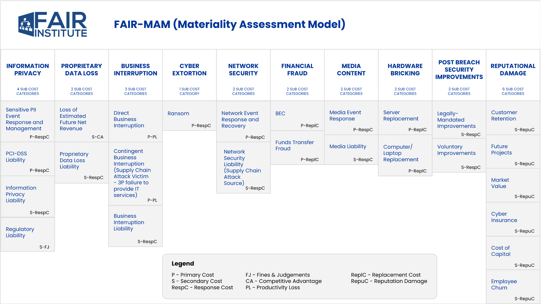

Slide 3
How Material is that Hack?

Slide 4
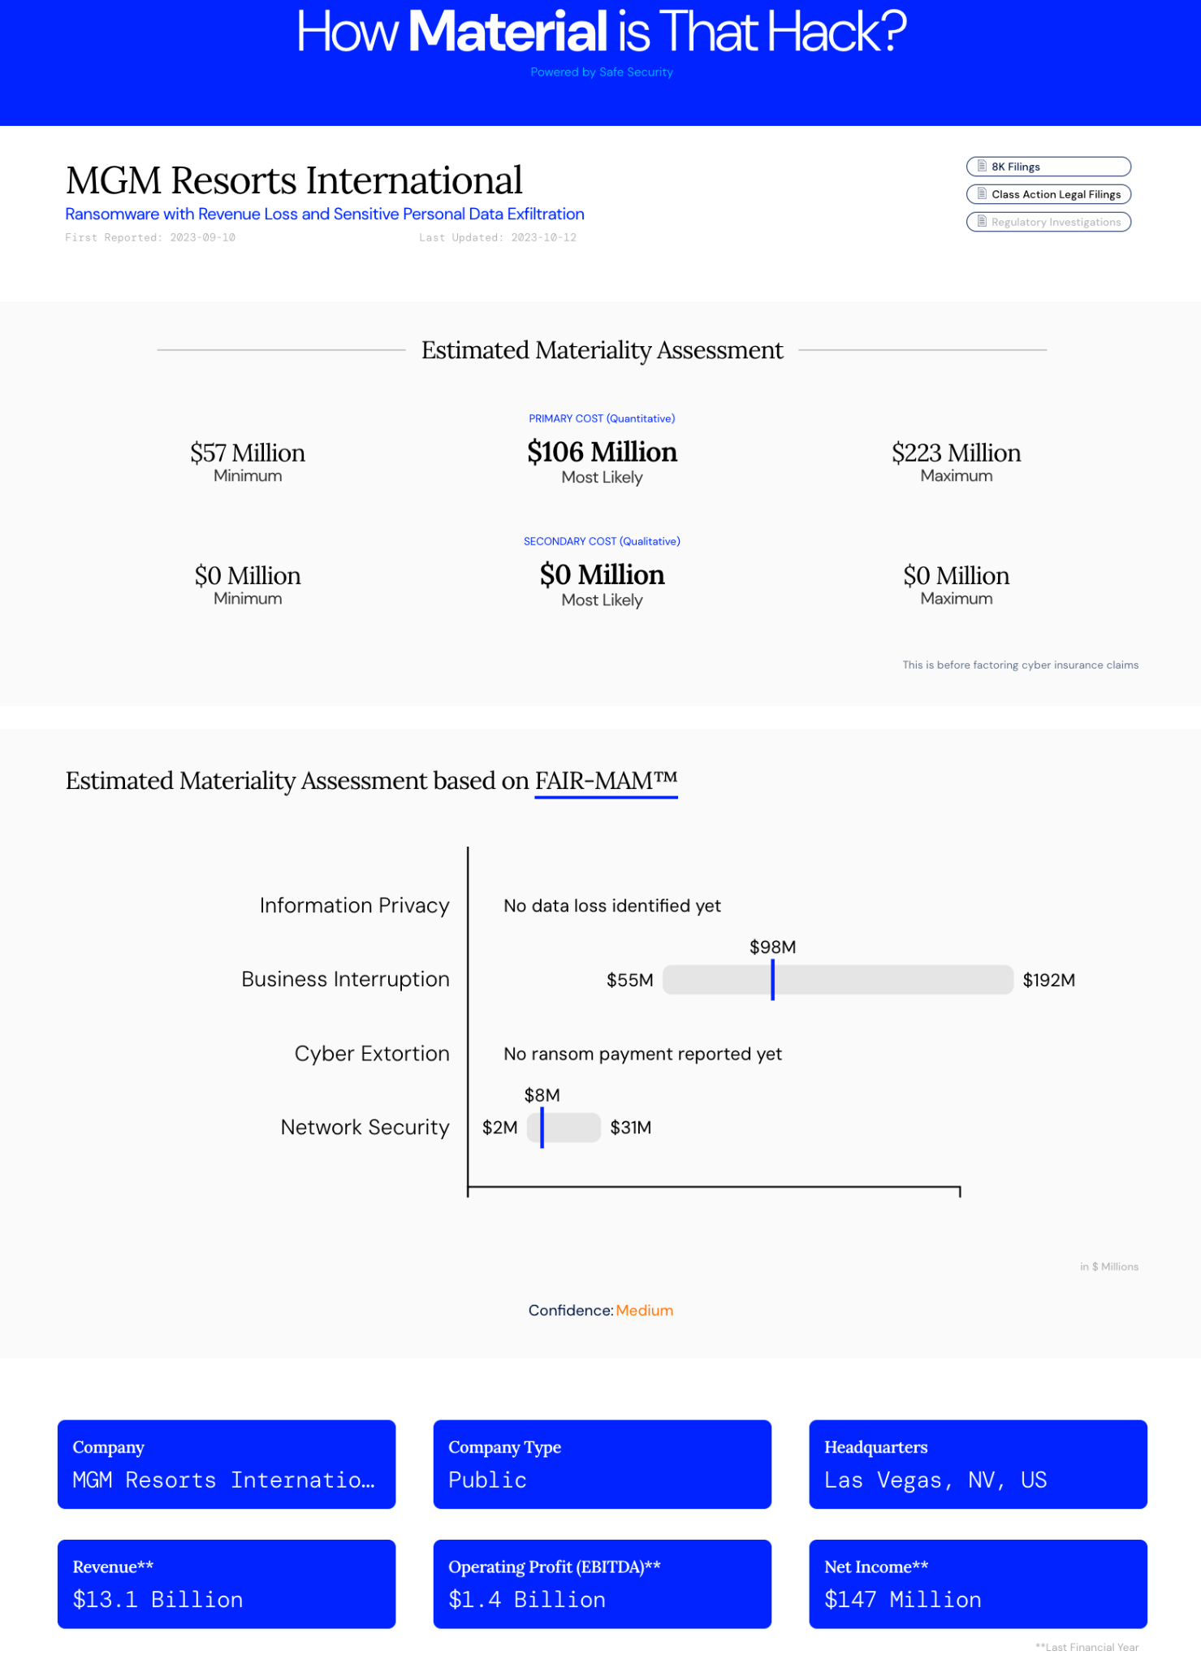
MGM Materiality Assessment #1
Only Business Interruption and system shutdown in the news.
MGM reported financial effect of attack on quarterly results:
~$100M business interruption loss
less than $10M network incident response loss

Slide 5
MGM Estimated Materiality Assessment #1
Only primary (Quantitative) losses
Gross profit loss
Network Incident response costs
Modules generating losses
Business Interruption
Network Security
NOTE: Cyber Extortion is not included because there is no indication that MGM paid a ransom

Slide 6
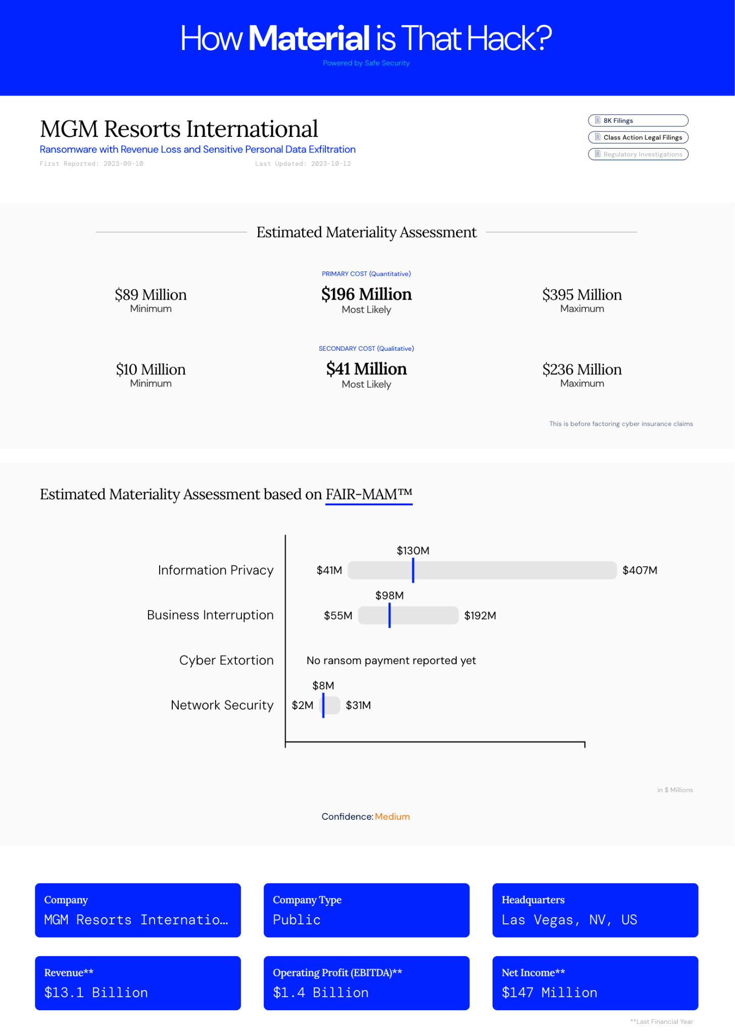
MGM Materiality Assessment #2
MGM reported that Sensitive Personal Data was also compromised in the attack:
as many as 200M guests worldwide who stayed at properties through 12/31/17
Records included:
SSN
Driver’s license numbers
Passport numbers
Military ID numbers

Slide 7
MGM Estimated Materiality Assessment #2
Primary and Secondary losses
Primary (Quantitative factors)
Information Privacy Event Response and Management
Gross profit loss
Network Incident response costs
Secondary (Qualitative factors)
Risked Class Action Settlement and Defense losses
Risked Regulatory penalty losses
Modules generating losses
Information Privacy
Business Interruption
Network Security

Slide 8
Introducing FAIR-MAM ™
A Comprehensive Approach to Loss Modeling in FAIR ™
Tom Macphee
Cyber Risk Senior Manager, Cigna
Filippo Curti
Financial Economist, Federal Reserve Board of Richmond
Erica Eager
Senior Director, Risk Quantification, Safe Security

