Slide 1
Improving Cyber Visibility & Decision Making at Maersk
Neil Davis
Cyber Risk | Maersk

Slide 2
Disclaimer
The following presentation is based on the presenter’s own opinions and may not necessarily reflect those of Maersk or The FAIR Institute or any other body.
Neither the presenter nor Maersk nor The FAIR Institute make any attestation as to the accuracy of the content presented.
Neither the presenter nor Maersk nor The FAIR Institute accept any liability for any decisions made or not made based on the content presented.

Slide 3
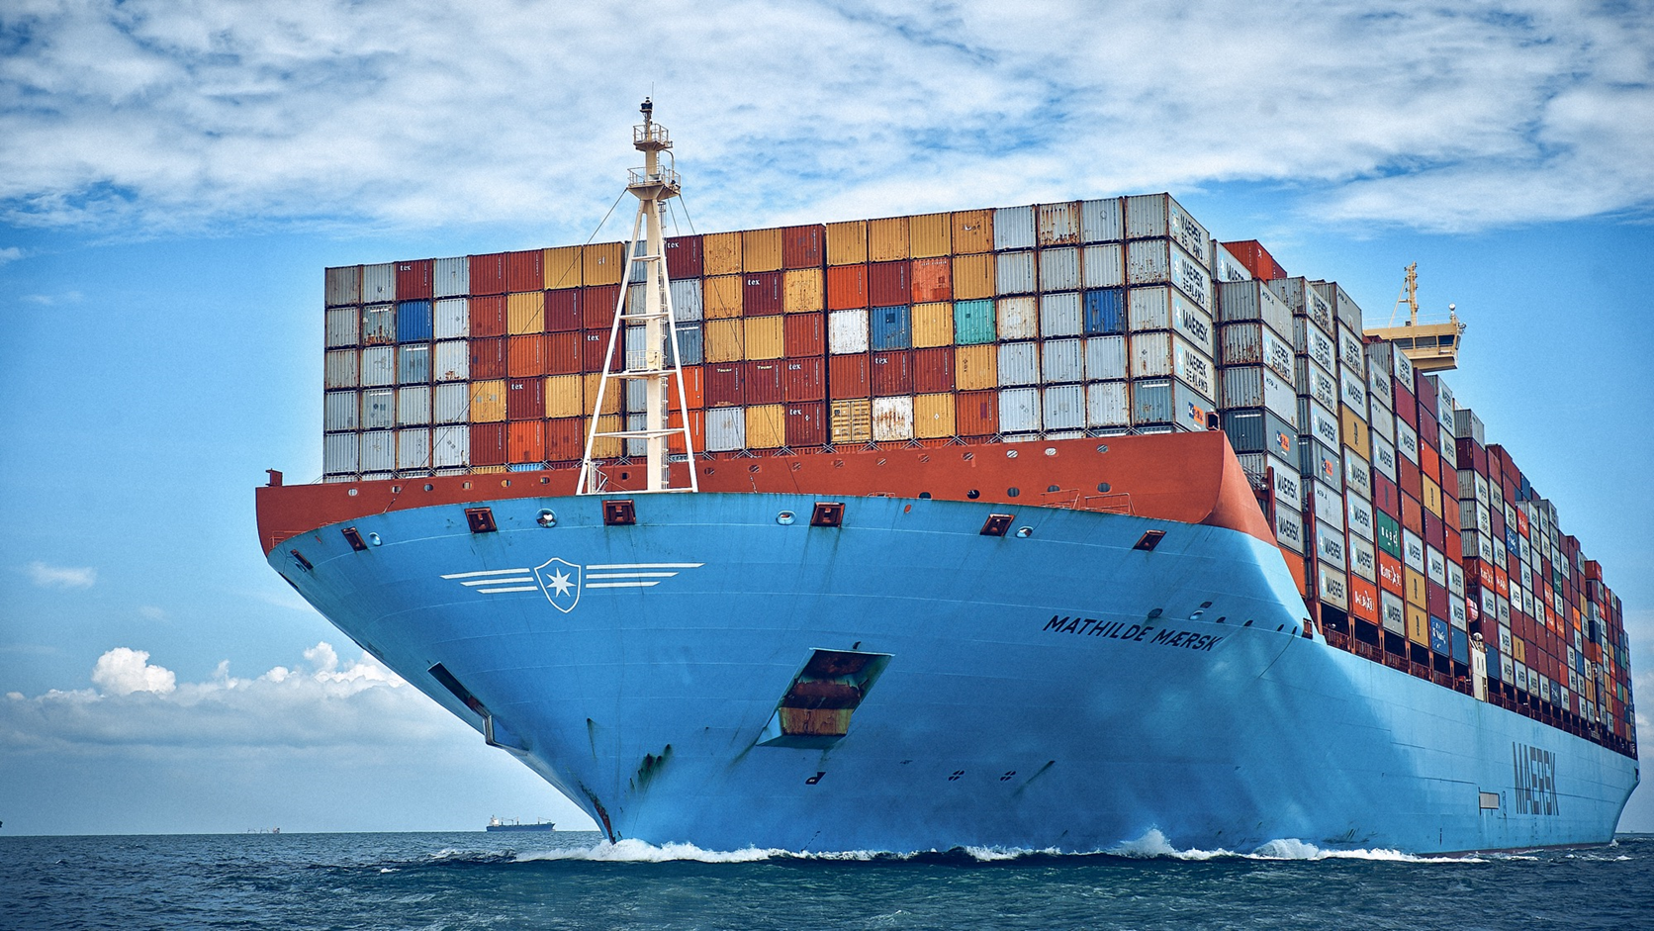

Slide 4
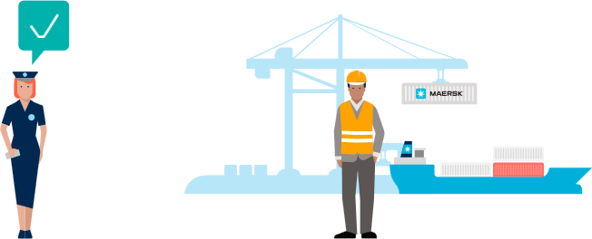
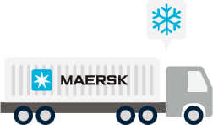
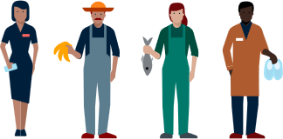
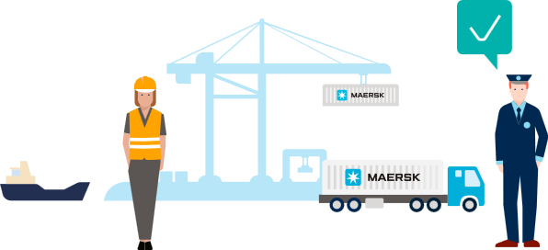
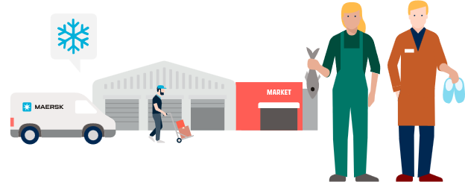
START
Meet the customer
Collect the goods
Store the goods
Clear the goods
Connecting and simplifying global supply chains
Rail Freight
Transport the goods
ALL THE WAY
Connecting and simplifying
our customers’ supply chains
A.P. Moller - Maersk enables its customers to trade and grow by transporting goods anywhere.
Maersk works to provide customers with a simple end-to-end offering of products and services, seamless customer engagement and a superior end-to-end delivery network, taking the complexity out of global supply chains.
Clear the goods at arrival
Store the goods
END
Deliver the goods

Slide 5
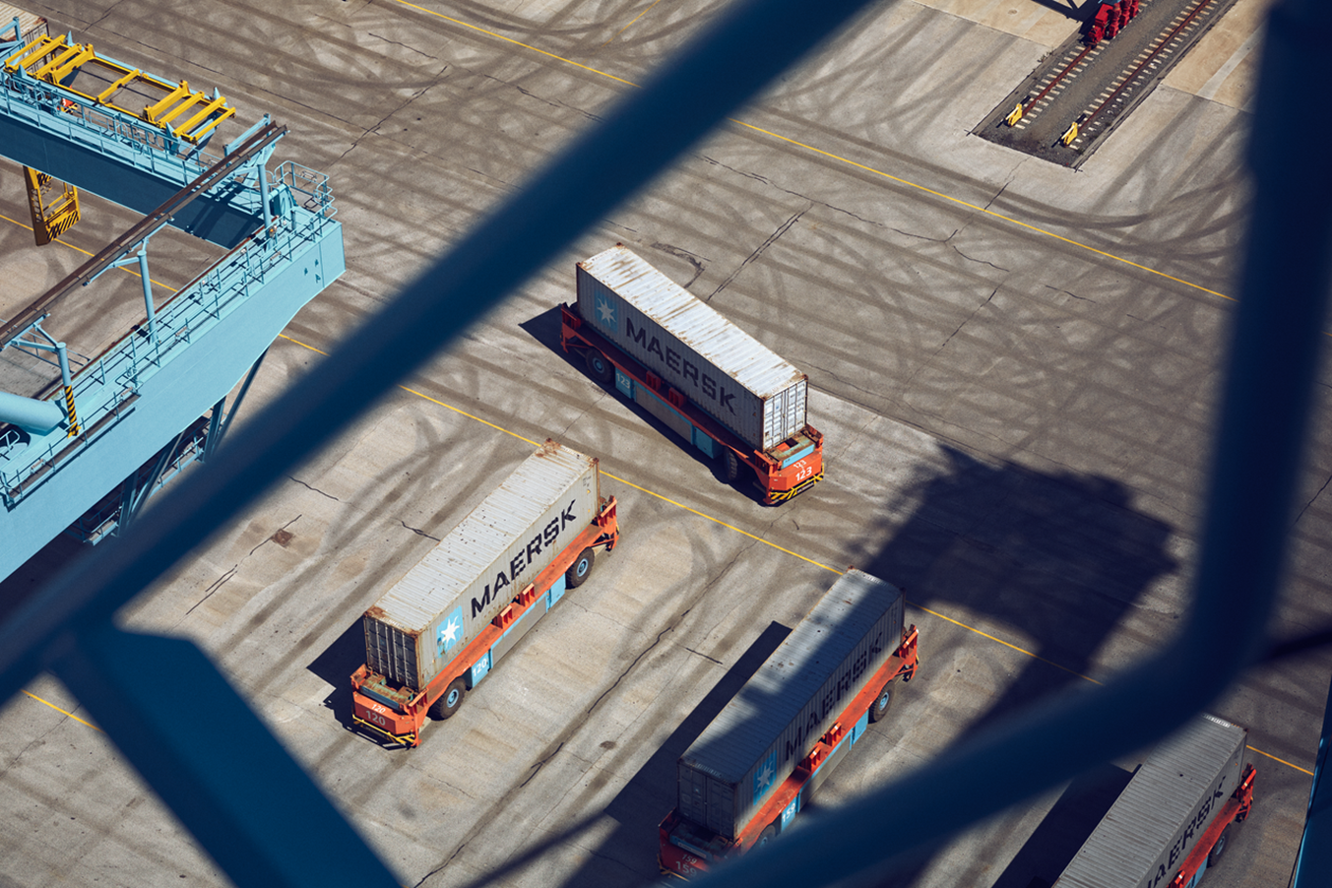
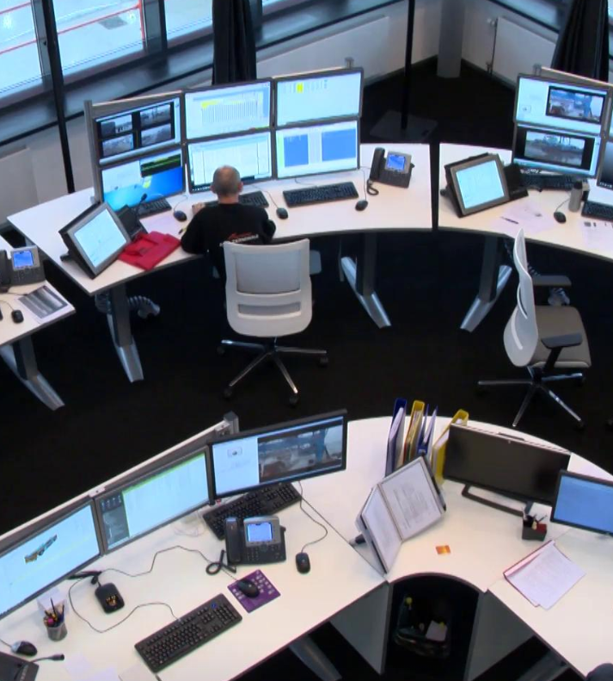
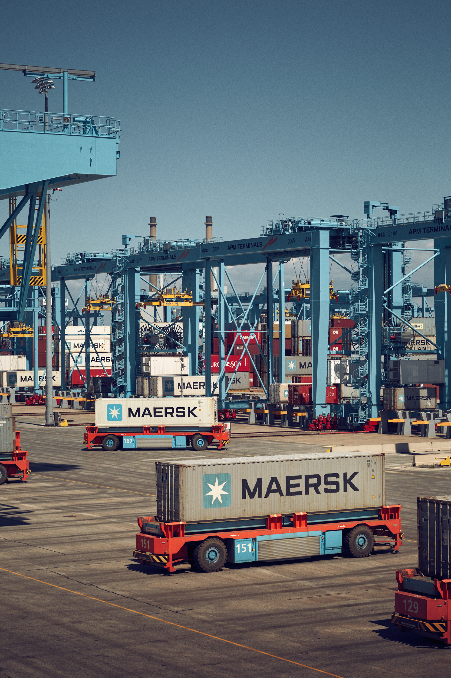

Slide 6
Every day, we help our customers move almost
of the world’s food, materials and goods – items we all depend on to live, work and thrive.

Slide 7
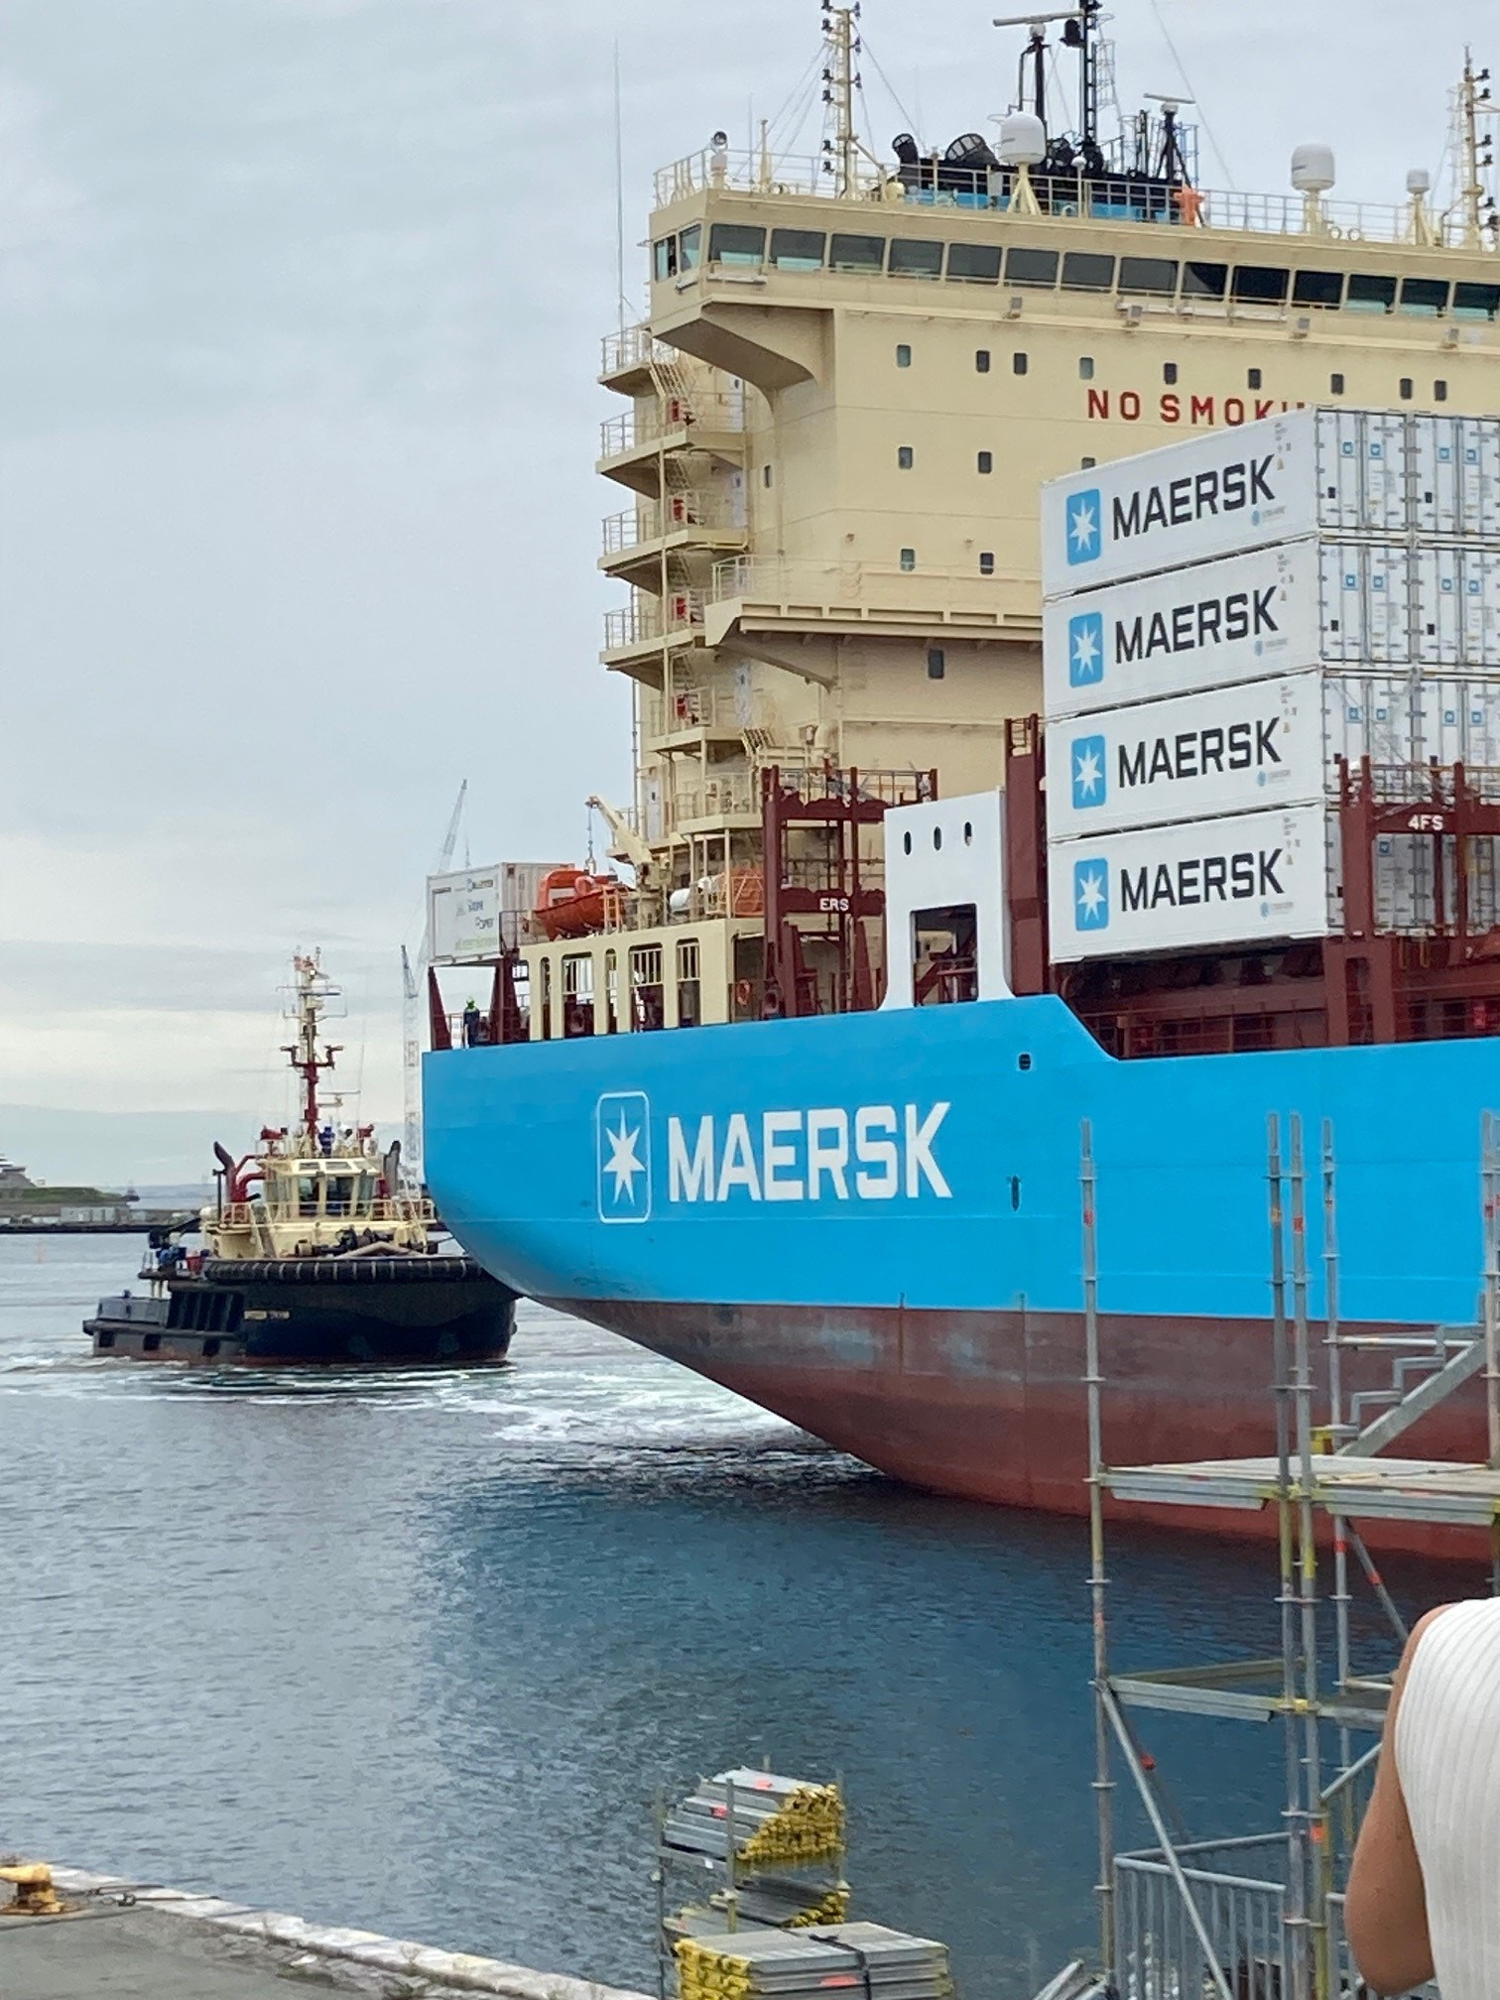
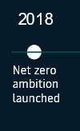
Roadmap to deliver net zero by 2040
New vision & accelerated
Commitments.
World's first
container ship
in operation on
green methanol
Nineteen methanol-
enabled vessels in operation
Aligned with a Science Based Targets initiative 1.5-degree pathway
Industry-leading green customer
offerings across the supply chain
Net zero across
our business
and 100% green
solutions to
customers

Slide 8
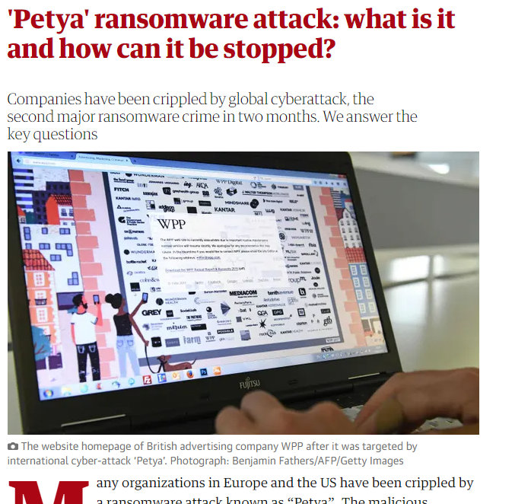
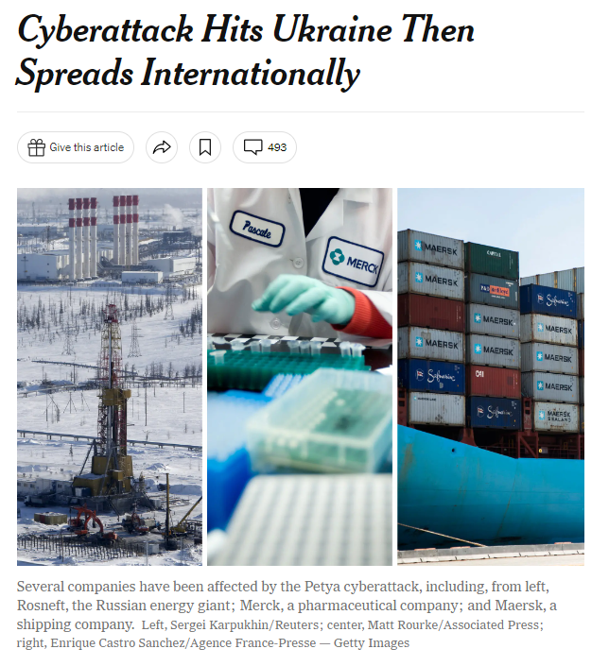
2017

Slide 9
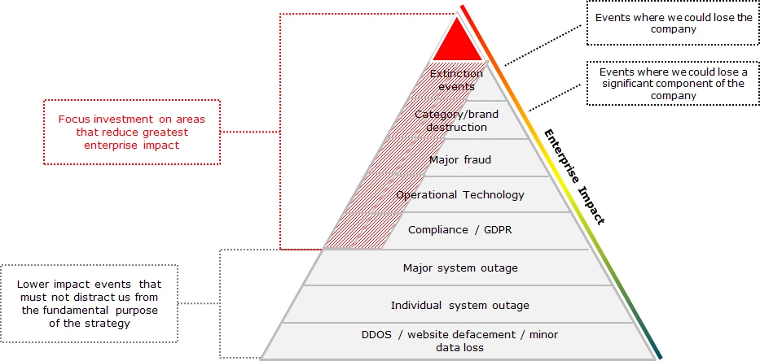
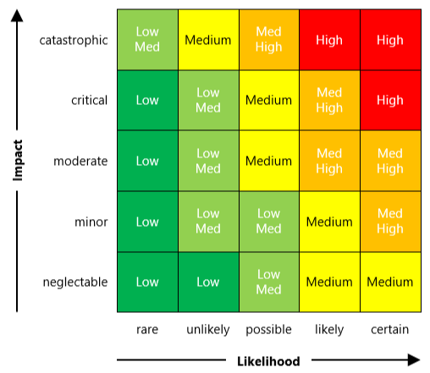
A big list of risks (issues) needing to be fixed….

Slide 10
Two problems…
What’s the risk from phishing?
What’s the risk from people working from home?
What’s the risk from Log4J?

Slide 11
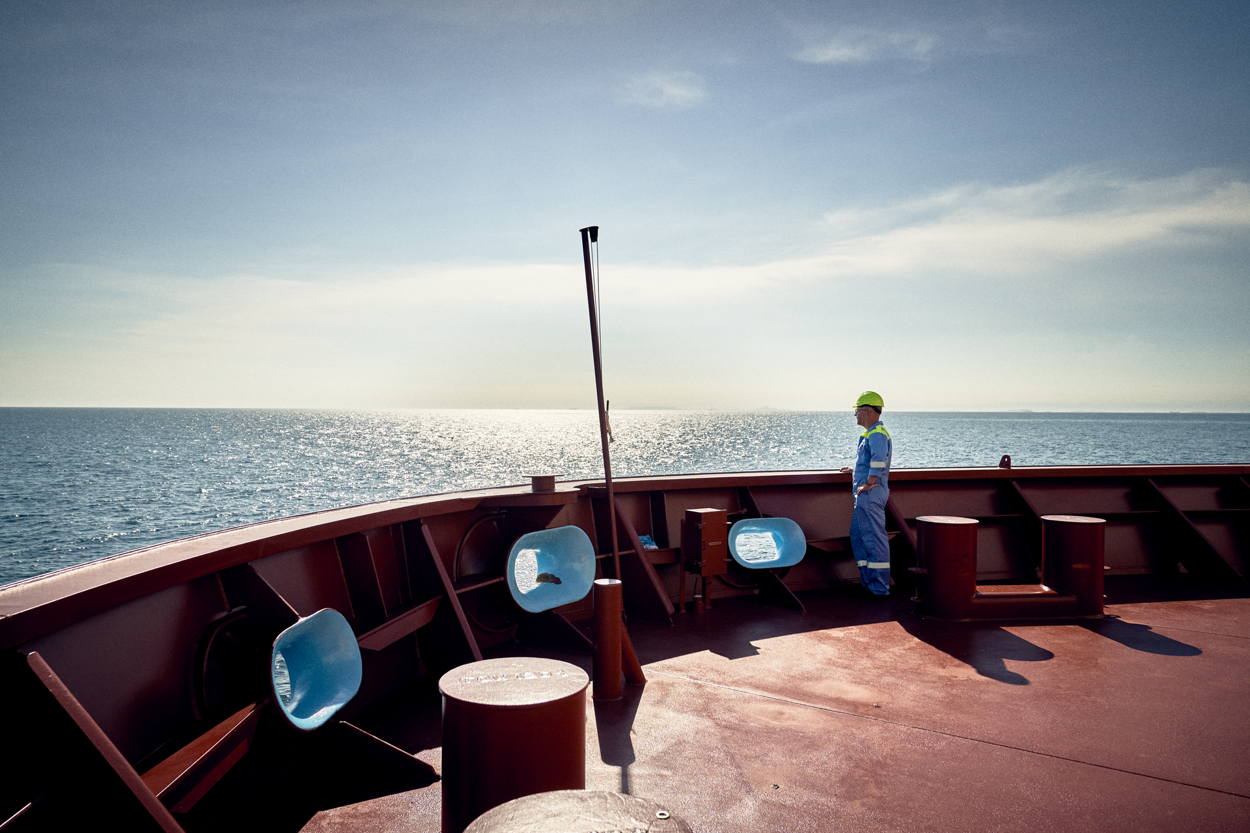
… to a forward looking register

Slide 12
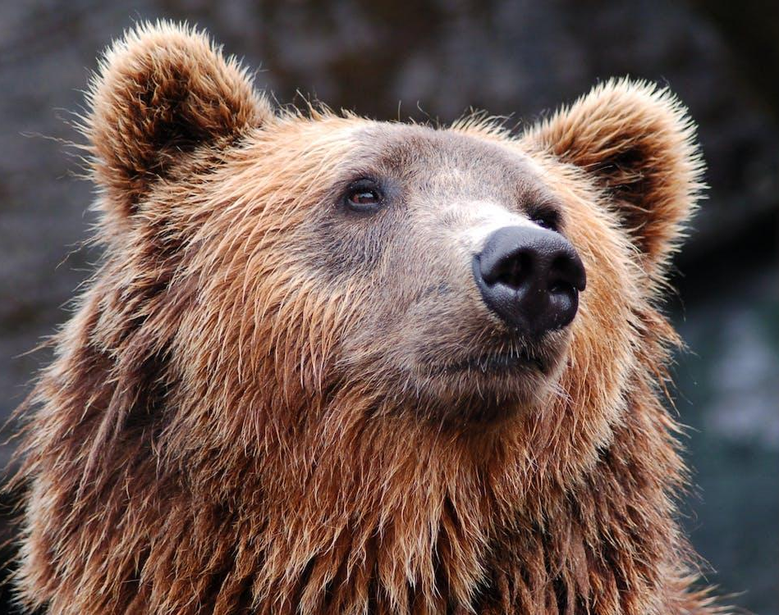
A bear means different things to different people

Slide 13
Multiple Cyber Risk Lenses...
Foresight: Radar
Possible
Bears could attack Maersk employees
Probable
Bears have attacked office workers in some European countries

Slide 14
Multiple Cyber Risk Lenses...
Foresight: Radar
Enterprise Risks
Risk to Employee Safety
Possible
Bears could attack Maersk employees
Business Risks
Risk to Maersk from bears attacking employees
FAIR
Probable
Bears have attacked office workers in some European countries

Slide 15
Multiple Cyber Risk Lenses...
Foresight: Radar
Enterprise Risks
Risk to Employee Safety
Possible
Bears could attack Maersk employees
Business Risks
Risk to Maersk from bears attacking employees
FAIR
Probable
Bears have attacked office workers in some European countries
Risk Scenarios
Employees attacked by bears whilst commuting to/from office
Employees attacked by bears whilst taking breaks/getting lunch

Slide 16
Multiple Cyber Risk Lenses...
Foresight: Radar
Enterprise Risks
Risk to Employee Safety
Possible
Bears could attack Maersk employees
Business Risks
Risk to Maersk from bears attacking employees
FAIR
What needs building soon to protect us in the future
Probable
Bears have attacked office workers in some European countries
Risk Scenarios
Employees attacked by bears whilst commuting to/from office
Employees attacked by bears whilst taking breaks/getting lunch
Enterprise Cyber Issues mgmt. (ECIM)
Gates to the office car park are broken
Operational Risk(s)
Bears could attack employees as the car park gates are broken, resulting in injury
“Known Vulnerability Focused”
“Known Vulnerability Focused”
What needs to be fixed right now!

Slide 17
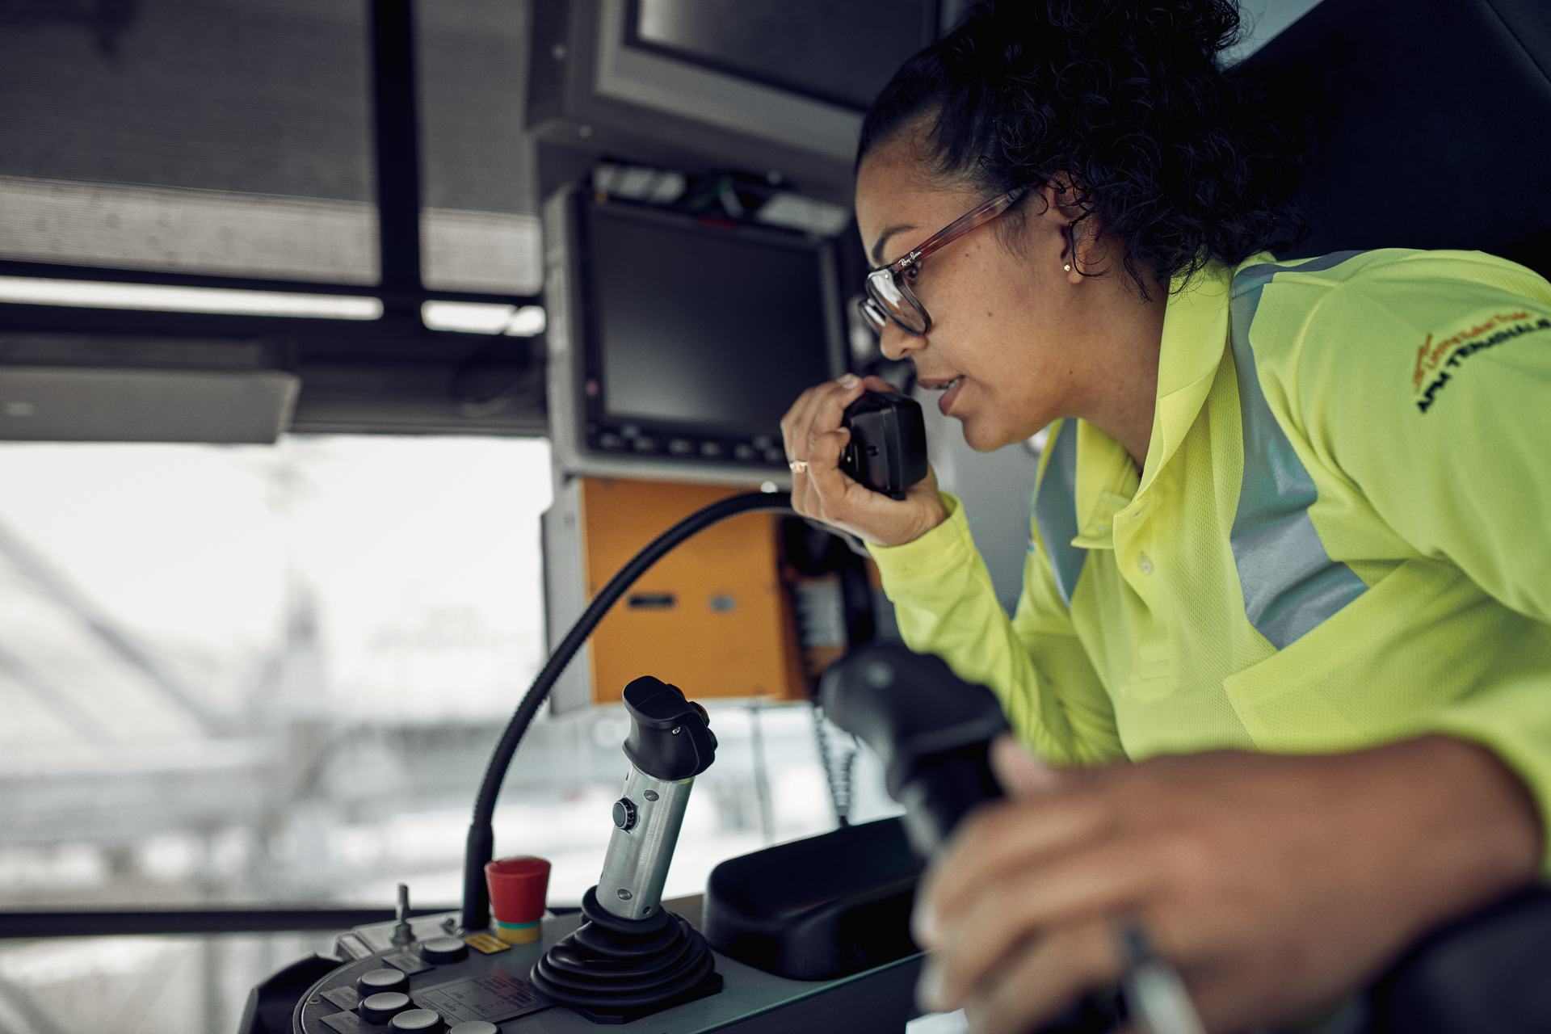
Communicating cyber risk

Slide 18
Risk Governance
Decision
Risk
Risk
Decision
Risk?
Risk?
🗶
✔

Slide 19
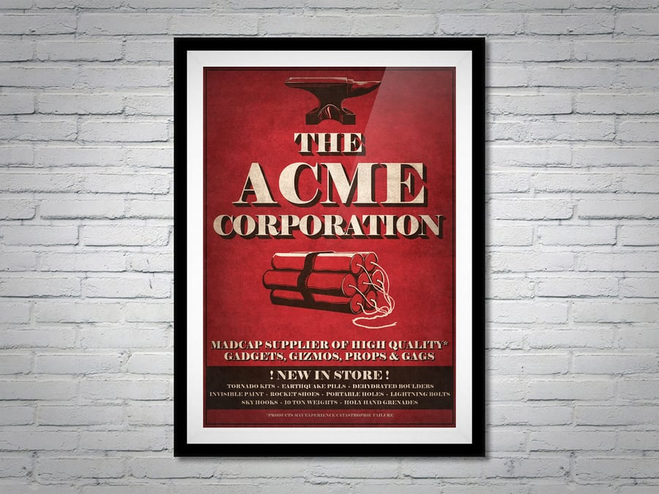
Acquisition of ACME Inc.

Slide 20
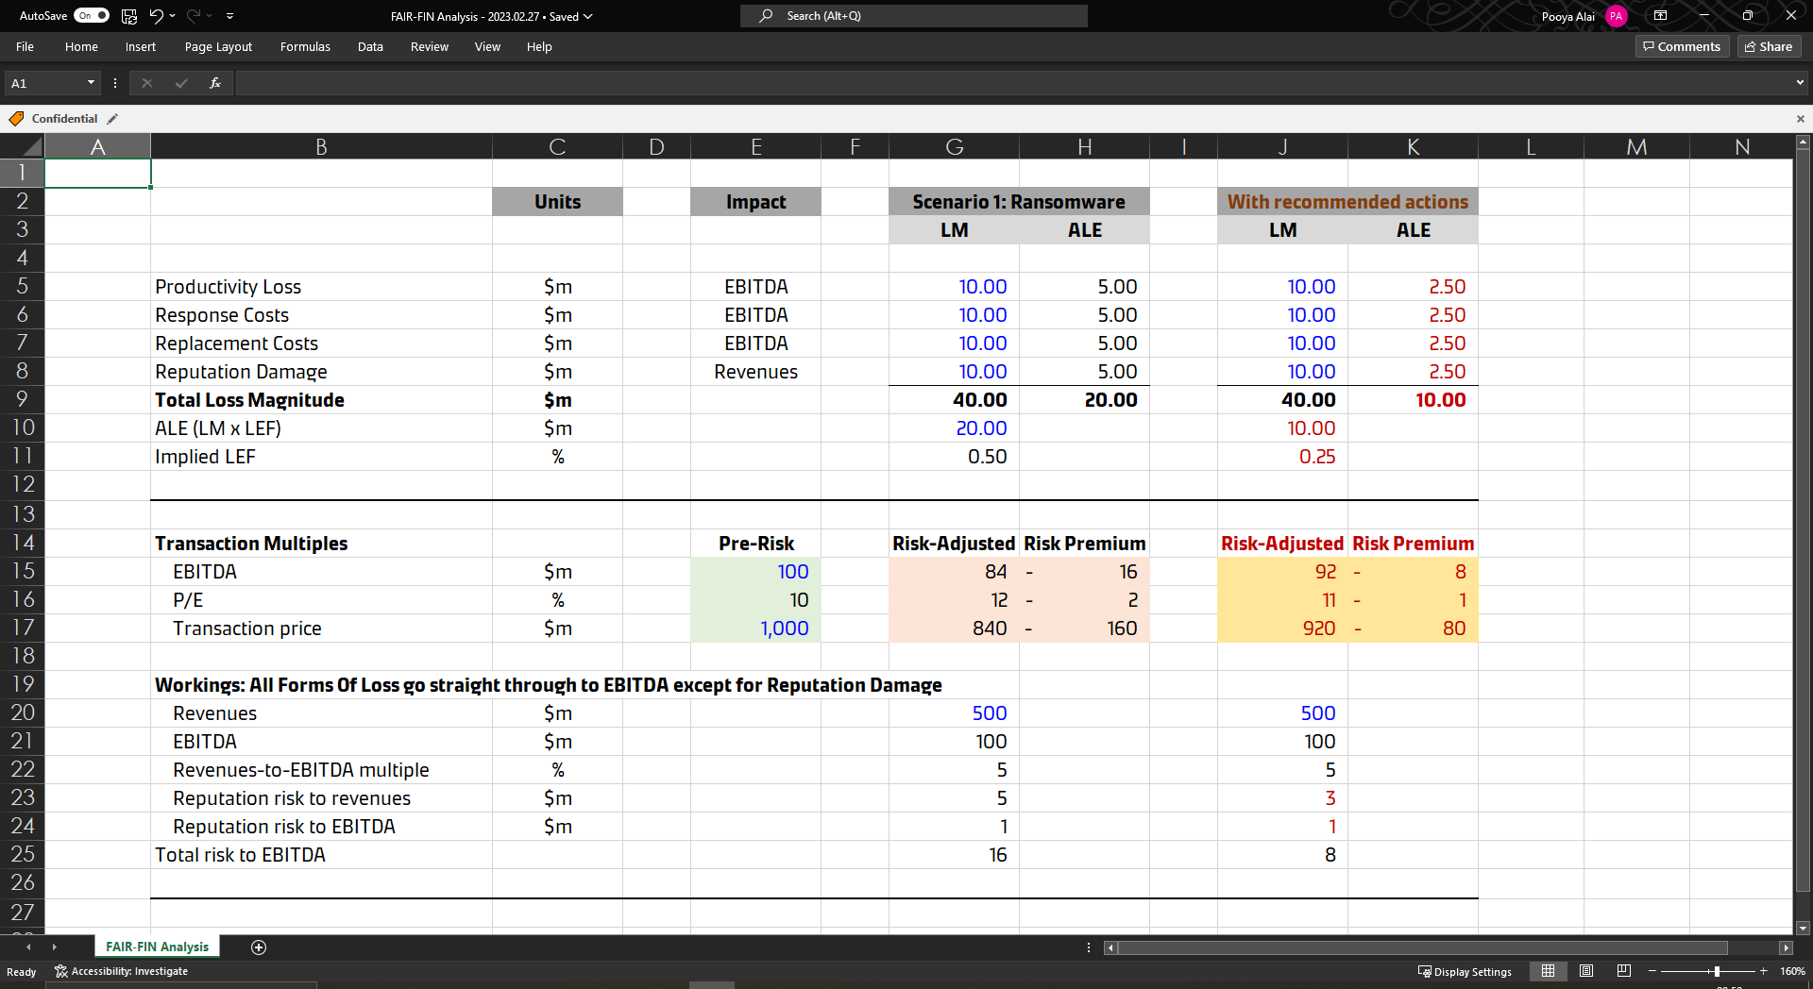
A narrative tailored to the audience

Slide 21
Maintaining cyber spend during uncertain times

Slide 22
People often think of gains and losses differently
Budget request for value creation
Budget request for value protection
If you give us $10k we might make a $1m gain!
Great!
If you give us $10k we might avoid a $1m loss!
Go away!

Slide 23
FAIR creates a level playing field and facilitates the right conversation
Don’t just focus on ALE
How much ‘tail’ risk can we afford to have?
Can we afford not to mitigate this risk?

Slide 24
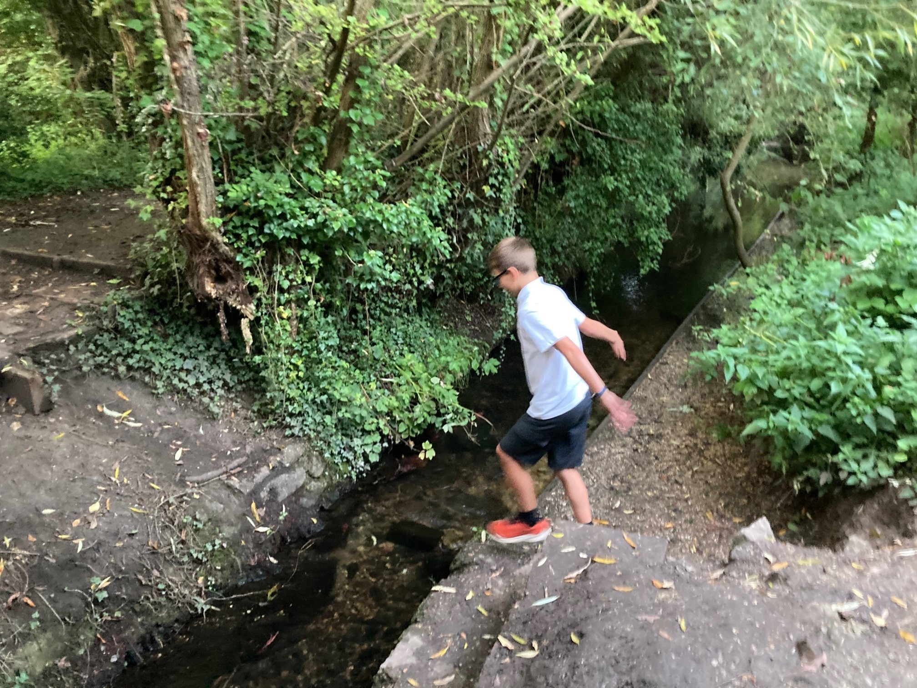
Different risks warrant different investment
How much should we spend mitigating this risk?

Slide 25
What have we learnt?

Slide 26
Risk Analysis…
FAIR enables us to:
provide quick answers to difficult questions
analyse risks with greater rigour & defensibility

Slide 27
Risk Governance…
FAIR enables us to:
shift left, become part of decision making process
forecast risk at early when there is greater uncertainty
provide input on return of investment

Slide 28
Communicating Risk…
FAIR enables us to:
have great conversations (and elicit more information)
visualise risk (both ALE and Tail)
communicate in right language

Slide 29
Challenges…
FAIR brings some challenges too:
time , tooling, education, understanding, belief
aggregation (“adding up” results from different analysis)
quickly becomes popular (and a “requirement”)
suddenly you’re asked to analyse other types of risk

Slide 30
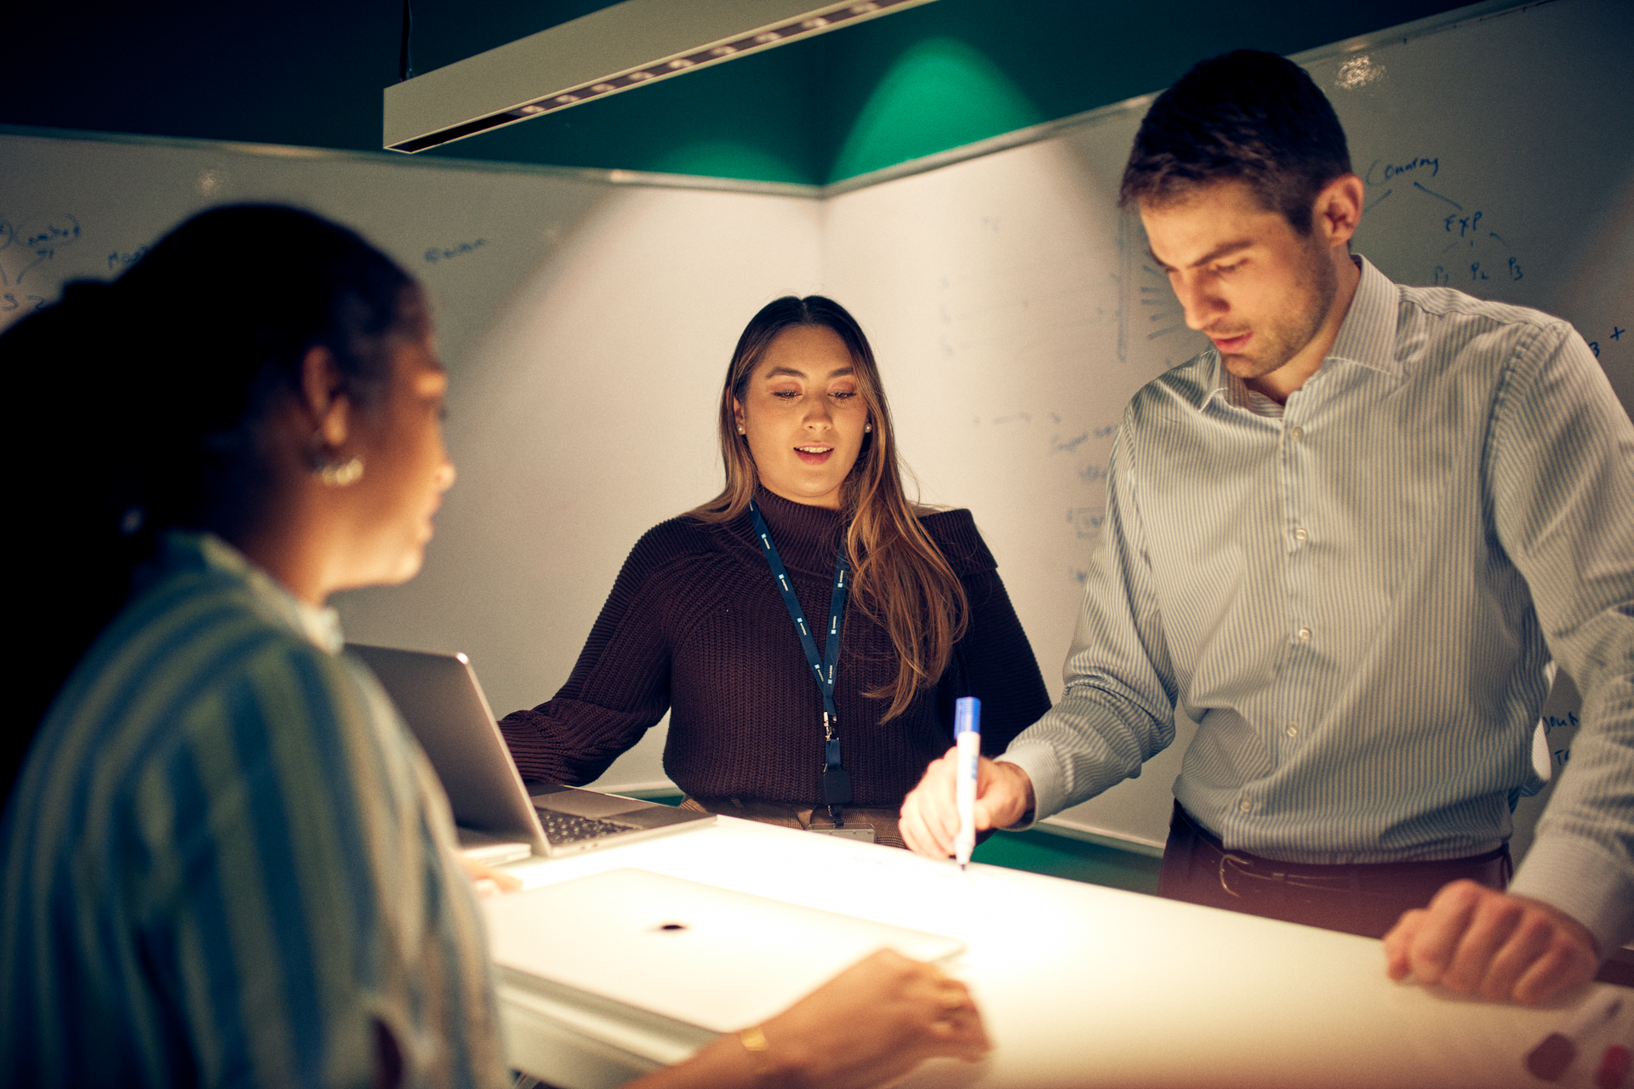
Trusted Advisor Journey

Slide 31
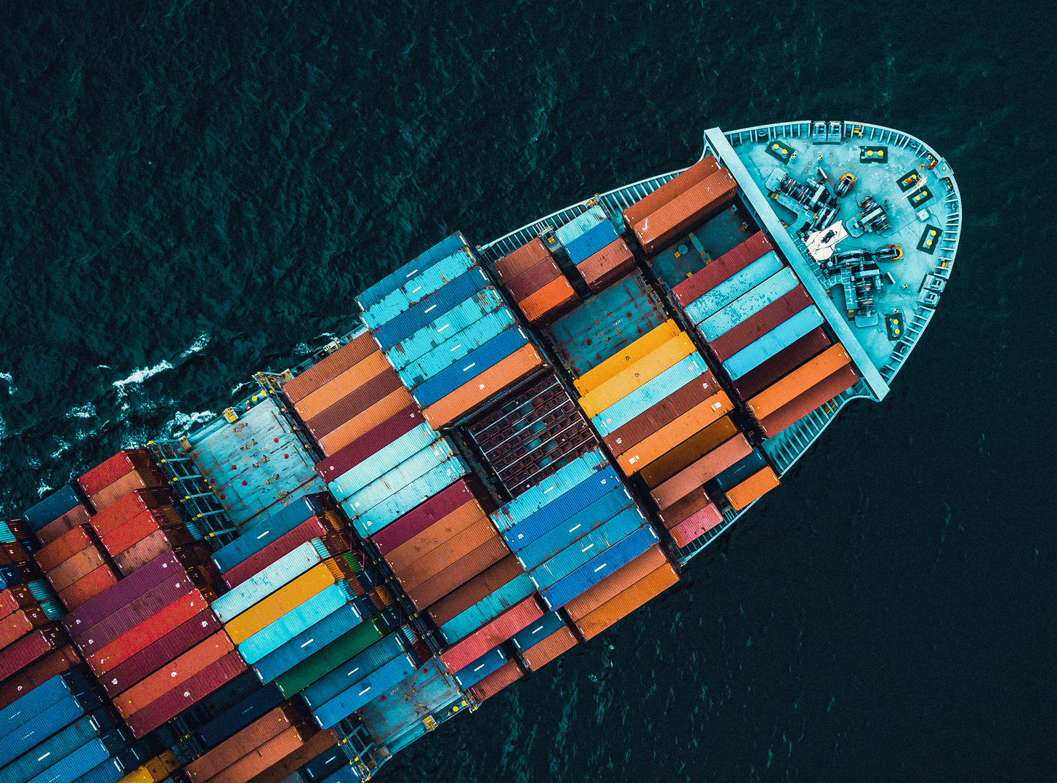
Q & A

