Slide 1
Third Party Risk Management
Time to re-think?
October 17 2023

Slide 2
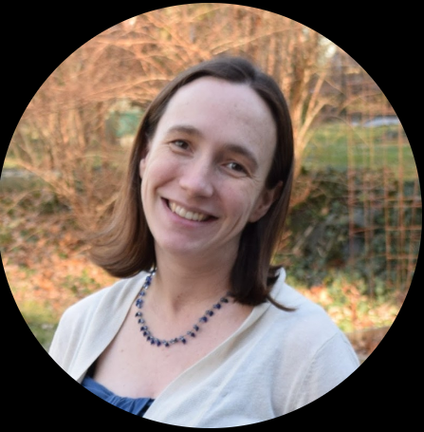
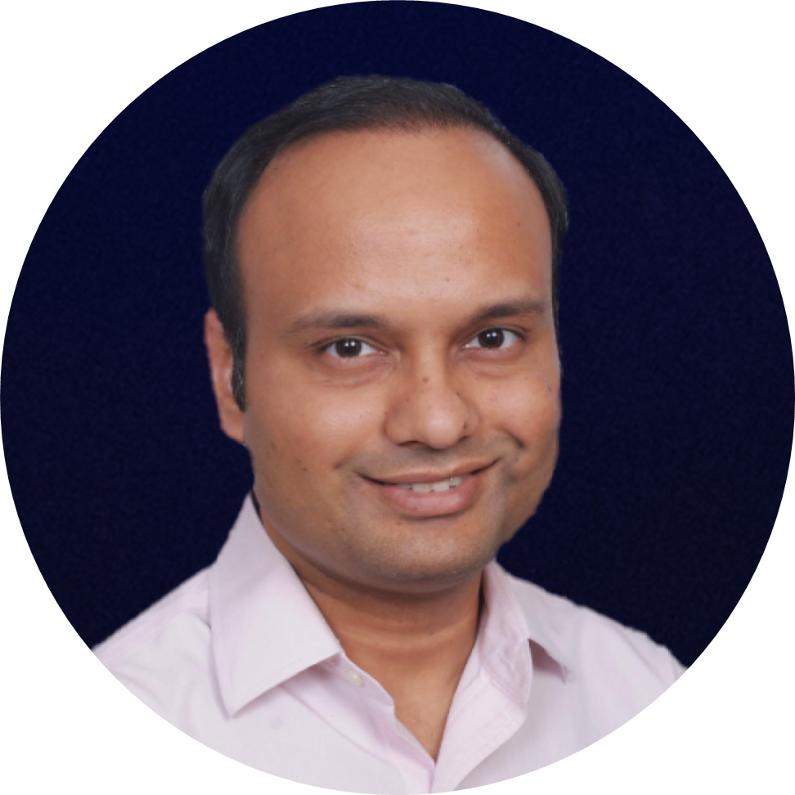
SPEAKER
SPEAKER
MODERATOR
Sarah Sullivan
Adam Wells
Pankaj Goyal
Director IS&T Performance,
Thomas Jefferson University Hospitals
Senior Manager, Cyber Risk Services,
Yum! Brands
Director, Standards & Research, FAIR Institute

Slide 3
Where to focus on, and what can you do about it
HOW TO SPEND THE MOST TIME HERE?
INFLUENCE
VS.
RISK MATRIX
HOW TO SPEND LESS TIME HERE?
How much can you influence?
WHAT CAN YOU DO HERE?
Risk to your business (driven by access to data, network, operations)

Slide 4
Where to focus on, and what can you do about it
DEEP DIVE TO UNDERSTAND THIRD PARTY CONTROLS & FOCUS ON INTERNAL CONTROLS (E.G. MSSP / SIS, CONTRACTORS)
BASIC HYGIENE WITH GUIDANCE TO THIRD PARTY
INFLUENCE
VS.
RISK MATRIX
How much can you influence?
FOCUS ON INTERNAL CONTROLS (ZERO TRUST PRINCIPLES) (E.G. IAAS, SAAS PLAYERS)
BASIC HYGIENE
Risk to your business (driven by access to data, network, operations)

