Slide 1
Deriving Probability Distributions with Pairwise Relative Comparisons
Ernest Forman, DSc. Professor of Decision Sciences
The George Washington University

Slide 2
Why Do We Need a Probability Distribution?
“Single Point Estimates are almost always wrong, at least for any complex question” Jones and Freund in measuring and Managing Information Risk
“To appropriately reflect measurement uncertainty, probability and impact should be expressed as ranges or distributions” Jones in Understanding Cyber Risk Quantification: A Buyer’s Guide
Flaw of Averages _{Sam Savage}
Loosely stated, the flaw of averages says that the consequence of the average is not the same as the average of the consequences
Picture a drunk walking down the centerline of a busy highway….
On the average the drunk will be on the centerline
The consequence of being on the center line is ALIVE
However, the drunk will be on the centerline only part of the time as vehicles pass by
The average of the consequences of the drunk’s position as each vehicle passes by is DEAD

Slide 3
Monte Carlo Simulation with a Probability Distribution
To avoid the ‘Flaw of Averages’ we need to do Monte Carlo simulations with a probability distribution for uncertainty
Where do we ‘get’ the probability distribution?
We can assume one of many families of distributions and estimate the parameters
FAIR analyses often use PERT or Triangular distributions
Today we will look at another approach that consists of using human judgment in the form of pairwise relative comparisons to estimate the probability of a range of outcomes

Slide 4
There is no data for the future!
Risk is about the future and there is no data for the future
Using historical data to estimate the future is problematic
We may be considering the risk of events that have never happened before
The situation might not be the same as when the data was collected
The world is changing fast and what worked before may not work now

Slide 5
Human Judgment to the Rescue
Humans, based only partly on what happened in the past, but also incorporating current related happenings, can provide judgments about the relative likelihoods of event outcomes
Judgments can be elicited from one or more ‘participants’ about the relative ratios of the likelihoods for pairs of outcomes (pairwise relative judgments)

Slide 6
Processing the Judgments
Care must be taken to observe the proper level of measurement (nominal, ordinal, interval, ratio)
Ratio level measurement is mandatory
Common ordinal measures such as colors in a risk map are misleading and can result in decisions worse than having no measurement at all
The judgments need not be consistent!

Slide 7
Processing the Judgments
For example, considering 3 outcomes, A, B and C
We make a judgment that A is 3 times more likely than B
Another judgment is that B is twice as likely as C
… to be consistent we would require A to be 6 times more likely than C
With a little algebra and normalizing we find:
A = 66.7%
B = 22.2%
C = 11.1%

Slide 8
But Wait!
The real world is hardly ever perfectly consistent
Suppose we did not assume consistency and elicited a third judgment
A is 7 times more likely than C
We now have 3 judgments each of which may have some error or noise
But which one?

Slide 9
Eigenvectors to the rescue
Eigenvectors are one of the
“10 Equations That Rule The World”… Sumpter, David, The Ten Equations That Rule the World: And How You Can Use Them Too
The matrix equation A X = lambda X
does not have a closed form solution but can be easily computed with today’s fast computers
Google’s Larry Page used this in a 2002 patent which won the internet search engine wars and propelled Google to what it is today
My former partner, Tom Saaty, used Eigenvectors in creating The Analytic Hierarchy Process (AHP) in the 1970’s
This computation relies on variety and redundancy in judgments to reduce the errors or ‘noise’ in each of the judgments

Slide 10
Eigenvector Process for Pairwse Comparisons
The process consists of finding the principle right hand eigenvector of a matrix X consisting of
1’s on the diagonal,
the ratio pairwise judgments of the row element to the column element above the diagonal, and
the reciprocals of the pairwise judgments in the elements below the diagonal
In our example with 3 inconsistent judgments, an Eigenvector computation results in the following estimates:
A = 68.17%
B = 21.58%
C = 10.25%
Which is very close to the algebraic results if we assumed the first two Judgments were correct and didn’t have a third judgment:
A = 66.7%
B = 22.2%
C = 11.1%

Slide 11
However…..
if one or the other or both of the first two judgments had some error or noise, as is usually the case
We would have results determined by inaccurate Judgments
hence inaccurate results.
By adding a third judgment, that is typically inconsistent with the first two judgments
the Eigenvector solution will reduce the errors in all three judgments, and
determine estimates closer to the ‘real’ outcomes’
The third judgment is “redundant”
in the sense that we could solve for all three outcomes algebraically with only two judgments,
but the redundant judgment is important for improving the accuracy of the results
When there are more than three outcomes, we can add more “redundant” judgments and reduce errors in all of the judgments to determine better estimates of the likelihoods of the outcomes

Slide 12
Example with a lot of ‘noise’ – from ordinal judgments
Suppose the current price of a stock is $100 and we wanted to derive a probability distribution for the price of the stock at a given time in the future
which we could use in Monte Carlo simulations
to evaluate stock options strategies such as Covered Calls
Given some knowledge about the stock, the economy, and other influencing factors, etc. an investor could make judgments such as
$105 is ‘moderately’ more likely than $110,
$105 is ‘extremely’ more likely than $150, and
110 is ‘strongly’ more likely 150
where the words are from the fundamental verbal scale of the Analytic Hierarchy Process
A lot of ‘noise’ with words instead of numerical ratios

Slide 13
Fundamental Verbal AHP Scale
When we express judgments as ordinal words, such as those in the Fundamental Scale of the Analytic Hierarchy Process, we introduce noise.
The Analytic Hierarchy Process has a fundamental verbal scale that equates words such as Moderate to 3x, Strong to 5x,Very Strong to 7x and Extreme to 9x with in between values of 2, 4, 6 and 8
So, a judgment of equal to moderate, for example might be used when one consequence is just a bit more likely than another, or 3 times or more likely
A lot of ‘noise’ in each judgment
Why would we want to do this?
Because it is easier to make such ‘approximate’ judgments, and
we don’t have to justify an exact numerical ratio when prioritizing qualitive factors
such as the importance of objectives in a risk analysis where the loss is the consequence of the event times the importance of the event to one or more objectives

Slide 14
The power of the eigenvector solution to produce accurate estimates is remarkable
Numerous ‘validation studies’ have been conducted over the years to estimate priorities with verbal judgments in situations where there is a known result to which we can compare…
Such as”
estimating the relative areas of different shapes;
estimating the brightness of light on a chair placed different distances from a light source
estimating the relative consumption of water, coffee, beer, wine, … and comparing the results to published statistics

Slide 15
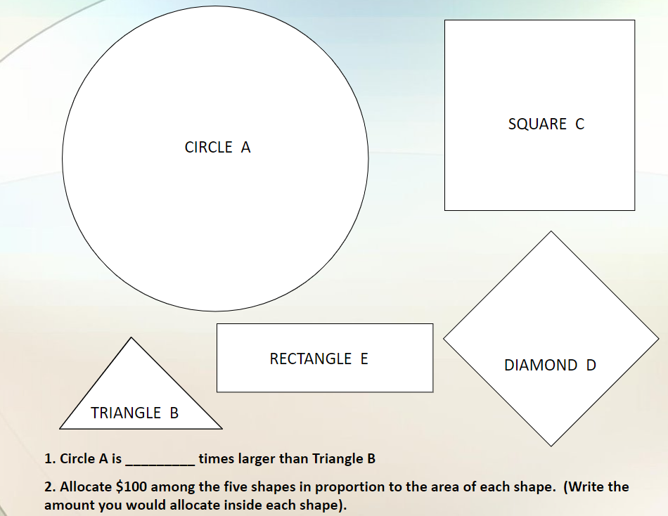
Validation Example
Take a minute to write down your answers to these two questions:
How many times larger (area) is Circle A than Triangle B?
What percentage of the total is each of the five shapes?

Slide 16
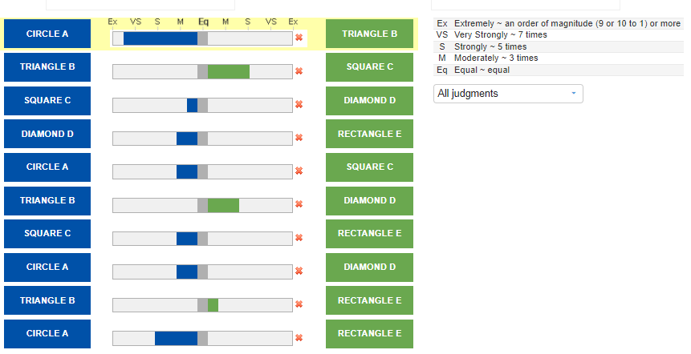
Validation Example
The results of pairwise verbal judgments such as those shown below, are shown on the next slide for you to compare to the actual relative sizes as measured with a ruler:

Slide 17
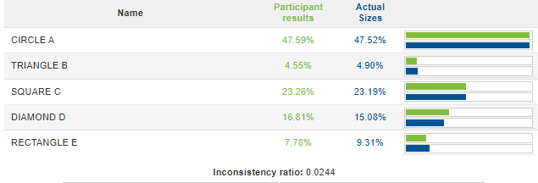
Validation Example

Slide 18
Wisdom of Crowds
It is possible to produce even more accurate estimates by eliciting judgments from more than one person
And averaging the results
But with a geometric average, not an arithmetic average

Slide 19
Summary
The only scientific way that I know of for dealing with uncertainty requires probability distributions
Risk is about the future and there is no data for the future
Human judgment about the future, based only in part on past data, is effective in deriving probability distributions to drive Monte Carlo simulations and avoid the “Flaw of Averages”
Not only for risk measurement and management but for other decisions such as:
Comparing the risk-rewards of alternatives for such situations as:
Whether or not to take a vaccine
Closing schools during a pandemic or epidemic
Investing in different alternative energy sources for the future
Evaluating stock options and strategies
Designing and maintaining a portfolio of investments tailored to an individual's risk tolerance and reward aspirations

Slide 20
Professor Forman

Slide 21
Q & A

