Slide 1
Modeling Ransomware Risk using FAIRTM and ATT&CK®
Jon Baker
Co-founder & Director
Center for Threat Informed Defense
Arvin Bansal
CISO
Nissan Motor Corporation
Vidit Baxi
Co-founder & CISO
Safe Security

Slide 2
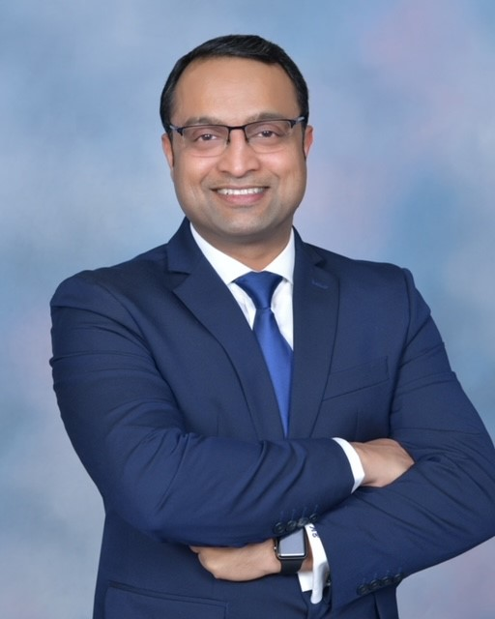
Speakers
Jon Baker
Co-founder & Director
Center for Threat-Informed Defense
Arvin Bansal
vCISO
Fortune500
Vidit Baxi
Co-founder & CISO
Safe Security
https://linkedin.com/in/jonathanobaker/
https://linkedin.com/in/ArvinBansal/
https://linkedin.com/in/viditbaxi

Slide 3
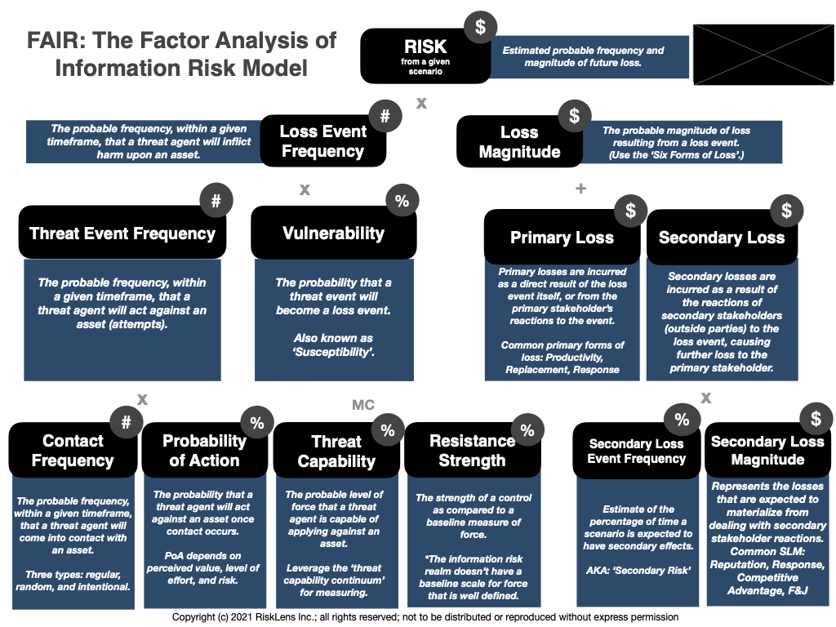
FAIR Model
Risk is a measurement of future loss from a given scenario derived from probable frequency and probable magnitude of loss events.

Slide 4
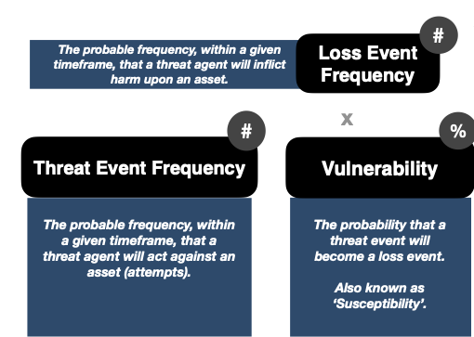
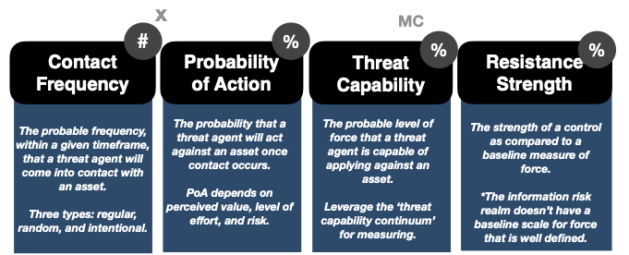
Focus (for this discussion)
Our objective is to feed data into the LEF side of the model with the ATT&CK matrix.
Leverage the Real Data
Reduce the Guesswork
Increase Confidence
Dynamically Change Scenario Results

Slide 5
Ingredients…
Leverage Threat-Informed Defense with ATT&CK Matrix
ATT&CK Components
Leverage Attack Flow
FAIR and FAIR-U
Accurate Assumptions :)

Slide 6
Sneak Peak at ATT&CK and Threat-Informed Defense

Slide 7
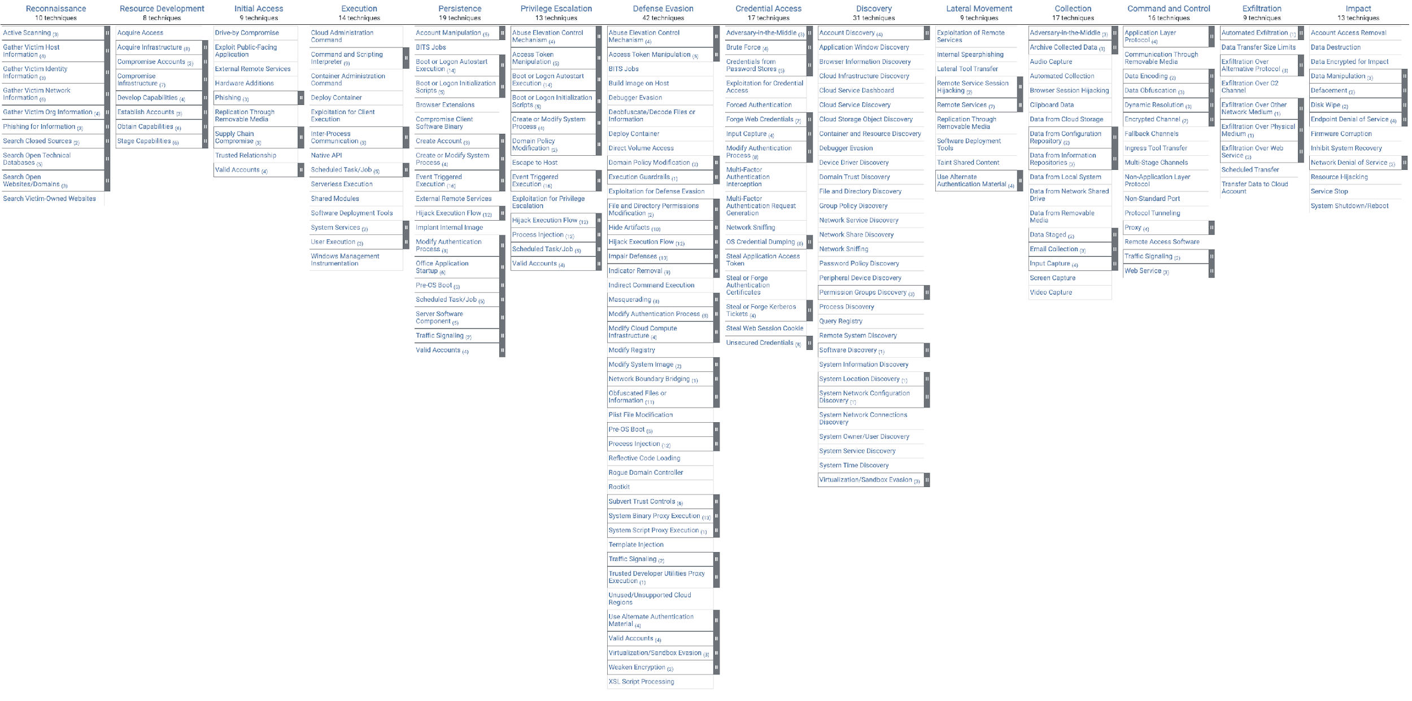
How to Quantify Ransomware Risk?
A community-driven knowledgebase of adversary TTPs
607 Techniques and Sub-Techniques
43 Mitigations
41 Detection Data Sources

Slide 8
From TTPs to Mitigation and Detection
Adversary Group
Tactic
Mitigation
Attributed To
Uses
Accomplishes
Prevents
Uses
Campaign
(Sub-) Technique
Uses
Uses
Detects
Implements
Software
Data Source

Slide 9
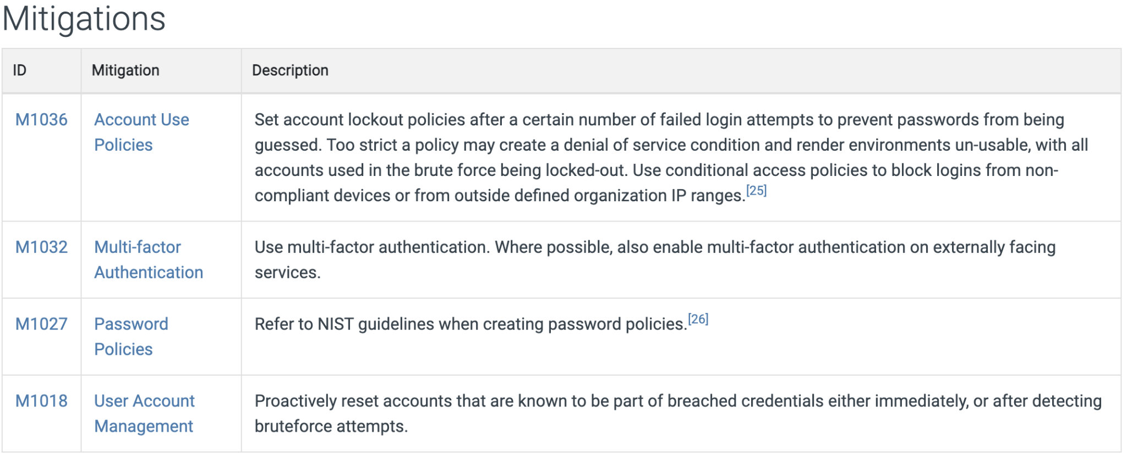
Example Technique
Technique: Bruteforce (https://attack.mitre.org/techniques/T1110/)
4 Sub-techniques
19 Threat Actors
19 Campaigns

Slide 10
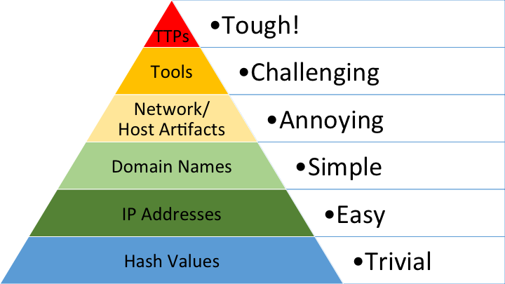
Increasing the Cost for the Adversary
+

Slide 11
What is Threat- Informed Defense?
The systematic application of a deep technical understanding of adversary tradecraft and technology to improve defenses.

Slide 12
What is Threat-Informed Defense?
a lens, through which, you can understand your security posture
a way of assessing the effectiveness of security your investments
a way to think about your security architecture and operations
a way to prioritize your security strategy and investments
Thinking like an attacker…

Slide 13
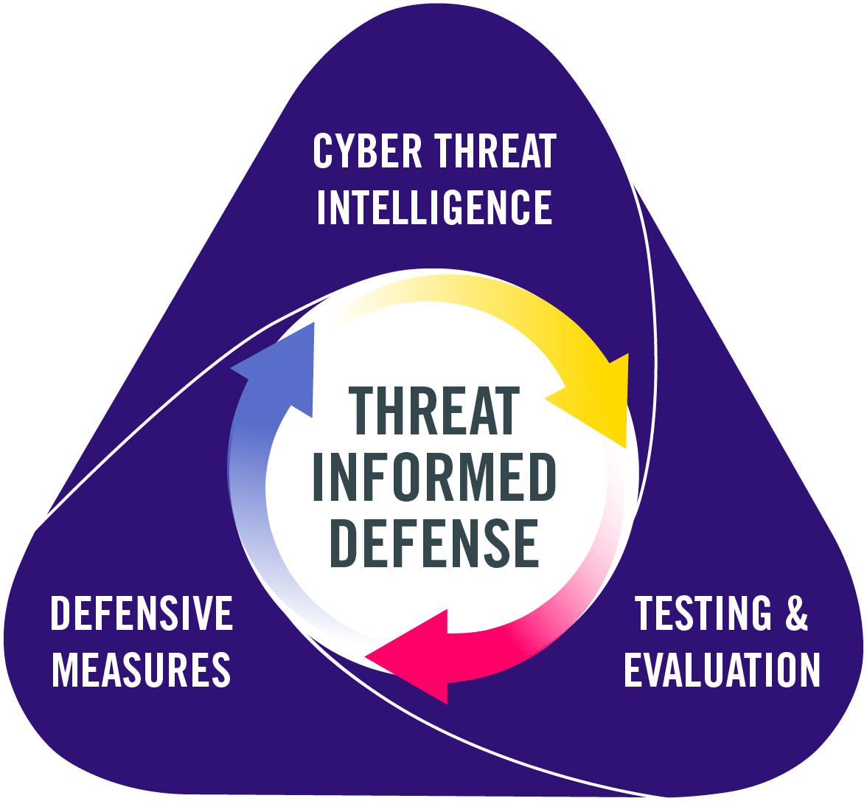
Threat-Informed Defense Cycle
is at the core of the Threat-Informed Defense.
Threat-Informed Defense is a continuous process.
As our defenses improve, our environments change, and adversaries evolve, the cycle continues…

Slide 14
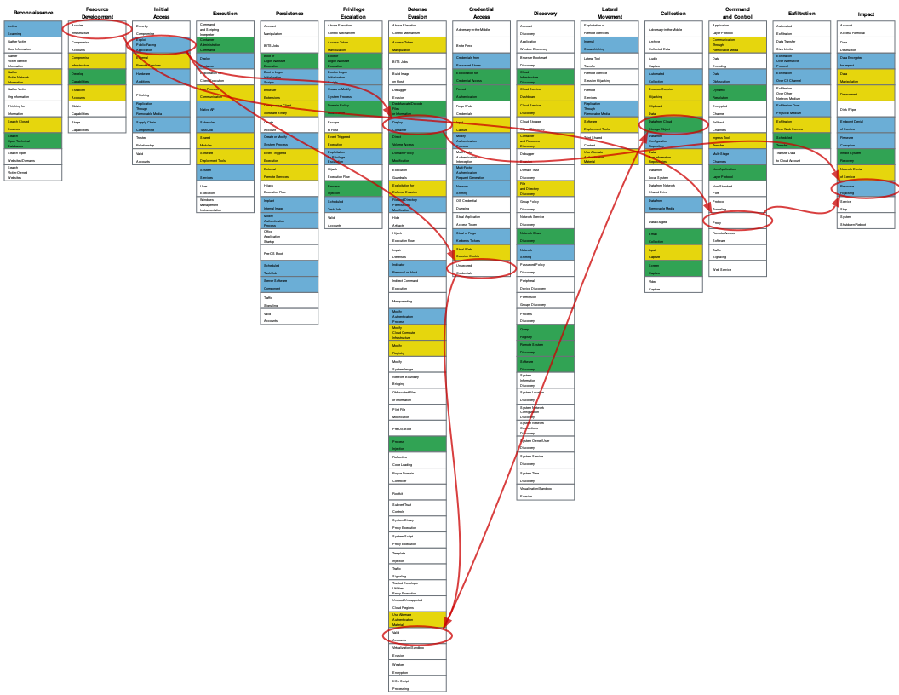
Attack Flow
Problem
Defenders often track adversary behaviors atomically, focusing on one specific action at a time. This makes it hard to understand and build effective defenses against those attacks.
Solution
Create a language, and associated tooling, to describe flows of ATT&CK techniques and combine those flows into patterns of behavior.
Impact
Help defenders and leaders understand how adversaries operate and compose atomic techniques into attacks to better understand defensive posture.
Understand, share, and make threat-informed decisions based on the sequence of actions in a cyber-attack.
identify common patterns in adversary behavior
overlay on ATT&CK to understand defensive coverage
create intel-driven adversary emulation plans
*ATT&CK is not a kill-chain; but one can visualise the Attack Path.

Slide 15
Connecting the Dots…
The Recipe

Slide 16
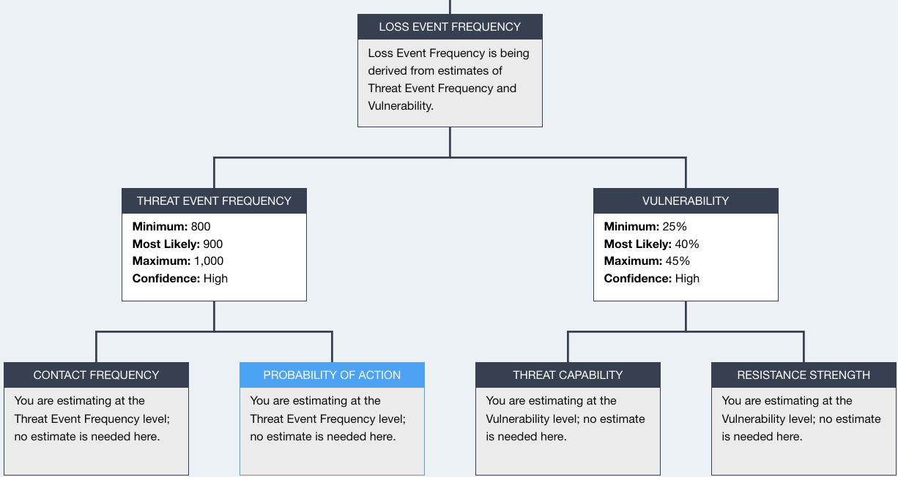
Leverage ATT&CK and Real Data in FAIR Model
Map your security findings and controls against ATT&CK Techniques, Subtechniques, Mitigations and Detections to better understand your Resistance Strength and Probability of Action
Use Attack Flow to understand frequently used Techniques and Sub-techniques by Threat Groups during a specific attack type (method) to better understand Threat Capability
Failing Techniques
Threat Group + Software + Campaign Techniques
Mitigations & Detections
SIEM

Slide 17
Let’s see a Real World Example…
The Dish…

Slide 18
Conti Ransomware
Sept 7 – three indictments related to Conti unsealed
More than 900 victims worldwide (47 states, 31 countries)
More critical infrastructure victims than any other ransomware
Attacked businesses, non-profits, and governments
justice.gov - Thursday, September 7, 2023
MITRE ATT&CK – Conti Software - https://attack.mitre.org/software/S0575/
MITRE ATT&CK – Wizard Spider Group - https://attack.mitre.org/groups/G0102/

Slide 19
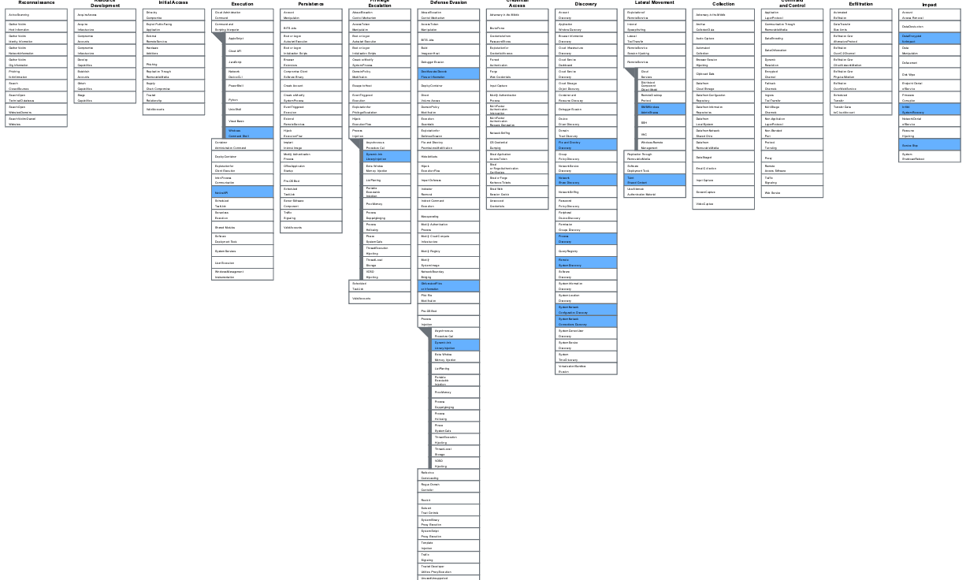
ATT&CK Techniques used by Conti Software (RaaS)
17 Documented Techniques

Slide 20
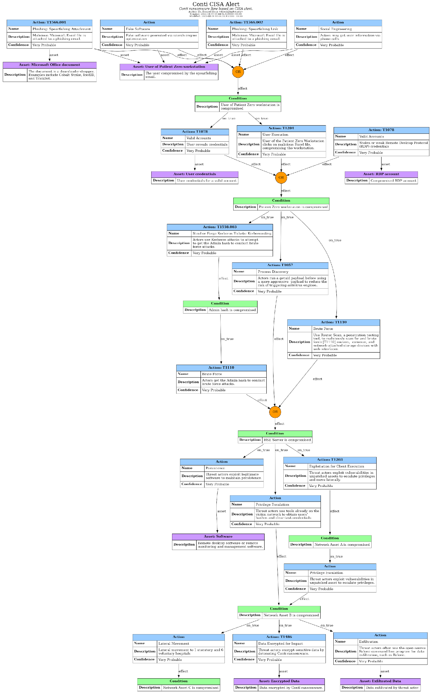
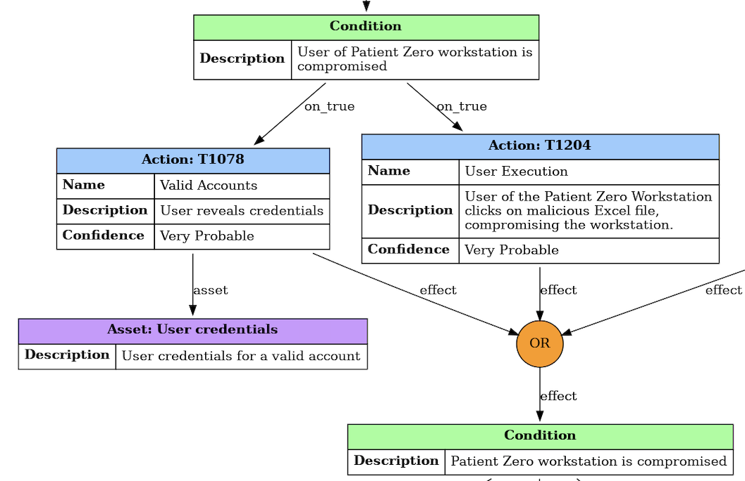
Understand the Attack Flow: CISA Conti Report

Slide 21
Understand the Attack Flow: CISA Conti Report
Initial Access
Data Encryption & Exfiltration
Frequently starts with a Spear Phishing Attack (T1566)
The user gives up their credentials (T1078) or runs a malicious Excel file (T1204)
Result – > patient zero workstation is compromised.
Uses the AES-256 algorithm to encrypt files with a public key that's hard-coded in the conti software (T1486)
Exfiltration to Cloud Storage using Rclone command line program for syncing files with cloud storage services (T1567.002)

Slide 22
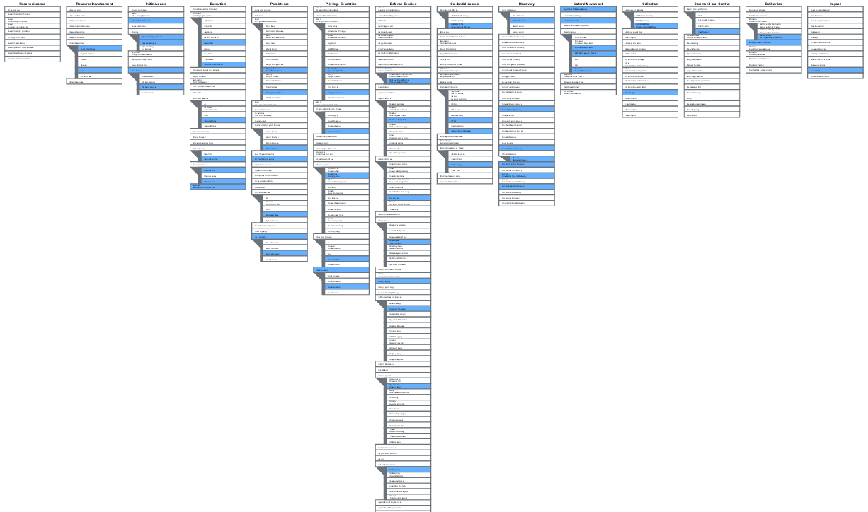
ATT&CK Techniques used by Wizard Spider Group
37 Documented Techniques

Slide 23
Leverage ATT&CK and Real Data in FAIR Model
Asset - PII Data
Threat - Wizard Spider Group
Effect - Availability Impact
Method - Data Encrypted using Ransomware

Slide 24
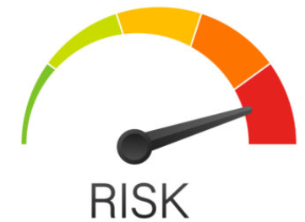
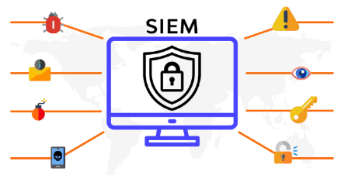
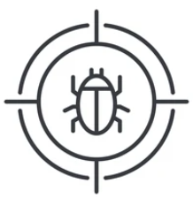
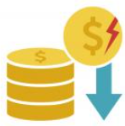
Fortune-10 Healthcare Win
Risk
Min: $3.2
Most Likely: $4.6M
Max:$6.2M
Loss Event Frequency
Min: 9
Most Likely: 12
Max: 15
Loss Magnitude
Min: $1.6M
Most Likely: $3.4M
Max: $5.3M
Threat Event Frequency
Min: 400
Most Likely: 650
Max:900
Vulnerability
Min: 26%
Most Likely: 60%
Max:78%
Primary Loss
Min: $1.1M
Most Likely: $2.2M
Max: $3.1M
Secondary Loss
Min: $0.5M
Most Likely: $1.2M
Max: $2.2M

Slide 25
Success Story :)
Business Enablement:
Enabled business to continue securely
Board Engagement:
Effective Communication with the Board and the business leadership
Cross Team Alignment:
Focused Execution towards common goal with accurate context setting between Security and Risk teams.
Risk Based Security:
Crown Jewels protection
Build encryption
Key management and enhanced DB security program
Cost: $2.1M
Value:
Loss Exposure: Reduced from $8M to $1.9M
Increased Data Protection: Secured 33M PHI records vs 5M PHI records that were at risk
Increased Maturity: Enhanced Cyber program maturity by securing all DBs and implementing enhanced monitoring and Access.

Slide 26
Drive risk analysis based on what we have seen
Ongoing Research to Enhance TID:
Attribution - based on a set of observed TTPs what group may be behind an attack?
Pattern Frequency - what are the most common patterns of attack. What did we see last year? How have patterns changed?
Threat hunting - based on 2 or 3 observed TTPs what likely comes next? What likely proceeded those TTPs?
Notes:
Analyzing collections of Attack Flows

Slide 27
MITRE ATT&CK https://attack.mitre.org/
Attack Flow https://center-for-threat-informed-defense.github.io/attack-flow/
800-53 Mapped to ATT&CK https://mitre-engenuity.org/cybersecurity/center-for-threat-informed-defense/our-work/nist-800-53-control-mappings/
Azure Mapped to ATT&CK https://mitre-engenuity.org/cybersecurity/center-for-threat-informed-defense/our-work/security-stack-mappings-azure/
Join us and change the game
https://ctid.mitre-engenuity.org/

