Slide 1
Integrated Decision Management for Cybersecurity
Making Cybersecurity Part of a Coordinated Enterprise Solution for Improved Decisions
Douglas Hubbard, President, Hubbard Decision Research

Slide 2
Review of Decision Making
Overconfidence
Inconsistency
Inefficient Collaboration
I’m right 95% of the time.
(Before coffee) P(X)=.05
(After coffee) P(X)=.2
This control is 95% effective.
I agree.
Slow Feedback
Inference Errors
Analysis Placebos
This will happen once in 20 years.
This hasn’t happened yet, so I have no data.
Our new method is working great!
Track Performance
Use outside data (both the object and method of measurement)
Do less math in our heads

Slide 3
Combining Experts: The FrankenSME
942 individuals with 53,000+ responses were used to create 1.8 million virtual teams of 3.
60%, 70% 70%
Count: 7906
Average:67%
Actual:75%
Averaging produces underconfident estimates.
The FrankenSME closely predicts actuals.
In many cases, the FrankenSME and actual is higher than the highest confidence of the three
Actual
Actual
The size of bubbles represents number of virtual teams with that response.
60%, 70% 70% Count:7906
FrankenSME:78%
Actual:75%
Average of 3 SME’s
FSME of 3 SME’s
Copyright Hubbard Decision Research 2020
Notes:
It comes from Bayes theorem. You’ve may have heard me talk about this before. Think of it this way. If there are two people taking their own random samples from the same population of some food packaging and they each happen to compute that there is a 80% chance that the average amount of food in the package is greater than, say, 100 grams, what would you get if you put their samples together? The single larger sample would tell you that there is greater than an 80% the mean is greater than 100 grams. Bayes plus a few other axioms in probability theory can help produce an equation. Here it is. Now this equation is still a bit of a simplification. I’m not even looking at how correlated people’s answers might be. If people tended to find that some of the same questions were hard and they also found some of the same types of questions were easy, they would be correlated enough that they equation wouldn’t be a good fit, especially if you were combining a lot of individuals. But here we are just combining two, so let’s see how well this equation performs.

Slide 4
Some Questions From Risk Management
How big should an event be to classify as a risk?
How uncertain should the loss be?
Is not meeting an ambitious goal a “risk”, even if being short of it is not a loss?
Where do we assess how much more risk is acceptable given a higher return?
Questions like these are only issues if we think of risk management as separated from the larger topic of managing decision making.
Some definitions of risk confuse risk with opportunity

Slide 5
Risk vs. Opportunity in Decision Making
In the context of broader decision making, Risk Management makes as much sense as a left-foot shoe department.
Decisions
Decisions Under Uncertainty
The inputs are uncertain
I realize some definitions of risk management include ALL uncertainties, but that is not a universal use of the term, it’s an unnecessary use of the term, and it is inconsistent with previous definitions and quantitative methods.
Definitions that try to combine Risk and Opportunity only further distance RM from the rest of decision making.
Decisions Under Certainty
You have perfect information, but the problem is complex
Opportunity (Uncertainty about reward/return)
Risk
(Uncertainty about pain/loss)

Slide 6
Getting Closer To The Whole Solution
Cybersecurity is just one part of Risk Management. Risk Management is one part of a much larger system required for making informed decisions.
Integrated Decision Management
Decision Analysis & Optimization
Empirical Methods & Monitoring
Risk Management
Cyber
Risk Analysis
Decision Psychology
Modeling Methods

Slide 7
Integrated Decision Management
The major components of decision making are among the least measured in any organization.
We need some form of a dashboard for estimation performance including individuals, teams, and tools.
Integrated Decision Management
Training
Evaluating
Tracking

Slide 8
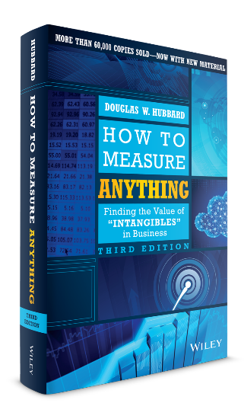
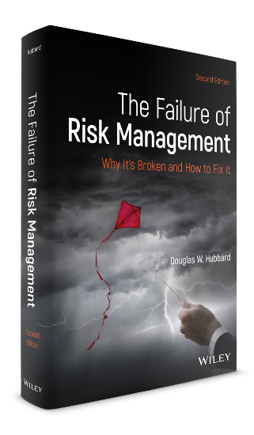
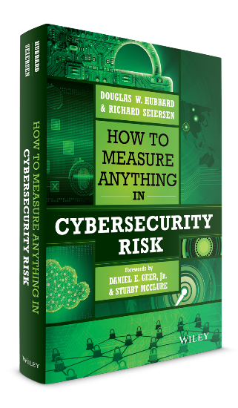
How to Measure Anything in Project Management
Cover TBD

Slide 9
The Oxford/HDR Project Survey
We are looking for project managers to describe a real project in a 15-to-20-minute survey.
If you give us your input, you will receive a summary report on the survey findings and get a chance to attend a webinar with my co-authors and me, summarizing our ideas in the book.
https://oxford.onlinesurveys.ac.uk/oxford-hdr-project-management-questionnaire

Slide 10
Dis-integrated Decision Making
Can we manage all of these in a more cohesive way?
Risk Management
Machine Learning
Artificial Intelligence
Risk Assessment
Subject Matter Experts
Project Prioritization
Data Science
Dashboards
Finance & Accounting
Performance Metrics
Quality Control
Decision Quality

Slide 11
One of the Last and Most Important Pieces
Tracking improving judgement itself is one of the “last frontiers” of improving risk management.
Key Judgement Metrics
Calibration
Correlation between judges
Noise
External factors
Aggregation performance
Augmentation (AI and more)
Quant Models
Data
Most effort, analysis, and solutions - most improved
Judgement
Little or no analysis, critical need for solutions

Slide 12
Integrating Expert Judgement Into the Solution
A complete Cybersecurity Risk solution should address the following.
Calibration Training
Tracking real-world performance
Measuring correlation among experts
Measuring noise
Identifying conditions for best estimates
Algorithmic aggregation outperforming the best individual SME
Augmented with AI coaching
Testing multiple models as an ensemble approach

Slide 13
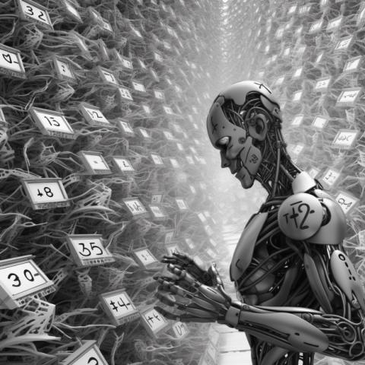
Instead of Speculating About AI, Start Measuring It
https://hubbardresearch.com/is-chatgpt-as-overconfident-as-humans/
 | % Within 90% CI | Sample Size
ChatGPT, events after 2021 training data cutoff | 60% | 360 (20 events, 18 sessions)
Humans, general trivia | ~55% | 80,000+
Example forecast for ChatGPT: “How much will the top-grossing film earn internationally at the box office in 2022?”
Copyright Hubbard Decision Research 2020

Slide 14
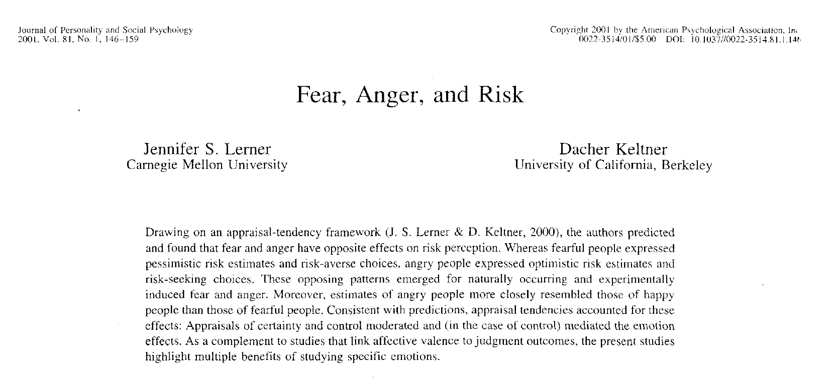
The Psychology of Risk Aversion
Neuron Vol. 47, (2005): 763–770
The Neural Basis of Financial Risk Taking
Camelia M. Kuhnen and Brian Knutson
Abstract
Investors systematically deviate from rationality when making financial decisions, yet the mechanisms responsible for these deviations have not been identified.
Using event-related fMRI, we examined whether anticipatory neural activity would predict optimal and suboptimal choices in a financial decision-making task. We characterized two types of deviations from the optimal investment strategy of a rational risk-neutral agent as risk-seeking mistakes and risk-aversion mistakes. Nucleus accumbens activation preceded risky choices as well as risk-seeking mistakes, while anterior insula activation preceded riskless choices
as well as risk-aversion mistakes. decision making.
Decision makers are also inconsistent regarding their own aversion to risk.
Factor | Risk Aversion
Being around smiling people
Recalling an event causing fear
Recalling an event causing anger
A recent win in an unrelated decision
A recent loss in an unrelated decision
Copyright Hubbard Decision Research 2020

Slide 15
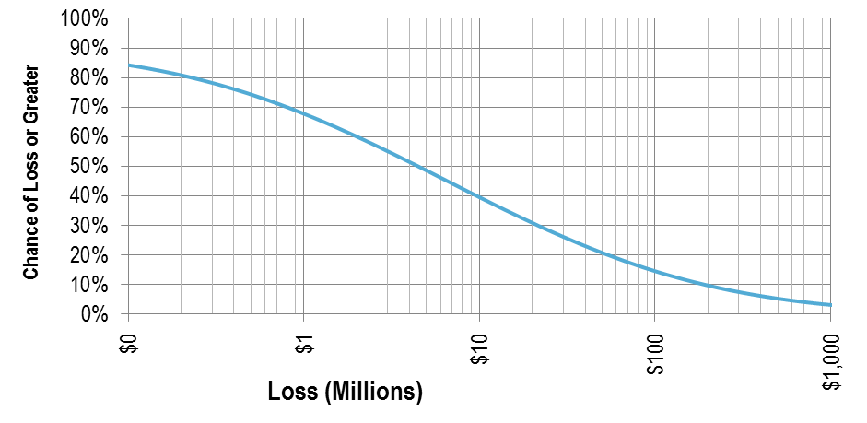
A Version of Risk Tolerance: The Loss Exceedance Curve
Explicitly stating risk tolerance is a key part of a decision and cannot be excluded from dashboard-informed decisions.
Loss Exceedance Curve
Utility
This means there is about a 40% chance of losing more than $10M in a year and about a 10% chance of losing more than $200M.
Risk Appetite
Inherent Risk
Residual Risk
-$10MM 0 +$10MM +20MM
Copyright Hubbard Decision Research 2020

Slide 16
Risk vs. Return in Decision Making
Distribution of Net Benefit for Various Initiatives:
In isolation, risk management is not about how we should select and prioritize investments, how we should track their performance, or about the methods used to make those decisions.
A
B
C
D
-$10MM
0%
$10MM
$20MM
Copyright Hubbard Decision Research 2020

Slide 17
Risk vs. Return in Decision Making
Distribution of Net Benefit for Various Initiatives:
To prioritize actions with uncertain net benefits like these, we need to compare them on a single dimension, like “Certain Monetary Equivalent” (CME) All it takes is a few preferences stated in terms of bets.
A
B
We can ask two or three questions like, “If you had a bet with a binary outcome, where there was a 60% chance of winning $10MM but a 40% chance of loss, how large of a loss would be just barely acceptable?”
C
D
-$10MM
0%
$10MM
$20MM
Copyright Hubbard Decision Research 2020

Slide 18
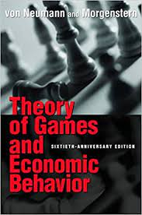
Expected Utility Theory
Expected Utility Theory is the most quantitatively sound method for describing risk preferences. It is the basis of the field of Decision Analysis and is widely used in portfolio management and actuarial science.
It is based on the idea that in order for risk preferences to be consistent, they should be guided by the probability-weighted average utility of choices.
There is a whole set of mathematics showing functions that describe expected utility in ways that can’t violate basic common sense about preferences.
Copyright Hubbard Decision Research 2020

Slide 19
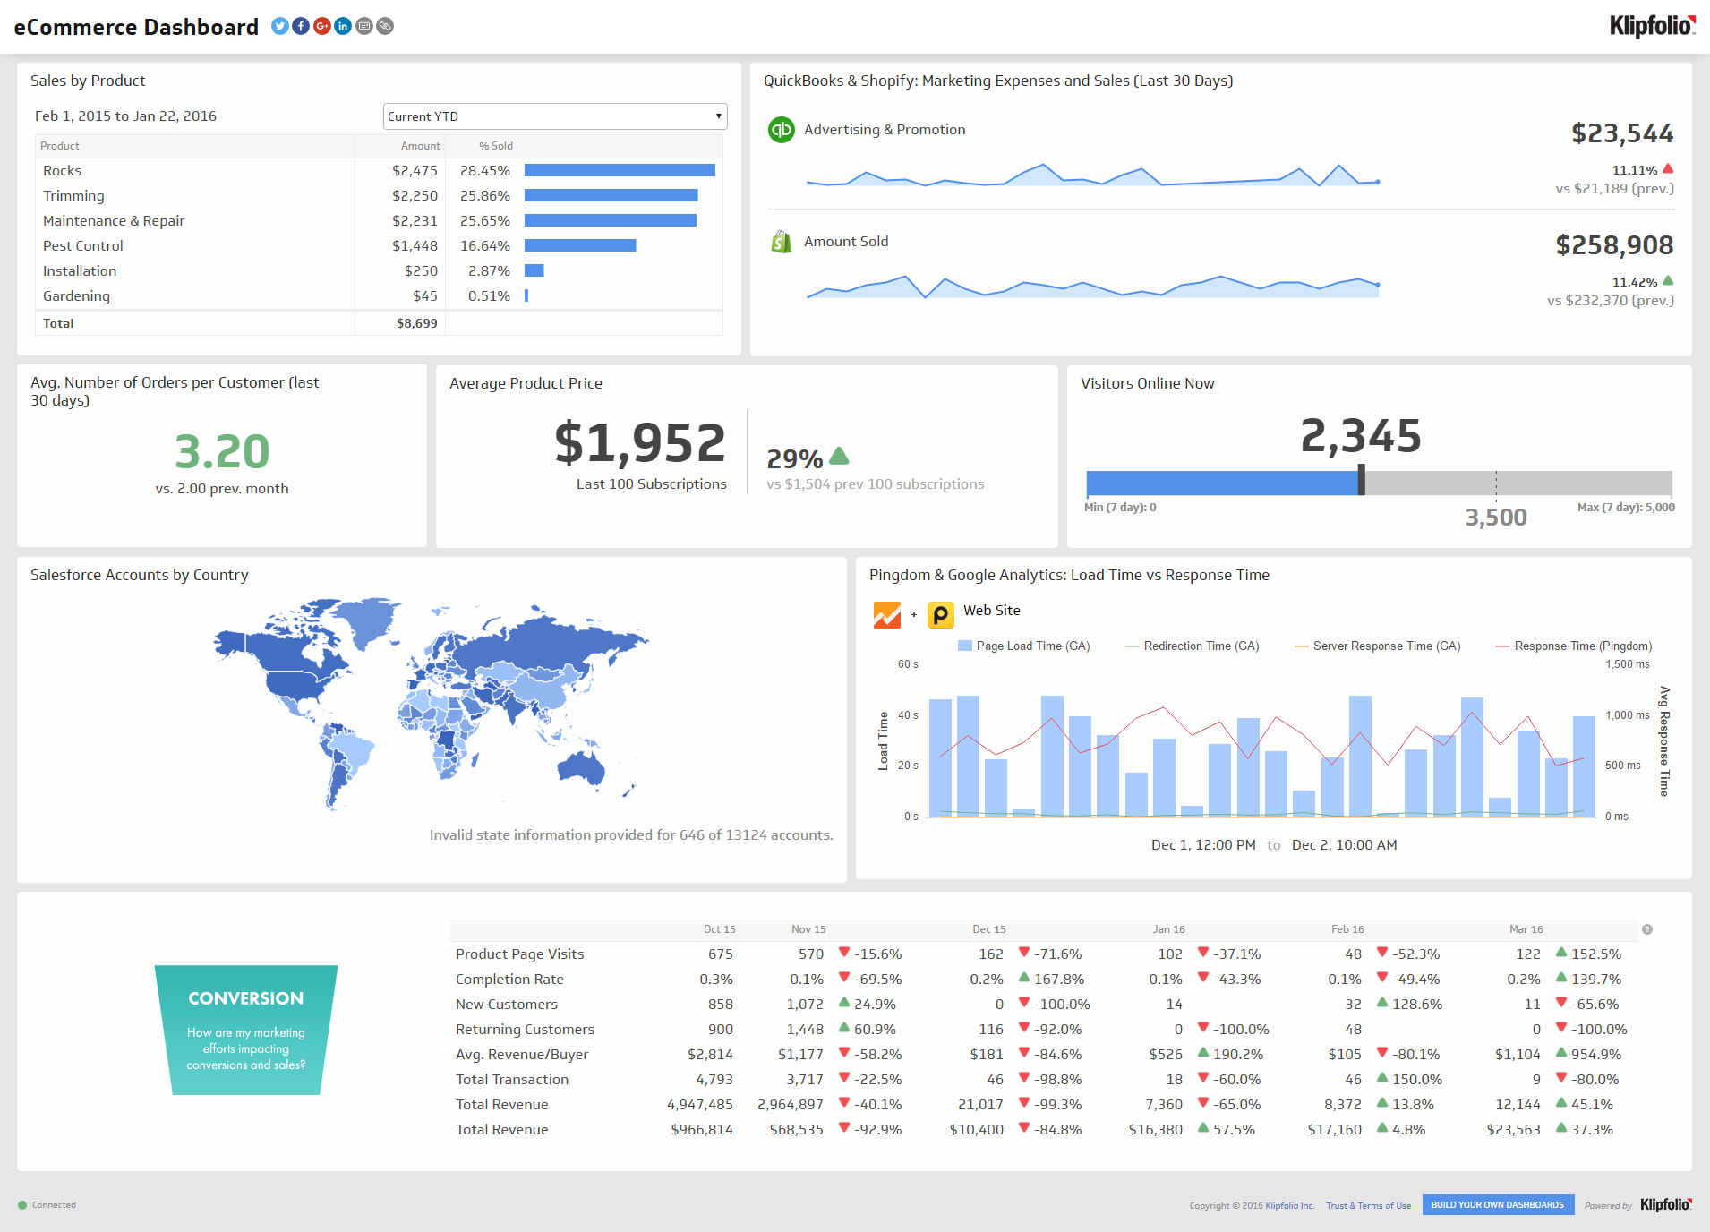
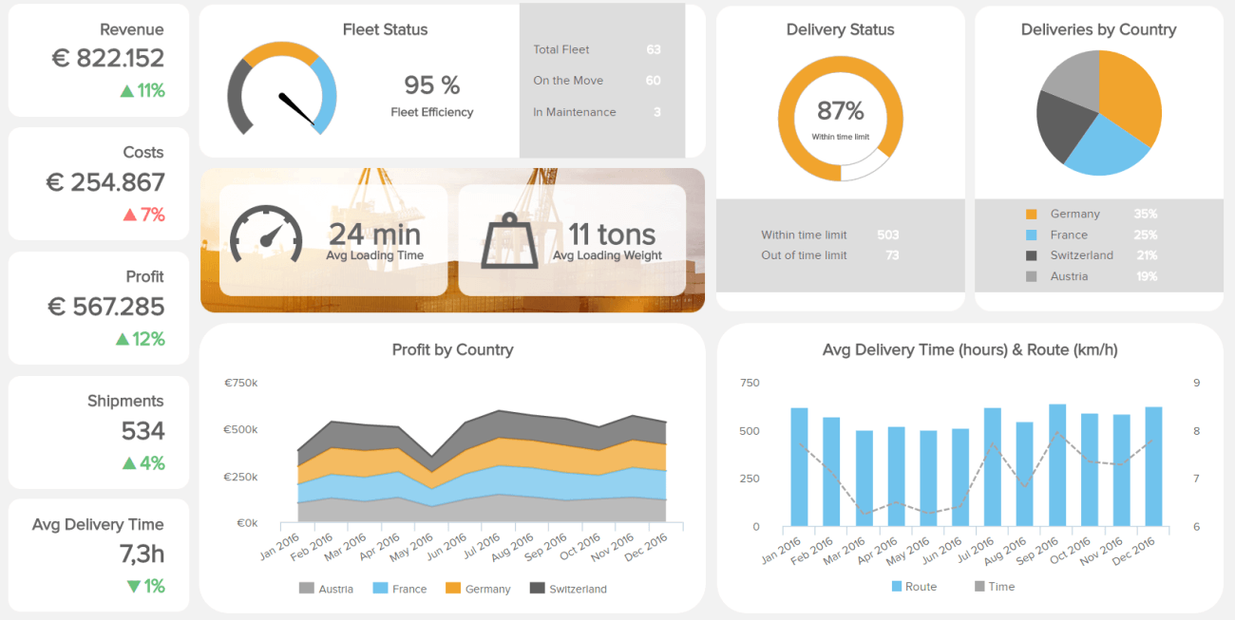
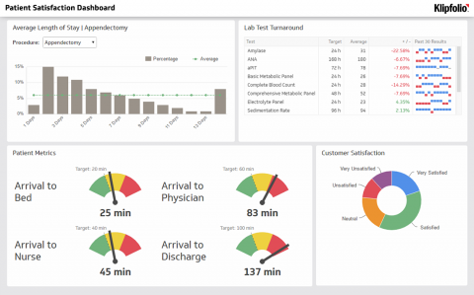
Examples of “Typical” Dashboards
Copyright Hubbard Decision Research 2020

Slide 20
Hope is Not a Strategy
Are you counting on a “Dashboard Epiphany” for important decisions?
Are you confident you will “know it when you see it?”
Are you considering multiple interacting conditions?
Are you forecasting from those conditions the net benefit of different actions at different times?
Copyright Hubbard Decision Research 2020

Slide 21
Are Dashboards & Metrics Driven By Information Value?
IEEE Transactions on Systems Science and Cybernetics (1966 )
Information Value Theory
Ron Howard
Abstract
The information theory developed by Shannon was designed to place a quantitative measure on the amount of information involved in any communication. The early developers stressed that the information measure was dependent only on the probabilistic structure of the communication process. For example, if losing all your assets in the stock
The economic value of measuring a variable is usually inversely proportional to the measurement effort.
HDR has observed a “Measurement Inversion” in nearly every industry, profession, and type of decision model we’ve ever made.
The cure starts with knowing which variables are the highest information value.
Lowest
Information Value
Most Measured
Highest Information Value
Least Measured
Copyright Hubbard Decision Research 2020

Slide 22
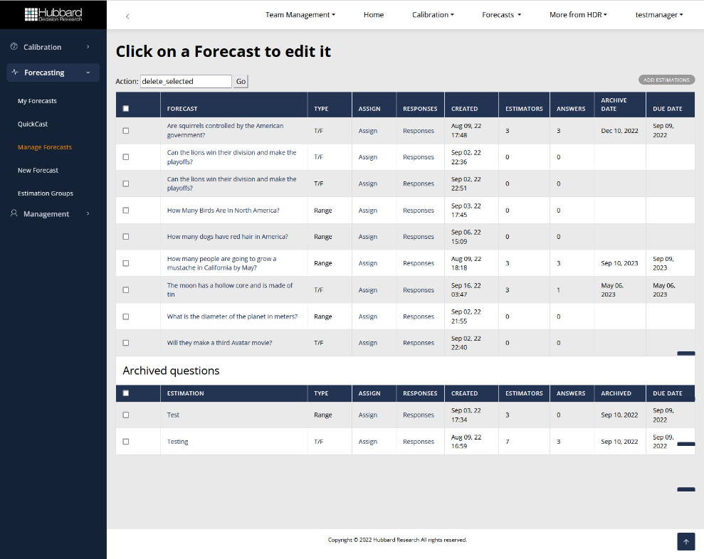
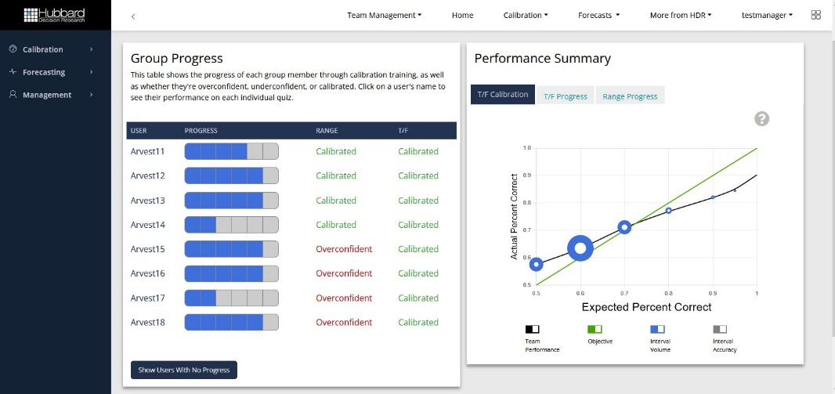
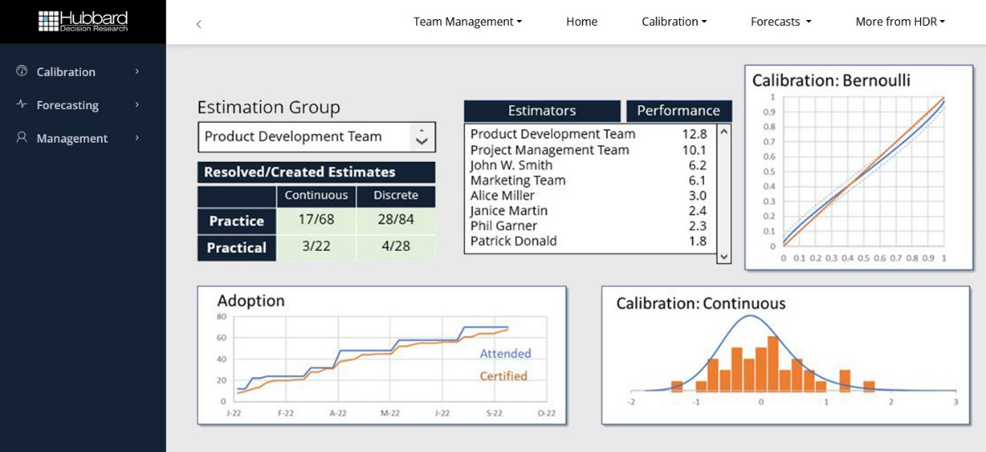
Tracking Decisions and Estimates is Practical
What we need are dashboards for estimates and decisions which answer the questions:
How well are we estimating?
Which estimation methods work best (SMEs, combinations of SMEs, models, etc.)?
What measurements have priority?
What actions are needed now?
Copyright Hubbard Decision Research 2020

Slide 23
A Decision Ecosystem
External Research
Model Building
Model Performance
Empirical Measurements
Model
Model
Model
Individual Past Performance: calibration, consistency, accuracy, speed, etc.
Decision
Decision
Teams
Decision
Aggregated Estimates
Individual Estimate
Aggregated Estimates
Subject
Individual Estimate
Aggregated Estimates
Personal: Fatigue, Stress etc.
Subject Matter Expert
Individual Estimate
Physical Environment: location, time of day, etc.
Copyright Hubbard Decision Research 2020

Slide 24
Summary
Think of Cybersecurity Risk Management as a component of a larger decision-making process – it is part of Enterprise Risk Management which is part of Enterprise Decision Management.
Getting the most value out of Cybersecurity Risk Management may involve developing the other components of decision making.
One of the first steps is starting to track the performance of SMEs, decision makers, and models. Don’t assume they work.
Copyright Hubbard Decision Research 2020

Slide 25
Thank you for Your Time!
Doug Hubbard
Hubbard Decision Research
dwhubbard@hubbardresearch.com
www.hubbardresearch.com
Measure What Matters.
Make Better Decisions.
‹#›

Slide 26
Supplementary Material

Slide 27
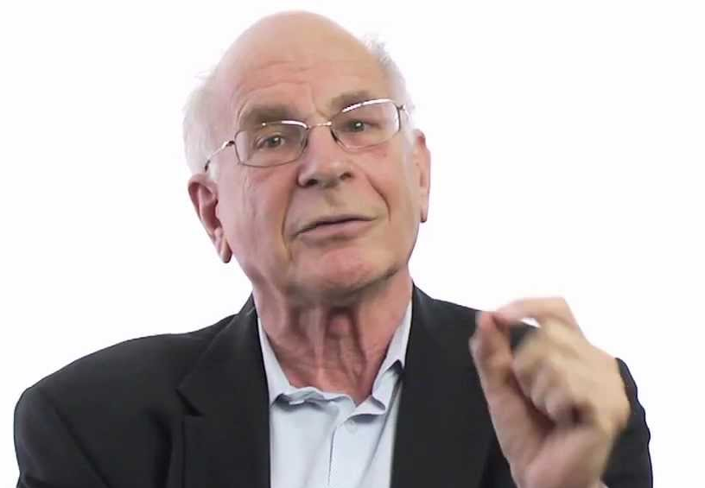
Calibrated Experts
“Overconfident professionals sincerely believe they have expertise, act as experts and look like experts. You will have to struggle to remind yourself that they may be in the grip of an illusion.”
Daniel Kahneman, Psychologist, Economics Nobel
Decades of studies show that most managers are statistically “overconfident” when assessing their own uncertainty.
Studies also show that measuring your own uncertainty about a quantity is a general skill that can be taught with a measurable improvement.

Slide 28
Measuring and Reducing Judgement Inconsistency
Comparison of 1st to 2nd Estimates of Cyber risk judgments by same SME
We have gathered over 30,000 estimates of probabilities of various security events.
These estimates included over 2,000 duplicate scenarios pairs.
21% of variation in expert responses are explained by inconsistency.
(79% are explained by the actual information they were given)

Slide 29
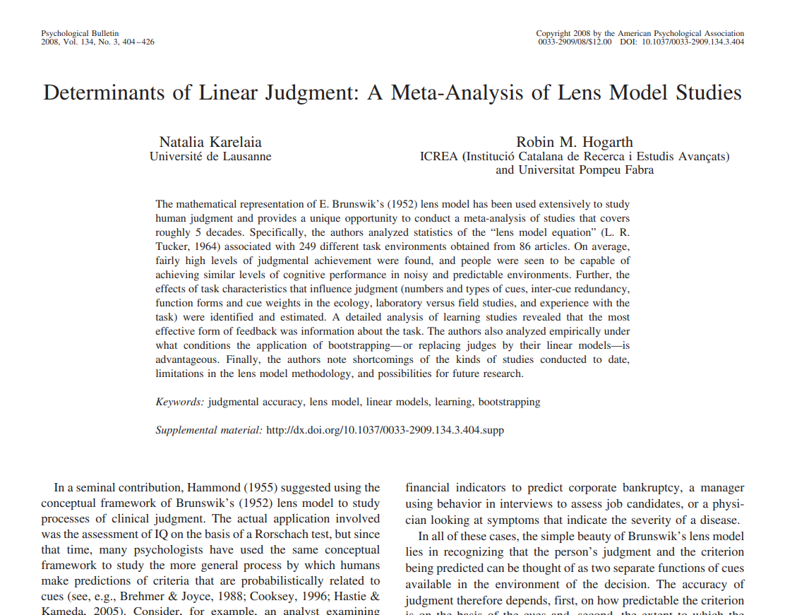
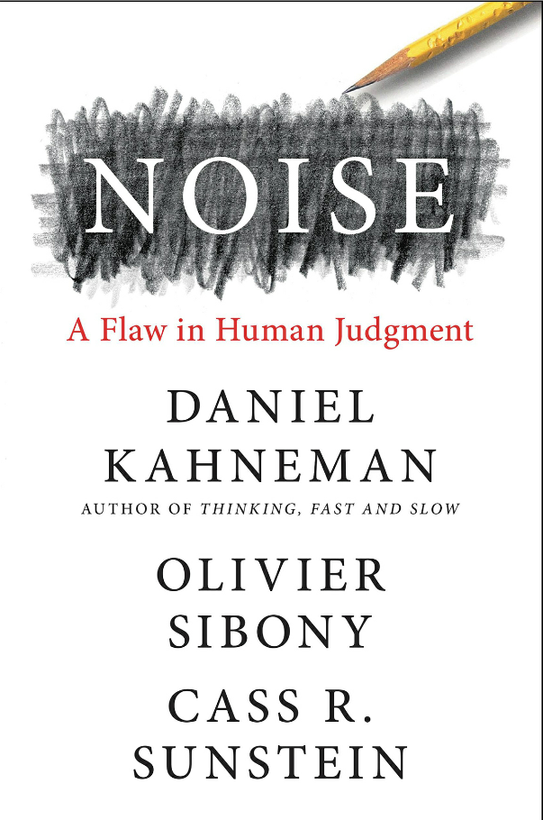
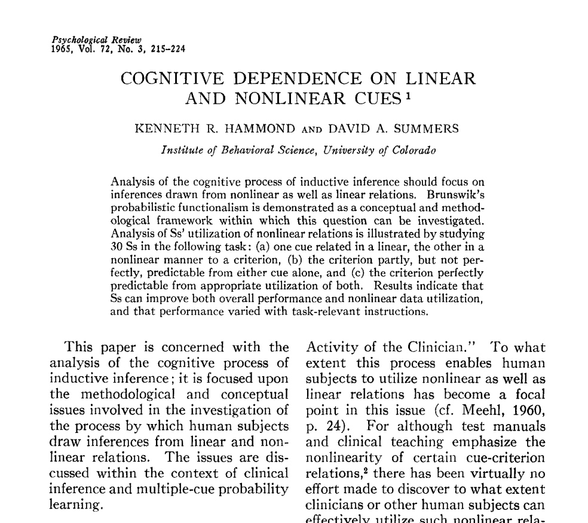
Measuring (And Removing) Inconsistency
The “Lens Method” statistically “smooths” estimates of experts. Several studies for many different kinds of problems show it reduces judgement errors.
Cancer patient recovery
Psychology course grades
Changes in stock prices
Other Published Studies
Mental illness prognosis
Business failures
IT Portfolio Priorities
My Studies
Battlefield Fuel Forecasts
R&D Portfolio Priorities
0%
10%
20%
30%
Reduction in Errors

Slide 30
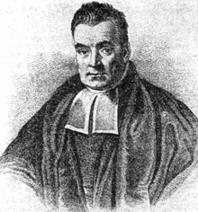
Combining Data With Bayes
Bayes Theorem is a simple and powerful concept. It allows us to update our “prior” probabilities with new information – and combine the priors of experts.
P(X)P(Y|X)
P(X)P(Y|X)
Bayes Theorem:
P(X|Y)
=
=
ΣP(Y|X_{i}) P(X_{i})
P(Y)
_{i}
P(X) = the probability of X
P(X|Y) = the probability of X given the condition Y
Σ P(Y | X_{i}) P(X_{i}) = the sum of the probability of Y under each possible condition
Thomas Bayes, 1701-1761
Copyright Hubbard Decision Research 2020
Notes:
It comes from Bayes theorem. You’ve may have heard me talk about this before. Think of it this way. If there are two people taking their own random samples from the same population of some food packaging and they each happen to compute that there is a 80% chance that the average amount of food in the package is greater than, say, 100 grams, what would you get if you put their samples together? The single larger sample would tell you that there is greater than an 80% the mean is greater than 100 grams. Bayes plus a few other axioms in probability theory can help produce an equation. Here it is. Now this equation is still a bit of a simplification. I’m not even looking at how correlated people’s answers might be. If people tended to find that some of the same questions were hard and they also found some of the same types of questions were easy, they would be correlated enough that they equation wouldn’t be a good fit, especially if you were combining a lot of individuals. But here we are just combining two, so let’s see how well this equation performs.

Slide 31
Measuring Overconfidence
Perfect Calibration
We’ve trained over 2,000 individuals in subjective estimation of probabilities.
Almost everyone is overconfident on the first benchmark test.
Sampling Error
Percent Correct
Before Calibration
Assessed Chance Of Being Correct
Copyright Hubbard Decision Research 2020

Slide 32
Measuring Calibration Training
After Calibration
Perfect Calibration
Sampling Error
Training improves the ability to provide calibrated estimates.
We’ve done experiments which shows this training improves real-world estimates.
Percent Correct
Before Calibration
Assessed Chance Of Being Correct
Copyright Hubbard Decision Research 2020

Slide 33
Final Calibration Adjustments
After Calibration
Perfect Calibration
Sampling Error
Further adjustments using actual performance data for individual SMEs will make them nearly perfectly calibrated.
Percent Correct
Before Calibration
Assessed Chance Of Being Correct
Copyright Hubbard Decision Research 2020

Slide 34
Comparing Aggregation Methods
Calibration and information (width of the interval) are measures of different aggregation methods.
The width of confidence intervals is normalized to use the average trained SME as a width of “1.”
The objective is to be narrow but calibrated.
The best of 7 is about as wide as 1 on average but better calibrated (closer to 90% within the CI).
The untrained individual has a narrow but extremely uncalibrated range.
% W/in Interval
Best Calibrated SME of 7
Average Trained SME w/o final calibration
Relative Width
Off the chart – uncalibrated single individual
‹#›

Slide 35
Comparing Aggregation Methods
Averaging improves calibration with 3 SMEs but makes the range wider on average.
Averaging more than 3 tends to make the range too wide and underconfident.
7
Averaging
5
% W/in Interval
3
3
Best Calibrated SME of 7
Average Trained SME w/o final calibration
Relative Width
Off the chart – uncalibrated single individual
‹#›

Slide 36
Comparing Aggregation Methods
Only the FrankenSME gets narrower with more SMEs and stays calibrated.
There are other aggregation algorithms, but they also tend to create wider ranges as more SMEs are included.
FrankenSME
7
Averaging
5
% W/in Interval
7
5
3
3
Best Calibrated SME of 7
Average Trained SME w/o final calibration
Relative Width
Off the chart – uncalibrated single individual
‹#›

Slide 37
A Special Case: Aggregating Two Experts
0.9
0.8
0.7
0.6
0.05
0.1
0.2
0.3
0.4
0.6
0.7
0.8
0.9
0.95
0.5
0.4
0.3
0.2
0.1
Assuming Perfect Calibration
0.05
0.1
0.2
0.3
0.4
0.6
0.7
0.8
0.9
0.95
Adjusted Imperfect Calibration
Copyright Hubbard Decision Research 2020
Notes:
It comes from Bayes theorem. You’ve may have heard me talk about this before. Think of it this way. If there are two people taking their own random samples from the same population of some food packaging and they each happen to compute that there is a 80% chance that the average amount of food in the package is greater than, say, 100 grams, what would you get if you put their samples together? The single larger sample would tell you that there is greater than an 80% the mean is greater than 100 grams. Bayes plus a few other axioms in probability theory can help produce an equation. Here it is. Now this equation is still a bit of a simplification. I’m not even looking at how correlated people’s answers might be. If people tended to find that some of the same questions were hard and they also found some of the same types of questions were easy, they would be correlated enough that they equation wouldn’t be a good fit, especially if you were combining a lot of individuals. But here we are just combining two, so let’s see how well this equation performs.

Slide 38
What Measuring Risk Looks Like
The Loss Exceedance Curve
What if we could measure risk more like an actuary? For example, “The probability of losing more than $10 million due to security incidents in 2016 is 16%.”
What if we could prioritize security investments based on a “Return on Mitigation”?
This means there is about a 40% chance of losing more than $10M in a year and about a 10% chance of losing more than $200M.
‹#›

Slide 39
The Analysis Placebo
Organizational Behavior and Human Decision Processes
107, no. 2 (2008): 97– 105.
Effects of Amount of Information on Judgment Accuracy and Confidence
Tsai, Klayman, and Hastie
Abstract
When a person evaluates his or her confidence in a judgment, what is the effect of receiving more judgment-relevant information? We report three studies that show when judges receive more information, their confidence increases more than their accuracy, producing substantial confidence-accuracy discrepancies. Our results suggest that judges do not adjust for the cognitive limitations that reduce their
When evaluating judgement methods, you can’t rely on perceptions of effectiveness.
Journal of Behavioral Decision Making 3, no. 3 (July/ September 1990): 153– 174.
Judgmental Extrapolation and Market Overreaction: On the Use and Disuse of News
Andreassen
Abstract
The tendency of future stock prices to revert toward the mean of past prices was originally explained by the market overreaction hypothesis, which assumed that recent media reports cause investors to underuse base rate information. However, assuming that investors underweigh older stores of financial information cannot
Law and Human Behavior 23 (1999): 499– 516.
“I’m Innocent!” Effects of Training on Judgments of Truth and Deception in the Interrogation Room
Kassin and Fong
Abstract
The present research examined the extent to which people can distinguish true and false denials made in a criminal interrogation, and tested the hypothesis that training in the use of verbal and nonverbal cues increases the accuracy of these judgments. In Phase One, 16 participants committed one of four mock crimes
Organizational Behavior and Human Decision Processes 61, no. 3 (1995): 305– 326.
Interaction with Others Increases Decision Confidence but Not Decision Quality: Evidence against Information Collection Views of Interactive Decision Making
Heath and Gonzalez
Abstract
We present three studies of interactive decision making, where decision makers interact with others before making a final decision alone. Because the theories of lay observers and social psychologists emphasize the role of information collection in interaction, we developed a series of tests of information collection. Two studies
Confidence
Performance
‹#›

Slide 40
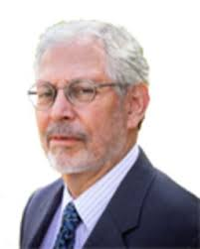
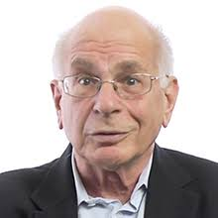
The Need for Feedback
Experience does not automatically produce learning.
And that feedback has to be CONSISTENT…
…IMMEDIATE…
…and UNAMBIGUOUS.
To learn from experience, you need feedback.
Daniel Kahneman
Gary Klein
‹#›

Slide 41
The (Very) Slow Feedback Problem
A Bayesian Look at Mitigation Assessment Over Time
Suppose we have an event we assess as having a 10% chance/yr of occurrence.
We implement a mitigation that we think may reduce that chance to 5%.
Uncertain of whether the risk will actually be reduced, we give a prior probability that there is a 50% chance the mitigation works as stated.
How long do we have to watch our environment to see if the annualized probability went from 10% to 5%?
Probability Mitigation Worked
Zero occurrences in time period
Years Since Mitigation
Solving for the probability a mitigation reduced event likelihood from 10% to 5% per year given number of occurrences in time period

