Slide 1
FAIR-MAM™: Your (Not-So) Secret Tool to Build Defensible Resiliency
FAIR Institute Thought Leadership Webinar
Wednesday, April 15, 2025

Slide 2
Speakers
Pierre Olodo
Cyber Risk Management Lead
Richemont
Erica Eager
Author, FAIR-MAM
Sr Director, CRQ, SAFE Security
Pankaj Goyal
Director, Research & Standards
FAIR Institute

Slide 3
FAIR-MAM v2 (Materiality Assessment Model)
INFORMATION PRIVACY
PROPRIETARY DATA LOSS
BUSINESS INTERRUPTION
CYBER
EXTORTION
NETWORK SECURITY
FINANCIAL
FRAUD
MEDIA
CONTENT
HARDWARE BRICKING
POST BREACH SECURITY IMPROVEMENTS
REPUTATIONAL DAMAGE
4 SUB COST CATEGORIES
2 SUB COST CATEGORIES
3 SUB COST CATEGORIES
1 SUB COST CATEGORY
2 SUB COST CATEGORIES
2 SUB COST CATEGORIES
2 SUB COST CATEGORIES
2 SUB COST CATEGORIES
2 SUB COST CATEGORIES
6 SUB COST CATEGORIES
Sensitive PII Event Response and Management
Proprietary Data Response and Recovery
Direct Business Interruption
Ransom
Network Event Response and Recovery
Funds Transfer Fraud
Media Event Response
Server Replacement
Legally- Mandated Improvements
Customer Retention
P-RespC
P-ReplC
P-RespC
P-ReplC
S-RepuC
P-RespC
P-RespC
P-PL
P-RespC
Financial Fraud Liability
S-RespC
Contingent Business Interruption
(Supply Chain Attack Victim - 3P failure to provide IT services)
Media Liability
Computer/ Laptop Replacement
Voluntary Improvements
Future Projects
PCI-DSS Liability
Loss of Estimated Future Net Revenue
Network Security Liability
S-RespC
S-RespC
S-RepuC
P-RespC
P-ReplC
S-RespC
S-CA
S-RespC
Market
Value
Information Privacy Liability
Proprietary Data Loss Liability
S-RepuC
P-PL
S-RespC
Business Interruption Liability
Cyber Insurance
S-RespC
Regulatory Liability
S-RepuC
S-RespC
Cost of Capital
S-FJ
Legend
S-RepuC
P - Primary Cost
S - Secondary Cost
RespC - Response Cost
FJ - Fines & Judgements
CA - Competitive Advantage
PL - Productivity Loss
ReplC - Replacement Cost
RepuC - Reputation Damage
Employee Churn
S-RepuC

Slide 4
History of FAIR-MAM™
FAIR-MAM™ is an open standard cyber risk quantification framework released by the FAIR Institute in Sept. 2023
Principles of FAIR-MAM™
Fully FAIR™ compliant
MECE (Mutually Exclusive and Comprehensively Exhaustive)
General alignment with corporate financial statements - most similar to a Profit & Loss statement
Research behind FAIR-MAM™
Aligned with cyber insurance claims categories
Categorization of costs into loss modules and loss categories based on in-depth analysis of tens of thousands of cyber attacks and the costs of attributable to different types of attack and assets compromised
Primary costs are Income Statement line items (eg, usually included in SG&A costs or one-time cost line items)
Secondary costs are Balance Sheet items (eg, reserves against probable future liabilities or lower than expected future additions to retained earnings due to reputational damage)
FAIR-MAM Architecture
Modular
Fully transparent
Fully tunable
Bottom-up loss driver driven loss model
Notes:
Control Centre: “Universe” of cyber controls as defined in Safe’s Control Centre
Control: Defined controls which reduce frequency or magnitude of loss
Maturity: How do we measure controls in Safe? Evaluate maturity in terms of Capability, Coverage, and Reliability (M0-M3, very similar to CMMC scale)
Capability = Intended Efficacy of a control
Coverage = how “implemented” is the control in context of intended efficacy?
Reliability = how reliable is the control in terms of variant conditions from intended efficacy? Does the control ‘fail’ frequently?
Example 1 (SIEM = SIM)
SIEM is a control (i.e. monitoring/logging)
Monitoring is a Loss Event Detection control (because it provides evidence of activity that potentially may be anomalous or illicit in nature.)
(more complex at the function level) - Monitoring is the control function of a SIEM
Example 2 (Patching = PTM)
Patch Management is a control (corrects variant conditions)
Patch Management is a Variance Management Control (Variance Management Controls affect the Operational Performance of other controls by limiting the frequency and duration of ineffective control conditions (i.e., variances from an intended state of efficacy).)
(more complex at the function level) - Variance Correction is the control function of Patching (definition: Variance Correction includes those controls that take place after variant conditions have been identified.)
Example 3 (Audit = AAA)
Auditing is a control (i.e. internal/external audits, compliance checks, and assessments of processes)
Auditing is a Decision Support Control control (it helps to ensure that decisions are aligned with organizational objectives and expectations.)
(more complex at the function level) - Identifying Mis-Aligned Decisions is the control function of auditing

Slide 5
Difference between FAIR-MAM™ and the
6 categories of loss in the FAIR Methodology?
FAIR-MAM’s 10 loss modules categorize loss by the type of Business Resource compromised or type of cost incurred
Information Privacy - PII records
Proprietary Data Loss - IP & Trade Secrets
Business Interruption - Revenue
Cyber Extortion - Ransom paid
Network Security - Network forensic investigation, remediation and data restoration
Financial Fraud - Cash & Equivalents
Media Content - Defamation and other claims against the gathering and dissemination of information
Hardware Bricking - Replacement of IT systems destroyed by wiper type attacks
Post Breach Security Improvements - Voluntary and mandatory increased cyber spend post breach
Reputational Damage - long term loss of revenue or cost increases due to a cyber incident
FAIR Methodology 6 forms of loss
Response Cost | Replacement Cost
Productivity Loss | Fines & Judgments
Competitive Advantage | Reputational Damage
Notes:
Control Centre: “Universe” of cyber controls as defined in Safe’s Control Centre
Control: Defined controls which reduce frequency or magnitude of loss
Maturity: How do we measure controls in Safe? Evaluate maturity in terms of Capability, Coverage, and Reliability (M0-M3, very similar to CMMC scale)
Capability = Intended Efficacy of a control
Coverage = how “implemented” is the control in context of intended efficacy?
Reliability = how reliable is the control in terms of variant conditions from intended efficacy? Does the control ‘fail’ frequently?
Example 1 (SIEM = SIM)
SIEM is a control (i.e. monitoring/logging)
Monitoring is a Loss Event Detection control (because it provides evidence of activity that potentially may be anomalous or illicit in nature.)
(more complex at the function level) - Monitoring is the control function of a SIEM
Example 2 (Patching = PTM)
Patch Management is a control (corrects variant conditions)
Patch Management is a Variance Management Control (Variance Management Controls affect the Operational Performance of other controls by limiting the frequency and duration of ineffective control conditions (i.e., variances from an intended state of efficacy).)
(more complex at the function level) - Variance Correction is the control function of Patching (definition: Variance Correction includes those controls that take place after variant conditions have been identified.)
Example 3 (Audit = AAA)
Auditing is a control (i.e. internal/external audits, compliance checks, and assessments of processes)
Auditing is a Decision Support Control control (it helps to ensure that decisions are aligned with organizational objectives and expectations.)
(more complex at the function level) - Identifying Mis-Aligned Decisions is the control function of auditing

Slide 6
FROM THE WELL KNOWN 6 TYPES OF LOSSES…
Productivity Loss: Losses that result from an organization’s inability to deliver its products or services.
Response Loss: Losses that are associated with managing the event itself. This form of loss will be the most common across your analyses.
Replacement Loss: The costs associated with the replacement of a capital asset or a person.
Fines & Judgments: Penalties levied against an organization through civil, criminal or contractual actions, usually the result of a Confidentiality related scenario.
Competitive Advantage: Losses associated with a diminished competitive advantage.
Reputation Damage: Losses associated with an external actor’s perception that the value proposition of your organization has been diminished
High-Level guidance on how to define and assess primary and secondary losses
Defendability is set at a high-level. Not ideal if facing both executives and mid-management levels

Slide 7
…TO FAIR-MAM (EXAMPLE 1 – INCIDENT RESPONSE COST)
Incident Response Cost
USD 1M
Data Event Response
USD 1M
Forensic Investigation
USD 166k
Legal Support
USD 997k
Public Relations
USD 15k
Customer Notification
USD 28k
Monitoring & iD protection
USD 34k
Structured and repeatable way to breakdown losses, bringing consistency across risk scenarios.
Support the risk analyst in organizing its journey by easing:
Identification of Subject Matter Experts (SMEs);
Detailed information gathering.

Slide 8
…TO FAIR-MAM (EXAMPLE 2 – FINES & JUDGMENTS)
Fines & Judgments
113k
Attorney’s Fees
USD 5k
Information Privacy Liability
USD 113k
Class Action Settlement
USD 108k
Information Privacy Liability
USD 144k
Attorney's Fees
USD 6k
Regulatory Liability USD 31k
Privacy Violations from DB
USD 25k
Structured and repeatable way to breakdown losses, bringing consistency across risk scenarios.
Support the risk analyst in organizing its journey by easing:
Identification of Subject Matter Experts (SMEs);
Detailed information gathering.

Slide 9
Q&A

Slide 10
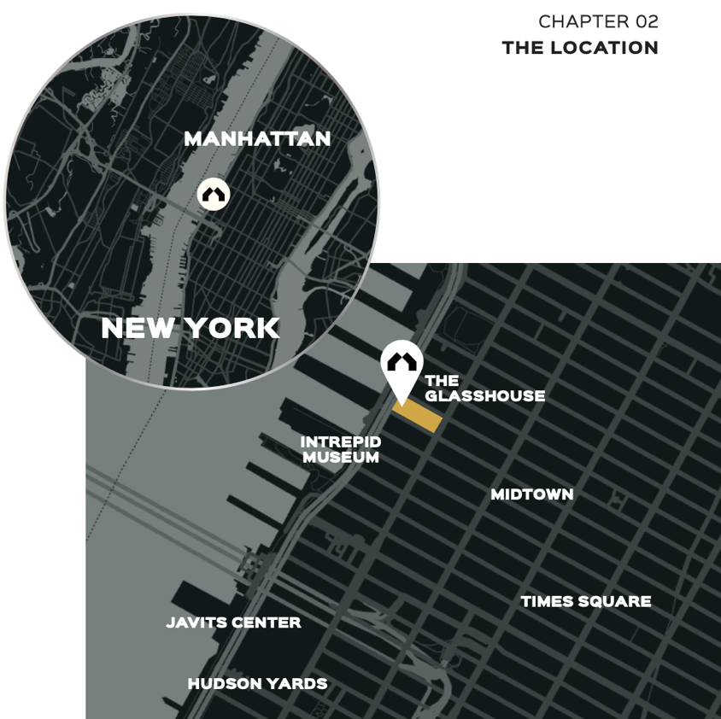
2025 FAIR Conference
November 4-5 | The Glasshouse | New York, NY
Resetting Cyber Risk in the Age of AI
The two-day global conference will bring together CISOs, CIOs, and cyber risk experts to meet on the rapid evolution in cyber risk management.
Key topics will include:
Aligning cybersecurity investments to business risk
Managing AI risk and using AI to manage risk
Ensuring cyber resilience and managing third-party risk
Cyber risk management as a scalable system
November 2-3: Brand new FAIR Foundations and FAIR Cyber Risk Analysis Training courses
Learn more / register: www.fairconference.org

