Slide 1
How to Achieve
SEC Compliance with Real-time and Automated FAIRTM Solution
August 31, 2023

Slide 2
Agenda
Learn about the new FAIR-MAM framework and how to automate FAIRTM.
Discover how SAFE is built to help you meet the SEC’s requirements, quickly and effectively.
Hear real-life examples of how companies are leveraging FAIR and SAFE to demonstrate a transparent cybersecurity strategy protecting investor interests.

Slide 3
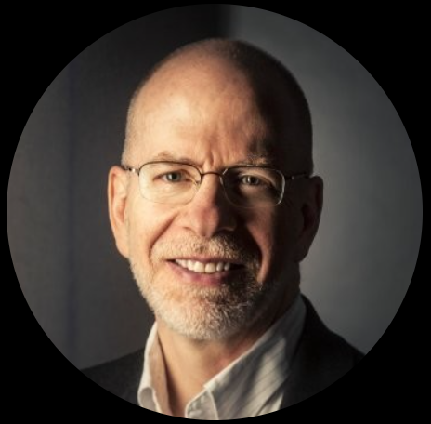
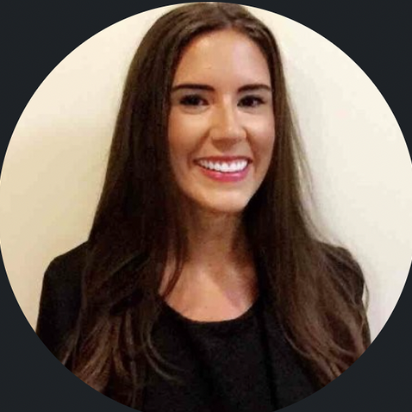
Session Speakers
Jack Jones
Molly Slocum
Chief Research Scientist
Director of Product Management

Slide 4
In our previous webinar, we discussed “What the New SEC Rules Mean for the Risk Management Profession”
… but we were left with pertinent questions from CISOs and security leaders.
Notes:
Main Bullets:
Why NOW? It matters as the stakes are high
There is a now personal liability for the CISOs. (Solar Winds/Uber example - we will touch on it in a moment)
With the newly adopted SEC rule, Organizations are mandated to ensure SEC compliance
Materiality
Disclosure
Ongoing practice and processes
Any non compliance or breach could significantly taint your brand - Example of Equifax

Slide 5
How can I determine the “material” impact of cyber risk on my business, based on my current cyber risk posture?
I have time until December – what is the most efficient way to meet the SEC’s rules without breaking bank?
How can I communicate cybersecurity and risk strategy to my Board that meets the SEC’s reporting requirements?
How do we confirm that our processes for determining materiality are thoroughly documented and report-ready?
… and more
Notes:
Allows us to take a step back and think through what an Insanely Great Product for CRQ would be

Slide 6
As the industry evolves,
the FAIRTM Methodology is also transforming
Notes:
Allows us to take a step back and think through what an Insanely Great Product for CRQ would be

Slide 7
FAIR
FAIR-CAM
World’s only quantitative cyber, technology, and operational risk measurement model
FAIR-MAM
World’s only open controls analytics model
World’s only standardized Loss Magnitude Model
Notes:
Allows us to take a step back and think through what an Insanely Great Product for CRQ would be

Slide 8
While the SEC hasn’t explicitly called out Cyber Risk Quantification, it will be next to impossible for companies to comply without it.
Notes:
Allows us to take a step back and think through what an Insanely Great Product for CRQ would be

Slide 9
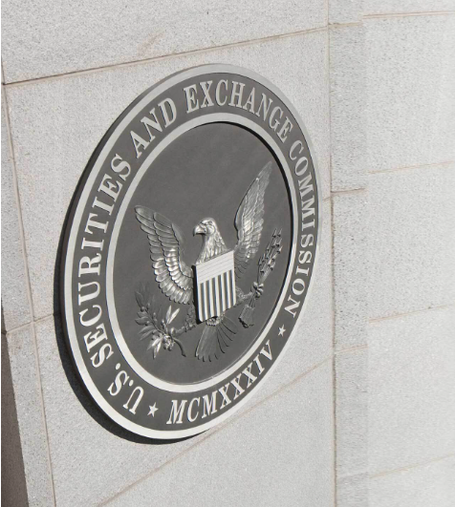
The SEC has addressed the very core of cyber risk management:
To protect investors
Maintain fair, orderly, and efficient markets
Facilitate capital formation

Slide 10
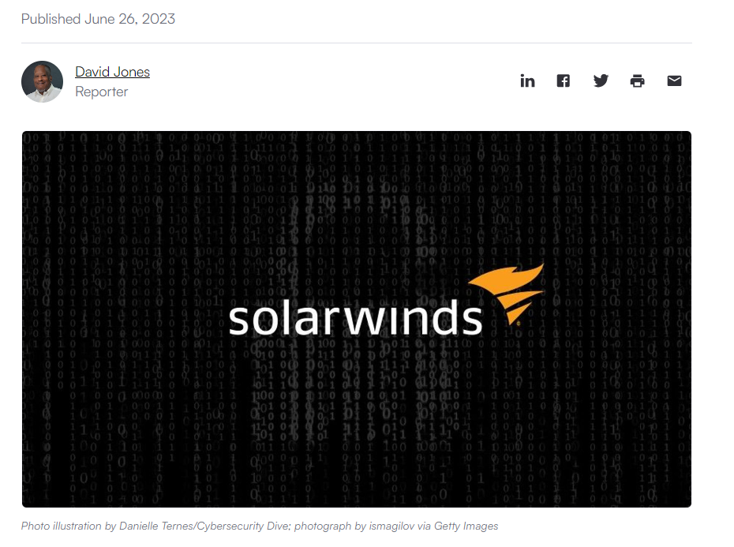
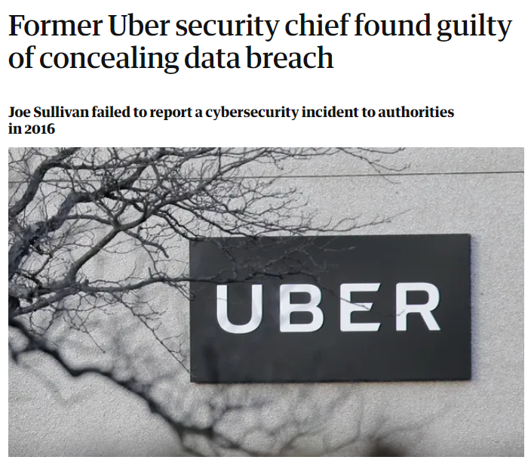
The target was already on the CISO’s back, much before the new SEC Cyber Rules

Slide 11
As a CISO, what should I do?
Perform Materiality Assessments
Develop a Risk Management Program
Invest in Real-time Risk Monitoring
Rely on Industry Accepted Frameworks

Slide 12
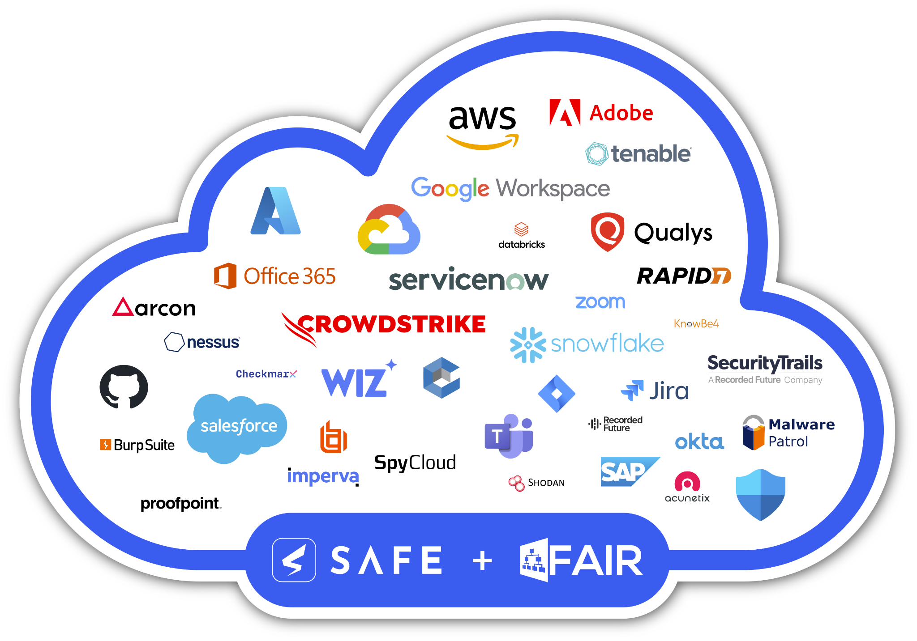
Introducing SAFE: A unified interface that combines the power of FAIR with AI and automation
Identify the Top Business Risks
Measure and Quantify “Incident Materiality”
Board Reporting for SEC Compliance
Automated, Continuous, and Real-Time Risk Monitoring

Slide 13
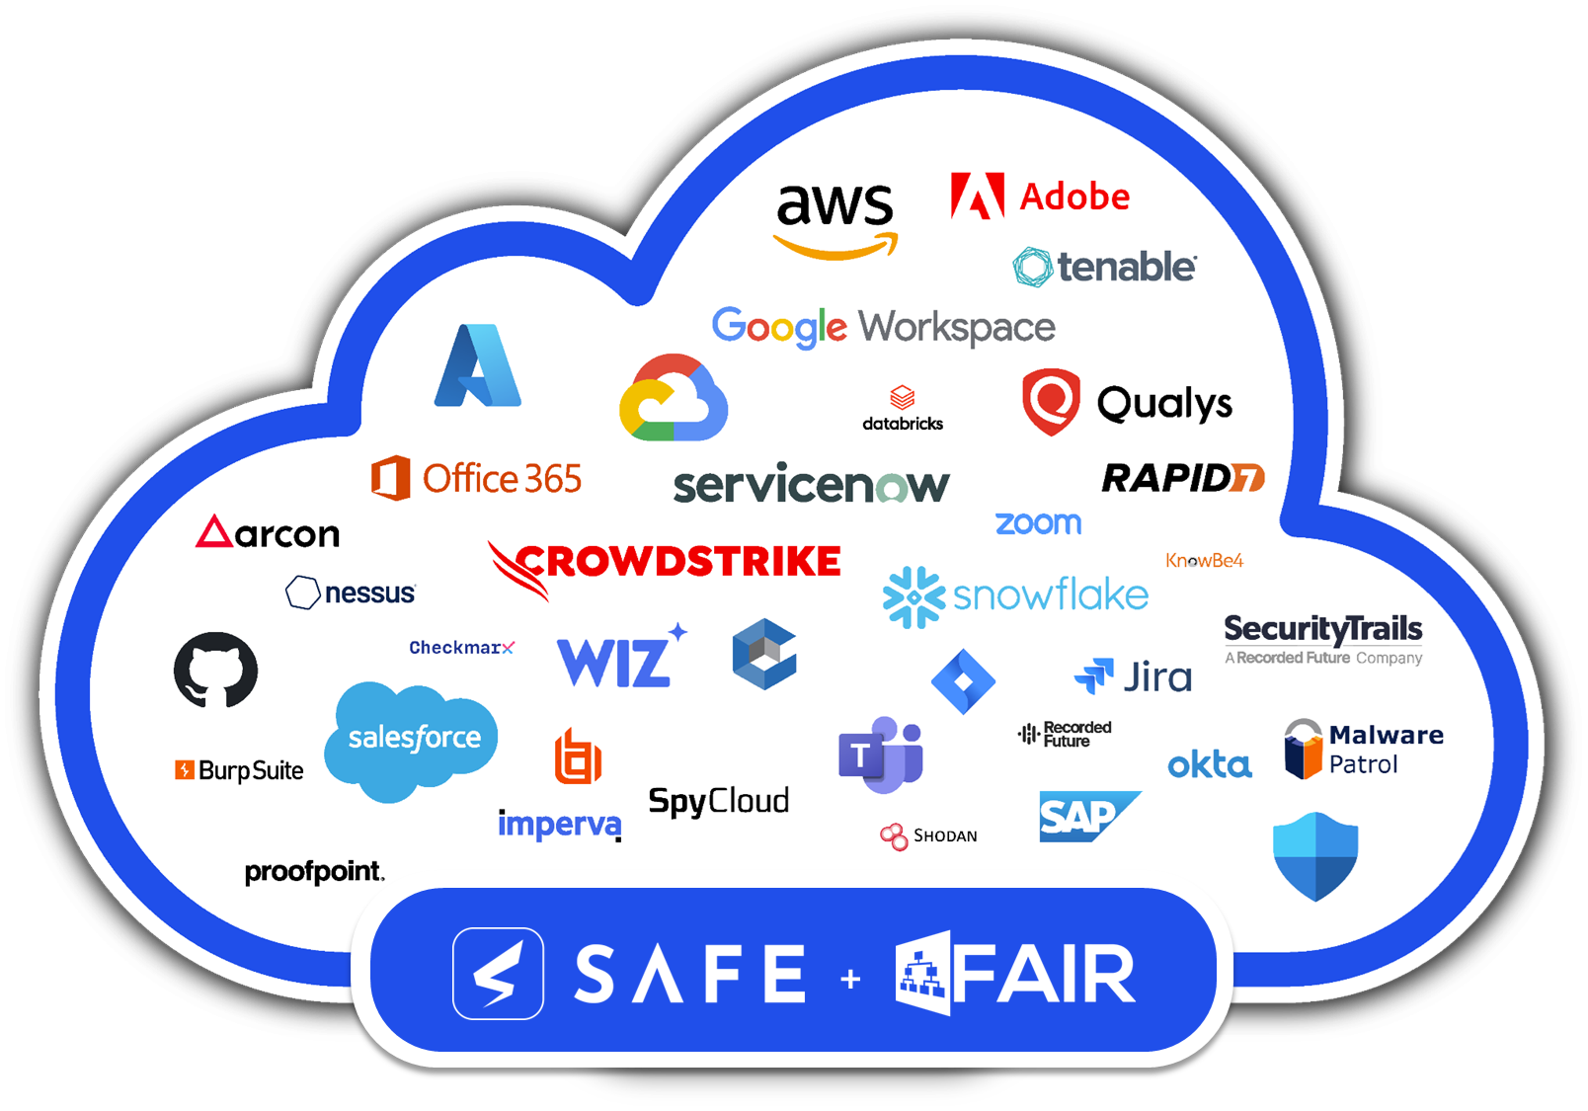
Technology assets
Threat Intel
Users
50+
Integrations
Notes:
Speaker Notes
Real time, in sync with your current products
Automated Attack surface onboarding
Data enrichment at SAFE - Automated MITRE mapping

Slide 14
SAFE Overview
INPUTS
OUTPUTS
AUTOMATED DATA: 50+ APIs to connect with instantaneously
BREACH LIKELIHOOD AND TREND
Likelihood of a successful breach in the next 12 months (using MITRE ATT&CK Framework & FAIR-CAM)
MATERIALITY ASSESSMENT
Estimated Financial Impact and Financial Risk of the organization (using FAIR, FAIR-MAM)
PRIORITIZED ACTIONABLE INSIGHTS
For every Risk Scenario at Enterprise and Business Level based on Return on Security Investment (ROSI)
MINIMAL MANUAL DATA

Slide 15
Watch SAFE in Action – Demo

Slide 16
Why SAFE?
Global enterprises are already leveraging SAFE’s AI-driven approach to secure their estate and comply with the SEC’s requirements

Slide 17
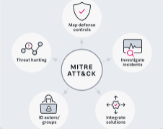
Customer Challenges
SAFE Solution
Eliminate inflated probability and financial risk data
Lack visibility of cyber risk exposure at varying levels of asset groups
No quantified view into control gaps making it difficult to defend budget priorities
Aligned controls to open standards ATT&CK and FAIR for defensible probability and financial risk impact
Gained visibility of risk exposure to Enterprise and critical business applications
Increased confidence in evaluating budget priorities
Gained Visibility Across:
Top 4 business units
Mitigation insights based on ROSI
“The SAFE platform provides us with a more data-driven risk program and objectively showcases the risk of business-critical applications and assets.”
Shaun Khalfan
CISO
Desire to enhance the maturity of their cyber risk program with a platform that provided real-time data to increase efficiencies and improve decision making based on risk impact to the business.

Slide 18
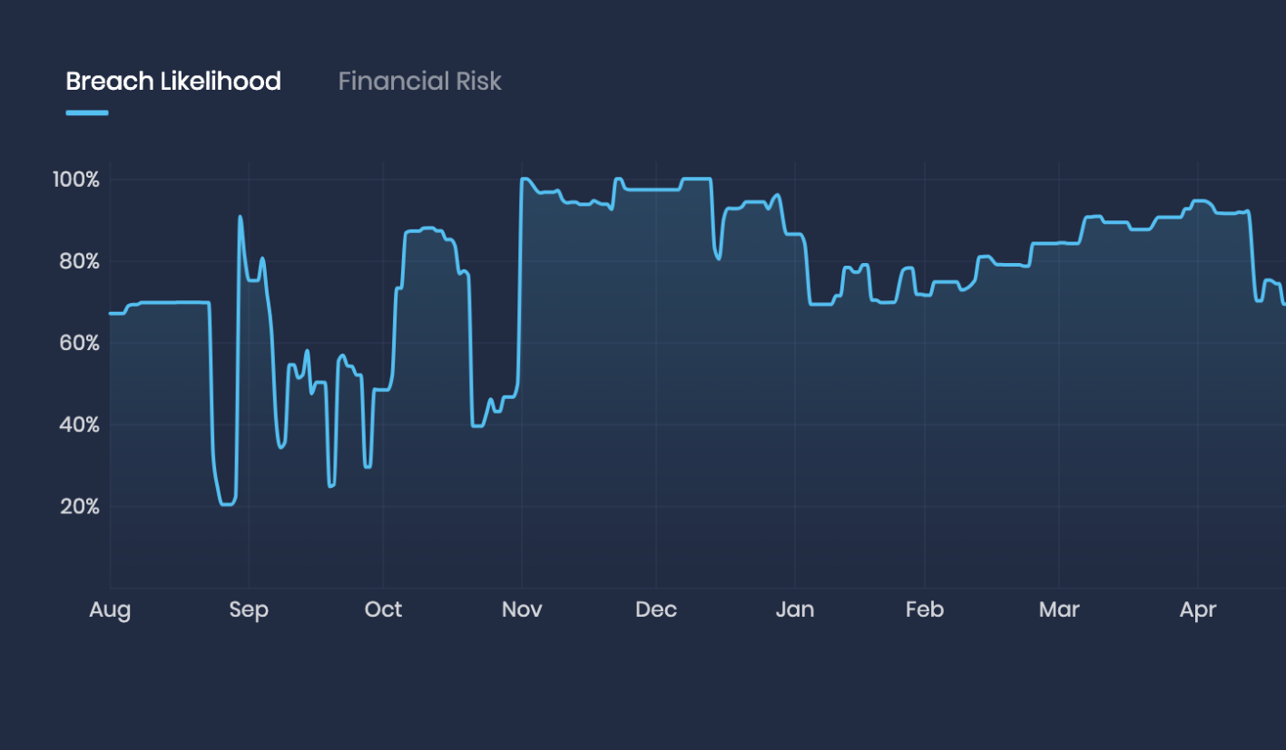
Customer Challenges
SAFE Solution
Lack of a real-time quantified view of risk in critical applications storing PHI
No centralized tool to monitor the security loopholes
Manual, spreadsheet-based security was cumbersome and time consuming
No common vernacular to communicate cyber risk to stakeholders
Breach likelihood score per employee, hybrid asset, LoB, and crown jewels
Gained unified visibility of enterprise-wide risk identified by security initiatives
Automated, real-time, and always-on risk identification and prioritization via API hooks
Translating cyber risk to the financial impact became a common vernacular for all teams
Gained visibility across applications, asset, business units, and the enterprise
Unearthed the most critical gaps in their hybrid environment, drastically reducing the probability of a cybersecurity breach
“Getting a trending real-time view of risk and breach likelihood scores offered by SAFE goes a long way in helping me chart Molina’s journey through security posture improvement.”
Amir P. Desai
CIO
It was a top priority for Molina to get a real-time, data-backed and continuous view of exactly how secure its critical applications storing, processing and managing PHI.

Slide 19
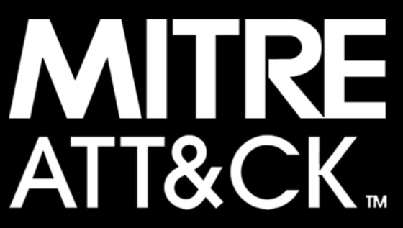
SAFE: The strongest CRQM Platform in Market
API + Threat Intel Data
Control Data
Loss Data
Data Science and AI
+
+
+
MITRE ATT&CK
FAIR-CAM
FAIR-MAM
FAIR
Notes:
Allows us to take a step back and think through what an Insanely Great Product for CRQ would be

Slide 20
QUESTIONS?

Slide 21
See you at the 2023 FAIR Conference
October 17 & 18, 2023
At the Fairmont Washington D.C. Hotel.

Slide 22
Thank you!

