Slide 1
Throwing the “Bad” Data in With the “Good”
Documenting and classifying data utility – for effect
Jack Whitsitt | Ostrich | Director of CRQ
Jack.Whitsitt@ostrichcyber-risk.com

Slide 2
Throwing Bad Data in with the Good
It’s not so much that any data is “bad”
“Good”: “Useful for purpose”
We should be able to quantify (or at least classify) the degree of utility
Not doing so creates problems
Doing so adds value

Slide 3
Classifying Data Utility: A Simple Framework
'Reference Similarity’
'Reference Currency’
'Forecast Value’
'Data Quality’
'Source Quality’

Slide 4
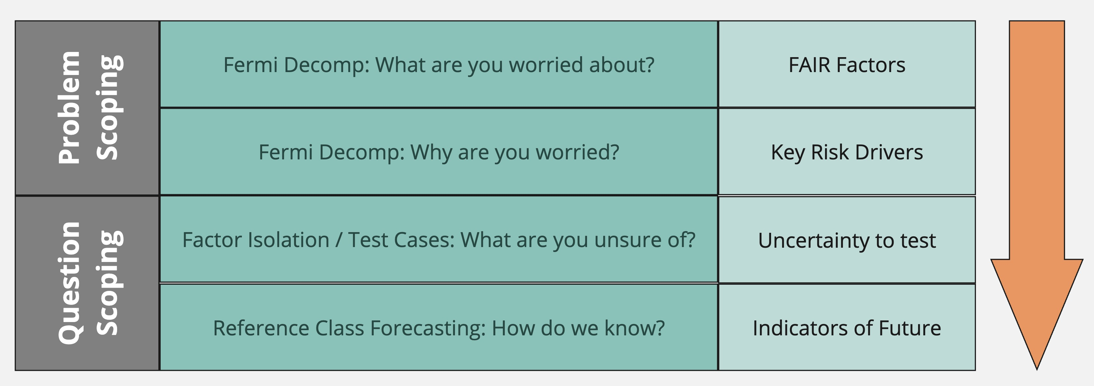
Wait! What is Data Utility? Simple Analysis Model
Data Utility: How well does data answer the questions it needs to?

Slide 5
Indicate data utility
Back to: A Simple Framework
Given Data Objectives
'Reference Similarity’
'Reference Currency’
'Forecast Value’
'Data Quality’
'Source Quality’

Slide 6
Data Utility: Reference to what?
Reference Similarity | Reference Currency | Forecast Value | Data Quality | Source Quality
“THREAT EVENT DRIVER FRAMEWORK”:
Why will THESE attacks occur HERE? And how OFTEN?
MOTIVE/TARGETING CRITERIA MATCH
THREAT RISK CALCULUS
POPULATION
Target Characteristics
Reputation & Visibility
Industry
“Functionality” available
Externalities
Content (eg Data or people)
Capability:
Right Technology
Right Vulnerabilities
Lack of Controls
Consequence for Action
Probability of Consequence
Degree of Consequence
Sufficient Incentives Given Consequence
Resources
Time
Effort
Chance of Success
ROI on resources
Number of actors
Total active
Aware of target chars
Complexity
Off the shelf
Bespoke
Combo
Visibility
Stealth
Dwell Time
Penetration Depth

Slide 7
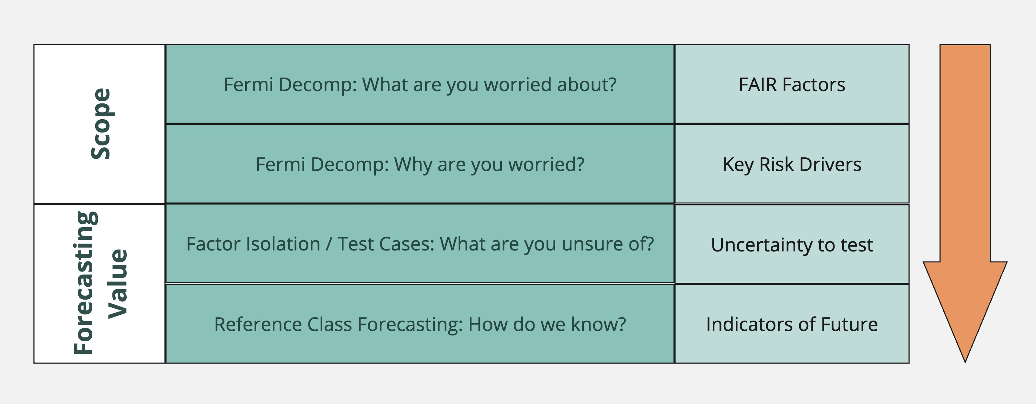
Data Utility: Scenario Scope Example
Scenario: Healthcare Provider Ransomware Attack
Target Characteristics: Regional healthcare provider managing critical patient data, with potential for significant healthcare delivery disruption.
Capability: Customized ransomware targeting weak network security protocols, exploiting the lack of regular security audits.
Threat Risk Calculus: Medium probability of operational paralysis and privacy violations, balanced by the risk of law enforcement attention, with moderate ROI.
Population: Small hacker group, selecting targets for their vulnerability, combining malware with social engineering for moderate stealth and penetration depth.
Pertinent Factors for Scenario
Target Characteristics: Industry, Externalities
Capability: Right Technology, Lack of Controls
Threat Risk Calculus: Chance of Success
Population: Aware of Target Characteristics and Willing to Act

Slide 8
Some assumptions are fixed or do not drive.
Why will THESE attacks occur HERE? And how OFTEN?
“THREAT EVENT FREQUENCY FRAMEWORK”:
MOTIVE/TARGETING CRITERIA MATCH
THREAT RISK CALCULUS
POPULATION
Target Characteristics
Reputation & Visibility
Industry
“Functionality” available
Externalities
Content (eg Data or people)
Capability:
Right Technology
Right Vulnerabilities
Lack of Controls
Consequence for Action
Probability of Consequence
Degree of Consequence
Sufficient Incentives Given Consequence
Resources
Time
Effort
Chance of Success
ROI on resources
Number of actors
Total active
Aware of target chars
Complexity
Off the shelf
Bespoke
Combo
Visibility
Stealth
Dwell Time
Penetration Depth

Slide 9
Data Utility: Questions for data
Pertinent Factor: Industry - Healthcare
Factor Detail: Cybersecurity threats and trends in healthcare.
Question: What are the latest cybersecurity threats and trends in healthcare?
Pertinent Factor: Externalities - Healthcare Delivery Disruption
Factor Detail: Impact of ransomware on healthcare operations.
Question: How do ransomware attacks impact healthcare delivery?
Pertinent Factor: Right Technology - Customized Ransomware
Factor Detail: Ransomware variants targeting healthcare.
Question: What customized ransomware is used against healthcare targets?
Pertinent Factor: Lack of Controls - Weak Network Security Protocols
Factor Detail: Network security weaknesses in healthcare.
Question: What are common network security weaknesses in healthcare?
Pertinent Factor: Chance of Success - High due to Weaker Defenses
Factor Detail: Success rate factors of ransomware in healthcare.
Question: Why are ransomware attacks often successful in healthcare?
Pertinent Factor: Aware of Target Characteristics/ Willing to Act Against Healthcare
Factor Detail: Hacker target selection in healthcare.
Question: How do hacker groups choose healthcare targets?
We make some assumptions about the world, so your data utility is defined by the data that can help questions you actually have.
Note that data generally speaks to the past or the present, we need to evaluate how helpful it is to determining what will change, not just what is.

Slide 10
Classifying Data (”Scoring”)
Data Objectives
Data Sources
Data Utility
 | KEY THREAT EVENT FREQUENCY DRIVERS |  |  | TARGET CRITERIA | QUESTION FOR DATA |  | SOURCE |  | SIMILARITY | CURRENCY | FORECAST VALUE | DATA CONF | SOURCE CONF
1 | Motive | Target Characteristics | Industry | Healthcare | What are the latest cybersecurity threats and trends in healthcare? |  | 2019 Government Healthcare Cybersecurity Bulletins |  | 5 - Identical: Direct Relevance | 1 - Past Factor State (High Variance) | 2 - Associative | 4 - Non-material gaps | 4 -Trusted
2 | Motive | Target Characteristics | Externalities | Healthcare Delivery Disruption | How do ransomware attacks impact healthcare delivery? |  | 2019 Healthcare Service Disruption Studies |  | 3 - Shared Core Features | 2 - Past Factor State (Low Variance) | 4 - Predictive Model | 3 - Closeable gaps | 3 - Believeable
3 | Motive | Capability | Right Technology | Customized Ransomware | What customized ransomware is used against healthcare targets? |  | Targeted Dark Web Intelligence Services |  | 5 - Identical: Direct Relevance | 3 - Current Factor State (High Variance) | 3 - Correlative | 4 - Non-material gaps | 4 -Trusted
4 | Motive | Capability | Lack of Controls | Weak Network Security Protocols | What are common network security weaknesses in healthcare? |  | Network Security Audit Reports |  | 5 - Identical: Direct Relevance | 3 - Current Factor State (High Variance) | 2 - Associative | 5 - No additional info Needed | 5 - Unaruguable
5 | Risk to Threat | Resources | Chance of Success | High due to Weaker Defenses | Why are ransomware attacks often successful in healthcare? |  | Cybersecurity Vulnerability Assessments |  | 3 - Shared Core Features | 3 - Current Factor State (High Variance) | 1 - Speculative | 2 - Significant Inference Required | 4 -Trusted
6 | Population Size | Number of Actors | Aware & Willing to Act | Small Hacker Groups Targeting Healthcare | How many hacker groups are there targeting healthcare companies? |  | Cyber Criminal Behavior Studies |  | 3 - Shared Core Features | 1 - Past Factor State (High Variance) | 1 - Speculative | 2 - Significant Inference Required | 2 - Questionable

Slide 11
Classifying Data (”Scoring”)
Data Objectives
Data Sources
Data Utility
 | KEY THREAT EVENT FREQUENCY DRIVERS |  |  | TARGET CRITERIA | QUESTION FOR DATA |  | SOURCE |  | SIMILARITY | CURRENCY | FORECAST VALUE | DATA CONF | SOURCE CONF
1 | Motive | Target Characteristics | Industry | Healthcare | What are the latest cybersecurity threats and trends in healthcare? |  | 2019 Government Healthcare Cybersecurity Bulletins |  | 5 - Identical: Direct Relevance | 1 - Past Factor State (High Variance) | 2 - Associative | 4 - Non-material gaps | 4 -Trusted
2 | Motive | Target Characteristics | Externalities | Healthcare Delivery Disruption | How do ransomware attacks impact healthcare delivery? |  | 2019 Healthcare Service Disruption Studies |  | 3 - Shared Core Features | 2 - Past Factor State (Low Variance) | 4 - Predictive Model | 3 - Closeable gaps | 3 - Believeable
3 | Motive | Capability | Right Technology | Customized Ransomware | What customized ransomware is used against healthcare targets? |  | Targeted Dark Web Intelligence Services |  | 5 - Identical: Direct Relevance | 3 - Current Factor State (High Variance) | 3 - Correlative | 4 - Non-material gaps | 4 -Trusted
4 | Motive | Capability | Lack of Controls | Weak Network Security Protocols | What are common network security weaknesses in healthcare? |  | Network Security Audit Reports |  | 5 - Identical: Direct Relevance | 3 - Current Factor State (High Variance) | 2 - Associative | 5 - No additional info Needed | 5 - Unaruguable
5 | Risk to Threat | Resources | Chance of Success | High due to Weaker Defenses | Why are ransomware attacks often successful in healthcare? |  | Cybersecurity Vulnerability Assessments |  | 3 - Shared Core Features | 3 - Current Factor State (High Variance) | 1 - Speculative | 2 - Significant Inference Required | 4 -Trusted
6 | Population Size | Number of Actors | Aware & Willing to Act | Small Hacker Groups Targeting Healthcare | How many hacker groups are there targeting healthcare companies? |  | Cyber Criminal Behavior Studies |  | 3 - Shared Core Features | 1 - Past Factor State (High Variance) | 1 - Speculative | 2 - Significant Inference Required | 2 - Questionable

Slide 12
Classifying Data (”Scoring”)
Data Objectives
Data Sources
Data Utility
 | KEY THREAT EVENT FREQUENCY DRIVERS |  |  | TARGET CRITERIA | QUESTION FOR DATA |  | SOURCE |  | SIMILARITY | CURRENCY | FORECAST VALUE | DATA CONF | SOURCE CONF
1 | Motive | Target Characteristics | Industry | Healthcare | What are the latest cybersecurity threats and trends in healthcare? |  | 2019 Government Healthcare Cybersecurity Bulletins |  | 5 - Identical: Direct Relevance | 1 - Past Factor State (High Variance) | 2 - Associative | 4 - Non-material gaps | 4 -Trusted
2 | Motive | Target Characteristics | Externalities | Healthcare Delivery Disruption | How do ransomware attacks impact healthcare delivery? |  | 2019 Healthcare Service Disruption Studies |  | 3 - Shared Core Features | 2 - Past Factor State (Low Variance) | 4 - Predictive Model | 3 - Closeable gaps | 3 - Believeable
3 | Motive | Capability | Right Technology | Customized Ransomware | What customized ransomware is used against healthcare targets? |  | Targeted Dark Web Intelligence Services |  | 5 - Identical: Direct Relevance | 3 - Current Factor State (High Variance) | 3 - Correlative | 4 - Non-material gaps | 4 -Trusted
4 | Motive | Capability | Lack of Controls | Weak Network Security Protocols | What are common network security weaknesses in healthcare? |  | Network Security Audit Reports |  | 5 - Identical: Direct Relevance | 3 - Current Factor State (High Variance) | 2 - Associative | 5 - No additional info Needed | 5 - Unaruguable
5 | Risk to Threat | Resources | Chance of Success | High due to Weaker Defenses | Why are ransomware attacks often successful in healthcare? |  | Cybersecurity Vulnerability Assessments |  | 3 - Shared Core Features | 3 - Current Factor State (High Variance) | 1 - Speculative | 2 - Significant Inference Required | 4 -Trusted
6 | Population Size | Number of Actors | Aware & Willing to Act | Small Hacker Groups Targeting Healthcare | How many hacker groups are there targeting healthcare companies? |  | Cyber Criminal Behavior Studies |  | 3 - Shared Core Features | 1 - Past Factor State (High Variance) | 1 - Speculative | 2 - Significant Inference Required | 2 - Questionable

Slide 13
Classifying Data (”Scoring”)
Data Objectives
Data Sources
Data Utility
 | KEY THREAT EVENT FREQUENCY DRIVERS |  |  | TARGET CRITERIA | QUESTION FOR DATA |  | SOURCE |  | SIMILARITY | CURRENCY | FORECAST VALUE | DATA CONF | SOURCE CONF
1 | Motive | Target Characteristics | Industry | Healthcare | What are the latest cybersecurity threats and trends in healthcare? |  | 2019 Government Healthcare Cybersecurity Bulletins |  | 5 - Identical: Direct Relevance | 1 - Past Factor State (High Variance) | 2 - Associative | 4 - Non-material gaps | 4 -Trusted
2 | Motive | Target Characteristics | Externalities | Healthcare Delivery Disruption | How do ransomware attacks impact healthcare delivery? |  | 2019 Healthcare Service Disruption Studies |  | 3 - Shared Core Features | 2 - Past Factor State (Low Variance) | 4 - Predictive Model | 3 - Closeable gaps | 3 - Believeable
3 | Motive | Capability | Right Technology | Customized Ransomware | What customized ransomware is used against healthcare targets? |  | Targeted Dark Web Intelligence Services |  | 5 - Identical: Direct Relevance | 3 - Current Factor State (High Variance) | 3 - Correlative | 4 - Non-material gaps | 4 -Trusted
4 | Motive | Capability | Lack of Controls | Weak Network Security Protocols | What are common network security weaknesses in healthcare? |  | Network Security Audit Reports |  | 5 - Identical: Direct Relevance | 3 - Current Factor State (High Variance) | 2 - Associative | 5 - No additional info Needed | 5 - Unaruguable
5 | Risk to Threat | Resources | Chance of Success | High due to Weaker Defenses | Why are ransomware attacks often successful in healthcare? |  | Cybersecurity Vulnerability Assessments |  | 3 - Shared Core Features | 3 - Current Factor State (High Variance) | 1 - Speculative | 2 - Significant Inference Required | 4 -Trusted
6 | Population Size | Number of Actors | Aware & Willing to Act | Small Hacker Groups Targeting Healthcare | How many hacker groups are there targeting healthcare companies? |  | Cyber Criminal Behavior Studies |  | 3 - Shared Core Features | 1 - Past Factor State (High Variance) | 1 - Speculative | 2 - Significant Inference Required | 2 - Questionable

Slide 14
Classifying Data (”Scoring”)
Data Objectives
Data Sources
Data Utility
 | KEY THREAT EVENT FREQUENCY DRIVERS |  |  | TARGET CRITERIA | QUESTION FOR DATA |  | SOURCE |  | SIMILARITY | CURRENCY | FORECAST VALUE | DATA CONF | SOURCE CONF
1 | Motive | Target Characteristics | Industry | Healthcare | What are the latest cybersecurity threats and trends in healthcare? |  | 2019 Government Healthcare Cybersecurity Bulletins |  | 5 - Identical: Direct Relevance | 1 - Past Factor State (High Variance) | 2 - Associative | 4 - Non-material gaps | 4 -Trusted
2 | Motive | Target Characteristics | Externalities | Healthcare Delivery Disruption | How do ransomware attacks impact healthcare delivery? |  | 2019 Healthcare Service Disruption Studies |  | 3 - Shared Core Features | 2 - Past Factor State (Low Variance) | 4 - Predictive Model | 3 - Closeable gaps | 3 - Believeable
3 | Motive | Capability | Right Technology | Customized Ransomware | What customized ransomware is used against healthcare targets? |  | Targeted Dark Web Intelligence Services |  | 5 - Identical: Direct Relevance | 3 - Current Factor State (High Variance) | 3 - Correlative | 4 - Non-material gaps | 4 -Trusted
4 | Motive | Capability | Lack of Controls | Weak Network Security Protocols | What are common network security weaknesses in healthcare? |  | Network Security Audit Reports |  | 5 - Identical: Direct Relevance | 3 - Current Factor State (High Variance) | 2 - Associative | 5 - No additional info Needed | 5 - Unaruguable
5 | Risk to Threat | Resources | Chance of Success | High due to Weaker Defenses | Why are ransomware attacks often successful in healthcare? |  | Cybersecurity Vulnerability Assessments |  | 3 - Shared Core Features | 3 - Current Factor State (High Variance) | 1 - Speculative | 2 - Significant Inference Required | 4 -Trusted
6 | Population Size | Number of Actors | Aware & Willing to Act | Small Hacker Groups Targeting Healthcare | How many hacker groups are there targeting healthcare companies? |  | Cyber Criminal Behavior Studies |  | 3 - Shared Core Features | 1 - Past Factor State (High Variance) | 1 - Speculative | 2 - Significant Inference Required | 2 - Questionable

Slide 15
Classifying Data (”Scoring”)
Data Objectives
Data Sources
Data Utility
 | KEY THREAT EVENT FREQUENCY DRIVERS |  |  | TARGET CRITERIA | QUESTION FOR DATA |  | SOURCE |  | SIMILARITY | CURRENCY | FORECAST VALUE | DATA CONF | SOURCE CONF
1 | Motive | Target Characteristics | Industry | Healthcare | What are the latest cybersecurity threats and trends in healthcare? |  | 2019 Government Healthcare Cybersecurity Bulletins |  | 5 - Identical: Direct Relevance | 1 - Past Factor State (High Variance) | 2 - Associative | 4 - Non-material gaps | 4 -Trusted
2 | Motive | Target Characteristics | Externalities | Healthcare Delivery Disruption | How do ransomware attacks impact healthcare delivery? |  | 2019 Healthcare Service Disruption Studies |  | 3 - Shared Core Features | 2 - Past Factor State (Low Variance) | 4 - Predictive Model | 3 - Closeable gaps | 3 - Believeable
3 | Motive | Capability | Right Technology | Customized Ransomware | What customized ransomware is used against healthcare targets? |  | Targeted Dark Web Intelligence Services |  | 5 - Identical: Direct Relevance | 3 - Current Factor State (High Variance) | 3 - Correlative | 4 - Non-material gaps | 4 -Trusted
4 | Motive | Capability | Lack of Controls | Weak Network Security Protocols | What are common network security weaknesses in healthcare? |  | Network Security Audit Reports |  | 5 - Identical: Direct Relevance | 3 - Current Factor State (High Variance) | 2 - Associative | 5 - No additional info Needed | 5 - Unaruguable
5 | Risk to Threat | Resources | Chance of Success | High due to Weaker Defenses | Why are ransomware attacks often successful in healthcare? |  | Cybersecurity Vulnerability Assessments |  | 3 - Shared Core Features | 3 - Current Factor State (High Variance) | 1 - Speculative | 2 - Significant Inference Required | 4 -Trusted
6 | Population Size | Number of Actors | Aware & Willing to Act | Small Hacker Groups Targeting Healthcare | How many hacker groups are there targeting healthcare companies? |  | Cyber Criminal Behavior Studies |  | 3 - Shared Core Features | 1 - Past Factor State (High Variance) | 1 - Speculative | 2 - Significant Inference Required | 2 - Questionable

Slide 16
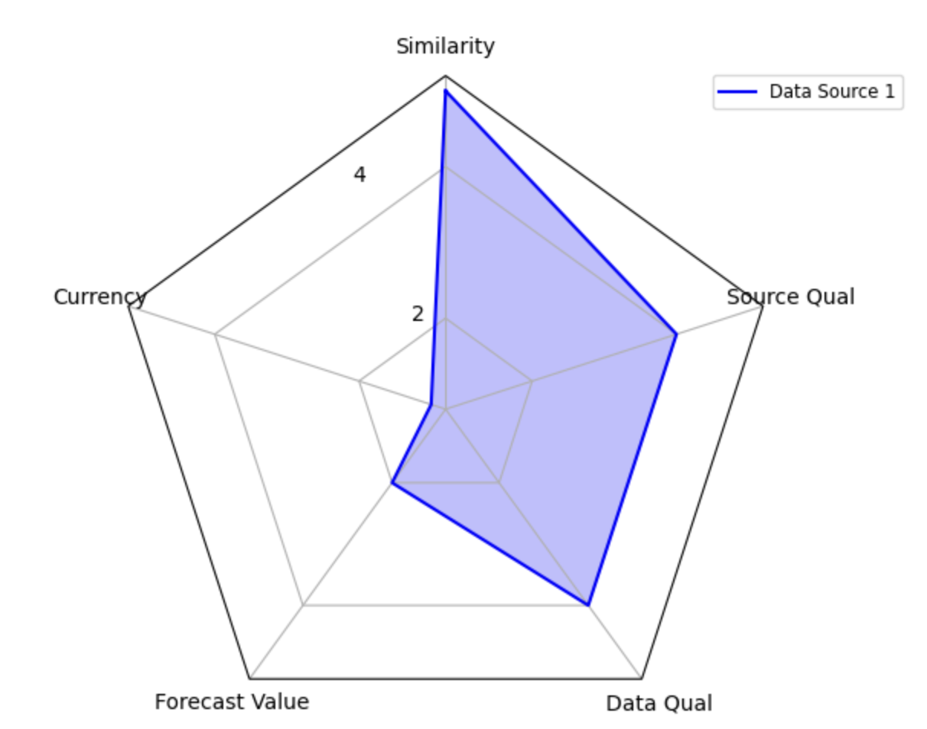
Use Case Examples: Single Source Eval
SOURCE |  | SIMILARITY | CURRENCY | FORECAST VALUE | DATA CONF | SOURCE CONF
2019 Government Healthcare Cybersecurity Bulletins |  | 5 - Identical: Direct Relevance | 1 - Past Factor State (High Variance) | 2 - Associative | 4 - Non-material gaps | 4 -Trusted

Slide 17
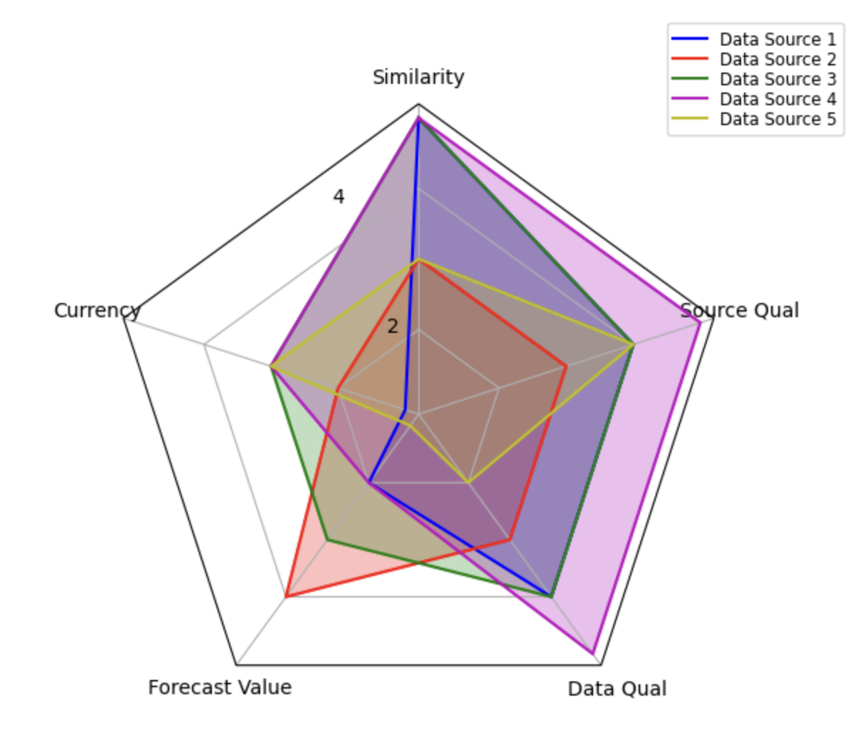
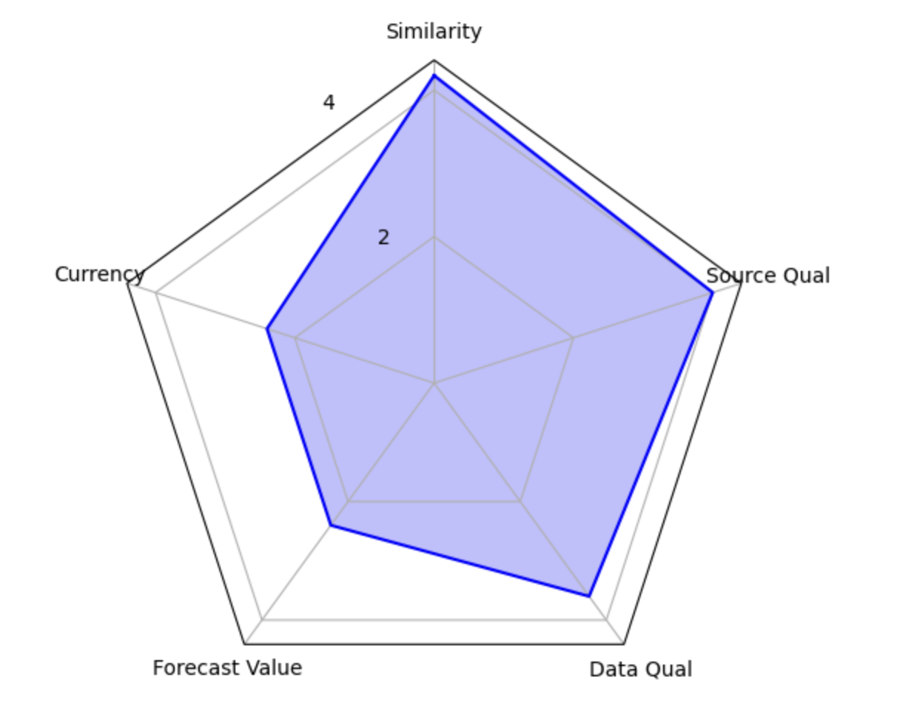
Use Case Examples: Whole Scenario
SOURCE |  | SIMILARITY | CURRENCY | FORECAST VALUE | DATA CONF | SOURCE CONF
2019 Government Healthcare Cybersecurity Bulletins |  | 5 - Identical: Direct Relevance | 1 - Past Factor State (High Variance) | 2 - Associative | 4 - Non-material gaps | 4 -Trusted
2019 Healthcare Service Disruption Studies |  | 3 - Shared Core Features | 2 - Past Factor State (Low Variance) | 4 - Predictive Model | 3 - Closeable gaps | 3 - Believeable
Targeted Dark Web Intelligence Services |  | 5 - Identical: Direct Relevance | 3 - Current Factor State (High Variance) | 3 - Correlative | 4 - Non-material gaps | 4 -Trusted
Network Security Audit Reports |  | 5 - Identical: Direct Relevance | 3 - Current Factor State (High Variance) | 2 - Associative | 5 - No additional info Needed | 5 - Inaruguable
Cybersecurity Vulnerability Assessments |  | 3 - Shared Core Features | 3 - Current Factor State (High Variance) | 1 - Speculative | 2 - Significant Inference Required | 4 -Trusted
Scenario Average

Slide 18
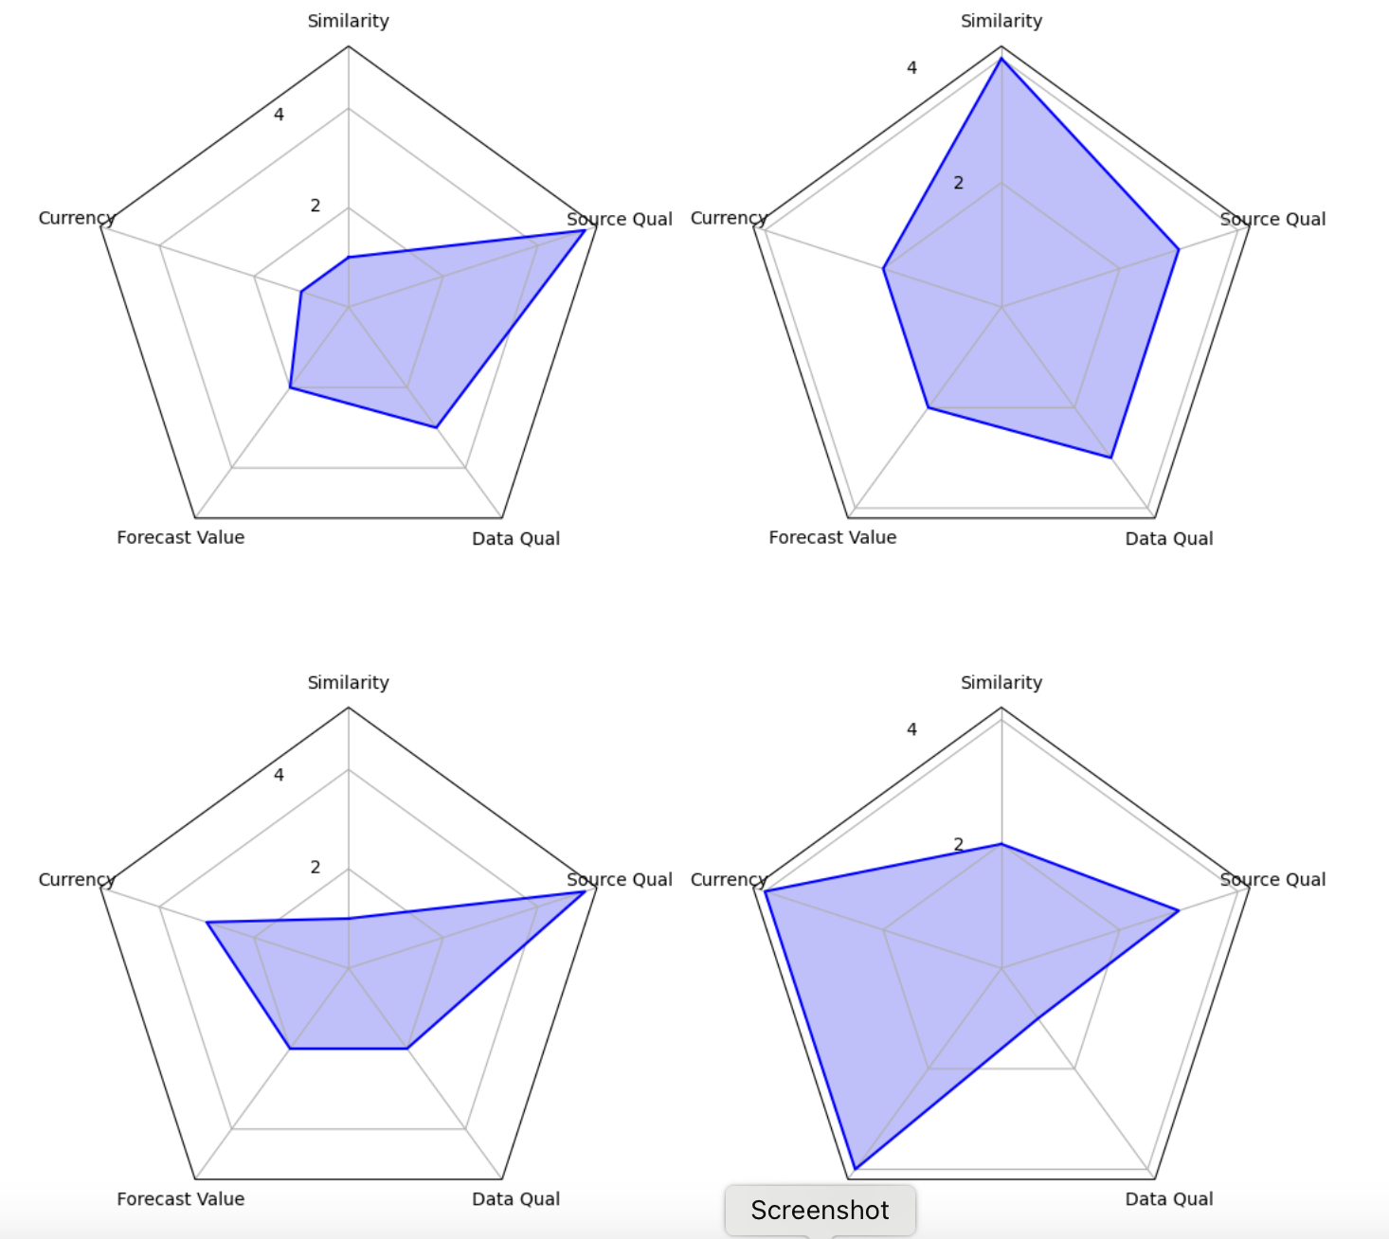
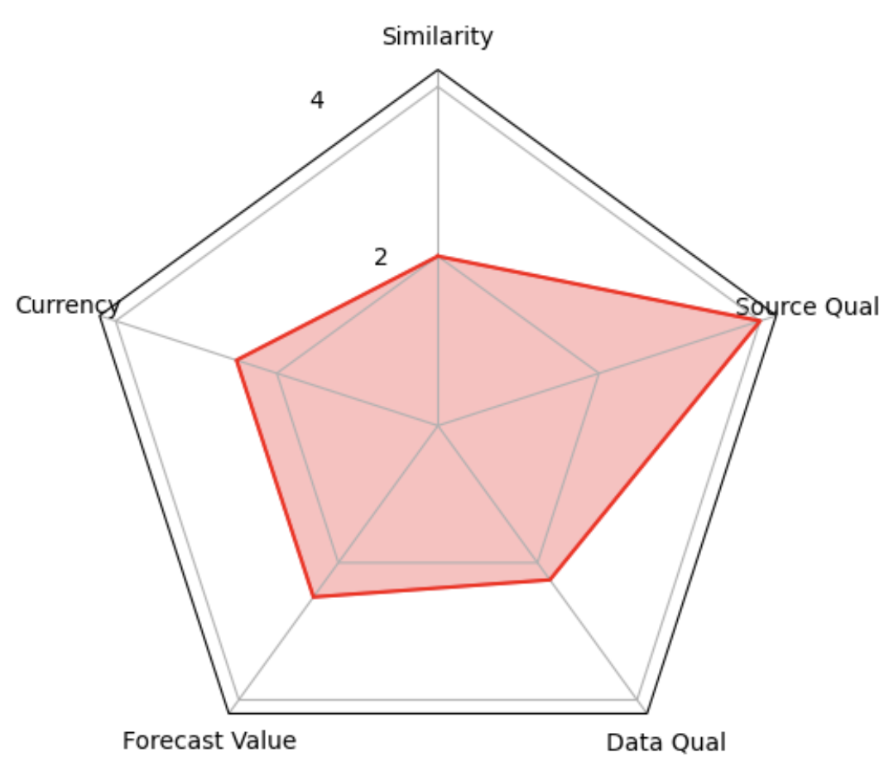
Use Case Examples: Improvement Opportunity ID
Scenario 1
Scenario 2
All Source Avg
Scenario 3
Scenario 4

Slide 19
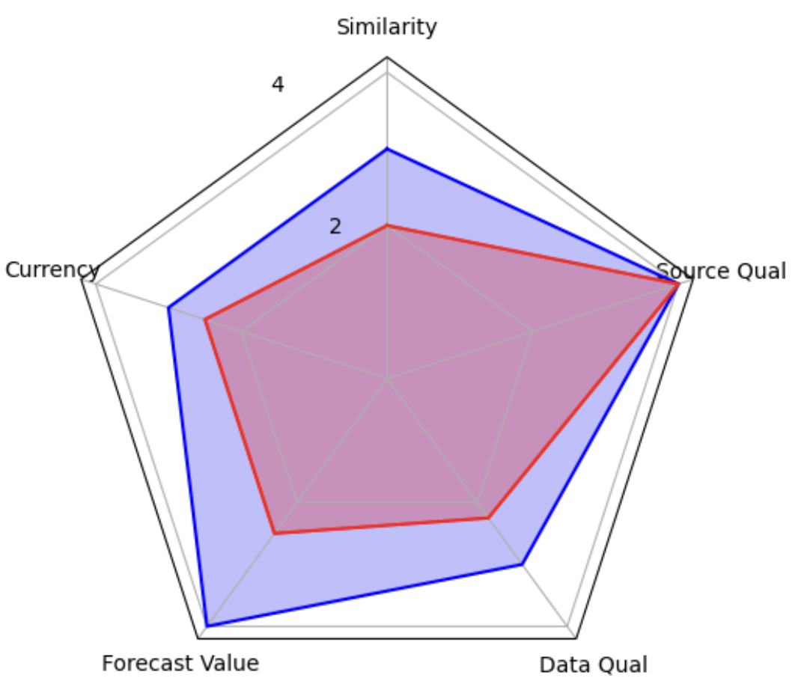
Scoring Use Case Examples: Expected Value of Perfect Information?←- Question mark intentional!
Base risk forecast Uncertainty with current Data Quality
Blue: Target
Red: Current
Base risk forecast Uncertainty with Target Data Quality
Can we create a structured system that helps manage investment in visibility according to uncertainty reduction vs cost of investment?

Slide 20
Thank you!
Questions?
Jack Whitsitt | Ostrich | Director of CRQ
Jack.Whitsitt@ostrichcyber-risk.com

