Slide 1
Using FAIR and MITRE to Understand How Controls Impact Risk

Slide 2
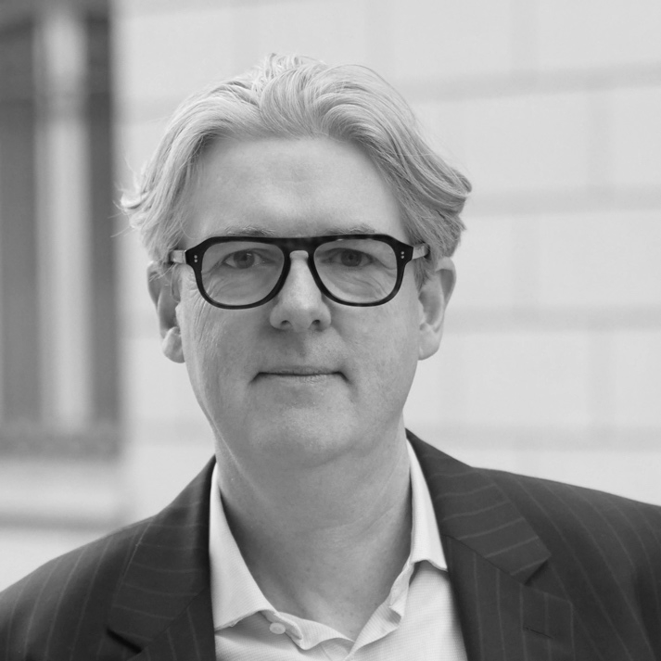
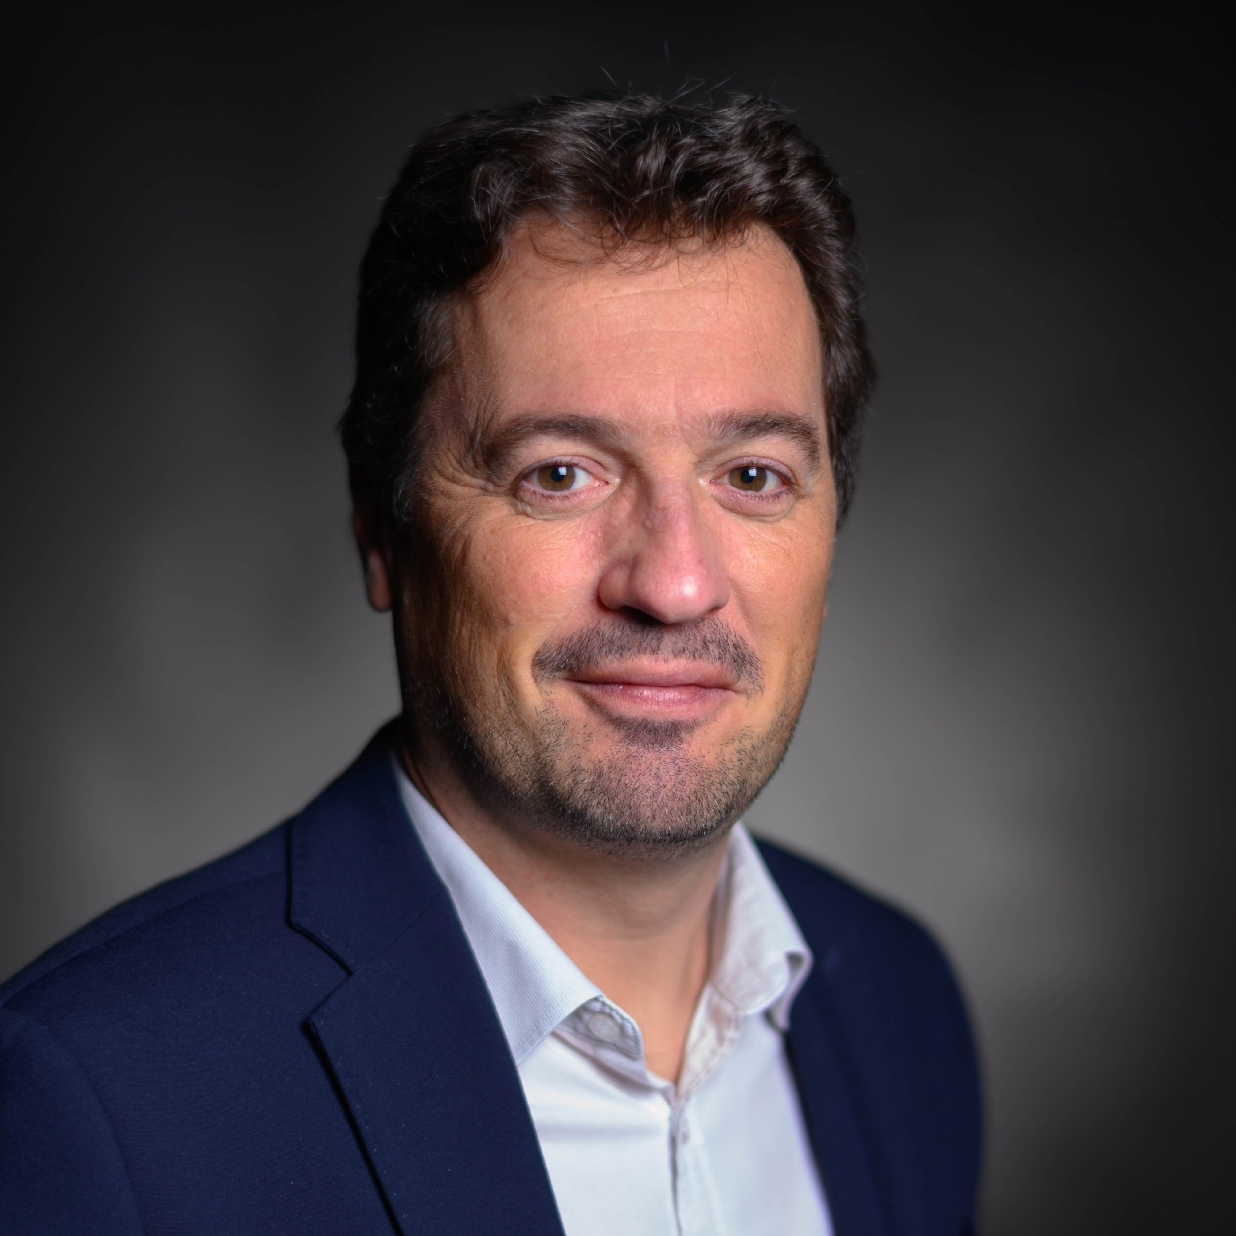

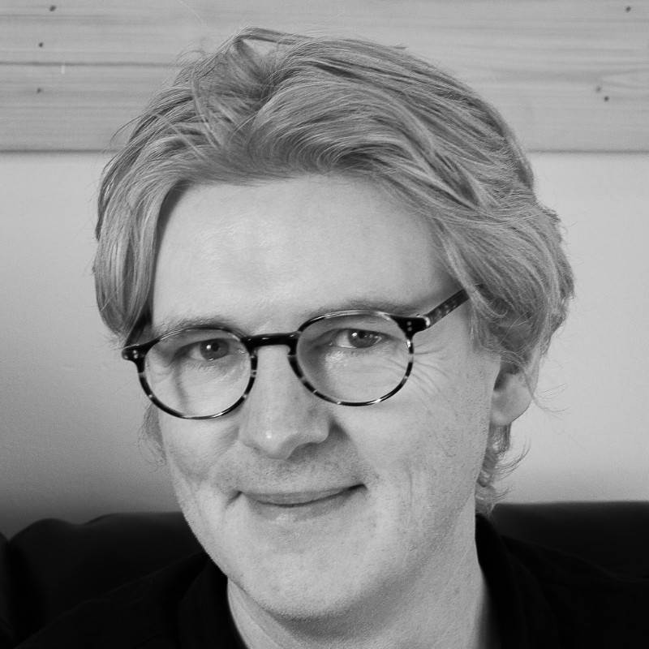
Speakers
Frédéric Bouveresse
Francesco Chiarini
Tom Callaghan
IS&T Cyber Risks Governance Specialist
Alstom
Global Head - Technology Resilience
Sandoz
Co-Founder
C-Risk

Slide 3
Agenda
Mapping Controls to Risk Scenarios
Alstom Use Case
What is Resilience and how can we model it in FAIR?
Wrap up

Slide 4
Using FAIR-(CAM) and MITRE to Understand How Controls Impact Risk
Toolkit:
FAIR
MITRE
Control Frameworks
KRI’s
FAIR-CAM
Scope Quantifiable Risk Scenarios taking into consideration the most probable tactics and techniques adversaries use (FAIR + MITRE)
Define / Model how controls impact Probability and Impact (MITRE + FAIR-CAM + KRI’s)
Perform Control return on investment analysis work (FAIR)
      Prioritize
      Transparent Decision Making

Slide 5
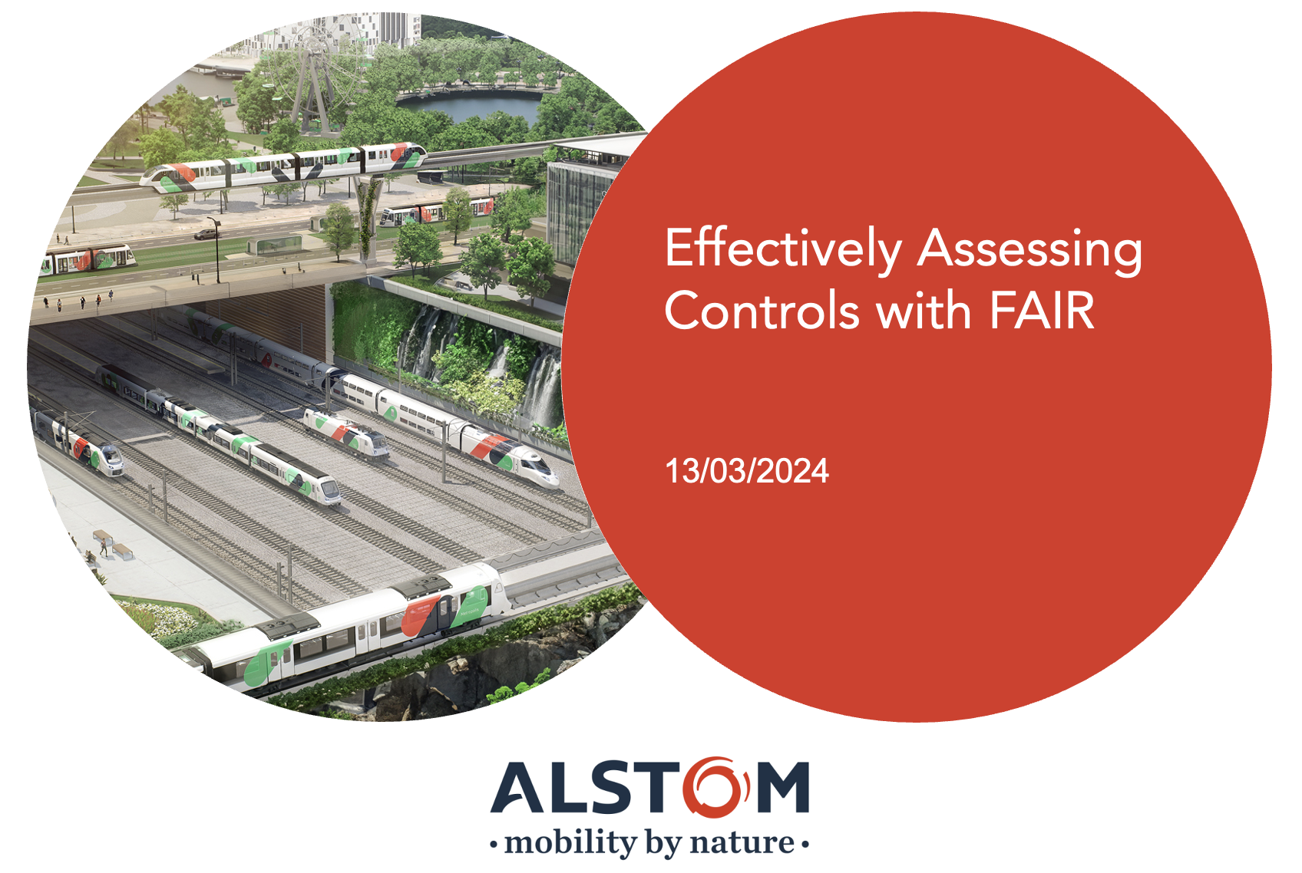
Frederic Bouveresse | Alstom
Notes:
Frederic – Role at Alstom
Where is Alstom in your Risk Quant Journey?
What are you going to show us today?

Slide 6
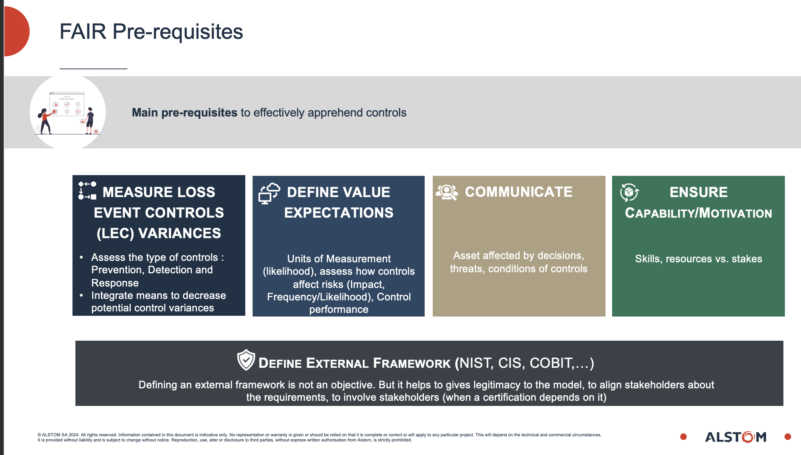
Frederic Bouveresse | Alstom

Slide 7
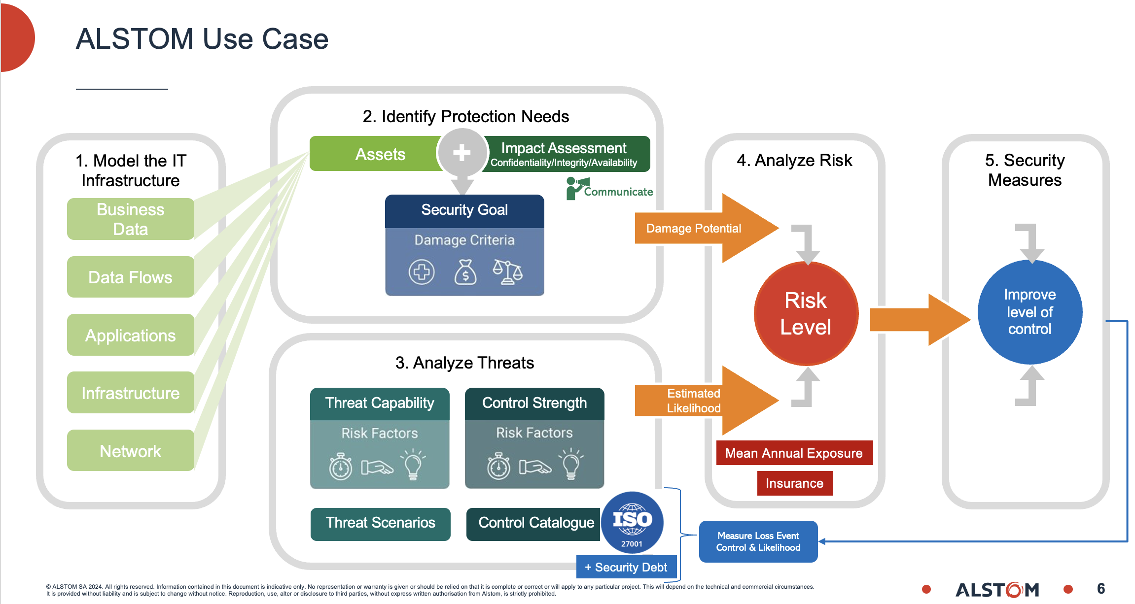
Frederic Bouveresse | Alstom

Slide 8
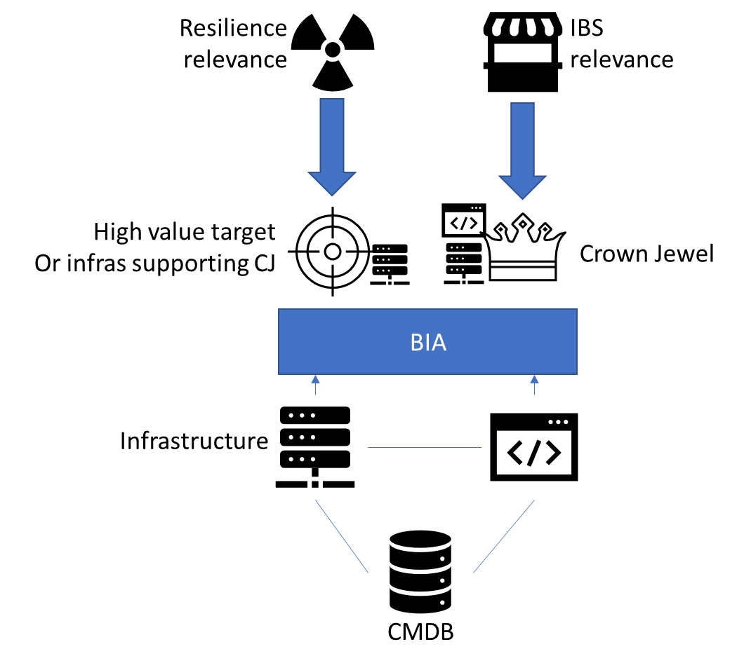

What is Cyber Resilience –
Francesco Chiarini | ISSA
Controls
Cybersecurity is based on NIST 800-53.
Cyber Resilience is based on NIST 800-160.
Cybersecurity protects high value assets (business).
Cyber Resilience protects even high value targets (adversary).
Cybersecurity focuses on severe but plausible scenarios.
Cyber Resilience on extreme but plausible.
Cybersecurity focuses on reducing likelihood of occurrence.
Cyber Resilience focuses on reducing magnitude of impact.
Assets
Core Infrastructure
Mission critical assets with
complex dependencies.
Control environment assets, sensitive configuration.
Security Tools
Protective, investigative and response assets to withstand.
Assets with the most critical or secret data.
Threats
Risks

Slide 9
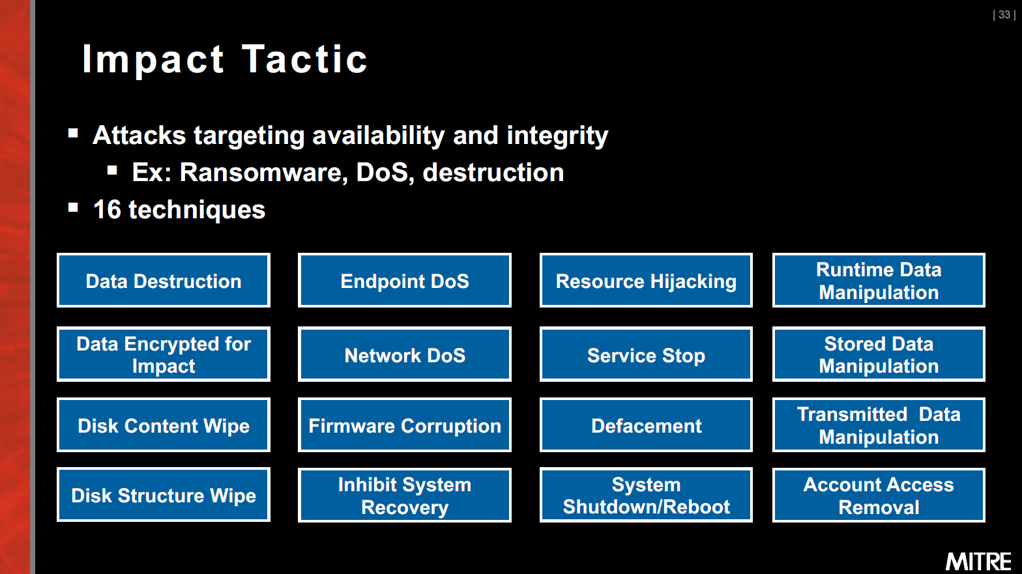
Achieving Cyber Resilience - Francesco Chiarini | ISSA
ATT&CK Impact Tactic TA0040
NIST 800-53, 800-160, 800-172
Security Controls’ Selection
A catalog of security and privacy controls for information systems and organizations to protect organizational operations and assets.
A set of enhanced security requirements for protecting controlled unclassified information in nonfederal systems and organizations from APTs when asset is associated with a high value asset.
Outcomes:
control baselines selected and tailored
system-level continuous monitoring strategy developed
enable threat-informed defense (MITRE ATT&CK, D3F3ND)
Incident Scenario | MITRE TID | MITRE Impact | MITRE Mitigation | NIST 800-160 Technique
Destructive Malware | T1485 | Data Destruction | Data Backup | Redundancy (#11)
 | T1486 | Data Encrypted for Impact
 | T1488 | Disk Content Wipe | Encrypt Sensitive Information | Deception (#5)
 | T1487 | Disk Structure Wipe
 | T1490 | Inhibit System Recovery | Network Segmentation | Segmentation (#12)
Intrusion / Unauthorized Access | T1494 | Runtime Data Manipulation
 | T1492 | Stored Data Manipulation | OS Configuration & Restrict Permissions | Analytic Monitoring & Dynamic Provisioning (#2 & #7)
 | T1493 | Transmitted Data Manipulation
 | T1531 | Account Access Removal | Remote Data Storage | Privilege Restriction (#9)
 | T1491 | Defacement
From scenarios
To Tactics
To Mitigations
To Controls

Slide 10
Insights
Scenario Scoping Level – Macro v’ Detail
Mapping Risk Scenarios to MITRE and FAIR
Power of Working in collaboration with 1st and 2nd lines of defense
Using Control Frameworks to measure effectiveness
Accuracy v’s Precision and stakeholder management
Resilience Controls and how they impact Risk – Focus on
A new way to consider asset value
Using CRQ Loss Magnitude to consider extreme tail events
What controls improve resilience?
What is the ROI of these controls? What is the investment case for resilience controls?
3rd Party Risk and Resilience
How will DORA, NIS2 and other EU regulations change the way organizations need to consider Cyber Resilience?

