Slide 1
The Future of Cyber Risk Management
Jack Jones Chairman Emeritus FAIR Institute

Slide 2
Let’s talk medicine…

Slide 3
Medical “epochs”
Medicine is here
Medicine 0.x
Medicine 1.0
Medicine 2.0
Medicine as Craft
Shamanism
Reliance on placebo effect
Bloodletting
Scientific but Reactive
(Focus is on diagnosis and treatment)
Introduction of scientific methods
Has given us advanced:
Diagnostics
Medicines
Surgeries
Roughly doubled our lifespan
Proactive Medicine
(Focus is on “Health-span” — living longer and healthier)
Reduces medical costs
Understanding and treating root causes
Genetics
Environment
Lifestyle

Slide 4
Where is cyber risk management maturity-wise?
Medicine is here
Medicine 0.x
Medicine 1.0
Medicine 2.0
CRM 0.x
CRM 1.0
CRM 2.0
CRM is here
Do NOT confuse technical sophistication with maturity!

Slide 5
“The less a science is advanced, the more its terminology rests on an uncritical assumption of mutual understanding.”
W.V. Quine

Slide 6
CRM today
CRM 0.x
CRM 1.0
CRM 2.0
CRM as craft
Scientific but reactive
Proactive CRM
Inconsistent terminology
FUD
Reliance on “best practice”
Focus on compliance
Reliance on mental models
Reliance on qualitative measurement
(Focus on diagnosis and treatment)
Diagnosis
Event detection
Malware recognition
Behavioral analysis
Treatment
Accurately prioritized remediation
“Personalized” solution recommendations
Introduction of science
Formal analytic models (e.g., FAIR)
Quantitative measurement
Use (and sharing) of data
(Focus on preventing “disease”, and improving organization “health-span”)
Understanding and treating root causes
Organization environmental factors
Organizational “Life style” choices
Organization “genetics”
Advanced scientific methods
Advanced application of ML and AI
Synthetic risk experimentation
Cyber “genetic engineering”

Slide 7
Achieving CRM 1.0

Slide 8
CRM 1.0
CRM 0.x
CRM 1.0
CRM 2.0
CRM as craft
Scientific but reactive
Proactive CRM
Inconsistent terminology
FUD
Reliance on “best practice”
Focus on compliance
Reliance on mental models
Reliance on qualitative measurement
(Focus on diagnosis and treatment)
Diagnosis
Event detection
Malware recognition
Behavioral analysis
Treatment
Accurately prioritized remediation
“Personalized” solution recommendations
Introduction of science
Formal analytic models (e.g., FAIR)
Quantitative measurement
Use (and sharing) of data
(Focus on preventing “disease”, and improving organization “health-span”)
Understanding and treating root causes
Organization environmental factors
Organizational “Life style” choices
Organization “genetics”
Advanced scientific methods
Advanced application of ML and AI
Synthetic risk experimentation
Cyber “genetic engineering”

Slide 9
Achieving CRM 1.0…
Normalization of quantitative models and methods
Changes to standards and regulations
Data sharing
Analysis automation

Slide 10
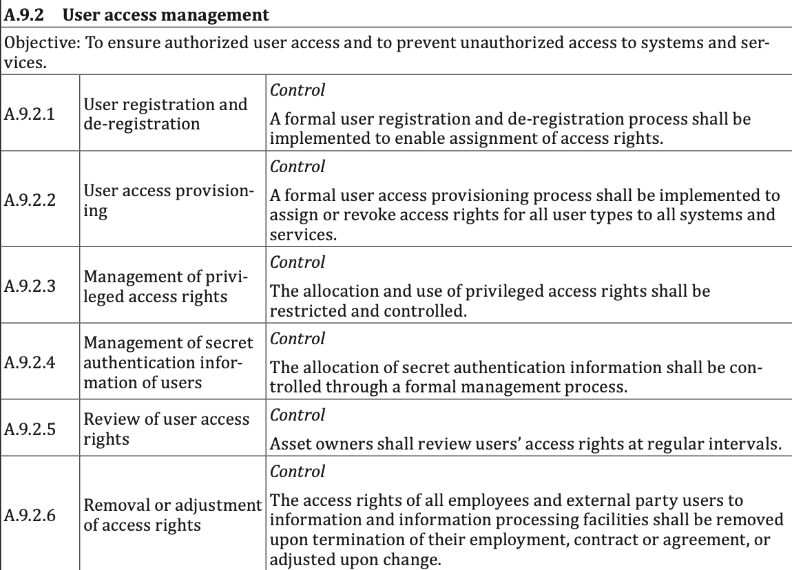
This is NOT quantification…
NOT quantitative values!
“3”
“4”
“4”
“1”
“4”
“4”
“4”
“5”
“2”
“3”
“2”
“2”
Avg.
3.17
=?
3.17

Slide 11
Math on colors
(
Green
x
Yellow
) /
Red
= ?
Very Low
Low
Medium
High
Very High
“1”
“2”
“3”
“4”
“5”
“-8”
“4”
“28”
“53”
“2961”

Slide 12
Actual units of measurement…
Loss Event Control Functions
Prevention
Detection
Response
Avoidance
Deterrence
Resistance
Visibility
Monitoring
Recognition
Containment
Resilience
Loss Minimization
%
%
%
%
Time
%
Time
Time
€£$

Slide 13
Accounting for control functions and dependencies
Directly affect the frequency or magnitude of loss
Indirectly affect risk
Enable well-informed decisions
Asset management
Threat intelligence
Anti-phishing training
Risk analysis
Etc.
Personnel
Anti-malware
Access privileges
Data recovery processes
Etc…
Decision Support Controls
Assets
Loss Event Controls
Risk
Ransomware outage via a phishing attack
Controls
Scanning
Patching
Anti-phishing testing
Change management
Etc…
Threats
Variance Mgmt. Controls
Affect the reliability of other controls

Slide 14
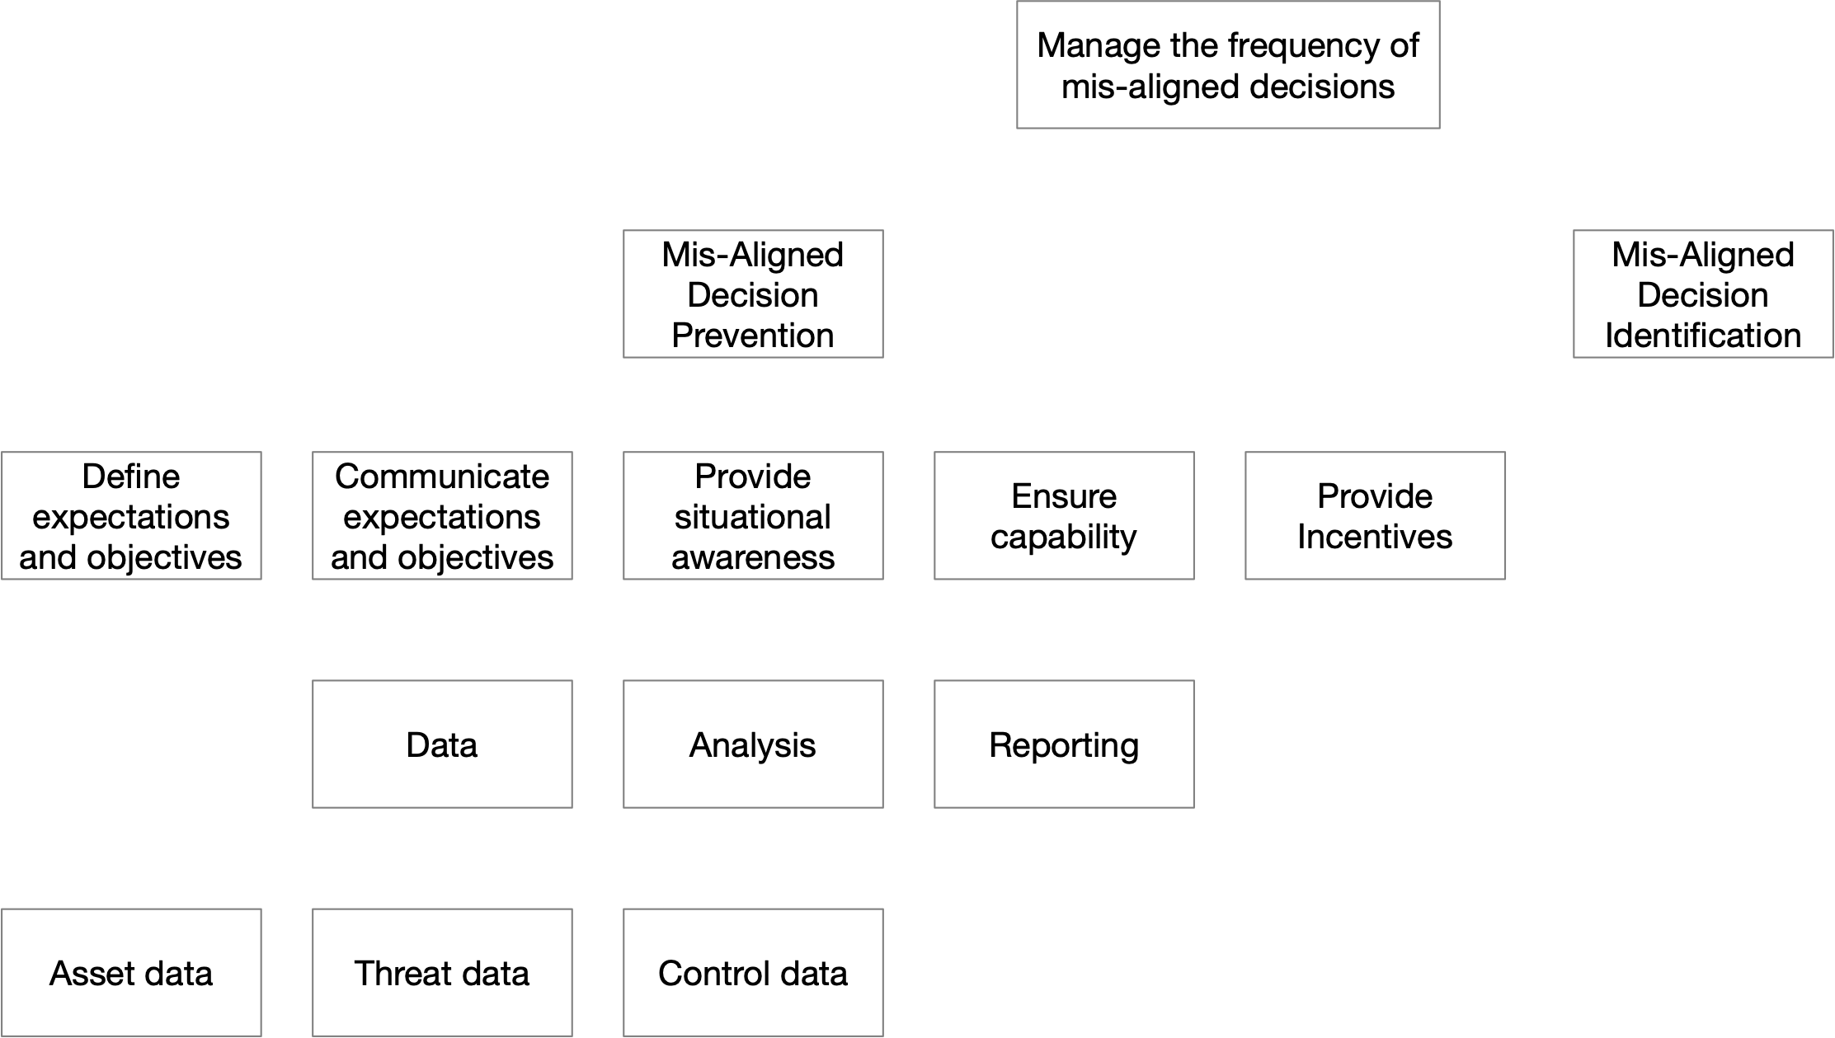
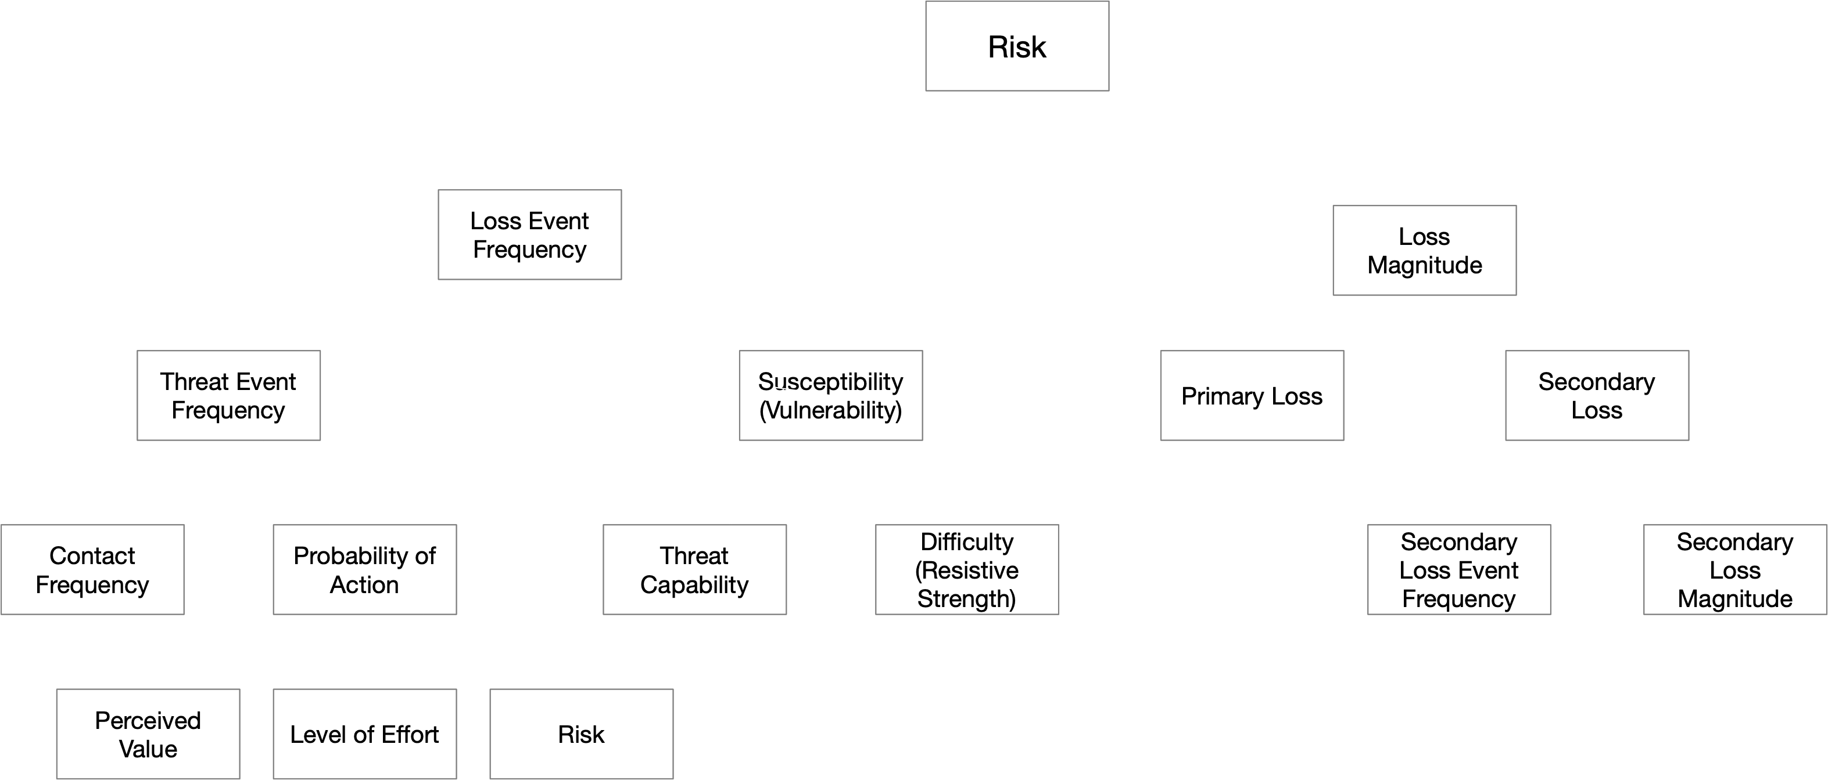
Control Anatomy AND Physiology
Anatomy
Physiology
Directly affect the frequency or magnitude of loss
Indirectly affect risk
Decision Support Control Functions
Assets
Loss Event Control Functions
Risk
Controls
Variance Mgmt. Control Functions
Threats

Slide 15
CRM 1.0
We’re not fully in CRM 1.0 until these things are mainstream
CRM 0.x
CRM 1.0
CRM 2.0
CRM as craft
Scientific but reactive
Proactive CRM
Inconsistent terminology
FUD
Reliance on “best practice”
Focus on compliance
Reliance on mental models
Reliance on qualitative measurement
(Focus on diagnosis and treatment)
Diagnosis
Event detection
Malware recognition
Behavioral analysis
Treatment
Accurately prioritized remediation
“Personalized” solution recommendations
Introduction of science
Formal analytic models (e.g., FAIR)
Quantitative measurement
Use (and sharing) of data
(Focus on preventing “disease”, and improving organization “health-span”)
Understanding and treating root causes
Organization environmental factors
Organizational “Life style” choices
Organization “genetics”
Advanced scientific methods
Advanced application of ML and AI
Synthetic risk experimentation
Cyber “genetic engineering”

Slide 16
Achieving CRM 2.0

Slide 17
Achieving CRM 2.0
CRM 0.x
CRM 1.0
CRM 2.0
CRM as craft
Scientific but reactive
Proactive CRM
Inconsistent terminology
FUD
Reliance on “best practice”
Focus on compliance
Reliance on mental models
Reliance on qualitative measurement
(Focus on diagnosis and treatment)
Diagnosis
Event detection
Malware recognition
Behavioral analysis
Treatment
Accurately prioritized remediation
“Personalized” solution recommendations
Introduction of science
Formal analytic models (e.g., FAIR)
Quantitative measurement
Use (and sharing) of data
(Focus on preventing “disease”, and improving organization “health-span”)
Understanding and treating root causes
Organization environmental factors
Organizational “Life style” choices
Organization “genetics”
Advanced scientific methods
Advanced application of ML and AI
Synthetic risk experimentation
Cyber “genetic engineering”

Slide 18
“Healthy” cyber risk management
Cost-effective cyber security that’s aligned with an organization’s objectives and risk tolerances

Slide 19
Cybersecurity-related “disease”…
Wasted resources
Inefficiency
Repeat findings (whack-a-mole)
Ineffective/unnecessary cybersecurity solutions
Over-controlled risk
Risk levels not aligned with organization tolerances
Missed mitigation SLAs
Numerous policy exceptions
Friction between cybersecurity and the organization

Slide 20
Being truly proactive…
Understanding and treating root causes
Directly affect the frequency or magnitude of loss
Indirectly affect risk
Decision Support Control Functions
Assets
Loss Event Control Functions
Risk
Controls
Variance Mgmt. Control Functions
Threats

Slide 21
Synthetic experimentation of root cause analysis

Slide 22
Real-life root cause analysis examples
Vulnerability management
Access privilege management
Audit finding SLAs

Slide 23
What about AI?
How useful would AI have been to medicine in the mid-1800’s?
Lack of data
Insufficient understanding of basic physiology
AI can be very helpful in specific use-cases where there’s better data.
AI is less useful when there’s less data and where the fundamentals aren’t well understood
The ability to apply AI broadly and effectively in cyber risk management is going to be limited by the profession’s immaturity

Slide 24
Exploring cybersecurity “genetics”…

Slide 25
Wrapping-up

Slide 26
Cyber risk management is a very young and immature discipline
Advancement begins by acknowledging the current state
This won’t change overnight
This presents challenges, opportunities AND a responsibility
Commit to being part of the solution

Slide 27
Thank you!

