Slide 1
Re-thinking Third Party Risk Management

Slide 2
Speakers
Meena Martin
Pankaj Goyal
VP, Cyber Risk and Assurance, GSK
Director, Standards & Research, FAIR Institute
(pankaj@fairinstitute.org)

Slide 3
We are in the middle of a crisis!
The current risk management approach is NOT working!

Slide 4
Third Party Risk Management needs a RESET!

Slide 5
Why does TPRM matter in a cyber risk program?
Dependencies on suppliers are increasing as we can get things done faster, cheaper and will dedicate SMEs
Increase in the footprint with 4th/5th parties
Increase in M&As on third party side
Backdoor or blind spot for organisations

Slide 6
What is working? What is NOT working?
NOT Working
Working
Questionnaire based
Time consuming (avg 2-4 weeks)
Point in time
Not 100% reliable
Tools that scan the external presence
Too many false positives
No actionable insights based on risks
Don’t want to become vendor’s security department
No strong partnership with vendors
Vendor classification (Critical, high, medium, low)
Vendor relationships

Slide 7
The Next Gen TPRM has to be…
Data driven decisions
Risk based
Continuous
Correlate between multiple data points to give a risk score

Slide 8
How is GSK building its next gen TPRM program?
Third parties that are within GSK (Infra mgt, consultancy etc.)
Third parties that provide services from outside (e.g. Performing clinical trials)
Data flow
Access controls

Slide 9
Supplier Risk Index (SyRex)
Who you are (engagement type)
Access (connectivity, access rights, exceptions etc)
Behaviour (Phishing/DLP/offboarding leavers etc)
Plus
External presence scans
Threat intel (GSK TIP + other threat intel sources)
Incidents
M&As
Risk profile based on individual/vendor peer groups with events, issues & incidents

Slide 10
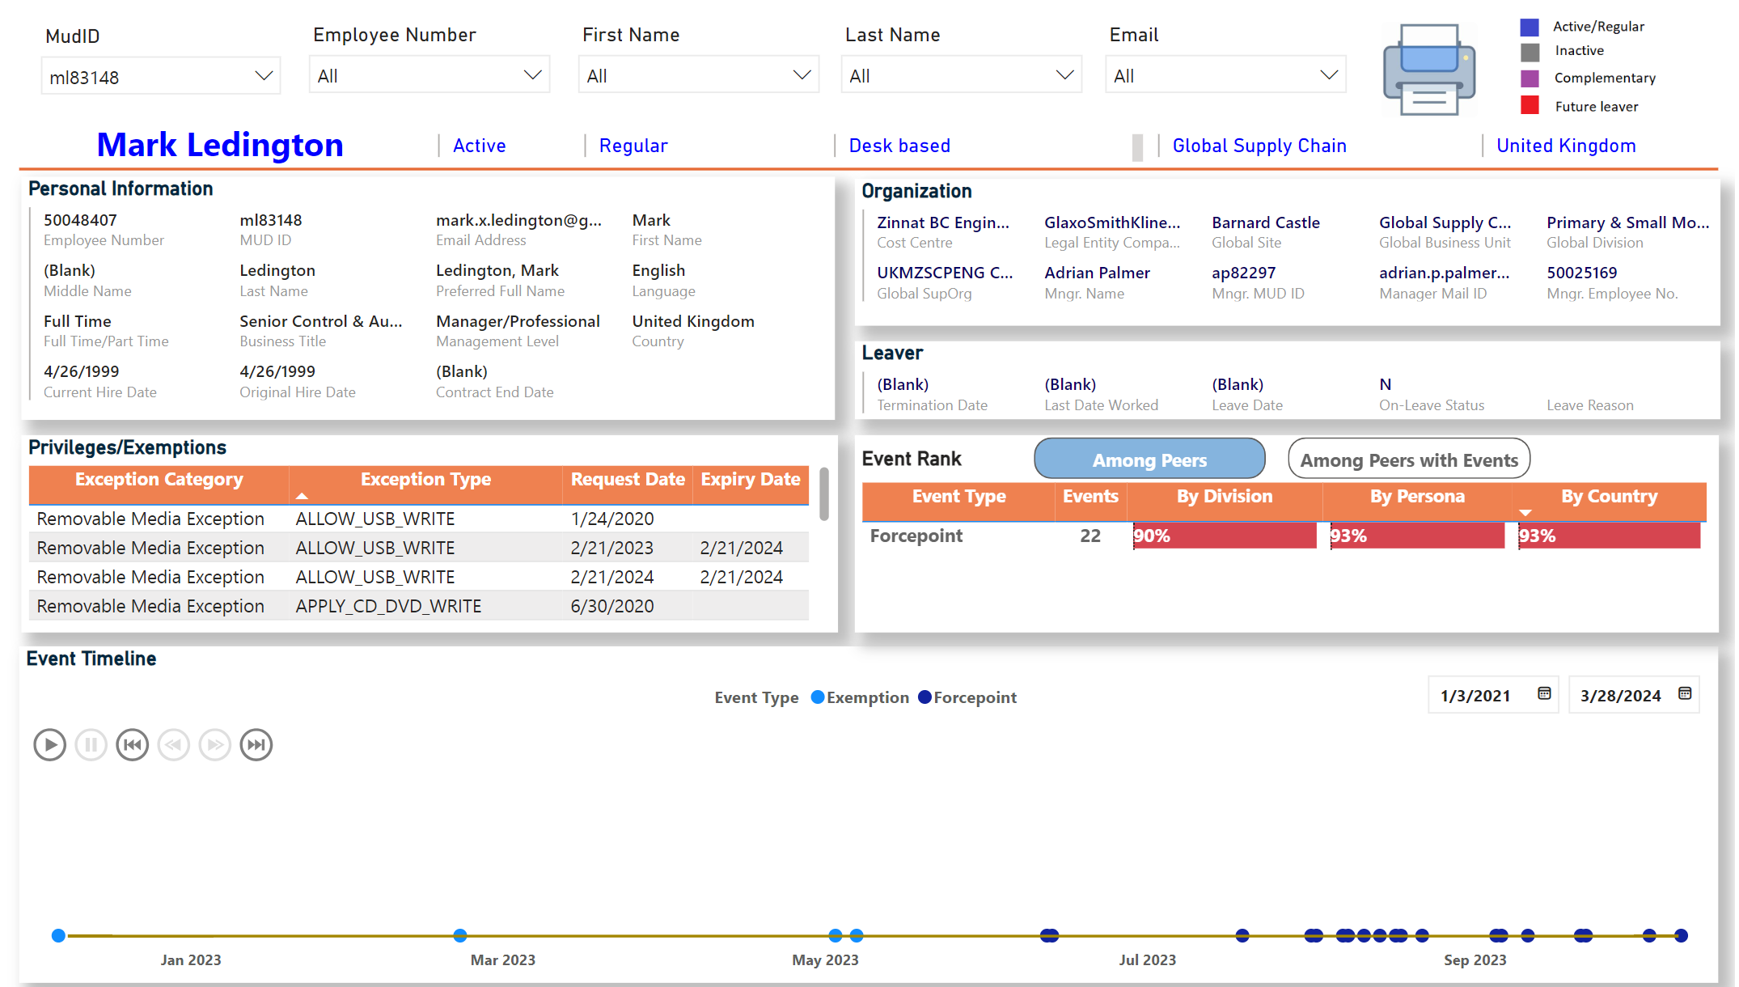
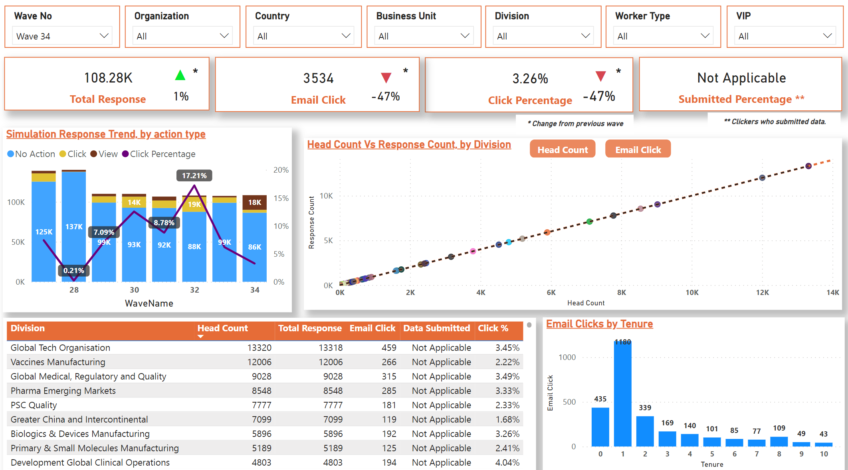
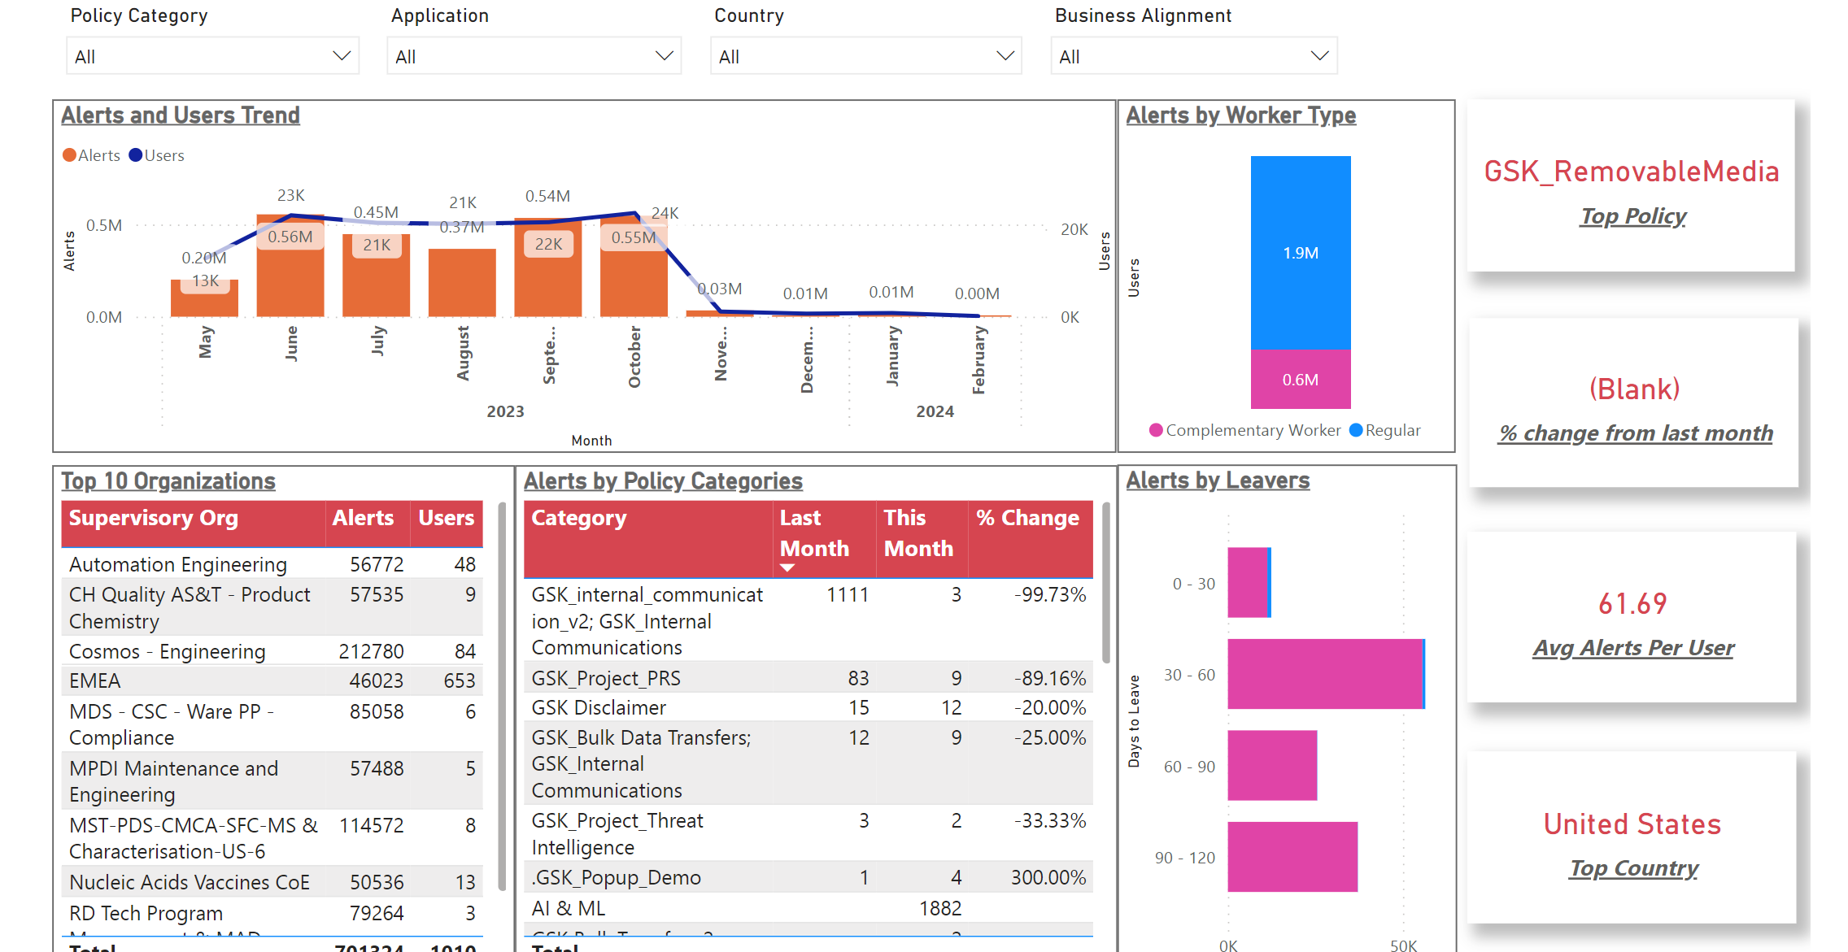
Supplier Risk Index (SyRex)
 | Data Source Name | Scope
2023 Q1 - 2023 Q2 | HR Operational Data Store | Basic attributes & Leavers
 | Microsoft Defender for Cloud | HR People Insights Ecosystem (PIE) & Code Orange Enterprise Node
 | ESG | Malicious Emails & Clicks
 | Removable Media Exemptions | USB/CD/HDD exemptions
2023 Q3 - 2023 Q4 | Web Blocking Exceptions | Exception details pertaining to web mail, cloud storage/file transfer, and personal instant messaging
 | Local Admin Exceptions | Local admin exception requests from ServiceNow
 | Incident Management tool | All cases with DFIR involvement
 | ServiceNow (Data Forensics) | All tasks assigned to/created by Data forensics teams
 | Phishing Simulation | Phishing simulation data for last 2 years
 | DLP | All alerts from Forcepoint On-Prem
2024 Q1 | DLP Cloud | All alerts from Forcepoint Cloud
 | Access Controls | Type of access including privileged access
Vendor Profile and Access
Behaviour - Phishing Simulation Insights
Behaviour - DLP Insights

Slide 11
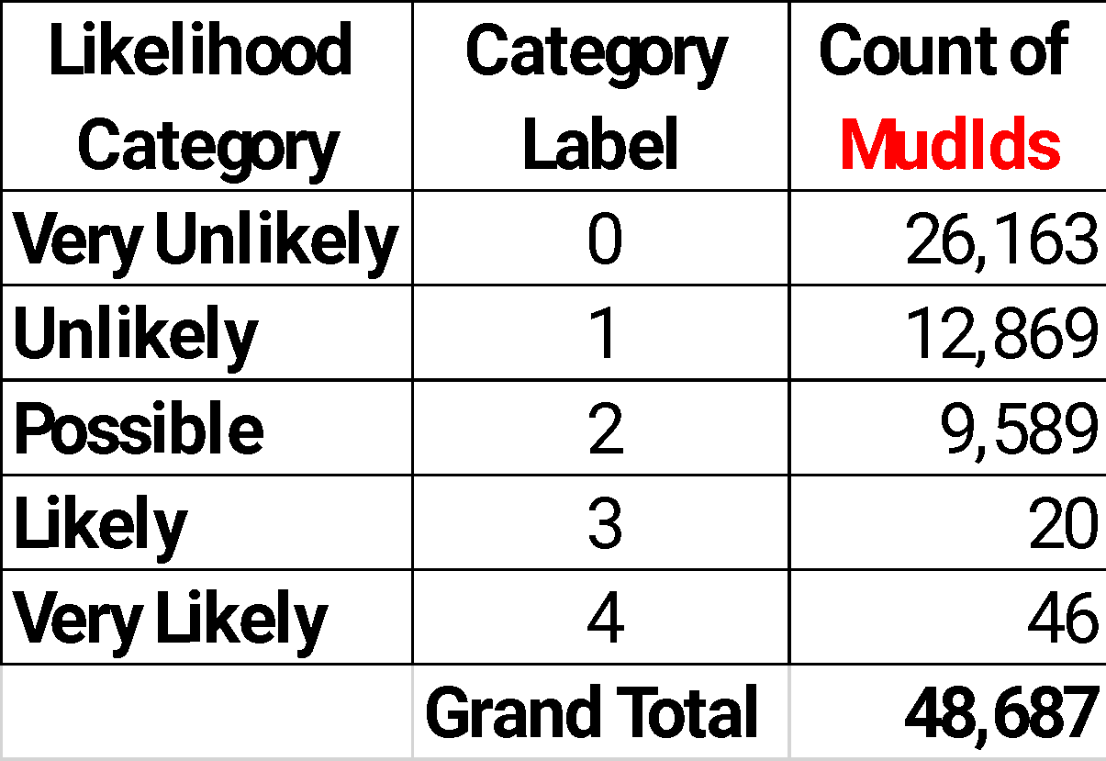
Supplier Risk Index (SyRex)
Key requirements for an index:
Calculate Impact & Likelihood
Vendor Risk Group Determination
Concept Validation
Explainable (What factors are influencing the score)
Reproducible (Simple to calculate)
Interpretable (Usually single number with higher score indicating higher risk)
Monotonicity (Risk increases with increase in the influencing factors or inverse)
Science based (ISO/IEC 27005: Risk for Information Security should be evaluated along the 3 key requirements: Confidentiality, Integrity, Availability)
Calculate Impact: Impact of a user is measured on a 5-point scale across the 3 pillars (Confidentiality, Integrity, Availability) based on their role, grade, access levels and exemptions, privileges etc. Impact is dependent on attributes that are either static or change infrequently, for ex with role change or new privileges.
Calculate Likelihood: Likelihood of a user is also measured on a 5-point scale across the 3 pillars (Confidentiality, Integrity, Availability) based on their behavior like phishing clicks, DLP alerts, intent to leave etc. Likelihood is dependent on behavioral attributes which are more dynamic in nature with frequent changes.
Vendor Risk Group Determination: Each vendor is evaluated for Risk level across the 3 pillars (Confidentiality, Integrity, Availability) based on Risk Mapping. Final Risk level for a user is determined as maximum Risk level of the 3 pillars.
Method: Statistical comparative analysis.
Target Population: Users with behavioral events like phishing clicks, DLP alerts etc.
Model Results: Initial results align with our expectation of risk classification and identifying high risk individuals that could be focused upon for risk mitigation.

Slide 12
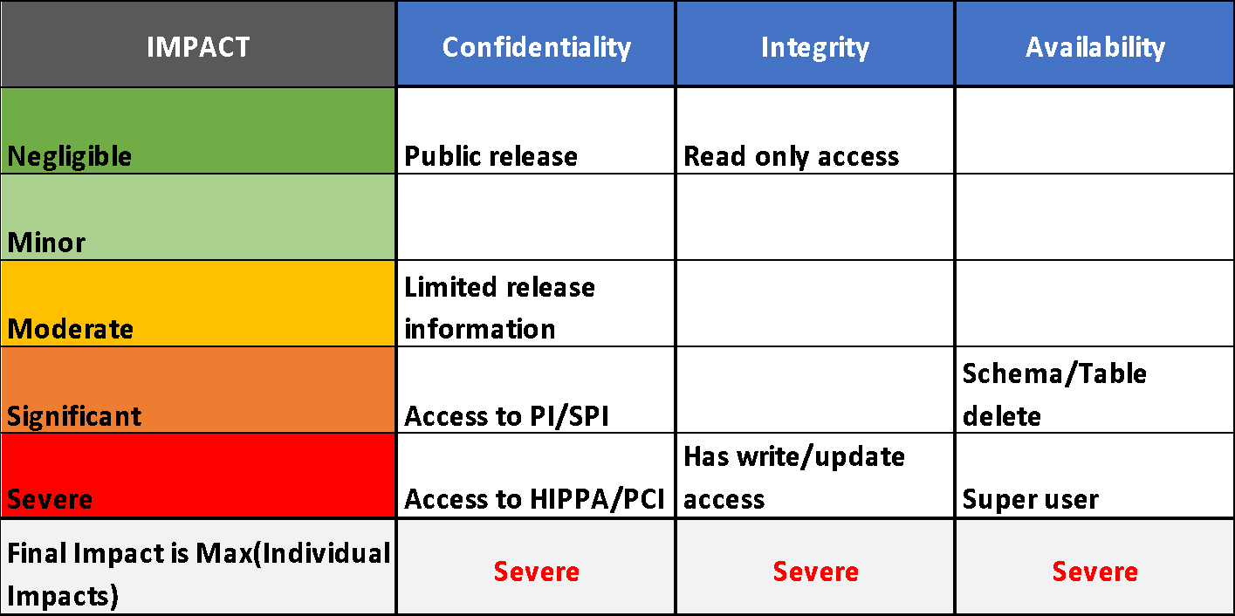
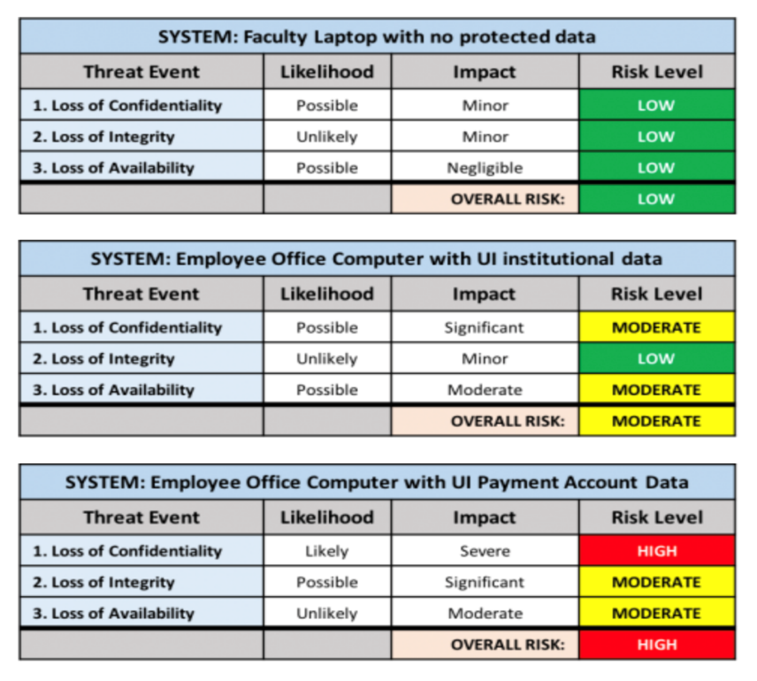
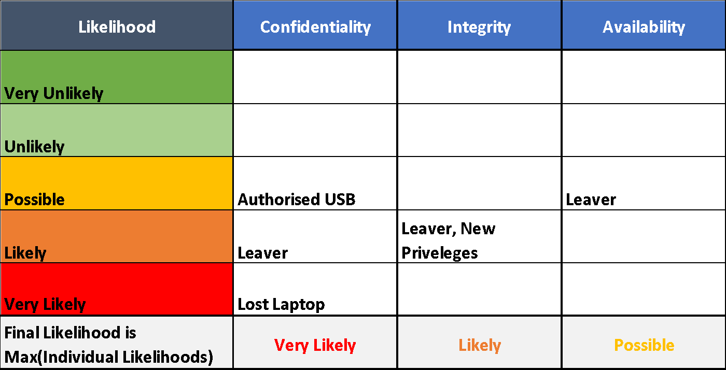
Supplier Risk Index (SyRex)
User Risk Group Determination: Each User is evaluated for Risk level across the 3 pillars (C,I,A) based on Risk Mapping. Final Risk level for a user is determined as maximum Risk level of the 3 pillars.
Below are 3 example profiles showcasing risk evaluation for the 3 pillars and final risk determination.
USER 1
USER 2
USER 3
*(C,I,A): Confidentiality, Integrity, Availability

Slide 15
Supplier Risk Index (SyRex) - Potential use cases
Proactive
Reactive
Identify high risk vendors based on cyber behavior profile and prioritize for risk mitigation.
Index explanation offers insights into key drivers of risk thereby enabling tailored mitigation plans like learning modules, privilege re-assessment etc.
Understand the patterns over time in risk evolution and implement early intervention protocols to prevent vendors from crossing the high-risk threshold.
Monitor risk and alert upon elevation, for custom groups like leavers, CWs, special projects etc.
Prioritize Incident Response, security tool alerts/notifications, vendor reported cybersecurity incidents and concerns etc., based on risk and impact.
Assist investigations and incident triages by supplying critical cyber behavioral indicators.
Evaluate effectiveness of risk mitigation plans by monitoring pre and post implementation risk statistics.

Slide 16
FAIR Approach for TPRM
FAIR-TAM
Risk based prioritization
Comprehensive continuous monitoring
Actionable mitigations

Slide 17
FAIR-TAM
Prioritization based on contract value, size of the vendor…
❌
Risk based prioritization
Prioritization based on risk to YOUR business - data, network, revenue access - using FAIR-MAM
✅

Slide 18
FAIR-TAM
Just outside-in
One-time manual questionnaires
Not
enough
Comprehensive continuous monitoring
Inside-out telemetry from first and third parties
Likelihood using FAIR-CAM
✅

Slide 19
FAIR-TAM
‘You have more control than you think’ – actively fix and build your controls
Active collaboration with vendors
Open dialogue and sharing of data
Actionable mitigations

Slide 20
FAIR Approach for TPRM
FAIR-TAM
Risk based prioritization
Comprehensive continuous monitoring
Actionable mitigations

