Slide 1
Optimizing Cyber Insurance with Risk Quantification

Slide 2
Speakers
Patrick Montagner
Leopold Larios
Andreas Schmitt
Deputy Secretary General ACPR
Director, Cyber Insurance Offering Descartes Underwriting
Global Cyber Underwriting Manager Zurich Insurance
Thierry Zucchi
Christopher Khadan
Head of Cyber Activity
Relyens
Chief Customer Officer
Safe Security

Slide 3
The Cyber insurance designed for Corporates
Cyber Shutdown Cover
Paris March 13th, 2024

Slide 4
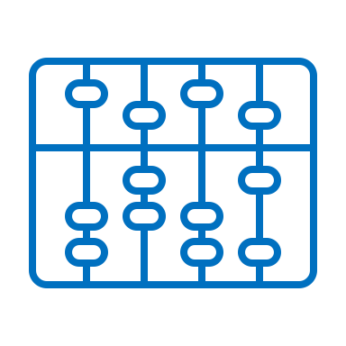
WHY CYBER REMAINS ONE OF THE MAIN THREAT FOR COMPANIES?
Confidential
The cyber risk is among the few risk able to jeopardize companies.
Loss experience
Risk Management
Risk mapping of the risks
Risk exposure
Internal assessment of the potential loss
External Loss expert
Risk Library
Naming
Quantification
Dimension of Impact
Risk owner
Risk appetite
Risk mitigation
Finance controller
Rough estimate

Slide 5
HOW TO QUANTIFY THE CYBER RISK?
Confidential
Cyber risk quantification motivates firms to improve IT Security investment, response time in case of incident, awareness, and ability to transfer the risk.
Quantification
CERTIFICATION / Standards
FAIR™ Factor Analysis of Information Risk
ISO 27001-5
Frames for analysis
COMPLIANCE
NIST US National Institute of Standards and Technology
EBIOS Risk Man - ANSSI
OCTAVE Operationally Critical Threat, Asset, and Vulnerability Evaluation - Carnegie Mellon University
COBIT® 5 Information Systems Audit and Control Association (ISACA) for IT risk’s governance.
GDPR 20 M€ - 4% revenues
NIS 2 2% revenues

Slide 6
DATA COLLECTION FOR THE CYBER SHUTDOWN COVER
Confidential
As the first cyber insurance product that rewards companies with lower premiums for actively improving their cybersecurity rating, our underwriting process is able to offer optimal coverage at a competitive price.
Company Information
Assets, potential loss from shutdown, loss history
Key
Providers
Data storage, software
External Vulnerability Scan
Board of Cyber
Internal Cybersecurity
Backup policy, cyber awareness, firewall
Cyber Threat Intelligence
Dark web investigations, sector analysis
Non-cyber parameters
Cybersecurity parameters
Cybersecurity parameters
Cybersecurity parameters
Cybersecurity parameters
Cyber Shutdown Cover
Frequency of Attack
Duration of Attack
Simulated attack dates YEAR i
Simulated attack and duration YEAR i
Incident & response costs
Simulated attacks and duration YEAR 50000
Business Interruption
Score of the risk
Pricing of the risk

Slide 7
Confidential
Descartes offer
A renewable energy company
owns several wind farm sites in France and Germany with an annual revenue of €250 million.
BI Limit (€) | 2,500,000
Max Daily Indemnification (€) | 100,000
Waiting Period (days) | 5
Maximum Coverage (days) | 25
I&R Limit (€) | 250,000
I&R daily indemnification (€) | 10,000
HOW IT WORKS
The daily margin is €150,000.
The company IT team determines that resuming activities will take no longer
than 5 days.
The renewable energy producer decides to buy Cyber Shutdown Cover for 25 days of coverage with a €2,750,000 limit. Premium net € 87,000.
Cyber risk for manufacturers & industrials
Cyberattack
1 wind farm suffers a ransomware attack, forcing total shutdown of the production for 20 days.
Willing to secure its assets, the company requests for a cover for the loss of revenue during a shutdown period up to 25 days + I&R costs
Total BI loss indemnification = €1,500,000
+
I&R costs covered = €150,000
=
Total indemnification of €1,650,000 by Descartes Insurance
Descartes uses the questionnaire and vulnerability scan to check the level of exposure of 3 wind farms.
On this basis, Descartes internal model generates the following offer.
Descartes partner I&R team supports the IT team of the client in order to determine the attack path and rebuild the IT/OT system, from day 1.

