Slide 1
Meeting Regulatory Compliance - How to Think About Materiality with FAIR™

Slide 2
Speakers
Mouhamad el Houssaini
Pankaj Goyal
Risk Director ADP
Director, Standards & Research, FAIR Institute
(pankaj@fairinstitute.org)

Slide 3
A lot has been happening in the the world of Cyber Materiality
… and FAIR Institute has been driving the dialogue research

Slide 4
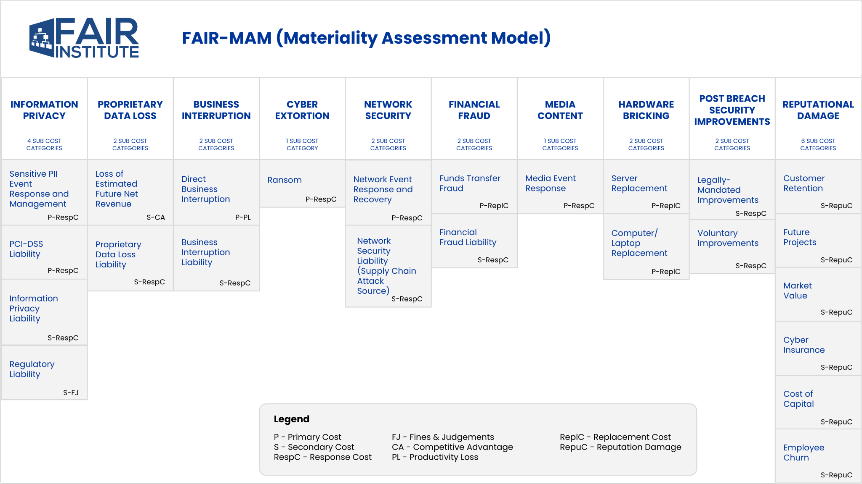
AT FAIRCON23 in Washington, DC - we published FAIR-MAM

Slide 5
We launched howmaterialisthathack.org

Slide 6
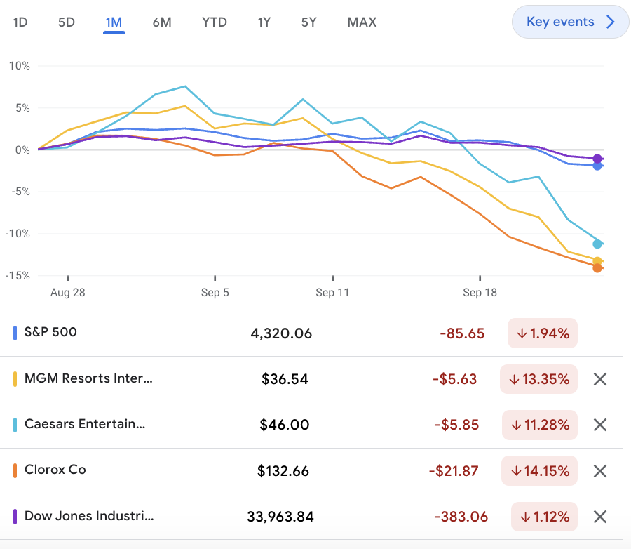
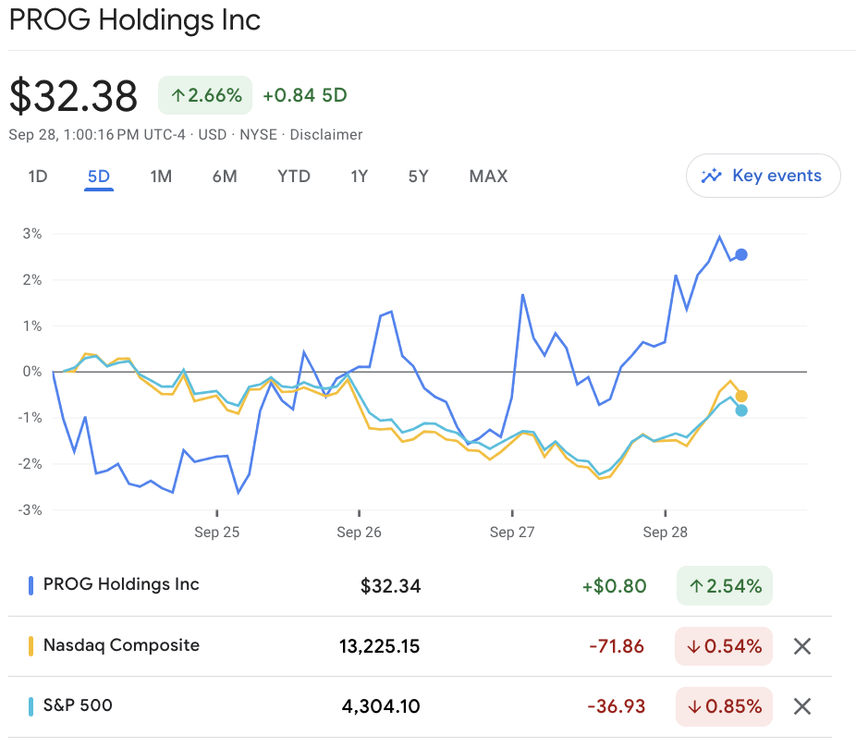
Cybersecurity 8-Ks can have a significant impact on stock price
When you declare event is Material OR ‘We don’t know if the event will be material’
When you declare the event is NOT material
>12% drop in Stock price
No Drop in Stock price!

Slide 7
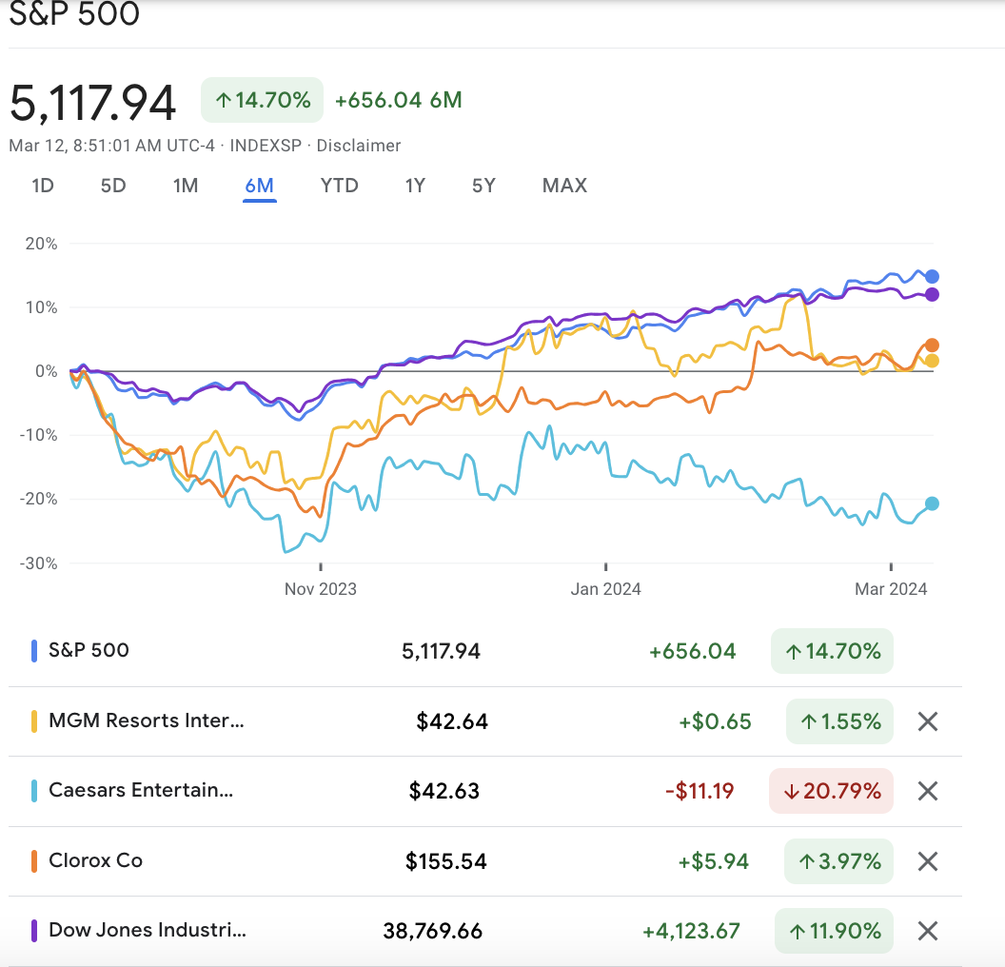
But long term impact is still debatable

Slide 8
As per FAIR-MAM based assessments done by FAIR Institute
Cyber attacks have had material $ impact
The SEC cybersecurity rules describe a material incident as a matter
”to which there is a substantial likelihood that a reasonable investor would attach importance” in an investment decision.
Clorox
~$225M Impact
~$110M Impact

Slide 9
It is NOT easy to say that an Event is NOT material. Hence the problem of ‘False Negatives’
Don’t know?
Can be a False Negative
Is it Material?
An Event happens
Yes
>10% drop in Stock price
Most historical cyber events are not material. A company should be able to confidently say that the event is NOT material.
No
No Drop in Stock price!

Slide 10
Discussion
Mouhamad el Houssaini
Risk Director ADP

Slide 11
FAIR-MAM for specific Risk scenarios (Ransomware example below)

Slide 12
Using FAIR-MAM for pre and post incident analysis
Pre-incident
Post-incident
Define ‘Materiality thresholds’ for the organization
Identify Top Cyber Risk Scenarios
Quantify potential Materiality of these risk scenarios using FAIR-MAM
Assess effectiveness of Post-incident response controls
Agree on all of the above with stakeholders: GC, Finance, Cyber, IT, Board
Understand the extent of the loss in real time
Update the cost drivers in the pre-incident model as new information flows in from IT, Ops and other departments
Real time comparison of losses vs. the materiality thresholds
As the risked categories become known, revert the loss category to an unrisked financial view

Slide 13
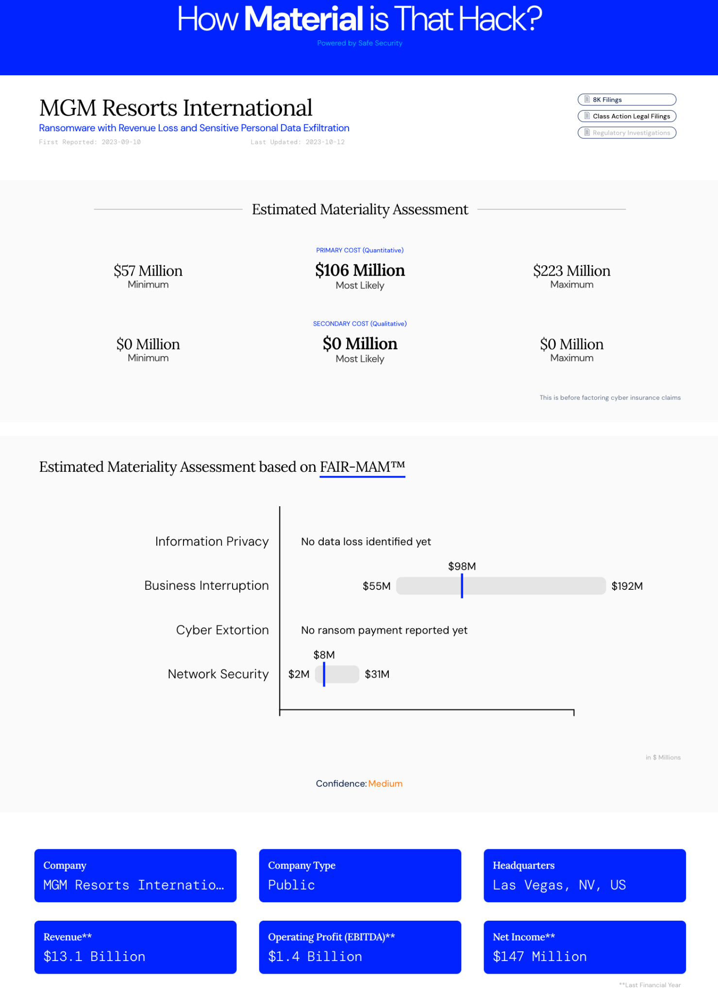
More publications on www.howmaterialisthathack.org

Slide 14
Collaboration with the Cyber Insurers on FAIR-MAM
BROKERS
CARRIERS

Slide 15
Conclusions
We are still learning about ‘materiality’ in the cyber world
We are seeing more proactive transparency and reporting from the organizations
FAIR-MAM can be a strong analytics foundation to build a materiality framework for your organization - pre and post incident

