Slide 1
Mastering Cyber Risk Navigating the Era of New Incident Disclosure Rules
Nicola (Nick) Sanna Founder, FAIR Institute President, SAFE Security

Slide 2
Cyber Risk is Business Risk
Notes:
Cyber risk has become a strategic business risk, according to the WEF second only to climate induced risks
Global annual losses from cyber crime are estimated at $8 trillion in 2023 and projected to rise to $10.5 trillion by 2025
Examples
United HC
But is this how most organizations are treating it?
We’re throwing more money at cybersecurity, but are still treating cyber risk for the most part as a technology risk
Which often results in losing the war against cybersecurity by incurring losses that are larger than expected, that have a material impact on the company’s financial results
Why is that? We are treating cybersecurity as a technical compliance issue…
How well has that served us… not very well

Slide 3
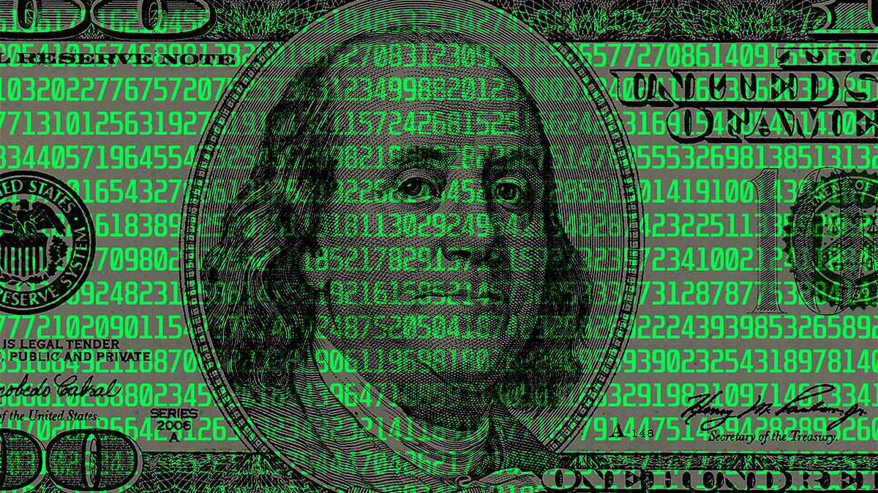
The Economics Are Evolving
Notes:
Threat Actors have first mover advantage
As the Internet was built as an open system without security in mind
The business model for threat actors is attractive, as it’s relatively inexpensive to buy hacking tools and launch attacks
When it comes to defense, the economics model is reversed
Cybersecurity is expensive and ROI is difficult to demonstrate
But there is some hope as new models such as FAIR are emerging making it easier to prioritize on what matters, automatically measure controls effectiveness and assess ROI
There are costs associated with implementing an effective cyber risk management program, but the cost of inaction is greater

Slide 4
Boards are Taking Notice

Slide 5
Business demanding
cybersecurity to move
at the pace of the business
Notes:
This is a unique conference in cyber risk management. There are a lot of cybersecurity conferences, but we uniquely fill in a gap
FAIRCON a truly future shaping conference over the years
Every year we dare to stretch the limits of what is possible in risk management, we provide a vision for what is possible, and then along with all of you work in the pursuit of that
This year might be even more significant given 4 key new developments in our industry

Slide 6
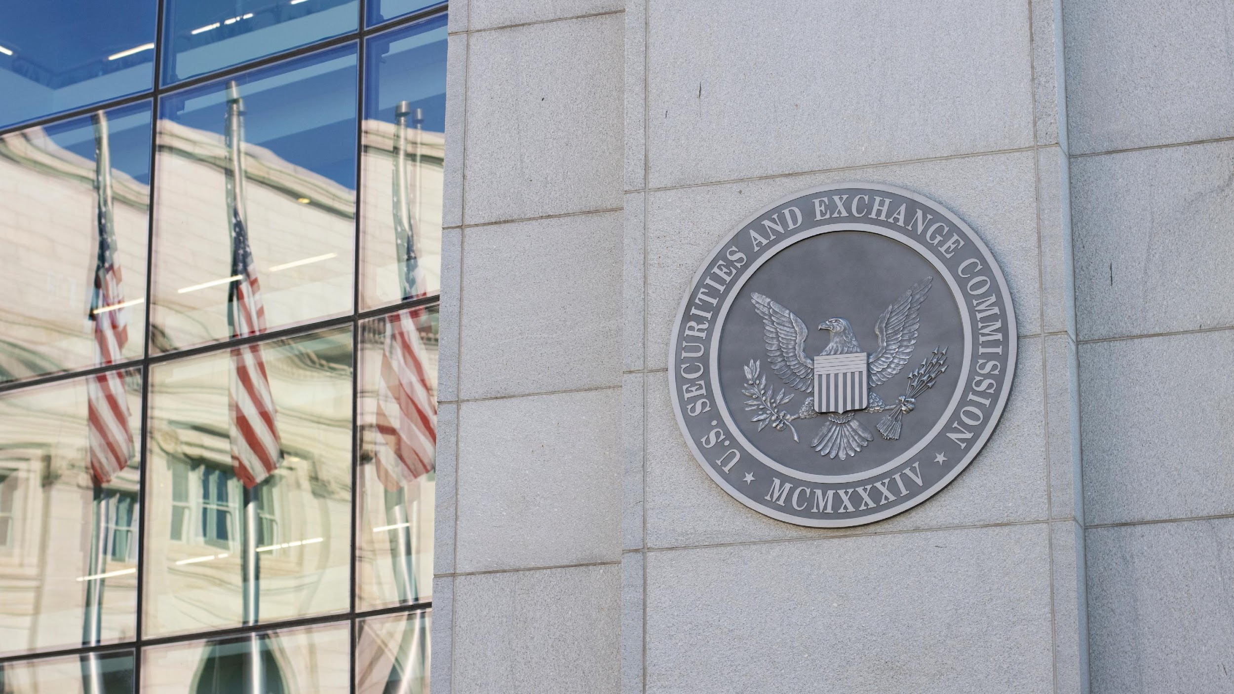
New Regulations
Notes:
The first new development is the advent of regulations, in the US with the SEC rule, in Europe with NIS2 and DORA, in Australia as well.
Many of you commented in the past that we needed new types of regulation in cybersecurity
Note ones that focused on mandating compliance to lists of cybersecurity practices, which have been useful as a list of best practices but that did not allow to focus on what matters most for organizations
We have advocated since the day 1 of the FAIR Institute that we needed to incentivize the adoption of advanced, quantitative risk assessment practices that would allow to measure, prioritize and manage risk from the economic perspective, based on what matters most
Some organizations, many of whom are members of the FAIR Institute, have been leading the way because they saw this as a possible way to cost-effectively manage cyber risk and as a possible competitive advantage
And I remember vividly that we commented how other risk management disciplines such as insurance really took off once government stepped in and required everyone to do the most prudent thing.
We saw our discipline really taking off when the right type of regulation would be put into place and where the non early adopters would be forced to do the right thing. I believe that we are starting to see that happen in our industry.
I remember the Disney example
That is very likely to change now

Slide 7
SEC - “…require registrants to disclose any cybersecurity incident they determine to be material and to describe the material aspects of the incident's nature, scope, and timing, as well as its material impact or reasonably likely material impact on the registrant.”
Notes:
Here in the US, we saw the SEC rule on cyber reporting being approved in July and coming into effect at the end of the year.
The SEC regulations state that both Quantitative and Qualitative Materiality factors must be considered when assessing the material impact of a cyber incident.
One should note, however, that if Qualitative factors materialize, then they become Quantitative factors.
For example, sensitive personal data is exfiltrated as part of a cyber incident. Therefore, the possibility of a lawsuit settlement is accounted for as a risked Qualitative loss factor. Soon after the incident, a class action lawsuit related to the breach of sensitive personal data is filed. The risked likelihood – Qualitative loss factor – of a lawsuit settlement increases. Eventually, the parties agree to settle. Again, the lawsuit settlement Qualitative loss factor increases. As losses related to that settlement are finalized, they become Quantitative loss factors.
Tomorrow we’ll have the chance to hear from the SEC itself… and..

Slide 8
NIS2 – “After 72 hours, a full notification report must be communicated, containing the assessment of the incident, severity and impact and indicators of compromise…”
Notes:
https://www.ey.com/en_be/cybersecurity/how-to-prepare-for-the-nis2-directive
The Network and Information Security Directive from the EU is the first piece of EU-wide legislation on cybersecurity and its specific aim is to achieve a high common level of cybersecurity across the member states.
This directive entered into force in January 2023 and the member states have until Oct 2024 to transpose its measure in to national law.
Among its requirements for large organization is incident reporting, similarly to the SEC Rule

Slide 9
DORA – Entities must implement stringent governance structures and risk management processes to identify, manage, and mitigate ICT risks effectively

Slide 10
Jordan NCSC - “Promote the concept of Cyber Security Economics to help organizations develop sophisticated, economically-driven cyber risk measurements that blend into their business plans”
Notes:
One of the 5 pillars of the Jordanian cybersecurity framework

Slide 11
Our Mission
Notes:
How is the Institute responding to these new developments?
By undergoing its most significant transformation since I started the Institute in 2016
Turning into a more explicitly research-driven organization

Slide 12
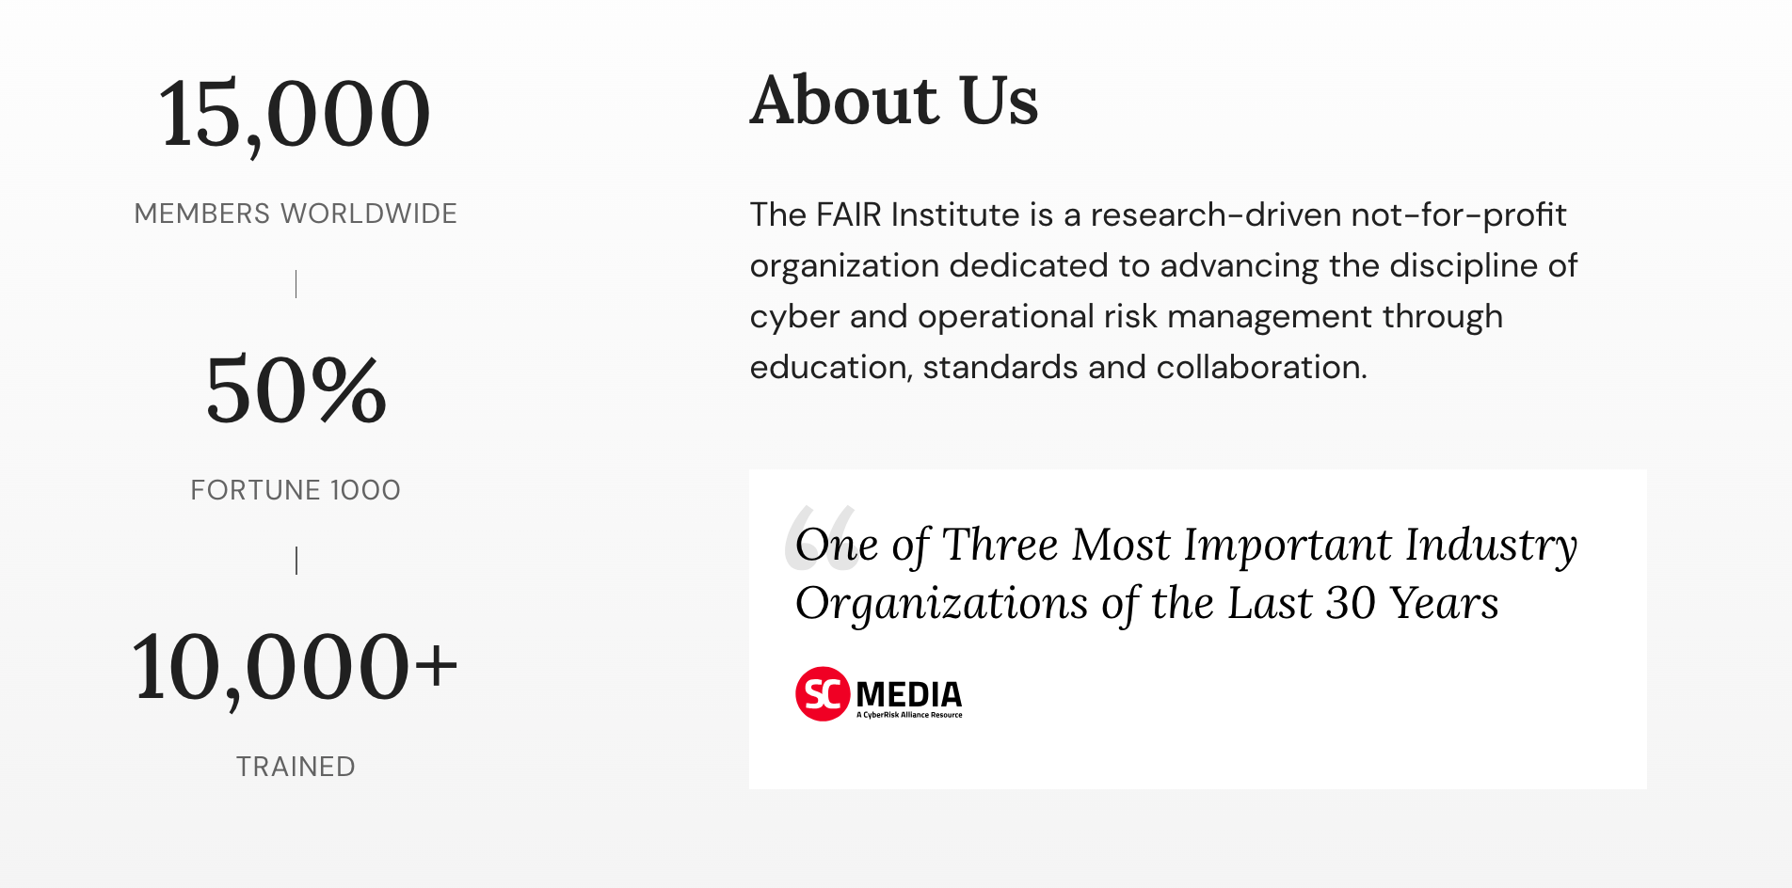
Notes:
Our about statement now reads…

Slide 13
Notes:
Agenda 2023-2024
A research that will focus on the most important risk analysis and modeling challenges of our times

Slide 14
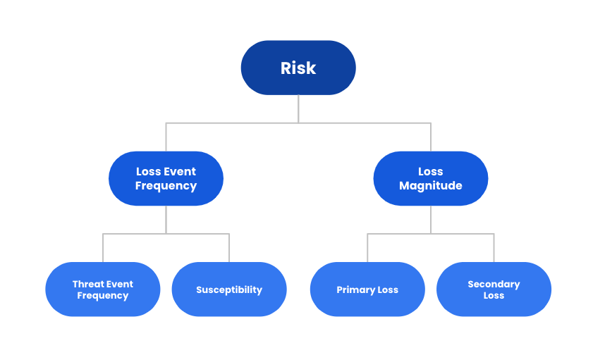
Notes:
A research that will lead to a plurality of FAIR standards; There will be multiple ancillary standards off the main FAIR standard

Slide 15
Materiality
FAIR-MAM

Slide 16
Controls Effectiveness
FAIR-CAM

Slide 17
Generative AI
FAIR-AIR
Notes:
The 2nd key development is the advent of Generative AI
Market interest has exploded and Gartner survey says that close to 60% of CIOs and Tech Leaders are experimenting with AI.
“Generative AI technologies can generate new derived versions of content, strategies, designs, and methods by learning from large repositories of original source content. Generative AI has profound impacts on business including content discovery, creation, authenticity, and regulations; automation of human work, and the customer and employee experience.”
What is gen AI & benefits
Generative AI is a type of artificial intelligence that produces new content that is often creative and realistic, and its uses include:
Content creation (Text, image and music)
Personalization (generate personal recommendations)
Automation (automates content generation)
Fostering creativity (assists in generating innovative ideas)
Natural language processing
Data augmentation
Research and exploration (discovering patterns in large datasets)
Personal assistance (helping with Q&A)
Cost savings
Art and entertainment (create art, music and interactive experiences.
Generative AI has a wide range of applications and offers the potential to enhance productivity, creativity, and user experiences in many domains.
However, he use of generative AI also comes with certain risks and challenges:
Misinformation: Generative AI can be used to create fake news, deepfakes, and other misleading content, which can have serious consequences for public trust and decision-making.
Privacy Concerns: The technology can be used to generate sensitive or personal information, potentially violating privacy and security.
Bias and Discrimination: Generative AI models trained on biased data may produce content that perpetuates stereotypes or discrimination.
Intellectual Property Issues: Content generated by AI can raise legal questions regarding copyright and intellectual property rights.
Security Threats: Malicious actors can use generative AI for cyberattacks, phishing, and other security threats.
Algorithmic Fairness: Ensuring fairness and equity in AI-generated content can be a complex and ongoing challenge.
Regulatory and Legal Concerns: The legal and regulatory landscape for generative AI is still evolving, creating uncertainty and potential compliance issues..
The reactions from organization have varied across the full spectrum of possibilities: some organizations have banned any possible use of Gen AI, while others have asked their teams to experiment widely and quickly adopt it when they saw a big economic advantage
Now management in most companies is asking risk officers to help them assess the significance of those risk and identify effective risk mitigations when possible.
This is the new emerging risk du jour, similarly to ransomware in the last 2-3 years
No wonder that we had our very first workshop yesterday teaching how to scope, quantify and possibly manage gen AI risk scenarios, that we have a CISO workshop this afternoon and and multiple other session on this topic tomorrow afternoon.
We, as a community, have a big role to play as a community to help management and the board balance the opportunities that gen AI can bring with the associated risk risks.

Slide 18
Third-Party Risk
FAIR-TAM
Notes:
The third key development is
Third-Party Risk remains a big problem,
third parties are increasingly the source of significant cyber risk to an organization. Fueled by the accelerated digital transformation and the shift to the cloud, organizations are turning to more third party vendors to increase efficiency, innovation, and competitive advantage. However, the risk of experiencing a cybersecurity incident introduced by a third party has also risen dramatically.
according to a survey by the Ponemon Institute and Shared Assessments, 62% of organizations do not monitor the cybersecurity and privacy practices of their third-party vendors.
T-Mobile In January 2023, T-Mobile suffered a data breach that exposed the personal information of over 40 million customers. The breach occurred when hackers gained access to the company’s systems through a third-party vendor. The stolen data included customers’ names, phone numbers, and addresses, as well as their Social Security numbers and driver’s license information. T-Mobile has since offered free credit monitoring to affected customers and implemented additional security measures to prevent future breaches.
AT&T In March 2023, AT&T announced that approximately 9 million wireless accounts had their customer proprietary network information accessed when an unauthorized person breached a third-party vendor’s system. The vendor, who wasn’t named, provides marketing services.
The mass hack of file transfer tool, MOVEit, has impacted more than 200 organizations and up to 17.5million individuals as of July 2023. Multiple federal agencies are among those affected. breaches have been confirmed at Shell, Siemens Energy, Schneider Electric, First Merchants Bank, City National Bank, and a number of international targets. the attack originated with a security vulnerability in MOVEit’s software. While MOVEit patched the flaw once identified, hackers had already gained access to hordes of sensitive data.
Regulators are taking notice: Although the SEC cybersecurity disclosure requirements are drafted relatively broadly, there is one particular area in which the SEC requires specific disclosure: third party risk. In fact, the SEC clearly states in its regulation that companies should disclose whether they have “processes to oversee and identify such risks from cybersecurity threats associated with its use of any third-party service provider.”

Slide 19
Cyber Insurance
Notes:
The third key development is
Third-Party Risk remains a big problem,
third parties are increasingly the source of significant cyber risk to an organization. Fueled by the accelerated digital transformation and the shift to the cloud, organizations are turning to more third party vendors to increase efficiency, innovation, and competitive advantage. However, the risk of experiencing a cybersecurity incident introduced by a third party has also risen dramatically.
according to a survey by the Ponemon Institute and Shared Assessments, 62% of organizations do not monitor the cybersecurity and privacy practices of their third-party vendors.
T-Mobile In January 2023, T-Mobile suffered a data breach that exposed the personal information of over 40 million customers. The breach occurred when hackers gained access to the company’s systems through a third-party vendor. The stolen data included customers’ names, phone numbers, and addresses, as well as their Social Security numbers and driver’s license information. T-Mobile has since offered free credit monitoring to affected customers and implemented additional security measures to prevent future breaches.
AT&T In March 2023, AT&T announced that approximately 9 million wireless accounts had their customer proprietary network information accessed when an unauthorized person breached a third-party vendor’s system. The vendor, who wasn’t named, provides marketing services.
The mass hack of file transfer tool, MOVEit, has impacted more than 200 organizations and up to 17.5million individuals as of July 2023. Multiple federal agencies are among those affected. breaches have been confirmed at Shell, Siemens Energy, Schneider Electric, First Merchants Bank, City National Bank, and a number of international targets. the attack originated with a security vulnerability in MOVEit’s software. While MOVEit patched the flaw once identified, hackers had already gained access to hordes of sensitive data.
Regulators are taking notice: Although the SEC cybersecurity disclosure requirements are drafted relatively broadly, there is one particular area in which the SEC requires specific disclosure: third party risk. In fact, the SEC clearly states in its regulation that companies should disclose whether they have “processes to oversee and identify such risks from cybersecurity threats associated with its use of any third-party service provider.”

Slide 20
Turning cyber risk management into a true business science Together
Notes:
How is the Institute responding to these new developments?
By undergoing its most significant transformation since I started the Institute in 2016
Turning into a more explicitly research-driven organization

