Slide 1
Case Study Panorama Mastercard and Fresenius

Slide 2
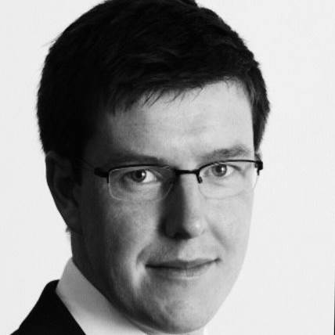
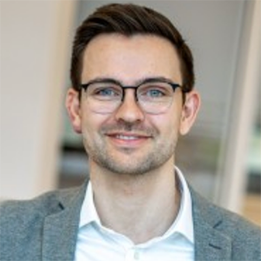
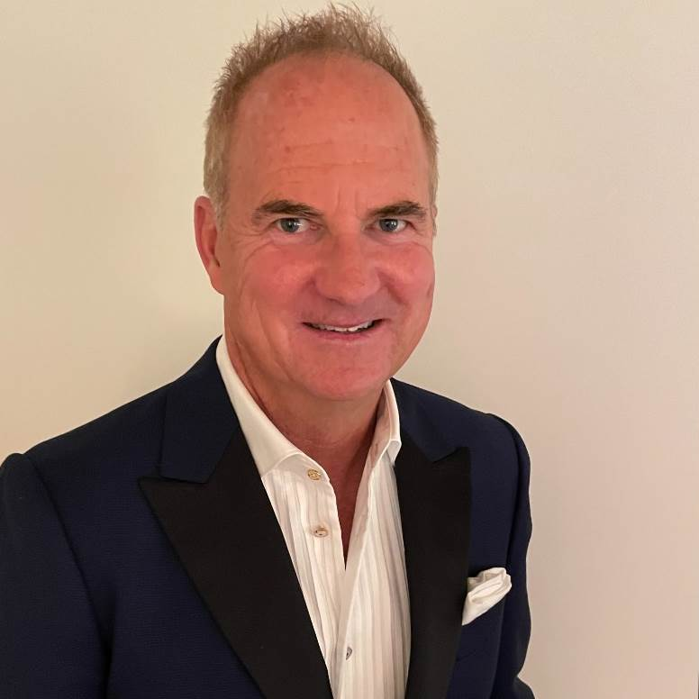
Speakers
Rob Moore
David Steng
Greg Spicer
VP, Technology Risk Management Mastercard
Director, Cyber Risk & Economics
Fresenius Group
Co-Founder & CRO
Ostrich Cyber-Risk

Slide 3
Agenda
Introductions
RISK EXPOSURE
Loss Event Frequency
Loss Magnitude
CRQ Journey
Threat Event Frequency
Susceptibility
Primary Loss
Secondary Loss
Secondary Loss Event Frequency
Secondary Loss
Insights

Slide 4
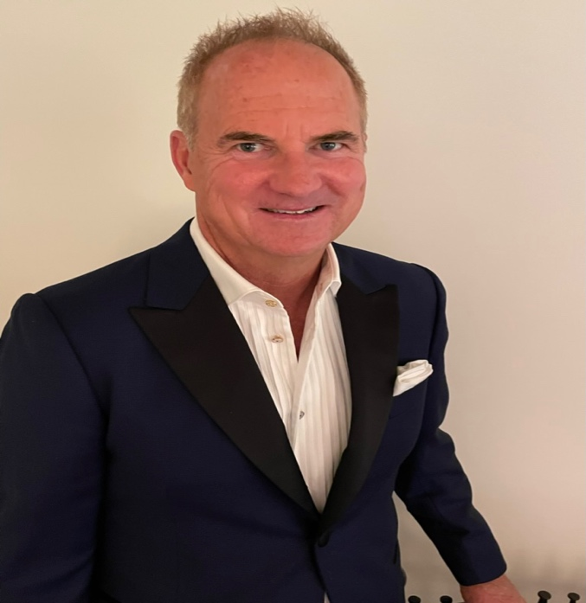
Greg Spicer | Ostrich Cyber-Risk
Co-founded Ostrich Cyber-Risk in 2021. CRO of Ostrich.
Overseeing the development of the Southern California (USA) FAIR Chapter.
20 years of experience in technology, cybersecurity, and risk management across various industries, including finance, healthcare, and insurance.

Slide 5
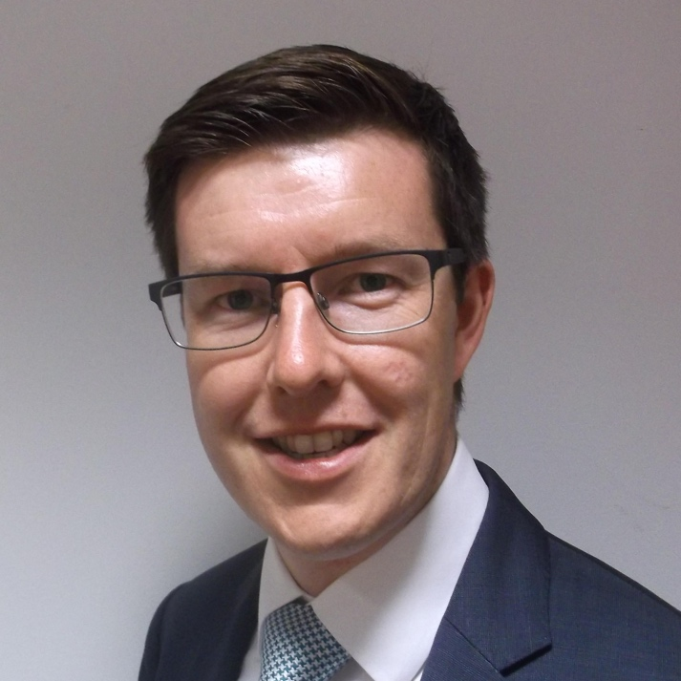
Rob Moore | Mastercard
Joined Mastercard in 2018 and built Security and Operational Risk Assessment function around the FAIR Methodology
Chair of the FAIR Institute London Chapter and Member of the Cyber Risk Institute Standards Committee.
16 years’ experience across risk management and security within the payments and banking sectors
Masters in Risk Management

Slide 6
About Mastercard
5
82
130+
26,000+
Continents
Countries
Office locations
Employees
We power transactions in more than
One of the world’s largest data sets
$90.1 Billion
$6.5 trillion
150 currencies and 210 countries
Transactions switched
Gross dollar volume

Slide 7
FAIR at Mastercard
Risk oversight: Board and committees
Global team of FAIR certified risk professionals
Integrated process with Mastercard's ERM Framework (right)
C-Level reporting that informs Mastercard Board
Supports regulatory obligations
Strategy
Risk governance structure (3 lines of defense)
Risk Identification/ Risk Assessment
Risk Taxonomy
Risk Appetite
Policies and Procedures
Strategic Operational Legal/Regulatory Financial
Risk Appetite Statement
Approach to identify, measure, respond, monitor and report risks
(Principles by each key area of risk company faces)
Corporate Policies/ Procedures
Risk Appetite Metrics and Limits
(Establish risk management principles and controls to manage our risks)
(Quantitative articulation of level of risk the company is willing to take by category)
Risk Exposure
Loss Event Frequency
Loss Magnitude
Threat Event Frequency
Susceptibility
Primary Loss
Secondary Loss
Secondary Loss Event Frequency
Secondary Loss

Slide 8
Building Risk Assessment Capability
Being a risk manager can mean different things to different people - this makes recruitment of the right capabilities difficult
Introducing FAIR Methodology as the first step in building a risk function can embed a baseline set of skills
From a recruitment perspective, promoting FAIR certification can help differentiate risk analysts in the market.
FAIR can be a starting point for building risk management maturity not the end goal.

Slide 9
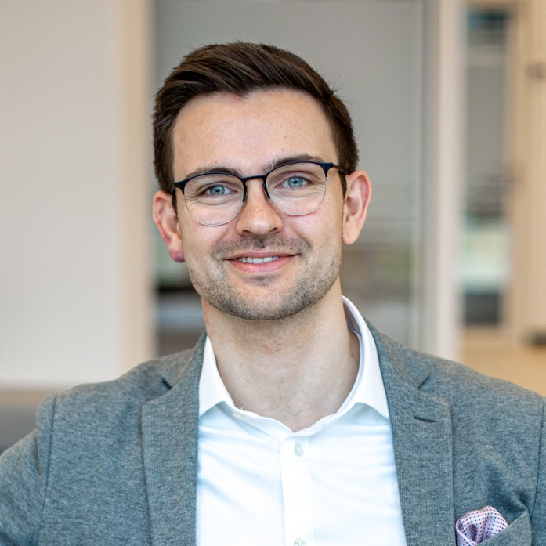
David Steng | Fresenius
Joined Fresenius in 2018 to build the Group Cybersecurity Office
Leads the Group Cyber Risk & Economics function as “Cyber CFO” (risk management, cyber investments, financial management)
Co-Chairs the FAIR Institute Germany Chapter with Sebastian Hoffmann & Gideon Knocke
Background in computer science and business administration

Slide 10
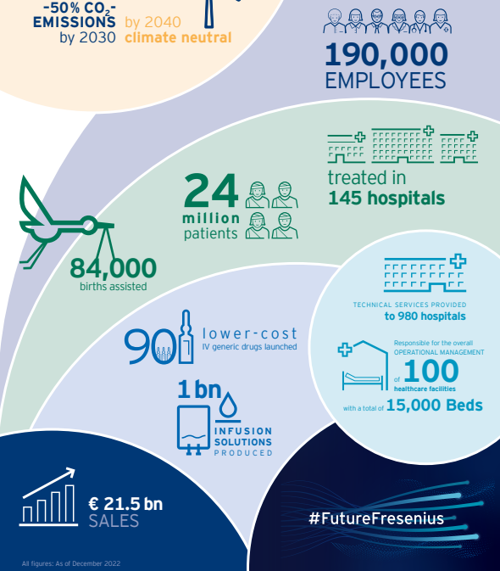

Slide 11
FAIR at Fresenius
PDCA
2019
First experiments with FAIR
Establishing the foundation for strategic cyber risk mgmt.
2021
Defining scenario catalogue
Top CRQ for first BU
Cyber insurance use case
2024
Integrating TPRM
Implementing CRQ solution
Scaling CRQ across all BU‘s
2020
Top CRQ for Corp. functions
Integrating FAIR principles into cyber & enterprise risk mgmt.
2022-2023
Operationalizing CRQ for strategic cyber risk mgmt.
Bi-annual executive reporting on “EBIT@Risk” (95th VaR)
Note: Timeline is not representative due to simultaneous establishment of the cybersecurity function

Slide 12
Use Cases Insights
Use cases and benefits in the early stages of your program
Tips for presenting CRQ output to stakeholders?
Greatest Challenges
Advice to scale and industrialize a CRQ program
ERM Framework integration
CRQ supporting Regulatory requirements

