Slide 1
Case Study Panorama
Econocom and Richemont

Slide 2
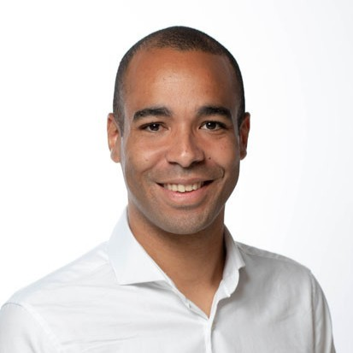
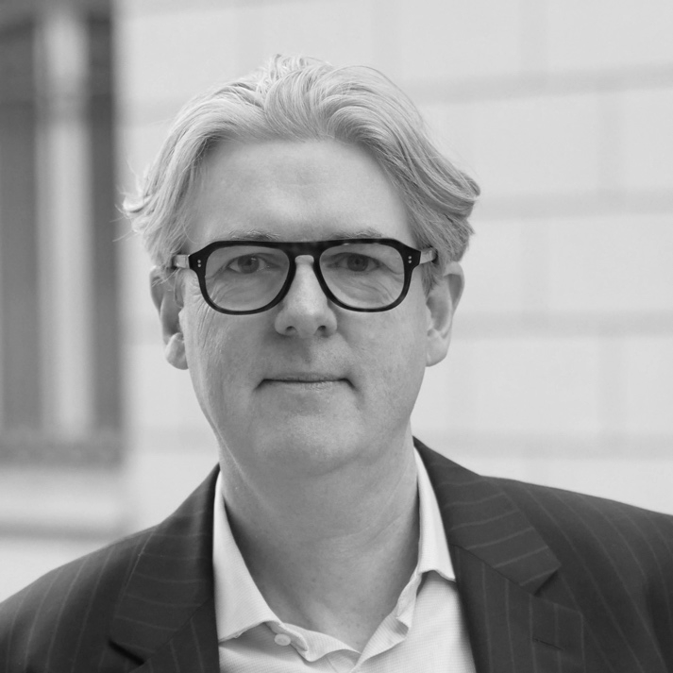
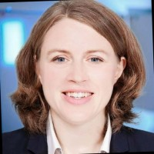
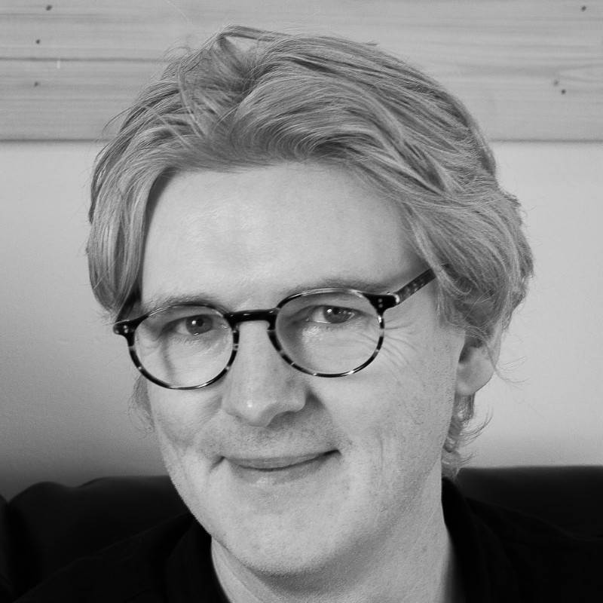
Speakers
Anne Lupfer
Pierre Olodo
Tom Callaghan
Deputy CSO
Econocom
Senior Lead Cyber Risk
Richemont
Co-Founder
C-Risk

Slide 3
Agenda
Introductions
RISK EXPOSURE
Loss Event Frequency
Loss Magnitude
CRQ Journey
Threat Event Frequency
Susceptibility
Primary
Loss
Secondary
Loss
Secondary
Loss Event Frequency
Secondary Loss
Insights

Slide 4
Tom Callaghan | C-Risk
Co-founder of C-Risk
FAIR Institute Advisory Board member
Overseeing the development FAIR Chapters throughout Europe
25 years of experience in various IT and Information Security leadership roles.

Slide 5
Anne Lupfer | Econocom
Joined Econocom in 2023. Deputy Group CISO and Head of Group Cyber Risk Management
Co-Chair of the FAIR Institute Swiss Chapter, with Laura Voicu and Pierre Olodo
20 years’ experience across risk management and Infosec including multiple vCISO roles

Slide 6





Econocom at a glance
Econocom Group in Figures
€2.7 Bn
revenue
in 2023
8,800
employees worldwide
16
Countries
50 years
of experience
4 Business Lines
Equipment
Services
Financing
Audiovisual

Slide 7
FAIR at Econocom
Clients
Law & Regulation
Clients
Laws & Regulations
Global Laws & Regulations
Processes
Activities
Projects
Processes
Activities
Project
Processes
Activities
Project
Enterprise
Risks
Local Info Sec Risks
Mutual reliance
Local Info Sec Risks
Global Info Sec Risks

Slide 8
Pierre Olodo | Richemont
Joined Richemont in 2022. Lead Cyber Risk Management practice within the Group using FAIR methodology.
Co-Chair of the FAIR Institute Swiss Chapter, with Laura Voicu and Anne Lupfer
10 years of experience across risk management and security within audit firms, private banking, and luxury goods sectors.

Slide 9










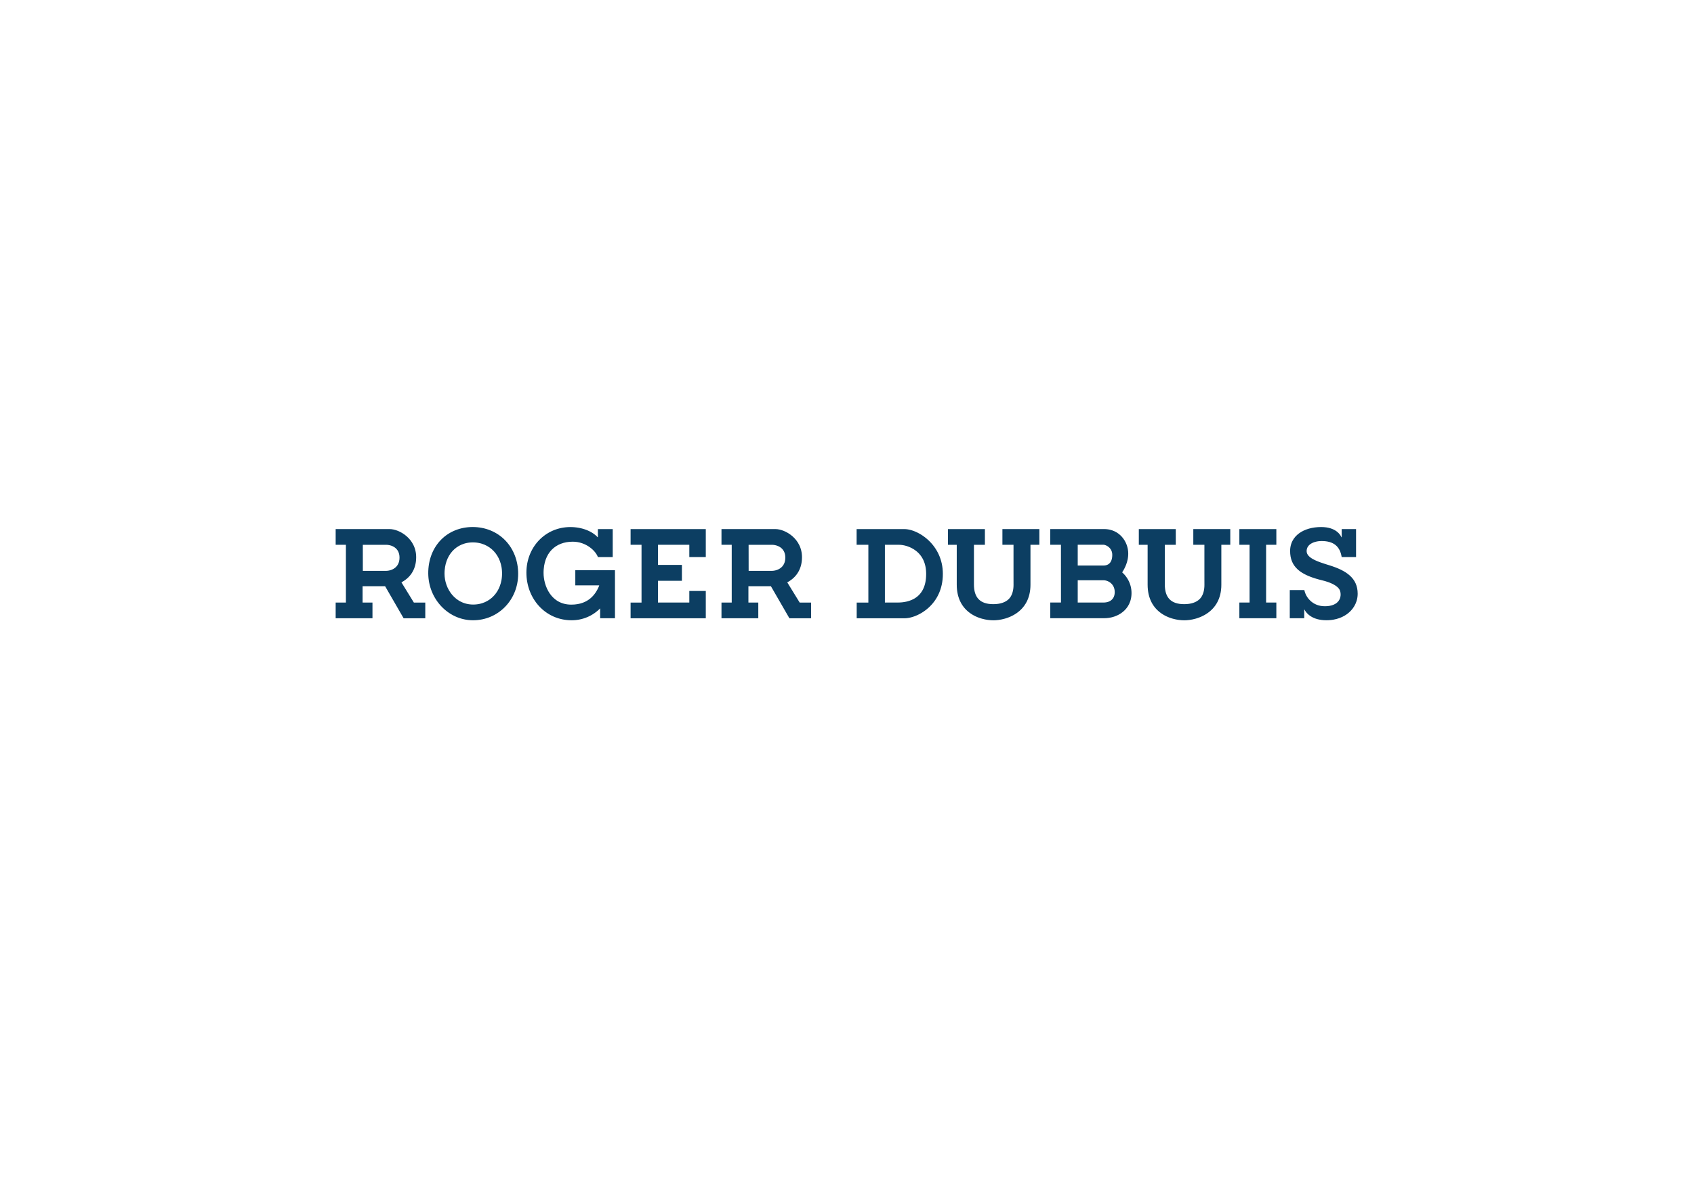





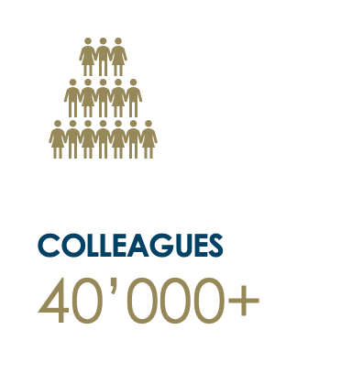










Jewellery Maisons
Richemont at a glance
Specialist Watchmakers
Founded in 1988, one of the world’s leading luxury goods groups.
Our unique portfolio includes prestigious Maisons distinguished by their craftsmanship and creativity.
Fashion
& Accessories / Other

Slide 10







FAIR at Richemont
Business-oriented Initiative
Data Lake implementation in a specific region
Technology-oriented Initiative
Email gateway change
REGION PII RECORDS
data lake
REGION PII RECORDS
External malicious
actor sends social engineering emails
Malicious email in inbox
Successful foothold in network and then successful compromise of PII
Perimeter controls/ Email filtering

Slide 11
Use Cases Insights
Use cases and benefits in the early stages of your program
Greatest Challenges?
Advice to scale and industrialize a CRQ program
Insights on tooling and integration of multiple data sources?
Adoption beyond traditional Infosec

