Slide 1
&
Automating and Scaling FAIR Quantitative Risk Analysis

Slide 2
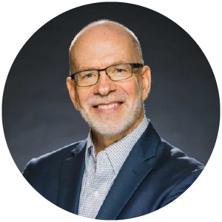
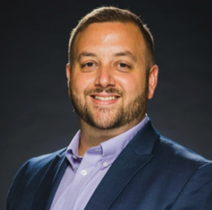
Jack Jones
Nate Papaleo
Chad Weinman
Chairman Emeritus
FAIR Institute
Lead Cyber Risk Analyst
Victoria’s Secret
VP, Risk Strategy & Success
Safe Security
Notes:
Content Brief

Slide 3
Let’s talk medicine…

Slide 4
Medical “epochs”
Medicine is here
Medicine 0.x
Medicine 1.0
Medicine 2.0
Medicine as Craft
Shamanism
Reliance on placebo effect
Bloodletting
Scientific but Reactive
(Focus is on diagnosis and treatment)
Introduction of scientific methods
Has given us advanced:
Diagnostics
Medicines
Surgeries
Roughly doubled our lifespan
Proactive Medicine
(Focus is on “Health-span” — living longer and healthier)
Reduces medical costs
Understanding and treating root causes
Genetics
Environment
Lifestyle

Slide 5
Where is cyber risk management maturity-wise?
Medicine is here
Medicine 0.x
Medicine 1.0
Medicine 2.0
CRM 0.x
CRM 1.0
CRM 2.0
CRM is here
Do NOT confuse technical sophistication with maturity!

Slide 6
Today vs. the future of CRM
CRM 0.x
CRM 1.0
CRM 2.0
CRM as craft
Scientific but reactive
Proactive CRM
FUD
Reliance on “best practice”
Focus on compliance
Reliance on mental models
Reliance on qualitative measurement
(Focus on diagnosis and treatment)
Introduction of science
Formal analytic models (e.g., FAIR)
Quantitative measurement
Use (and sharing) of data
Diagnosis
Event detection
Malware recognition
Behavioral analysis
Treatment
Accurately prioritized remediation
“Personalized” solution recommendations
(Focus on preventing “disease”, and improving organization “health-span”)
Understanding and treating root causes
Organization environmental factors
Organizational “Life style” choices
Organization “genetics”
Advanced scientific methods
Advanced application of ML and AI
Synthetic risk experimentation
Cyber “genetic engineering”

Slide 7
The FAIR Model — introducing science into risk measurement
Risk
Loss Frequency
Loss Magnitude
Threat Event Frequency
Susceptibility
Primary Loss
Secondary Risk
Contact Frequency
Probability of Action
Loss Event Frequency
Loss Magnitude
Notes:
This is our taxonomy... don’t worry it goes deeper, but rarely do we go there.
Discussion opportunity!
Notice that risk is made up of what?
Where is vulnerability?

Slide 8
FAIR-CAM — Understanding and measuring control efficacy
Directly affect the frequency or magnitude of loss
Indirectly affect risk
Enable well-informed decisions
Personnel
Anti-malware
Access privileges
Data recovery processes
Etc…
Asset management
Threat intelligence
Anti-phishing training
Risk analysis
Etc.
Decision Support Controls
Assets
Risk
Ransomware outage via a phishing attack
Loss Event Controls
Controls
Scanning
Patching
Anti-phishing testing
Change management
Etc…
Variance Mgmt. Controls
Threats
Affect the reliability of other controls

Slide 9
Today vs. the future of CRM
CRM 0.x
CRM 1.0
CRM 2.0
CRM as craft
Scientific but reactive
Proactive CRM
FUD
Reliance on “best practice”
Focus on compliance
Reliance on mental models
Reliance on qualitative measurement
(Focus on diagnosis and treatment)
Introduction of science
Formal analytic models (e.g., FAIR)
Quantitative measurement
Use (and sharing) of data
Diagnosis
Event detection
Malware recognition
Behavioral analysis
Treatment
Accurately prioritized remediation
“Personalized” solution recommendations
(Focus on preventing “disease”, and improving organization “health-span”)
Understanding and treating root causes
Organization environmental factors
Organizational “Life style” choices
Organization “genetics”
Advanced scientific methods
Advanced application of ML and AI
Synthetic risk experimentation
Cyber “genetic engineering”

Slide 10
What it will take to move the needle…
Our profession won’t achieve CRM 1.0 until quantitative methods are mainstream.
Quantitative methods won’t be mainstream until CRQ becomes more scalable and efficient.

Slide 11
Where CRQ Programs are Today
Static, Manual, Cumbersome
Point-in-time analysis with based on SME estimates
Narrow view of overall landscape
No visibility of high impact risk reduction
Board does not understand Materiality / Risk Reporting
Elevate
Your Cyber Risk Management
Strategy
Where leading programs will be Tomorrow
Real-time, AI-Driven, Easy
Automated, Real-Time Risk, Controls driven
Visibility across entire landscape
Prioritized Risk Actions and Investments
Customizable and Friendly Dashboards for Communication
Notes:
Risk trending Trendlines / heatmap Risk treatment / comparison How to burn risk Integration options 100+ Safe GPT (what the future looks like)

Slide 12
What does this mean for you if you are a Risk Analyst? How does your role change?
What does this mean for you if you are a Program Leader?

Slide 13
Victoria’s Secret
Why did we create a quantitative risk program?
Where did we start?
What are the challenges?

Slide 14
How can we overcome our challenges?
What are the emerging challenges?

Slide 15
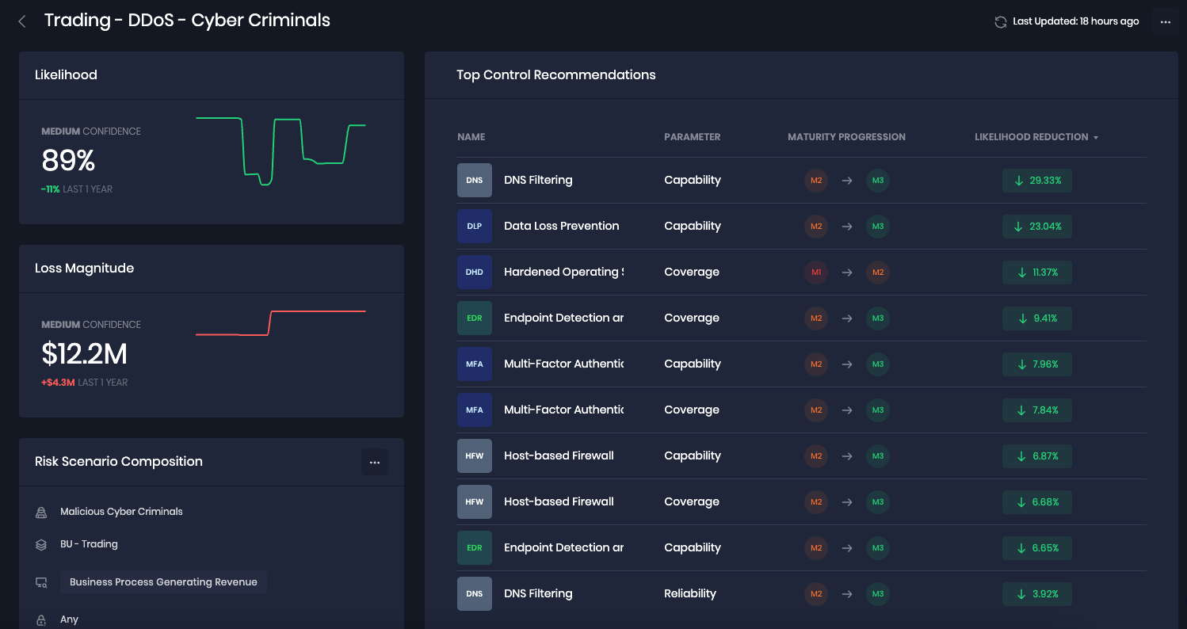

Slide 16
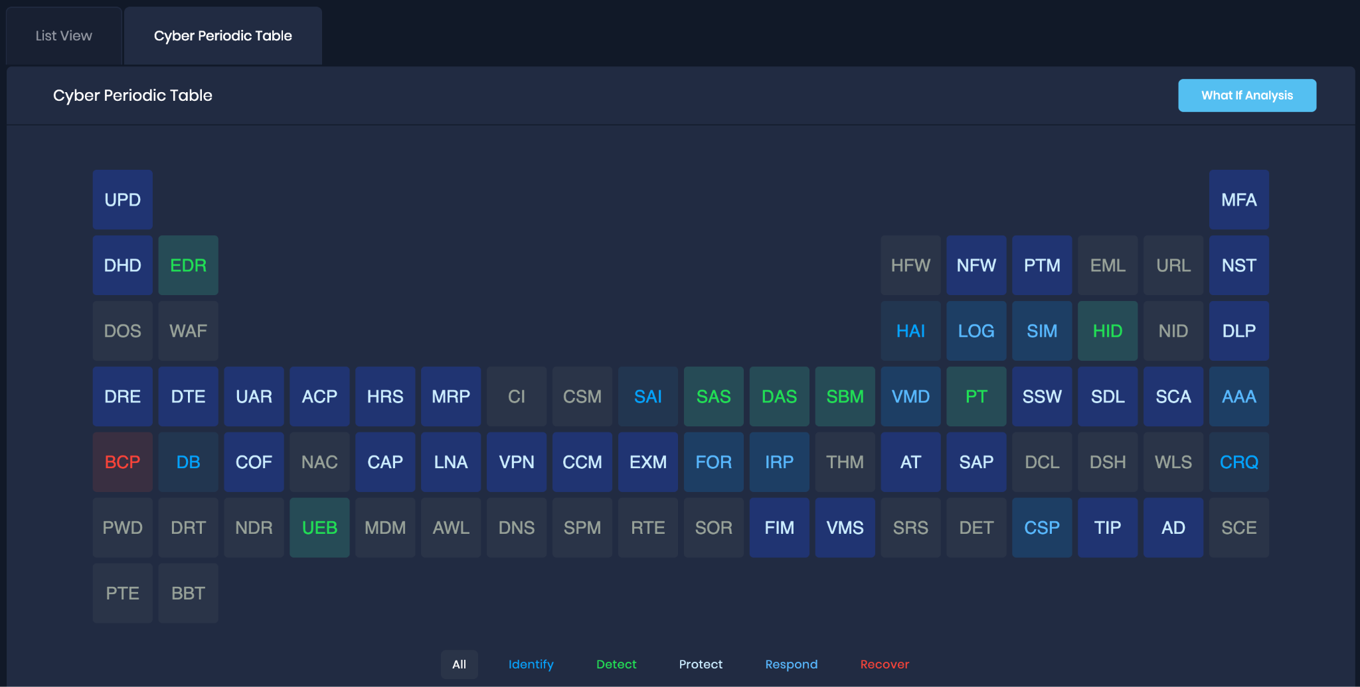
Powered by FAIR-CAM™

Slide 17
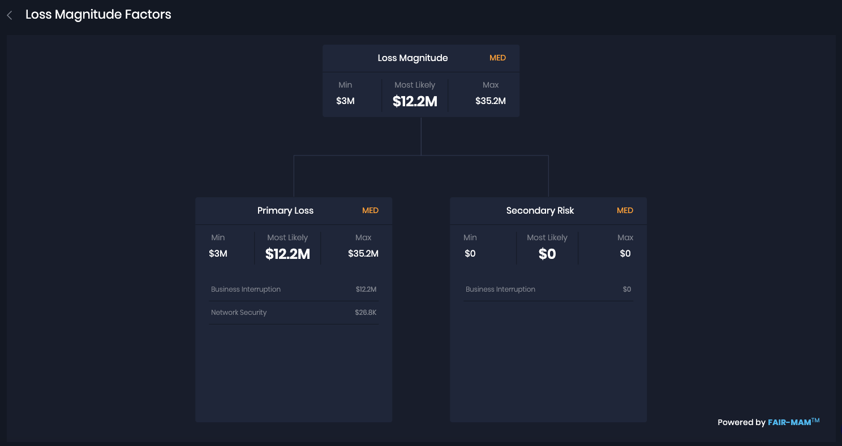
Powered by FAIR-MAM™

Slide 18
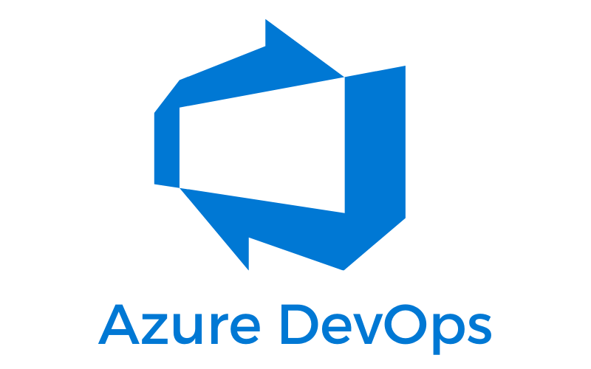
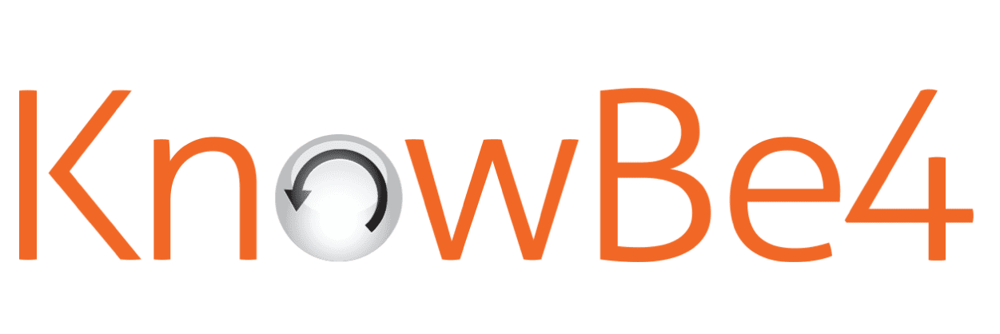
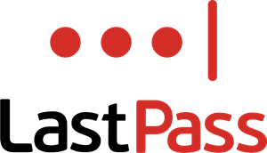
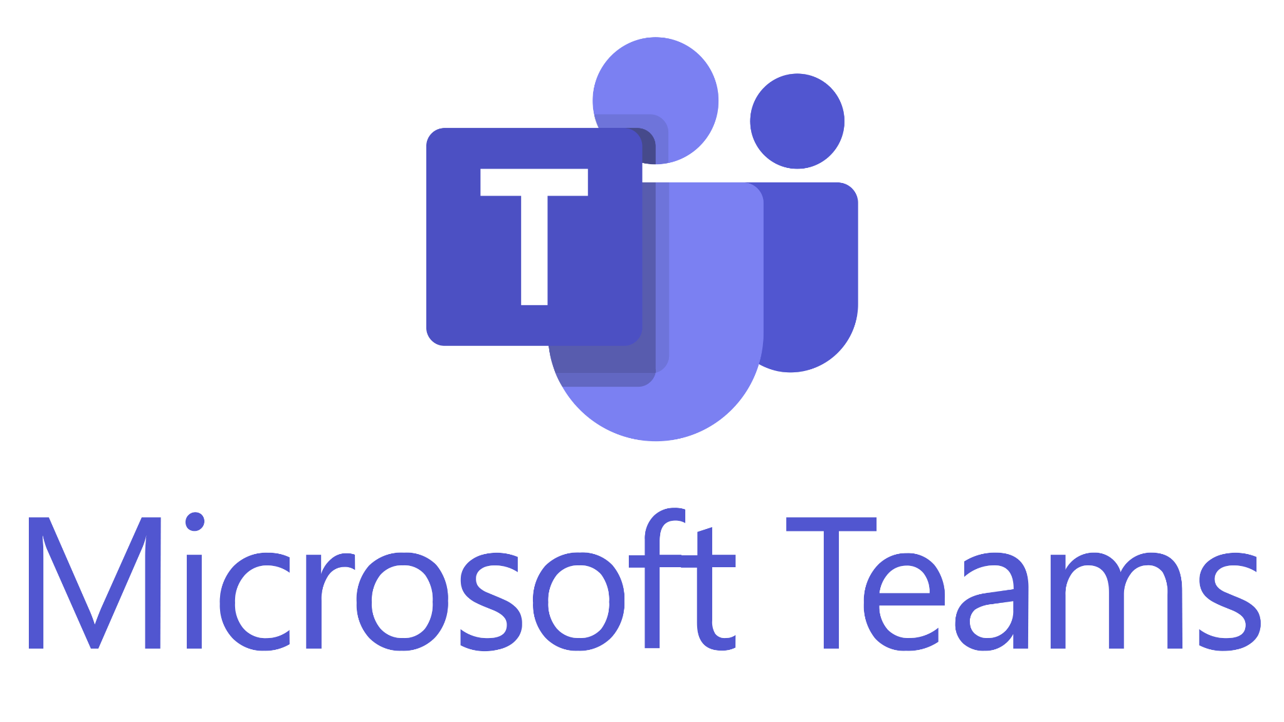
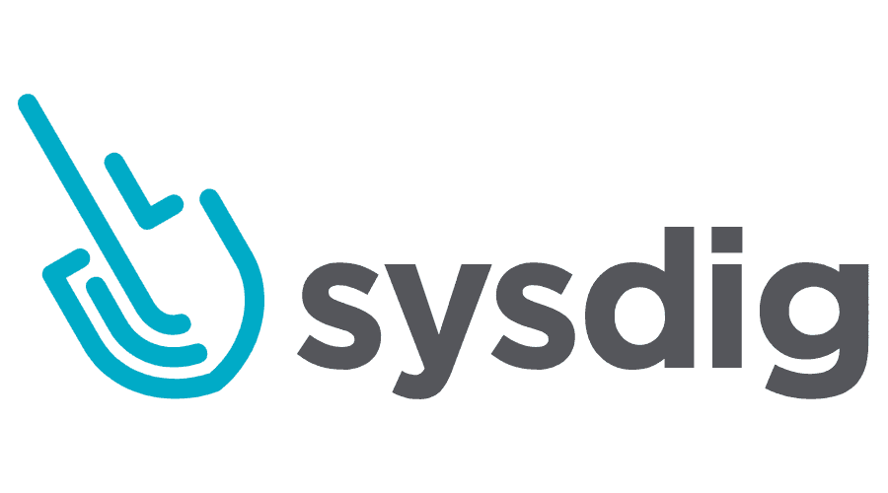
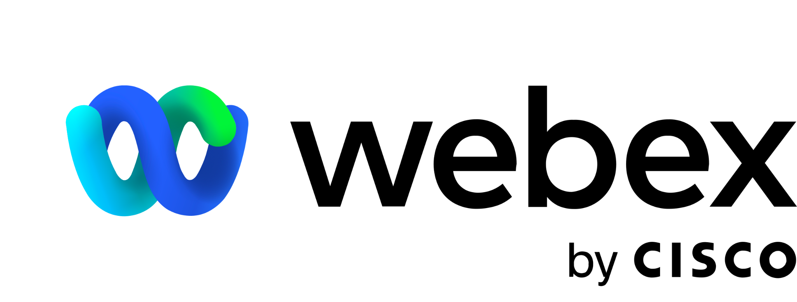
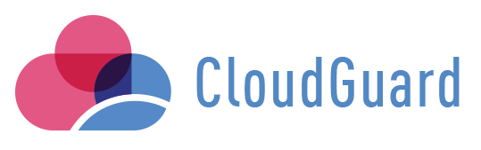
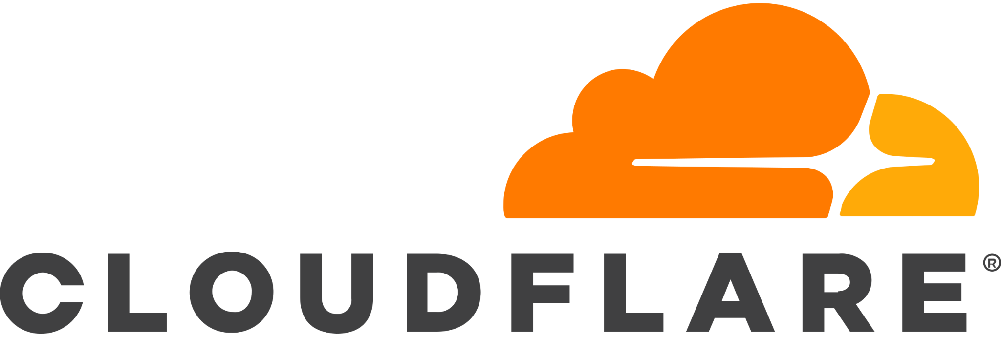
100+ Integrations
And Many More…
Slack, Asana, Gong, Hubspot, GitLab, SendGrid, Bamboo HR, Fastly, Cisco Meraki, Cisco Secre Endpoint, Cisco Umbrella, Atlassian Confluence, Atlassian Jira, Atlassian Opsgenie, GitHub, Bitbucket, Datadog, and many more.

Slide 19
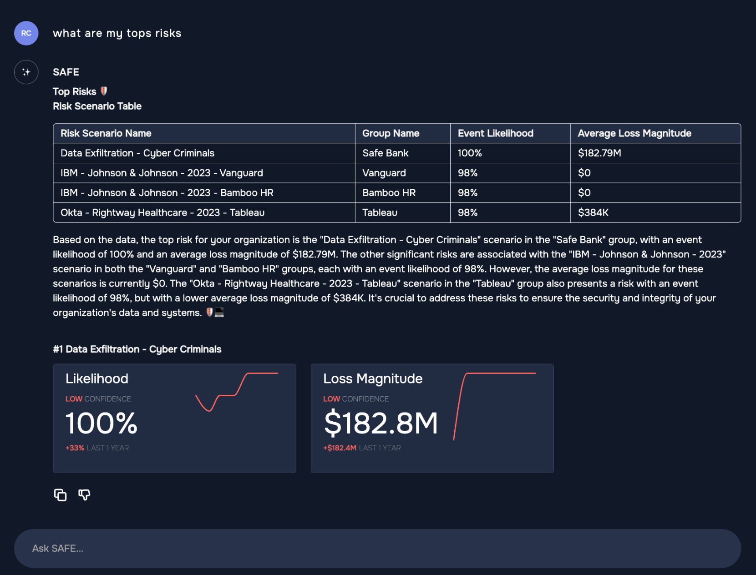
SAFE GPT

Slide 20
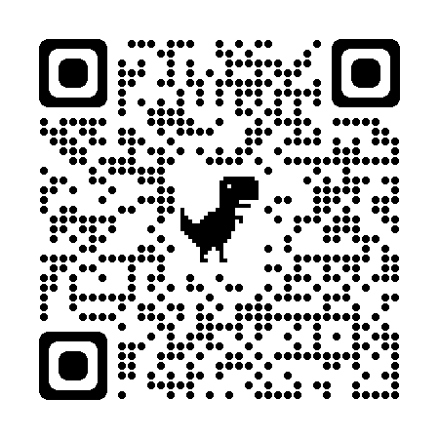
Learn more about SAFE and the FAIR Institute
Schedule a 1-Hr Virtual Workshop for Automating FAIR
https://bit.ly/SAFE-VWorkshop
www.safe.security
www.fairinstitute.org
Notes:
Schedule a 1 hr Virtual Workshop for automating fair
Program assessment
Playbook for moving to an automated fair
Define key outcomes

