Slide 1
assessing & Quantifying enterprise genai risk
Mike Radigan, Cyber Risk Advisor @ Cisco
Greg Spicer, Co-Founder & CRO @ Ostrich
December 10, 2024

Slide 2

Meet Your Speakers

Slide 3
What to expect from today’s webinar
A practitioners thought process on how to apply the FAIR-AIR Playbook
How to deconstruct the “problem” of quantifying GenAI risk
Useful resources

Slide 4

(Is)
GenAI adoption is exposing you to new risks!
(?)
Notes:
This is what we are being told … is it true?
Whose perspective? Today let’s assume we are under the CISO organization, have the responsibility of cyber risk analysis. Now what do you think?
The Financial Impact side of the equation isn’t “new” – 6 forms of loss or FAIR-MAM will still apply
The knowledge required to understand the “new” ways we can experience the 6 forms of loss is not familiar to the cyber risk analyst. What do we know about the models and algorithms? What about the compute, where is it located, how is it connected and protected? Where is the data?
What are the top financial exposures? What would need to play out for the organization to have a material financial loss? What is the probability of this occurring? Is it a cyber threat actor that can do this harm?

Slide 5
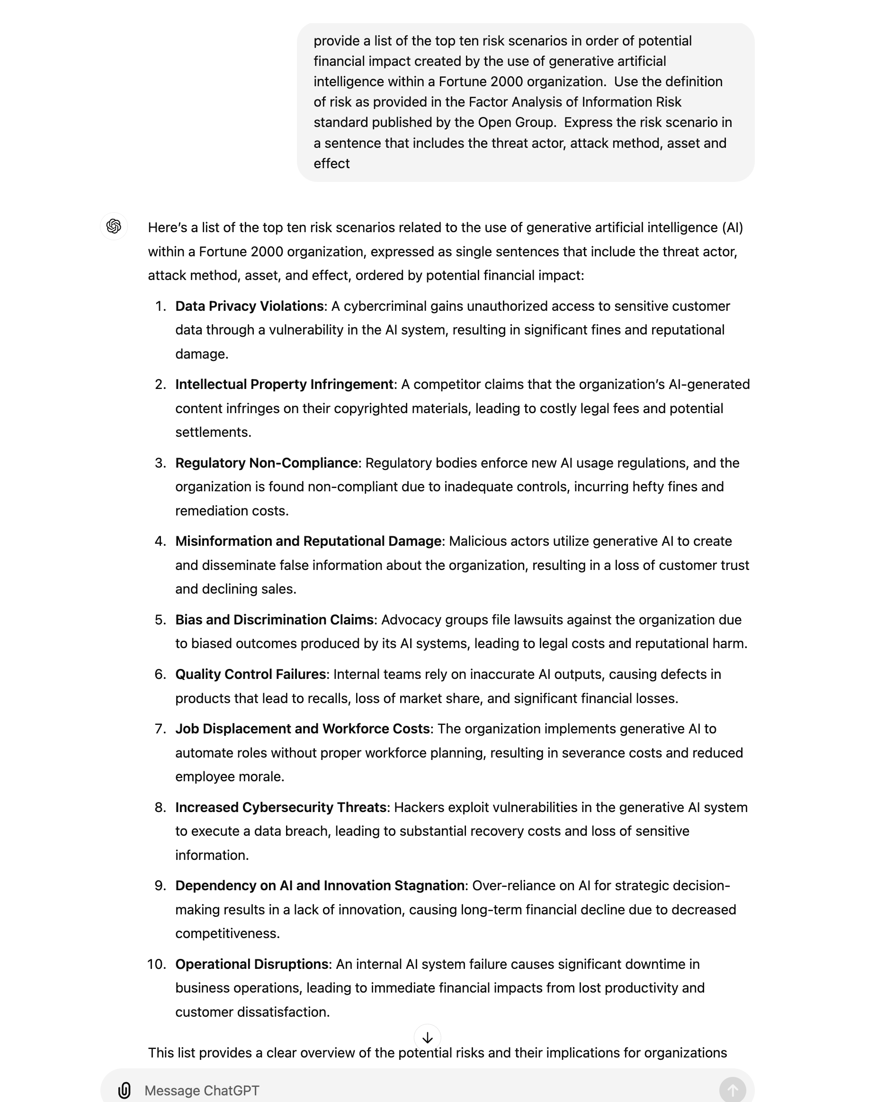
Let’s ask ChatGPT!
Notes:
Let’s ask the devil himself .. ChatGPT

Slide 6
Top 10 Risks of Deploying GenAI
Data Privacy Violations
Intellectual Property Infringement
Regulatory Non-Compliance
Misinformation and Reputational Damage
Bias and Discrimination Claims
Quality Control Failures
Job Displacement and Workforce Costs
Increased Cybersecurity Threats
Dependency on AI and Innovation Stagnation
Operational Disruptions
Notes:
On a first pass, here are the results.
Let’s triage these and determine how many are due to “cyber threats” and the loss forms fall nicely into our three buckets of C.I.A.
The FAIR AI Working group member Arun Pamulapati, AI expert at Databricks, conducted an exercise to build risk scenarios that should be considered when building foundational LLM’s. Of the 55 risk scenarios they defined, 35 of them could be categorized as cyber risks where 20 of the 55 were novel risks.

Slide 7
Top 10 Risks of Deploying GenAI
C
Data Privacy Violations
Intellectual Property Infringement
Regulatory Non-Compliance
Misinformation and Reputational Damage
Bias and Discrimination Claims
Quality Control Failures
Job Displacement and Workforce Costs
Increased Cybersecurity Threats
Dependency on AI and Innovation Stagnation
Operational Disruptions
X
X
-----------------------------------------------------------------
X
X
X
C
X
A
Notes:
On a first pass, here are the results.
Let’s triage these and determine how many are due to “cyber threats” and the loss forms fall nicely into our three buckets of C.I.A.
The FAIR AI Working group member Arun Pamulapati, AI expert at Databricks, conducted an exercise to build risk scenarios that should be considered when building foundational LLM’s. Of the 55 risk scenarios they defined, 35 of them could be categorized as cyber risks where 20 of the 55 were novel risks.

Slide 8
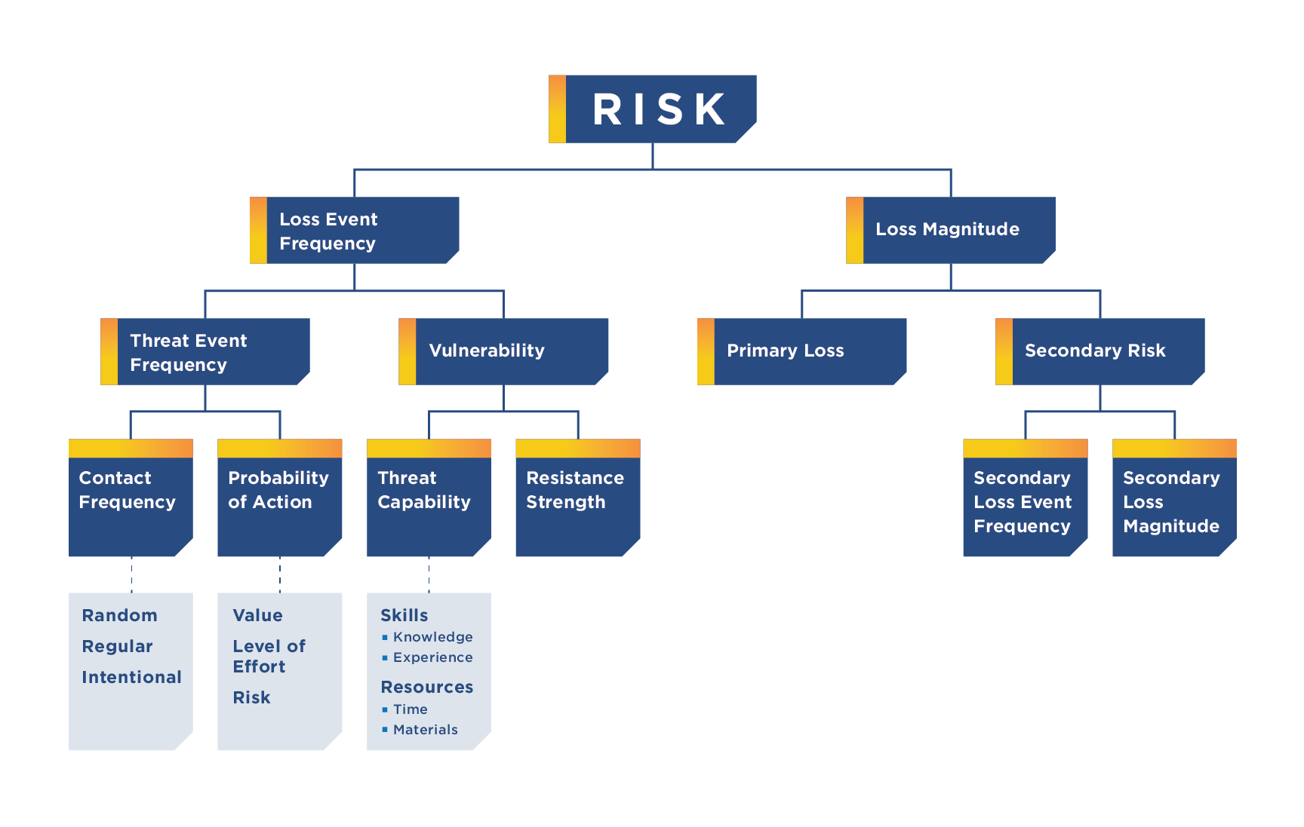
The Open FAIR™ Body of Knowledge
Resources
Risk Analysis (O-RA), Version 2.0.1
Risk Taxonomy (O-RT), Version 3.0.1
Open FAIR™ Risk Analysis Process Guide
Open FAIR™ Defines How Risk Works
Notes:
Reminder the FAIR MODEL is agnostic, we can analyze any risk issue in any domain.
We are going to apply the processes of Risk Analysis and use the Taxonomy to analyze any risk issue

Slide 9

https://www.fairinstitute.org/ai-risk
Notes:
As a FAIR practitioner, I look to the FAIR Institute and its community to provide me resources to help me take on challenges like this and apply my skills as a risk analyst
Having the risk knowledge and tools is essential to be efficient and accurate.

Slide 10





FAIR AIR
PRIORITIZE/ TREAT
DECISION MAKING
CONTEXTUALIZE
SCOPE
QUANTIFY
Understand what you’re quantifying
Identify vectors of AI risk
Decide what risks you’re trying to mitigate
Visualize risk scenarios within chosen vector
Identify the attack surface, threat actor, method of attack, and impact of threat on your asset
Create a risk statement
Analyze data and quantify your risk
Review outcomes within ‘loss event frequency’ and ‘loss Magnitude
Actionable Insights from quantification scenarios
Pinpoint mitigation options with the largest impact
Gather all quantified data, and treatment options
Decide plan for execution and tools based on threat impact
Notes:
THIS IS AN OVERVIEW OF THE FAIR AIR PROCESS – THIS SHOULD LOOK VERY FAMILIAR, IT’S THE RISK ANSLYSIS PROCES – STARTING WITH UNDERSTANDING THE “WHY”, WHAT DECISION IS BEING SUPPORTED, HOW IMPORTANT IS THIS TO THE ORGANIZATION, HOW MUCH EFFORT SHOULD BE INVESTED
THEN YOU SCOPE THE RISK ISSUE, BUILD THE SCENARIOS AROUND THE “BAD THINGS” THAT ARE POSSIBLE, HOW CAN THEY MATERIALIZE, … YOU KNOW THE DRILL
THE FAIR MODEL THEN DIRECTS US TO FIND THE DATA, ACCOUNT FOR THE UNCERTAINTY AND RUN THE COMPUTATIONAL ENGINE THAT WILL INFORM US AS TO THE PROBABILITIES OF THE SCENARIOS AND OUTCOMES.
WE ARE NOW IN A POSITION TO COMPARE RISK ISSUES, PERFORM WHAT-IF SCENARIOS FOR MITIGATION OPTIONS AND INFORM OUR DECISION MAKERS OF THEIR OPTIONS.
In this first phase you will want to understand the why behind the risk analysis you are doing. Who are you doing an assessment for, what decisions are they trying to make? Why are they trying to make these decisions?

Slide 11
Defining Success – Contextualize
PRIORITIZE/ TREAT
DECISION MAKING
CONTEXTUALIZE
SCOPE
QUANTIFY
What is our desired outcome from the work we are doing
Who is it for?
What is the decision(s) to be supported?
How much risk is associated with … ?
What is the timeframe / deadline?
What is the Gen AI Vector:
  Shadow Gen AI
  Hosting an LLM
  Active Cyber Attacks
  Foundational LLM
  Managed LLM
Notes:
In this first phase you will want to understand the why behind the risk analysis you are doing. Who are you doing an assessment for, what decisions are they trying to make? Why are they trying to make these decisions?

Slide 12

Gen AI Vectors
Shadow GenAI
You’re using GenAI - you just don’t know it
Foundational LLMs
You are building foundational LLMs
Hosting on LLMs
Using them to develop use cases
Managed LLMs
Developing use cases with third-party LLMs
3rd Party GenAI
You’re suppliers are using your data to inform their AI
Active Cyber Attack
Your adversaries are using LLMs to attack
Notes:
What vectors will you be approach as an organization. Based on the survey results I have identified the following vectors:

Slide 13
Scope (Scenarios)
CONTEXTUALIZE
SCOPE
PRIORITIZE/ TREAT
DECISION MAKING
QUANTIFY
What assets (attack surface) are impacted by Gen AI Vector?
What are we concerned will happen to these assets through Gen AI Vector
Who has access to Gen AI Vector?
What are the current use cases for Gen AI Vector?
Do you have any known threats via Gen AI Vector?
What LLM is Gen AI Vector based on?
Notes:
Focus on your most relevant vector and think through which risk scenarios to quantify, based on the priorities of the business. In this phase, you will work to identify your assets, the relevant threats, and effects. After you understand the key assets within your chosen AI vector you can properly scope the scenarios used to quantify your risk.
Here are some sample scenarios for each of the 5 vectors.

Slide 14
Shadow GenAI
Loss scenarios due to Internal Threat
Leaking company-sensitive information via an open-source LLM Models such as ChatGPT.
  Marketing conducting comparative competitive analysis releases competitive advantage IP resulting in lost sales.
  Sales reps analyzing target accounts based on installed base data resulting in customer data compromise.
  Product management analyzing the top features for the roadmap resulting in competitive (IP) theft and loss of market share or sales.
  R&D releases source code resulting in zero-day vulnerabilities being used to exploit products resulting in reputational damage, lost sales.
Using LLMs to complete a use case-specific job duty that is mission critical, and the LLM provides input to the process that is inaccurate or inappropriate resulting in delays and lost revenue.
Using LLMs to complete a use case-specific job duty and the LLM goes offline, causing an outage to a mission-critical process – think no business continuity plan (BCP).

Slide 15
Foundational LLMs
Loss Scenarios due to External Threats
  Prompt Injection Attacks: Malicious intent inputs result in sensitive information compromise or producing “harmful content” resulting in lawsuits
  Data Poisoning: Malicious data is introduced into the training set leading to model manipulation generating harmful content, biased outputs or sensitive information compromise.
  Model Inversion and Extraction: Extracting training data resulting in sensitive information (PII) resulting in confidentiality compromise.
  Adversarial Examples: Inputs designed to cause the model to make mistakes result in harmful or incorrect outputs.
Loss Scenarios due to Internal Threats
  Developer are not using safety controls leading to unexpected output for the LLM resulting in negative reaction by stakeholders
  Developer using training data without appropriate permissions to use to train the model resulting in privacy violation or IP theft lawsuits
  Developer training the model without using the appropriate safeguards to ensure the integrity of the outcomes is not corrupted by bias with data inputs resulting in negative reaction from stakeholders.
  Using LLMs to complete a use case-specific job duty and the LLM goes offline, causing an outage to a mission-critical process – think no business continuity plan (BCP).

Slide 16
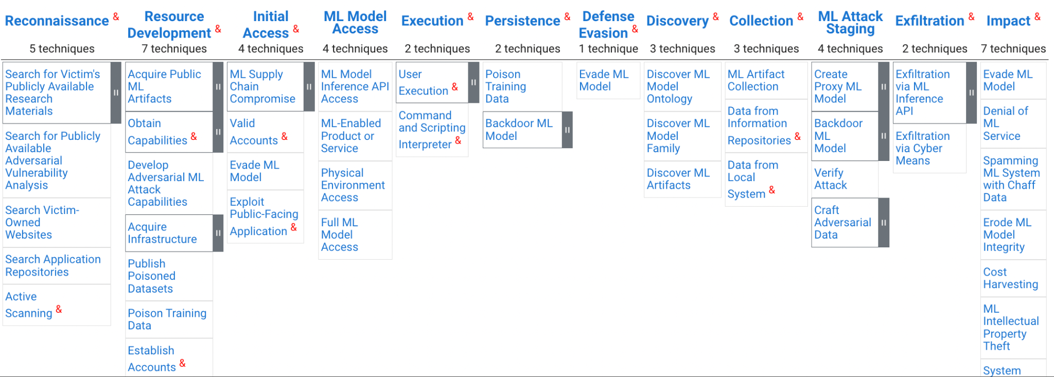
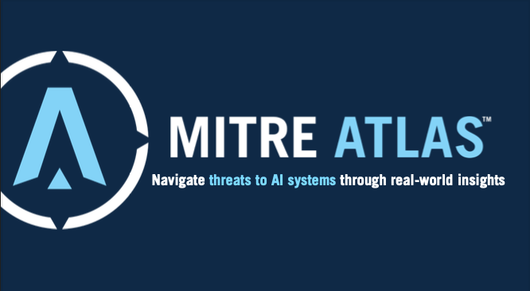
MITRE ATLAS
ADVERSARIAL THREAT LANDSCAPE FOR ARTIFICIAL-INTELLIGENCE SYSTEMS
Source: https://atlas.mitre.org/matrices/ATLAS
Notes:
ATLAS (Adversarial Threat Landscape for Artificial-Intelligence Systems) is a globally accessible, living knowledge base of adversary tactics and techniques against Al-enabled systems based on real-world attack observations and realistic demonstrations from Al red teams and security groups.

Slide 17
QUANTIFY
PRIORITIZE/ TREAT
DECISION MAKING
CONTEXTUALIZE
SCOPE
QUANTIFY
Triage a list of partially scoped scenarios; Perform full risk analysis on those with the largest impact based on the context and full scope.

Slide 18
QUANTIFY
What are the key risk drivers in the identified scenarios?
  Number of employees with access to IP / PII / PHI / Confidential Data (salaries, strategic plans, etc.)
  Existing DLP (insider risk) controls
  Data governance maturity
  Record count exposed
  Incident response effort
  Response to customers and/or regulators
  Fines and judgments

Slide 19
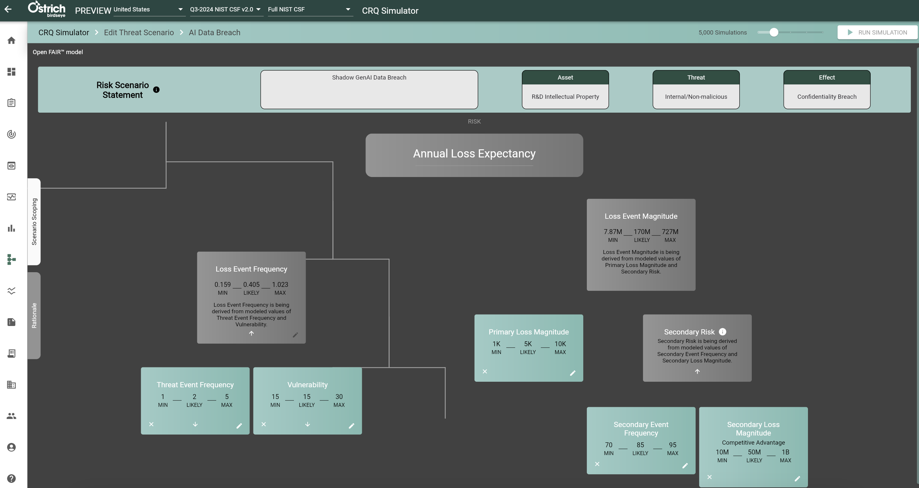
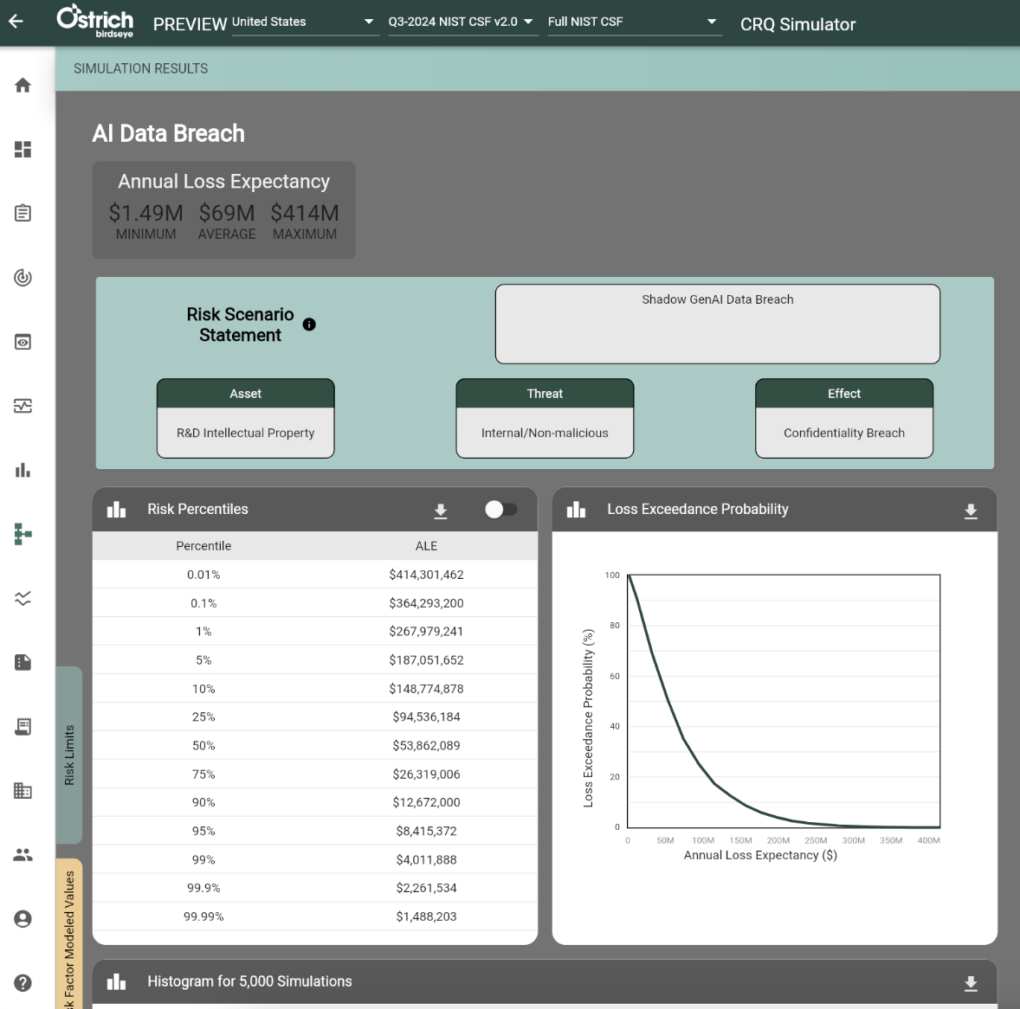
Notes:
IP released via Shadow IT / GenAI

Slide 20
PRIORITIZE / TREAT
PRIORITIZE/ TREAT
DECISION MAKING
CONTEXTUALIZE
SCOPE
QUANTIFY
Prioritize risk scenarios using ALE, SLE magnitude, Loss Exceedance Curve
Treat based on cost-benefit of mitigation solution options
Notes:
andPri

Slide 21
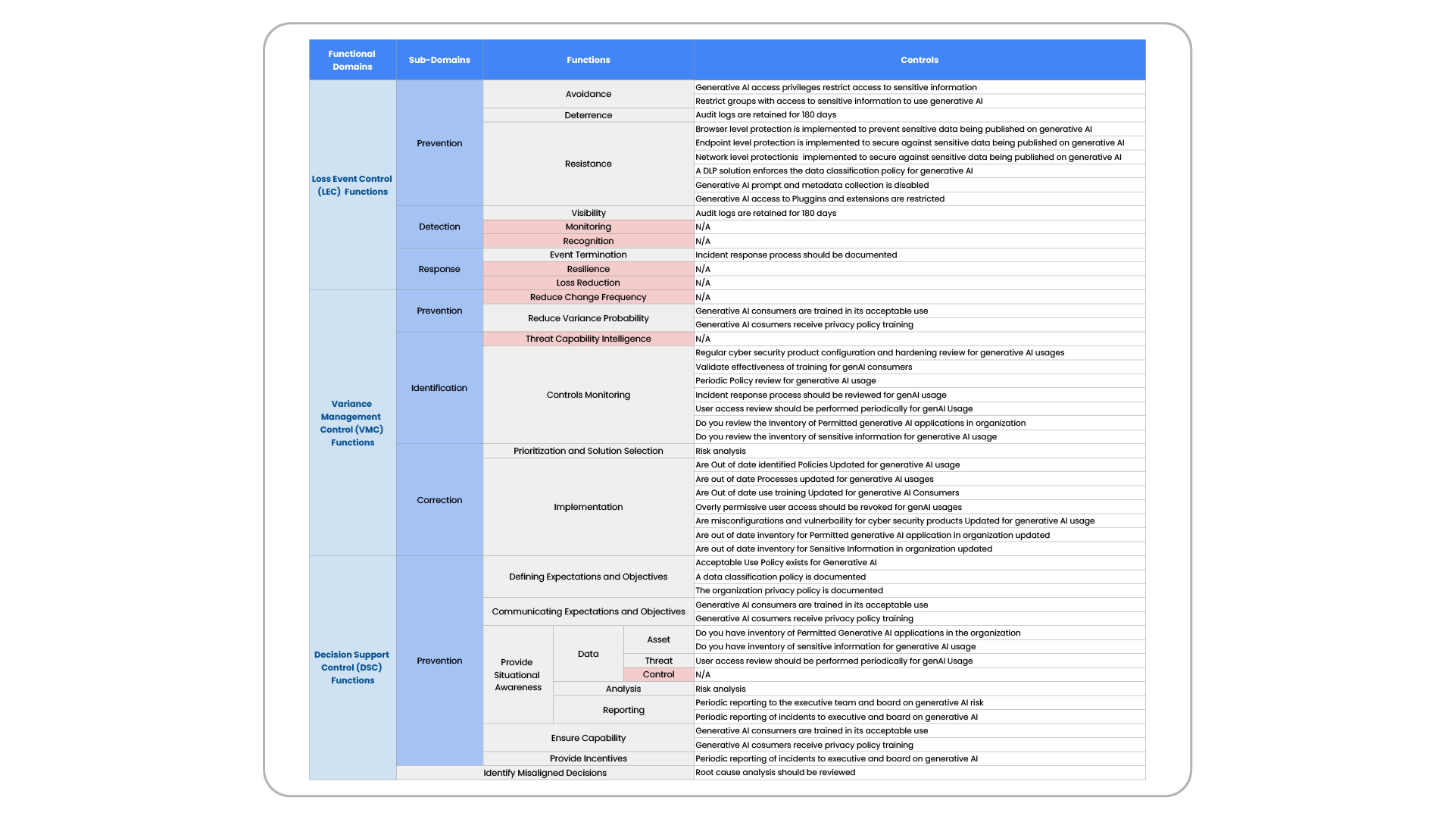
GenAI Control Library: Loss of Confidentiality
Source: Accelerating your GenAI adoption through AI Risk Posture Management; FAIR Conference 2023

Slide 22
prioritize / treat
What controls will have the largest impact on risk?
  Implement DLP, user training, blacklist
  Evaluation of impact through both velocity and spend
By how much will they reduce risk?
  Cost benefit analysis shows reduction in ALE
  Decision to mitigate/accept/transfer

Slide 23
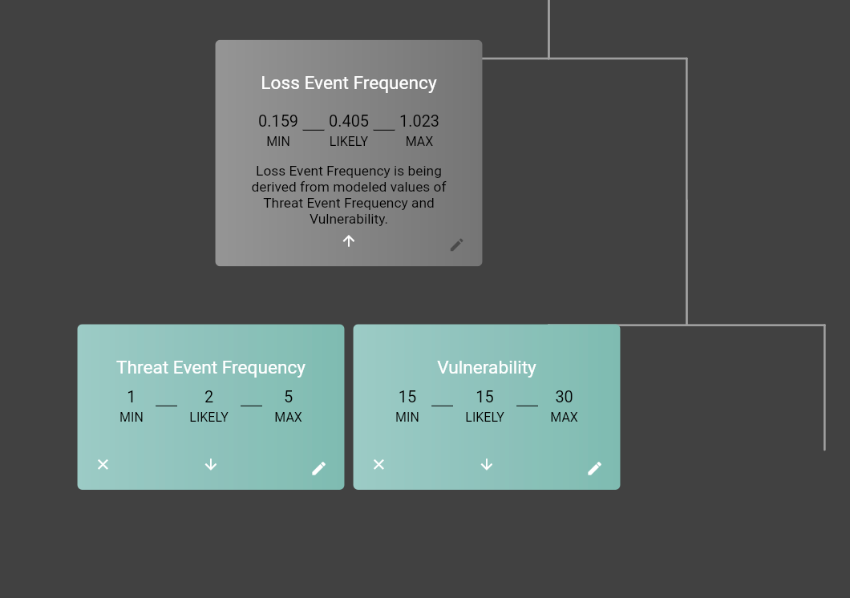
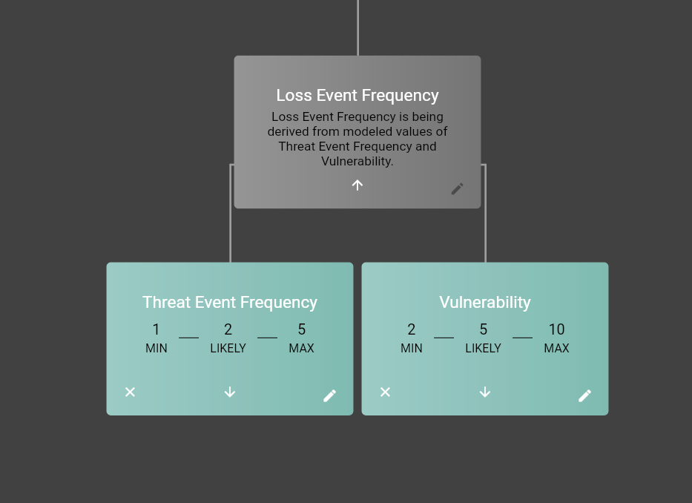
Current State: ML Vulnerability @ 15% w/low confidence
Future State: ML Vulnerability @ 5% w/medium confidence

Slide 24
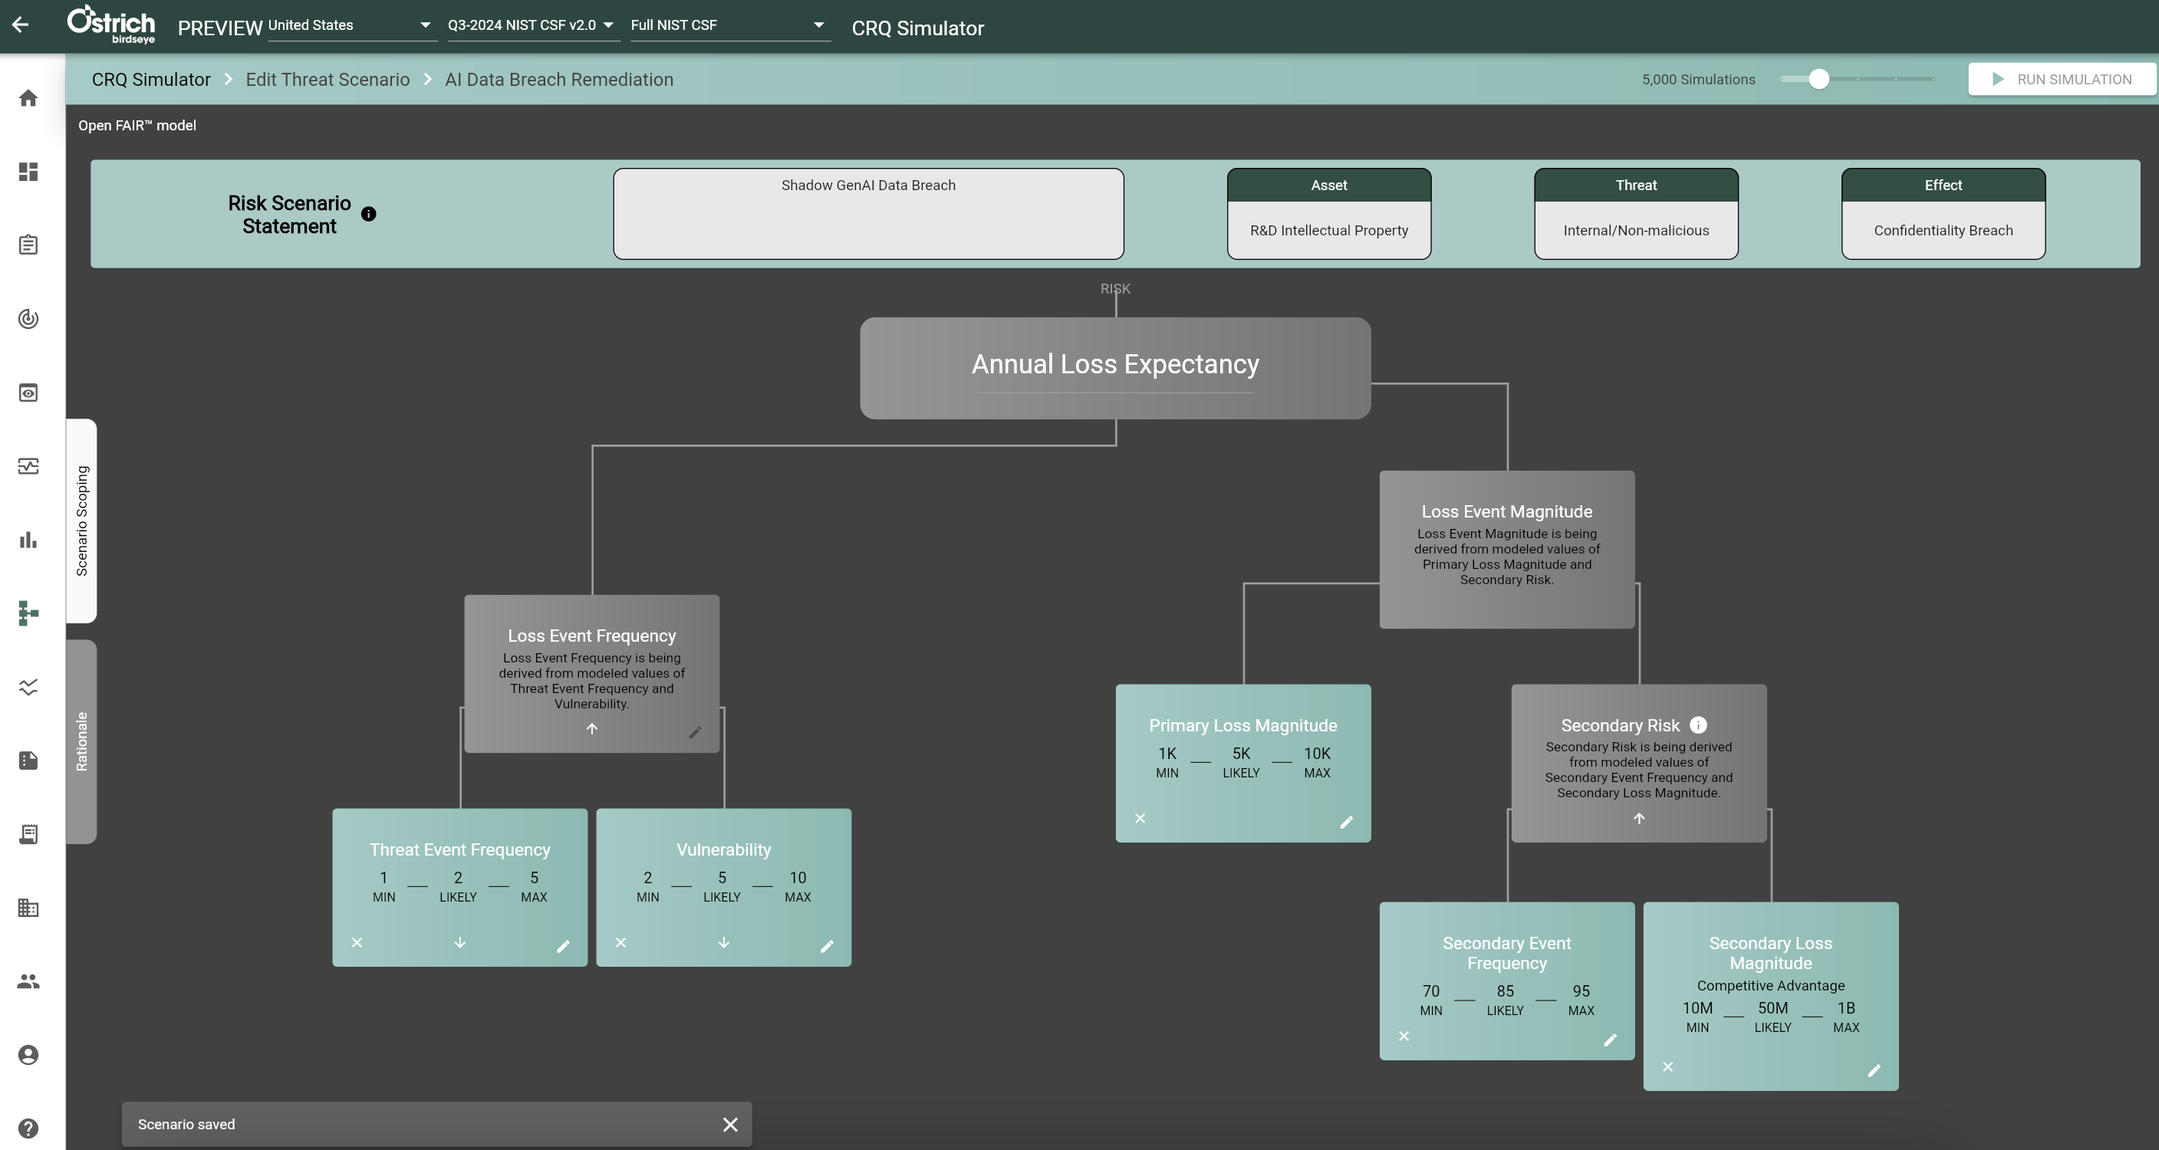

Slide 25
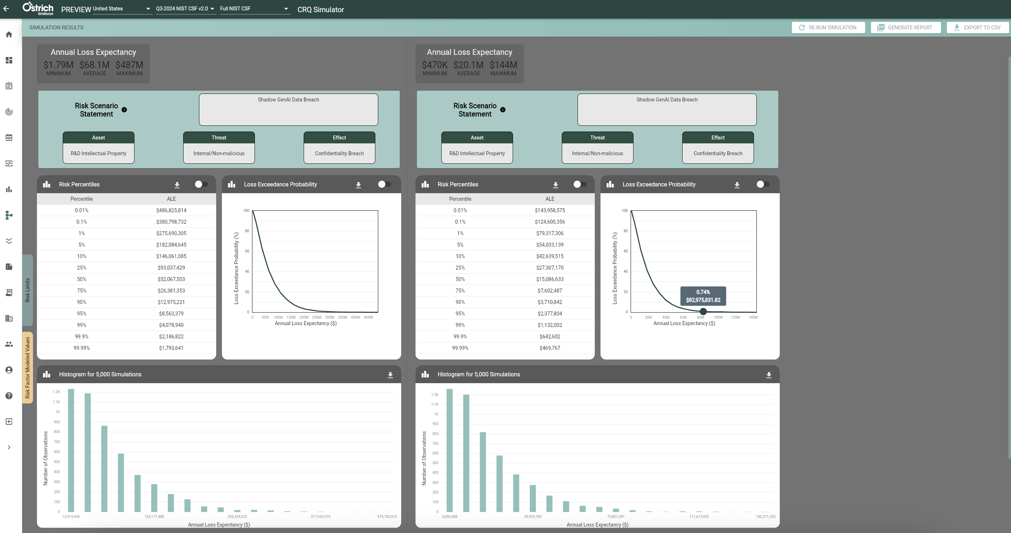
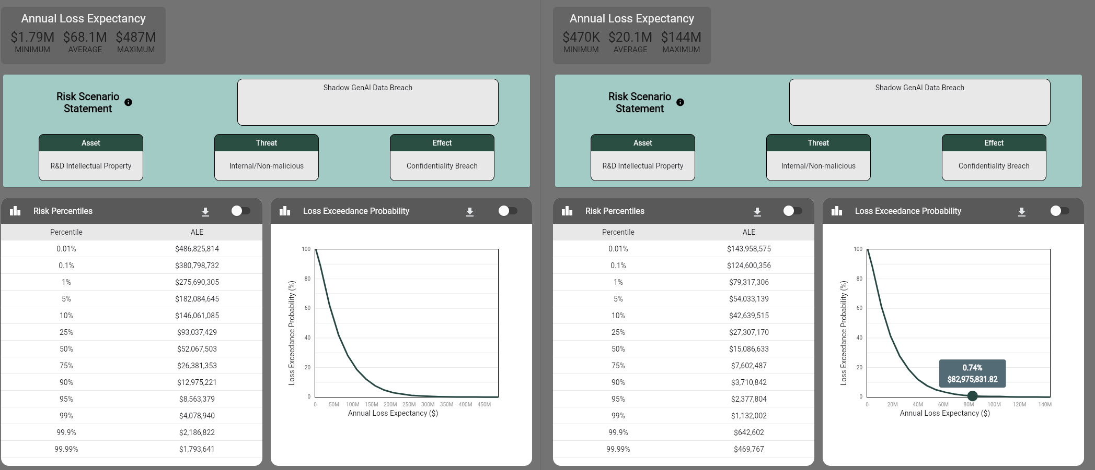

Slide 26
FAIR-AIR Resources
A FAIR Artificial Intelligence (AI) Cyber Risk Playbook
FAIR Institute AI Working Group
https://www.fairinstitute.org/blog/how-to-get-started-with-fair-analysis-for-genai-risk-1
https://www.fairinstitute.org/blog/assessing-ai-risks-a-triage-approach-with-the-owasp-top-10-for-llms

Slide 27
Q&A

Slide 28
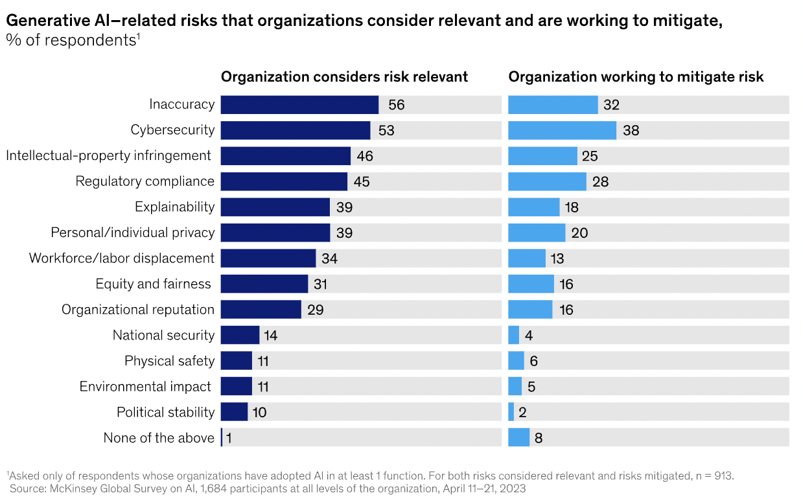
Top 10 Risks of Deploying GenAI
Data Privacy Violations
Intellectual Property Infringement
Regulatory Non-Compliance
Misinformation and Reputational Damage
Bias and Discrimination Claims
Quality Control Failures
Job Displacement and Workforce Costs
Increased Cybersecurity Threats
Dependency on AI and Innovation Stagnation
Operational Disruptions
Notes:
The ChatGPT output is very similar to the results of this McKinsey survey of relevant risk issues associated with the adoption of AI in at least one use case.
The challenge for the cyber risk analyst is to apply our risk analysis process against loss events and scenarios that do not include the classic adversaries or threat communities we are familiar with, but threat actors none the less.
Reminder the FAIR MODEL is agnostic, we can analyze any risk issue in any domain.

Slide 29



Connect With Us

